Slide 1
CSIRO Open Data Cube and Earth Analytics Industry Innovation Hub
Image courtesy of Digital Earth Australia, Geoscience Australia
Robert Woodcock | Matt Paget | Alex Held
WGISS 44 2017
Minerals | Land and water

Slide 2
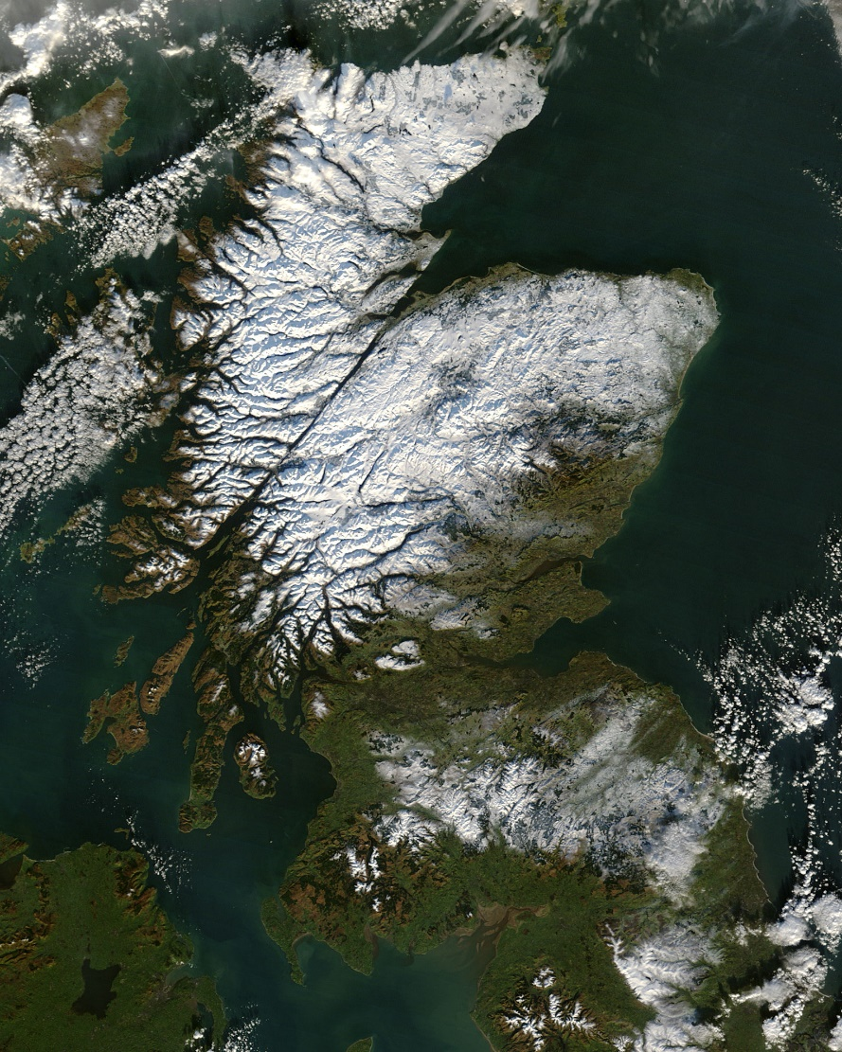
Outline
CSIRO and EO – The impact and opportunity of new EO data and applications
CSIRO and the Open Data Cube
ODC Architecture
CSIRO extensions
CSIRO Earth Analytics Industry Innovation Hub
CSIRO and CEOS Future Data Architectures
This Photo by Unknown Author is licensed under CC BY-SA

Slide 3
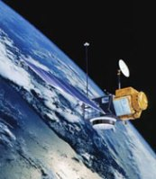
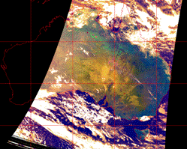
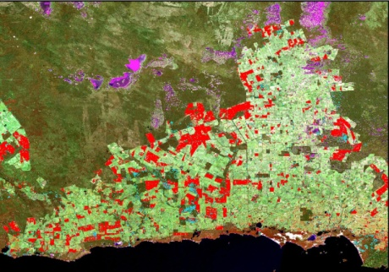
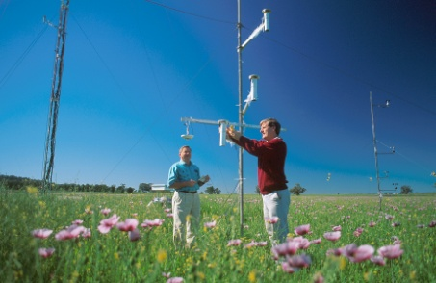
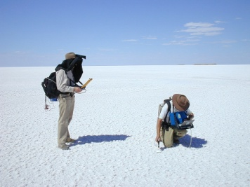
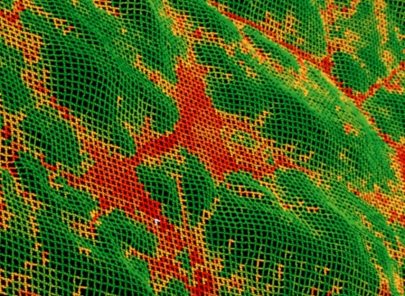
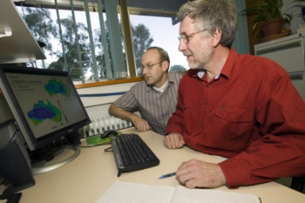
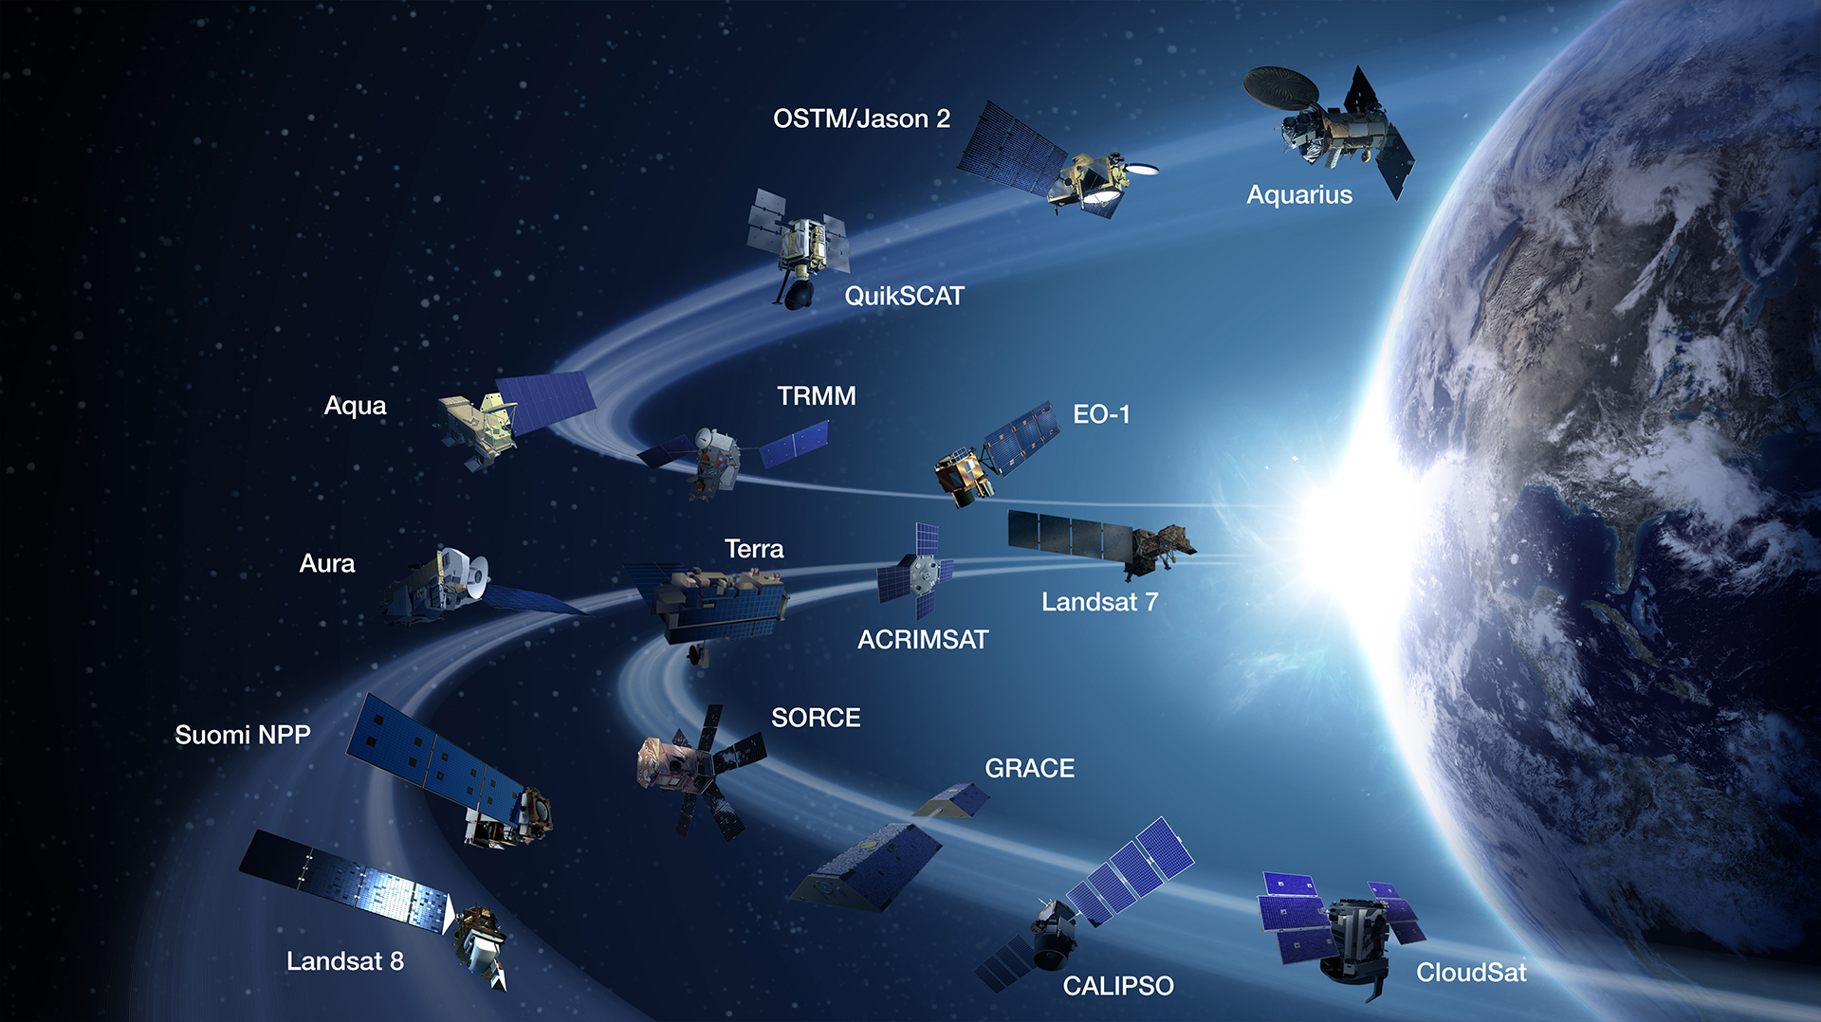
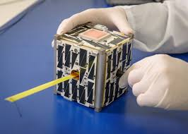
New EO Data and Applications
Over 400 EO sensors next decade
New affordable satellites
Notes:
Over view of changes in satellite observation and economics
Higher spatial resolution
Greater diagnostic capability through increased spectral resolution (hyperspectral) and new modalities (active and passive radar)
New applications in monitoring through increased acquisition rate
Openly available data and Cloud computing combine to create new industries
Cubesats and similar for industry specific missions – SME growth
New applications based on new IP that exploits new satellites

Slide 4
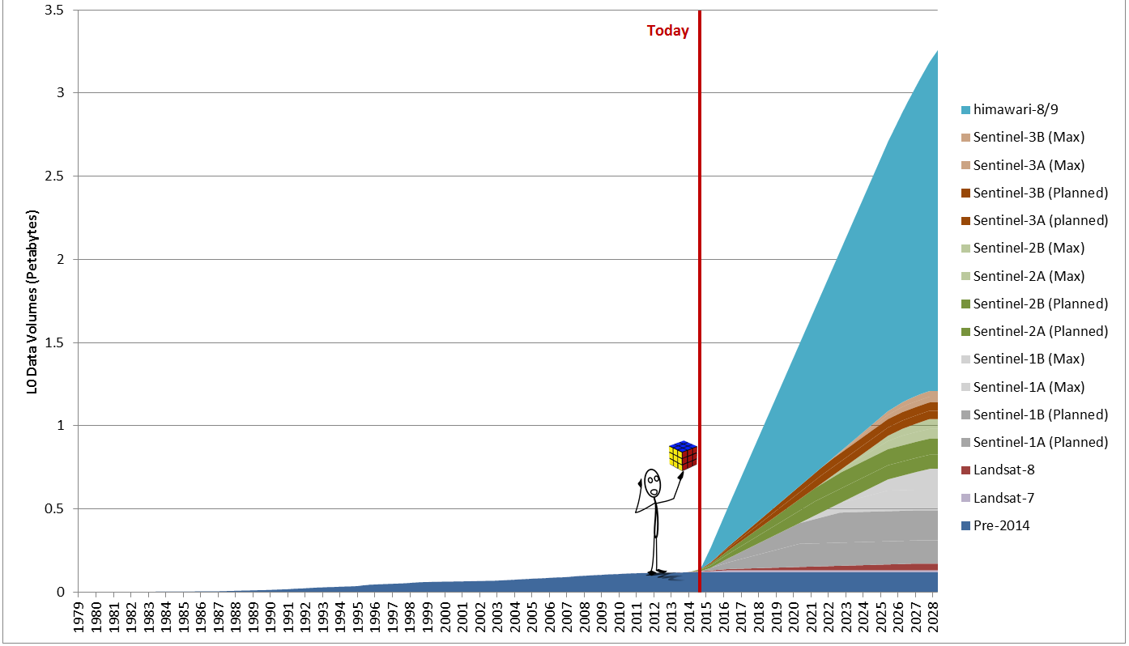
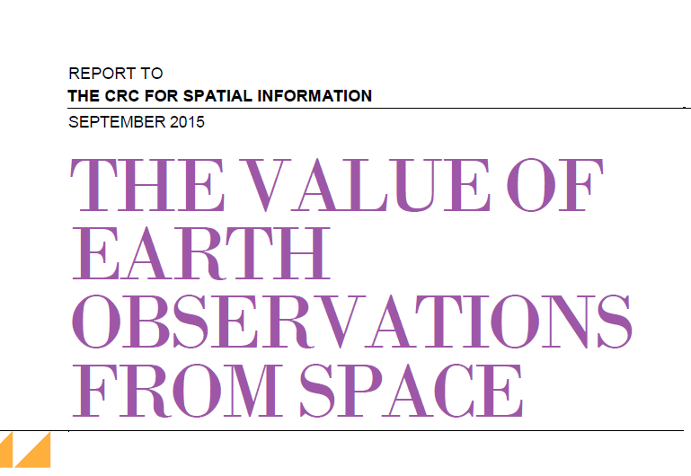
Challenges and Opportunities
A step change in EO satellite capability over the next 5 years leading to pressure on CSIRO capability and new business opportunities
Substantial growth in the EO based digital economy across Industry and Government domestically and internationally
Growth from $5.5. B to $8.8 B in Australia’s Cubesats and similar for industry specific
Estimating growth of ~$100 Billion internationally
Notes:
Threat and Opportunity – and the question is how to address the threat and exploit the opportunity – at Domestic and International scale – both people and technology.
Threat
Individual business investments will be insufficient to cope with the rapid change in data volumes and computational scale required
Security of Data Supply will require greater coordination and representation given:
the increasing number of satellite operators with which agreements must be managed
the increasing volume of data requiring regional data distribution hubs to be established to spread the load
CSIRO EO scientists may not remain competitive scientifically:
Individual EO scientists will no longer be able to acquire data directly from Satellite providers at sufficient volumes to support research into the higher resolution data available. Providers are restricting data downloads in order to manage finite bandwidth.
The majority of EO scientists are not experienced in the use of petascale computing which will be required for these data volumes and new applications
CSIRO EO tools and processes are often tied to desktop, rather than Cloud or petascale distributed computing paradigms which are required for many new applications
Without the transformation of capability, the creation of new EO IP and applications CSIRO will lose its competitive edge and ability to deliver future value to the nation

Slide 5
CSIRO EO Analytics Strategy
Securing EO data supply
CEOS Future Data Architectures and WGISS contribution
Australian Regional Copernicus Data Hub
EO Analytics Platform
Open Data Cube
CSIRO Data Cube
Industry Innovation pipeline
CSIRO EO Applications
Earth Analytics Industry Innovation Hub

Slide 6
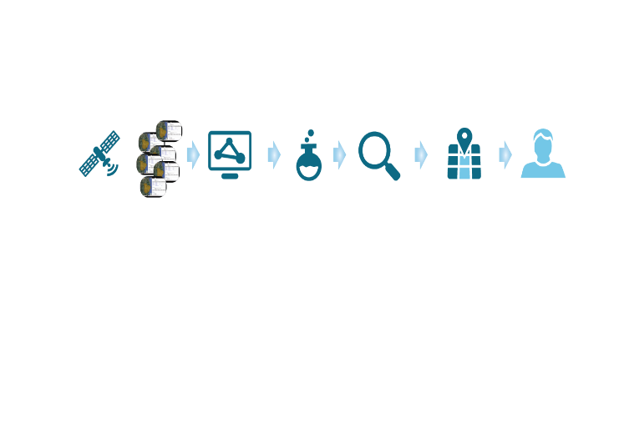
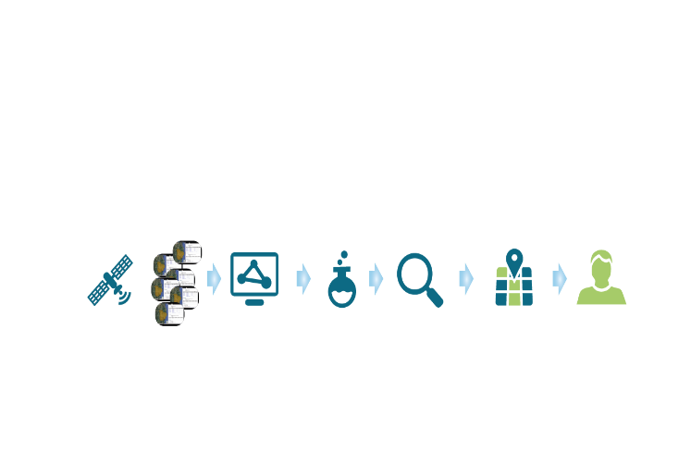
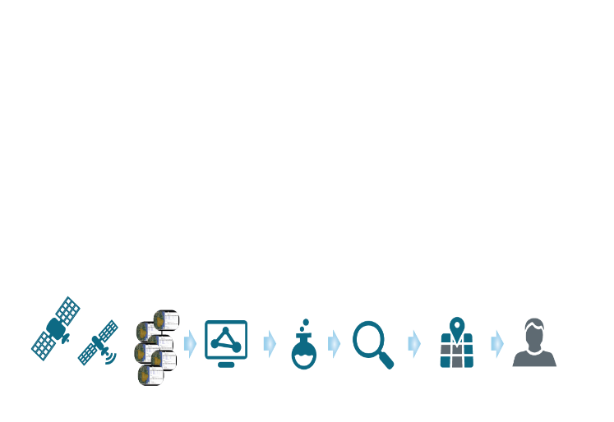
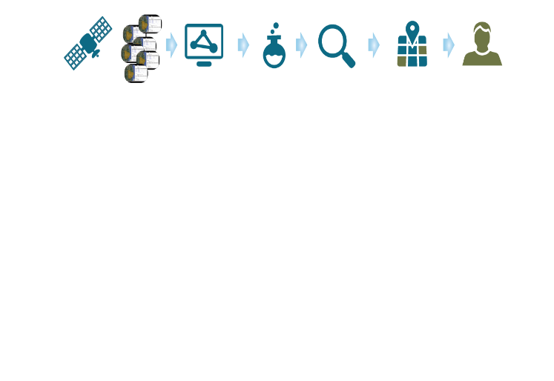
Open Data Cube: Petascale EO Analytics
Before: Individual business units invest in entire value chain
After: Data supply and big data analysis platform is shared investment – business units still deliver impact individually
Notes:
Our key Technology Platform is petascale EO Analytics Platform called the Data Cube. It’s objective so to remove the commonly repeated stages of data preparation for analysis, and the burden of parallel computation that everyone has to deal with so that EO scientists and application developers can exploit new data and opportunity and no one drowns in the deluge.
Initiated by GA and formerly known as the Australian Geoscience Data Cube partnership between GA, CSIRO and NCI. The AGDC has won international awards and been adopted by CEOS as an architecture and community that provides value to global Earth observation (EO) satellite data users and increases the impact of EO satellite data.
In Australia, as seen in the previous slide, the AGDC has become Digital Earth Australia this year with $15M in funding allocated to provide services to Govt and to serve the digital Economy.
CSIRO, GA and NCI continue to work together to developer DEA and ODC.

Slide 7
Open Data Cube community
Formed at the Data Cube workshop in Canberra, Feb/Mar 2017
Community for the open source development of the data cube
Participants (NASA, USGS, GA, CSIRO, VNSC, …)
Initiatives (CEOS DC, Digital Earth Aust, Vietnam DC, Colombia DC, …)
https://github.com/opendatacube

Slide 8
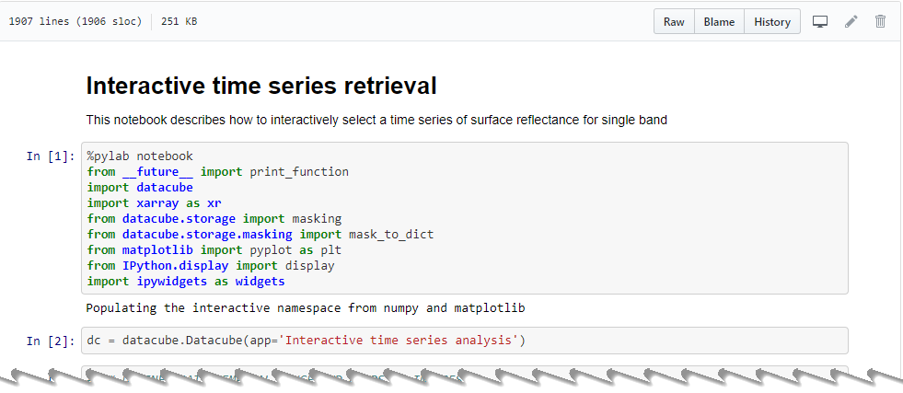
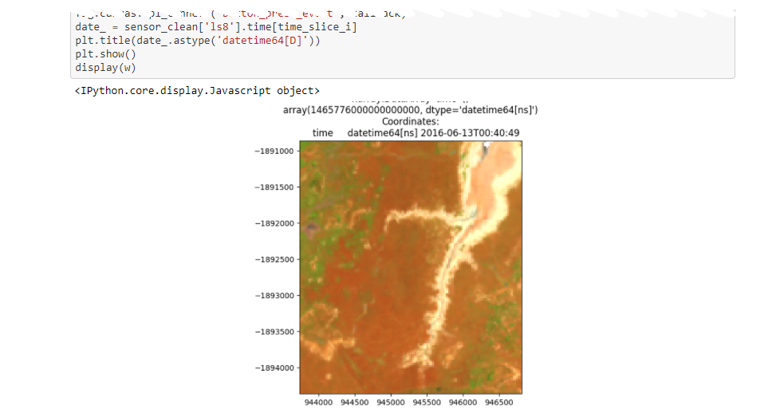
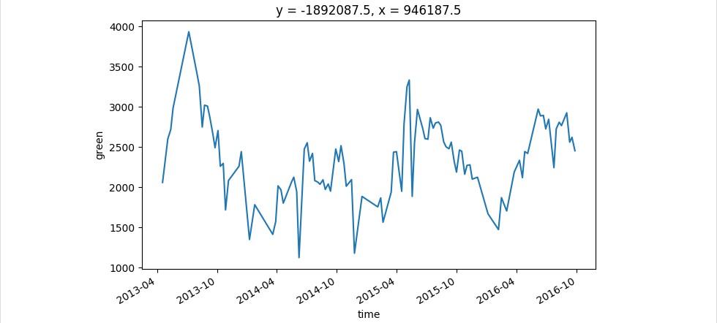
Open Data Cube Capabilities
Analysis Ready Data
Data+Compute=Ready-to-Run
Pixels, not Files
EO data integration
Desktop, HPC, Cloud
Python Jupyter Notebooks for Interactive Analysis
Notes:
A key enabler in bringing EO scientists and users on the journey is to meet them where they are.
Typically the EO IP generation path begins with tinkering on small amounts of data on Desktop PC. We need support interactive Exploratory Data Analysis (python notebooks work well).
Of course once it works the goal it to test and ultimately use it everywhere so the ODC is designed to allow algorithms to be portable between systems – HPC and Cloud are both supported.
In both environments Petabytes of Analysis Ready Data are available or easily accessed. At NCI for example….national EO data collections for Australia.
Internationally working with CEOS we’re developing standards for Analysis Ready Data (LSIVC CARD4L). CSIRO and GA remain at the forefront of these efforts.
Globally we use AWS, and other Cloud providers and business to host a lot of EO data - USGS and EU both have their data available via Cloud services.
But the Data Cube paradigm has enabled us to do not only undertake this analysis at a regional scale for the first time, it has in fact enabled us to scale this to produce a comprehensive national product
We can now analyse 15 years of data, across the country, representing every <n> square metres … in under 1 day.
Not only does this mean we can now for the first time produce this analysis once …
It means that we can produce it in an ongoing basis, enabling the production of updated information as new data becomes available, and enabling researchers to interact with the data iteratively to improve quality and try new ideas
And it means that, in future, industry and others can build value-adding products on top of this data by leveraging the services-based approach adopted
The important thing to note here is that, prior to the US opening the Landsat archive, GA charged $1000 per scene, which equates to $133M worth of data. Based on traditional data processing methods on original infrastructure, extracting and processing that data to the level in the AGDC would have taken around 8 years.
The Open Data Cube makes comprehensive information about our Earth available as information infrastructure, supporting the digital economy
In this model, new data is proactively acquired and processed to further enhance the data cube, and users and the applications they develop can interact with the cube, rather than being passive recipients of ‘one off’ products … this type of interaction enables the answer to one question provided by EOS to trigger the next inquiry and so forth ...
The very large data is co-located with very large computing capacity at NCI – so the infrastructure is both data AND ANALYSIS. In effect, algorithms are sent to the AGDC.

Slide 9
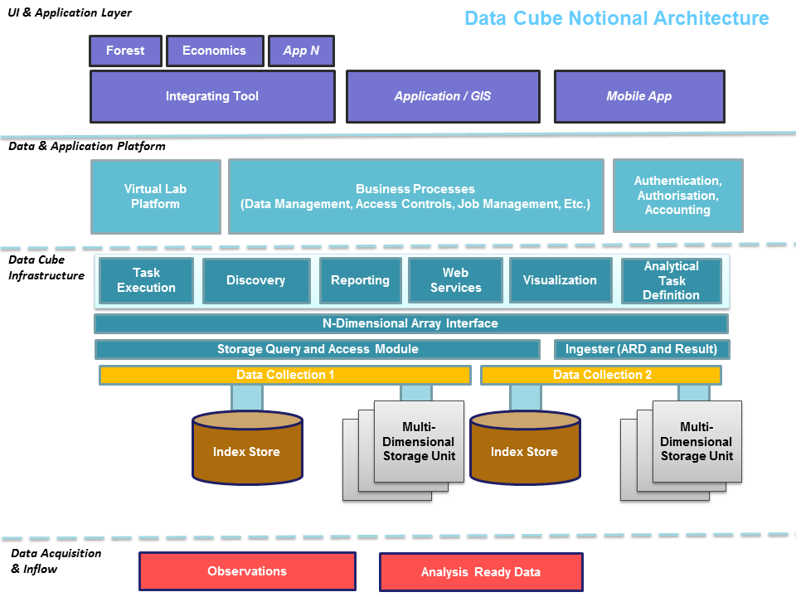

Slide 10
Platforms
Super computer - NCI
Collaboration between GA, CSIRO and NCI
Amazon Web Services (AWS)
CEOS: Files in S3 + single EC2 instance
CSIRO: Arrays in S3 + scalable EC2
Desktop
Github code
Linux, Mac, Windows

Slide 11
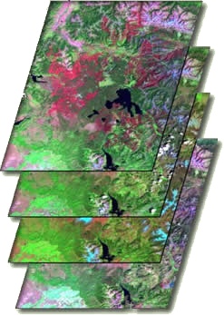
Storage formats and indexes
Many GDAL formats can be supported
Constraint: Within a data collection, pixels need to spatially align
Projection: Any PROJ4 projection
NCI, AWS (CEOS)
netCDF, Albers projections (equal area)
In file metadata
USGS, AWS Earth
GeoTiff
USGS, MODIS land products
HDF-EOS, Sinusoidal projection (equal area)
CSIRO (AWS)
S3 array structures
No in file metadata
Databases
PostgreSQL (documents, spatial)
AWS RDS
TIME

Slide 12
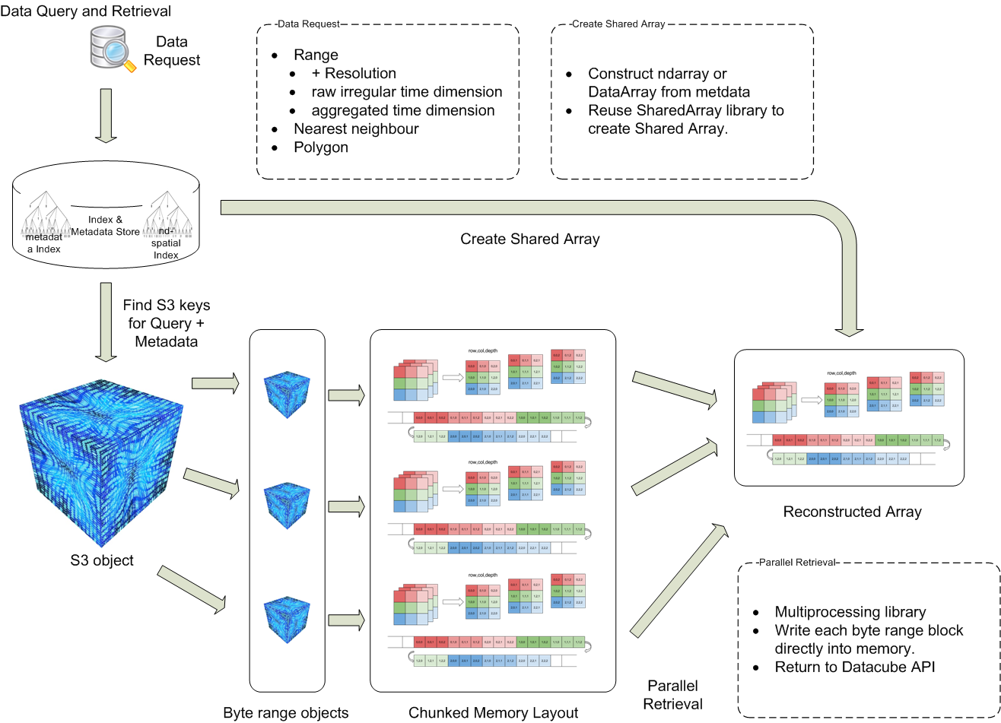
CSIRO Data Cube on AWS – S3 Arrays
AWS
Fast, scalable, accessible, durable
Industry ecosystem
EO data on Cloud
Aligned with S3 principles – objects not files
Take advantage of I/O concurrency
No change to Applications – S3 driver
Execution engine
exploiting Cloud elasticity
EC2 Spot instances – cheap Top 500?
Notes:
Of course, to have impact we need to be where Users are. Both Industry and Govt are increasingly using the Cloud and many EO data suppliers both Govt agency and Industry are storing data in the Cloud to make it more accessible.
We learned about key issues from interviews with Industry (LLP) – discrete service availability, elasticity (ability to grow with business), and are designing the ODC to provide the necessary support.
Cloud services
Performance achieved through distributed data arrays in the S3 Object storage – high levels of parallel IO and Compute that work for a LOT of EO use cases.
Costs vary but you can buy a top 500 scale compute capacity on the AWS Spot market for US$1000 per hour (which is insanely cheap!).
Importantly being on AWS its part of a broader business ecosystem which is important for industry to exploit our EO contribution to the overall business process.

Slide 13
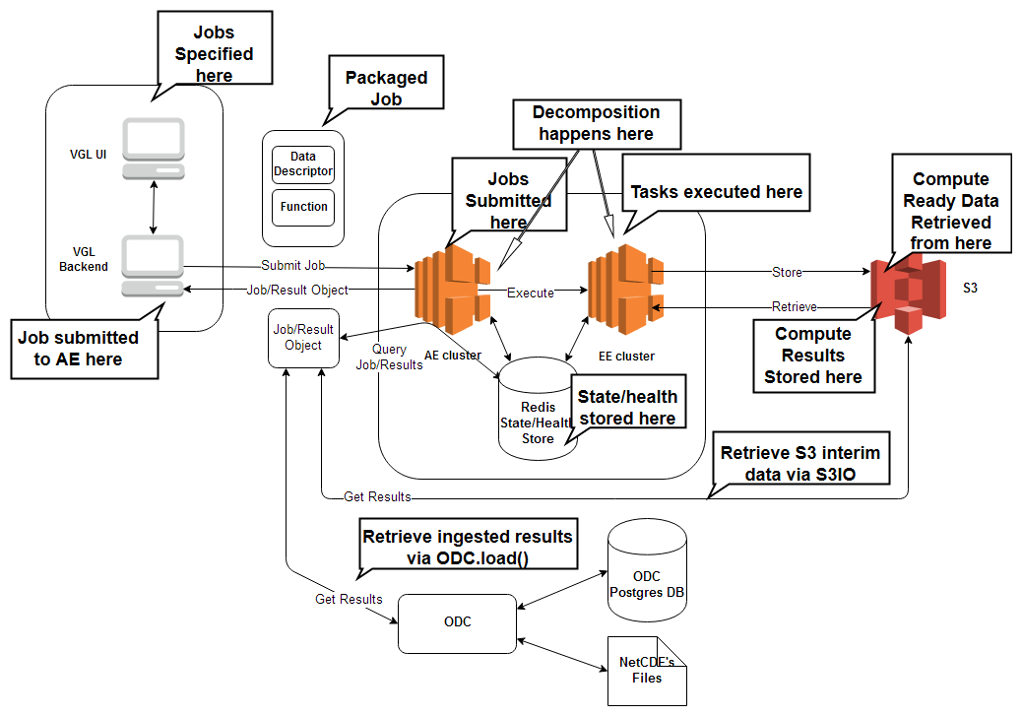
AWS Execution Engine
Work in progress

Slide 14
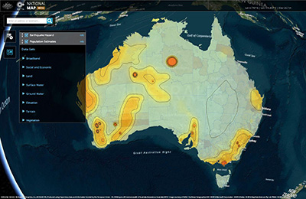
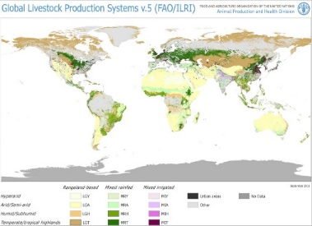
Earth Analytics Industry Innovation Hub
Helping SMEs build their business
CSIROs EO analytics innovation
Ready to Run applications and services
Quality data
Scalable with your business
Industry Services
Licensing
Consulting
International Services and Partnerships
CSIRO EO Science-as-a-Service Platform
Notes:
EAIIH update – replace with business plan areas
Successful delivery of new CSIRO IP and its market impact will require appropriate access to the data and compute at petascale for our target customers. Whilst some, particularly international organisations will be able to afford such infrastructure many, particularly Australian SME’s, would need an alternate model.
Deploying CSIRO’s EOI Big Data Analytics platform on commercially accessible Cloud computing environments combined with a pipeline of BU science and applications could provide such a solution delivery platform and:
Direct sales business engagement through cloud services provision sold on a “pay as you use” or “subscription basis to SMEs
Spin-off organisations and business models – notably the platform can provide usage analytics for the CSIRO IP and services and thus aid in understanding which solutions provided by CSIRO are of most demand and likely to provide a viable business model. This reduces risk in the creation of spin-off organisations or creates sales opportunities for that portion of the IP.
Attracting purchasers of CSIRO IP licenses
In addition supporting efficient delivery for individual BU activities: Such a delivery platform would:
1. provide a significant implementation of the Oznome vision
2. Create a registry of CSIRO EO IP from across the organisation
3. Provide opportunities for BU to apply each others algorithms and solution in alternate domains.
Commercial component
Business processes and engagement to sustain science and data pipelines
“App Store” of analytics routines
EO and geoscience researchers delivering to Minerals, agriculture and environment domains

Slide 15
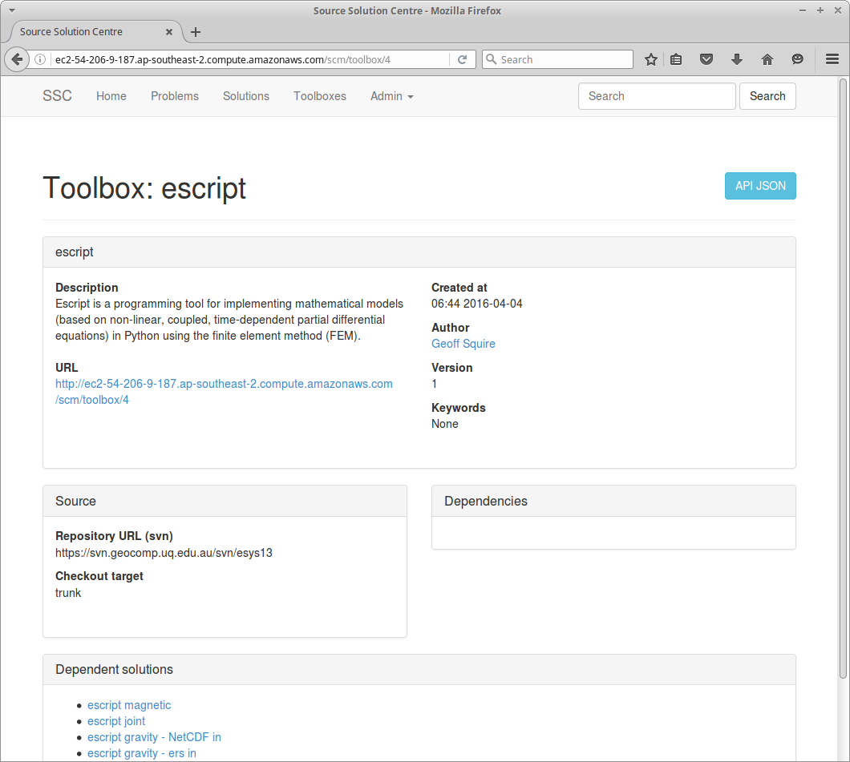
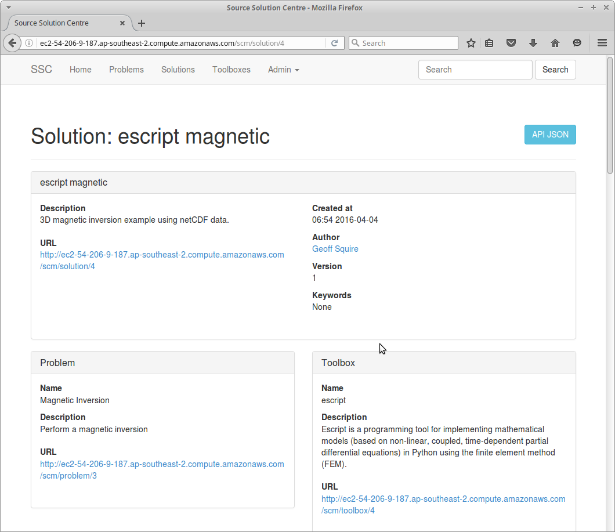
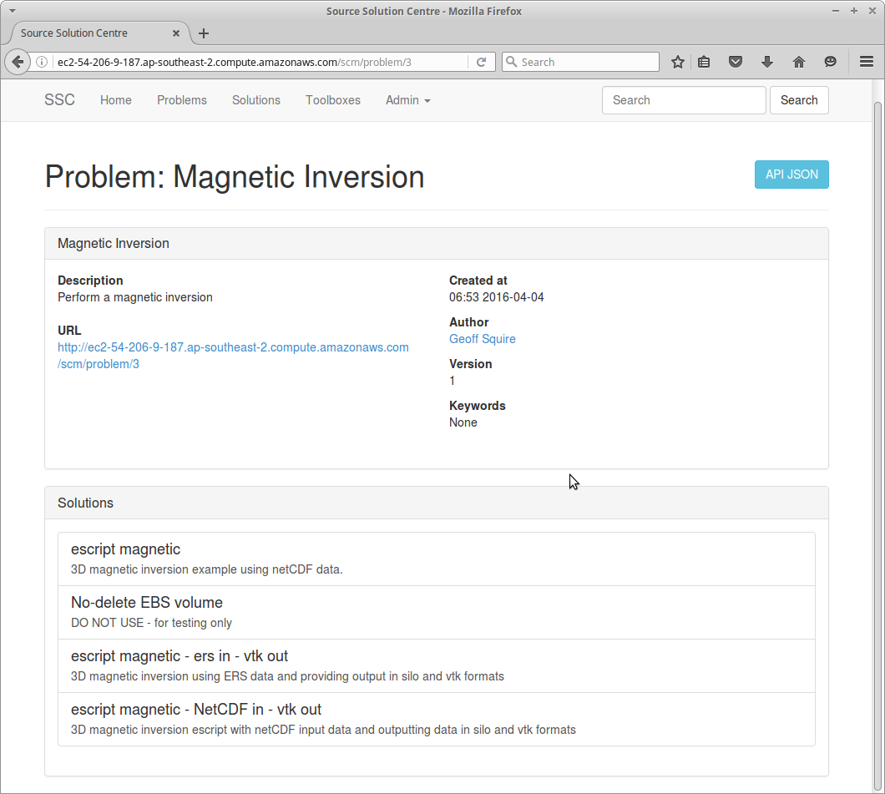
EAIIH Workflows and Interfaces
Data, tools and compute resources are loosely coupled
Architecture based on international standards and web services
Component reuse:
Solutions Centre for Discovery
…
Components useful for WGISS FDA
Register, Review,
Reference, Run,
Repeat

Slide 16
Applications
Terrestrial
BRDF (MODIS, Landsat)
Fractional cover (MODIS, Landsat)
NDVI anomaly
Surface water (WOfS)
Landslide (SLIP)
…
Aquatic
TSM
Algal Alert
Swampy
Coastal change
…
Notes:
Supporting new EO science at scale through better platforms (more of on that shortly) and assisting EO science teams to consider the new opportunities – we actually seek EO IP and create a path to impact via the Industry Hub (more on this later) and have that revenue return to science teams to support more science.
There are new opportunities for new science due to the new satellites:
Time- fire flood, monitoring
Resolution – paddock scale growth monitoring in, algal blooms, mangroves
Radar- see through clouds!
GEOGLAM RAPP
This is global rangelands pasture productivity.
Rangelands and pasture productivity are important for livestock productivity and global food resources.
The background image is the monthly anomaly of vegetation fractional cover – the amount of photosynthetic, non-photosynthetic and bare soil within a pixel, derived from MODIS data – and a time series for a polygon in India.
CSIRO EO science is going global.
There’s a combination of Computer Science and EO science involved here. Ultimately we seek to use VRE to accelerate the path from IP creation to IP exploitation at scale for all involved – Jens will touch on this in his talk.
Importantly, this is a key behavioral change and in some cases a large shift in thinking from paddock to planet scale processing, or historical analysis to real time or prediction.

Slide 17
From Data to Impact…
New Big Data Cube platform for EO analytics
Accelerate IP through to Industry use
Ensured EO data supply
Global impact from EO science through our network of DC and CEOS engagement
Strong collaboration
This Photo by Unknown Author is licensed under CC BY-SA
Connecting Science to Impact in Earth Observation
Notes:
We’ve mapped our path and are well on the way to progressing it

Slide 18
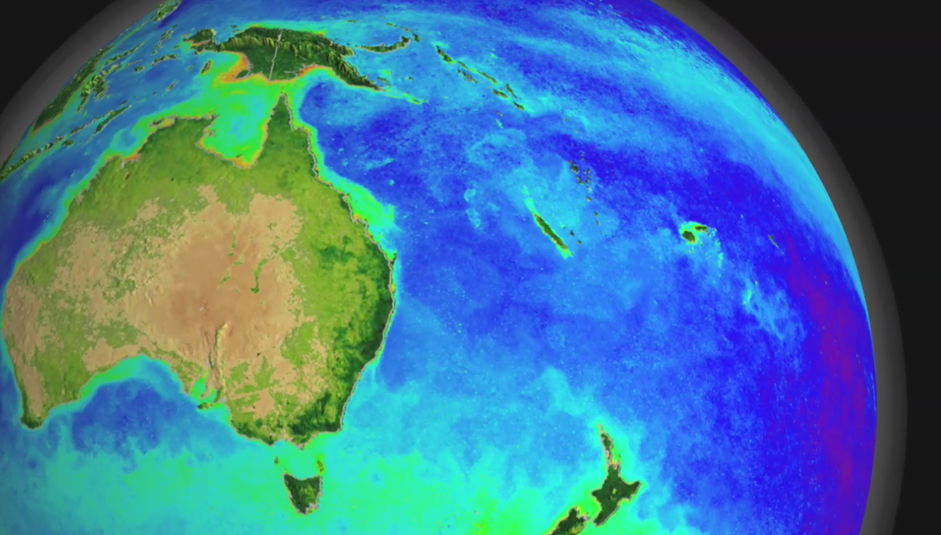
Dr Robert Woodcock Research Consultant
t +61 412 298 696
e Robert.Woodcock@csiro.au
w www.csiro.au
Mineral resources | Land and Water

Slide 19
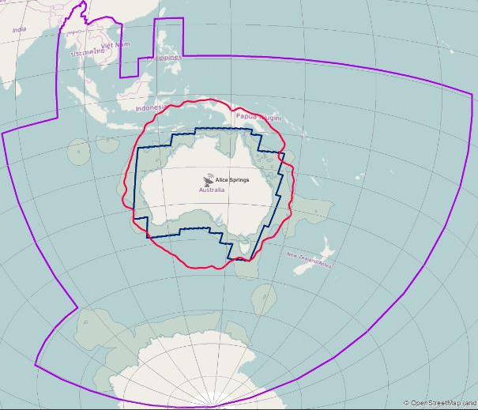
All Sentinel Products for the region
EU – Australia Copernicus Data Hub
Mission / Instrument | Level-0 | Level-1 | Level-2 | NCI Archive
S-1 SAR | RAW | SLC GRD | OCN | 184 TB
S-2 MSI | - | L1C | (by GA) | 104 TB
S-3 OLCI | - | OL_1_EFR OL_1_ERR | 2017 Land/Water | 72 TB
S-3 SLSTR | - | SL_1_RBT | 2017 Land/Water | 91 TB
S-3 Altimetry | - | SR_1_SRA | SR_2_LAN SR_2_WAT | 11 TB

Slide 20
Acquisition to Products
Data Access
public good & industry?
instrument development
partnerships
Reduction to Reflectance/ Emittance/ Backscattering
vicarious calibration
atmospheric effects
Information Extraction
data volumes
DD fusion/MD fusion/MDA
libraries (standards)
mixing
accuracy (standards)
Access
data volumes
web access
metadata
Information Products
climate
exploration & mining
environment
Agriculture, forestry
aquaculture
Outputs
web portal?
metadata standards
Outputs
instruments
Data access
relationship agreements
Outputs
methods
software
publications
Outputs
mineral, agriculture, forestry, carbon and environmental maps
tech transfer
Outputs
product standards
methods
software
publications
Open Data Cube
Diagram inspired by Dr Cindy Ong
Notes:
The mid-section of the data flow is effectively the same for everyone, remove this pain and suffering – that is the objective

Slide 21
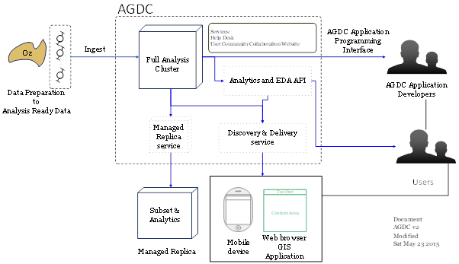
Data Cube - External Interfaces (Concept)

Slide 22
Applications
Terrestrial
BRDF (MODIS, Landsat)
Fractional cover (MODIS, Landsat)
NDVI anomaly
Surface water (WOfS)
Landslide (SLIP)
Agriculture (SAR S1, rice, wheat)
Biomass (carbon)
Aquatic
TSM / aLMI
Algal Alert
Swampy / SAMBUCA
Coastal change
Mangroves
Particle size
Good | In development | In pipeline
Spatial - Temporal
Tides
CCDC, BFAST
Custom mosaics
(MODIS-Landsat) Blending
High resolution (ZY3)
Atmos. corr.
Observation information
Pixel observation quality
Sensor ignorance (aliases)
Semantics
Surface brightness temp (ET)
User interfaces
CEOS SEO
Virtual Lab
AWS S3

Slide 23
Scientific Software Solution Centre (SSSC)
Enhancing discovery for research outcomes, tools and application
Register, Review,
Reference, Run,
Repeat
Notes:
Scientific Software Solution Centre (SSSC), is a (part) implementation the five “R’s” by linking Solutions (workflows) to Problems
The Solution Centre makes published software more useful by enabling automation of scientific solutions
VLs and applications can be clients of the Solution Centre
Published solutions immediately available in VLs
Users select a solution to run
VL generates configuration UI from solution
VL spins up job instance and assembles environment
VL orchestrates job inputs and outputs
Provenance can be recorded
Solution Centre provides basic PROV-O descriptions
Persistent URIs for entries
Prototyped in VHIRL, VGL and ANVGL
Openstack (Nectar, NCI) and AWS clouds
Work with any application that can query ws

