Slide 1
CDCOL
Advances and lessons learned on Colombia Data Cube

Slide 2
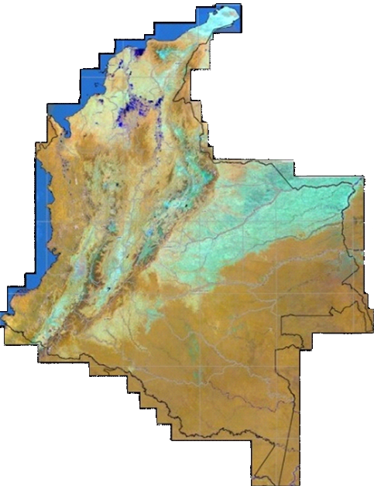

  COLOMBIA
Colombia has a total area of 2.070.408 km²
55.14% of land area
44.85% of sea surface

Slide 3
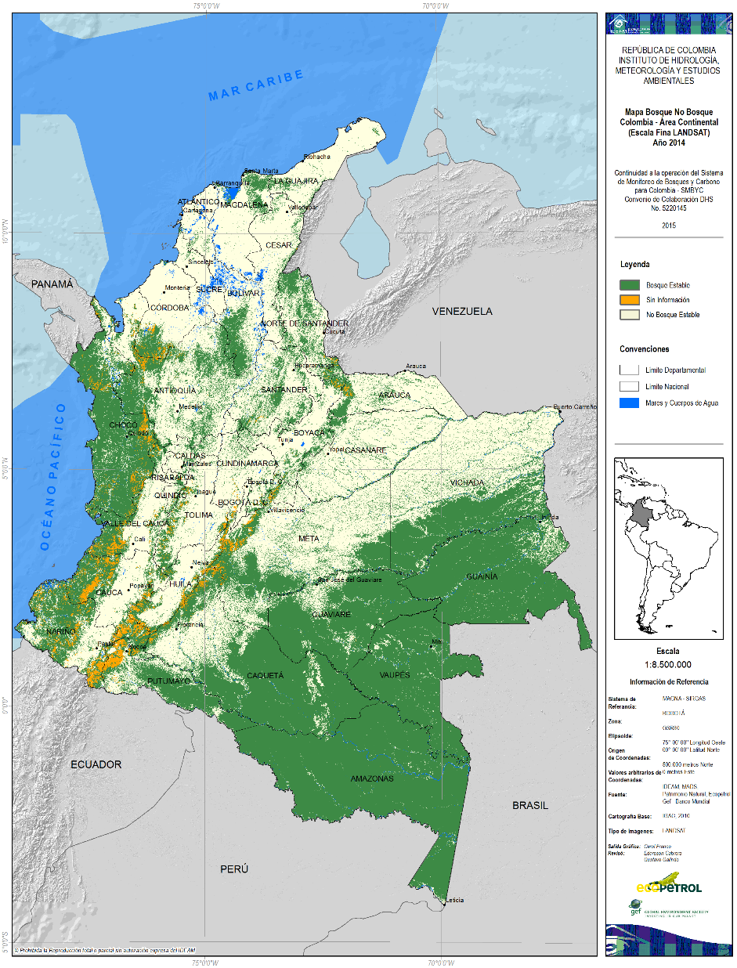

  FOREST AND CARBON MONITORING SYSTEM
Since 2016 Quarterly
Semestral
Early warning
Identifying hot spots
C&A Deforestation and Degradation
- Caracterization
- Modelation
Carbon monitoring
- Carbon stocks
- GHG Emissions
National quantification of deforestation
- Forest areas
- Forest change detection
Deforestation rate
Since 2013 Annual
2015

Slide 4
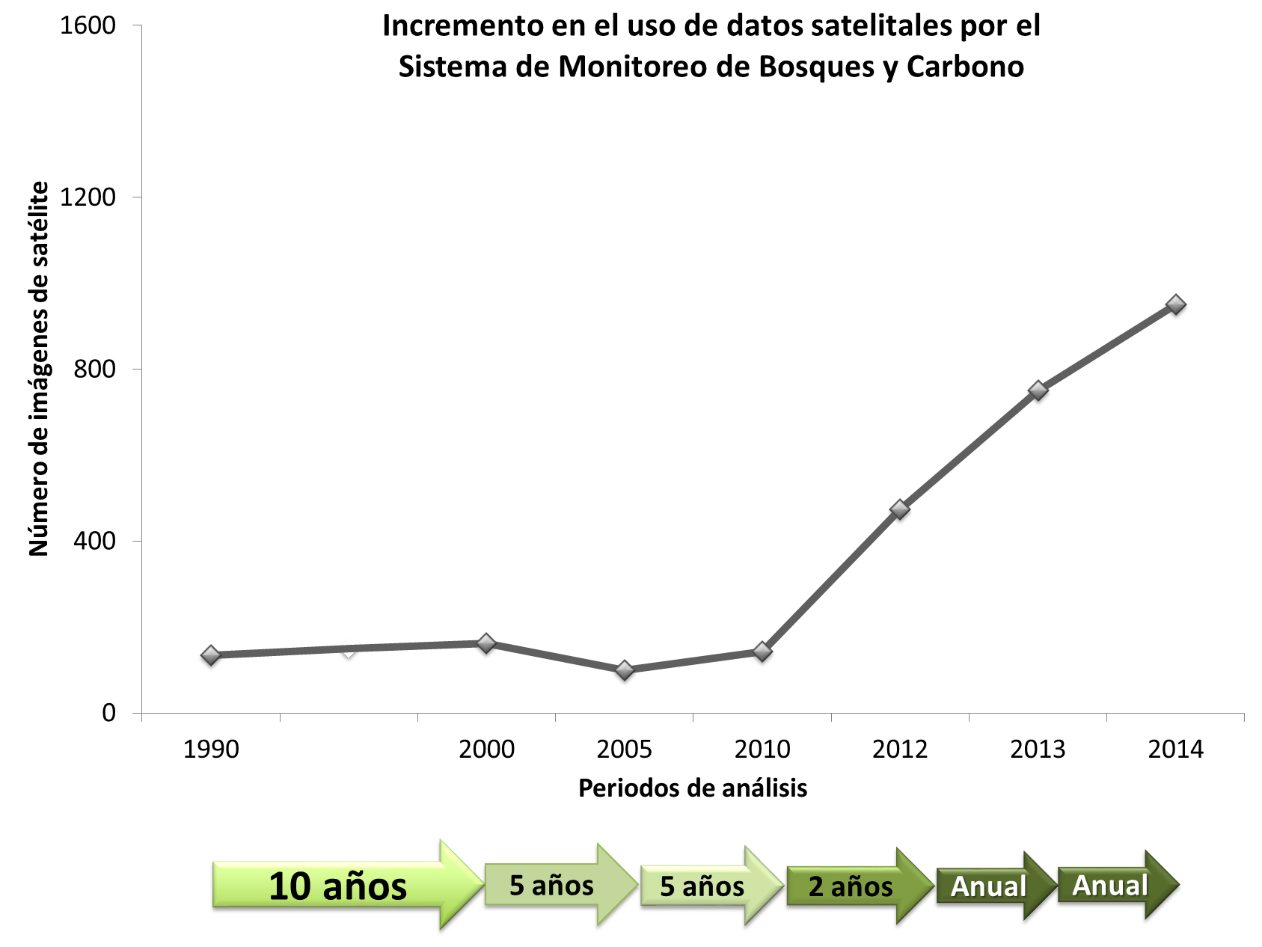
Increasing the use of satellite data

Slide 5
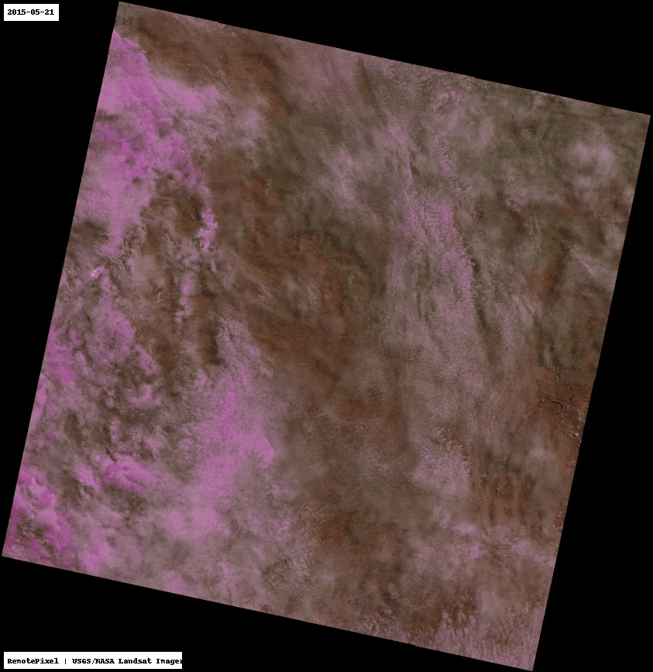
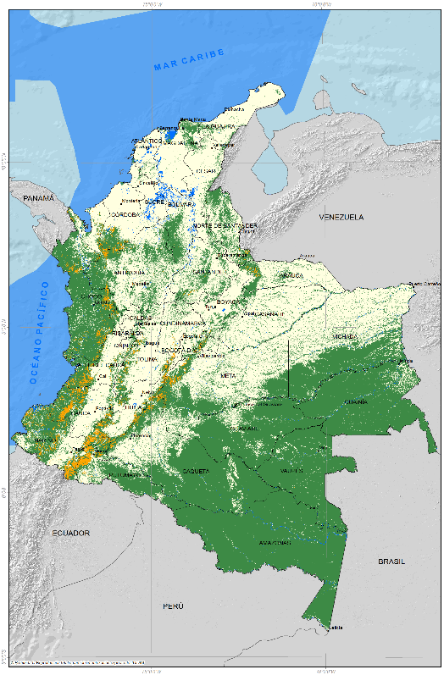
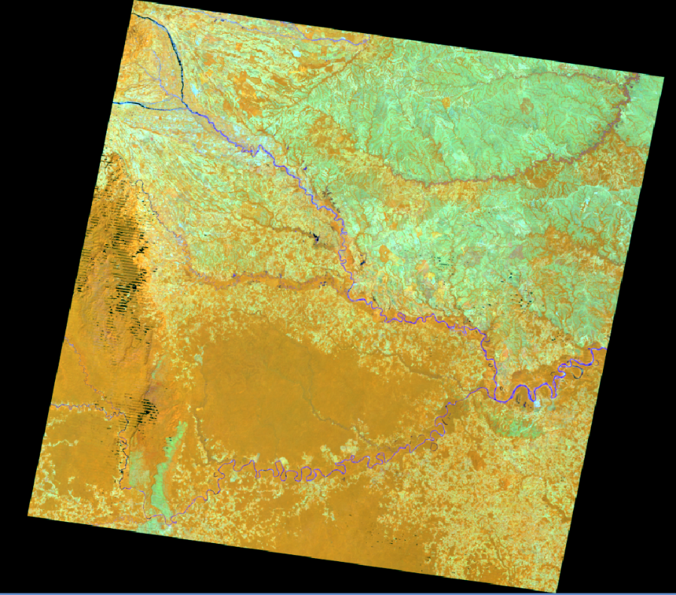



Forest area monitoring
Landsat Median Temporal Composite
Landsat 8 OLI Time series 2015
2015

Slide 6
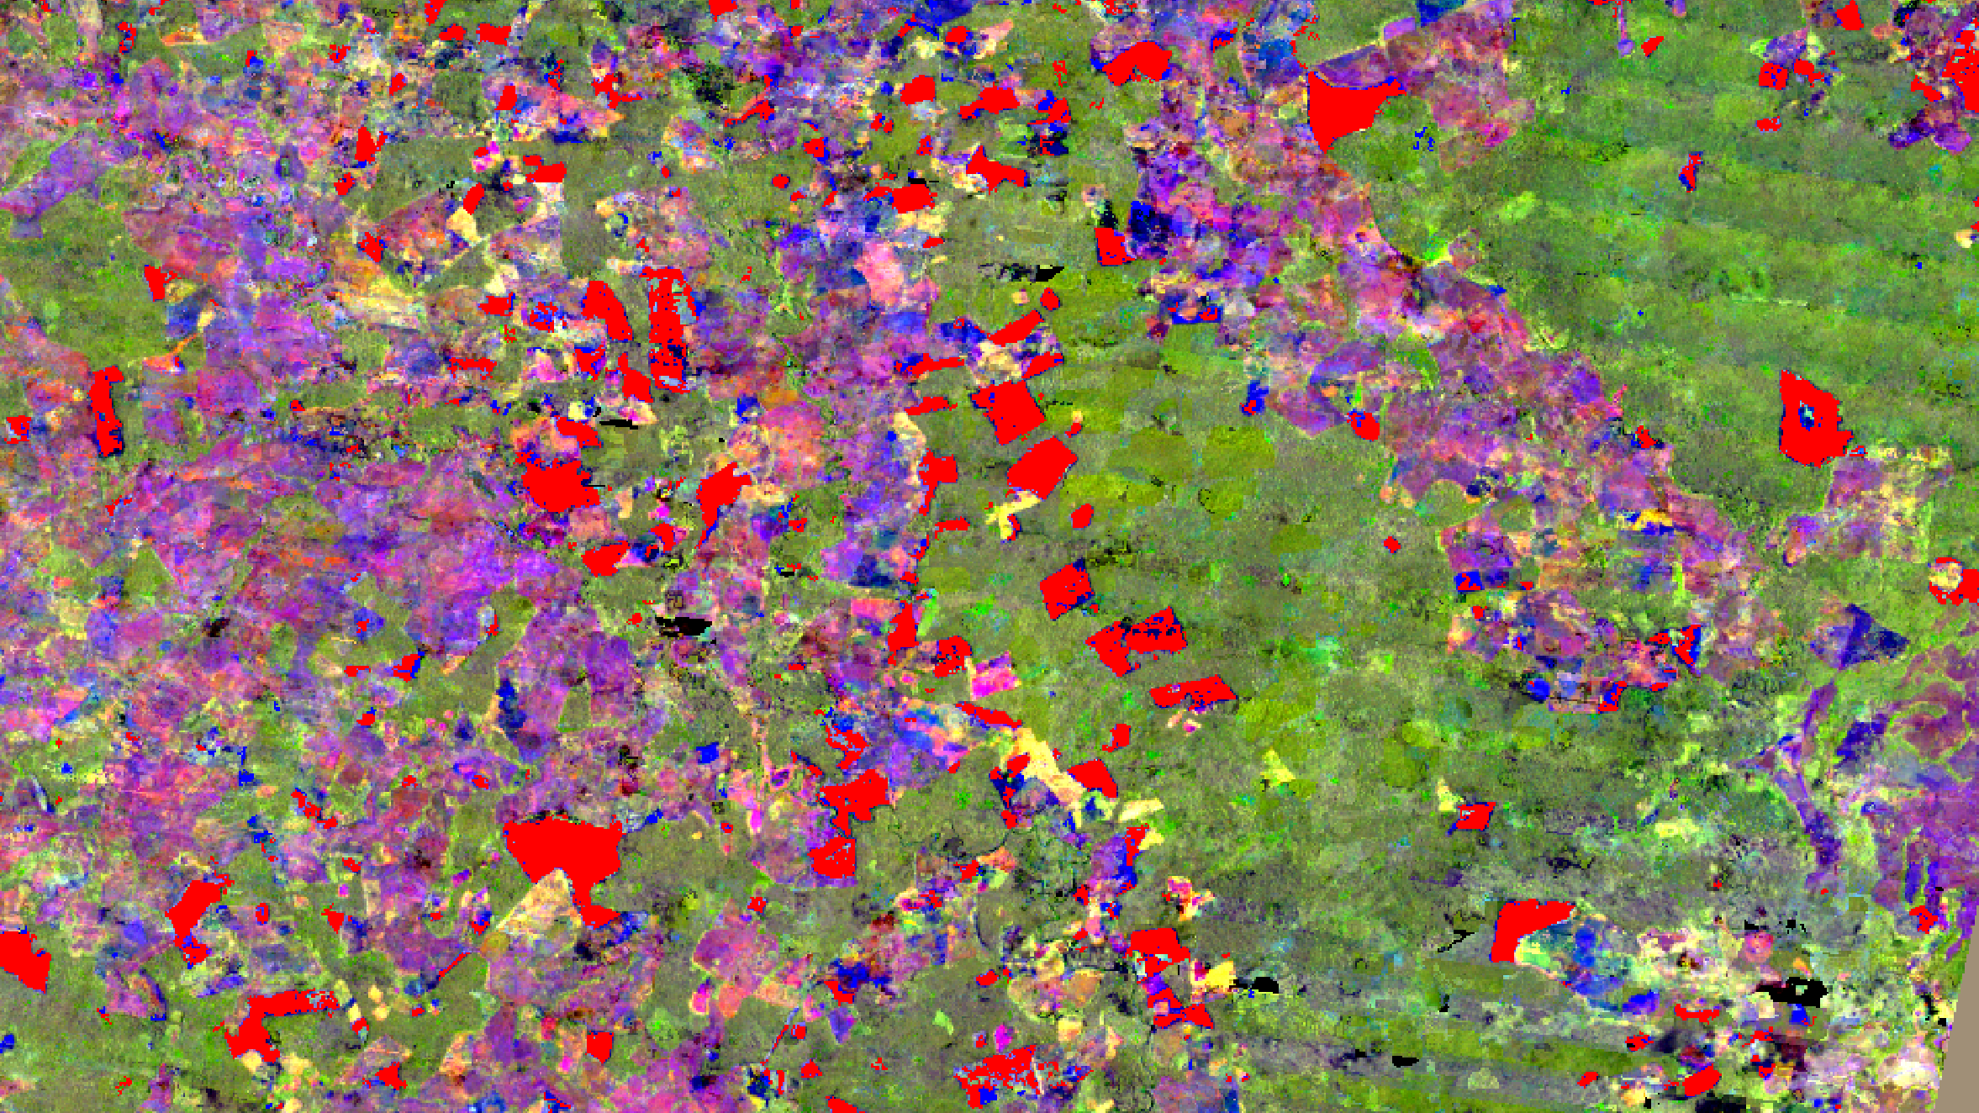
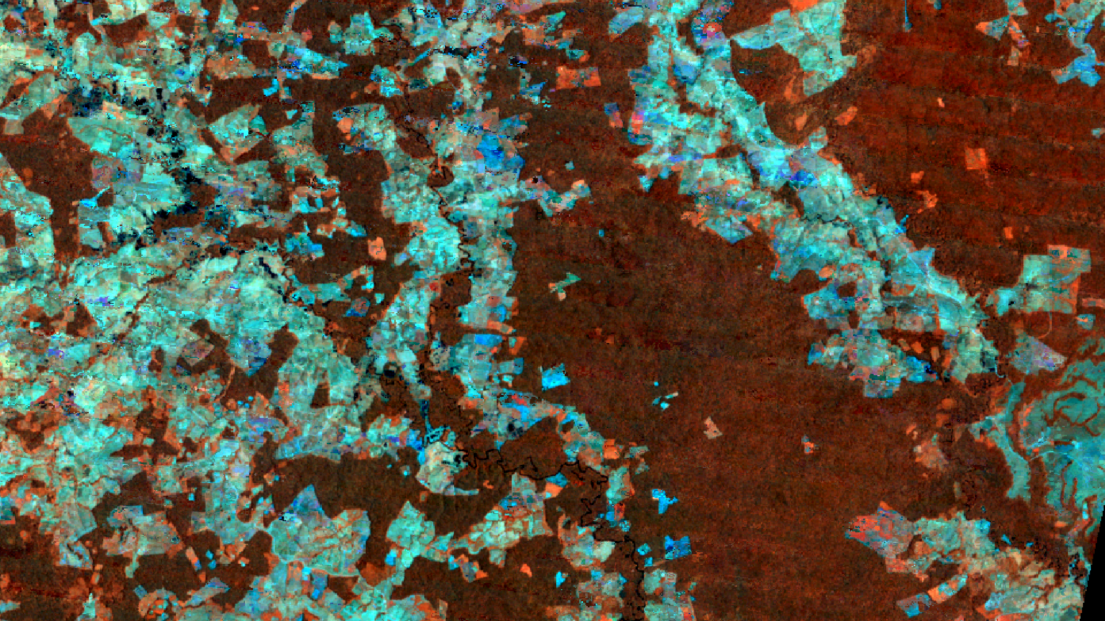
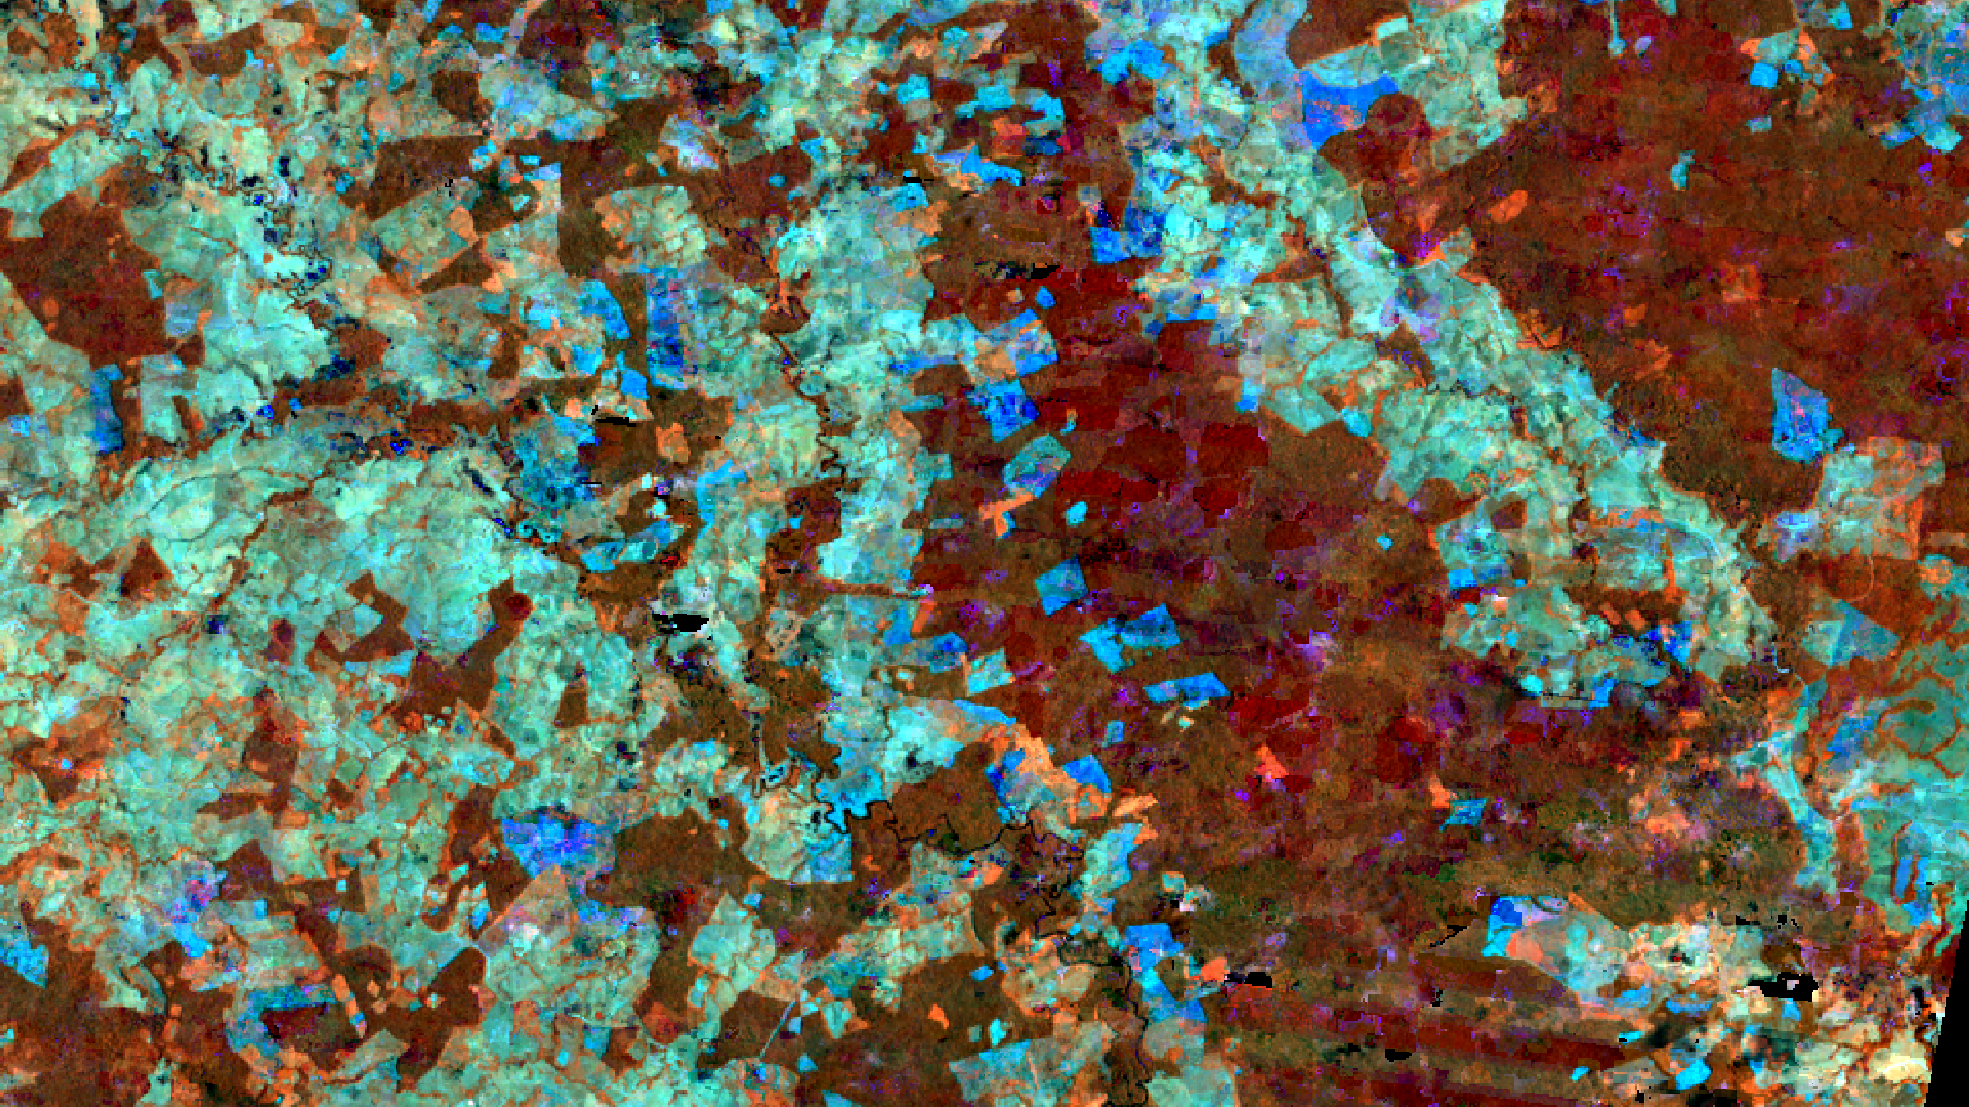

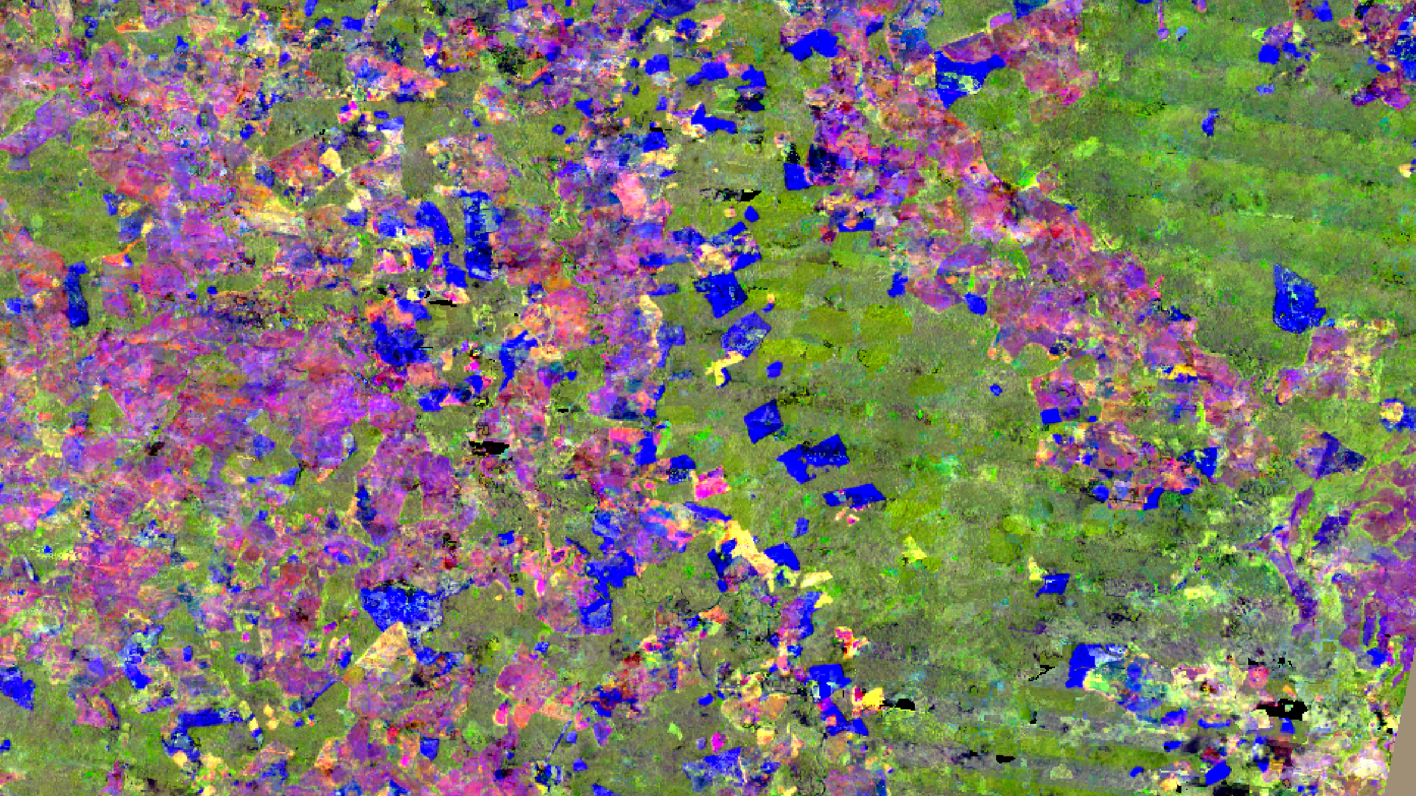

COMPONENTES PRINCIPALES MULTITEMPORALES
CHANGE DETECTION - DEFORESTATION (FOREST LOST IN RED).
COMPUESTO TEMPORAL 2013
COMPUESTO TEMPORAL 2014

Slide 7
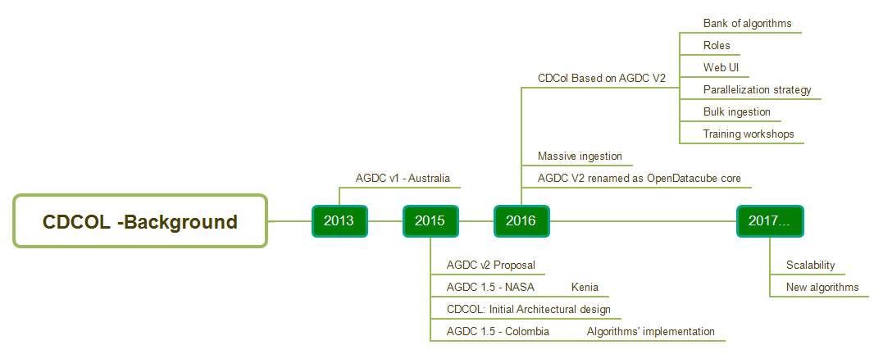
CDCol Timeline

Slide 8


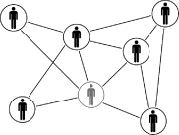

Advances of Colombian Data Cube CDCol
15años
DATOS DE 2000-2015
30metros
RESOLUCIÓN DE PIXEL
3sensores
LANDSAT 5/7/8
Downloading and ingestión of all country (Landsat 5-7-8)
27.070imágenes descargadas
LANDSAT 7, 5 Y 8
Interface WEB: user management, algorithms bank
16.400 imágenes ingestadas
LANDSAT 7/8/5
17.2TB
FUERA DEL CUBO
Workshops and capacity building
135.441tiles
LANDSAT 7 – CUBO DE DATOS
3.8TB
DENTRO DEL CUBO - NETCDF
Applicacions: temporal composed imagery, change detection PCA, WOFS, land cover classification
1.4x 10¹²
PIXELES

Slide 9
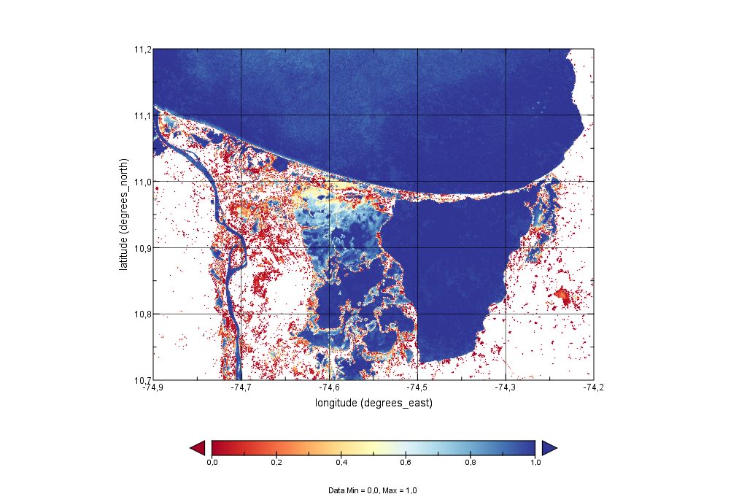
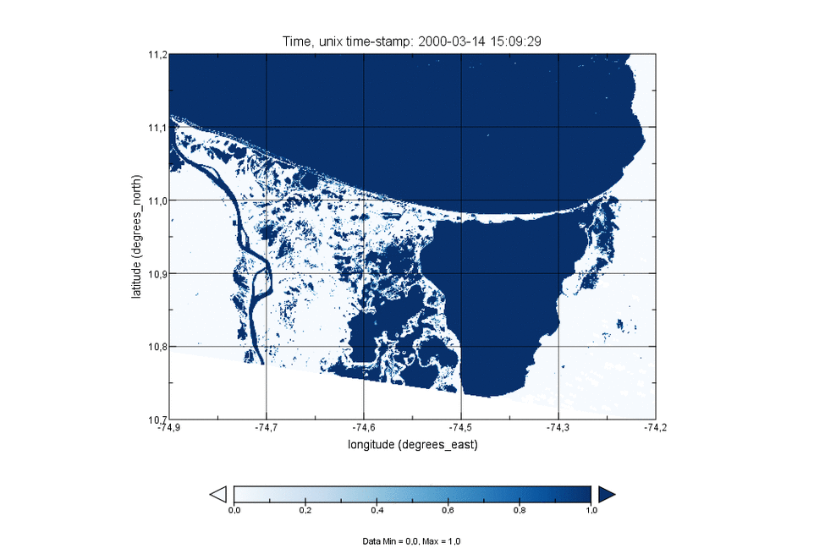
Results
15años
DATOS DE 2000-2015
30metros
RESOLUCIÓN DE PIXEL
342 escenas
LANDSAT 7/8
2h
PROCESAMIENTO

Slide 10
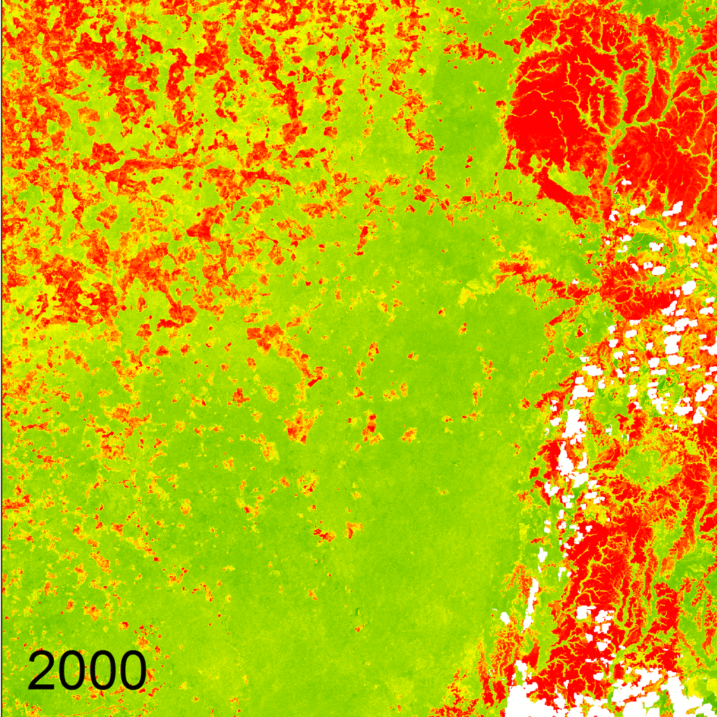
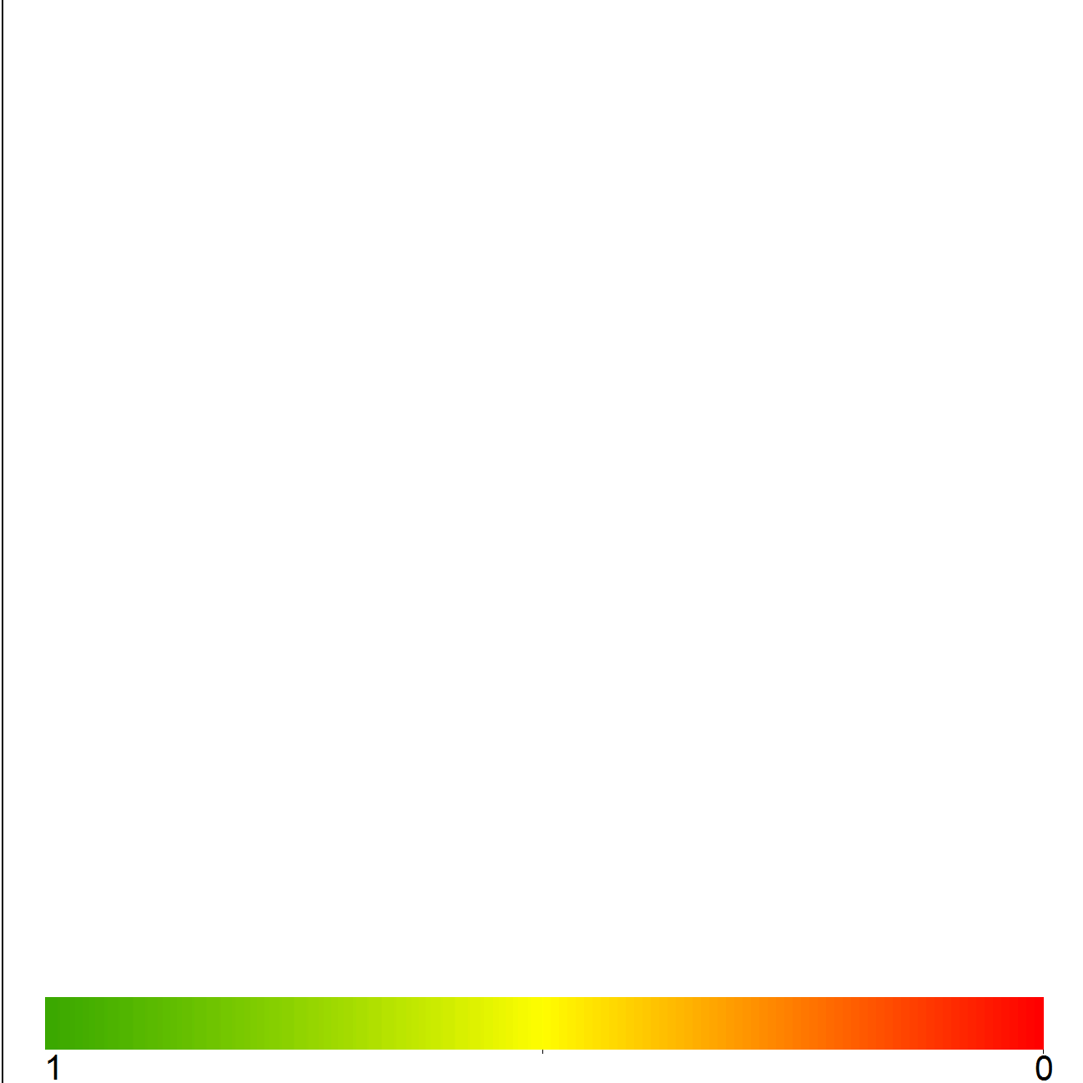
Results
15años
DATOS DE 2000-2015
30metros
RESOLUCIÓN DE PIXEL
466 imágenes
LANDSAT 7/8
2min x año
PROCESAMIENTO
Bosque
Otras Coberturas

Slide 11
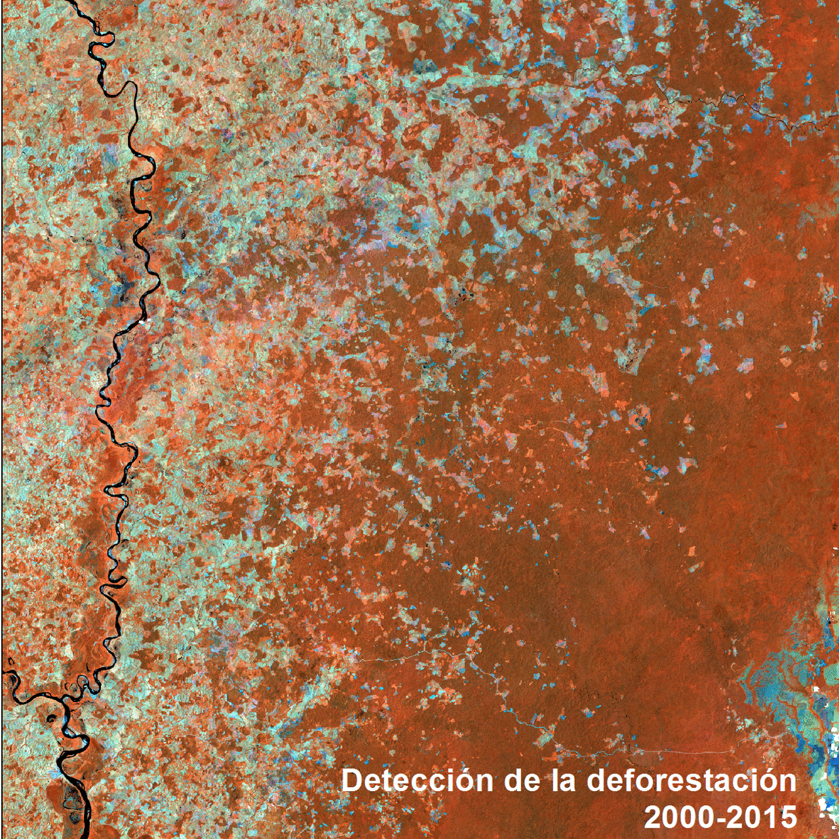
Results
15años
DATOS DE 2000-2015
30metros
RESOLUCIÓN DE PIXEL
45 imágenes
LANDSAT 7
20min x periodo
PROCESAMIENTO

Slide 12
CDCol Goals
Data ownership
Extensibility
Lineage
Replicability
Complexity abstraction
Ease of use
Parallelization
Standardization
Reusability

Slide 13
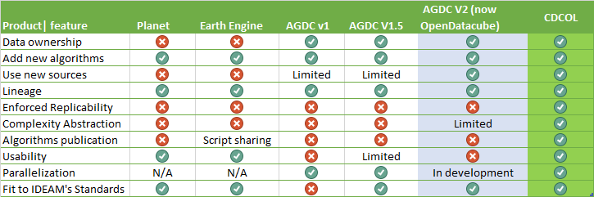
Related Works

Slide 14
Solution Strategy (on v2 July 2016)
Bank of algorithms and results
Web UI
Parallelization strategy
Training Workshop
Roles

Slide 15
CDCol User Roles
Bank of algorithms and results
Web UI
Parallelization strategy
Bulk Ingestion
Training Workshop
Roles
System Administrator
Data Administrator
Developer
Analyst

Slide 16





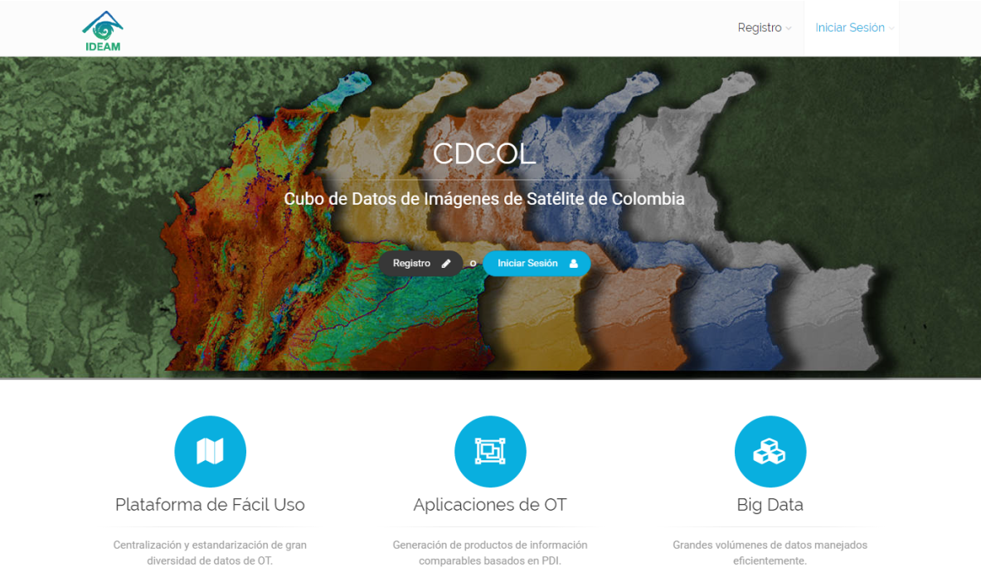





CDCol User Roles
Bank of algorithms and results
Web UI
Parallelization strategy
Training Workshop
Roles
Data administrator
Developer
Analyst
System administrator
Portal Web CDCOL

Slide 17
Administrador de Datos
Desarrollador
Analista
Administrador
del Sistema
Portal Web CDCOL

Slide 18
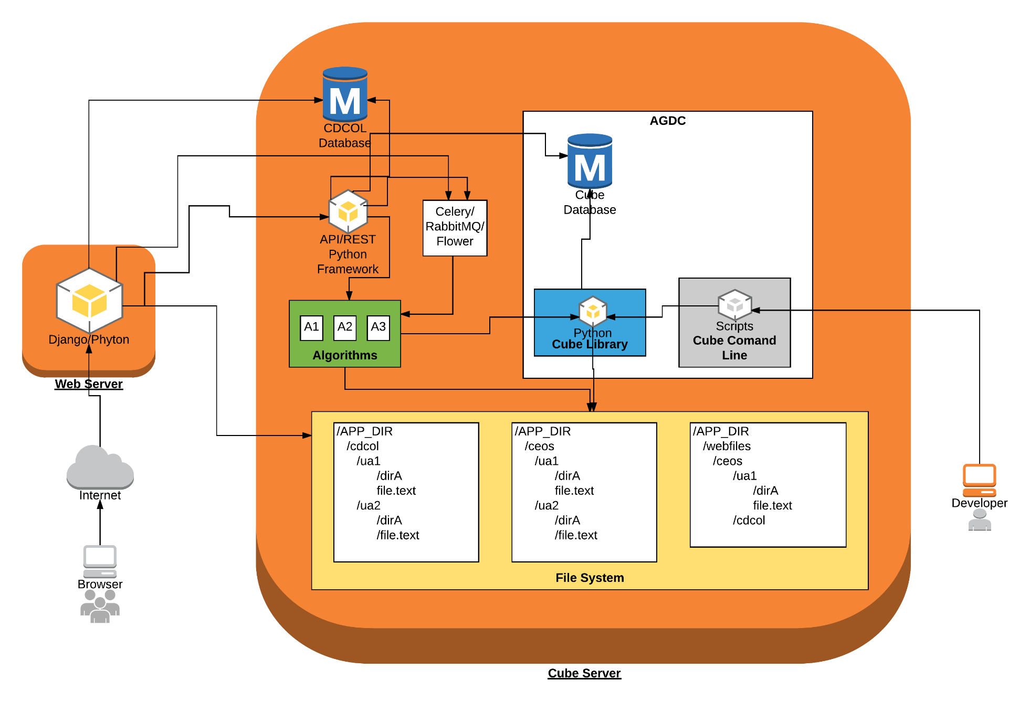
Arquitectura CDCol
Despliegue

Slide 19
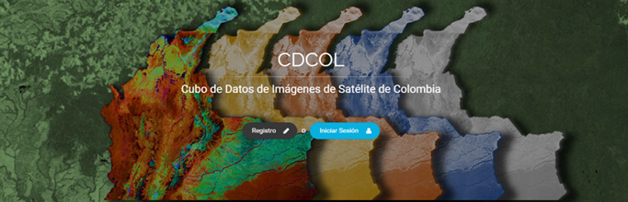
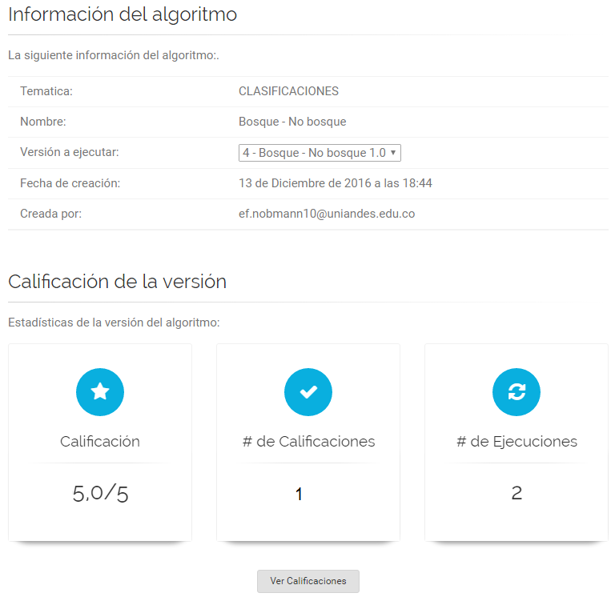
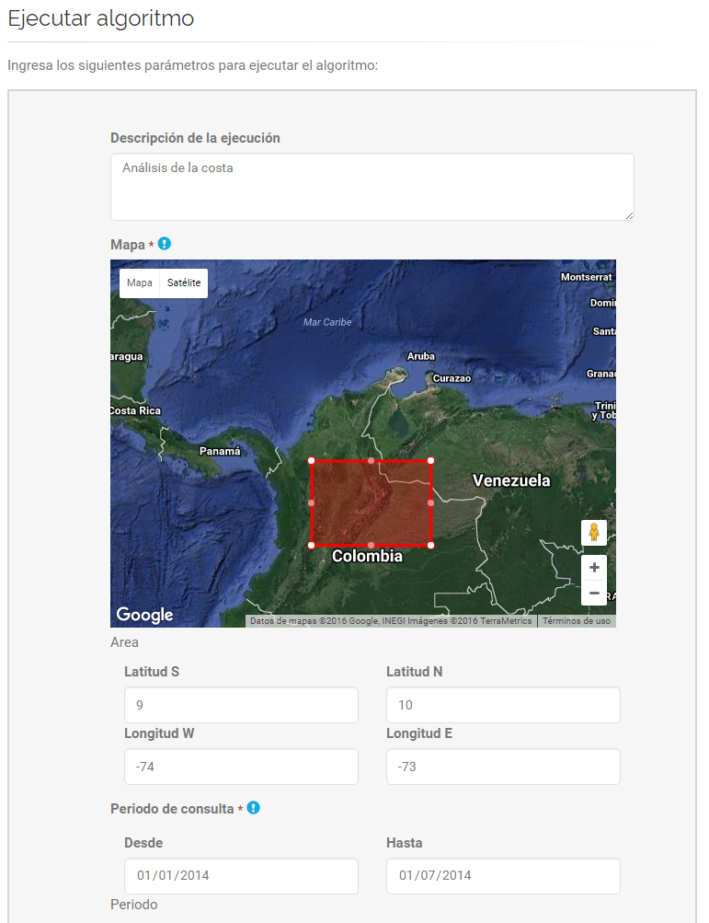
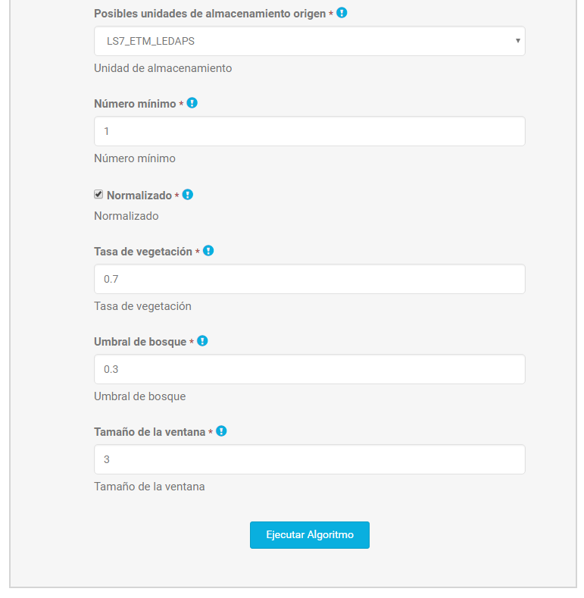
ANALIST – ALGORITHMS EXECUTION

Slide 20
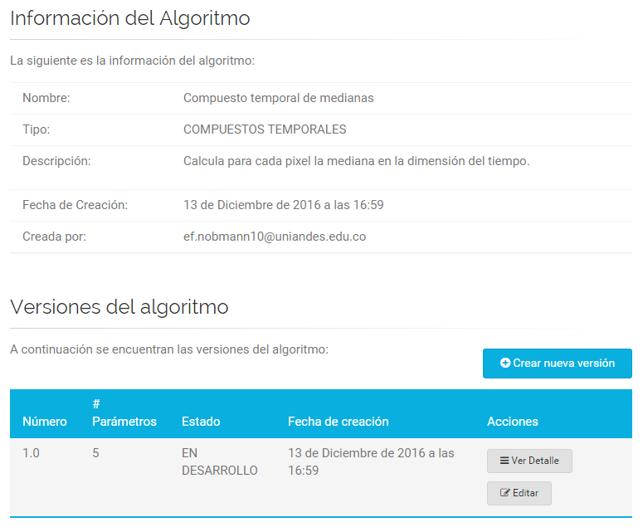
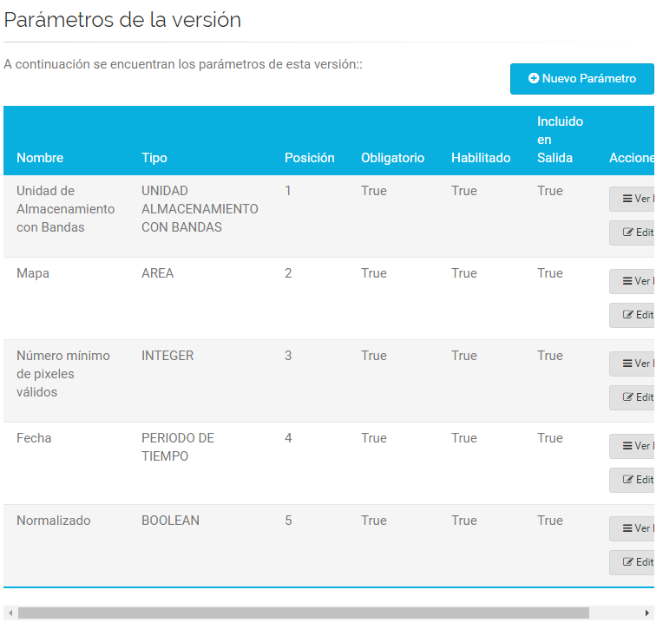
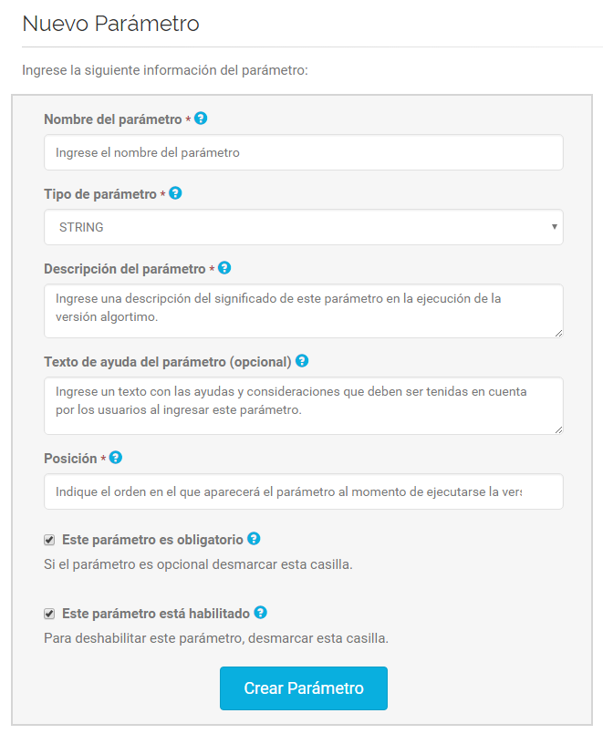
DEVELOPER- ALGORITHMS PUBLISHING

Slide 21
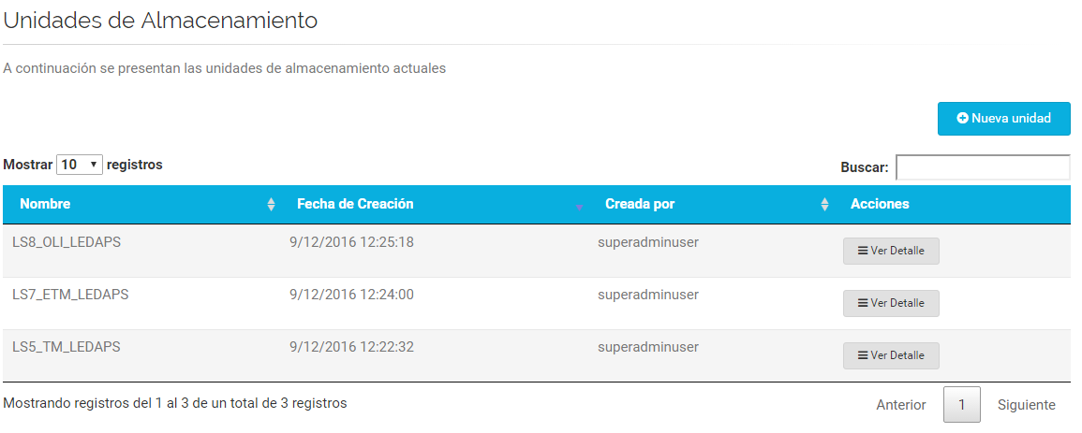
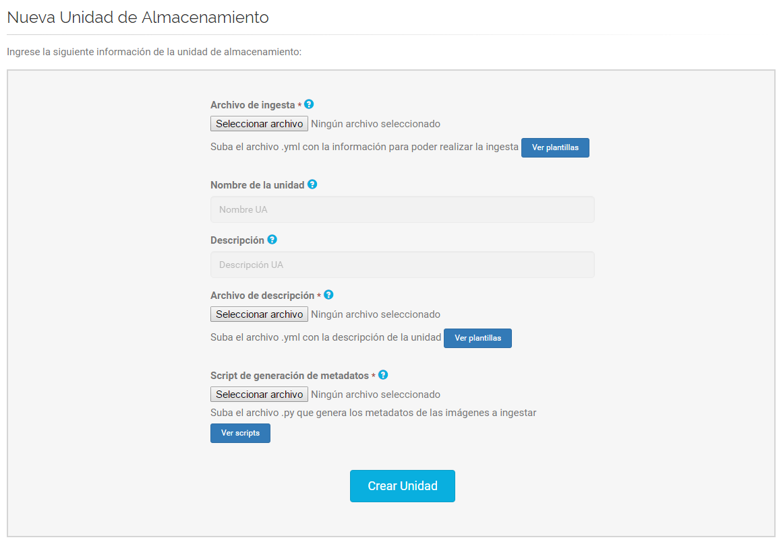
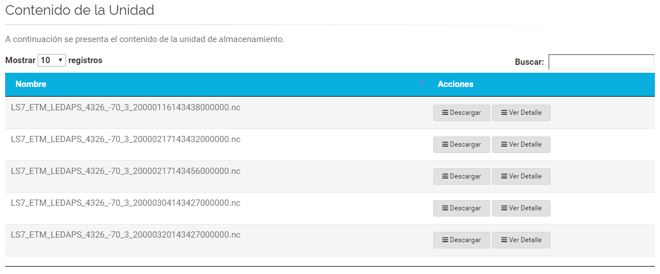
DATA ADMIN– COLEECTIONS MANAGEMENT

Slide 22
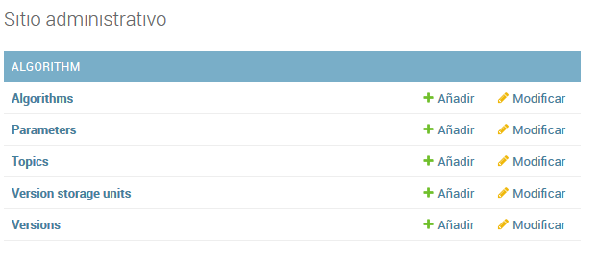
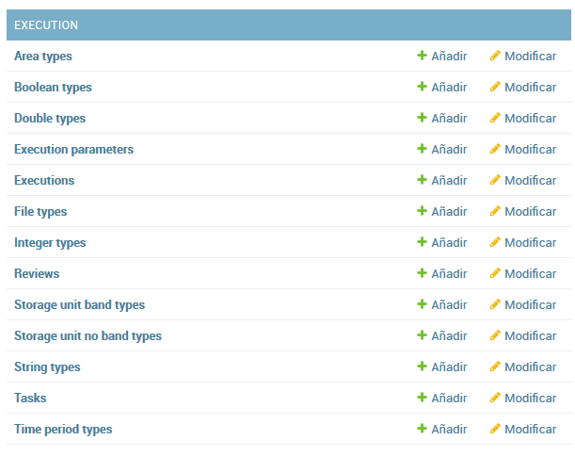
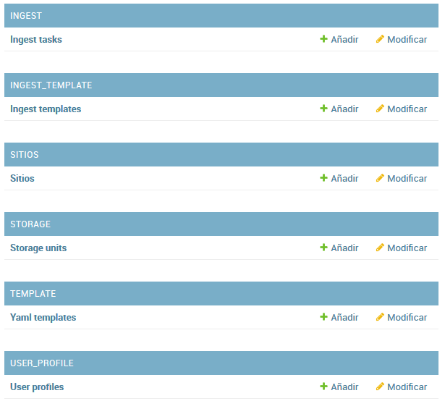
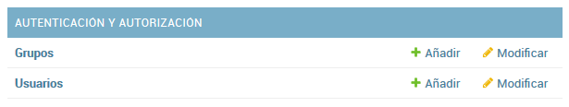
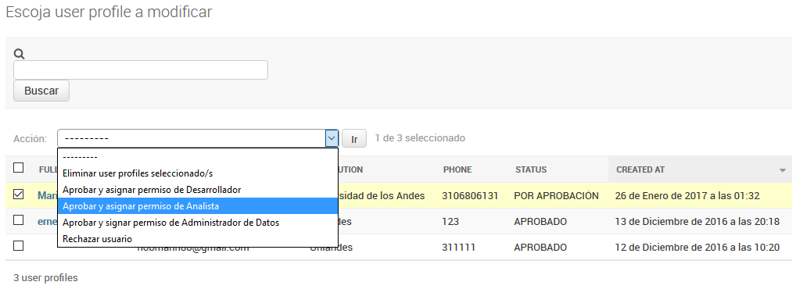
SYSTEM ADMIN– USERS MANAGEMENT

Slide 23
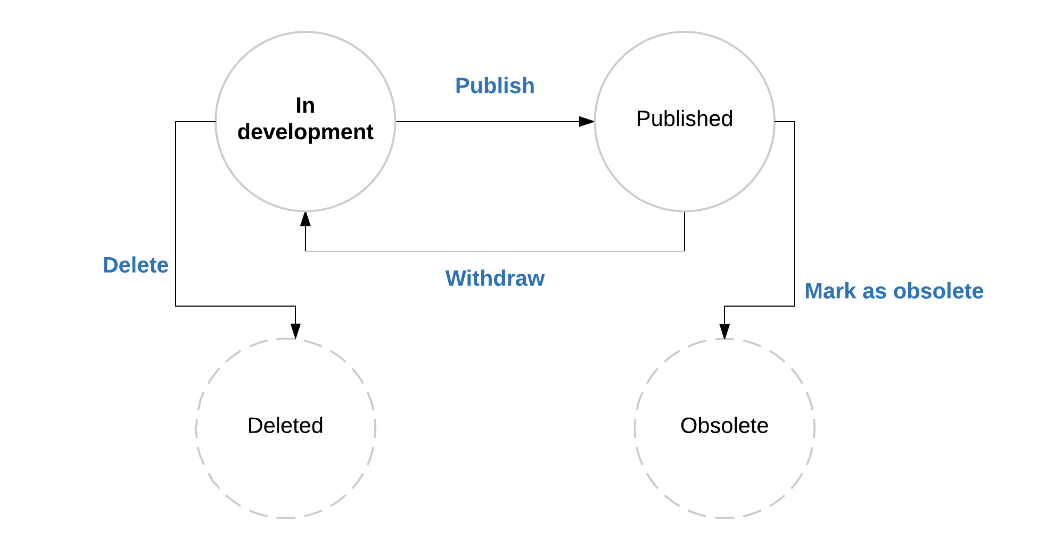
Algorithms Life Cycle
Bank of algorithms and results
Web UI
Parallelization strategy
Training Workshop
Roles

Slide 24
Development
Bank of algorithms and results
Web UI
Parallelization strategy
Training Workshop
Roles
Complexity Abstraction
Independent of datacube-core
Automatic parallelization
Python well known libraries
Numpy
xArray

Slide 25
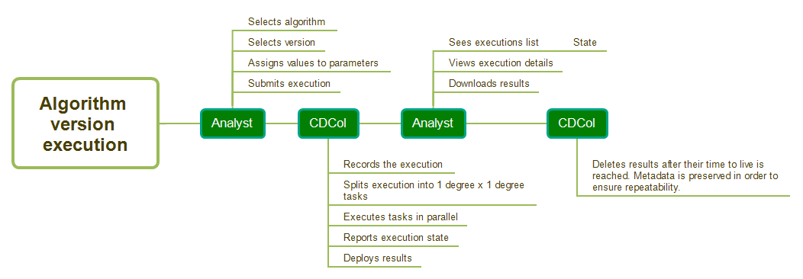
Execution
Bank of algorithms and results
Web UI
Parallelization strategy
Training Workshop
Roles

Slide 26
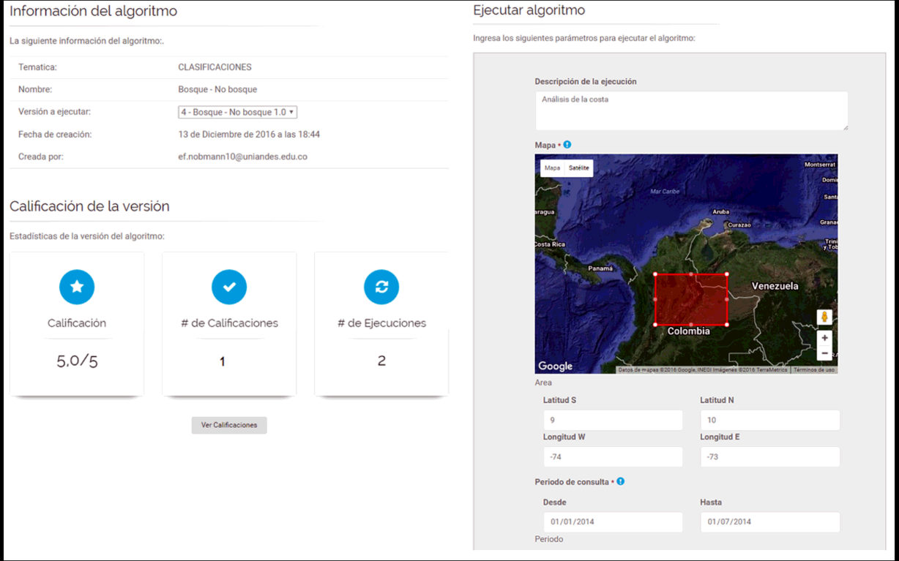
CDCol Web UI
Bank of algorithms and results
Web UI
Parallelization strategy
Training Workshop
Roles
Empowers users to work on a large set of satellite images from any device
Reduces learning curve
Authentication and roles management

Slide 27
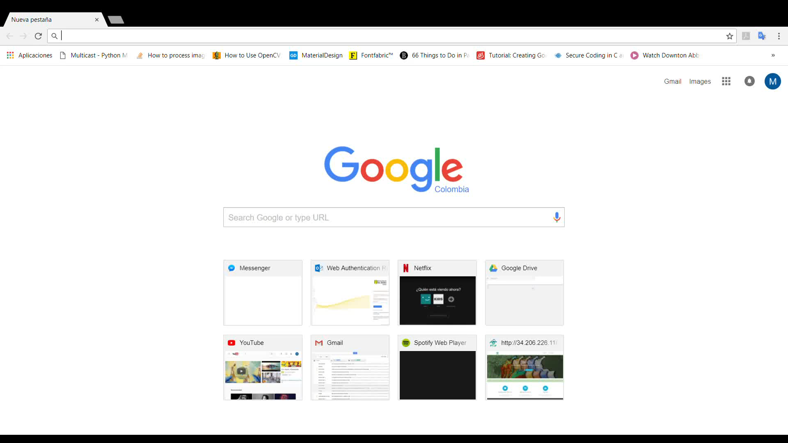

CDCol Demo
Bank of algorithms and results
Web UI
Parallelization strategy
Training Workshop
Roles

Slide 28
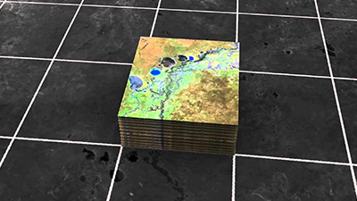

Parallelization Strategy
Bank of algorithms and results
Web UI
Parallelization strategy
Training Workshop
Roles
Automatic
By Tile
Generic Task
Celery

Slide 29
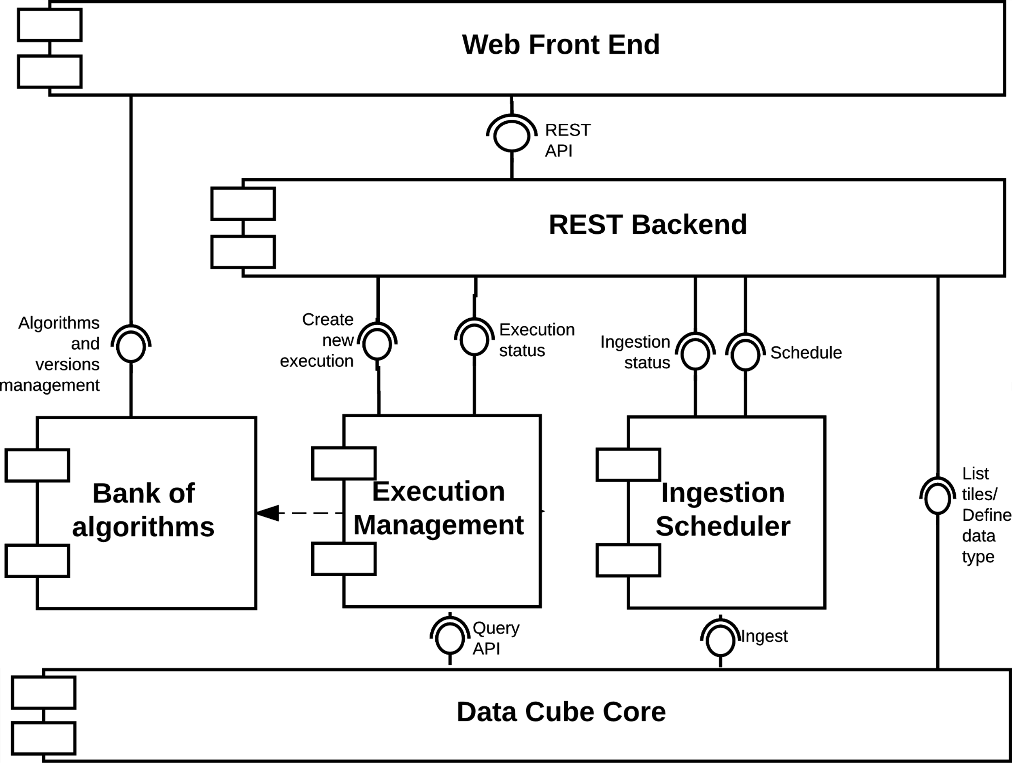
CDCol Components

Slide 30
Lesson Learned and future work
Is important to define a governance for administration and operation of the Data Cube
Data is growing exponentially, how can our technological infrastructure can grow up?
Training and research should be a continuous activities
Horizontal Scaling
Algorithm dependent parallelization schemes
Workflows management
New sensors
New algorithms
Cloud enabled-CDCol

Slide 31
Acknowledgements
Brian Killough from NASA
Alex Held and AGDC researchers team from CSIRO
Alfredo Delos Santos and Kayla Fox from AMA team
Environmental Ministry of Colombiafor financial support.

Slide 32

Thanks for your attention…
Any question?
María Teresa Becerra mtbecerra@ideam.gov-co
Edersson Cabrera ecabreram@ideam.gov.co
Gustavo Galindo ggalindo@ideam.gov.co
Pilar Lozano-Rivera plozano@ideam.gov.co
Harold Castro hcastro@uniandes.edu.co

