Slide 1
FDA Objectives and Implementation Planning
Committee on Earth Observation Satellites
WGISS-44
Beijing, China
25th September 2017

Slide 2
Significant Change…
Significant Opportunities
FDA Driving Themes:
Satellite data volumes and variety are increasing
Satellite data demand and expectations of EO value are increasing
Users want data systems and analysis tools that allow easy access and use of satellite data
Many users desire ARD to minimize data preparation time and knowledge requirements
Substantial growth expectation in the EO based digital economy across Industry and Government
Step change in EO satellite capability leading to new applications
Freely available data and Cloud computing combine to create new industries
New applications from new capabilities in EO
Increased awareness leads to more (non-EO expert) users
Users expect near real-time, locally relevant EO derived information
Higher spatial resolution
Greater diagnostic capability through increased spectral resolution (hyperspectral) and new modalities (active and passive radar)
New capabilities in monitoring through increased acquisition rate and through new payloads (e.g. altimetry, atmosphere)

Slide 3
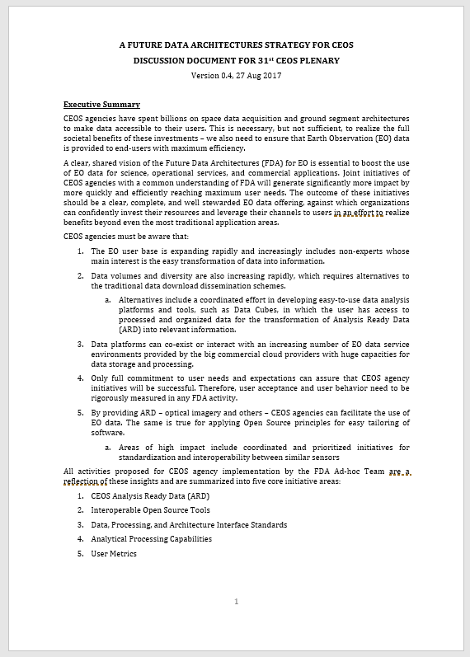
FDA Strategy Document

Slide 4
FDA Themes and Outcomes
CEOS Analysis Ready Data (ARD)
Implement and provision CEOS Analysis Ready Data for Land (CARD4L)-compliant products
Advance ARD for marine and atmosphere domains
Interoperable Open Source Tools
Continue supporting the CEOS Data Cube (CDC) initiative
Demonstrate new technologies through ongoing support of ‘pilot projects’ and consideration of alternate candidate architectures
Data, Processing, and Architecture Interface Standards
Develop standards for pixel-level data discovery, access, and common analytical processing requests (e.g., cloud free mosaics of ARD) exploiting EO satellite data among various CEOS exploitation platforms
Analytical Processing Capabilities
Prototype portable web-based analytical processing APIs/Web Services that work across CEOS exploitation platforms in full computing environments for time series and other analysis
User Metrics
Develop a data use metrics framework through which agencies can contribute to how EO data is being used, rather than just downloaded data quantities

Slide 5
How Can CEOS Agencies Contribute?
CEOS Analysis Ready Data (ARD) (through LSI-VC):
Produce ARD data and/or provide ARD production tools
Expand CEOS ARD to include the ocean and atmosphere domains
Participate in standard setting and review processes (including user feedback loops for evolution)
Engage through WGCV to define QA protocols and cross-validation projects across ARD products
Reach out to commercial providers to encourage their participation in ARD (at their cost)
Promote and enable discoverability of ARD datasets
Interoperable Open Source Tools (through SEO):
Promote the use of interoperable open source tools, such as Open Data Cube (ODC), and application algorithms to enhance the use and impact of CEOS satellite data
Continue to support the CEOS Data Cube (CDC) initiative and progress the development of core components, supporting documentation, and training materials
Support the initial deployment of the CDC architecture by providing training and capacity building to interested international users
Contribute application algorithms to the ODC repository along with documentation and case studies

Slide 6
How Can CEOS Agencies Contribute?
Data, Processing, and Architecture Interface Standards (through WGISS):
Identify key data and metadata standards experts to join WGISS
Support WGISS in the development of standards that ensure interoperability among one or more FDA platforms
Support prototype testing of data and application standards to ensure successful implementation
Identify specialists to join WGISS with expertise in their data holdings to provide guidance on how their holdings are changing to accommodate pixel level access
Identify key System Engineers, Applications Liaisons, and Communication/Outreach Liaisons to engage with WGCapD in developing strategies to promote FDA paradigms and systems
Analytical Processing Capabilities (through WGISS):
Identify Data Analysts, System Engineers, and System Architects to join WGISS
Provide agency computing resources for prototype testing of application algorithms to take advantage of locally stored data or to utilize web-based protocols (e.g., WCS, APIs) for data interaction
Engage CEOS agencies who have implemented authentication systems to provide their lessons learned and best practices
User Metrics (through WGISS):
Engage CEOS representatives familiar with user needs analysis and metric reporting
Support development of universal metric capturing
Participate in open venues for discussion of abstract CEOS projects (webinars, conferences, etc.)

Slide 7
31st CEOS Plenary
Endorsements
FDA Strategy for CEOS
Decisions
Continuation of FDA AHT into 2018 centered around the 5 FDA themes:
CEOS Analysis Ready Data (ARD)
Interoperable Open Source Tools
Data, Processing, and Architecture Interface Standards
Analytical Processing Capabilities
User Metrics
With CEOS Plenary endorsement, FDA AHT plans to continue its work to integrate and oversee the FDA-related activities of several key entities within the CEOS structure – specifically LSI-VC, SEO, WGISS, and WGCapD – and to keep the momentum that has been built

