Slide 1
Yonsook Enloe
Sept 26, 2017
Earth Data Search Tool Demo

Slide 2
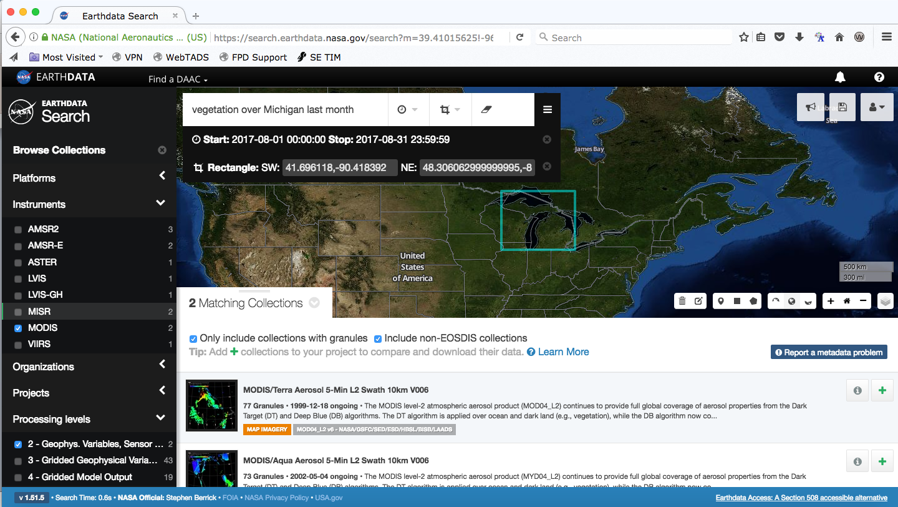
Data Collection Search:
Search by Keyword, Filter by Facet
Notes:
Earthdata Search is a web-based data discovery and access tool that enables the search of over 35,000 NASA Earth Observing System Data and Information System (EOSDIS), and U.S or international partner agency data holdings across the Earth science disciplines. It allows users, including those without specific knowledge of the data, to perform data searches, retrieve high-level descriptions of data sets and detailed descriptions of the data inventory, view browse images, and submit orders. A wide range of filtering capabilities are available.

Slide 3
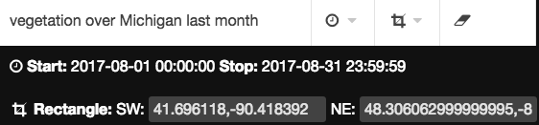
Natural Language Processor
Notes:
The natural language processor recognizes places, dates and times expressed in natural language and replaces them with well-defined search parameters.

Slide 4
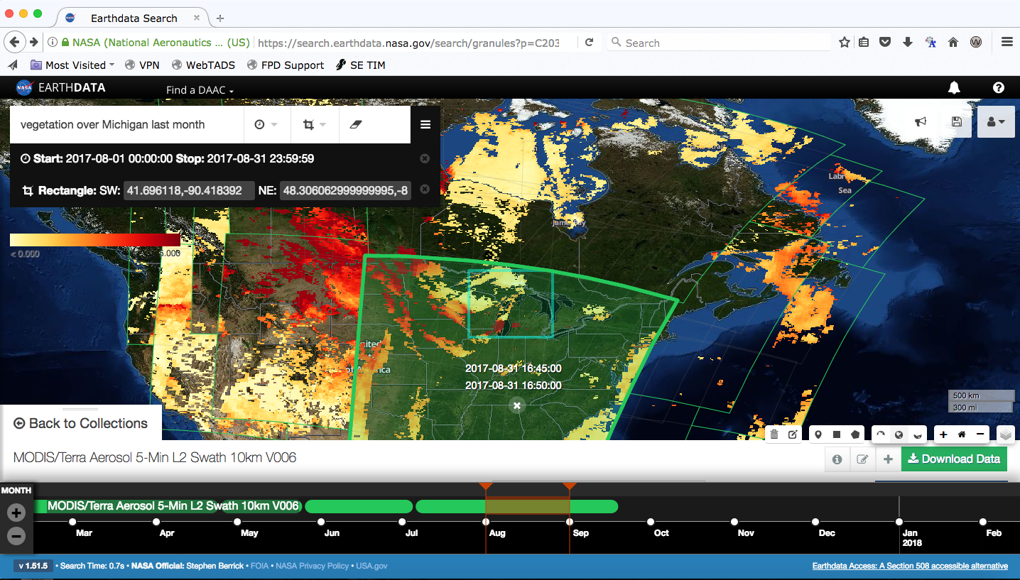
Browse visually in space and time
Granule spatial outline and selector
Time coverage display and selector
Notes:
The granule browse and outline display enable users to visually select data scenes based on location and content. The timeline shows coverage over time and also allows selection of granules.

Slide 5
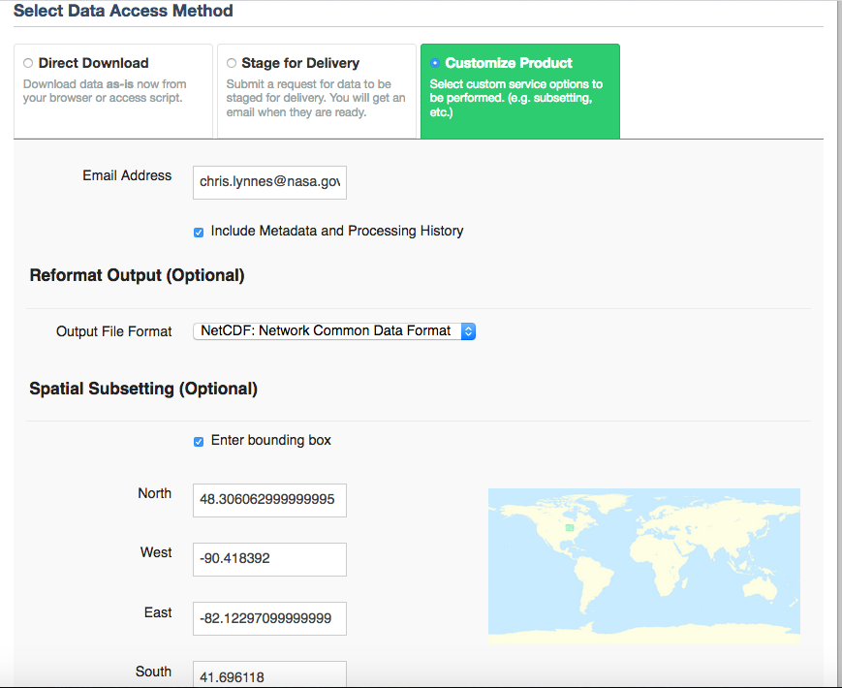
Subset (some) data products
Bounding box carried over from search criteria
Notes:
Subsetting is available through the user interface for some data products and is currently undergoing a significant expansion.

Slide 6
Earth Data Search Tool
https://search.earthdata.nasa.gov

