Slide 1
WGISS Connected Data Assets
Sept 26, 2017
Yonsook Enloe

Slide 2
WGISS
Science/Theme clients
GEOSS clients
WGISS Connected Data Assets
CWIC
FedEO
IDN
Technical supports
WGISS Connected Assets System Level Team

Slide 3
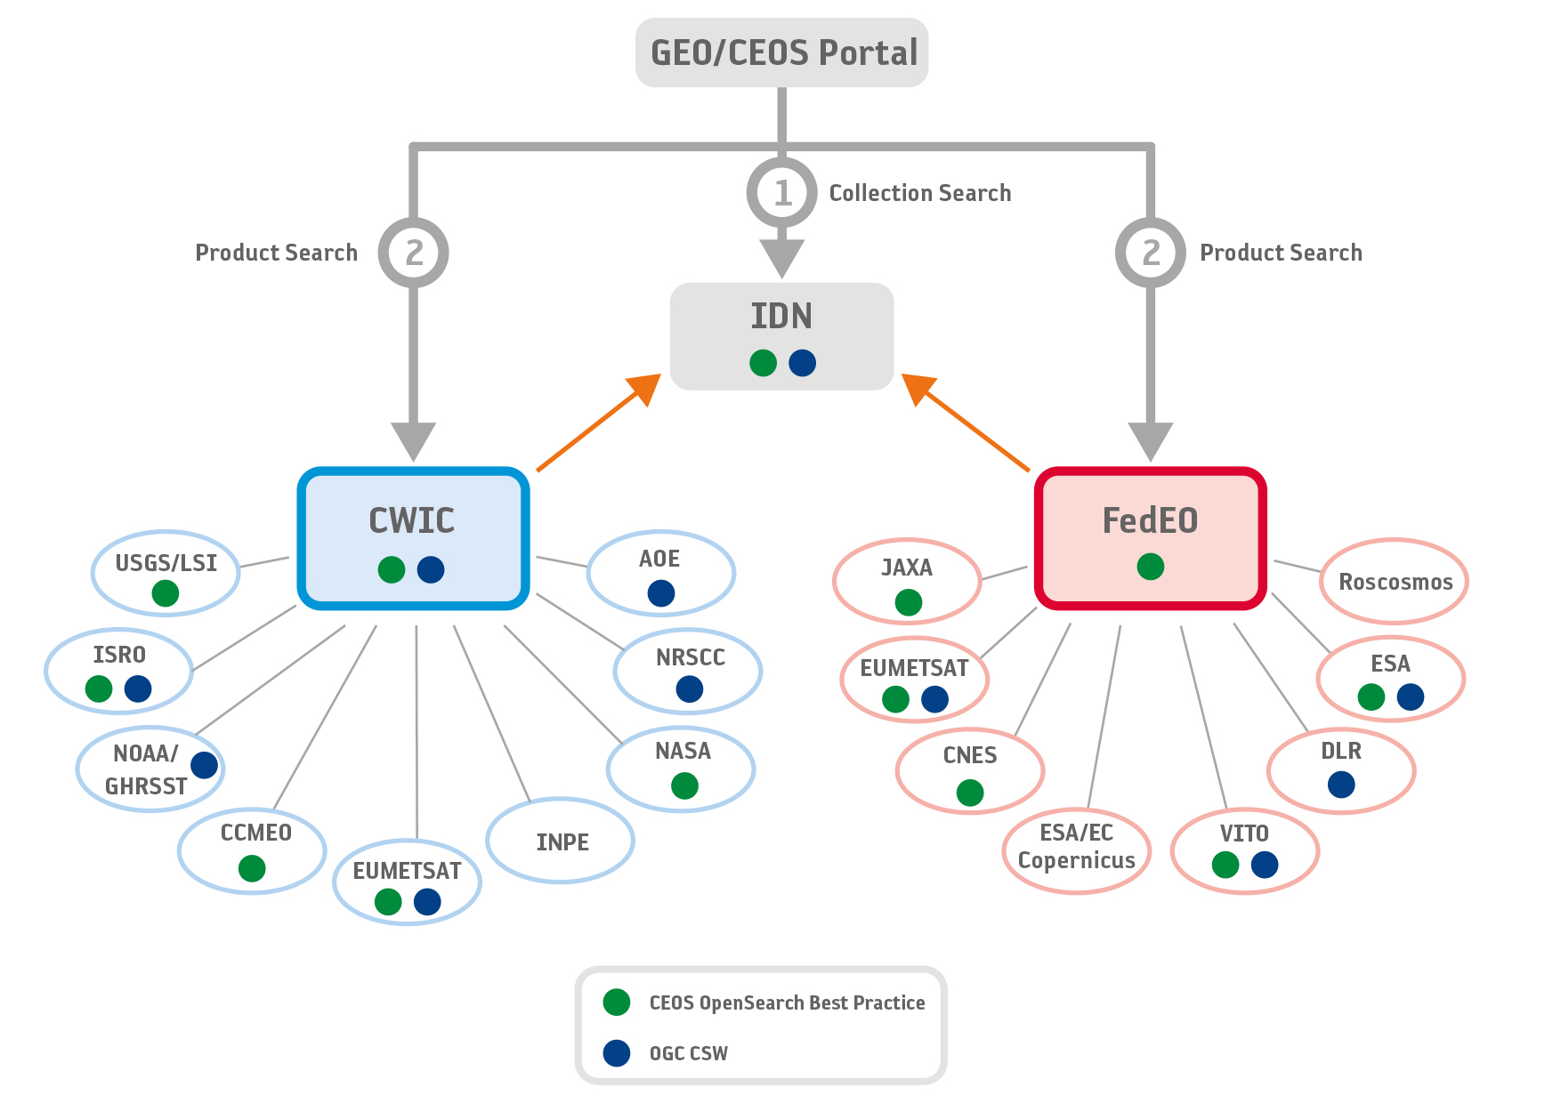
Architecture WGISS Data Assets

Slide 4
Towards a WGISS Federation
Data collection registration at the IDN using the IDN keywords; Info about how granule search is supported will be included in the data collection registration
Data partners need to support 1 of the 2 supported WGISS standards
  CEOS OpenSearch Best Practices (v 1.2)
  OGC CSW 2.0.2
All searchable data must have a data access path
  Data download
  Data order (free or with cost)
  Email order (free or with cost)
Servers must have high availability (99%?)
A technical POC needed for each data partner

Slide 5
Client Partners
Clients can offer search and access to all the satellite data available through the WGISS Federation
Clients can offer search and access to a limited subset of data available through the WGISS Federation along with other services through tagging (e.g. CWIC, FedEO, LSI, Carbon,…)
Clients can offer support for a 2-step search
  Discovery through collection search using platform, instrument, science keywords, etc. (IDN). The IDN data record will contain info about how granule search is supported
  Search granule metadata at data partners via CWIC, FedEO, Independent servers
All granule search results will contain links to data access

Slide 6
Recent Accomplishments
Oct 2016 – First WGISS Access System Level Team telecon
Access-SysTeam-Help@wgiss.ceos.org for questions about any of the systems – e.g. IDN, FedEO, CWIC
Agreement on support for 2-step search through IDN for collection searching and granule searching through FedEO/CWIC.
Team reviewed the CEOS OpenSearch BP document and agreed on the v1.2 release in June 2017.
CWIC Smart Client Validator for CEOS OS conformance testing.
Future Conformance Test document led by ESA.
ESA led effort to specify draft OGC 17-003 EO Dataset GeoJSON Encoding Standards with SLT Team review
Working with the GEODAB team to integrate with WGISS Connected Assets
  Distributed information about the new collection identifiers being used in the IDN
  Support for IDN incremental harvesting

Slide 7
What Data is Accessible?
WGISS webpage has current list of the data collections accessible from IDN, FedEO, and CWIC
Over 32,000 collections searchable in the IDN
Over 5000 collections accessible (collection search) with associated granule search
Over 300+ million granules accessible (granule search)
Additional data collections/granules continuously being added from heritage and current EO missions
Additional data partners can be added to FedEO and CWIC federations
Independent data partners who support the WGISS standards can be added to the WGISS Connected Data Assets

Slide 8
What’s Next?
Continued support for GEOSS integration
Continued support for CSW
FedEO data collections are being ingested into the IDN
IDN is the focal point for 2-step search for CEOS data assets: collection search that leads to granule search
Trend: more data providers supporting the CEOS OpenSearch BP for granule search
  USGS completed changeover
  NOAA, INPE, ISRO working on their new OS connections
Trend: more clients are supporting the CEOS OpenSearch BP for searching EO data

Slide 9
What’s Next?
CEOS OpenSearch enables seamless transition from collection search to granule search
  Supports independent data servers who can register data collections in the IDN and then offer granule search at data provider site
Outreach to client portal teams/communities
  What is working? What needs to work better?
  What are the pain points for search and access?
  What additional capabilities are needed?
How do we ensure that the WGISS Data Assets provide a stable and reliable search and access service?

Slide 10
WGISS System Level Team (SLT)
System level team to coordinate and oversee the WGISS integrated system and standards:
Coordinate operations, maintenance and evolution activities (e.g. for infrastructure, standards adoption, etc).
On-board new data partners
Provide technical support for client partners
Monitor the health of the federated system and report outages and errors etc. to the partners
Test all the components of the federated system, including end to end search and data access
Work with data and client partners to identify and resolve system and component bugs
Provide support for metrics collection
??

Slide 11
ACCESS Session Outline
IDN
FedEO
CWIC
Data Partner Reports
  ISRO
  NRSCC
  NOAA
Client Partner Reports
  WGISS Client/Carbon Portal
  Earth Data Search Tool
CEOS OpenSearch
GEO JSON

