Slide 1
Federated Earth Observation (FedEO)
CEOS WGISS Meeting #44
A. Della Vecchia, O. Barois, M. Albani (ESA)
Yves Coene (Spacebel)
26/09/2017

Slide 2
Outline
Introduction
Architecture Overview
Metrics
FedEO Use-Cases Scenario

Slide 3
Outline
Introduction
Architecture Overview
Metrics
FedEO Use-Cases Scenario

Slide 4
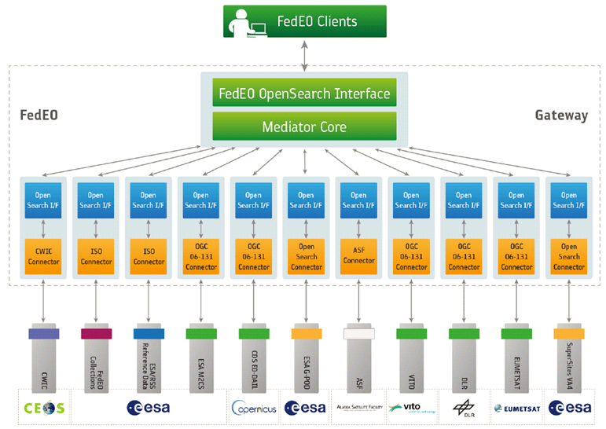
FedEO: Federated Earth Observation Gateway System
FedEO = Federated Earth Observation missions access
The FedEO system provides a unique entry point to a growing number of scientific catalogues and services for, but not limited to, EO European and Canadian missions.

Slide 5
FedEO: Federated Earth Observation Gateway System
FedEO is deployed with ESA (European Space Agency) infrastructure providing:
Brokered discovery, access and ordering capability to European/Canadian EO missions data based on both HMA (Heterogeneous Missions Accessibility) interfaces and customised WS interface
State-of-the-art data discovery WS Interface based on OpenSearch (OGC 10-032r8, OGC 13-026r8 and OpenSearch Best Practice 1.2)
Two step search (configurable option) aligned with CEOS WGISS initiative
Harvesting and internal cataloguing capabilities to support back-ends not able to provide interoperable interfaces

Slide 6
FedEO Current Brokered Architecture
Standardised and interoperable interface
To forward query to selected catalogues
Data discovery, access & ordering depending on agreement and interfaces (e.g. HMA, OpenSearch)
To manage with back-end protocol interface
Scientific Catalogues
& Services

Slide 7
Standard Interfaces
http://ceos.org/ourwork/workinggroups/wgiss/access/fedeo/ https://wiki.services.eoportal.org/tiki-index.php?page=FedEO
Metadata
OGC 10-157r4, Earth Observation Metadata profile of Observations & Measurements, 1.1, 10/06/2014
ISO 19139, Geographic Information – Metadata XML (ISO 19139:2007)
ISO 19139-2:2012, Geographic information -- Metadata -- XML schema implementation -- Part 2: Extensions for imagery and gridded data
INSPIRE Metadata Implementing Rules: Technical Guidelines based on EN ISO 19115 and EN ISO 19119
INSPIRE Technical Guidance for the Implementation of the INSPIRE Download Services
OGC 08-167r2, Semantic annotations in OGC standards, Version 2.0, 10/10/2012
Service Bindings
CEOS OpenSearch Best Practice
OGC 11-035r1, EO Collection and Service Discovery using the ebRIM Application Profile of CSW 2.0, 1.0, 26/03/2013
OGC 10-032r8, OpenSearch Geo and Time Extensions, version 1.0.0, 14/04/2014.
OGC 13-026r5, OpenSearch Extension for Earth Observation, DRAFT 1.0.0, 29/10/2014
OGC 13-084r2, OGC I15 (ISO19115 Metadata) Extension Package of CS-W ebRIM Profile, 1.0, 28/04/2014
OGC 06-141r6, Ordering Services Framework for Earth Observation Products Interface Standard, Version 1.0.0, 09/01/2012.
OGC 07-118r9, User Management Interfaces for Earth Observation Services, Version 1.1, 28/04/2014.

Slide 8
Outline
Introduction
Architecture Overview
Metrics
FedEO Use-Cases Scenario

Slide 9
Software Components
Architecture:
Modular
Used separately or combined
Interfaces:
Standard OGC/CEOS interfaces
Documentation:
SRS, SDD, SCF (incl. Installation instructions)
Main components:
B3 – Dataset Series Catalogue a.k.a. "Collection Catalogue"
B4 – Dataset Catalogue a.k.a “Granule Catalogue”
B2 – OpenSearch Gateway
A1 – FedEO eoPortal Client a.k.a. "OpenSearch Client"

Slide 10
Architecture Overview
FedEO is based on highly modular SW architecture.
ESA installation provides a full E2E scenario.
L3
Client
L2
Gateway
Collection Catalogue
Product
Catalogue
L1
Collection Metadata Ingestion Tool
Product Metadata Ingestion Tool
L0

Slide 11
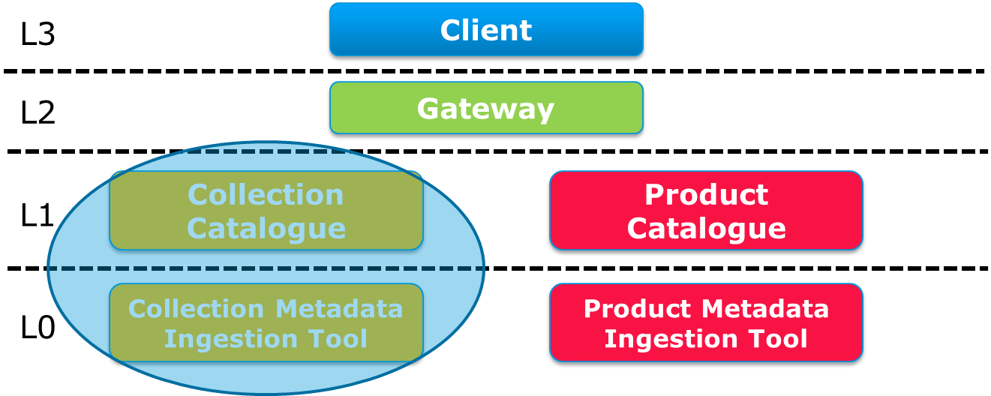
B3 – Collection Catalogue
Description:
Metadata store (catalogue) for collection metadata providing RESTful OGC-compliant CRUD interfaces (read/write)
Interfaces
OpenSearch, compliant with all OGC and CEOS Best Practices (OGC 13-026r8, OGC 10-032r8..)
OpenSearch OSDD Parameter extension:
Publishes possible values of "platform", "organisation", … consistent with catalogue content
Parameter extension (e.g. valid time range)
RESTful (W3C LDP 1.0)
Media types (out): Atom
Metadata formats (in/out): ISO19139, ISO19139-2

Slide 12
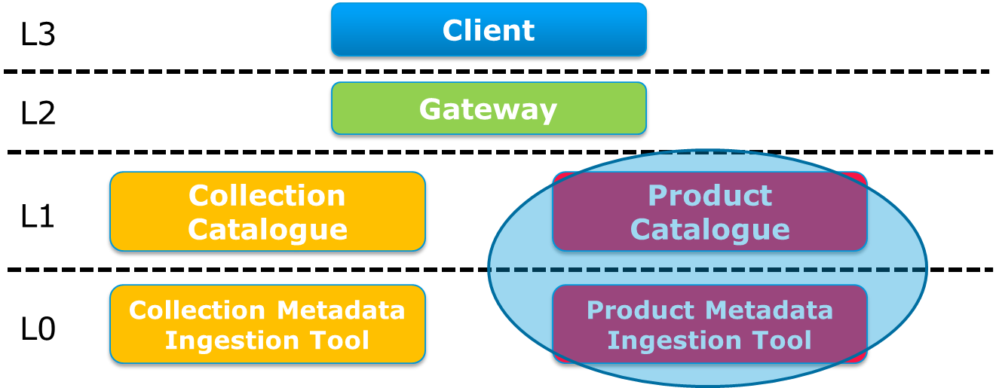
B4 – Product Catalogue
Same software as Dataset Series Catalogue
W3C LDP RESTful interface
Input mechanisms and harvester included for:
OGC 10-157r4
(ngEO-like) Index Files, .CSV …
Metadata formats (output):
OGC 10-157r3
OGC 10-157r4
OGC 17-003 GeoJSON (development platform)
Used for LDS and OADS product metadata, e.g. Cryosat-2, SMOS_Open, ERS, ENVISAT, OceanSat, TropForest, SPOT, Ikonos, Landsat…
Future work
Support OGC Web Context to link metadata to offerings (WMS, WCS, WPS)

Slide 13
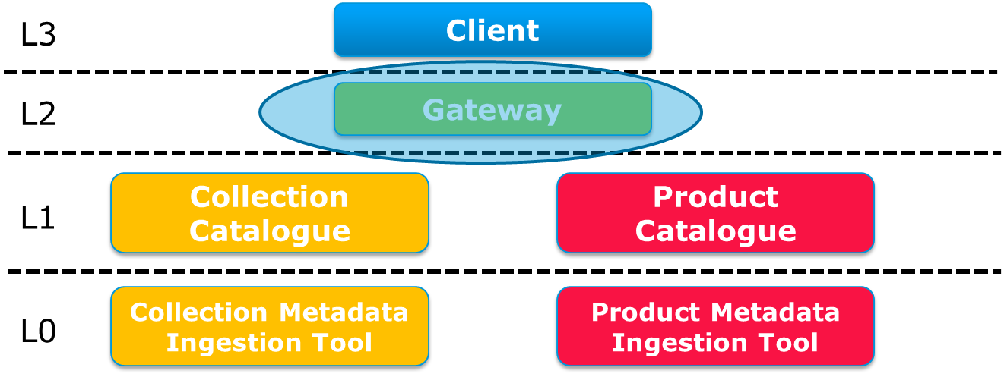
B2 – OpenSearch Gateway
Description
Configurable entry point combining internal/external collection and product catalogues through two-step search with single homogeneous interface
Provide access to ESA SciHub Sentinel-1/2/3
Interfaces (provided)
OpenSearch, compliant with all OGC and CEOS Best Practices (OGC 13-026r8)
Media types: Atom, JSON-LD, RDF, HTML (basic), GeoJSON (OGC 17-003)
Metadata formats:
Collections: Various ISO formats
Products: OGC 10-157r4, OGC 10-157r3, OGC 17-003
Instances
FedEO@ESA, CDS@ESA, delivered to VITO, SatCen, DLR

Slide 14
B2 – OpenSearch Gateway Improvements
At WGISS-44 time …
Distributed collection search or harvested collection metadata configurable for each individual collection search endpoint
Expected configuration:
Distributed search: FedEO + NASA CMR collections
Harvested: all collections except NASA CMR.
Evolution of standards:
Align with OGC 13-026r8
Improved CEOS Best Practices support (e.g. MBR)
Make OGC 10-157r4 default EOP O&M metadata format.
Allow obtaining Collection metadata from Gateway in:
ISO 19139,
ISO 19139-2,
ISO MENDS,
ISO 19115-3,
DIF-10

Slide 15
B2 – OpenSearch Gateway Improvements
Supported Collection metadata formats
Metadata format | {sru: recordSchema} name | alternative value for {sru:recordSchema} long name (OGC 13-026r8)
ISO 19139 | iso / iso19139 | http://www.isotc211.org/2005/gmd
ISO 19139-2 | iso19139-2 | http://www.isotc211.org/2005/gmi
ISO 19115-3 | iso19115-3 | http://standards.iso.org/iso/19115/-3/mdb/1.0
ISO MENDS | iso19115-3 | https://cdn.earthdata.nasa.gov/iso/gmi
DIF-10 | dif10 | https://cdn.earthdata.nasa.gov/dif/10.x
Dublin Core | dc | info:srw/schema/1/dc-v1.1
Supported Product metadata formats
Metadata format | {sru: recordSchema} name | alternative value for {sru:recordSchema} long name (OGC 13-026r8)
O&M 1.0 | om10 | http://www.opengis.net/eop/2.0
O&M 1.1 | om11 / om | http://www.opengis.net/eop/2.1

Slide 16
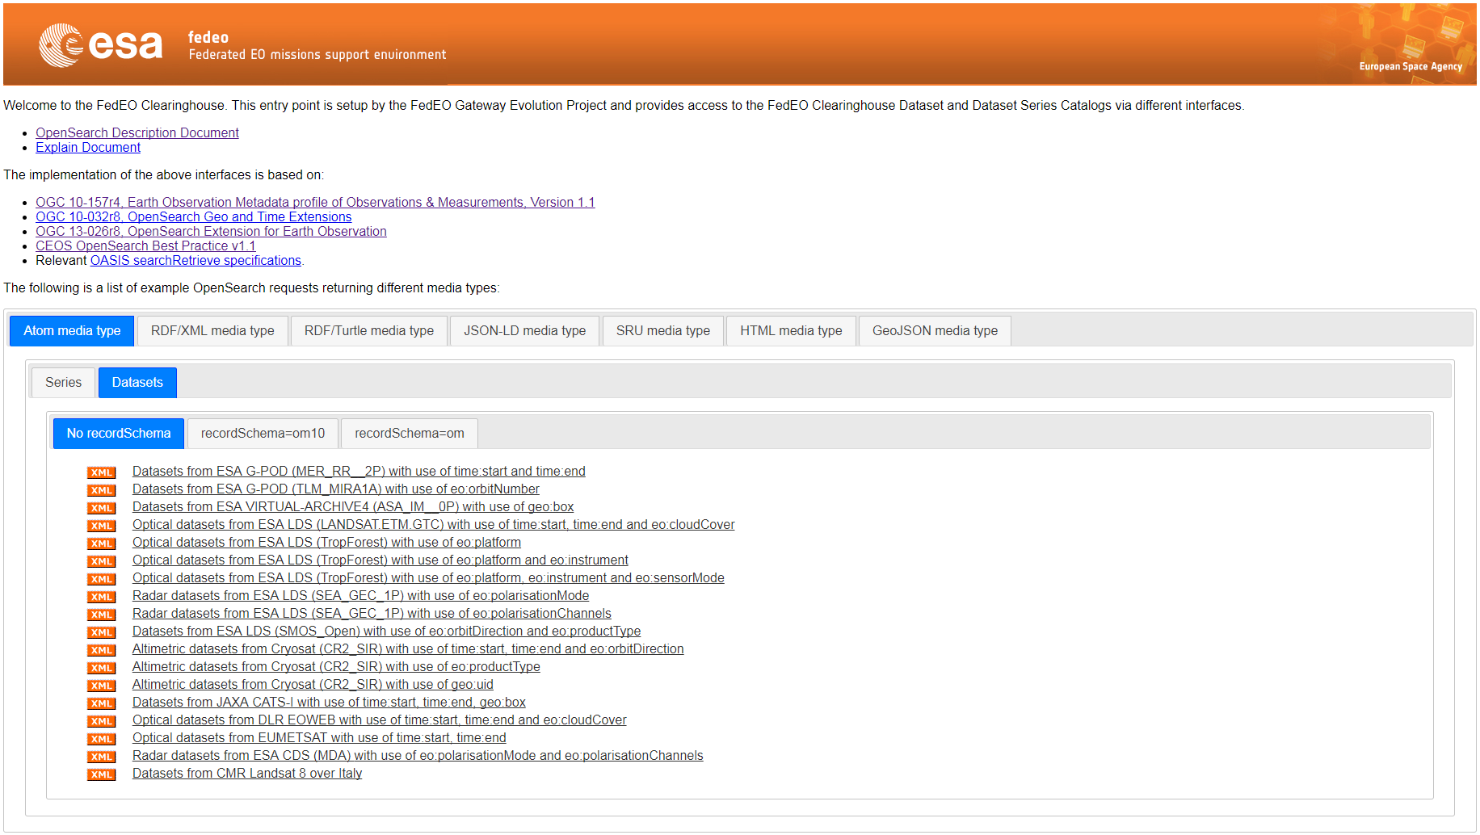
B2 – OpenSearch Gateway – metadata formats
Operational platform:
http://fedeo.esa.int/opensearch/readme.html
Development platform:
http://geo.spacebel.be/opensearch/readme.html
GeoJSON metadata and response:
OGC 17-003 GeoJSON(-LD) Encoding Dataset Metadata (draft)
Made available for OGC Testbed 13 activities (Apr ‘17-Dec ’17)

Slide 17
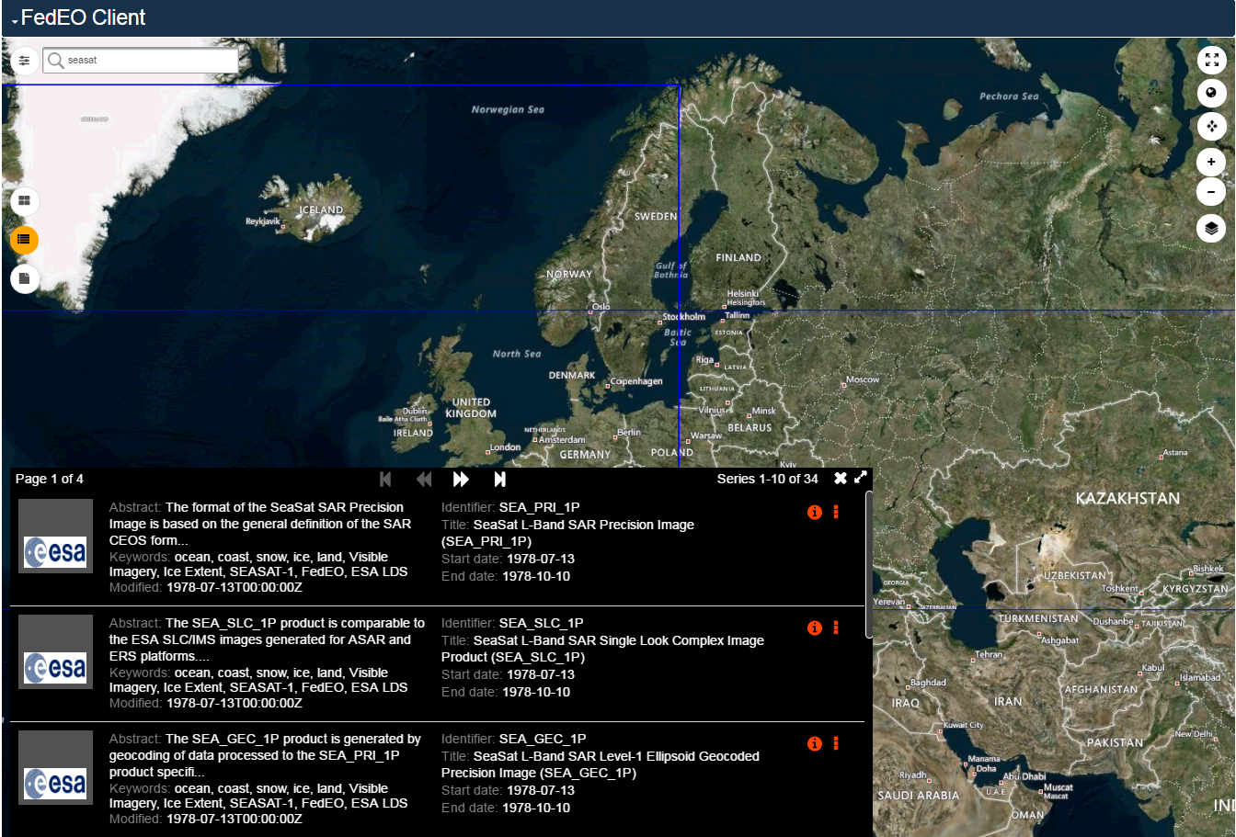
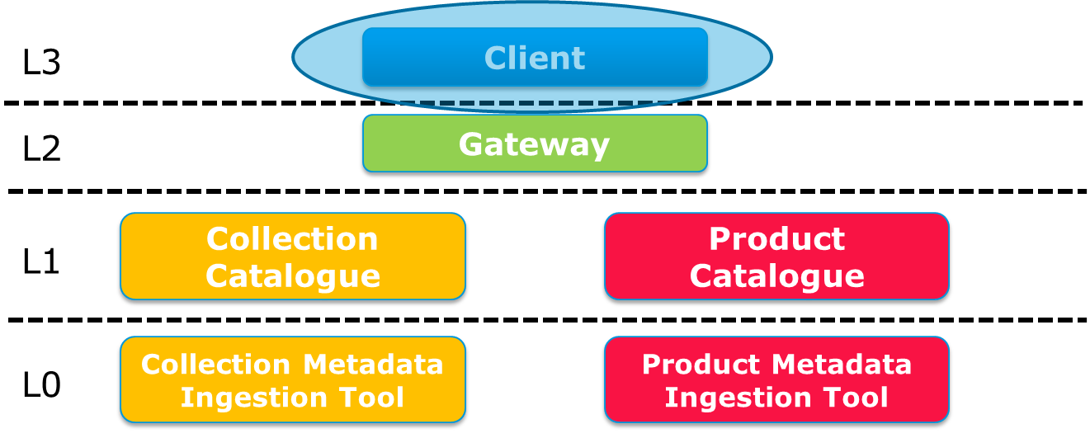
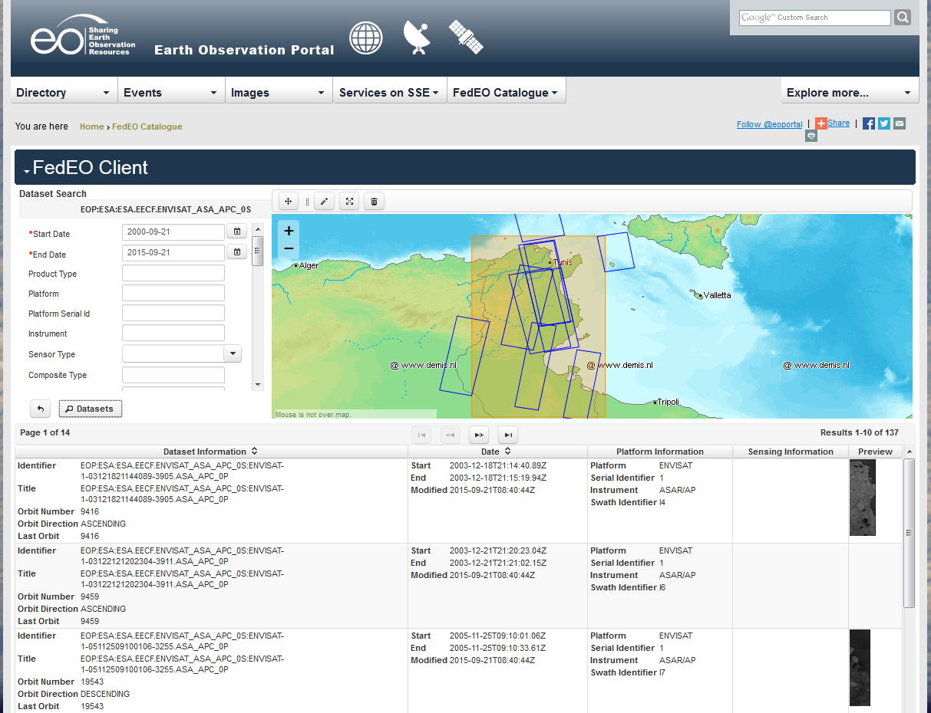
A1 – FedEO OpenSearch Client
WGISS-44
WGISS-43
Operational client available on eoportal https://eoportal.org/web/eoportal/fedeo
Development client http://eoportal.spacebel.be:8090/web/eoportal/fedeo

Slide 18
A1 – FedEO OpenSearch Client - Collection

Slide 19
A1 – FedEO OpenSearch Client - Collection

Slide 20
A1 – FedEO OpenSearch Client - Collection

Slide 21
A1 – FedEO OpenSearch Client - Collection
Annotations in ISO metadata as per OGC 08-167r2 refer to NASA GCMD (SKOS), GEMET and other thesauri

Slide 22
A1 – FedEO OpenSearch Client - Collection
Access to "collection" metadata and page on Earth Online (HTML)

Slide 23
A1 – FedEO OpenSearch Client - Products

Slide 24
A1 – FedEO OpenSearch Client (Granules)
Granule Download via EO-SSO
(Single Sign-on)

Slide 25
Outline
Introduction
Architecture Overview
Metrics
FedEO Use-Cases Scenario

Slide 26
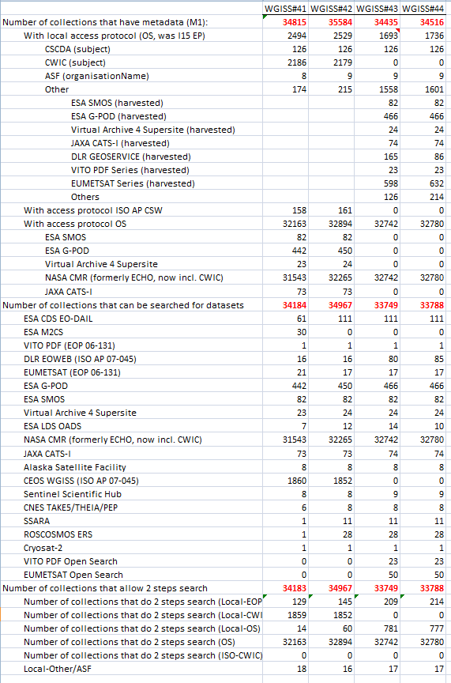
Metric at WGISS-44
Collections accessible through FedEO
Operational by end 9/2017
Notes:
Dataset series are harvested locally for uniform search interface
CWIC dataset catalogue now via CMR
VITO PDF Open Search (collection/granule) catalogue is added
EUMETSAT Open Search (collection/granule) catalogues is added
DLR EOWEB is updated with new list of supported collections
ESA OADS/LDS Collection/granule catalogue added (subset of ESA Collection repository)
Sentinel 1/2/3, OceanSat, ENVISAT, ERS, SMOS, Cryosat

Slide 27
Metrics
Two Step search:
Local FedEO Collection Catalog is now OpenSearch (SolR-based) replacing I15 EP.
CWIC collections no longer harvested
NASA CMR/CWIC not counted in metrics below

Slide 28
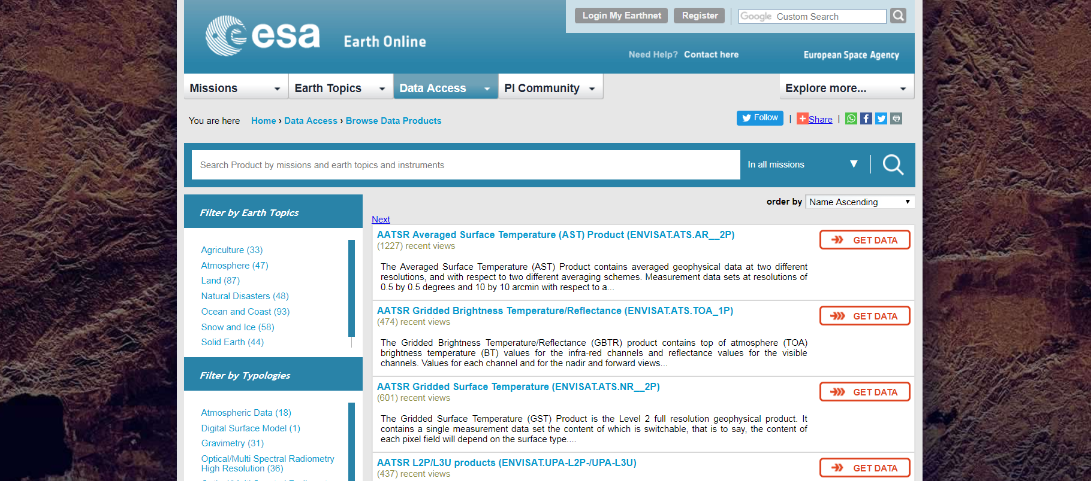
ESA Collections Export onto IDN
ESA Collections (170+) have been ingesting gradually in FedEO from ESA Earth On Line Web Page, for being prepared in DIF-10 to be harvested from IDN
https://earth.esa.int/web/guest/data-access/browse-data-products

Slide 29
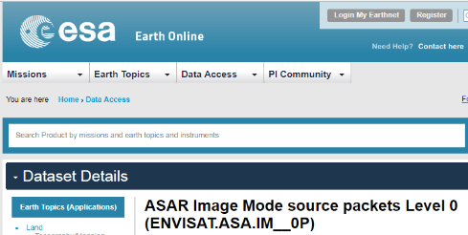
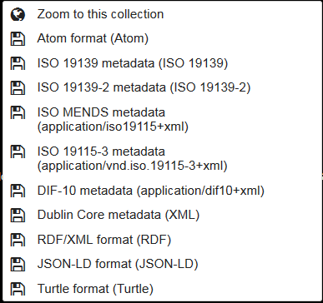
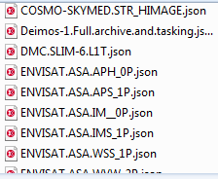
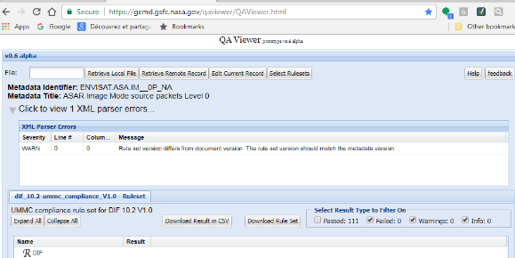
ESA Collections Export onto IDN
ESA Earth Online Scraper
B3.1: Dataset Series Metadata Import/Export
Utility
B3: Dataset Series Catalog
B2: OpenSearch Gateway
ISO 19139-2 Dataset Series
DIF-10 Dataset Series
(Response from Catalog)
JSON
Earth Online
Dataset Series
Keywords
ESA Earth Online
GEMET
Mapping
Keywords
ESA Earth Online
GCMD
Mapping
Platforms
ESA Earth Online
GCMD
Mapping
Instruments
ESA Earth Online
GCMD
Mapping

Slide 30
ESA Collections Export onto IDN
Example of OS request on FedEO GW returning Earth Online collections in ATOM format with links to the collections in DIF-10 format:
http://geo.spacebel.be/opensearch/request?subject=Earth Online

Slide 31
Outline
Introduction
Architecture Overview
Metrics
FedEO Use-Cases Scenario

Slide 32
CEOS Data Assets

Slide 33
CEOS Scope
FEDEO CLIENTS
EU CLIENTS
US CLIENTS
OpenSearch Interface
FedEO@ESA Gateway
CEOS IDN / CMR
FedEO
Internal
Collection
Catalogue
FedEO Internal
Product Catalogue
CMR Granule
(Dataset)
Catalogue
IDN Collection
Catalogue (IDN/CWIC/
GEOSS)
ESA
Presentation Layer
EUMETSAT
SO-CAT
(client part)
Web Pages
Catalog view
EOLI
ngEO
(client)
SO-CAT
Visualizer
New clients
MEA Client
Metadata Layer
Visualisation Std I/F
(WCS, WMS)
ESA Cross Collection OpenSearch Interface
DLR
Open Search i/f
Open Search i/f
Open Search i/f
….
Open Search i/f
Visualisation Server
TPM-1
Metadata Repository
TPM-1
Metadata Repository
TPM-1
Metadata Repository
EE-1
Metadata Repository
Harvester
Harvester
Harvester
Harvester
Data Layer
Quick looks, cloud mask, snow, …
OADS
….
CNES
ESA

Slide 34
Biomass Pilot Mission Exploitation Platform (MEP)
Search Engine
Processing Engine
Algorithm Development Engine
Search Engine
Processing Engine
Algorithm Development Engine
Fundamental RS datasets and index
Ground truth databases and index
Algorithm Library
Fundamental RS datasets and index
Ground truth databases and index
Algorithm Library

Slide 35
Proposed Architecture

Slide 36
FedEO Current Operational Set-up
FedEO Client Portal:
https://eoportal.org/web/eoportal/fedeo
http://eoportal.spacebel.be:8090/web/eoportal/fedeo
FedEO Readme Web Page:
http://fedeo.esa.int/opensearch/readme.html
geo.spacebel.be/opensearch/readme.html
FedEO OpenSearch Description Document (OSDD) :
http://fedeo.esa.int/opensearch/description.xml
geo.spacebel.be/opensearch/description.xml
FedEO documentation and information:
https://wiki.services.eoportal.org/tiki-index.php?page=FedEO
http://ceos.org/ourwork/workinggroups/wgiss/access/fedeo/
ESA RSS/SSE Team in charge of FedEO Routine Operations: SLA based on working hours (not 24/7)

