Slide 1
GCMD/IDN Capabilities: Keywords, Collection Discovery Interfaces, and Metadata Tools
Michael Morahan
CEOS WGISS-44 Meeting
CEOS WGISS Connected Assets Session
Beijing, China
September 26, 2017

Slide 2
Outline
GCMD Keywords
  Overview of GCMD Keywords
  Community Components
  What’s New: Keyword Viewer
Collection Discovery Interfaces
  GCMD/IDN Homepage (Link to Search Interface)
  CMR OpenSearch API Accessing GCMD/IDN Metadata
Tool for Submitting Metadata (i.e. Registration)
  docBUILDER
Tool for Translating Metadata
  Translator API

Slide 3
Overview of GCMD Keywords

Slide 4






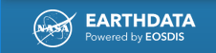







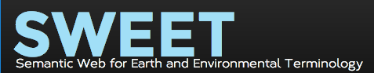




Communities Using GCMD Keywords

Slide 5
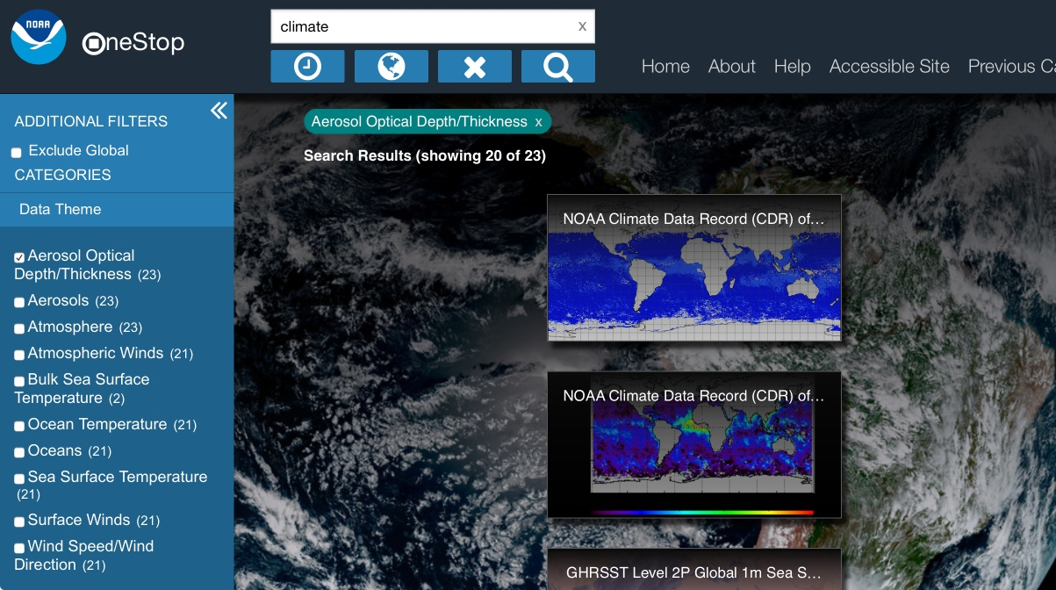
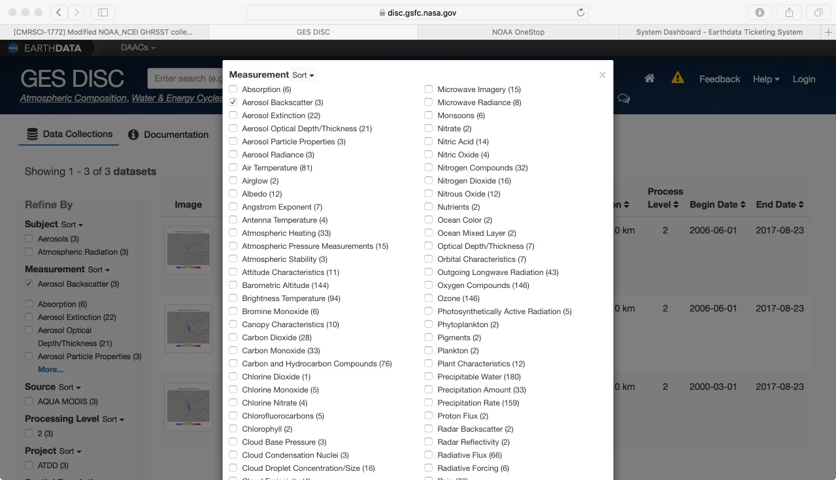
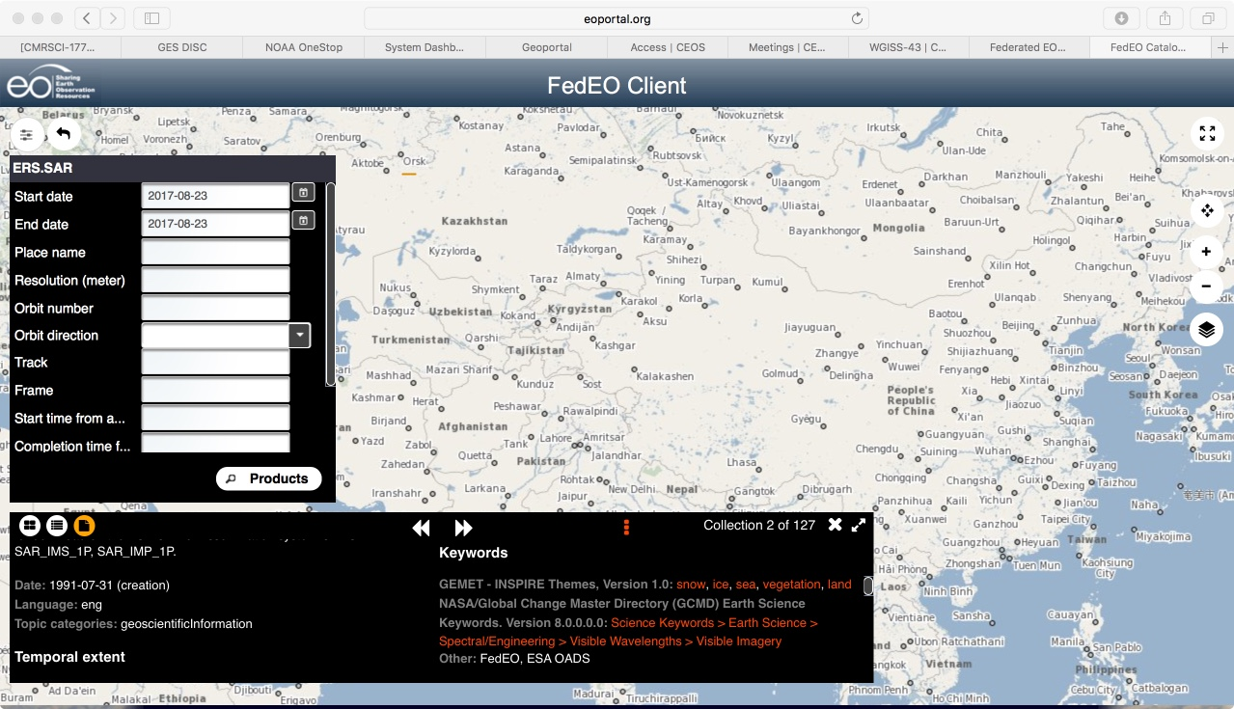
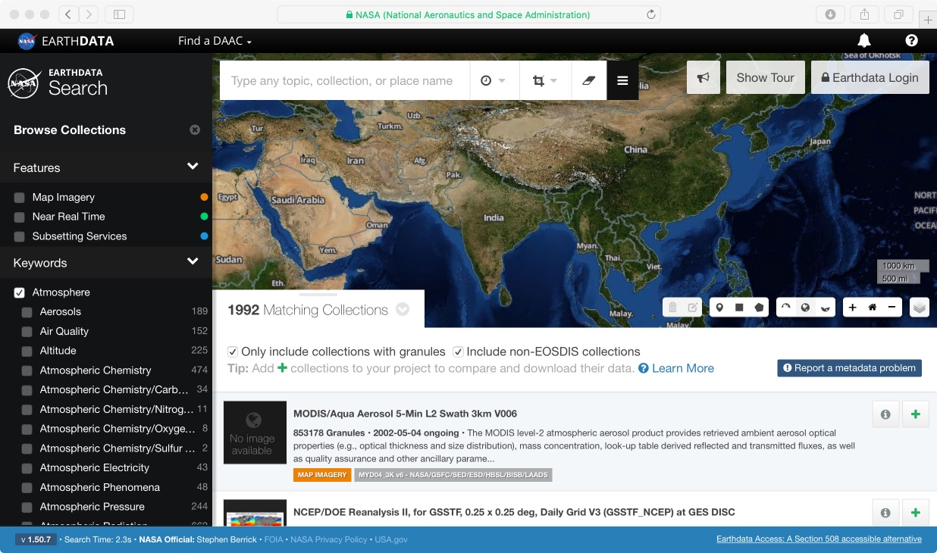
Interfaces Using GCMD Keywords
NOAA OneStop
NASA GES DISC Search
ESA FedEO Portal
NASA EARTHDATA

Slide 6
How Communities Are Using GCMD Keywords
Authoritative Vocabulary, Taxonomy, or Thesaurus
  Committee on Earth Observation Satellites, Standing Committee on Antarctic Data Management (SCADM), Socioeconomic Data and Applications Center, Japan Aerospace Exploration Agency (JAXA)
Foundation for Building Ontologies
  NASA Semantic Web for Earth and Environmental Terminology (SWEET), Sea Ice Ontology
Integration Within Metadata Catalogues for Search and Discovery
  NASA Earth Data Search Client, Oak Ridge National Laboratory (ORNL) Mercury, NOAA One-Stop, NASA JPL, NASA Goddard Earth Sciences Data and Information Services Center (GES DISC) User Search Interface
Integration Within Metadata Curation Tools
  GCMD/IDN docBUILDER, NASA EOSDIS Metadata Management Tool

Slide 7
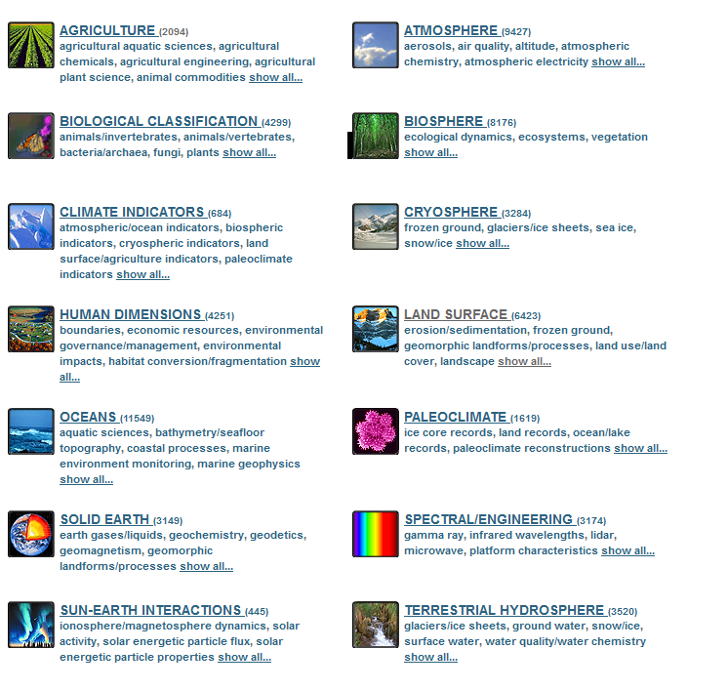
GCMD Keywords
A hierarchical set of controlled vocabulary covering Earth science disciplines that have been evolving for over 20 years.
Describe Earth science data and services in a consistent and comprehensive manner.
Allow for the precise searching of collection metadata and subsequent retrieval of data.
Follow a governance process which defines the procedure for recommending additions, modifications, and/or deprecations to the keywords, and the process by which the user community will be informed of changes.
Earth Science Keywords

Slide 8
Keyword Examples ^{(1 of 2)}

Slide 9
Keyword Examples ^{(2 of 2)}

Slide 10
Community Components

Slide 11
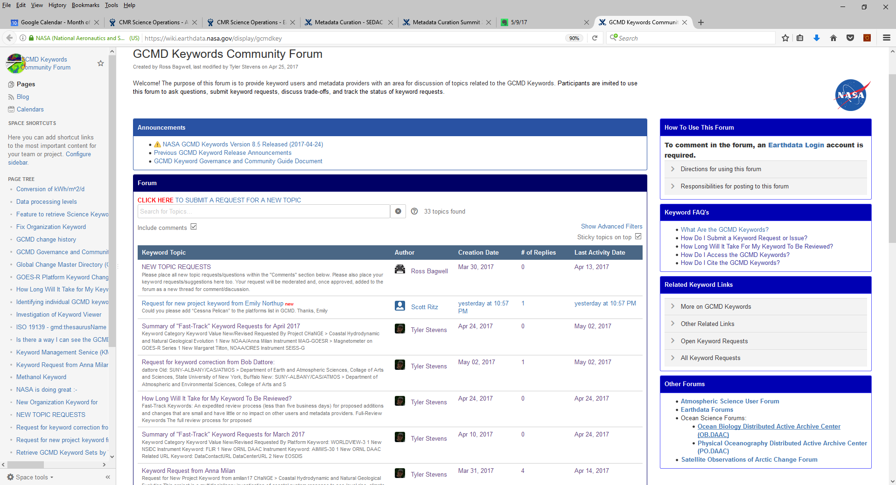
Keyword Forum
The GCMD Keywords Community Forum provides keyword users and metadata providers with an area for discussion of topics related to the GCMD Keywords. Participants are invited to use the forum to ask questions, submit keyword requests, discuss trade-offs, and track the status of keyword requests. See http://earthdata.nasa.gov/gcmd-forum.

Slide 12
Accessing the Keywords
Access the Static Copy of the Keywords
  https://wiki.earthdata.nasa.gov/display/CMR/GCMD+Keyword+Access
    Retrieve in CSV Format
Access the Dynamic Keyword API
  https://gcmdservices.gsfc.nasa.gov/kms/capabilities?format=html
    Retrieve in SKOS/RDF/OWL/XML formats
    Retrieve previous versions
    Retrieve in different case (Native, Title Case, Upper Case, Lower Case)
Documentation Keywords
  https://earthdata.nasa.gov/about/gcmd/global-change-master-directory-gcmd-keywords
    How to Access the Keywords
    How to Submit Keyword Suggestions
    Keyword Governance
    Keyword Forum

Slide 13
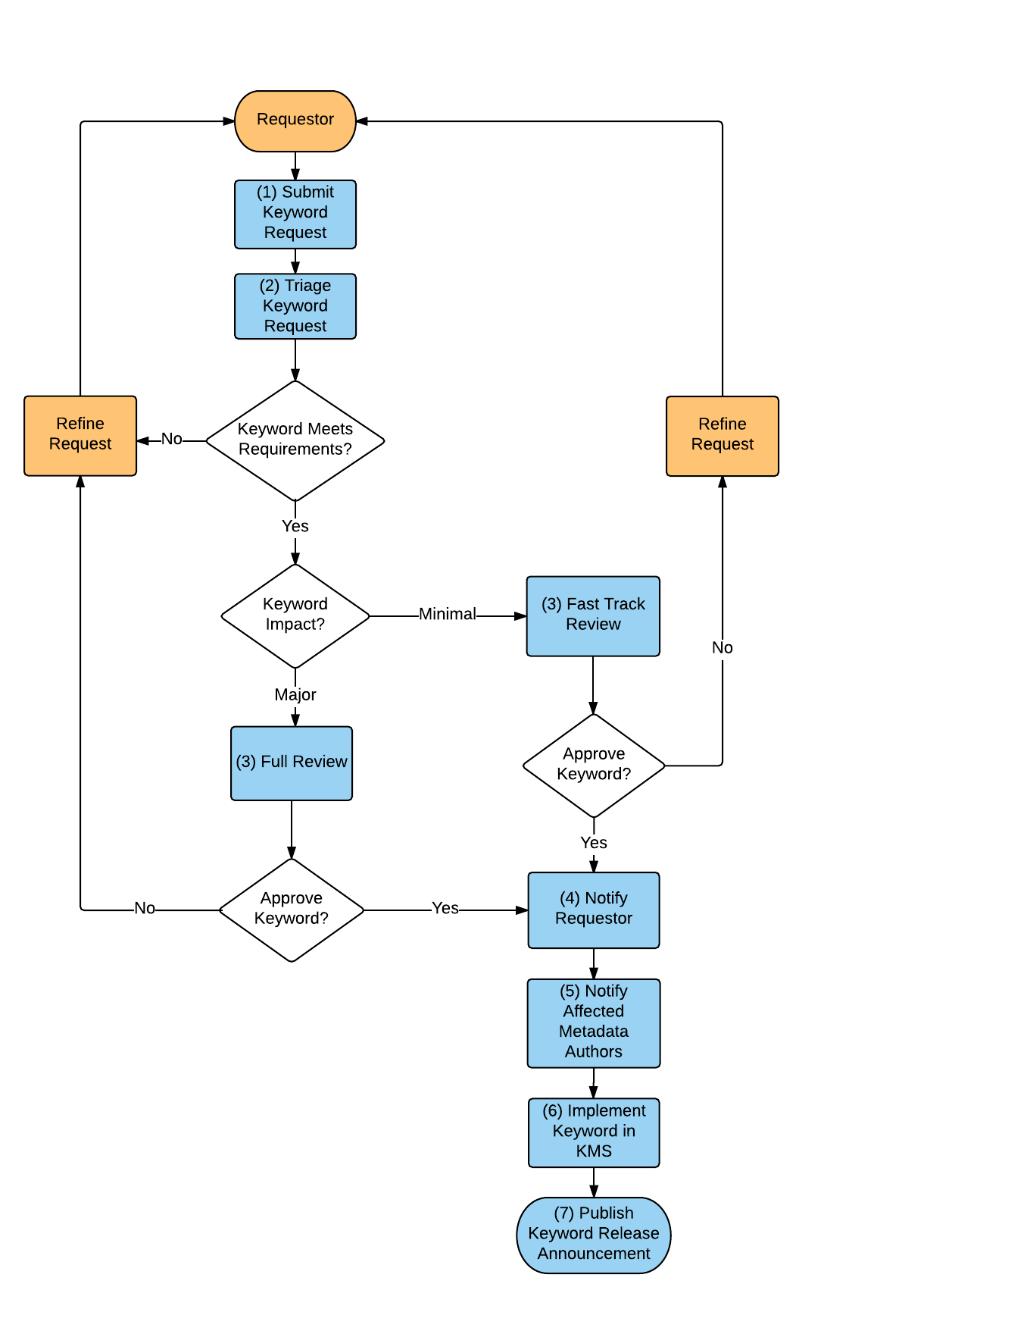
Community Involvement In Keyword Review
Keywords are either put on fast-track or full review
Fast-track keywords are generally new keywords with no impact to providers
GCMD and NASA ESDIS Standards Office (ESO) solicit volunteers to participate in the full review
GCMD prepares review package
ESO distributes review package to reviewers (1 month review)
GCMD and ESO respond to the feedback
Further keyword refinement takes place
GCMD finalizes the keyword release
Keyword Review/Update per year

Slide 14
Keyword Release 8.5
Published Keywords version 8.5 on 2017-04-24
  55 new keywords and 30 modified keywords under:
    Atmosphere > Atmospheric Water Vapor
    Atmosphere > Atmospheric Winds
  The keywords were reviewed by subject matter experts and approved by the ESDIS Standards Office.
  See the full keyword release, keyword summary table, and subject matter experts recommendations at: https://wiki.earthdata.nasa.gov/pages/viewpage.action?pageId=81070128

Slide 15
Prior Keyword Releases (2013-2016)
Keyword Version 8.0 (April 2013)
  Atmosphere > Clouds
  Solid Earth > Geodetics
  Solid Earth > Geothermal Dynamics
  Solid Earth > Tectonics
Keyword Version 8.1 (March 2015)
  Atmosphere > Atmospheric Precipitation
  Atmosphere > Atmospheric Temperature
  Land Surface > Geomorphic Landforms/Processes
  Land Surface > Land Use/Land Cover
  Land Surface > Surface Thermal Processes
  Land Surface > Surface Radiative Processes
  Land Surface > Topography
Keyword Version 8.2 (August 2016)
  Oceans > Coastal Processes
  Surface Water > Ground Water
  Surface Water > Surface Water
  Human Dimensions > Natural Hazards
  Locations
Keyword Version 8.3 (August 2016)
  Biosphere > Ecosystems
  Biosphere > Vegetation
Keyword Version 8.4 (August 2016)
  Atmosphere > Atmospheric Radiation
  Atmosphere > Weather Events

Slide 16

Keyword Reviewers
The GCMD Keywords review is facilitated by the NASA ESDIS Standards Office (ESO).
Keyword reviewers will review proposed keywords and complete a online questionnaire.
If you are interested in becoming a keyword reviewer, please contact the ESO at eso-staff@lists.nasa.gov.
We Value Your Input

Slide 17
What’s new: Keyword Viewer

Slide 18
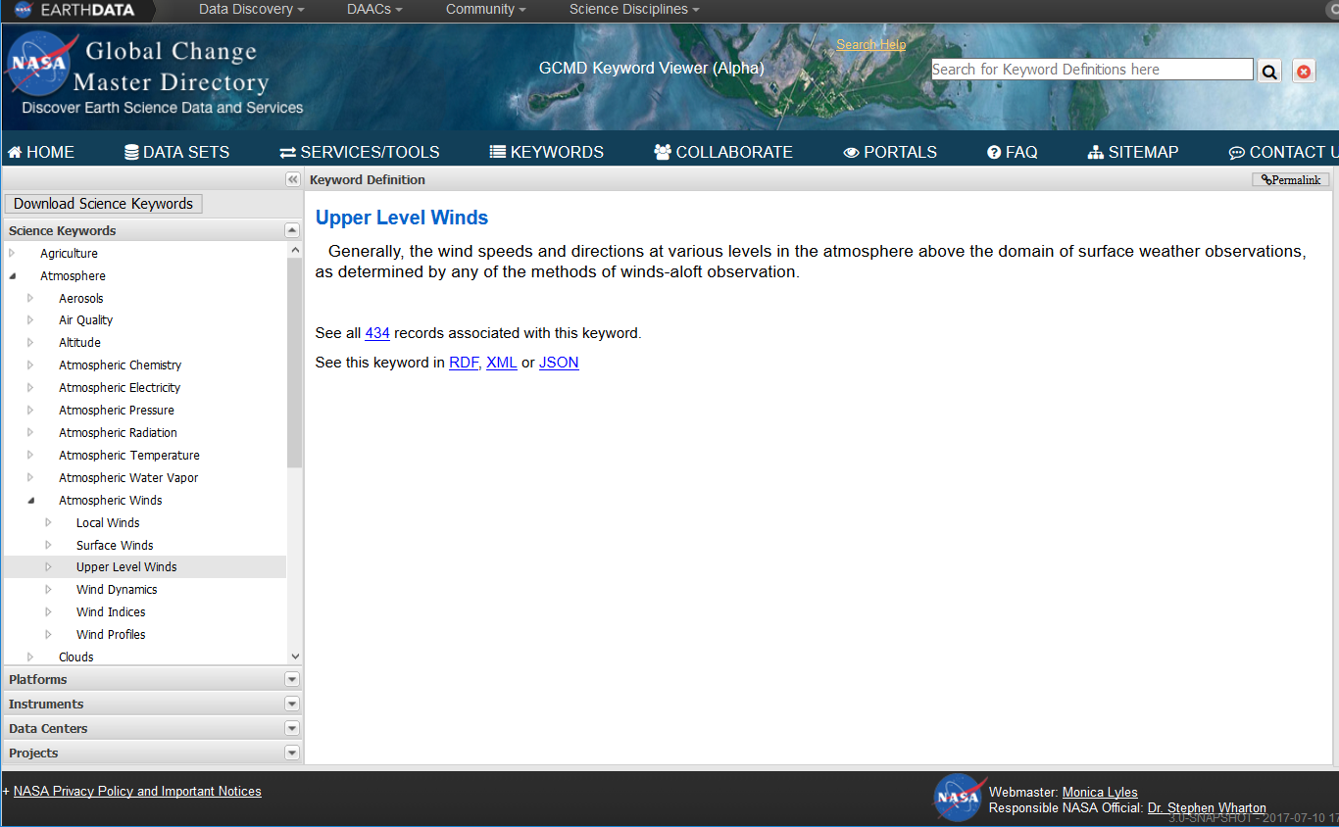
Keyword Viewer

Slide 19
Keyword Viewer Features
The Global Change Master Directory (GCMD) Keyword Viewer enables users to navigate through the GCMD keyword hierarchies:
Search Keywords:
  Free-Text
  Navigate Keyword Hierarchies
  Navigate Keyword Categories
Examine Information About Keywords:
  Keyword Definitions
  Related Keywords
  Related Data Set Descriptions
Download Keywords:
  Keywords in Different Formats (RDF, XML, JSON, CSV)
  Keywords By Category (Science, Platforms, Instruments)

Slide 20
Keyword Viewer Demonstration
DEMO:
https://gcmd.nasa.gov/search/Keywords.do
  Please provide feedback to:
  gsfc-gcmduso@mail.nasa.gov
  or
  Michael.P.Morahan@nasa.gov

Slide 21
Science Keyword View
Search Keywords By Free Text
Examine Related Data Set Descriptions
Download Keywords in Different Formats
Search Keyword Hierarchy
Search Keyword Categories

Slide 22
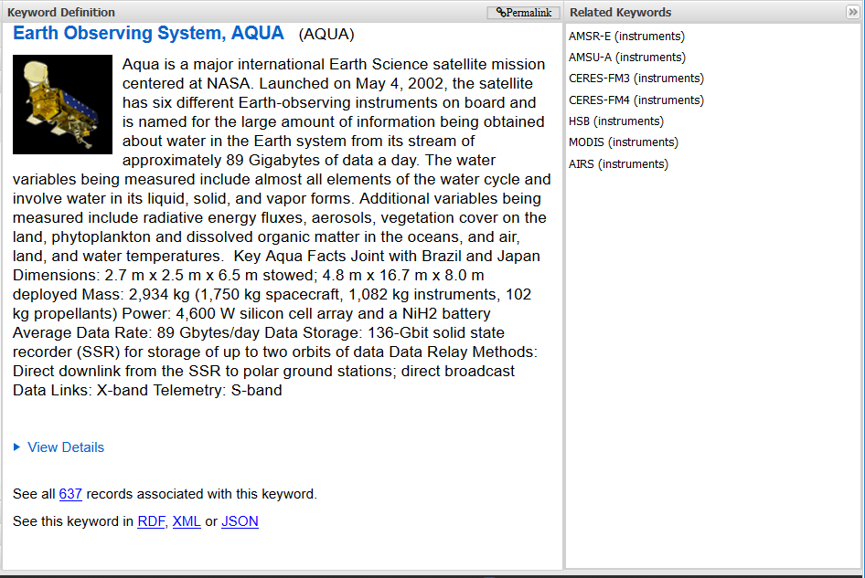
Example of Platform Keyword
Link to related instruments (i.e. instruments that fly on AQUA)
View more details about the platform

Slide 23
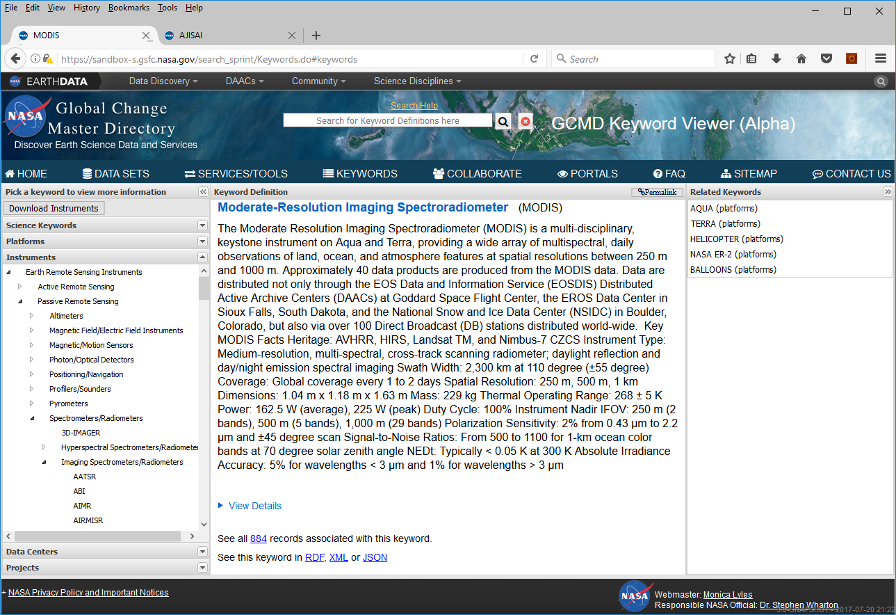
Example of Instrument Keyword
Link to related platforms (i.e. platform that contains the instrument)

Slide 24
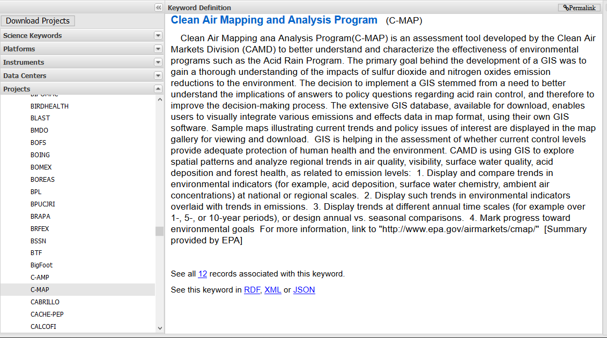
Example of Project Keyword

Slide 25
IDN Collection Discovery Interface

Slide 26
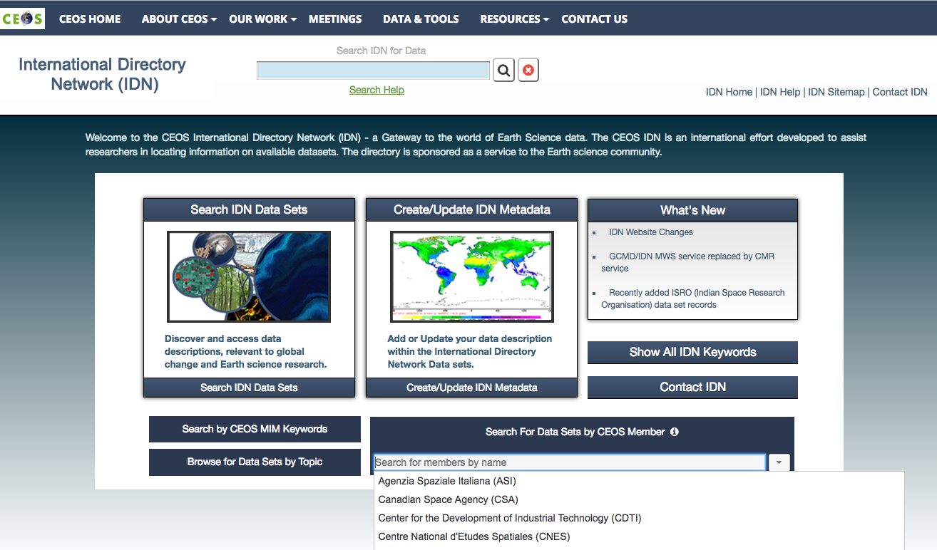
IDN Home Page
idn.ceos.org
Freetext Search
Help
New Developments
Access to
all Records
Keywords
MIM Keywords
Search
CEOS Agencies
Drill Down

Slide 27
IDN Search Interface
Interdisciplinary Search with Facets
Freetext and Refinement Search
Enhanced Sorting by Columns
View IDN Search Results

Slide 28
IDN Search Interface
Click on a record

Slide 29
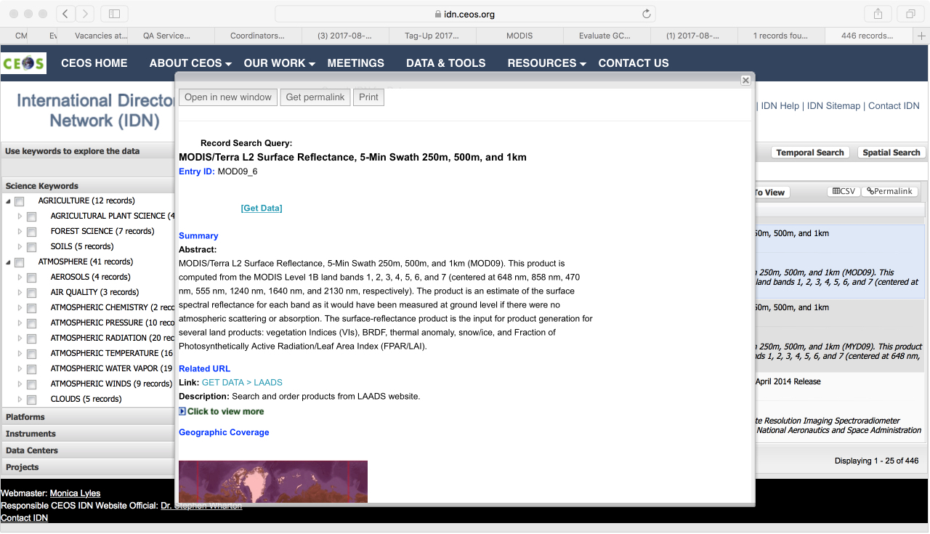
IDN Search Interface: Record Display
Click on a record
Record Display

Slide 30
CMR OpenSearch Accessing GCMD/IDN Collections

Slide 31
CMR OpenSearch API for GCMD/IDN Discovery
Search implementation based on the OpenSearch 1.1 specification
Queryable Fields:
keywokeywordrd
processingLevel
placeName
satellite
sensor
startTime
instrument
boundingBox
uid
campaign
geometry
endTime
  Queryable Tags: (Future tags isCeos and isFedeo)
  isCwic
  isGeoss
API Query Methods:
  Command-line
  Web browser
  OpenSearch API client
API result Formats:
  ATOM
  HTML
Web Browser Example

Slide 32
Example of an OpenSearch Query
IDN root collection URL with results in ATOM format
Search collection field with a specific value
  https://cmr.earthdata.nasa.gov/opensearch/collections.atom?satellite=Aqua
  &isGeoss=true&numberOfResults=50&offset=50&clientId=UserClient
Return only GEOSS DataCore Collections
Set the number of results return
Set the next results for the collection field search
Identify your OpenSearch client

Slide 33
Tool for Submitting Metadata

Slide 34
docBuilder: Overview
Web-based metadata authoring tool that allows authors to add or modify data set descriptions (DIF-9 and DIF-10)
Provides inline Quality assurance (QA) validation of field content, syntax and verification of controlled keywords
Customized QA rules
Implemented of field-to field editing, collapsible fields, tool-tips, and documentation
Download/upload metadata records to/from desktop
Submits directly to the GCMD/IDN
Earthdata User account need for docBUILDER:
https://urs.earthdata.nasa.gov/users/new

Slide 35
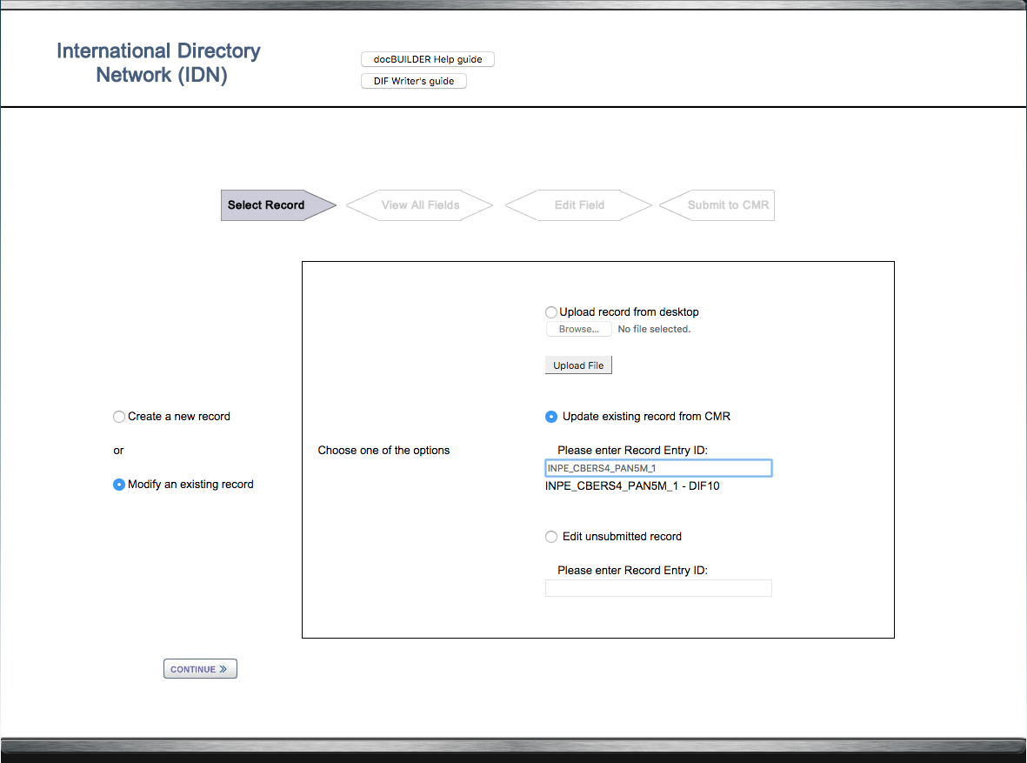
docBuilder: Modify a Record

Slide 36
docBuilder: Add Keyword Metadata

Slide 37
docBuilder: Select/Modify Science Keywords

Slide 38
docBuilder: Generate Error Report

Slide 39
docBuilder: View QA Feedback
39

Slide 40
Tool for Translating Metadata

Slide 41
GCMD/IDN Translator API
Translates different metadata formats to DIF-10
Translator Capabilities Document
    https://gcmdservices.gsfc.nasa.gov/translator/
Translator API:
    https://gcmdservices.gsfc.nasa.gov/translator/translator/
Eligible Formats:
API Access Method:
  Command-line
Example:
DIF-9 iso iso_cnes iso_esa iso_eumetsat
ECHO10 iso_noaa iso_noaa_ncdc iso_noaa_nodc iso_swedish_nadc

Slide 42
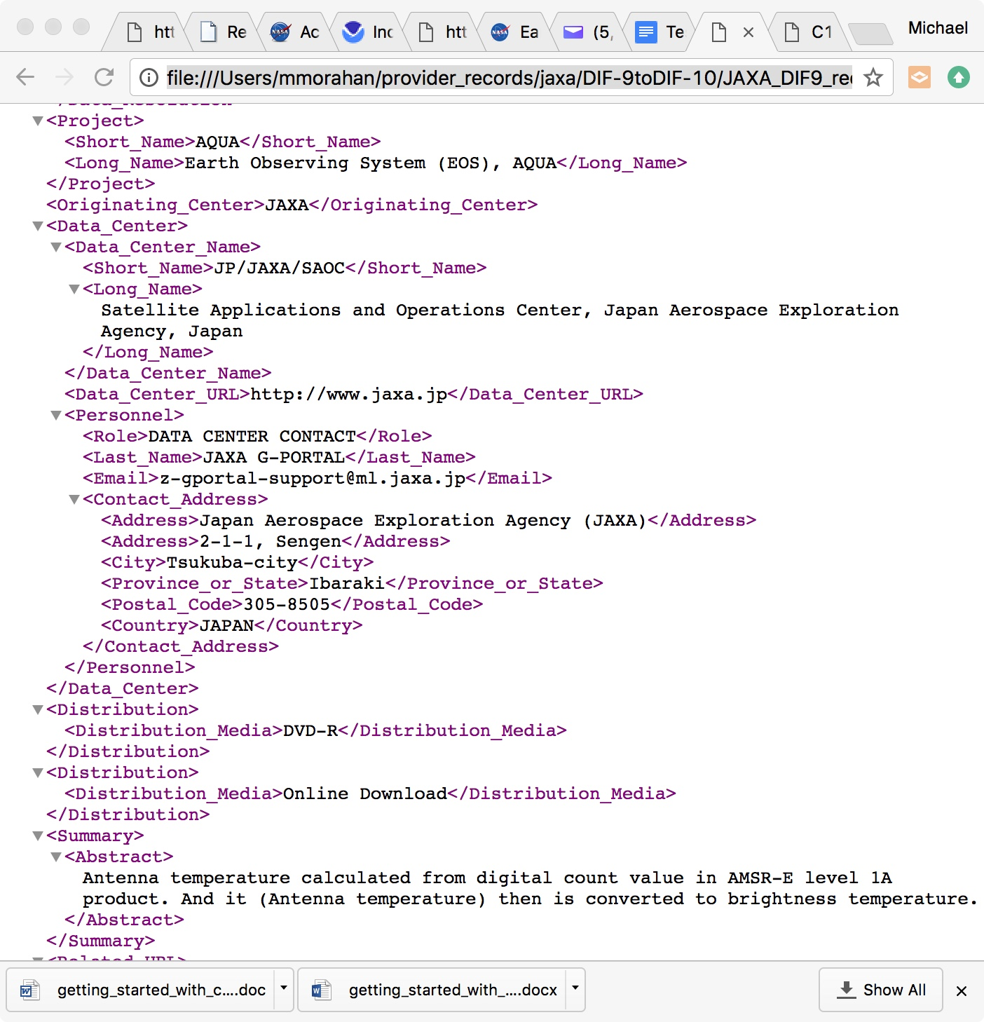
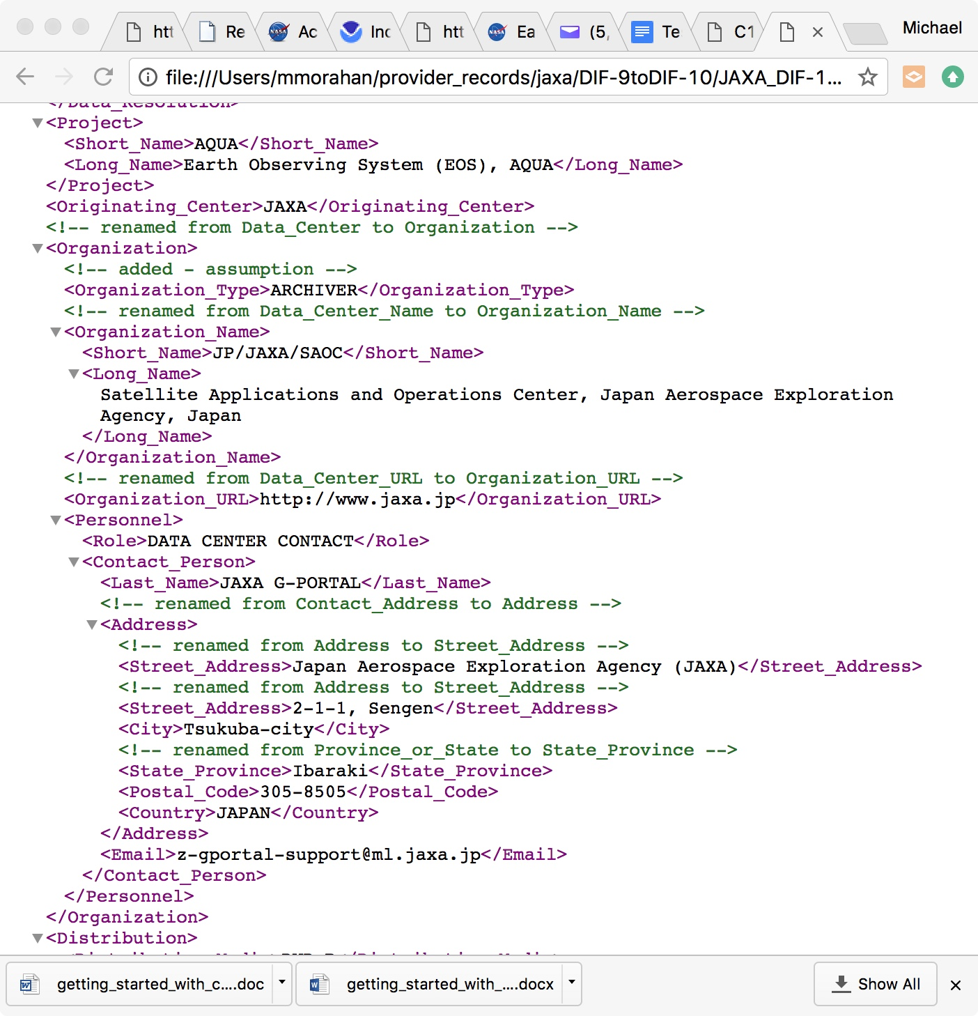
GCMD/IDN Translator API
DIF-9
Translator API
DIF-10

Slide 43
Highlights
GCMD Keywords: Examples, Process, and Access Methods
GCMD Keyword Viewer: Discovery and related Information
GCMD/IDN Search3 and CMR OpenSearch: Collection discovery using Keywords
docBuilder: Adding GCMD keywords to Collection Metadata
Translation API: changing Collection Metadata formats

Slide 44
  Questions
  Please provide feedback to:
  gsfc-gcmduso@mail.nasa.gov
  or
  Michael.P.Morahan@nasa.gov

Slide 45
Background

Slide 46
DIF and docBUILDER Documentation
DIF-10 writer's guide:
https://idn.ceos.org/subset/idn/defaultDif10/index.html
DIF-9 writer’s guide:
https://idn.ceos.org/subset/idn/defaultDif/index.html
DIF-10 schema:
https://gcmd.gsfc.nasa.gov/Aboutus/xml/dif/dif_v10.2.xsd
DIF-9 schema:
https://gcmd.nasa.gov/Aboutus/xml/dif/dif.xsd
docBUILDER (DIF-10): https://idn.ceos.org/DocumentBuilder/Home.do?Portal=ceos_idn&MetadataType=7
docBUILDER (DIF-9): https://idn.ceos.org/DocumentBuilder/Home.do?Portal=ceos_idn&MetadataType=0

Slide 47
CMR API Documentation
OpenSearch Documentation:
  https://cmr.earthdata.nasa.gov/opensearch/home/docs
OpenSearch API OpenSearch Descriptor Document (OSDD):
  https://cmr.earthdata.nasa.gov/opensearch/collections/descriptor_document.xml?clientId=cswOpenSearchDoc

Slide 48
GCMD Keyword References
Keyword Landing Page: https://earthdata.nasa.gov/about/gcmd/global-change-master-directory-gcmd-keywords
Keyword Forum:
  https://earthdata.nasa.gov/gcmd-forum
Keyword Governance Document: https://cdn.earthdata.nasa.gov/conduit/upload/5182/KeywordsCommunityGuide_Baseline_v1_SIGNED_FINAL.pdf

