Slide 1
NASA Earthdata Login
Committee on Earth Observation Satellites
Andrew Mitchell - NASA
WGISS-44
Beijing, China
25th September 2017

Slide 2
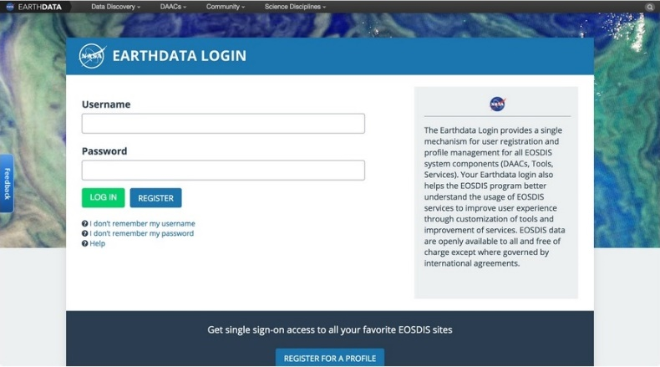

Slide 3
NASA’s Earthdata Login
For those interested in downloading and using the almost 22 petabytes of Earth science data archived by NASA’s Earth Observing System Data and Information System (EOSDIS), this registration is called Earthdata Login.

Slide 4
NASA’s Earthdata Login
During the registration process, data users are requested to note their fields of study, affiliation, and country in which they reside and/or conduct research. This information, combined with metrics on the specific data products being downloaded and how often they are downloaded, helps prioritize the development of new products and services and improve existing products and services. This ensures that NASA Earth science data and services constantly evolve to meet changing user needs.

Slide 5
NASA’s Earthdata Login - Benefits
A key benefit of registration for users is that it allows the user to be contacted with information about the data products and services they use. This information includes data updates, new data releases, or data quality issues, along with notices about new services or service outages.
An important point is that user registration via Earthdata Login is only required for downloading or retrieving EOSDIS data, such as from a Distributed Active Archive Center (DAAC). Registration is not required for non-data related activities, such as reading articles on the Earthdata website or on DAAC websites, or for using EOSDIS Worldview to explore data imagery.

Slide 6
Future Enhancements
Future enhancements to Earthdata Login will allow EOSDIS data users to more efficiently access and download data by maintaining a user’s spatial and temporal data search parameters between platforms.
For example, if a data user goes to the National Snow and Ice Data Center DAAC to download Soil Moisture Active Passive (SMAP) products covering North Africa between 1 June and 30 September 2017, these search parameters will be remembered if they want to download Moderate Resolution Imaging Spectroradiometer (MODIS) data from the Land Processes DAAC (LP DAAC), greatly reducing the time needed to find relevant data. Similar future enhancements will further streamline the process for finding data products.

