Slide 1
Committee on Earth Observation Satellites
WGISS Infrastructure Project (WISP) Report
Martin Yapur & Anne Kennerley WGISS-44
Beijing, China
September 25, 2017

Slide 2
Support Team
Lead
Martin Yapur (martin.yapur@noaa.gov)
Team
Anne Kennerley (anne.kennerley@noaa.gov)
Kim Holloway (kim.e.holloway@nasa.gov)
Michelle Piepgrass (michelle.piepgrass@ameritech.net)
For any technical CEOS server requests, contact: it@ama-inc.com

Slide 3
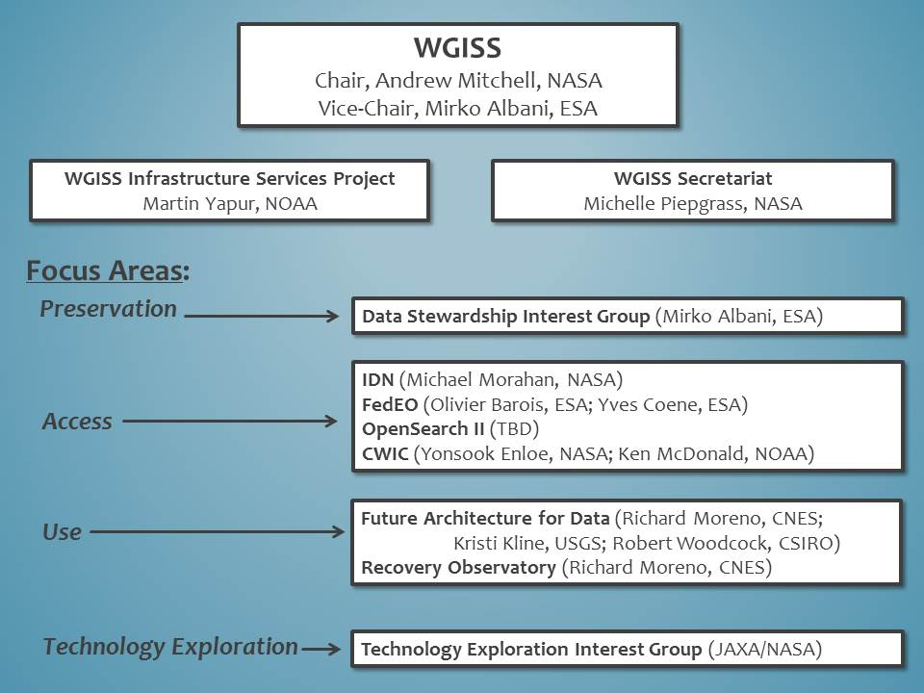
Whom do we support?

Slide 4
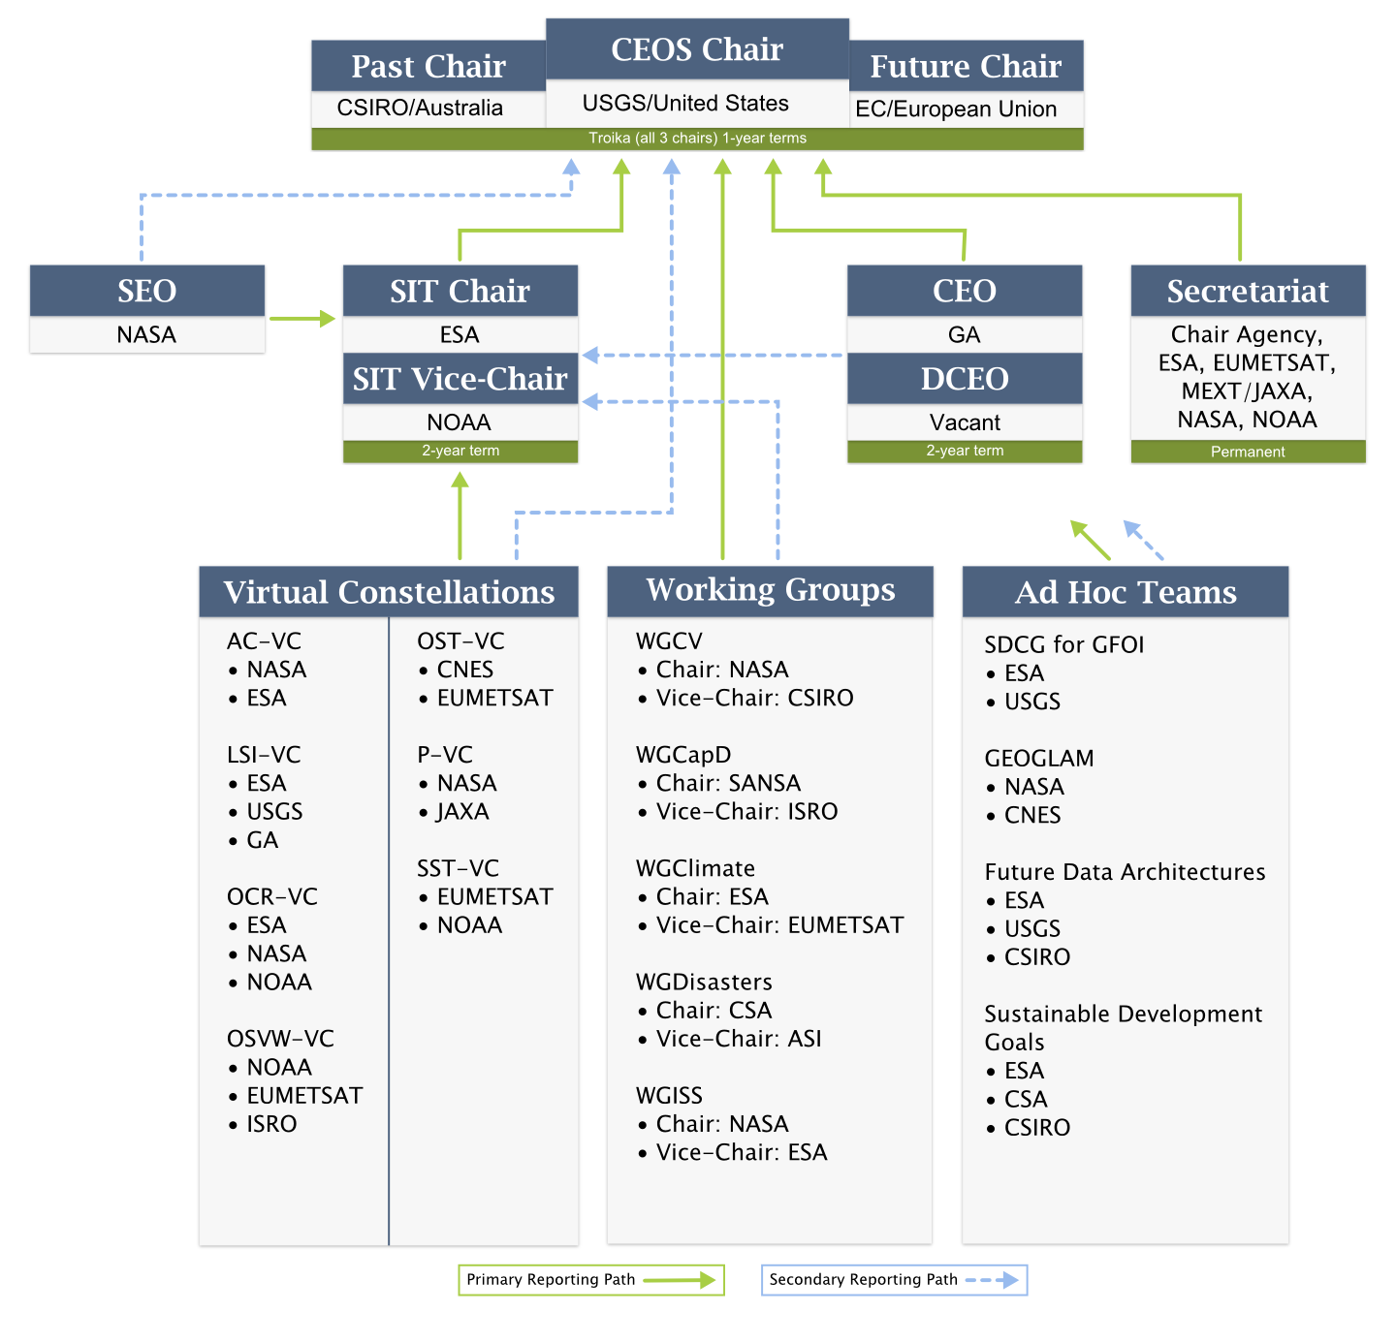
Whom do we support?

Slide 5
WGISS-44 Presentations
Presentation Format:
Date_Time_Title (ie. 2017.09.25_09.40_WISPREPORT)
***Please use two digit format for month, day, hour, and minutes (example: March =03) and use underscores ***
Delivery Method
Send email with presentation to
Michelle at michelle.piepgrass@ameritech.net
Anne at anne.kennerley@noaa.gov
Martin at martin.yapur@noaa.gov
Andy at Andrew.E.Mitchell@nasa.gov

Slide 6
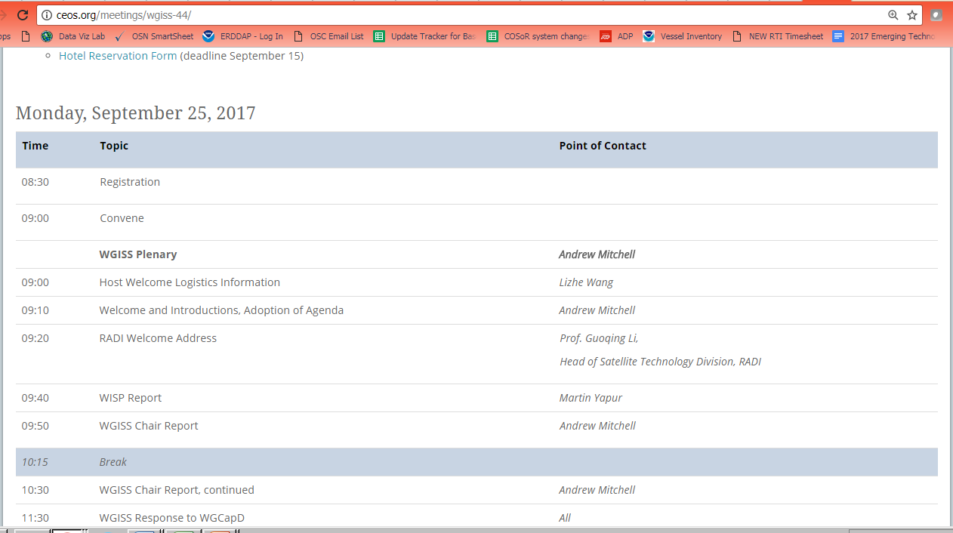
WGISS-44 Presentations
Presentations will be directly linked to the online agenda

Slide 7
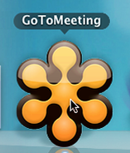
Web Conferencing
WGISS-44 Meeting Remote Participation
1. Please join my meeting.
https://global.gotomeeting.com/join/160468805
2. Use your microphone and speakers (VoIP) - a headset is recommended. Or, call in using your telephone.
United States: +1 (224) 501-3316
Australia: +61 2 8355 1034
France: +33 (0) 170 950 588
Germany: +49 (0) 692 5736 7207
Italy: +39 0 693 38 75 53
New Zealand: +64 4 974 7243
United Kingdom: +44 (0) 330 221 0097
Access Code: 160-468-805
Audio PIN: Shown after joining the meeting
Meeting ID: 160-468-805
WGISS Infrastructure Services (WISP)

Slide 8
WISP Request
The WISP’s success depends on YOU to:
Keep us informed of any new or departing members from your organization so we can keep the mailing lists up-to-date
Let us know of any changes needed to the
WGISS webpages
Support our outreach activities

Slide 9
Thank you!

