Slide 1
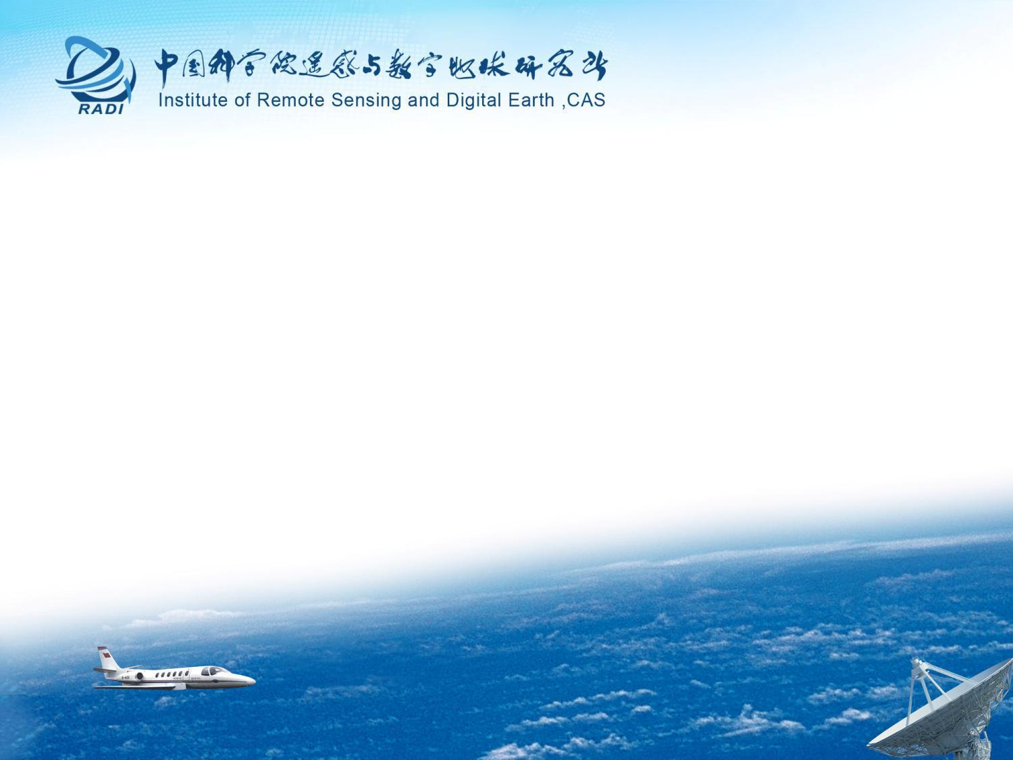
Introduction to RADI,CAS
Li Guoqing RADI, CAS
presented to 44th WGISS, Beijing
Sept 25, 2017

Slide 2
About RADI
The RADI is an independent research institute affiliated to the Chinese Academy of Sciences for remote sensing and digital Earth.
Mission
Reception, processing, archiving and dissemination of remotely sensed data.
Research and development on supporting new earth observation system, improving remote sensing data processing and analytical methodologies, and promoting multidisciplinary applications based on earth observation technology.
Theoretical and technological research into key issues concerning Geo-spatial Information science and Digital Earth Platform. They are involved together in solving some environmental problems at the global, regional and national scales.

Slide 3
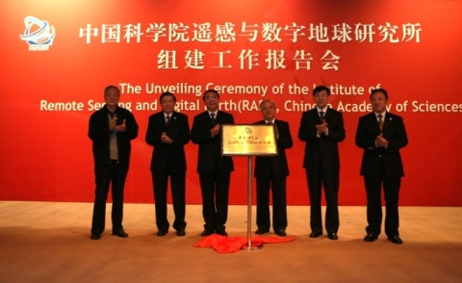
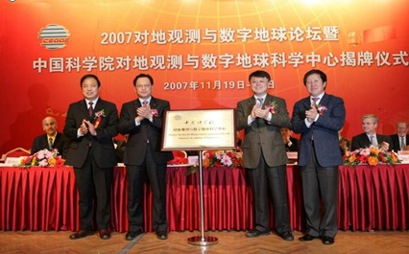
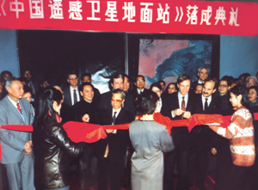
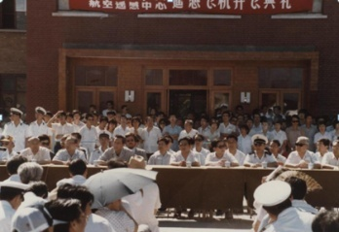
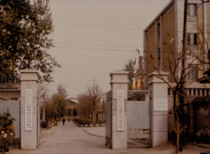
History
1979, Institute of Remote Sensing Applications (IRSA), CAS
1985, Airborne Remote Sensing Center, CAS
1986, Chinese Remote Sensing Satellite Ground Station, CAS
2007，Center for Earth Observation and Digital Earth (CEODE), CAS
2012, Institute of Remote Sensing and Digital Earth (RADI), CAS
2007
1986
1985
1979

Slide 4
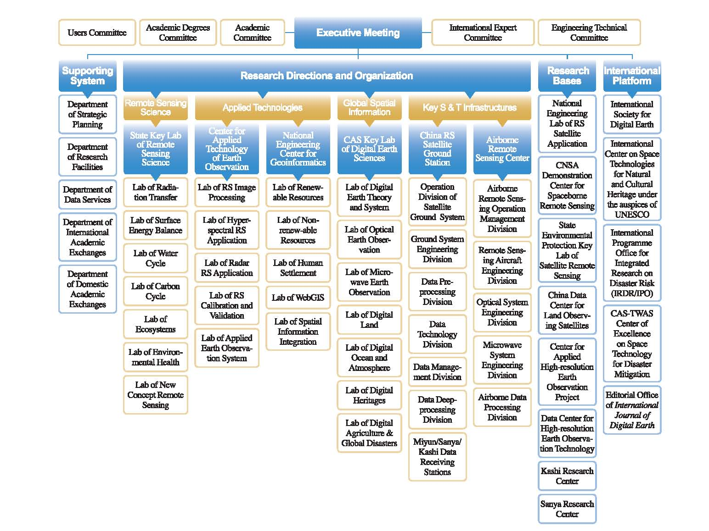
Organization
Notes:
Let’s see the framework of our institute.
this is the decision system, the head of our institute, including several committees、director etc;
this is the supporting system,the limbs of our institute, including administrative departments、supporting system etc.
This is the research organization, the heart of our institute, the major four research directions and the corresponding organizations are: remote sensing science, the corresponding organization is the state key laboratory of remote; applied technologies, the corresponding organizations include Center for applied technology of earth observation and National engineering center for Geoinformatics; Global spatial information,the corresponding organization is key laboratory of digital earth sciences of CAS; key science and technology infrastructures, the corresponding organizations include China remote sensing satellite ground station and airborne remote sensing center.

Slide 5
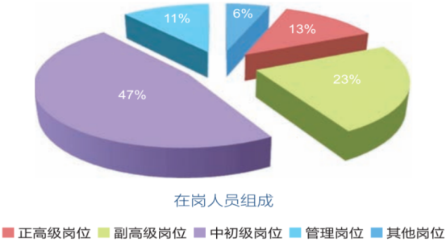
Staff
The institute currently has 697 employees and nearly 600 students.
3 CAS Members, 4 awardees of Thousand Talents Program and 1 National Science Fund for Distinguished Young Scholars, and 12 awardees of CAS Visiting Professorship for Senior International Scientists .
Notes:
There are 303 senior scientists & technicians in our institute, includes 102 professor-level professionals and 201 associate-professor-level professionals, with an average age of 37 years and employees with a Ph.D. degree taking up near 44%.

Slide 6
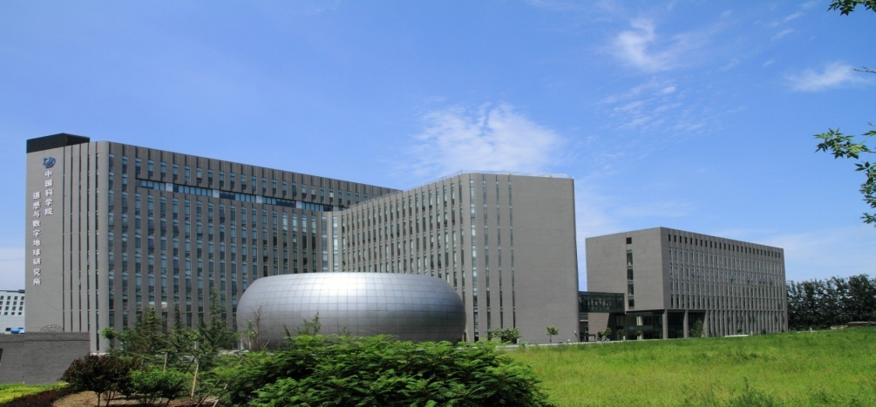
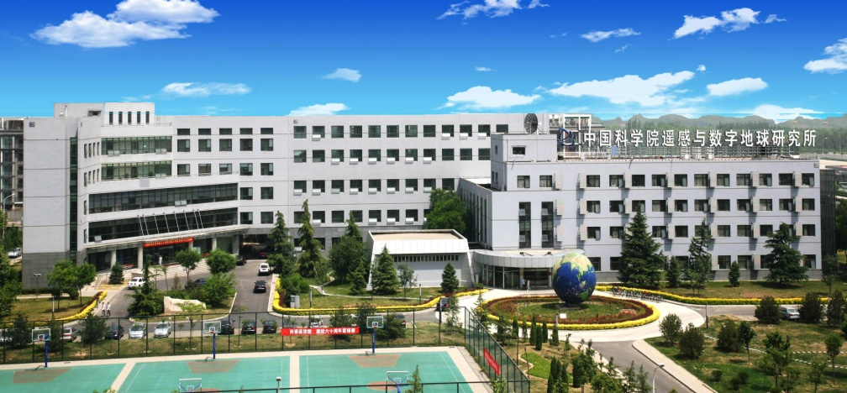
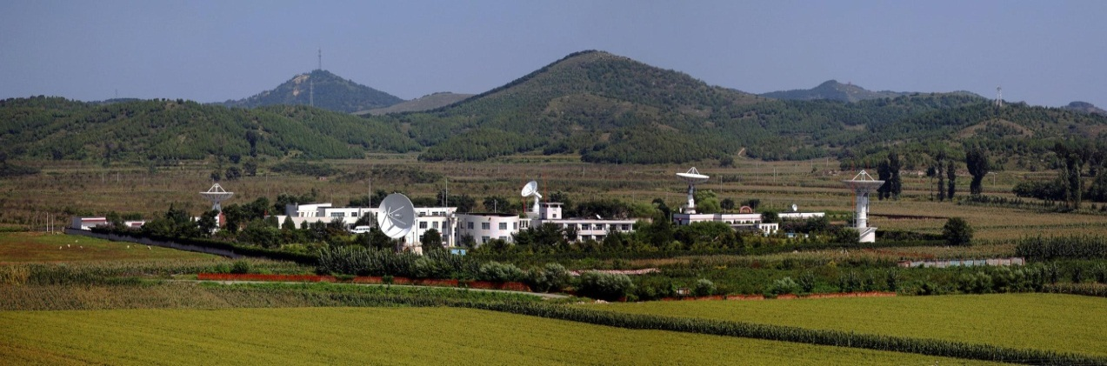
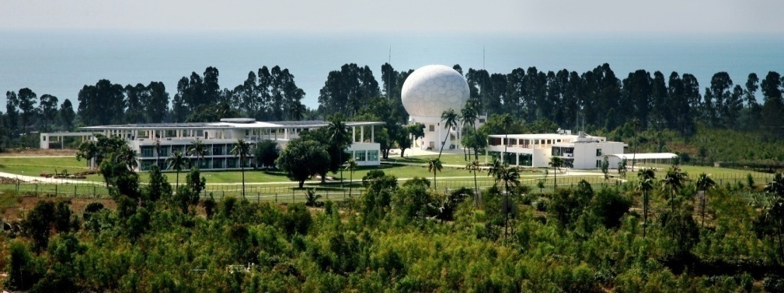
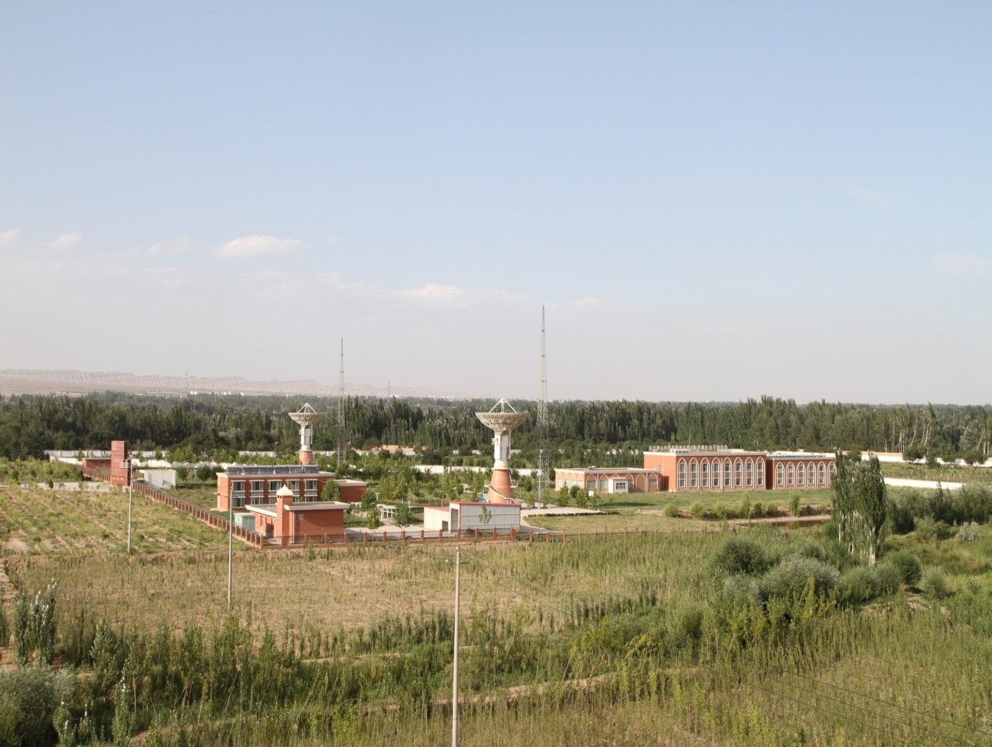
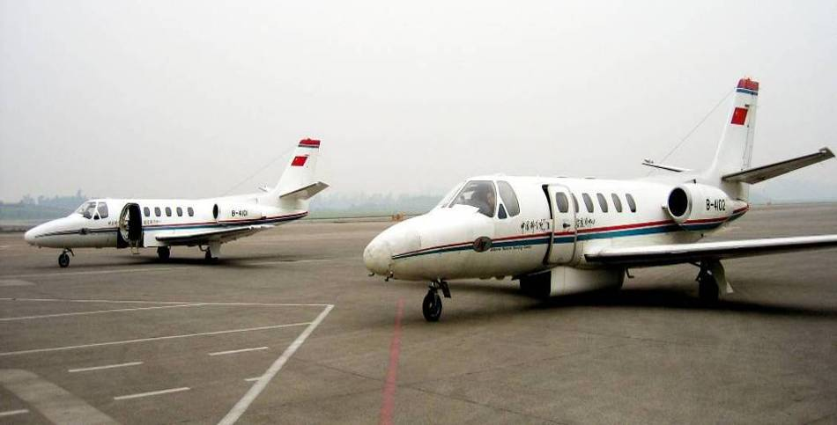
Campus
Adv.-tech. Camp.
Olympic Vil. Camp.
Miyun Station
Sanya Station
Kashi Station
L.X. Airport

Slide 7
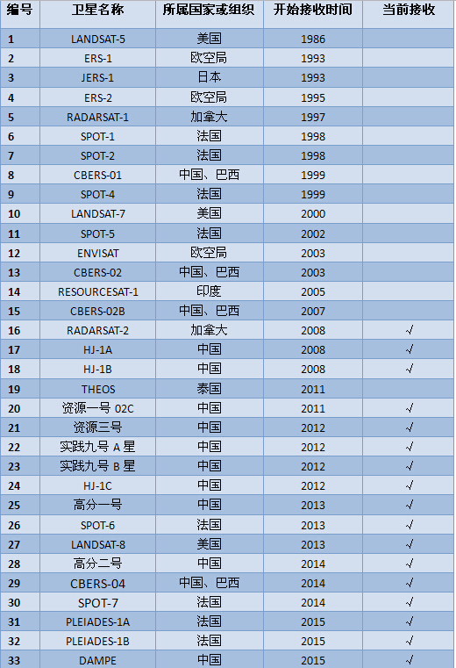

Spaceborne-airborne-ground remote sensing data acquiring and processing capacity
China Remote Sensing Satellite Ground Station a member of the Landsat Ground Station Operations Working Group, boasts one of the world's highest capacities for receiving, processing, and distributing satellite data.
With over 3.3 million scenes of satellite data filed since 1986, it is regarded as the largest Earth observation satellite data archive in China.

Slide 8
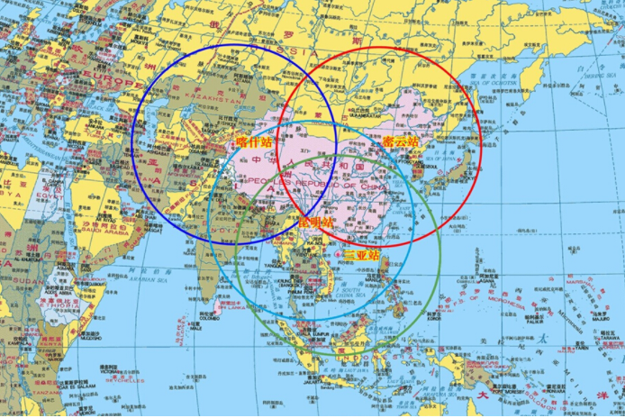
RADI ground station network with more than 20 antennas brings coverage capacity of 70% Asia area.
The Kiruna station began operating at 2016.
RADI is serving for the data receiving of 17 Chinese satellites, such as CBERS, ZY, HJ, GF, as well as dozen of scientific statellites of CAS.
Three stations of RADI have joined the Landsat global station network since 1986.

Slide 9
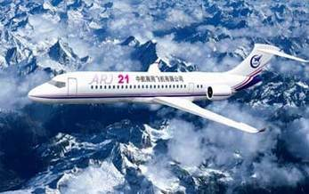
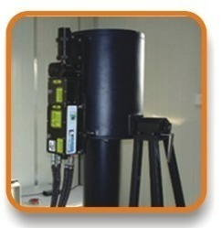
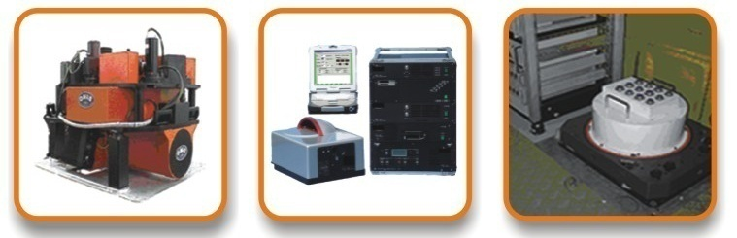
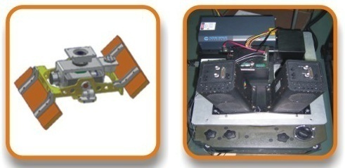
Two Remote Sensing Aircrafts
Cessna Citation S/II
Round-the-clock flying capability;
Equipped with various airborne remote sensors, and can be used to test newly-developed advanced sensors;
Provides high-resolution satellite data.
Technical Index
Max Altitude | 13,000 m
Max Range | 3,300 km
Max Speed | 746 km/h
Two new Remote Sensing Aircrafts
Equipped with 10 state-of-the-art remote sensors: visible, infrared, and microwave remote sensors and a high-performance data processing system.
New Airplane
Airborne atmospheric laser radar
Digital CCD camera
Airborne whiskbroom imaging spectrometer
(0.45μm-12.5μm)
Airborne 3-D light detection and ranging
Airborne X-band interferometry SAR
Airborne pushbroom imaging spectrometer
(0.45μm-2.5μm)

Slide 10
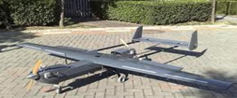

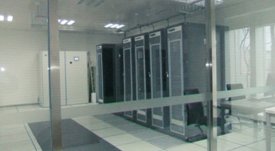
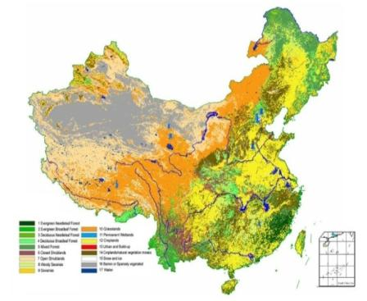
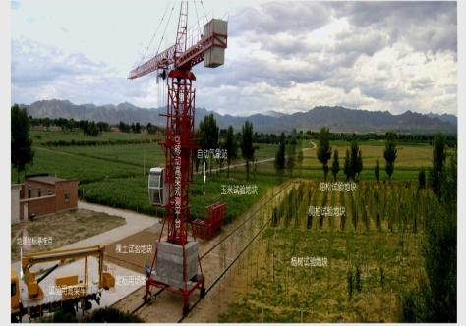
Experimental Observation Systems
Indoor control simulation test
Research on mechanism of radiative transfer, new theories and methods of earth observation
Field multi-platform real scene test
Verification on mechanism of radiative transfer; test on new theories and methods of earth observation; research on testing method for validation of pixel level
Network construction for validation test in remote sensing
Verification of remote sensing parameter inversion; validation test for remote sensing applications and data
Notes:
In addition to the two infrastructures used for data acquisition, we also have a complete ground , indoor experimental observation system and validation network. It can carry out indoor control simulation test ,field multi-platform real scene test, and validation etc.

Slide 11
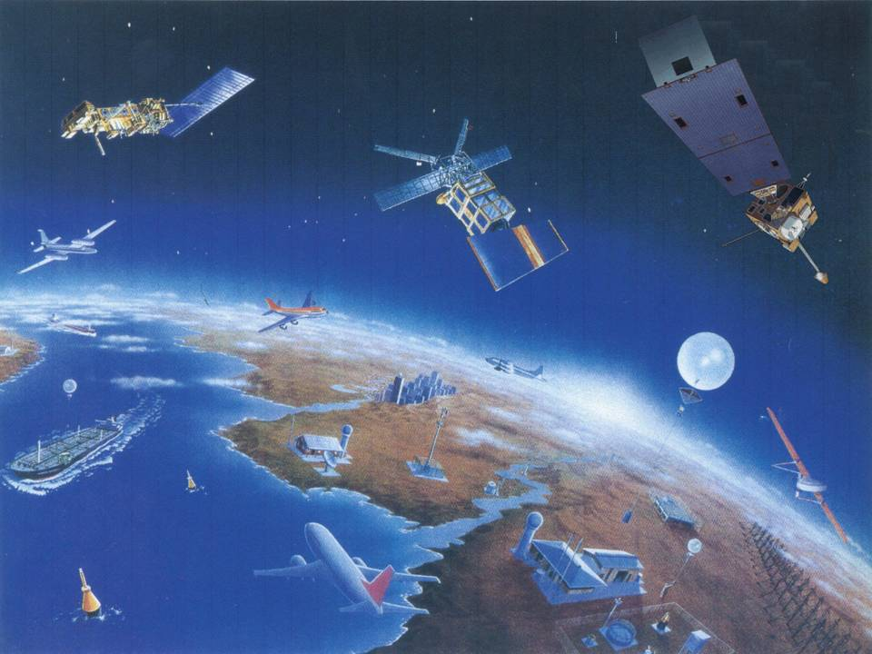
Remote sensing science and spatial information research capacity
Building All-band remote sensing mechanism simulation system, providing remote sensing theory and key technologies for Earth system key factors;
Erecting an advanced space remote sensing payload verification system, testing the new sensors for a variety of satellites, including satellite for water cycle observation, satellite-borne Lidar, China-Brazil Earth Resources Satellite and hyperspectral satellites.
Building up a Earth observation system simulation platform, providing planning support national major special projects.
Major Special Projects
Spatial Infrastructure for Natural Disasters
National Spatial Infrastructure Plan
Notes:
Depending on electromagnetic wave and related theories, our Institute has a good foundation for modeling research of multiband and multi-angle radiation transfer. It was expanded the scale problem research of polarization remote sensing and quantitative remote sensing. Based on information extraction technology research, the development of remote sensing from instantaneousness to time continuity; and on such basis, study was made on carbon, water circulation, and energy balance in earth system science.

Slide 12
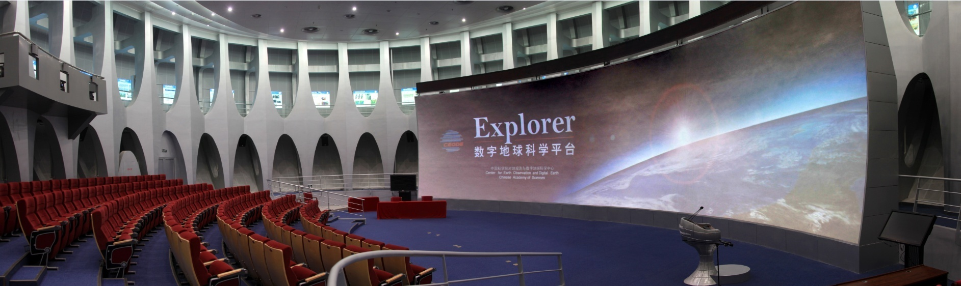
Digital Earth science platform and global environmental resources information analytical ability
Professional digital earth theory and application research laboratory－ CAS Key Laboratory of Digital Earth Science
Developing more than 30 spatial information products of global resource-environment, being adopted by many national information release platforms.
Developing the first Digital Earth Science Platform and establishing global resource-environmental spatial information system on the basis of the platform and the concept of “new generation Digital Earth” ;
A new CAS funded progamme of Big Earth Data will be launched since 2018 (about 2 billions RMB).

Slide 13

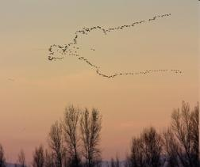


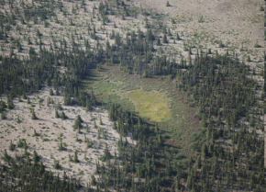

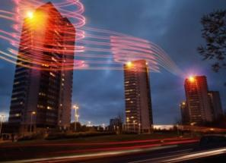
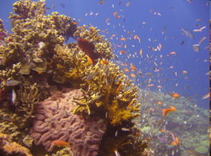
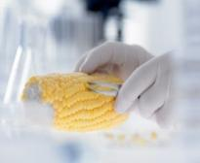
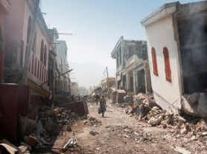
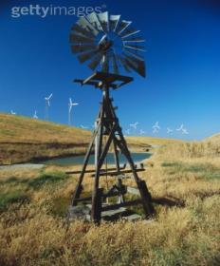


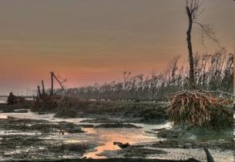
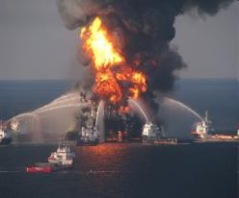
Digital Earth Applications
Global Climate Change
Food and Water Insecurity
Digital City
Natural Disaster
Energy Resources
30 categories of products, including land, ocean, atmosphere, urban construction;
Time-space scale: long-time series in global and regional scales.

Slide 14
International Cooperation
Notes:
Satellite data receiving ground station, Flight research center

Slide 15






























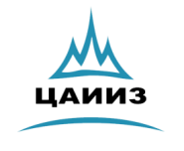











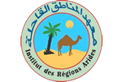








International Cooperation
Global network/connections: partners in over 20 countries
International Organizations
Government, Institutions & Universities
Companies

Slide 16
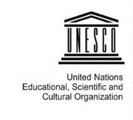



International organization hosted by RADI
  International Center on Space Technology for Natural and Cultural Heritage under the auspice of UNESCO (HIST)
  International Program Office of Integrated Research on Disaster Risk (IRDR IPO)
  CAS-TWAS Center of Excellence on Space Technology for Disaster Mitigation (SDIM)
  International Society for Digital Earth (ISDE)
  International Journal of Digital Earth (IJDE)

Slide 17
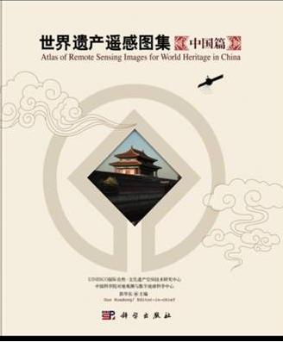
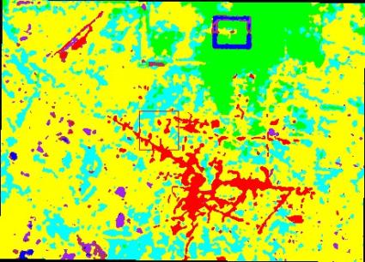
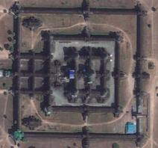
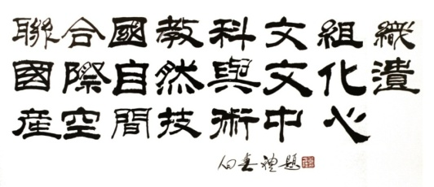
International Center on Space Technology for Natural and Cultural Heritage under the auspice of UNESCO
Hosted by RADI, it is the First UNESCO Category II Center in CAS &
First UNESCO International Center to apply space technologies to the monitoring and preserving natural and cultural heritage.
Research Works
  Remote Sensing for the Environment of the Historic Heritage Site of Angkor
  Analyses of natural and cultural heritage evolution and change.
  Natural and cultural heritage imagery database
  Atlas of Remote Sensing for World Heritage: China being published in 2011.

Slide 18

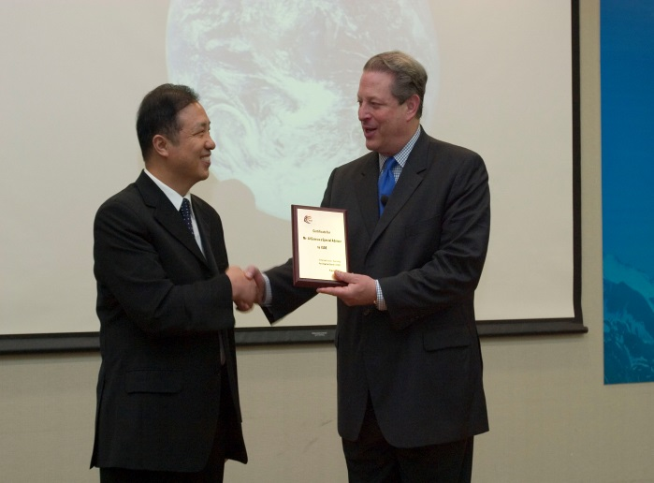
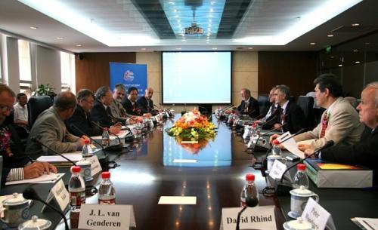
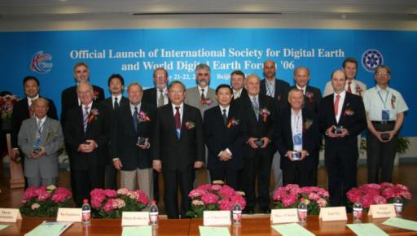
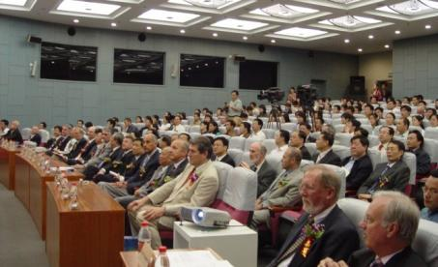
International Society for Digital Earth
ISDE, founded in Beijing in 2006, is a international scientific organization principally promoting academic exchange, science and technology innovation, education, and international collaboration towards Digital Earth.
The Mission of the Society is to benefit society by promoting the development and realization of Digital Earth.
International Society for Digital Earth
Time: May 2006
Place: Beijing ,China
Official Launch of ISDE and the first Executive Committee Meeting
学会成立大会
The first EC meeting
EC member of ISDE
Launch Ceremony of ISDE

Slide 19
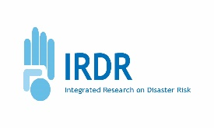
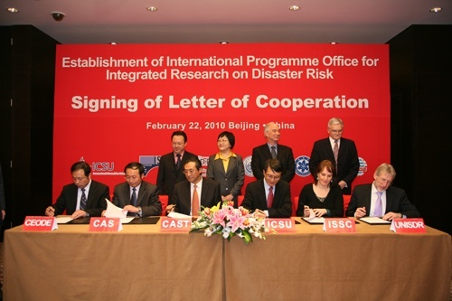
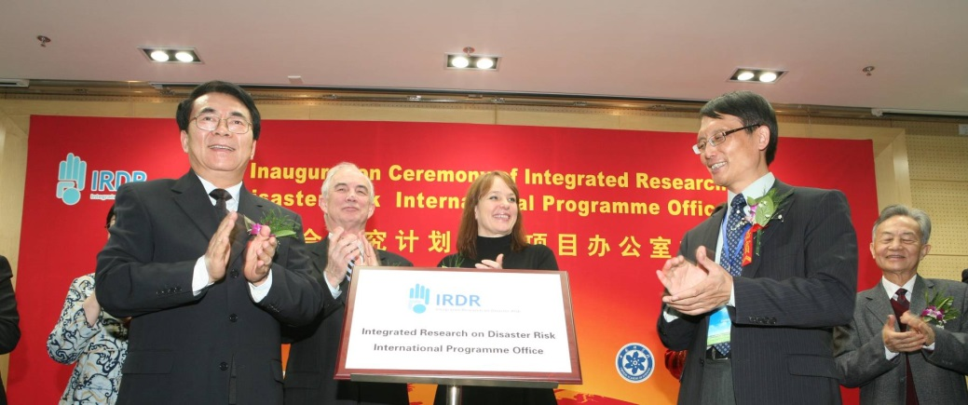
International Programme Office for Integrated Research on Disaster Risk
Being hosted by RADI (approved in November, 2009). First International Office of a large science program ever established in Asia.
IRDR CHINA established in 2010, one of the national committees of IRDR
Addressing the challenge of
natural and human-induced
environmental hazards
An integrated approach to research on disaster risk through: an international, multidisciplinary (natural, health, engineering and social sciences, including socio-economic analysis) collaborative research programme.

Slide 20

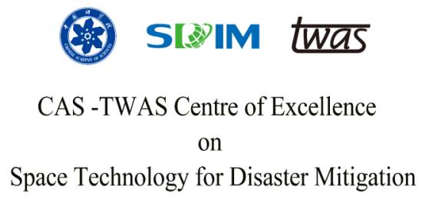

















CAS-TWAS Centre of Excellence on Space Technology for Disaster Mitigation (SDIM)
SDIM is committed to the studies of some key technologies of disaster reduction by using remote sensing, and focus on cooperation and capacity building for the developing countries.
TWAS, Trieste, Italy
CAS, Beijing, China
Joint Research Program
Education
Training Workshop
Conference and Seminar

Slide 21








CAS-NASA Join hands in HMA Glacier Research using Earth Observations
Within the framework of the China-US Joint Announcement on Climate Change and Cooperation between China and US Governments on Civil Space Technology, CAS and NASA kicked off joint glacier research in the HMA region using Earth Observations since 2014.
The NASA ESD in collaboration with CAS RADI.
Two main themes:
Glacier change. The changing climate, and human impacts have implications for glacier size and melt.
Glacier hazards, observations of hazards, and downstream effects on ecosystems and water resources.
Three Joint task groups:
Output:
Collaborate to complete the white paper in 2016.
NASA and CAS Fund projects for collaborate research separately in 2016.
1st CAS-NASA Workshop in Nepal in Jan 2015
The Joint task groups
pool the advantages of the two sides in EO and glacier and snow cover studies;
develop decision support tools for the sustainable development of the region;
promote the establishment of a mechanism underlying the long-term Sino-US cooperation on global change over HMA.
process modeling
data sharing
scientific verification
2nd CAS-NASA Workshop in USA in Sep 2015
3rd CAS-NASA Workshop in China in Mar 2016.
NASA Administrator Charles F. Bolden and
the USA delegation visit RADI

Slide 22
Asia-Oceania Global Earth Observation System of Systems (AOGEOSS)
GEO Initiative(GI-22 )
Asia-Oceania region
  Complex geographic
  Large population (70% of world’s)
  Climate change drastically
  Natural disasters occur frequently
  Unbalanced socioeconomic development
  Deteriorating ecological environment
Asia-Oceania GEOSS---a regional cooperation program on Earth observation with broad involvement
Strengthen comprehensive ability of Earth observation and applications for sustainable development at regional level.

Slide 23
AOGEOSS Functional Architecture
Biodiversity and Ecosystem Sustainability
Disaster Resilience
Energy and Mineral Resources Management
Improving regional observing ability
Data and information products processing
Earth observation data sharing service
Technology cooperation network
Regional applications
AOGEOSS
Food Security and Sustainable Agriculture
Infrastructure and Transport Management
Public Health Surveillance
Sustainable Urban Development
Water resources Management

Slide 24

AOGEOSS Activities

Slide 25















“Digital Belt And Road (DBAR)” Initiative
DBAR: Hand in Hand Program
Countries along the Belt and Road
International programs
International organizations
Let countries along the Belt and Road benefit from DBAR

Slide 26




DBAR Objectives
Scientific contributions
To address knowledge gaps in Earth system processes, which are limiting the achievement of the SDG targets in the Belt and Road countries.
Facilitating platform
To promote advanced science and decision support services to extract effective information from massive and diverse data in light of Big Earth Data.
Stakeholders
To enhance capacity building and technology transfer towards a system of partnerships and research networks.

Slide 27

Conceptual Framework of DBAR

Slide 28







DBAR Working Groups
  Big Earth Data (DBAR-DATA)
  Agriculture and Food Security (DBAR-AGRI)
Co-Chairs:
LI Guoqing Silap Boupha
Co-Chairs:
WU Bingfang Shukri Ahamd
Coastal Zone (DBAR-COAST)
Environment Change (DBAR-ENVI)
Co-Chairs:
LI Zhang LIN Hui Mazlan bin Hashim
Co-Chairs:
LI Xinwu JIA Gensuo Howard E. Epstein
Natural and Cultural Heritage (DBAR-HERITAGE)
                Disaster Risk Reduction (DBAR-DISASTER)
Co-Chairs:
WANG Xinyuan Shahina Tariq
Rosa Lasaponara Houcine Khatteli
Co-Chairs:
CHEN Fang Rajib Shaw
  Water (DBAR-WATER)
Co-Chairs:
JIA Li Marco Mancini Bob Su

Slide 29
On behalf of NRSCC, RADI, and its former bodies, has continually partcipated the activities and plenaries of WGISS from 2003.
RADI will support WGISS and other CEOS activies in the future.

Slide 30


