Slide 1

Host Welcome Logistics Information
Jining Yan, Lizhe Wang
Institute of Remote Sensing and Digital Earth (RADI)
Chinese Academy of Sciences (CAS)
September 25, 2017

Slide 2
WGISS 44 Agenda
 | Monday | Tuesday | Wednesday | Thursday
09:00 – 12:00 | WGISS PLENARY | Data ACCESS | Future Data Access and Analysis Architectures Workshop | Agency/Liaison Reports
12:00 – 13:30 | Lunch | Lunch | Lunch | Lunch
13:30-17:30 | CEOS/GEO Activities | The Palace Museum (also named Forbidden City ) Tour | Future Data Access and Analysis Architectures Workshop | Data PRESERVATION
19:00 |  | No-Host Dinner

Slide 3
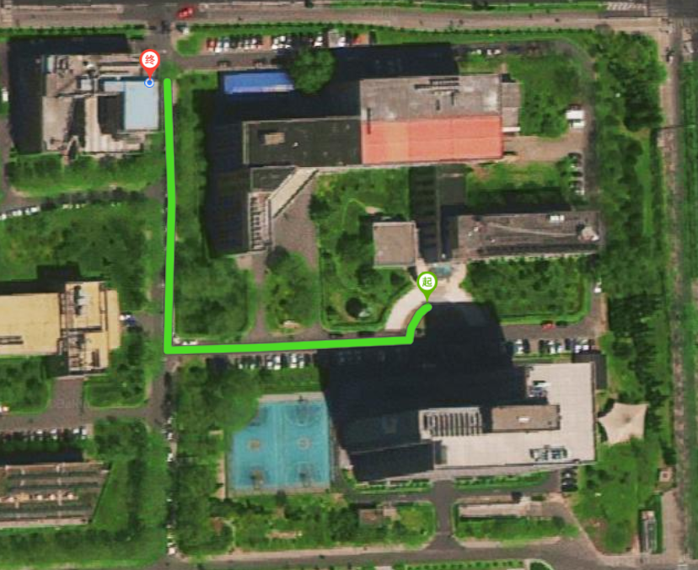
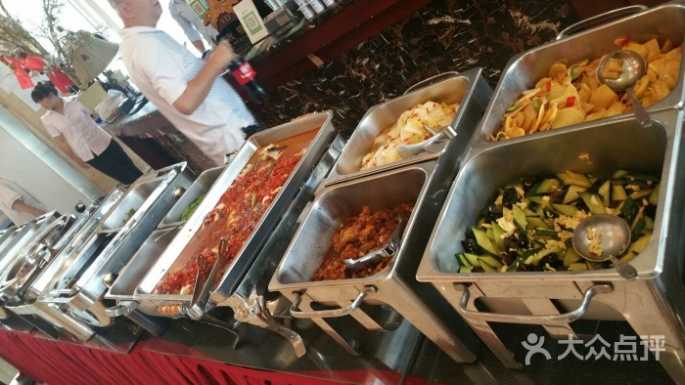
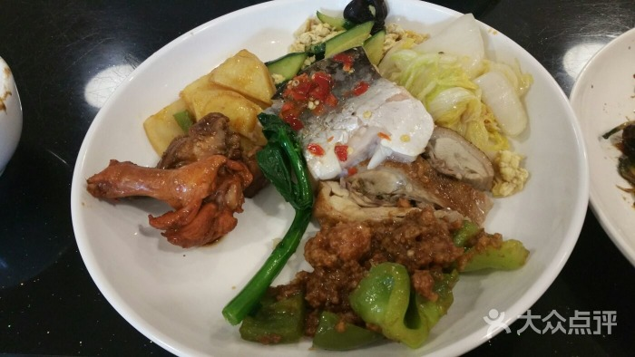
Buffet Lunch(12:00, Sep. 25-28)
Location
Sample
AoBeiTianXiang
Building A

Slide 4

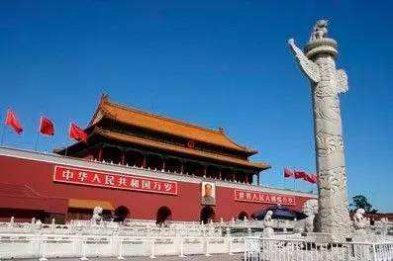
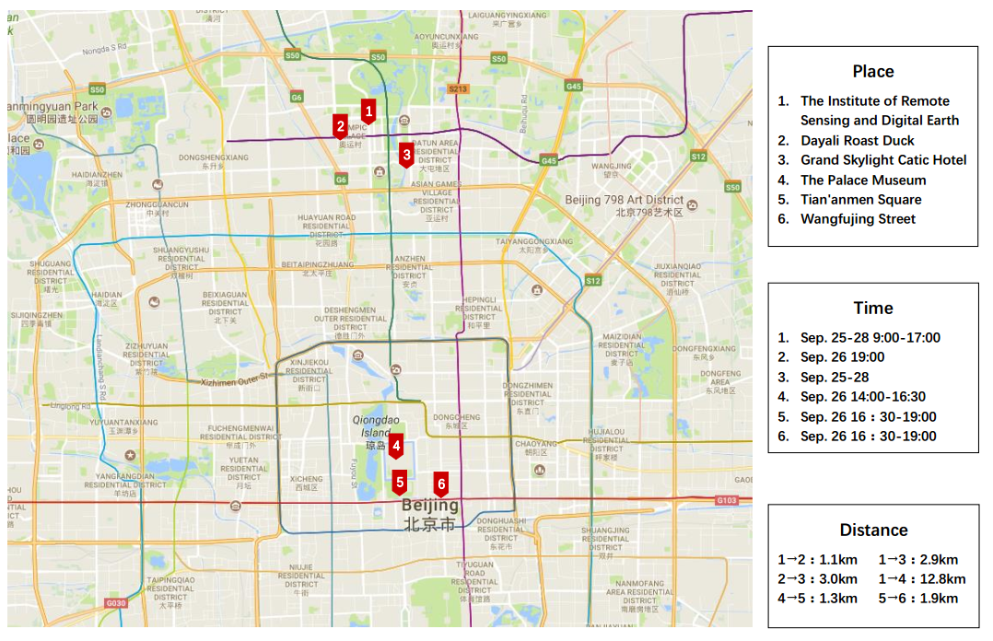
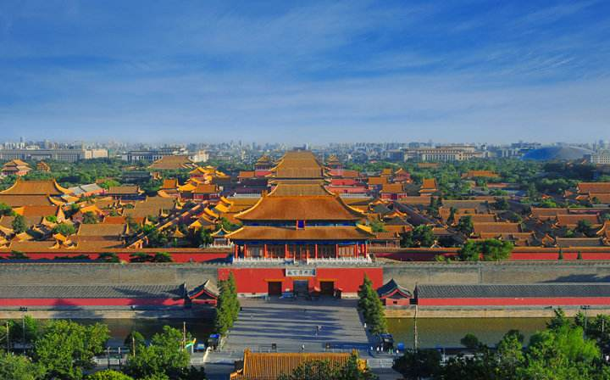
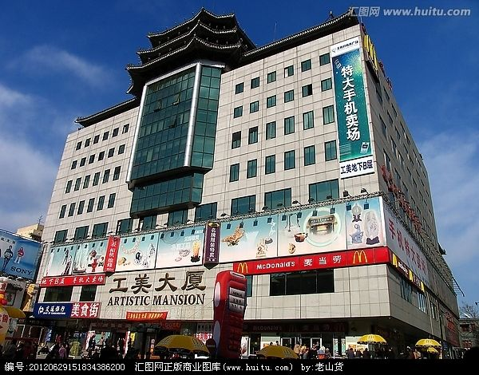
The Palace Museum Tour(Sep. 26 13:30)
!!! Passport must be taken for entrance ticket !

Slide 5
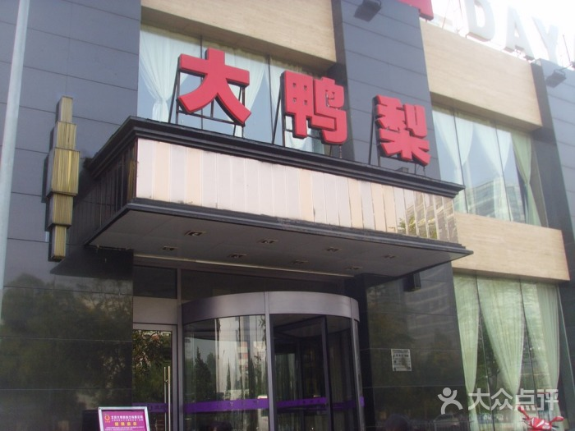
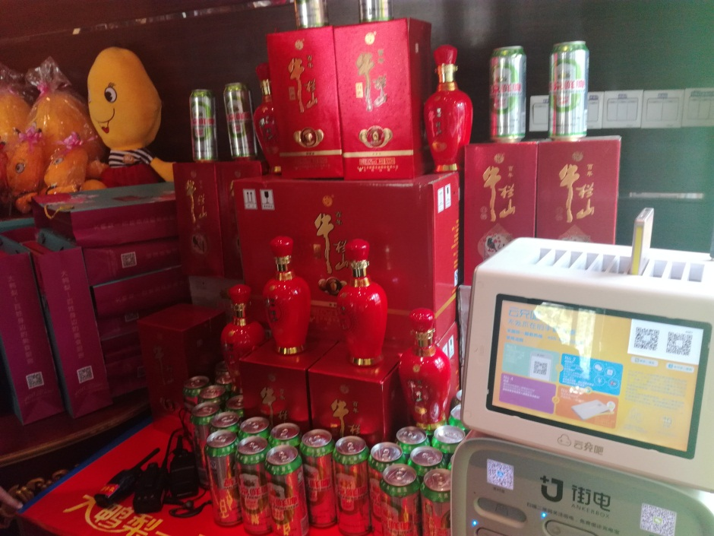
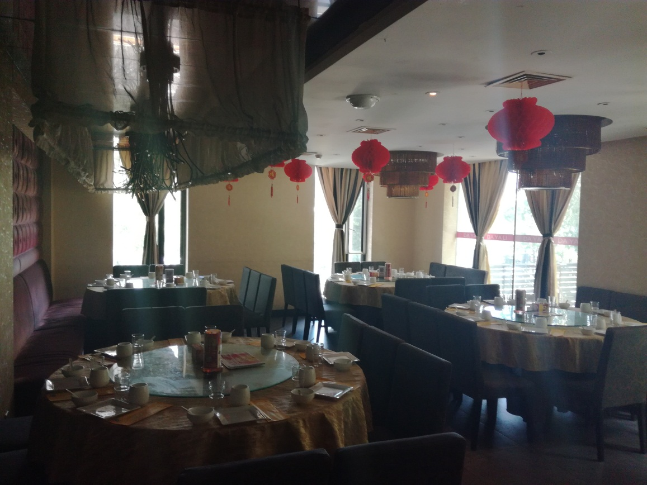
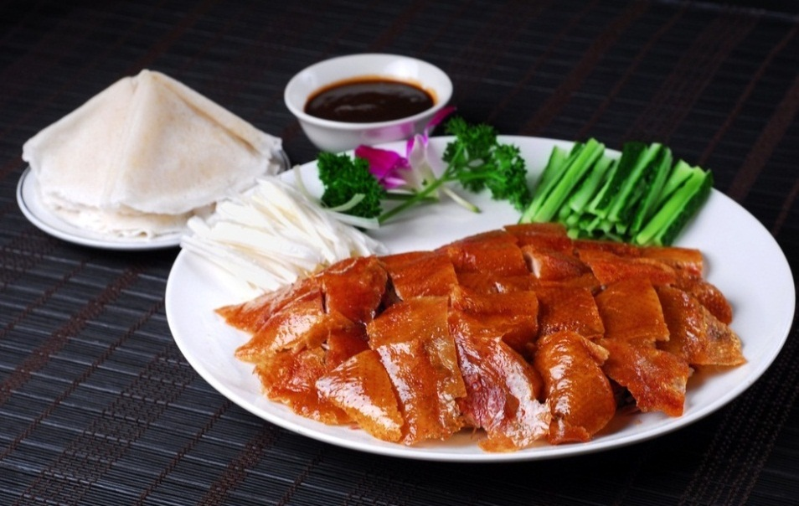
No-Host Dinner (Sep. 26 19:00)
Unlimited beer and white wine

Slide 6

Have a good time in Beijing!

