Slide 1
WGISS – 43 Logistics and Information
Committee on Earth Observation Satellites

Slide 2
Next Meeting
WGISS-43
Hosted by NASA
Annapolis, Maryland (USA)
April 3-6, 2017

Slide 3
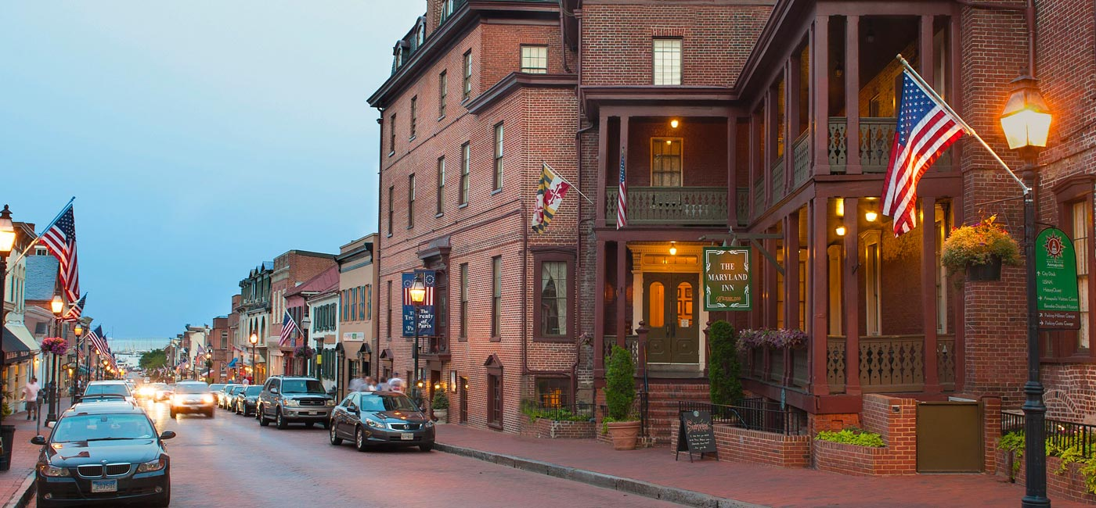
WGISS 43
Historic Inns Annapolis
58 State Circle Annapolis
Annapolis, Maryland 21401 USA
Host: NASA
April 2nd to 6th 2017
Notes:
Animated recolored picture fades in over black and white copy
(Advanced)
To reproduce the picture effects on this slide, do the following:
On the Home tab, in the Slides group, click Layout and then click Blank.
On the Insert tab, in the Images group, click Picture. In the Insert Picture dialog box, select a picture, and then click Insert.
Under Picture Tools, on the Format tab, in the Size group, click the Size and Position dialog box launcher. In the Format Picture dialog box, resize or crop the image so that the height is set to 3.58” and the width is set to 8”. To crop the picture, click Crop in the left pane, and in the right pane, under Crop position, enter values into the Height, Width, Left, and Top boxes. To resize the picture, click Size in the left pane, and in the right pane, under Size and rotate, enter values into the Height and Width boxes.
Under Picture Tools, on the Format tab, in the Adjust group, click Color, and then under Recolor click Dark Blue, Text color 2 Dark (second row, first option from the left).
Under Picture Tools, on the Format tab, in the Picture Styles group, click Picture Effects, point to Shadow, and then under Inner click Inside Diagonal Top Left (first row, first option from the left).
Drag the picture so that it is positioned above the middle of the slide.
On the Home tab, in the Clipboard group, click the arrow next to Copy, and then click Duplicate.
Press and hold CTRL and select both pictures on the slide. On the Home tab, in the Drawing group, click Arrange, point to Align, and then do the following:
Click Align to Slide.
Click Align Center.
Click Align Selected Objects.
Click Align Middle.
Select only the duplicate (top) picture. Under Picture Tools, on the Format tab, in the Size group, click the Size and Position dialog box launcher. In the Format Picture dialog box, resize or crop the image so that the width is set to 2.33”. To crop the picture, click Crop in the left pane, and in the right pane, under Crop position, enter values into the Height, Width, Left, and Top boxes. To resize the picture, click Size in the left pane, and in the right pane, under Size and rotate, enter values into the Height and Width boxes.
Under Picture Tools, on the Format tab, in the Adjust group, click Color, and then under Recolor, click No Recolor.
On the Home tab, in the Drawing group, click Shapes, and then under Rectangles click Rectangle (first option from the left). On the slide, drag to draw a rectangle.
Select the rectangle. Under Drawing Tools, on the Format tab, in the Size group, do the following:
In the Shape Height box, enter 7.5”.
In the Shape Width box, enter 2.33”.
Select the rectangle. Under Drawing Tools, on the Format tab, in the Shape Styles group, click Shape Outline, and then click No Outline.
Under Drawing Tools, on the Format tab, in the Shape Styles group, click Shape Fill, point to Gradient, and then click More Gradients. In the Format Shape dialog box click Fill in the left pane, select Gradient fill in the Fill pane, and then do the following:
In the Type list, select Linear.
In the Angle box, enter 90.
Under Gradient stops, click Add gradient stops or Remove gradient stops until two stops appear in the slider.
Also under Gradient stops, customize the gradient stops as follows:
Select the first stop in the slider, and then do the following:
In the Position box, enter 0%.
Click the button next to Color, and then under Theme Colors click White, Background 1 (first row, first option from the left).
In the Transparency box, enter 55%.
Select the second stop in the slider, and then do the following:
In the Position box, enter 100%.
Click the button next to Color, and then under Theme Colors click White, Background 1 (first row, first option from the left).
In the Transparency box, enter 100%.
On the slide, drag the rectangle to cover the duplicate picture.
Select the rectangle. On the Home tab, in the Drawing group, click Arrange, and then do the following:
Point to Align, and then click Align to Slide.
Point to Align, and then click Align Middle.
Click Send Backward.
On the Home tab, in the Drawing group, click Shapes, and then under Rectangles click Rectangle (first option from the left). On the slide, drag to draw another rectangle.
Select the rectangle. Under Drawing Tools, on the Format tab, in the Size group, do the following:
In the Shape Height box, enter 4”.
In the Shape Width box, enter 2.67”.
Under Drawing Tools, on the Format tab, in the Shape Styles group, click Shape Fill, point to Gradient, and then click No fill.
Under Drawing Tools, on the Format tab, in the Shape Styles group, click the Format Shape dialog box launcher. In the Format Shape dialog box, click Line Color in the left pane, select Solid line in the Line Color pane, and then do the following:
Click the button next to Color, and then under Theme Colors click White, Background 1 (first row, first option from the left).
In the Transparency box, enter 70%.
Also in the Format Shape dialog box, click Line Style in the left pane, and then do the following in the Line Style pane:
In the Width box, enter 0.75 pt.
Click the button next to Dash type, and then click Square Dot (third option from the top).
Drag the dotted rectangle on top of the small, full-color picture.
Press and hold SHIFT and select the dotted rectangle, the small picture, and the large picture on the slide. On the Home tab, in the Drawing group, click Arrange, point to Align, and then do the following:
Click Align Selected Objects.
Click Align Middle.
On the Insert tab, in the Text group, click Text Box, and then on the slide, drag to draw the text box.
Enter text in the text box, select the text, and then on the Home tab, in the Font group, select Gill Sans MT Condensed from the Font list, select 24 from the Font Size list, click the button next to Font Color, and then under Theme Colors click White, Background 1 (first row, first option from the left).
On the Home tab, in the Paragraph group, click Center to center the text within the text box.
On the slide, drag the text box below the dotted rectangle.
To reproduce the background effects on this slide, do the following:
Right-click the slide background area, and then click Format Background. In the Format Background dialog box, click Fill in the left pane, and then select Solid fill in the Fill pane.
Also in the Fill pane, click the button next to Color, and then under Theme Colors click Black, Text 1, Lighter 15% (fifth row, second option from the left).
To reproduce the animation effects on this slide, do the following:
On the View tab, in the Zoom group, click Zoom, and then in the Zoom dialog box, in the Percent box, enter 70%. (Note: Make sure that Fit is not selected in the Zoom dialog box.)
On the slide, select the dotted rectangle. On the Animations tab, in the Advanced Animations group, click Add Animation, and then, under Motion Paths, click Custom Path.
Press and hold SHIFT to conform the path to a straight, horizontal line, and then do the following on the slide:
Click the center of the dotted rectangle to create the first motion-path point.
Click approximately ½” beyond the right edge of the rectangle to create the second motion-path point.
Double-click approximately 2” beyond the left edge of the slide to create the third and final motion-path point.
On the slide, right-click the freeform motion path, and then click Reverse Path Direction.
On the Animations tab, in the Timing group, in the Start list, select With Previous.
On the slide, select the gradient-filled rectangle. On the Animations tab, in the Advanced Animations group, click Add Effect, and then click More Entrance Effects. In the Add Entrance Effect dialog box, under Subtle, click Fade, and then click OK.
On the Animations tab, in the Timing group, in the Start list, select With Previous.
On the Animations tab, in the Timing group, in the Duration box, enter 0.5.
On the slide, select the gradient-filled rectangle. On the Animations tab, in the Advanced Animations group, click Add Effect, and then click More Motion Paths. In the Add Motion Path dialog box, under Lines and Curves, click Down, and then click OK.
On the Animations tab, in the Timing group, in the Start list, select With Previous.
On the Animations tab, in the Timing group, in the Duration box, enter 2.
On the slide, right-click the down motion path and click Reverse Path Direction.
On the slide, select the smaller, full-color picture. On the Animations tab, in the Advanced Animations group, click Add Effect, and then click More Entrance Effects. In the Add Entrance Effect dialog box, under Subtle, click Fade, and then click OK.
On the Animations tab, in the Timing group, in the Start list, select With Previous.
On the Animations tab, in the Timing group, in the Duration box, enter 2.
On the Animations tab, in the Timing group, in the Delay box, enter 1.5.
On the slide, select the text box. On the Animations tab, in the Advanced Animations group, click Add Effect, and then click More Entrance Effects. In the Add Entrance Effect dialog box, under Subtle, click Fade, and then click OK.
On the Animations tab, in the Timing group, in the Start list, select With Previous.
On the Animations tab, in the Timing group, in the Duration box, enter 1.

Slide 4
Historic Inns Annapolis
“Experience 18th century charm and history mixed with 21st century convenience at our landmark boutique inns in historic downtown Annapolis, Maryland. Comprised of three historic buildings, our iconic Inns offer a mix of Victorian character and modern lifestyle amenities. Our beautifully restored boutique hotels celebrate a place in American history, and all are within walking distance of Chesapeake Bay attractions. “

Slide 5
Things to do in Annapolis…
“Stroll along the historic waterfront for a sunset over the bay or a brunch cruise, or wander the cobblestone streets to wonderful shopping and dining destinations. Enjoy seasonal Maryland cuisine in the elegant and romantic ambiance of Treaty of Paris, our famed restaurant that dates back to the 1700's. ”

Slide 6
HOST: NASA Goddard Space Flight Center
Interesting Goddard
Facts and Firsts
8800 Greenbelt Rd, Greenbelt, MD 20771, United States
Goddard was established on May 1, 1959.
Goddard was NASA's first space flight center.
Goddard employs approximately 10,000 civil servants and contractors
The center is named for Dr. Robert H. Goddard, the pioneer of modern rocket propulsion in the U.S.
Goddard is the largest combined organization of scientists and engineers dedicated to increasing knowledge of the Earth, the Solar System, and the Universe via observations from space in the U.S.
Goddard is a one-stop. Missions are designed here, and satellites are built here.
Goddard has launched over 290 missions over a period of 50 years.

Slide 7
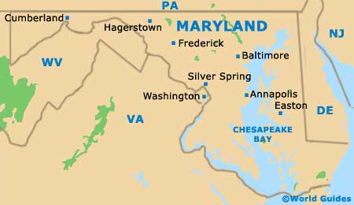
Close proximity to Baltimore, MD and Washington D.C.

Slide 8
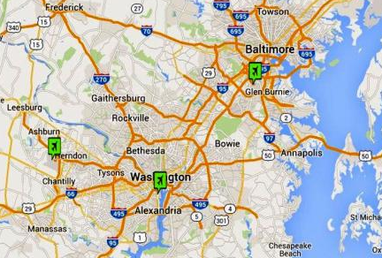
Nearest Airports to Annapolis
The nearest major airport is Baltimore/Washington International Thurgood Marshall Airport (BWI / KBWI). This airport has international and domestic flights from Baltimore, Maryland and is 26 miles from the center of Annapolis, MD.
Another major airport is Ronald Reagan Washington National Airport (DCA / KDCA), which has international and domestic flights from Washington, District of Columbia and is 37 miles from Annapolis, MD.
Another major airport is Washington Dulles International Airport (IAD/ KIAD), which has international and domestic flights from Dulles, Virginia and is 62 miles from Annapolis, MD.

Slide 9
BWI to Annapolis
Arriving…
By Car-- To get to Annapolis from the BWI airport, follow I-97 south to U.S. Route 50. Various exits will take you into town (although many chain hotels are right off Rte. 50). The Rowe Boulevard exit is the most direct one to the historic district.
By Taxi/Shuttle -- SuperShuttle (tel. 800/258-3826; www.supershuttle.com) charges about $30 between BWI and Annapolis. A taxi is about $45 one-way; call BWI Airport Taxi at tel. 410/859-1103.
By Train -- Amtrak and three Annapolis-area shuttle services have teamed up to make it easier to come to Annapolis by train. For about $26, a shuttle will take Amtrak passengers from the BWI terminal directly to their hotel or other destination in the Annapolis area. Reservations are required. For details or the reservation link, go to the Northeast Corridor timetable at www.amtrak.com.

Slide 10
Dulles to Annapolis
Arriving
By Car -- To get to Annapolis from the Dulles airport, follow I-495N to I-97 south to U.S. Route 50. Various exits will take you into town (although many chain hotels are right off Rte. 50). The Rowe Boulevard exit is the most direct one to the historic district.
By Taxi/SuperShuttle (tel. 800/258-3826; www.supershuttle.com) charges approximately $150 between Dulles and Annapolis. All taxis at Dulles are provided by Washington Flyer Taxi. Rates are here http://www.washfly.com/Taxi_rate.htm and while they don't have a rate to Annapolis, you can calculate that rate because their fares are $4 plus $2 per mile, and Annapolis is about 62 miles, so you are looking at a fare of at least $130, tip is discretionary but would probably be around $20, so you are looking at $150 minimum probably.

Slide 11
Reagan National Airport to Annapolis
Arriving
By Car -- To get to Annapolis from the Reagan National airport, follow I-495N to I-97 south to U.S. Route 50. Various exits will take you into town (although many chain hotels are right off Rte. 50). The Rowe Boulevard exit is the most direct one to the historic district.
By Taxi/SuperShuttle (tel. 800/258-3826; www.supershuttle.com) charges approximately $100 between Reagan N. and Annapolis. Taxis are easily accessible at Reagan National Airport. The approximate fare is $100 but consult your taxicab operator regarding exact fares for taxi trips.

Slide 12
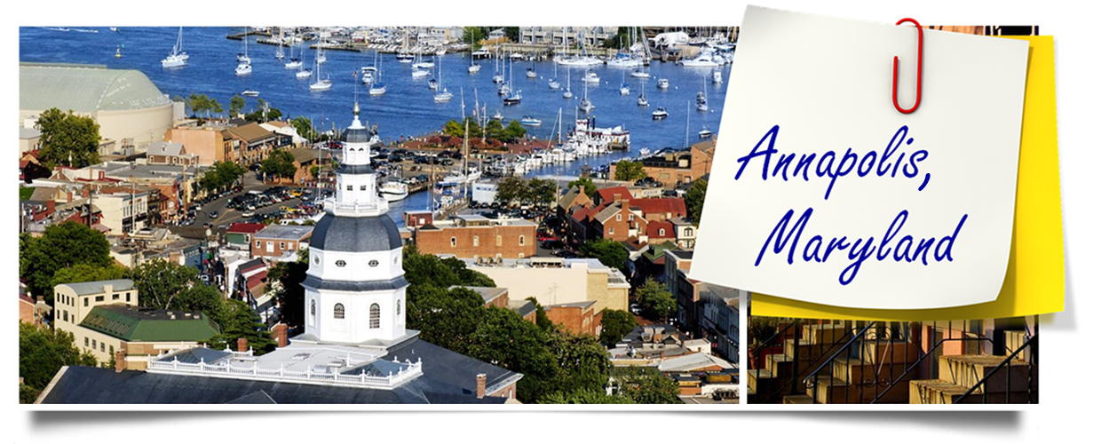
See you all at WGISS-43 in Annapolis!

