Slide 1
Presentation on Copernicus Dissemination
CEOS WGISS
European Commission, Copernicus
Daniel Quintart
Astrid Christina Koch

Slide 2
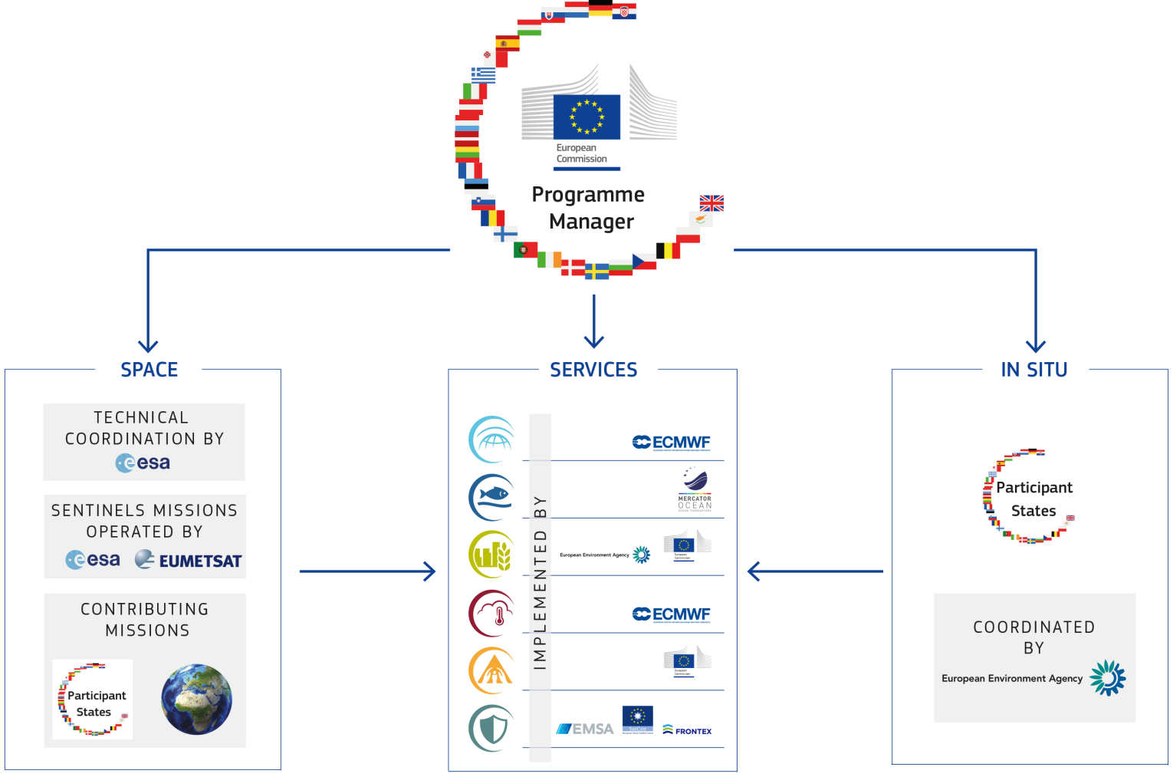
COPERNICUS GOVERNANCE

Slide 3

THE BIG DATA CHALLENGE
Massive amounts of data
Full, open and free-of-charge
Ease of access and use
Different types of dissemination infrastructures
Member States Collaborative GS
New technology developments
ICT and EO cross-fertilisation
Interoperability with non-EO datasets
Public programmes as enablers
Growth and jobs in downstream sector
Over 10 Petabyte/year of new data
with just Sentinels-1, -2 and -3 fully operational
(data are downloaded many times over)

Slide 4
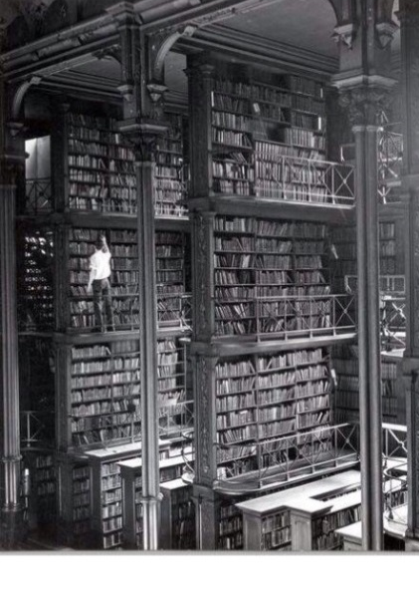
COPERNICUS BIG DATA APPROACH
Dual approach [risk management] :
Strengthening Copernicus Distribution Services for download
Setting up of Data Access and Information Services (DIAS)
  Access to all Copernicus data and information virtually collocated with computing resources
  Allowing Big Data analytics without the need to download the data and information
  Allowing data fusion with non-EO data and information

Slide 5
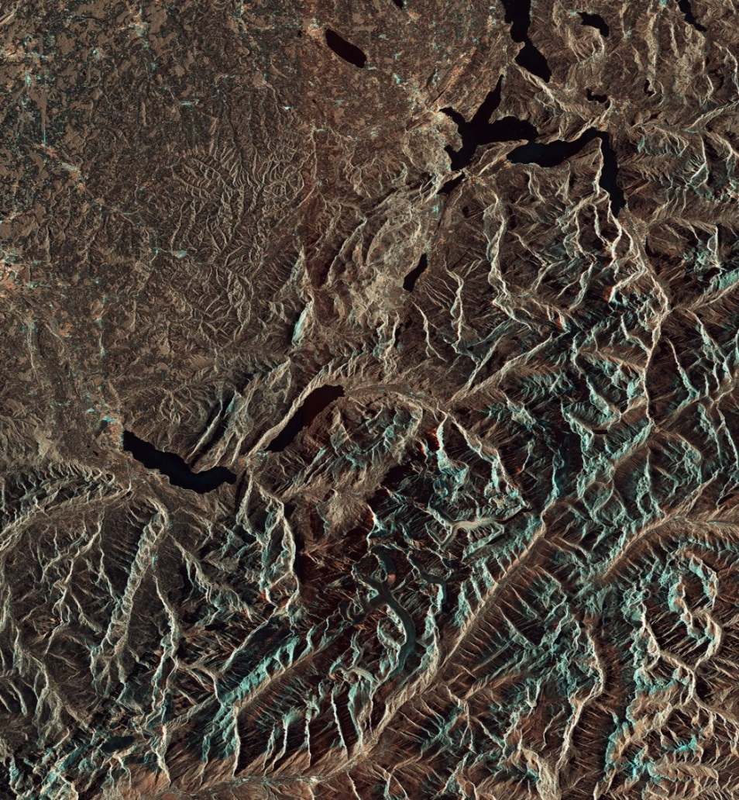
Functional Requirements- Overview
Functional Requirements publicly available(copernicus.eu) and address
  Copernicus Distribution Services
    Discovery, view, download provided by Copernicus Entrusted Entities
  Copernicus Data and Information Access Services (DIAS)
    Bringing the users to the data : embrace big data paradigm , cost mutualisation and improved efficiency - we are downloading the Earth too many times
  Related issues : stakeholder roles, governance and monitoring, visibility…
  Review by 2020

Slide 6



Overview Distribution and DIAS
User Domain
Commission
Member States
Private sector
Citizen
Regional/Local
Administration
Scientific users
ESA / EUMETSAT
Processing & Other Value Added Services &
Data
Processing & Other Value Added Services &
Data
User Data
Data/Information co-located with IT exploitation environment and tools
Information Access & Download
Copernicus Core Services
Copernicus Domain
Land
Data for Download
Data/Information Access
Marine
Atmosphere
Data Distribution service
Data and Information Access Service
Emergency
Security
S1
S2
S3
S4
S5
S6
Sentinel
Data
Service Information
Climate
Sentinels
improved
new
Service Information
Sentinel Data
ESA
Sentinel Data
EUMETSAT
Contributing Missions
In-Situ
National, International & Commercial Data

Slide 7
Copernicus Distribution Services
Catalogue, search and view
User management
User support
Copernicus Data and Information
Restricted access
Download
Access to NRT/QRT
Data
Data broadcast
Long-term archive

Slide 8
DIAS Concept
End-Users
Front Office
Third Party
Services &
Environment
Basic Data
Exploration
Tools
Integration
Interface layer
Third Party funded Services
Copernicus funded Services
Scalable computing
environment
Scalable computing
environment
Back office
Scalable storage(s) for 3rd party data
Scalable storage Copernicus Data & information
Copernicus DIAS

Slide 9


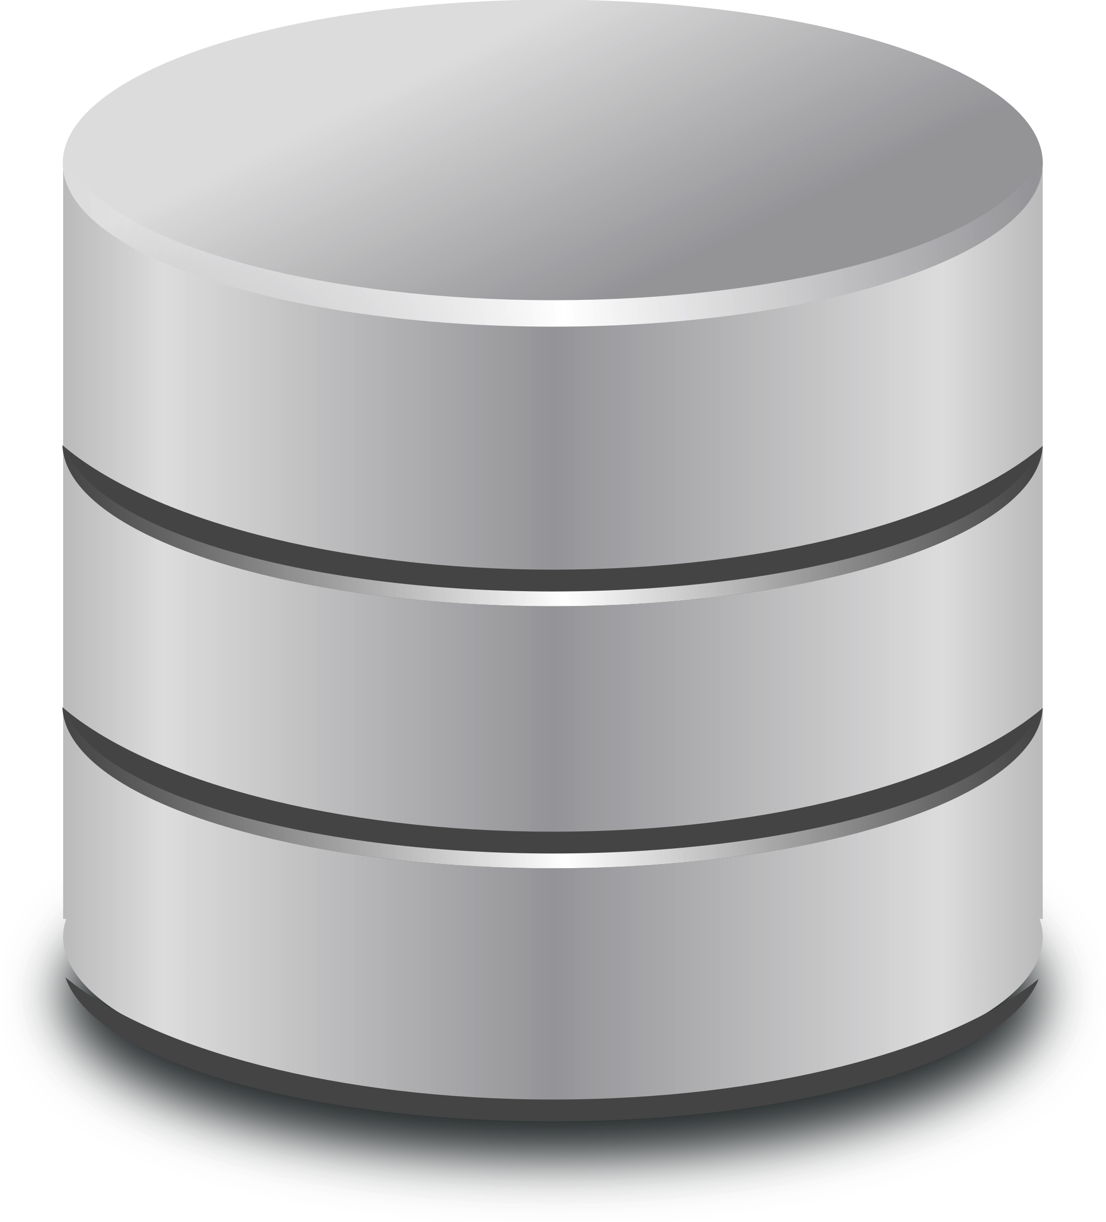

DIAS Concept
Front-office operations
Provision of Front-Office Infrastructure is under Third-Party responsibility
Third-Party: User implementing and/or operating a local service making use of the DIAS storage and interface
Interface for storage access & processing and management
Copernicus DIAS interfaces
Back-office operations
Scalable on-line storage
Copernicus DIAS Storage
DIAS Provider

Slide 10


Third-party service provision
Chaining of value adding services between Third Parties is a key feature for a dynamic market ecosystem
Third Party(2) interfaces and Services
Third Party(1) interfaces and Services
Copernicus DIAS Storage
DIAS Provider

Slide 11






European EO Data ecosystem on DIAS
End user: User of the third-parties services
Front
office service
Front
office service
Front
office service
Front
office service
Front
office service
Front
office service
Front
office service
Funded by
third-parties
Front
office service
Front
office service
Front
office service
Front
office service
Third Party
Users
Copernicus DIAS interfaces
DIAS
funded
Copernicus DIAS Storage
Third-party
Users
Copernicus Services & user uptake
Commercial or research users or initiatives (e.g. EO Market place,..)
Pathfinder projects
EOEP-5 (“EO Science for Society”)
EU Member States & particpating countries
Copernicus Data & Information Access Services
SAF
Heritage Data (LTDP+), Earthnet
National/commercial missions data access
Research and Innovation Projects (H2020)
EarthWatch CCI, InCubed
Sentinel Collaborative Ground Segment
Open Science Cloud & GEOSS Infrastructure

Slide 12













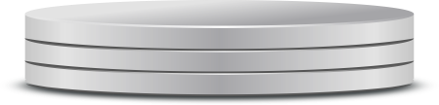
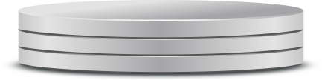
EUMETSAT& Partners-DIAS
Front
office service
Front
office service
Front
office service
Front
office service
Front
office service
Front
office service
Front
office service
Front
office service
Front
office service
Front
office service
Front
office service
Third Party
Users
Front
office
Copernicus DIAS interfaces
Third Party interfaces and Services
Third Party interfaces and Services
Third Party interfaces and Services
Third-party cloud interfaces
Back
office
Elastic Cloud Resources
Copernicus Data & Information

Slide 13
Multiple DIAS & Interoperability scenario
1 – MULTIPLE DIAS
2 – INTEROPERABILITY
3 – EXTERNAL RESOURCES
Third Party Service providers may choose between commercial IT offers and from possibly multiple DIAS service providers
Interfaces enabling cross-operations (open API) between multiple DIAS and between DIAS and “other environments”.
Third Party Service providers may integrate data/information from “other environment” in their service provision .
Third Party may provide services based on Copernicus data on “other environments”
Third Party interfaces and Services
Third Party interfaces and Services
Third-party cloud interfaces
Other environment
DIAS Provider (1)
DIAS Provider (2)

Slide 14
What are our objectives ?
• Easy and user-­friendly availability and access to all Copernicus data and information
• Maximise uptake and exploitation of Copernicus/ EO data in an efficient environment
• DIAS as an enabler: stimulate the emergence of an ecosystem, which facilitates activities by 3rd parties, bringing together research/operational, supply/demand, different data sources (both EO and non­‐EO) and know-how (EO, ICT, thematic)
• Defragmentation, increased efficiency and cross-­fertilisation)

Slide 15
What are our objectives ?
Key elements to be taken into account:
• Technical performance (innovation at core of procurement)
• Ability to interact with and attract third-­party users, different
European user communities and to mobilise European EO industry
• Ability to provide EU Member States a mutualised service offering
• Ability to attract additional data
• Ability to support and facilitate third-party value-­added services (e.g. data/ information/applications)

Slide 16
Thanks for your attention!
European Commission

