Slide 1

USGS Agency Report
WGISS-43
Kristi Kline
USGS EROS Center
U.S. Department of the Interior
U.S. Geological Survey

Slide 2
Major Activities
Landsat Archive/Distribution Changes
Sentinel-2
GloVis upgrade
Landsat 9

Slide 3
Landsat
Collection Processing
  Reprocessing the Landsat archive
  Improved calibration, geometric accuracy, and added/improved metadata
  TM and ETM+ Complete
  OLI/TIRS in Process (Completion by end of April)

Slide 4
Collection Definition Progress
The USGS defined three basic categories of products
  NRT (Near-real time) – products that are processed using ancillary data such as predicted ephemeris or bumper mode parameters that may be improved by reprocessing
  Tier 1 – products that meet the criteria for the collection definition (i.e. enable time-series stacking, <12m RMSEr)
  Tier 2 – products that do not meet the criteria for the collection definition and have been processed using the best known ancillary data

Slide 5
Landsat Status
Landsat Global Archive Consolidation (LGAC)
  Over 4 million scenes added to the archive
  Over 70% of scenes are unique additional data
  Updates to State of the Archive statistics graphically shows impacts of LGAC activities
    https://landsat.usgs.gov/usgs-landsat-global-archive

Slide 6
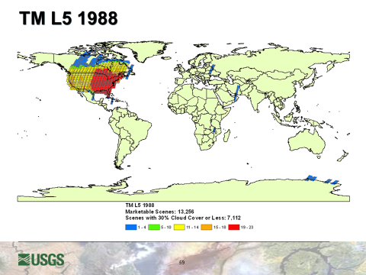
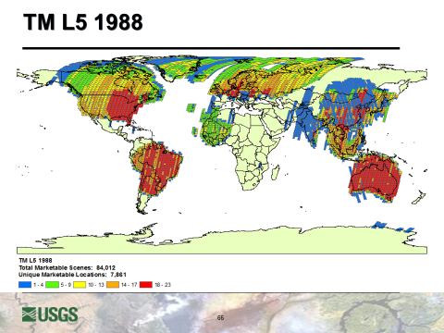
Pre-LGAC/LGAC Archive Impact
Post-LGAC
Pre-LGAC

Slide 7
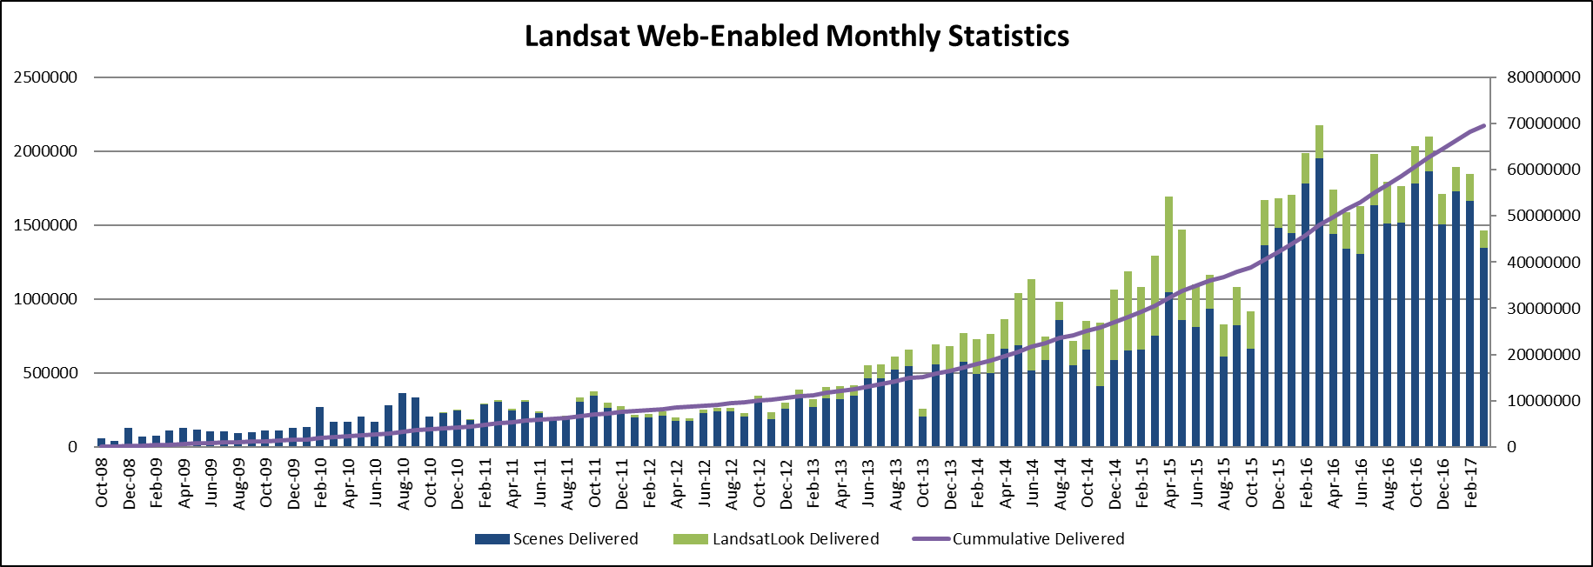
Monthly Downloads
Notes:
Final – circled month is reporting date used for LTWG #23 (April)
Date of LTWG #23 presentations was 9 June 2014

Slide 8
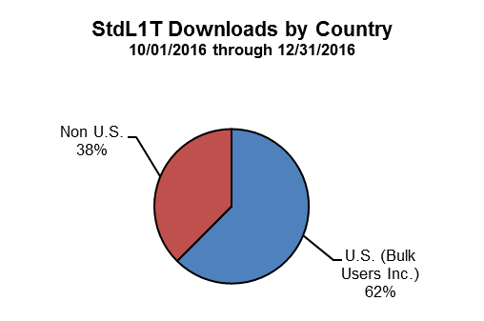
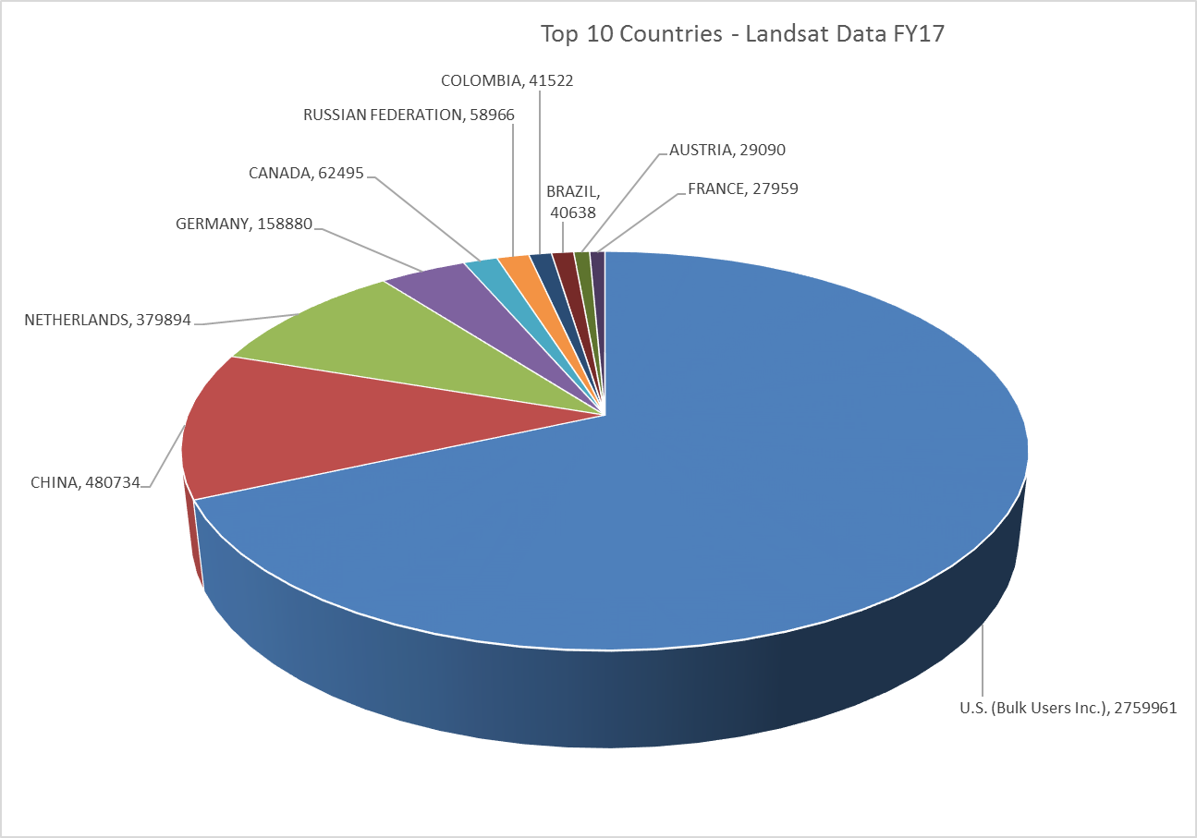
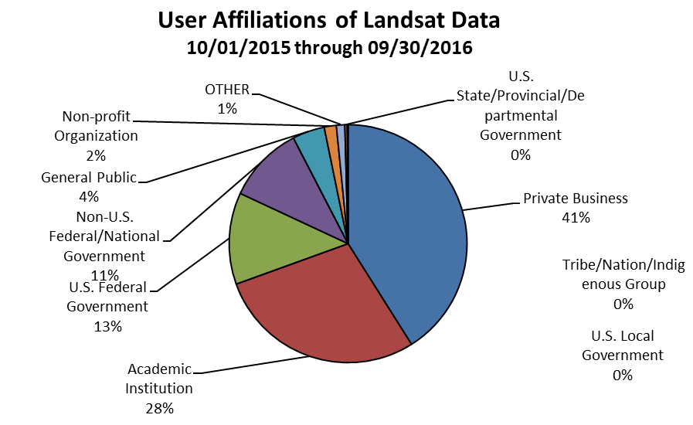
Customer Demographics

Slide 9
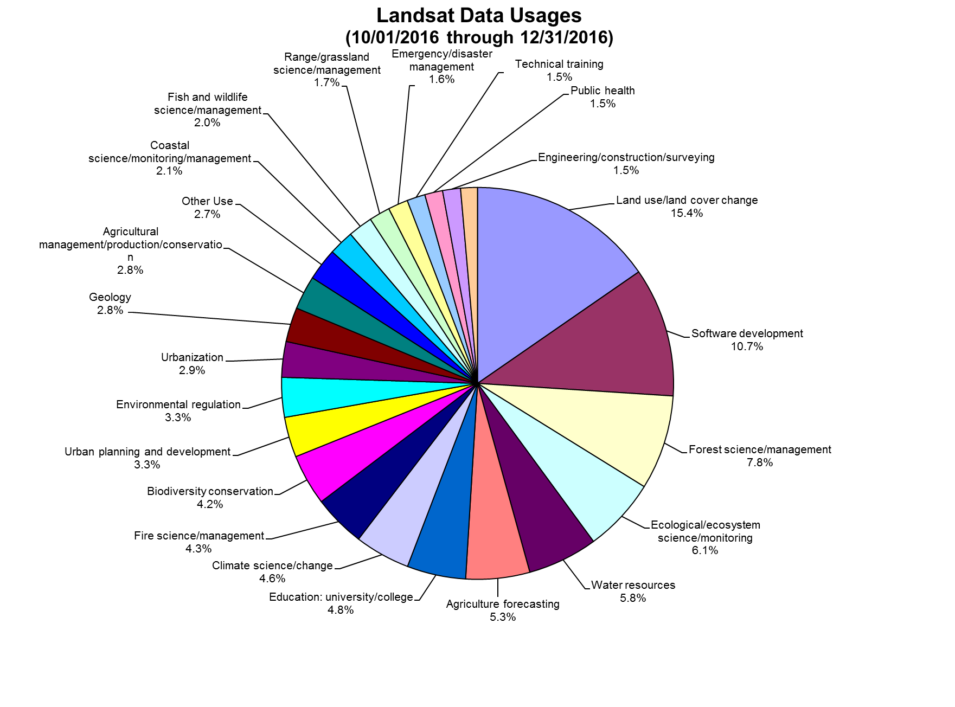
User Reported Primary Use of Landsat

Slide 10
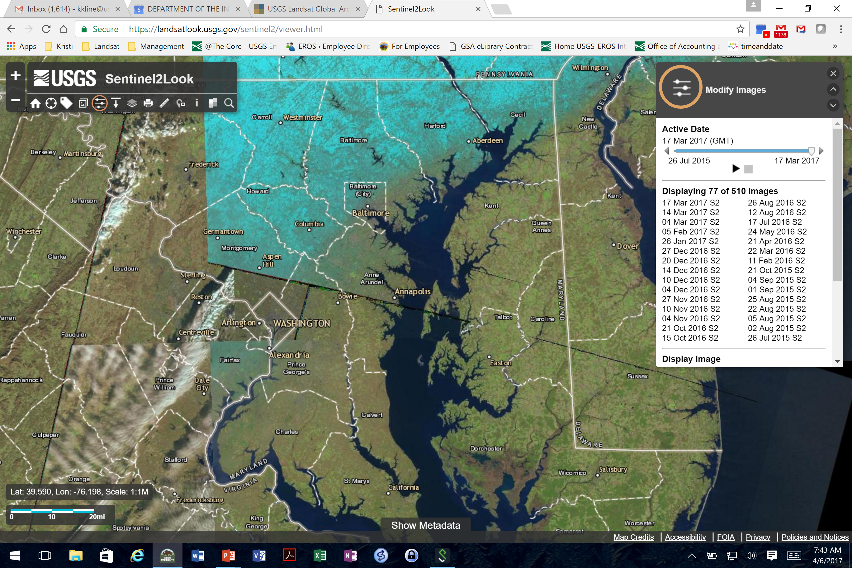
Sentinel 2
Released Sentinel 2 seamless viewer
  https://landsatlook.usgs.gov/sentinel2/

Slide 11
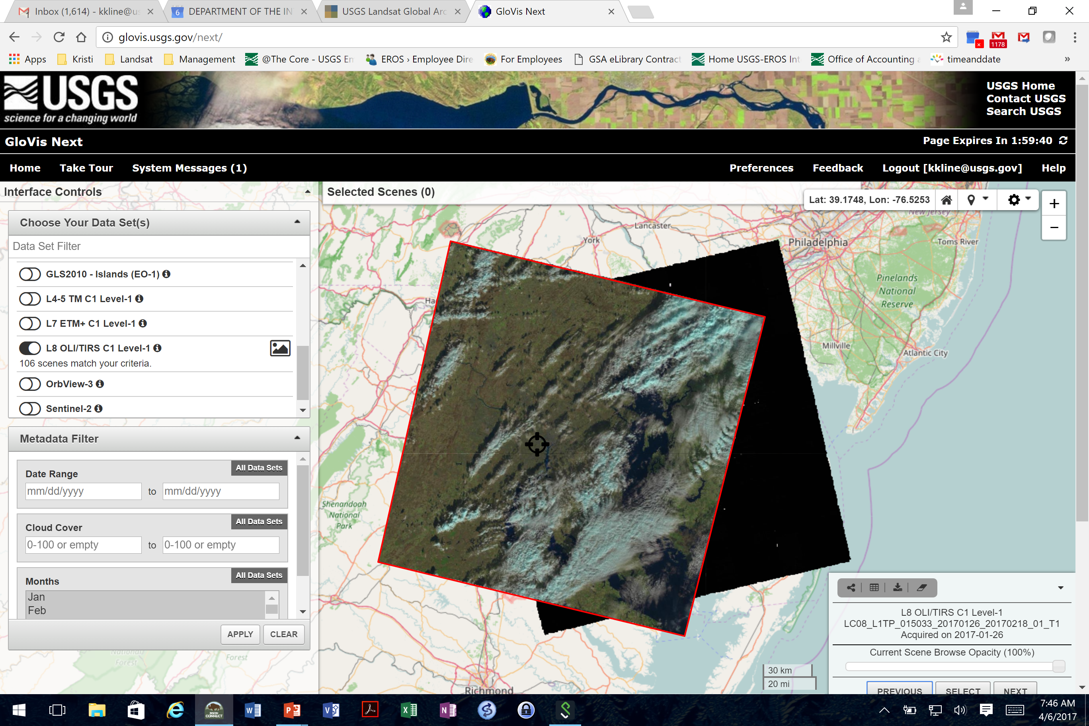
GloVis Next
http://glovis.usgs.gov/next/

Slide 12
Landsat 9
Spacecraft and Instruments in development
Systems Requirements Review for Ground systems at EROS next week
Contract for flight operations in work

Slide 13
Questions

