Slide 1

NOAA Report
Committee on Earth Observation Satellites
Martin Yapur
CEOS WGISS - 43 meeting
NASA, Annapolis, MD. USA
April 6, 2017

Slide 2
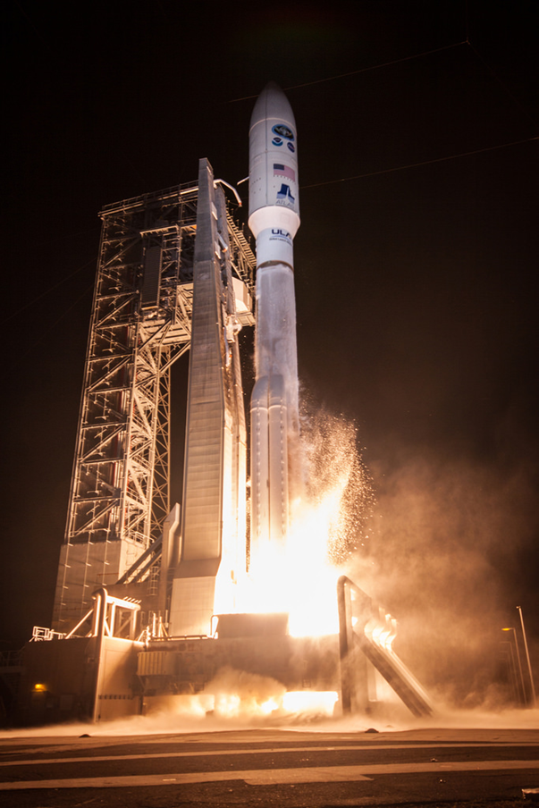
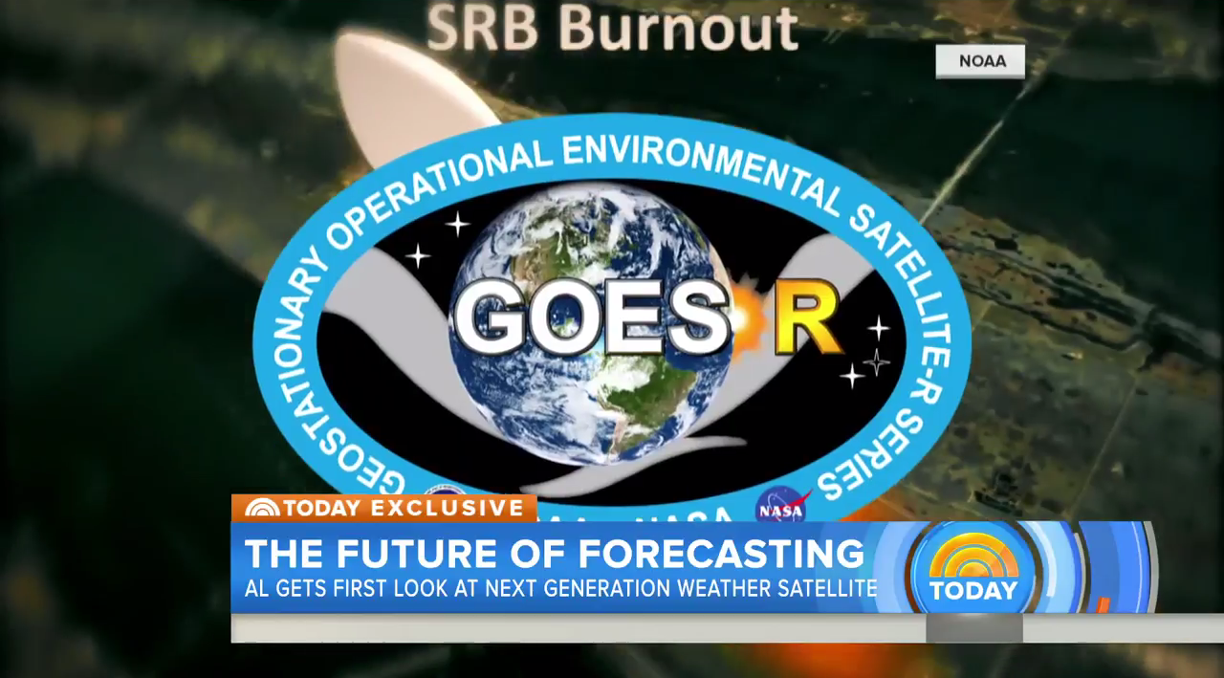
The Future of Forecasting
http://www.today.com/video/get-an-exclusive-first-look-at-noaa-s-new-weather-satellite-750733891982

Slide 3
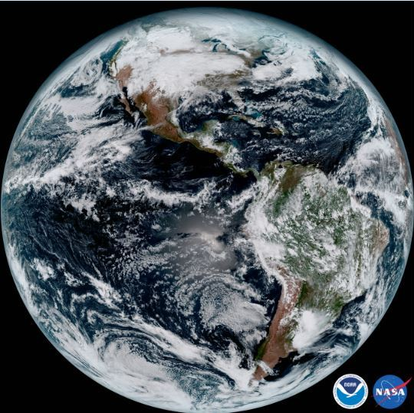
NOAA’s GOES-16 Satellite Sends First Images to Earth
NOAA’s GOES-16 satellite, formerly known as GOES-R, has sent its first, high resolution images, and now people around the world can see what this revolutionary satellite sees. These images from GOES-16’s new Advanced Baseline Imager (ABI) instrument show the complete full disk of the Western Hemisphere and the continental United States in all 16 channels of the ABI instrument.
GOES-16 was launched on Nov. 19, 2016 at 6:42pm EST from Cape Canaveral, Florida. The first images usher in a new era of Earth and space weather observation for the U.S.

Slide 4
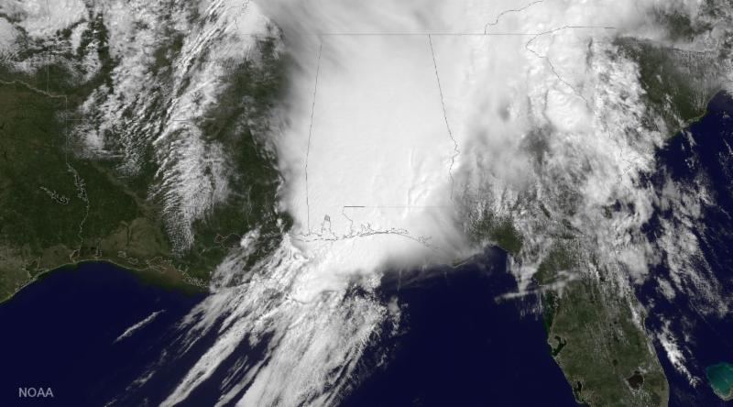
“Eyes in the Sky”
GOES East captured this visible image of a large storm system over Alabama, Georgia and western Florida on April 3, 2017. NOAA's GOES satellites orbit 35,800 km (22,300 miles) above Earth's equator in a geostationary orbit, meaning they travel around the globe at speeds equal to Earth's rotation, constantly monitoring a particular area of the planet. These constant "eyes in the sky" are critical for identifying atmospheric circulations and, as shown here, monitoring severe weather..

Slide 5
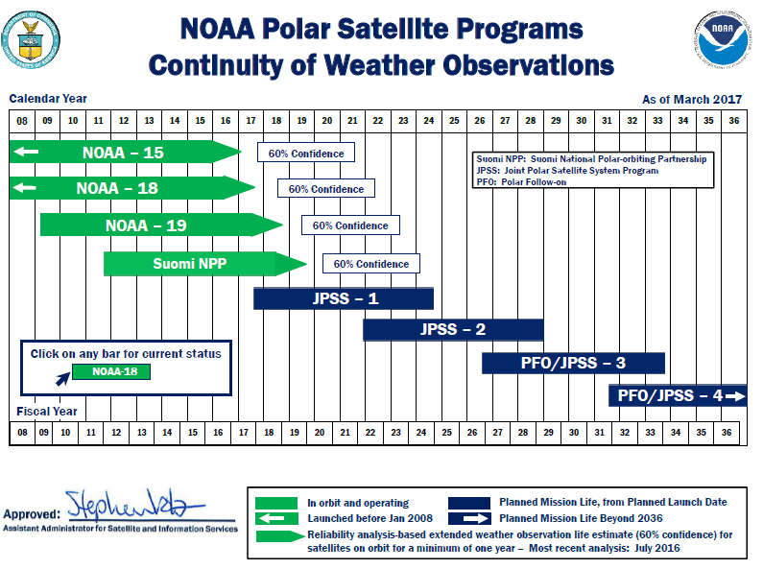
Upcoming Launches
Notes:
Messages:
We expect to launch 4 satellite missions between now and early 2017.
[transition to Jason-3]
Jason-3
Launching just a few days from now on January 17 out of Vandenberg Air Force Base, California
Continues legacy that began with Topex/Poseidon more than 20 years ago measuring sea surface height
Will help us continue to track global sea level rise, one of the key indicators of climate change
Partnership between NOAA, NASA, CNES, EUMETSAT
[transition to Cosmic 2A]
Cosmic 2A (6 satellites)
Part of a two orbit mission expected to launch in 2016 (Cosmic 2A) and 2019 (Cosmic 2B)
Collects radio occulation data to create a near real-time snapshot of atmospheric conditions, including temperature, pressure, density, and water vapor content
Together, 2A and 2B will provide 10 times the number of previous daily occultations and will utilize a much larger navigation satellite system including Russia’s GLONASS in addition to the U.S.’s GPS than is now available
Partnership among NOAA, NASA, the United States Air Force, and the National Space Organization of Taiwan
GOES-R
November 4 2016 launch scheduled
First of a series of GOES satellites (including S, T, and U)
The GOES-R series satellites will provide continuous imagery and atmospheric measurements of Earth’s Western Hemisphere, total lightning data, and space weather monitoring.
3x more channels, 4x better resolution, 5x faster scans than current GOES satellites
Partnership between NOAA and NASA
JPSS-1
2017 launch expected
Polar-orbiting satellite data is the most important type of observations for accurately predicting weather three to seven days in the future.
JPSS polar satellites circle the Earth from pole-to-pole and cross the equator about 14 times daily in the afternoon orbit—providing full global coverage twice a day
Partnership between NOAA and NASA
Part of agreement with EUMETSAT to share responsibility for the mid-morning and afternoon orbits

Slide 6
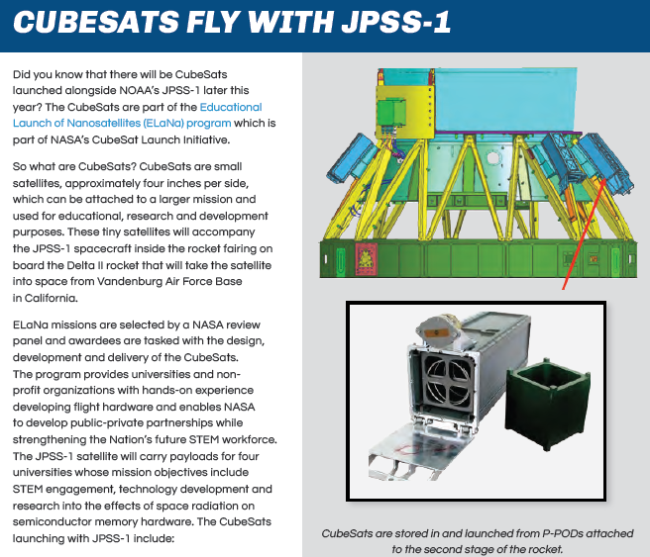
CubeSats to Fly with NOAA's JPSS-1
EagleSat—Embry-Riddle Aeronautical University, Prescott, Arizona
MakerSat—Northwest Nazarene University, Nampa, Idaho
MiRaTA—Massachusetts Institute of Technology, Cambridge, Massachusetts
RadFxSat—Vanderbilt University, Nashville, Tennessee

Slide 7
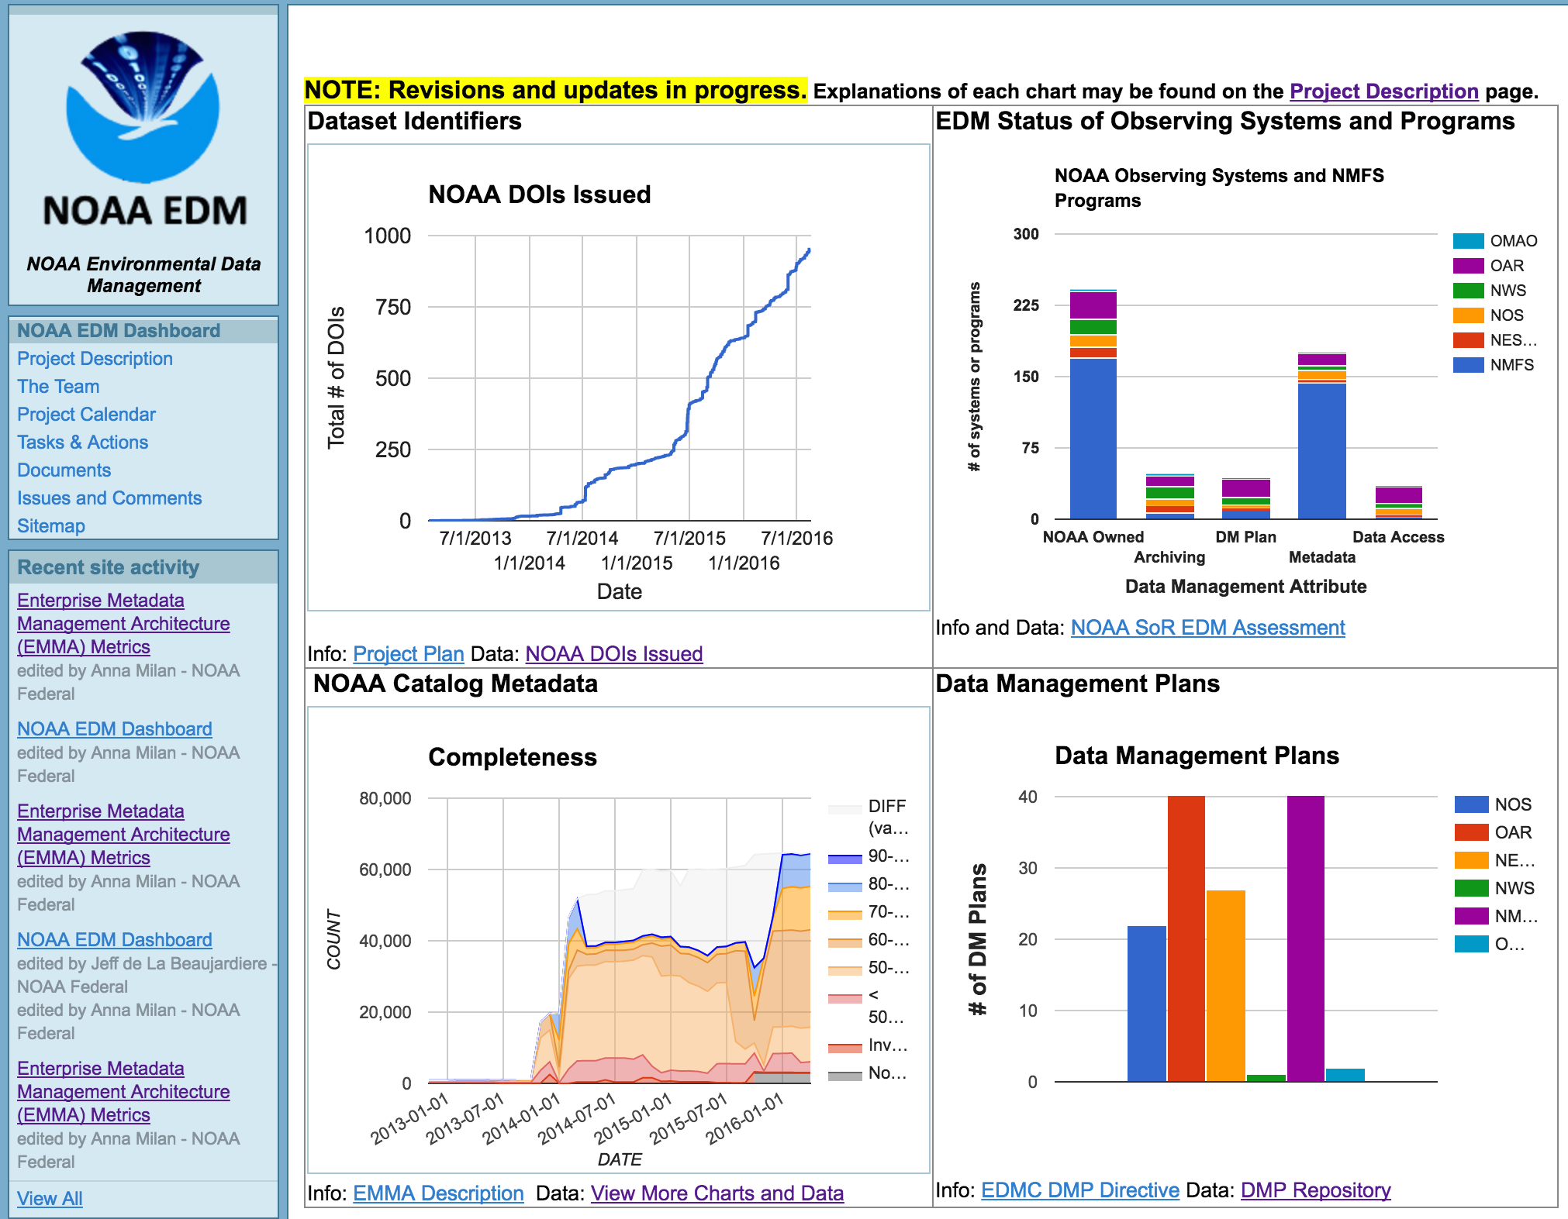
NOAA EDM Dashboard
In revision at https://sites.google.com/a/noaa.gov/edm-dashboard/

Slide 8
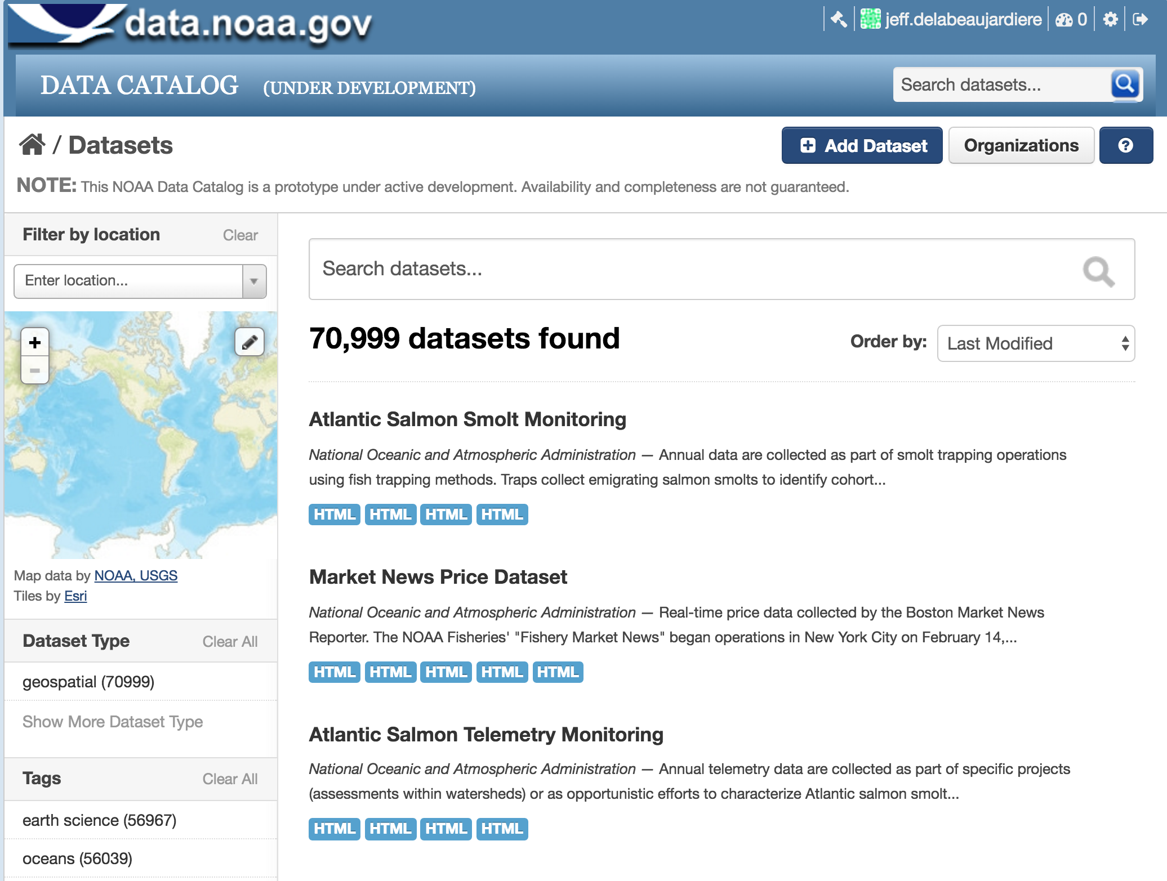
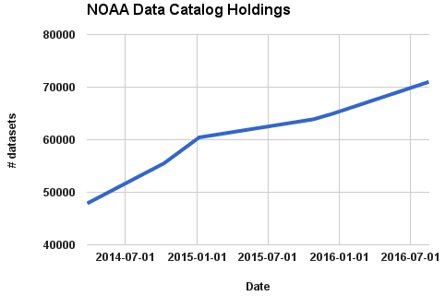
NOAA Data Catalog
Collaborators: Chris MacDermaid,
NOAA Catalog WG

Slide 9
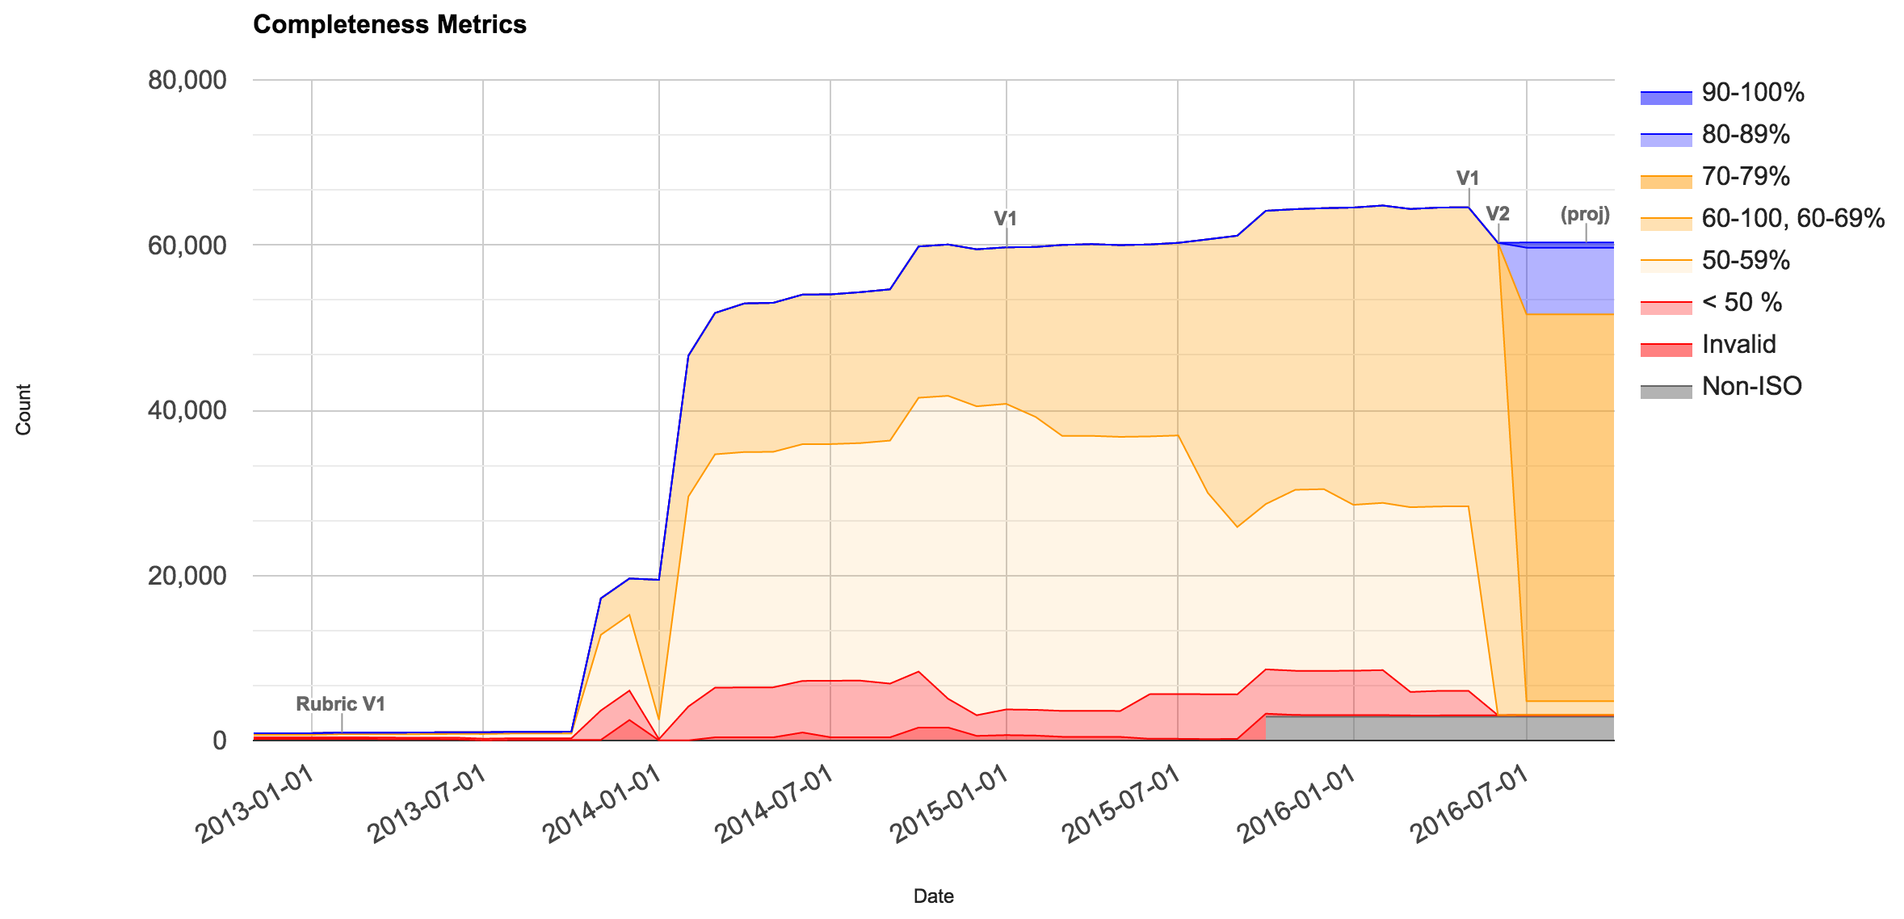
Metadata Metrics
Collaborators: Anna Milan, Martin Aubrey, Rich Fozzard, NOAA Metadata WG

Slide 10
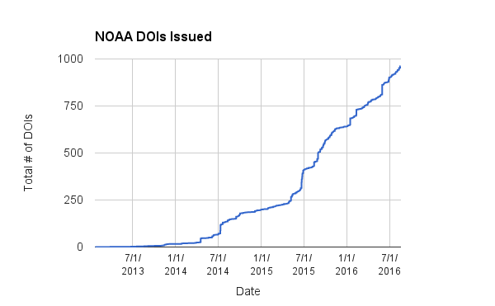
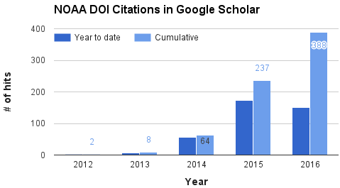
Dataset Identifiers & Citations
Collaborators: NOAA Data Citation WG

Slide 11
Big Earth Data Initiative (BEDI)
Collaborators:
Scott Hausmann (NCEI);
BEDI PIs
Inter-agency activity initiated by OMB/OSTP
Small NOAA internal grants to improve discovery, access, and usability of datasets
  14 projects funded 2015 ($700k)
  17 projects funded 2016 ($1.1M)
    started 2016 July 1
  2017 funding unknown

Slide 12





NOAA Big Data Project – R&D w/5 Cloud Vendors
User
User
User
User
User
User
use data
remotely
User
Cloud-hosted data analysis, visualization, integration
copy huge
datasets
Collaborators:
Ed Kearns (BDP Director),
Shane Glass (Proj. Mgmt.),
Advisory Board,
Cloud Vendors,
NOAA subject-matter experts
Agency Service Tier
NOAA Data

Slide 13
Big Earth Data Initiative (BEDI) 2017
Call for NOAA Proposals
Proposal Types
Dataset improvement: Proposals by producers or stewards of specific environmental dataset(s) to address deficiencies in the discoverability, accessibility, and usability of those specific datasets
Enterprise-wide improvement: Proposals to improve NOAA applications or shared services to support the discoverability, accessibility, and usability of broad classes of data
Cloud Computing applications: Proposals to support data, tools, or applications hosted in the Cloud, including either data already hosted as part of the NOAA Big Data Project (BDP - http://www.noaa.gov/big-data-project) or new datasets
Technical support: Proposals to provide technical guidance or development assistance to funded recipients of the types of proposals listed above.
Selection Factors
The proposal will improve datasets considered as particularly "high value" by OSTP or other stakeholders such as the NOAA Big Data Project
The proposal includes collaboration with NOAA National Centers for Environmental Information (NCEI).

Slide 14
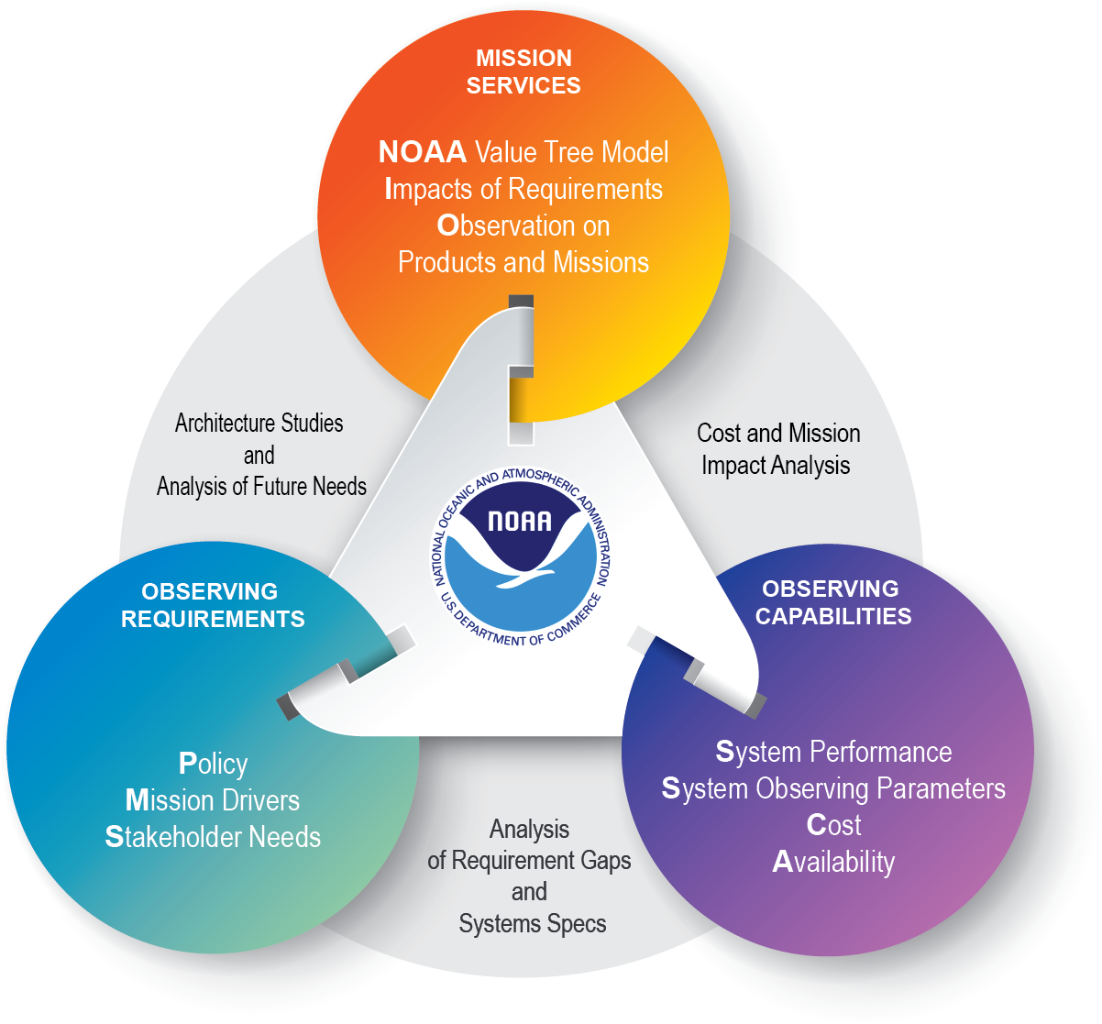
Managing NOAA's Observing System Architecture Portfolio
14

Slide 15

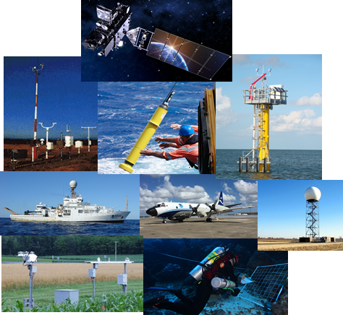
Intrinsic Value of Observations
Systems
Services
Stakeholders
Arctic Report Card
Drought Outlook
Fish Stock Assess-ments
Hypoxia Warning
Tornado Warning
Hurr.
Outlook
Societal
Benefits
Investments

Slide 16
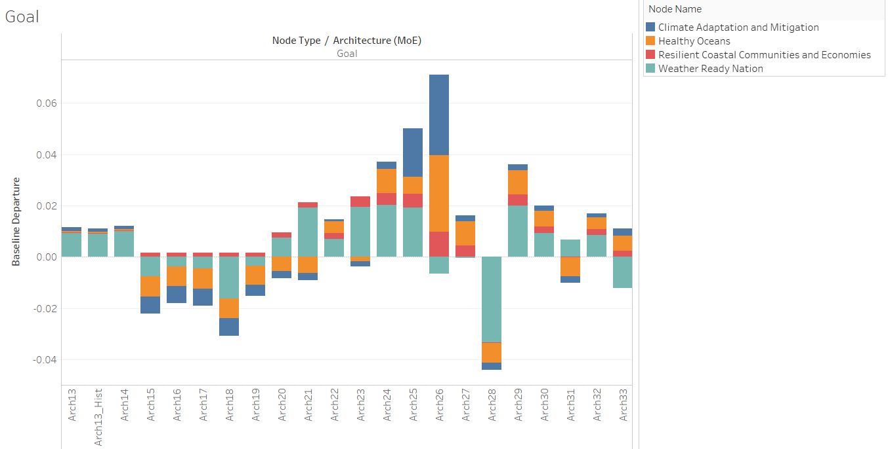
Impact of Potential Satellite Architectures on NOAA
Goals do not benefit equally from proposed architectures.
NOTIONAL
Measures of Effectiveness among Proposed Architecture

Slide 17



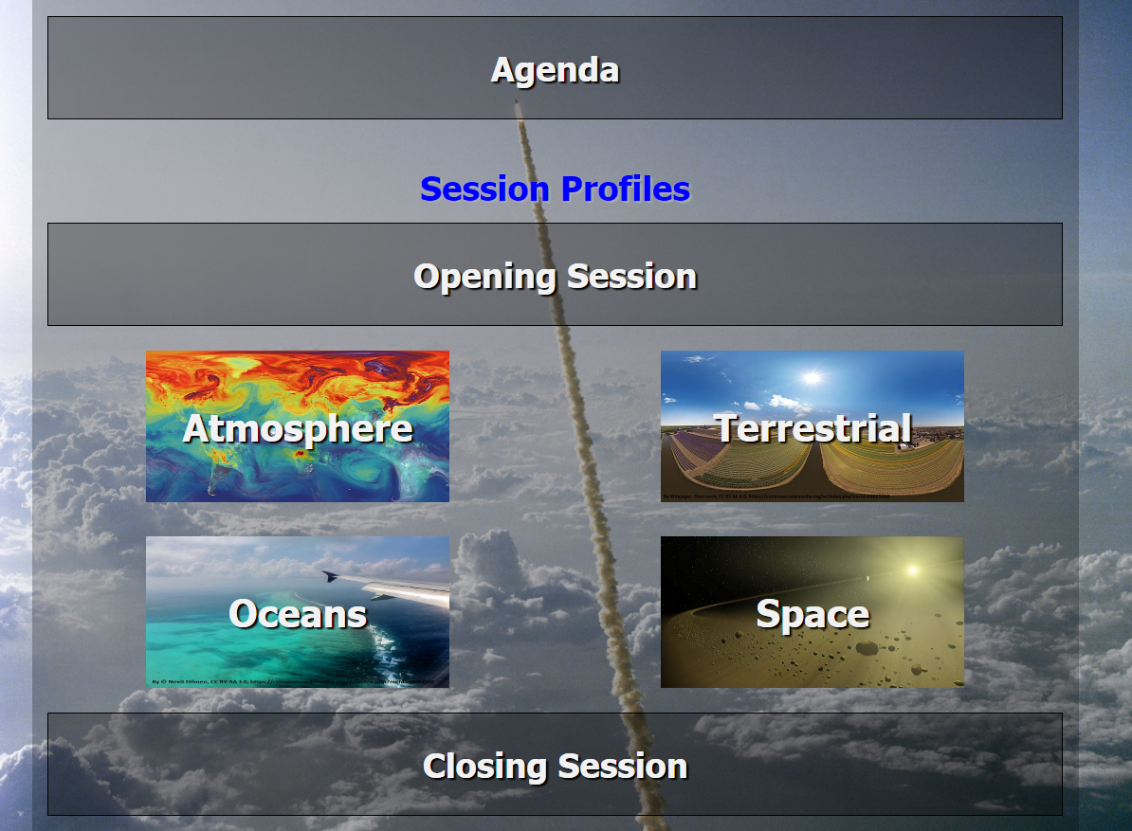
2017 NOAA Emerging Technologies Workshop for Observations
August 22-23, 2017
NOAA Center for Weather and Climate Prediction
College Park, MD
This workshop provided and will hopefully continue to provide a conduit for the connectivity of emerging technologies’ research and development activities across NOAA in order to create an integrated, impactful, and adaptable observing system portfolio.

Slide 18
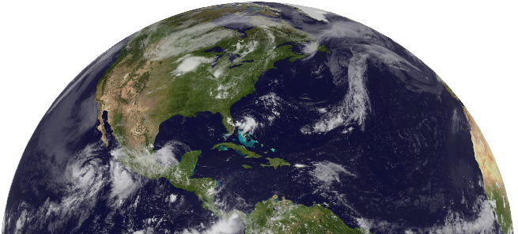
Thank you!

