Slide 1
Data Stewardship Interest Group WGISS-43 Meeting
Heritage Media Transcription Chains
NASA, Annapolis, MD, USA 03–06 April, 2017
Mirko Albani, European Space Agency

Slide 2
Agenda
Background
Transcription Chain Metadata definition
Heritage Media Transcription Chains in ESA
Status of transcription chains
Related Mission
Amount of data still on Heritage Media

Slide 3
Background
Issue: Recovery of unique data still on heritage media via dedicated transcriptions or to fill identified gaps in master datasets is a recurrent need in many space agencies.
Need:
Maintain heritage media transcription chains up and running
Proposed Activity:
Coordination of set-up and maintenance of heritage media transcription chains at different organization for possible mutual support.
Next Steps:
Definition of “Transcription Chains” metadata;
“Transcription Chains” information survey in CEOS agencies and creation of a common inventory;
Definition of further coordination and cooperation activities (e.g. collection of needs and potential activities).

Slide 4
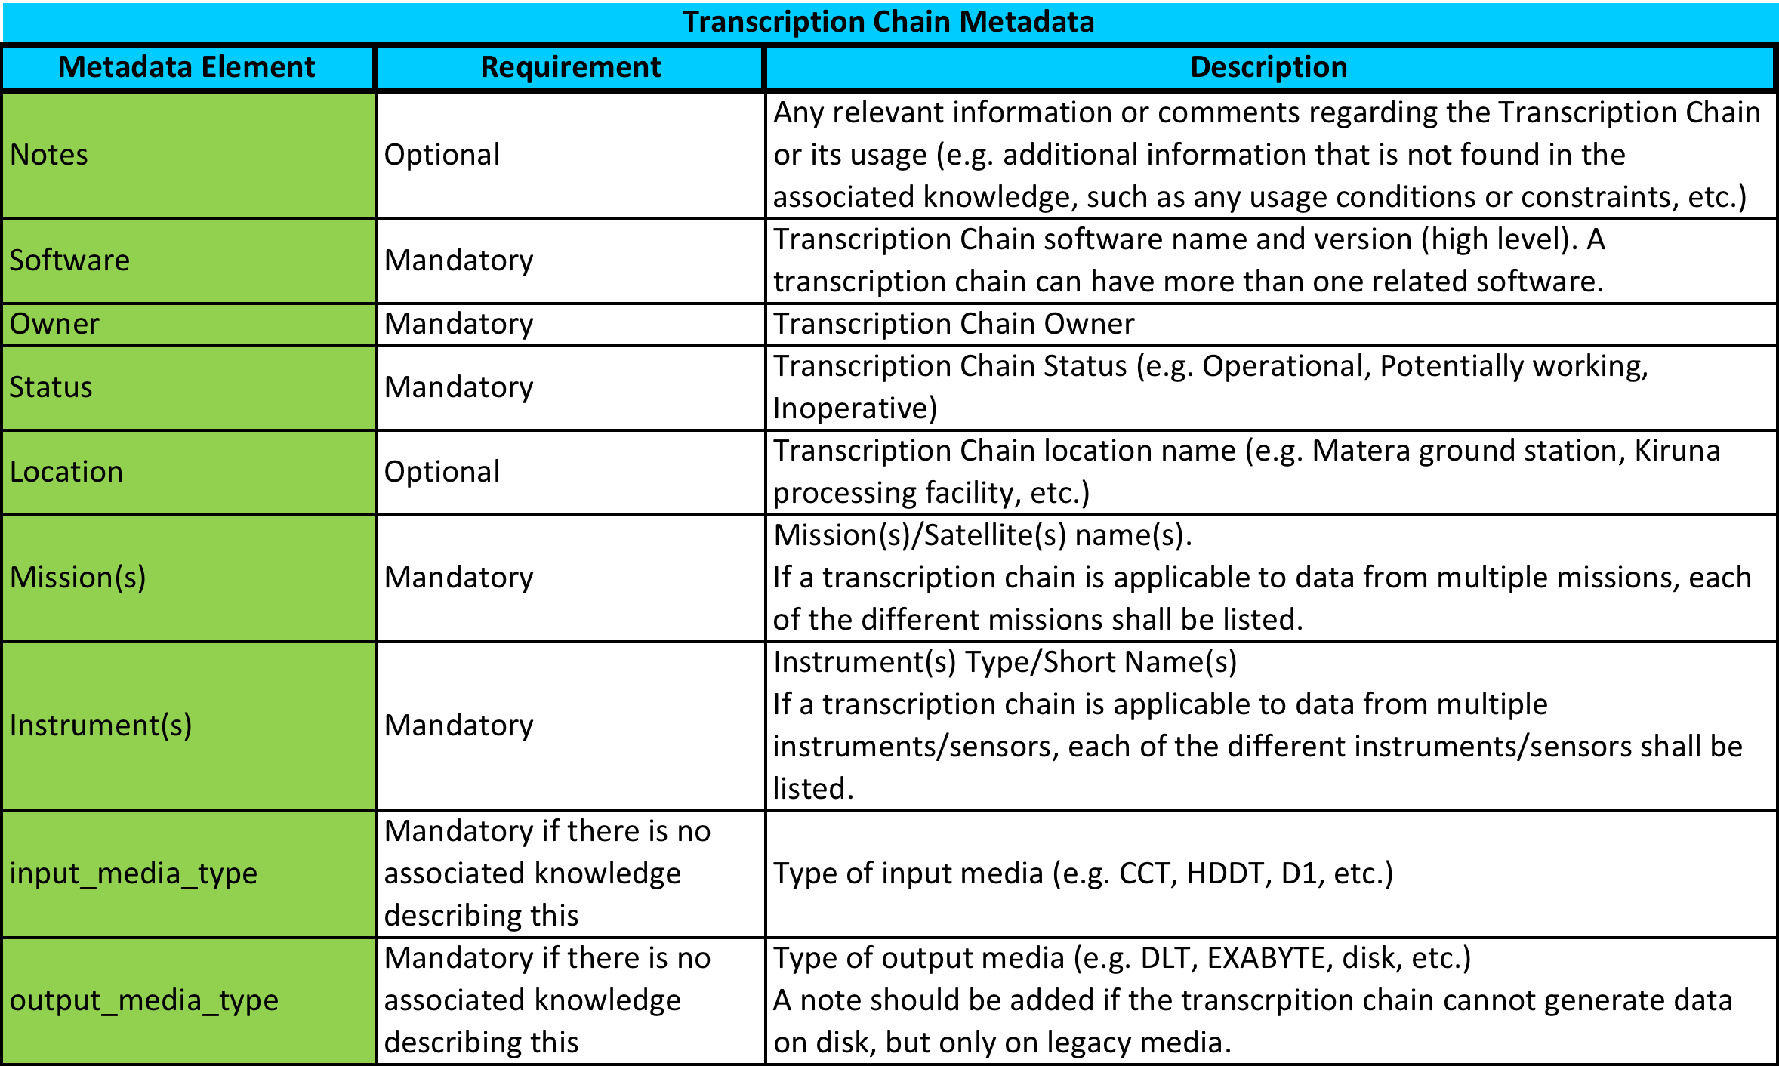
Transcription Chain Metadata

Slide 5
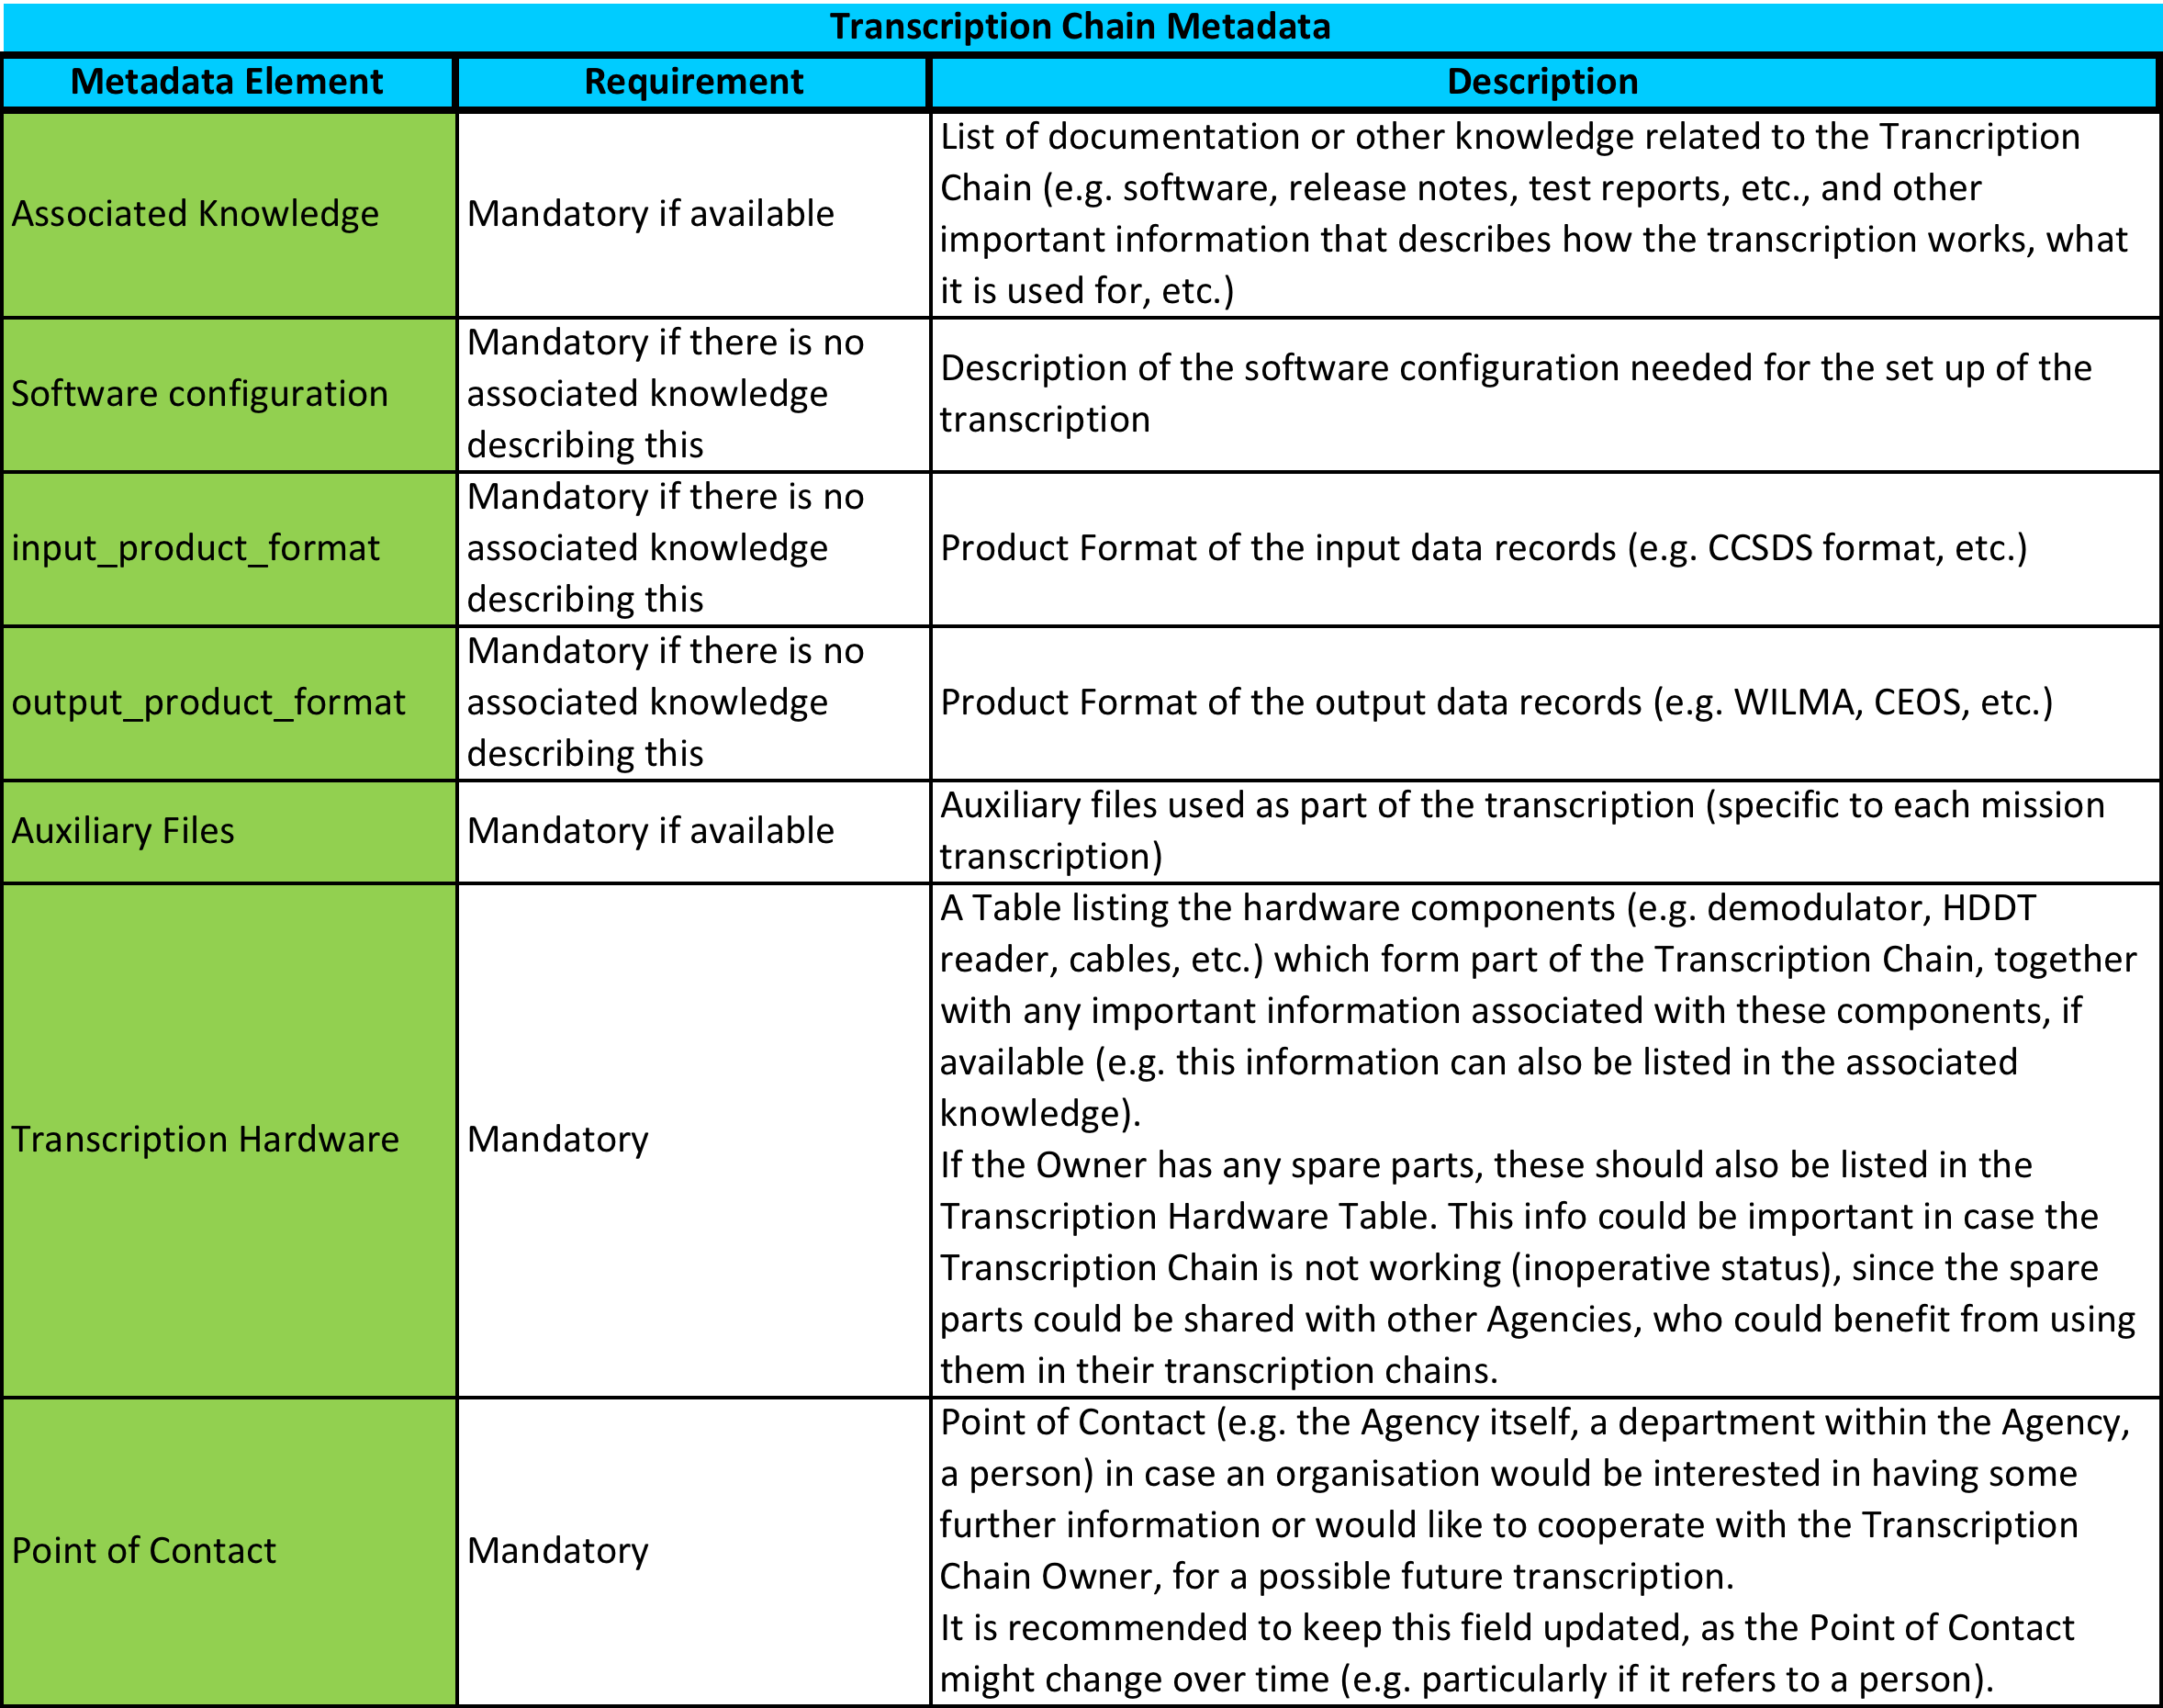
Transcription Chain Metadata

Slide 6
ESA Transcription chains

Slide 7
Operative Transcription Chains (1)
Optical Disks (LM Optical Disks & ATG Optical Disks)
Availability & Location: reader available at ESRIN
Status: transcription chain being set-up
Missions: NOAA (AVHRR), Nimbus-7 (CZCS)
# of media available at ESA: several thousands
Additional info: The reader available at ESRIN was used in Tromso to read AVHRR media with SeaShark processor.
HDDT Magnetic Tapes chain
Availability & Location: multiple transcription chains available at former ESA facilities: Matera (e-GEOS), Maspalomas (INTA), Kiruna (SSC)
Status: operative
Missions: Landsat, ERS-1/2, MOS-1/1b, SPOT
# of media: several thousands
Spare HDDRs at ESRIN.
Notes:
These are Heritage Media Transcription Chains that already available and operative at ESA facilities or to be implemented in ESRIN

Slide 8
Operative Transcription Chains (2)
D1 (SONY DTF-1)
Availability & Location: ERS/ENVISAT chain being set-up at ESRIN; Landsat/ALOS chain available in Matera.
Status: operative or being set-up
Missions: Landsat, ALOS, ERS-1/2, ENVISAT
# of media: several thousands
8mm Backup Format (Exabyte readers)
Availability & Location: transcription chains available at former ESA facilities: Matera (e-GEOS), Maspalomas (INTA); additional chain will be set-up at ESRIN
Status: operative or being set-up
Missions: Multi-Mission (Landsat TM/MSS, SPOT 1-2, JERS-1, MOS-1/1b, ERS-1/2)
# of media: several thousands
Additional info: Part of the CSDIS Transcription chain (1988-present).
Notes:
These are Heritage Media Transcription Chains that already available and operative at ESA facilities or to be implemented in ESRIN

Slide 9
Operative Transcription Chains (3)
DLT (Type I - Type IV)
Availability & Location: transcription chains available at former ESA facilities; several readers available at ESRIN, operative chain will be implemented.
Status: operative or being set-up.
Missions: Multi-Mission (Landsat TM/MSS, JERS-1, MOS1/1b, ERS-1/2, ENVISAT, NOAA AVHRR)
# of media: several thousands
Additional info: Part of the CSDIS Transcription (1988-present).
LTO-2
Availability & Location: readers available at ESRIN, operative chain will be set-up.
Status: being set-up
Missions: Multi-Mission (Landsat TM/MSS, JERS-1, MOS1/1b, ERS-1/2, ENVISAT, NOAA AVHRR)
# of media: several thousands
Additional info: Extensively used for ENVISAT. A lot data from other missions were transcribed on these tapes from historical media.
Notes:
These are Heritage Media Transcription Chains that already available and operative at ESA facilities or to be implemented in ESRIN

Slide 10
Operative Transcription Chains (4)
StorageTek 9940
Availability & Location: available at ESRIN
Status: operative
Missions: any ESA mission & TPM ESA managed mission
# of media: several thousands
Additional info: Used in the Multi-Mission Facility Infrastructure (MMFI) in ESRIN and any other ESA PAC in the AMASS driven Robotic Archive. These were replaced by the more recent T10000B tapes.
StorageTek T10000
Availability & Location: available at ESRIN
Status: operative
Missions: any ESA mission & TPM ESA managed mission
# of media: > 10,000
Additional info: T10000B originally used in the SAMFS driven MMFI. Following this, the latest T10000D tapes are currently used in the ESRIN Cold Back-up Archive.
Notes:
These are Heritage Media Transcription Chains that already available and operative at ESA facilities or to be implemented in ESRIN

Slide 11
Other Transcription Chains (1)
Computer Compatible Tapes
Availability & Location: reader available at ESRIN
Status: not known if still working. No plan to set-up a chain.
Missions: HCMM (HCMR)
# of media: <100
Digital Cassette Recording System improved (DCRSi)
Availability & Location: reader available at ESRIN
Status: potentially working. No plan to set-up a chain.
Missions: Multi-Mission (SPOT 1-2, JERS-1, MOS-1/1b, ERS-1/2)
# of media: unknown (no media at ESA facilities)
Additional info: Used >20 years ago and never used since then
IBM Magstar (NTP media)
Availability & Location: reader available at Kiruna
Status: operative. Chain will be transferred to ESRIN.
Missions: ENVISAT (both LR & HR)
# of media: >30,000 media (ESA will dispose these media)
Additional info: Originally used in the ENVISAT ground segment, for long-term archiving
Notes:
These are other Transcription Chains available at ESA facilities, however, these are not operative.

Slide 12
Other Transcription Chains (2)
ICI 1012 optical data storage tape (aka CREO)
Availability & Location: reader available at ESRIN
Status: unknown (possibly working)
Missions: Landsat (MSS, TM)
# of media: unknown (no media at ESA facilities)
Additional info: Was briefly used for Landsat and was dismissed due to reliability concerns. Will be kept in the ESRIN Permanent Exhibition.
Pegasus Magnetic Tape
Availability & Location: reader not available
Status: unknown
Missions: Landsat (MSS, TM)
# of media: several hundreds
Additional info: Used as part of a USGS campaign over Kenya. Media available at Fucino. Currently assessing availability of a reader at other ESA facilities.
Notes:
These are other Transcription Chains available at ESA facilities, however, these are not operative.

Slide 13
Next Steps
“Transcription Chains” information survey in CEOS agencies based on defined metadata
→ Circulation to WGISS and feedback by end June
Creation of a common inventory
→ report back to WGISS#44.
Definition of further coordination and cooperation activities (e.g. collection of needs).
→ WGISS#44

