Slide 1
INPE’s archiving of EO data
Lubia Vinhas
Josiane Mafra
General-Coordination on Earth Observation, INPE
CEOS/WGISS-43 Meeting, April 3-7 2017, Annapolis MD, USA

Slide 2
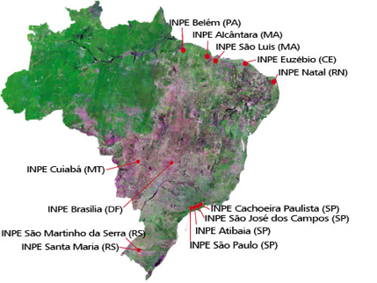
Timeline
1973: first reception antena installed in Cuiabá-MT
3rd country in the world to receive LANDSAT-1 data
LANDSAT-1, 2, 3, 5, SPOT and and CBERS-1 data tapes were sent INPE, SP for processing
Images could be ordered two weeks after the acquisition
2003: with the launching of CBERS-2, INPE inaugurated the Remote Sensing Data Center
Data received in Cuiabá transfered to INPE, in São Paulo, via internet
Big effort in cataloguing and efficient data distribution to end-users
Earth Observation
General-Coordination
OBT
Image Processing
Division
Remote Sensing
Division
EO Data Center
CDSR

Slide 3
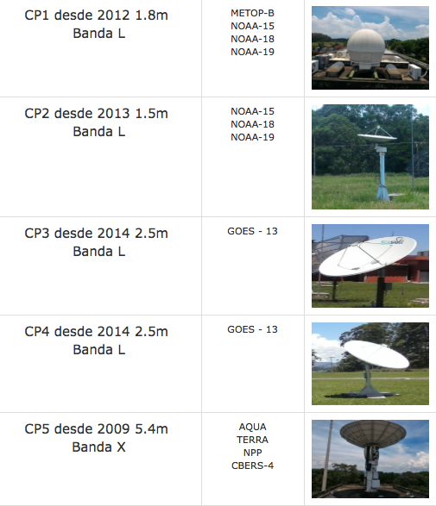
Reception
Cachoeira Paulista, SP

Slide 4
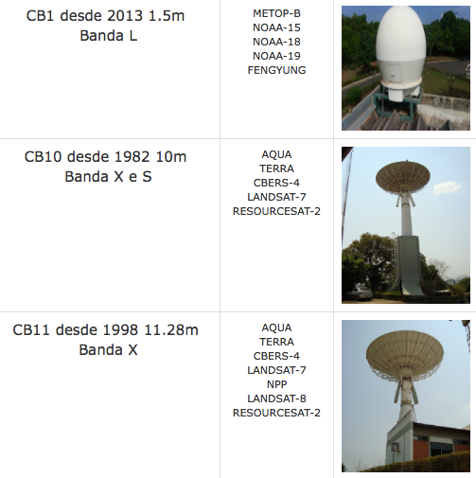
Reception
Cuiabá, MT

Slide 5
Coverage Band X

Slide 6
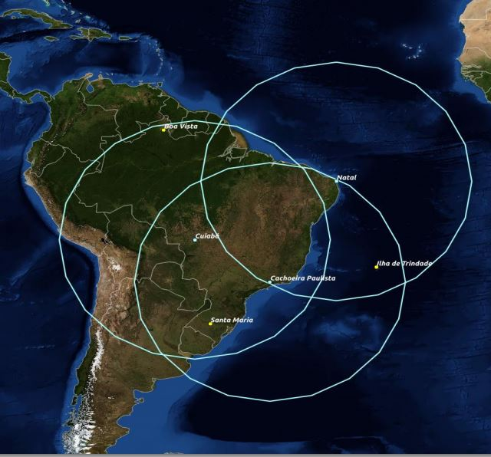
Coverage Band L

Slide 7
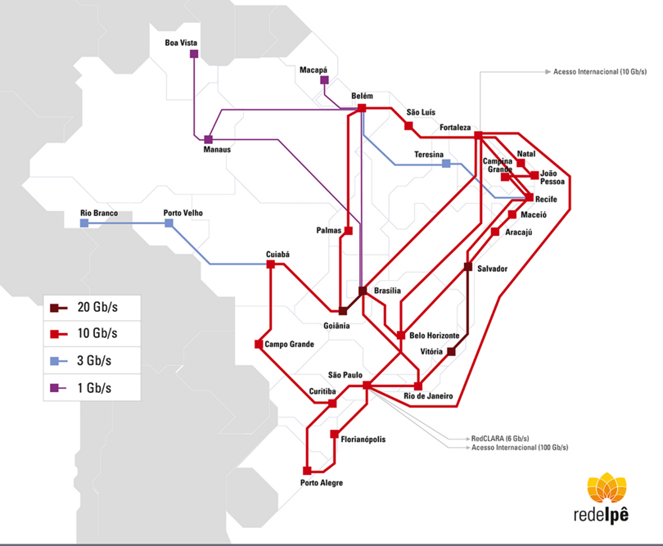
Transmission network

Slide 8
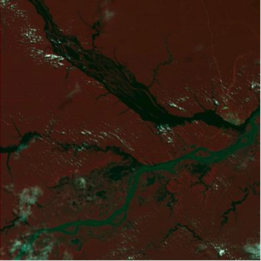
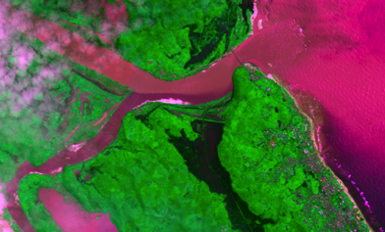
Timeline
2004: opening the archives, no costs or use restrictions, of CBERS-2, LANDSAT-1, LANDSAT-2 and LANDSAT-3
2007: opening the archives of LANDSAT-5 e LANDSAT-7
CDSR in 2017: CBERS-4, LANDSAT-8, ResourceSat-2, ResourceSat-1, NOAA-15, NOAA-18, NOAA-19, Feng Yun-3A, Feng Yun-3B, Feng Yun-3C, AQUA, TERRA, S-NPP, GOES-13, MetOp-B, UK-DMC 2, DEIMOS, Pleiades, SPOT, RapidEye*
L1/MSS, 1973-06-19, Manaus AM, Brazil
* Restricted access
CBERS-4/MUX+PAN10, 2017-03-09, Madagascar

Slide 9
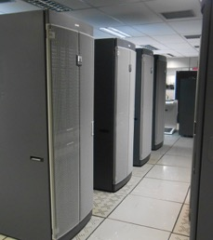
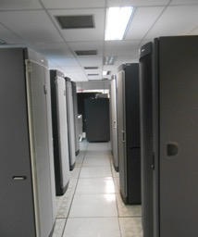
Storage System
Tier online: NetApp FAS 3240, Tier Nearline: Sun StorageTek L700, Tier offline: Tapes LTO-V
In 2012 moved to one tier, based on high performance SATA discs, with automatic back-up and recovery
Total of 1,5 Pb stored
Currently we work with an increase of 20 Tb/month, in 2018 we expect it to be 30 Tb/month

Slide 10
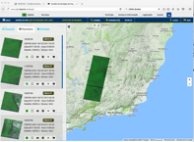
Processing Flow – Example CBERS-4
www.dgi.inpe.br/catalogo
Cataloguing
Dissemination
Reception
CWIC
OpenSearch
…
Quality control
MS³ System
Production: L2,L3 or L4

Slide 11
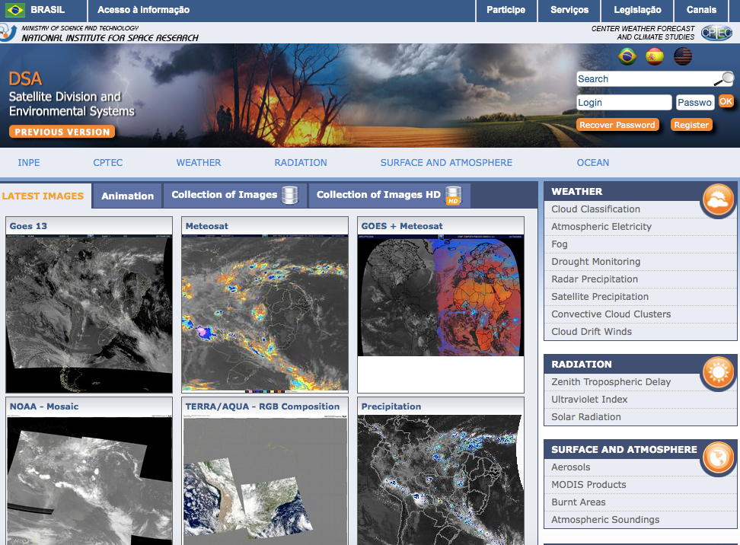
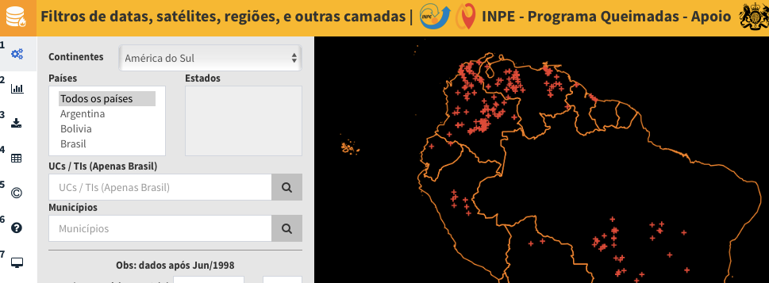
Processing Flow – others
satelite.cptec.inpe.br
Cataloguing
Dissemination
Reception
Quality control
www.dgi.inpe.br/catalogo
Processing
Production: L*
queimadas.dgi.inpe.br

Slide 12
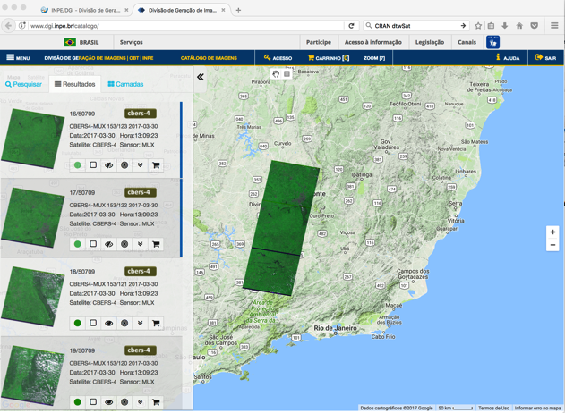
Distribution
Working on the integration of catalogues
CWIC Connector to access via CSW
Experimental OpenSearch interface
Experimental WMS
Scenes Distribution (2017-03-30)
Sensor | # scenes | Sensor | # scenes
CBERS-2 | 508685 | Pleiades | 753
CBERS-2B | 715955 | Spot-6 | 7
CBERS-4 | 38183 | Spot-7 | 98
Landsat-1 | 19572 | RapidEye-1 | 265
Landsat-2 | 27228 | RapidEye-2 | 200
Landsat-3 | 12845 | RapidEye-3 | 238
Landsat-5 | 1272090 | RapidEye-4 | 282
Landsat-7 | 128284 | RapidEye-5 | 255
Landsat-8 | 91582 | Terra | 9229
ResorceSat-1 | 189.544 | AQUA | 1405
ResorceSat-2 | 67651 | S-NPP | 1.405
UK-DMC | 1.719
62% orders delivered in less than 4 minutes
48% orders delivered in less than 1 minute

Slide 13
Long term preservation
LANDSAT 5 dataset repatriated to USGS (73 Tb)
LANDSAT 7 dataset repatriated to USGS (45 Tb)
Disaster recovery: complete a mirror site in Cuiabá, MT
No cloud computing initiatives

Slide 14
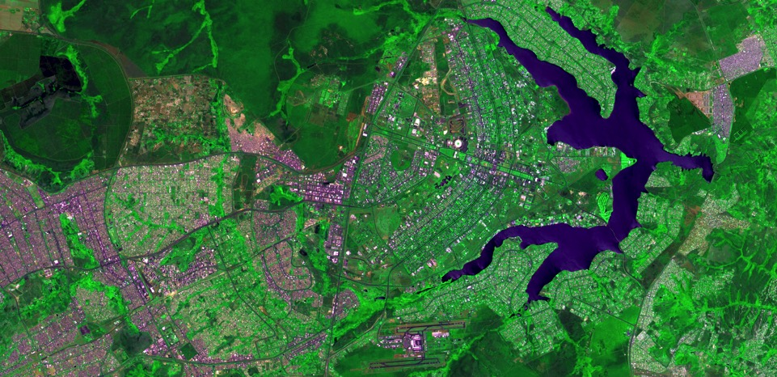
Thank you. Questions? lubia.vinhas@inpe.br josiane.mafra@inpe.br
CBERS-4 PAN10, 2016-09-16, Brasilia, Brazil

