Slide 1
Data Stewardship Interest Group
WGISS-43 Meeting
ESA Long Term Archive:
Infrastructure & Processes
NASA, Annapolis, MD, USA 03–06 April, 2017
Mirko Albani, European Space Agency

Slide 2
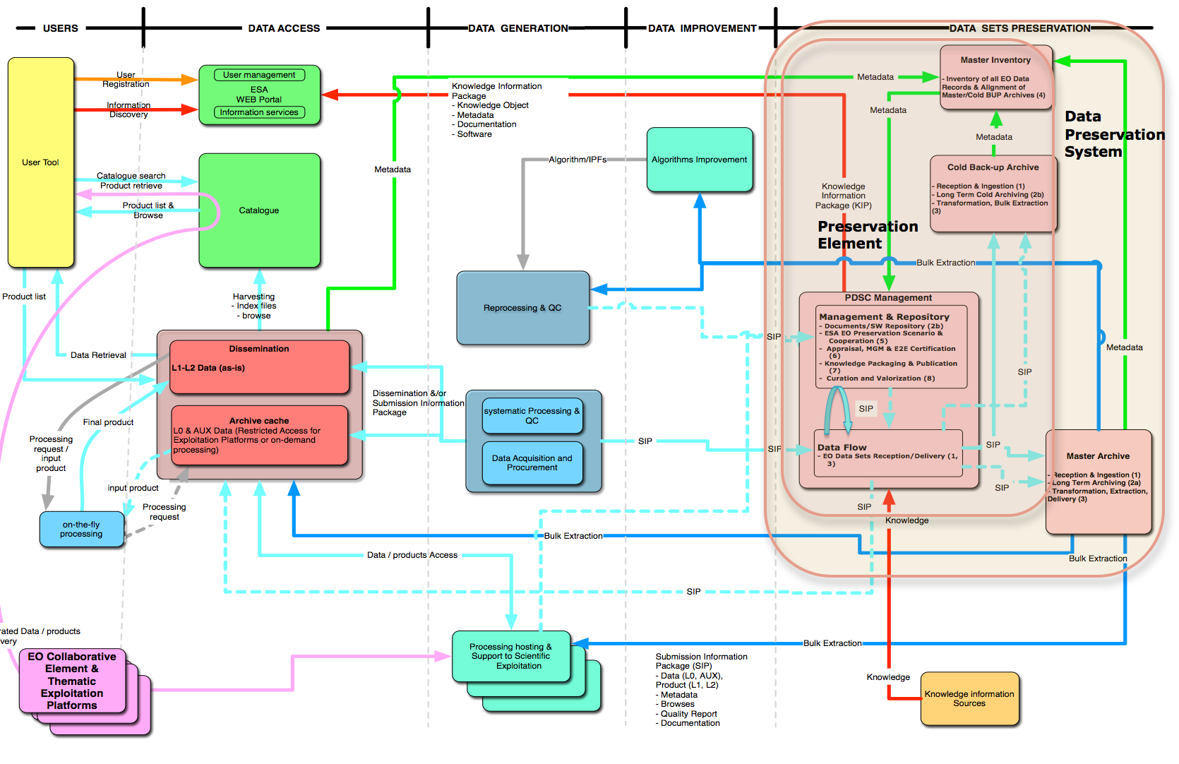
ESA Data Preservation System Operational Concept
Cold Backup Archive
Data Archive Service
Archival, preservation and bulk extraction of non Copernicus data
Archiving function decoupled from data production/dissemination
Data extracted as it was ingested – no transformation / conversion

Slide 3
Master Archive (DAS)

Slide 4
Data Archive Service (DAS)
Implements the ESA Master Archive through a dedicated service awarded to industry through an open ITT:
Contract Kicked-off in August 2016, ramp-up phase on-going
Two copies of the data held > 200 Km apart
Connection to the ESA WAN
Checks of the data at all stages from ingestion to delivery
Scalability required for growth of contents
Management of the data information (MetaData) in fully redundant Databases

Slide 5

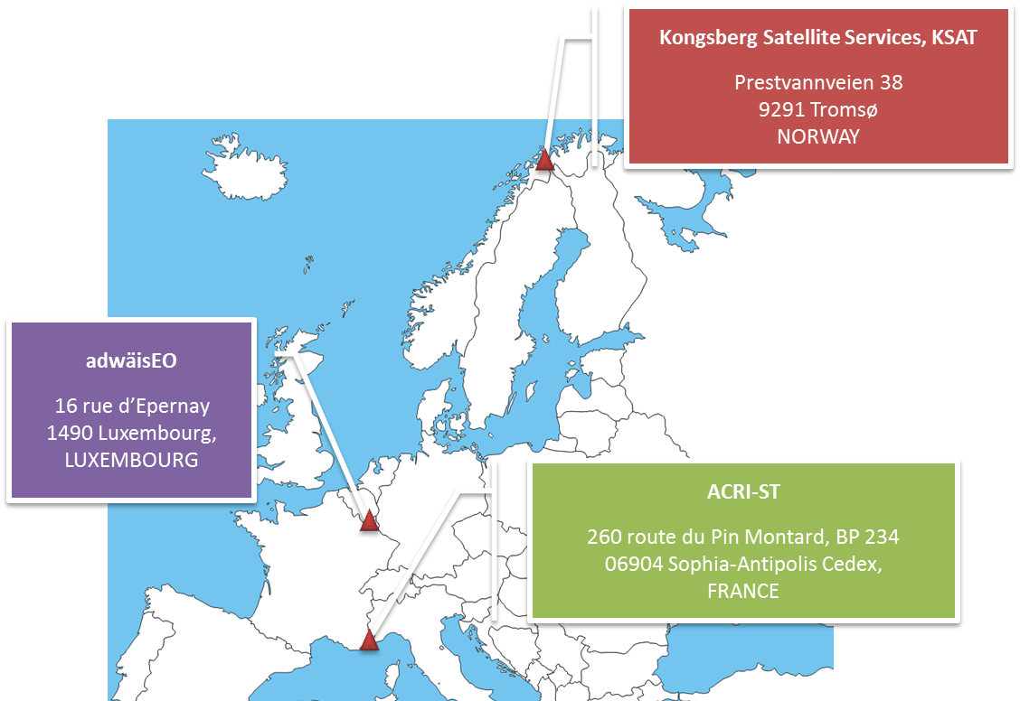


DAS Consortium
The industrial consortium is made of ACRI-ST (FR), adwäisEO (LU) and KSAT (NO), with the following distribution of roles:
ACRI-ST: Data Archiving (and delivery) Service provider – Prime contractor
adwäisEO: data archiving (and delivery) operation provider with its leading edge IT and connected secured infrastructure in Luxembourg
KSAT: data knowledge provider and overall ingestion validation

Slide 6
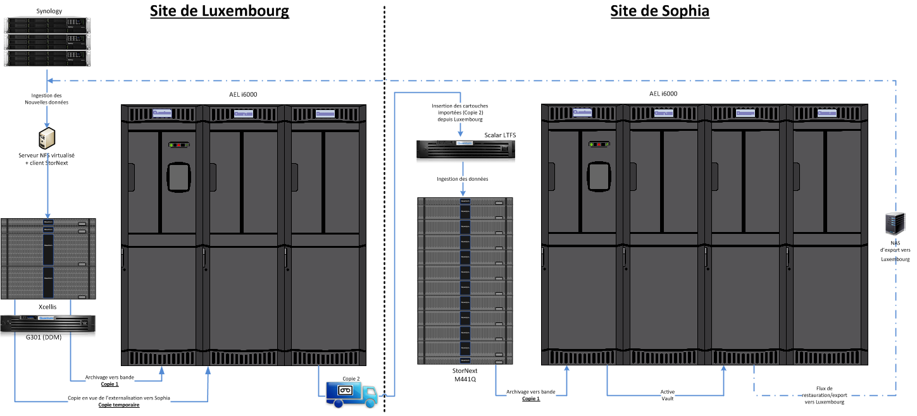
DAS Infrastructure
Central Archive
Backup Archive
Data ingestion
Data evolution
Data alignment
DMS
Daily tape transfer to Backup Archive
Data retrieval
Notes:
METTERE LE FRECCE COME DA PDF
Metterci

Slide 7
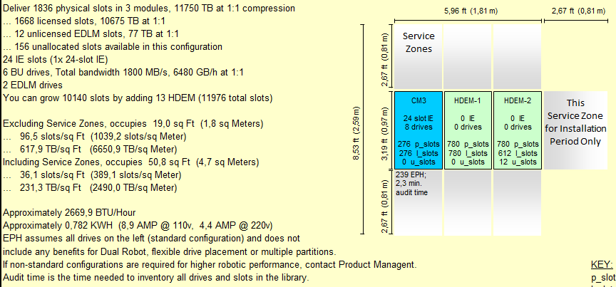
DAS Tape Library
Quantum Tape Library – i6000 – native + LTFS

Slide 8
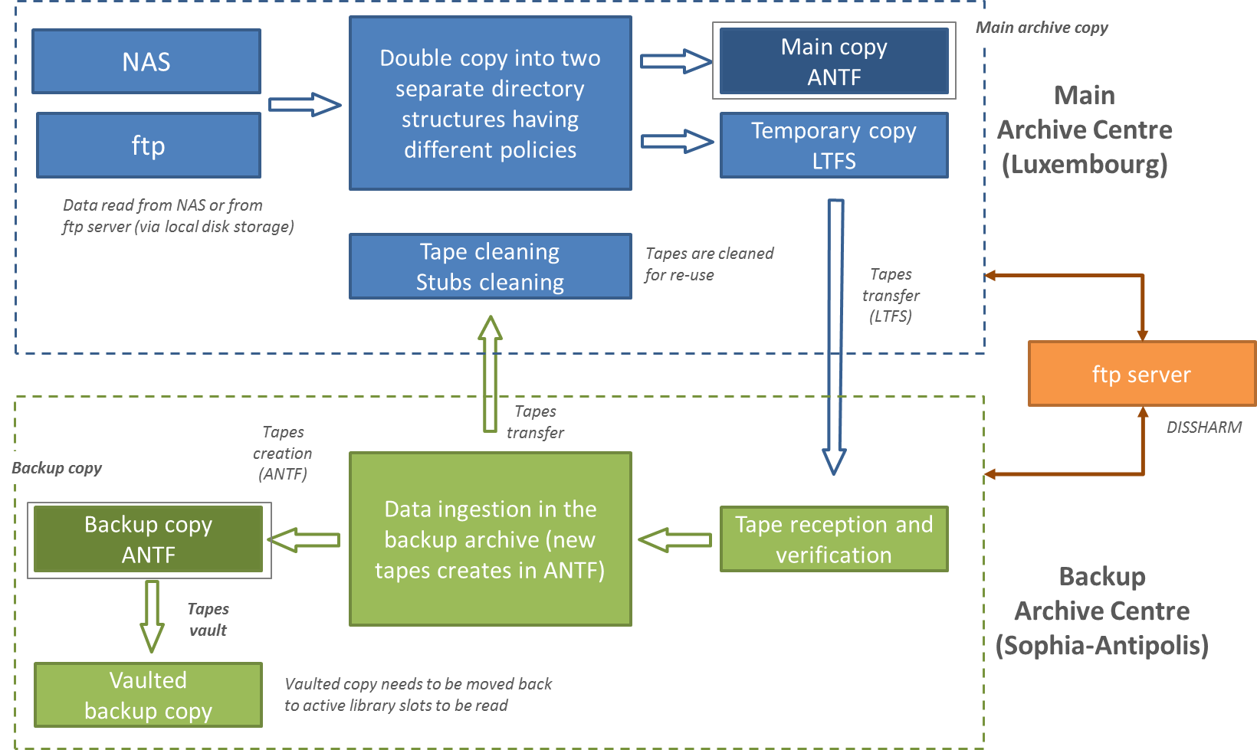
DAS Data flow

Slide 9
DAS Data flow (2)
Centre | Operation | Verification
Main | Ingestion | The list of files is compared with any delivered inventory (delivery listings)
Main | Ingestion | The structure and the content (repository, datasets, products, files) is compared with the delivery spreadsheet delivered by ESA
Main | Ingestion | The total number of products is compared to the delivery information.
Main | Ingestion | The actual file MD5 checksum is compared to the value extracted from the product metadata (manifest file or attached checksum file).
Main | Ingestion | If data is included in a container (zip, tgz, …), the integrity of the container is verified (i.e. container content can be accessed)
Main | Ingestion | After the generation of the zip container, the files are extracted in a scratch directory and checked with respect to the content of the checksum.txt file. This operation is logged for future use by the global verification of the dataset ingestion.
Main | Ingestion | MD5 hash code computed by Quantum from the products are queried from the StorNext database and compared to the DMPC MD5 hash code before products are set in “TAPE” status.
Both | Ingestion | LTO-7 drives apply an automatic verify-after-write technology to immediately check the data as it is being written
Both | Backend | Both Quantum libraries include EDLM. The Extended Data Life Management feature ensures that tapes are trouble-free (based on tape scan and tape memory analysis). Tapes scan and analysis is performed following predefined policies (max. 4 tapes per day i.e. 7% of a 10 PBytes archive per month using 2 LTO7 EDLM drives). Suspect tapes are automatically copied to new tapes.
Main | Validation | After the ingestion process where data has been verified at product level, a global ingestion verification is performed using the DPMC database information, the initial media inventory and the ingestion process log files.
Backup | Ingestion | The inventory of the tapes sent to the backup centre is retrieved and used for comparison with the copy process performed to copy the products from LTFS tapes to ANTF tapes via disk cache.
Backup | Ingestion | The zip container integrity is used to verify that the transferred products (LTFS à ANTF) have not been corrupted.
Main | Retrieval | The zip container integrity is used to verify that the transferred products (ANTF in backup centre à NAS/ftp à ANTF in main centre) have not been corrupted.
Main | Distribution | The MD5 checksum file (checksum.txt) available in each product container is used to verify that the individual products files have not been corrupted.
Notes:
Transition process between ingestion in Sophia and ingestion in Luxembourg
Before transition
✓Initial ingestion performed in Sophia during phase-in. Two copies in ANTF.
✓One copy is sent to Luxembourg to be ingested in the main archive
Transition
✓DAS infrastructure is assumed deployed Luxembourg and validated (phase-in)
✓Policies are created to get a single copy on tape of the two directory structures.
✓Existing tapes are ingested in the system as the main archive tapes via StorNext commands
✓Sophia storage policy is updated (single copy) and existing tapes become backup tapes and they are moved to the vault module
✓Note: nominal ingestion can start in Luxembourg in parallel of these activities.

Slide 10
Data ingestion – historical data
“Historical data” = all data except live data
Archive contents updated at KO: ~8 PB of historical data
Population during 1 year based on 200 TB max weekly throughput
Priorities set by ESA according to technical constraints
Progress visible on Service web-site
Overall Data Delivery and Ingestion Plan
  Done for phase-in
  Under preparation for full set of historical data

Slide 11
Data ingestion - live missions
Similar to a repeated series of bulk ingestions
1-week frequency ingestion of collected data
Same protocol / interface for all live missions to avoid cost increases and errors
Interface based on the Preservation Element Front End
Cryosat-2 and SPOT already operationally sending data
Additional missions will follow

Slide 12
Live missions data flow
Data flow between live missions and Data Preservation System via a common Front-end
Live missions
DAS
Ingestion report
Cryosat2
Preservation Element Front-End
DAS
dropbox
SMOS
Cold Backup Archive
….
Ingestion report
Notes:
DA TOGLIERE

Slide 13
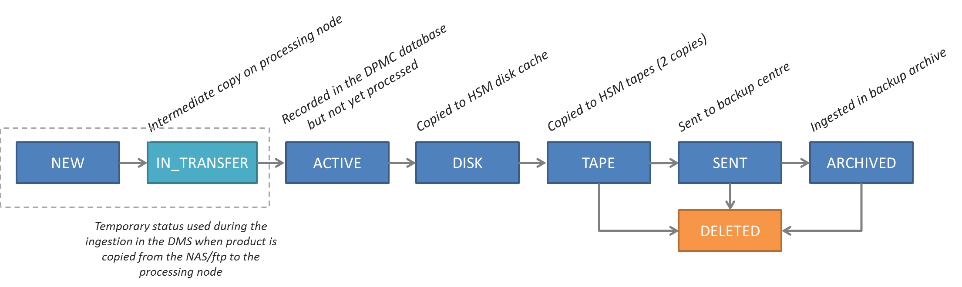
Data Management and Reporting
Data Management System of DAS Service
  Based on DPMC = in-house tool of ACRI
  Pre-defined reports to be based on Specs of Stakeholders
  Pre-defined reports include
    formatted reports for confirmation of ingestion to live missions
  R/O access for ESA
Service Web Site
Feedback to the overall Data Information System through formatted reports
Notes:
Fare capire bene che qui si parla del database

Slide 14
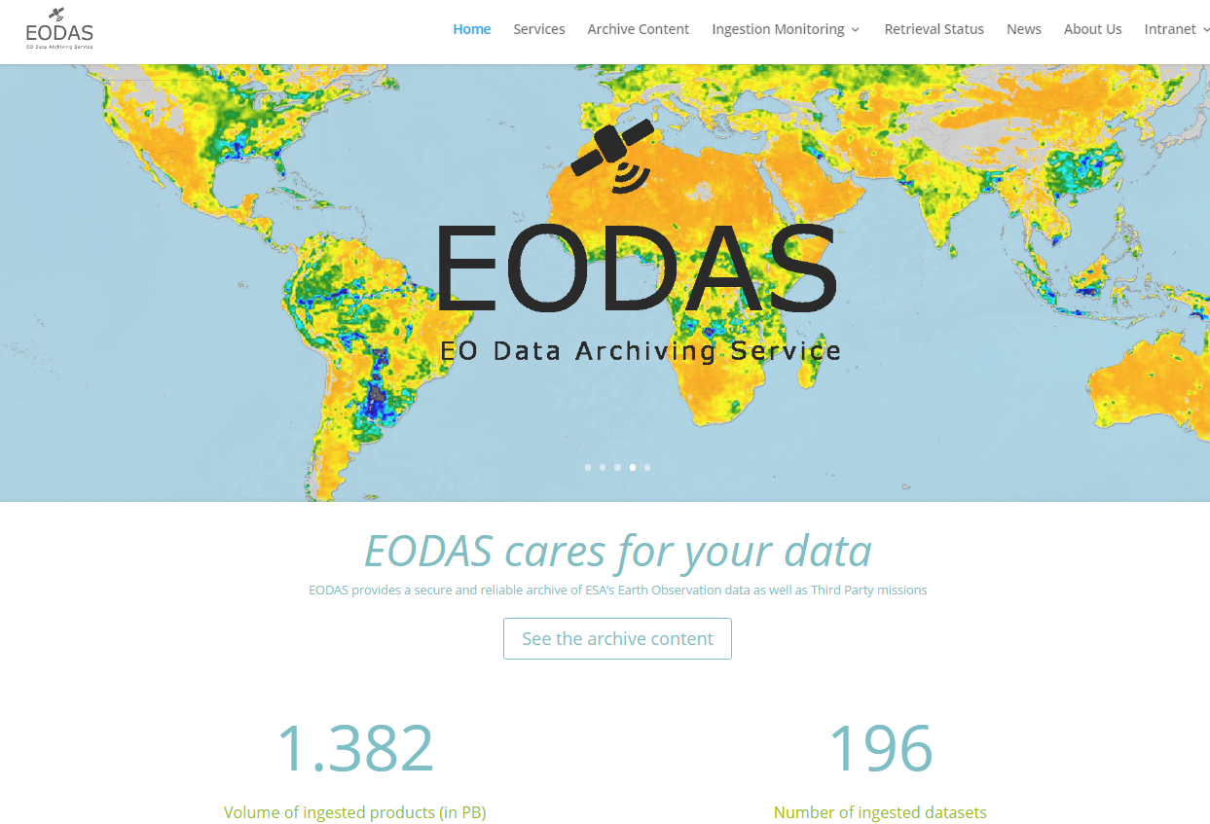
DAS Web Portal
http://www.eodas.info

Slide 15
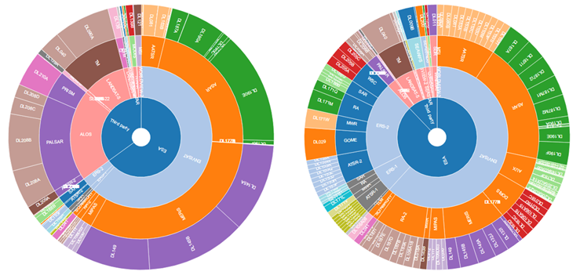
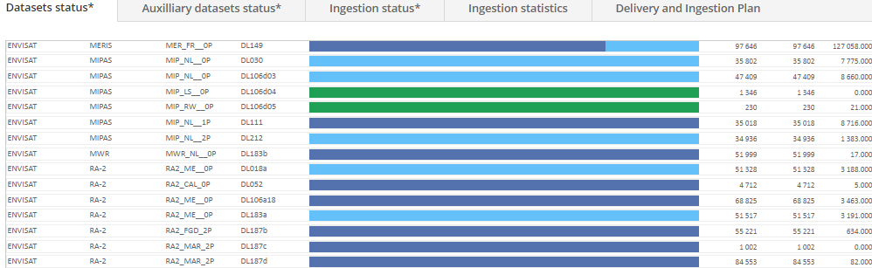
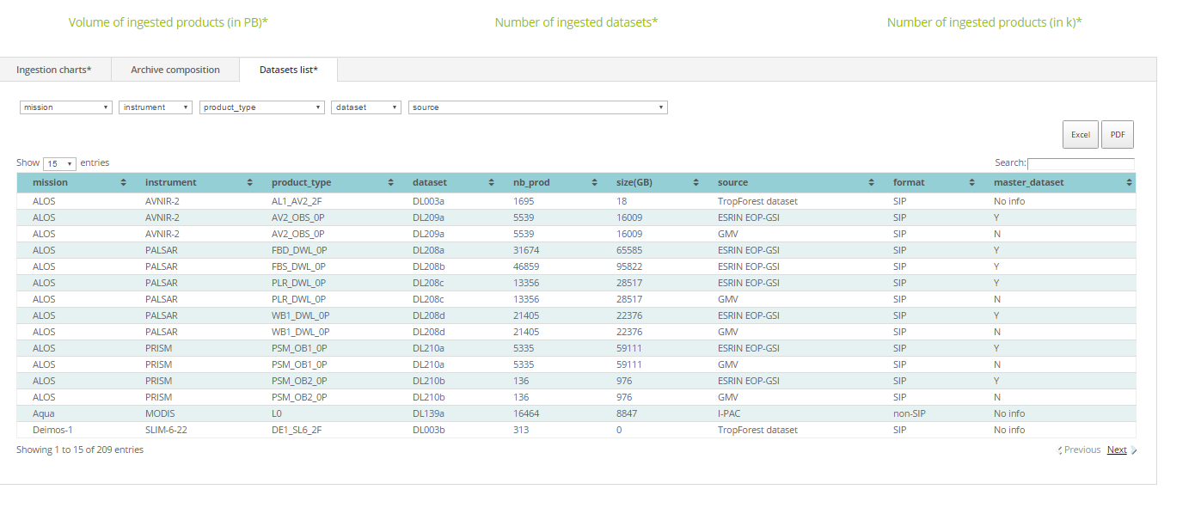
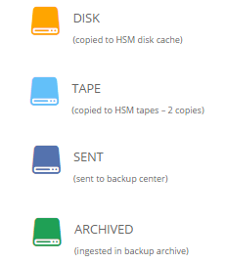
DAS Web Portal (2)

Slide 16
Cold Backup (CBA)

Slide 17
Cold Backup Archive (CBA)
Two copies of the data held at ESRIN in different buildings and different technology
ESA Internal LAN, not accessible from any network
Main Tape Library capable of storing 24 Petabytes
10 GB Network Environment
Unique data
PAC and Station Phase-out project data
Unconsolidated data
Live Mission support
Swarm (started in mid 2014)
Odin / SCISAT / Proba-1Cryosat-2 (started in March 2015)
SMOS (started in May 2016)
EO-SIP archiver
Native Format archiver to be implemented in 2017
Implemented ad no cost with Hardware already available at ESRIN

Slide 18
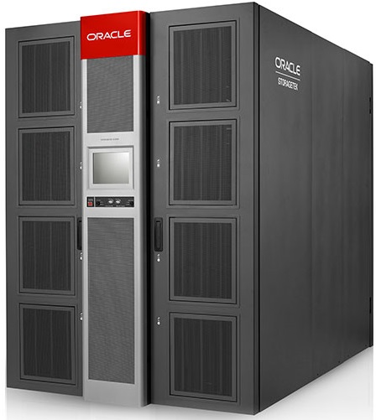
CBA Tape Library
STK SL8500
3000 slots
8 T1000D Drives (252 MB/s)
8 Robotic Arms
Fully redundant
16 GB Fibre Connection
90 TB Disk based cache
ORACLE HSM (aka SAMFS) driven
Virtual File System exported via ORACLE HSM client (Network + Fibre)

Slide 19
CBA Data flow
Physical File System
Copy Stations
NAS Devices
FTP
Archiving Tool
HSM
QFS Client
Virtual File System
T10000D
Tapes
EO-SIP packages
Non EO-SIP Data
Documentation
Auxiliary Data
Data written on the Physical File System is automatically copied onto tapes.
Data retrieved from the Virtual File System is read from the tapes and written to the Physical File System.
A dedicated server handles Input / Output request of data, mounting the Virtual File System trough a client. The Virtual File System is mounted via the 10GB network but routes read and write operations trough 16GB Fibre Optic.

Slide 20

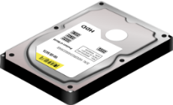

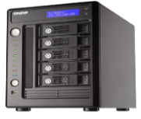
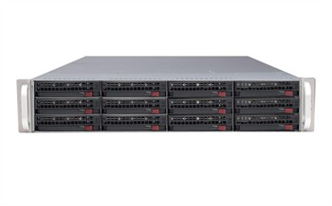
CBA Infrastructure
ARCHIVE
STORAGE
D1
D2
D..
D8
BULK EXTRACTION
BULK INGESTION

Slide 21
CBA Cold Backup and CSA
CSA
CBA
EO-SIP
EO-SIP
Documentation
Native Format
Auxiliary Data
EO-SIP products ingested by the Cold Backup Common Simple Archive (CSA) tool.
Non EO-SIP products copied in the Cold Backup data volume.
Next generation Archive capable of ingesting non EO-SIP products and populate its database with relevant metadata.

Slide 22
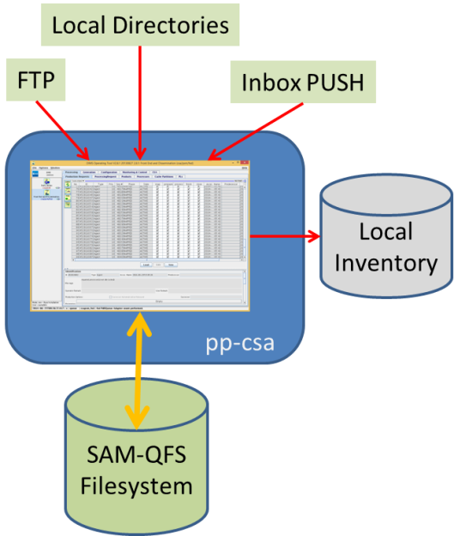
CBA EO-SIP
productName
Parameters
accessURL
archivePath
beginTime
downlinkedTo
endTime
imageQualityDegradation
imageQualityDegradationUnit
instrumentShortName
orbitDirection
orbitNumber
platformSerialIdentifier
platformShortName
processingMode
processingDate
processorVersion
productId
productType
productVersion
wrsLatitudeGrid
wrsLongitudeGrid
Bulk Ingestion from Local or remote locations
Automated Ingestion from inbox basked
EO-SIP Validation
Metadata extraction
Reporting

Slide 23

CBA non EO-SIP phase-out data

Slide 24

CBA Extraction – DAS Feeding
Name | Type | Mission | Data Type | Data Size | Delivery Date
DAS-05 | NAS | Mixed | non-SIP | 51 TB | 20160628
DAS-44 | NAS | Mixed | non-SIP | 30 TB | 20160628
GTDAS-015 | NAS | Mixed | non-SIP | 55 TB | 20160722
GTDAS-102 | NAS | ALOS | EO-SIP | 45 TB | 20160722
GTDAS-103 | NAS | Mixed | non-SIP | 20 TB | 20160722
DAS-48 | NAS | ALOS | EO-SIP | 55 TB | 20160923
GTDAS-101 | NAS | ALOS | EO-SIP | 40 TB | 20160923
GTDAS-111/112 | NAS | Mixed | non-SIP | 4 TB | 20161002
GTDAS-047 | NAS | ALOS | EO-SIP | 55 TB | 20161017
GTDAS-036 | NAS | ALOS | EO-SIP | 55 TB | 20161205
GTDAS-04 | NAS | ALOS | EO-SIP | 55 TB | 20170118
GTDAS-24 | NAS | ALOS | EO-SIP | 54 TB | 20170118
GTONAS8 | NAS | Mixed | non-SIP | 26 TB | 20170118
GTDAS-45 | NAS | ALOS | EO-SIP | 49 TB | 20170307
DAS-46 | NAS | ALOS | ADEN DWL | 55 TB

Slide 25
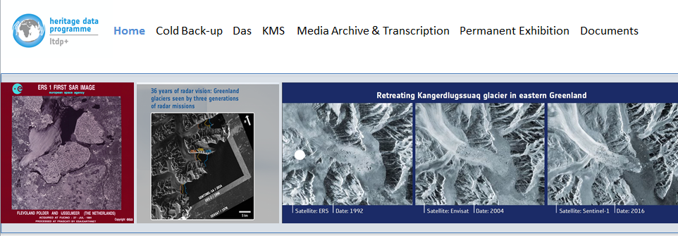

Preservation Element Web Portal
Cold Backup Figures
Link to DAS datasets
Knowledge
Media Archive
Documentation
Ingestion status reports
Extraction status and Reports

