Slide 1
EO OpenSearch GeoJSON Encoding
CEOS WGISS Meeting #43
olivier.barois@esa.int
05-Apr-2017

Slide 2
Background
OpenSearch EO Extension [OGC 13-026r8]: voted as an OGC standard in 2016 (First draft in 2013) – Sponsored by ESA
CEOS-WGISS OpenSearch Project – Led by ESA:
CEOS OpenSearch Best Practice Document
CEOS OpenSearch Developer Guide
CEOS OpenSearch Conformance test SW (on-going)
Enabled Catalogue interoperability at CEOS level:
Hundreds of EO dataset series/collections discoverable via NASA’s IDN/CWIC and ESA’s Fedeo gateways – Millions of datasets/products/granules
Adopted by many EO providers and EO data holders
Feedback to OGC: -> OGC 13-026r9
OpenSearch
OGC OS Geo & Time Extension
OS Parameter Extension
OpenSearch Extension for EO
CEOS OpenSearch Best Practice & Developer Guide

Slide 3
Limitations of OpenSearch for EO
Limitations | Solutions
Web Developer friendliness Many proprietary json encoding in the wild… | JSON encoding Due to its use in the web front-end, JSON has overtaken XML in APIs, and it has spread through all the layers in the stack one step at a time.
Atom format (XML) not ideal for web clients (and for popular javascript “mapping” libraries and apps: e.g. openLayers, Leaflet, WebWorldWind, Cesium, Mapbox, QGIS) | GeoJSON Native support in many js libraries (also in database engines)
“Poor” interoperability on EO metadata (NASA’s UMM-G vs ESA’s EO-O&M) | Mapping to a common set of geoJSON feature properties. Great opportunity for ESA/NASA & CEOS
No commonly agreed vocabulary (and not “linked data”) | Json-ld context and vocabularies
Linking datasets/ dataset series to EO/OGC services (e.g. WMTS/WMS for quicklook/browse image, WPS for processing, WCS…) | Consider the EO Catalogue search results as a “OWS context”.

Slide 4
Technical Context: Profusion of EO data and Services
User Clients
Service Layer:
Discovery (catalogue)
View
Download
Processing
Time serie analysis
Data integration/fusion
…
osEO
osEO
WMS
WMTS
WCS
WPS
…
EO Product & Service Catalogues
OWS
Context
osEO
EO Services
EO/OGC Services
osEO
Wxx
EO metadata
EO Data Providers
IT infrastructure
(IPT, DIAS, AWS, …)
EO products

Slide 5
Linking data and services
User Clients
osEO
osEO
WMS
WMTS
WCS
WPS
…
OWS
Context
EO Product & Service Catalogues
osEO
EO Services
EO/Other Domain Services
osEO
Wxx
EO metadata
EO Data Providers
IT infrastructure
(IPT, DIAS, AWS, …)
EO products

Slide 6
EO OpenSearch results as a OWS Context
OWS Context GeoJSON encoding standard [14-055r2]: approved in 2016
abstract:
The OWS Context Document standard (OWS Context) was created to allow a set of configured information resources to be passed between applications primarily as a collection of services (but also potentially in-line content). The objective is to support use cases such as the distribution of search results, the exchange of a set of resources in a Common Operating Picture (COP), or delivery of a set of configured processing services to allow the processing to be reproduced on different processing nodes.
Info on the OpenSearch request
OWS Context
a GeoJSON collection of features
EO Metadata
As feature properties
OpenSearch result pagination
“Links” Services on EO data Visualisation, Processing, …

Slide 7
Mapping of Product metadata attributes
Feature
UMM-G / EO-O&M
geometry
Product footprint (polygon, lineString, point,
multiPolygon, multiLineString, multiPoint)
properties
Use cases (Satellite EO):
Product derived from a single acquisition
Synergetic product derived from data acquired by various sensors/instruments of the same platform
Product derived from multiple acquisitions (one or more platforms)
Acquisition only (e.g. planned acquisitions)
Core attributes
Feature core attributes (status, date, updateDate, title, doi, parentIdentifier …)
Links & Offerings
quicklook, alternate metadata representation, download URL, reference to parent products, quality report, service offerings
acquisitionInformation
acquisitionInformation
All about the platform (satellite, serial identifier,…)
platform
All about the sensor/instrument (name, description, mode, wavelength, polarization, resolution, …)
instrument
All about the acquisition (start, stop, orbit, time since ascending node, track, cycle number, angles [sun illumination, sensor look angles, …], ….
acquisitionParameter
OGC 17-003
All about the product (processing date, algo version, quality, cloud/snow cover, productType, ….)
productInformation
Heritage vocabulary
EO OpenSearch vocabulary

Slide 8
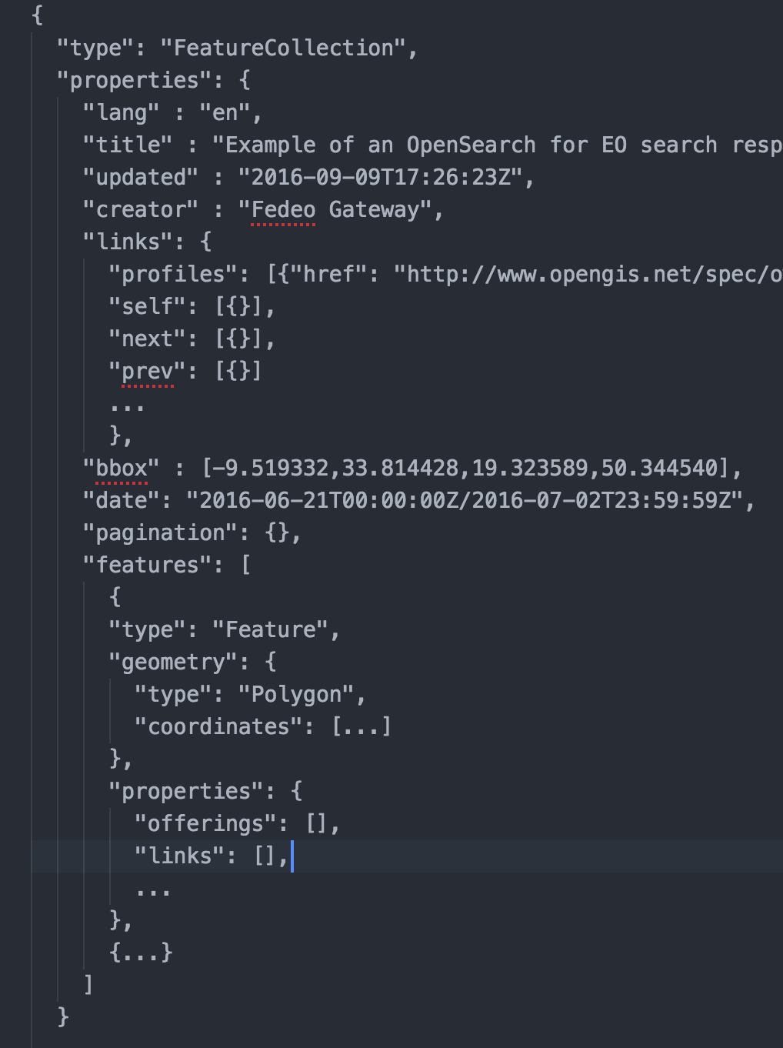
Metadata and Search response in GeoJSON
EO Metadata in GeoJSON (Feature)
EO OpenSearch response in GeoJSON (FeatureCollection)
OWS context

Slide 9
EO OpenSearch GeoJSON Standardisation Activities
Sponsored by
Dec 2016: KO joined EUMETSAT/ESA effort
Feb-2017: Draft specs first release
OpenSearch for EO update (OGC 13-026r9): addition of the GeoJSON(-LD) encoding
EO Metadata GeoJSON(-LD) encoding (OGC 17-003)
01-Mar-2017: Presentation to WGISS Acess Systeam, preliminary comments, Invitation to OGC SWG
22-Mar-2017: OGC TC-Delft
Re-activation of the EO OpenSearch and Metadata SWG
Nomination of chair (Uwe Voges/Conterra) and co-chair (Yves Coene/Spacebel)
presentation of activities and draft specs
Mar to Sep-2017: spec consolidation (SWG telco to be organized) – Experiment in Testbed 13 (Fedeo inkind contribution)
Sep-2017: OGC TC-Southampton – submission of final specs for public comments

Slide 10
Discussion Items
Participation of NASA to the OGC EO OpenSearch SWG (as a voting member)
Involvement/support from WGISS (Access Systeam/OpenSearch Project)
Document review, metadata mapping
Definition of vocabulary
Additional metadata attributes (e.g. relevant for data fusion)
Separate GeoJSON encoding from json-ld encoding:
EO Open Search update (CEOS BP feedback): OGC 13-026r9
EO Open Search GeoJson encoding standard (as OWS context): OGC 17-xxx
EO Metadata GeoJson encoding standard: OGC 17-003
JSON-LD encoding as best practice: OGC 17-xxx

Slide 11
Thank you !

