Slide 1
WGISS Connected Data Assets April 5, 2017 Yonsook Enloe

Slide 2
Connected Data Assets

Slide 3
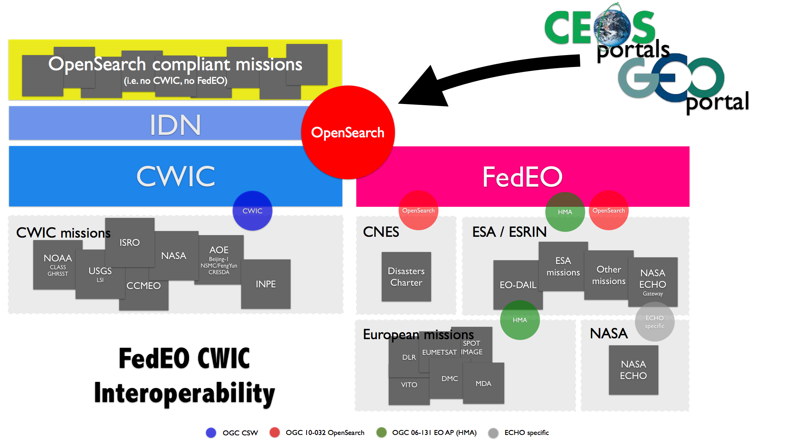
WGISS Interoperability Standards Architecture
WGISS has adopted the CEOS OpenSearch Best Practices in addition to the Open Geospatial Consortium (OGC) Catalog Services for the Web (CSW) v2.0.2 standards for searching EO data catalogs, both for collection and inventory information.
The IDN, FedEO, and CWIC systems have implemented the WGISS supported standards and are providing access to over:
The IDN provides descriptions of data sets (collection level) of relevance to global change research. Both the CWIC and the FedEO systems offer search of inventory data (granule level) and access to the data records

Slide 4
WGISS
Science/Theme clients
GEOSS clients
WGISS Connected Data Assets
CWIC
FedEO
IDN
Technical supports
WGISS Connected Assets System Level Team

Slide 5
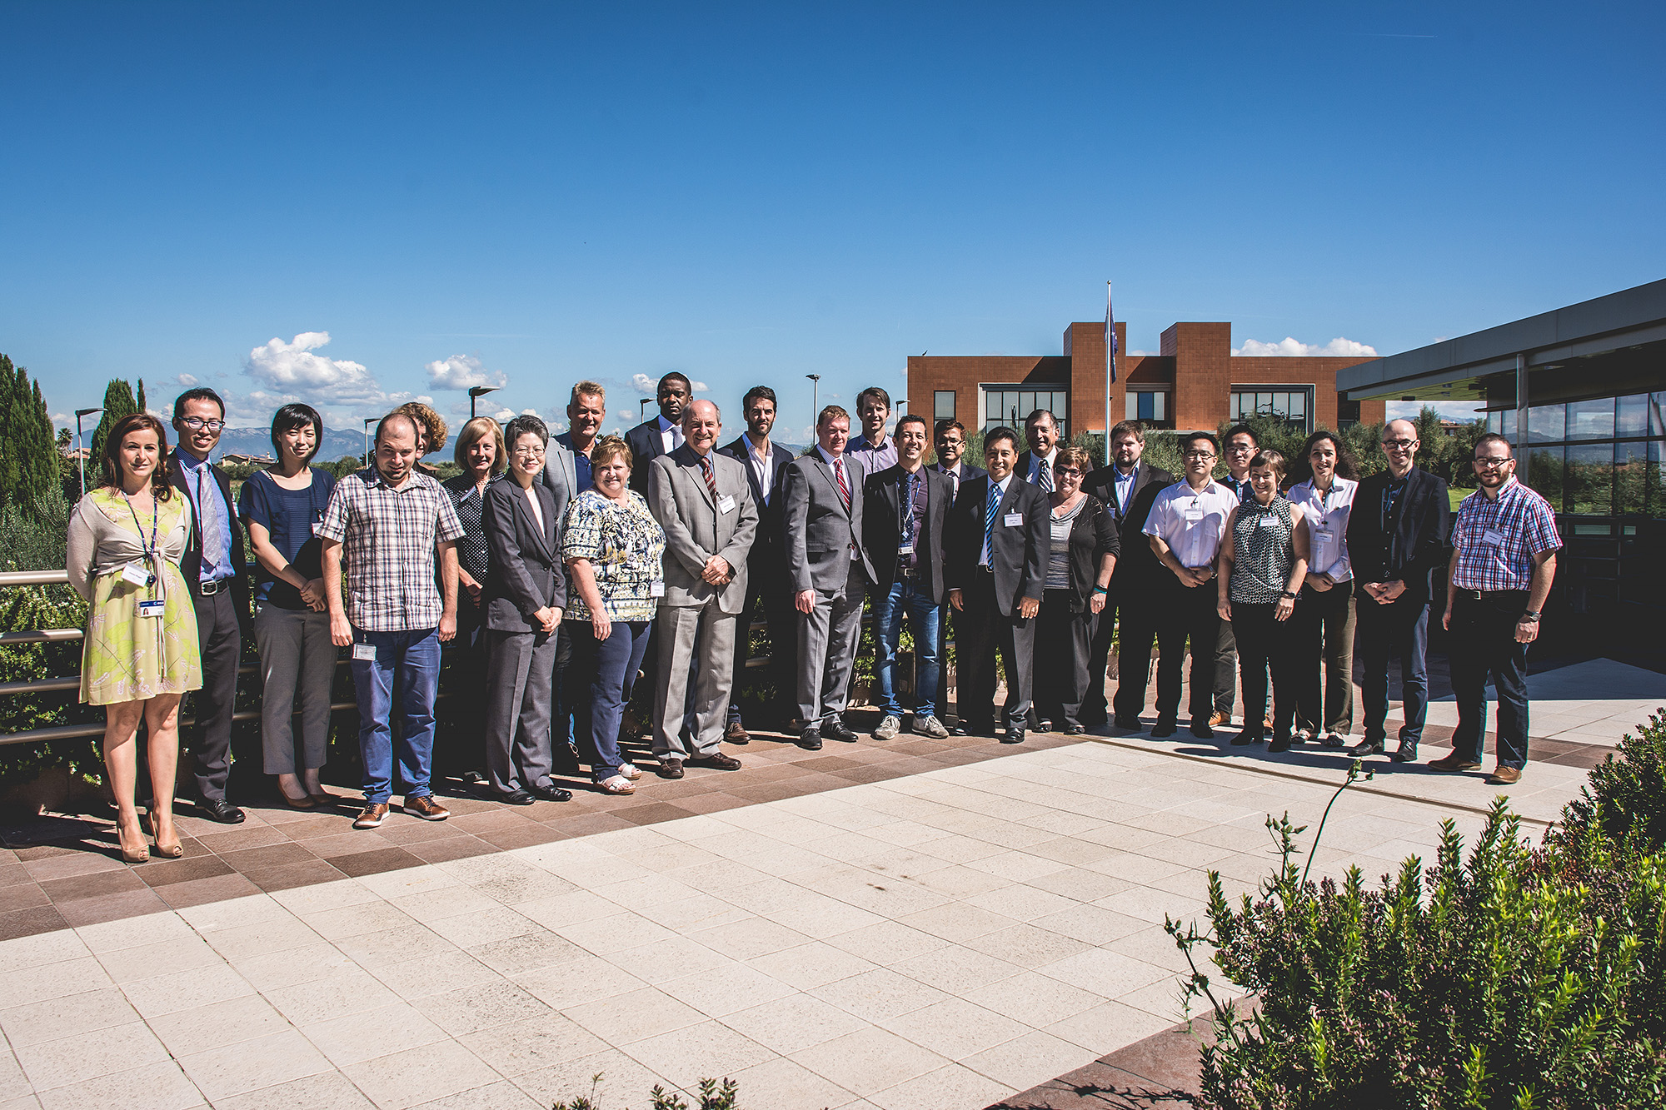
System Level Team
Created an integrated system team to coordinate and oversee the WGISS integrated system and standards:
Coordinate operations, maintenance and evolution activities (e.g. for infrastructure, standards adoption, etc).
On-board new data partners
Provide technical support for client partners
Monitor the health of the federated system and report outages and errors etc. to the partners
Test all the components of the federated system, including end to end search and data access
Work with data and client partners to identify and resolve system and component bugs
Provide support for metrics collection
Image Source: http://professionbiz.com/archives/7347

Slide 6
Current Architecture
CLIENTS
FedEO Node
CWIC Node
Collection
Directory
(FedEO, CWIC)
Collection metadata population & harvesting
Search (1st step)
IDN
Collection
Directory
(CWIC, FedEO, Others)
CWIC Partners include
USGS, NASA, ISRO, NOAA, NOAA/GHRSST, INPE, AOE, CCMEO, EUMETSAT, Australia
European Partner product catalogues:
ESA, EU Copernicus, DLR, CNES, ROSCOSMOS, VITO, EUMETSAT, ASI, UKSA

Slide 7
Collection search
FedEO Client
CWIC Client
IDN Collection
(CWIC, FedEO, independent)
FedEO gateway
IDN gateway
FedEO client searches IDN collection
CWIC client searches IDN collection
FedEO client searches FedEO collection
CWIC client searches FedEO collection
FedEO client searches
independent collection
CWIC client searches
independent collection

Slide 8
Granule search
FedEO Client
CWIC Client
FedEO gateway
CWIC gateway
CWIC Granule
FedEO Granule
Granules of
independent
data partner
CWIC client searches CWIC granule
FedEO client searches CWIC granule
CWIC client searches FedEO granule
FedEO client searches FedEO granule
CWIC client searches granules
of independent data partner
FedEO client searches granules
of independent data partner

Slide 9
Towards a WGISS Federation
Data collection registration at the IDN using the IDN keywords; Info about how granule search is supported will be included in the data collection registration
Data partners need to support 1 of the 2 supported WGISS standards
CEOS OpenSearch Best Practices (v 2)
OGC CSW 2.0.2
All searchable data must have a data access path
Data download
Data order (free or with cost)
Email order (free or with cost)
Servers must have high availability (99%?)
A technical POC needed for each data partner

Slide 10
Client Partners
Clients can offer search and access to all the satellite data available through the WGISS Federation
Clients can offer search and access to a limited subset of data available through the WGISS Federation along with other services through tagging (e.g. CWIC, FedEO, LSI, Carbon,…)
Clients can offer support for a 2-step search
Discovery through collection search using platform, instrument, science keywords, etc. (IDN). The IDN data record will contain info about how granule search is supported
Search granule metadata at data partners via CWIC, FedEO, Independent servers
All granule search results will contain links to data access

Slide 11
Recent Accomplishments
Oct 2016 – First WGISS Access System Level Team telecon
Access-SysTeam-Help@wgiss.ceos.org for questions about any of the systems – e.g. IDN, FedEO, CWIC
Will tag FedEO datasets registered in the IDN
Identified Interoperability Issues for CEOS OpenSearch implementations (e.g pagination handling to be advertised in the OSDD, unify how to distinguish between order/download links, ..)
Came to agreement on the resolution of the interoperability issues and documented those in the CEOS OpenSearch Best Practices document
CWIC Smart Client Validator for CEOS OS conformance testing
Future Conformance Test document led by ESA
ESA led effort to specify draft OGC 17-003 EO Dataset GeoJSON Encoding Standards
Working with the GEODAB team to integrate with WGISS Connected Assets

Slide 12
What Data is Accessible?
WGISS webpage has current list of the data collections accessible from FedEO and CWIC
Over 5000 collections accessible (collection search)
Over 300+ million granules accessible (granule search)
Additional data collections/granules continuously being added from heritage and current EO missions
Additional data partners can be added to FedEO and CWIC federations
Independent data partners who support the WGISS standards can be added to the WGISS Connected Data Assets

