Slide 1



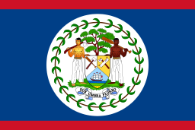

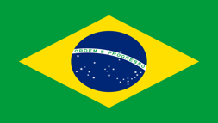


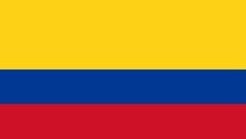
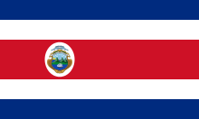
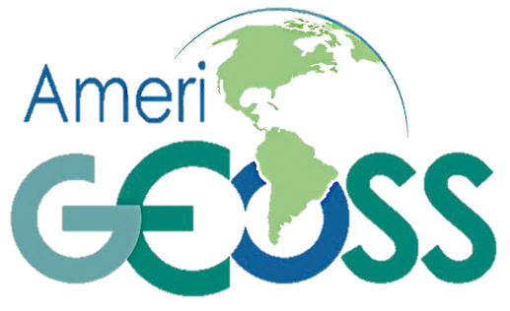
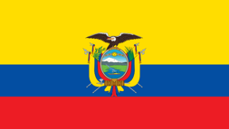
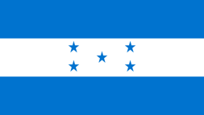

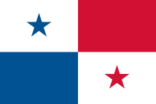




AmeriGEOSS Regional Initiative
A framework that seeks to promote collaboration and coordination among the
GEO Members of the American Continent
Working Group On Information Systems and Services (WGISS)
WGISS-43 Meeting
Angelica Gutierrez, Rich Frazier
April 5, 2017
Community Platform

Slide 2
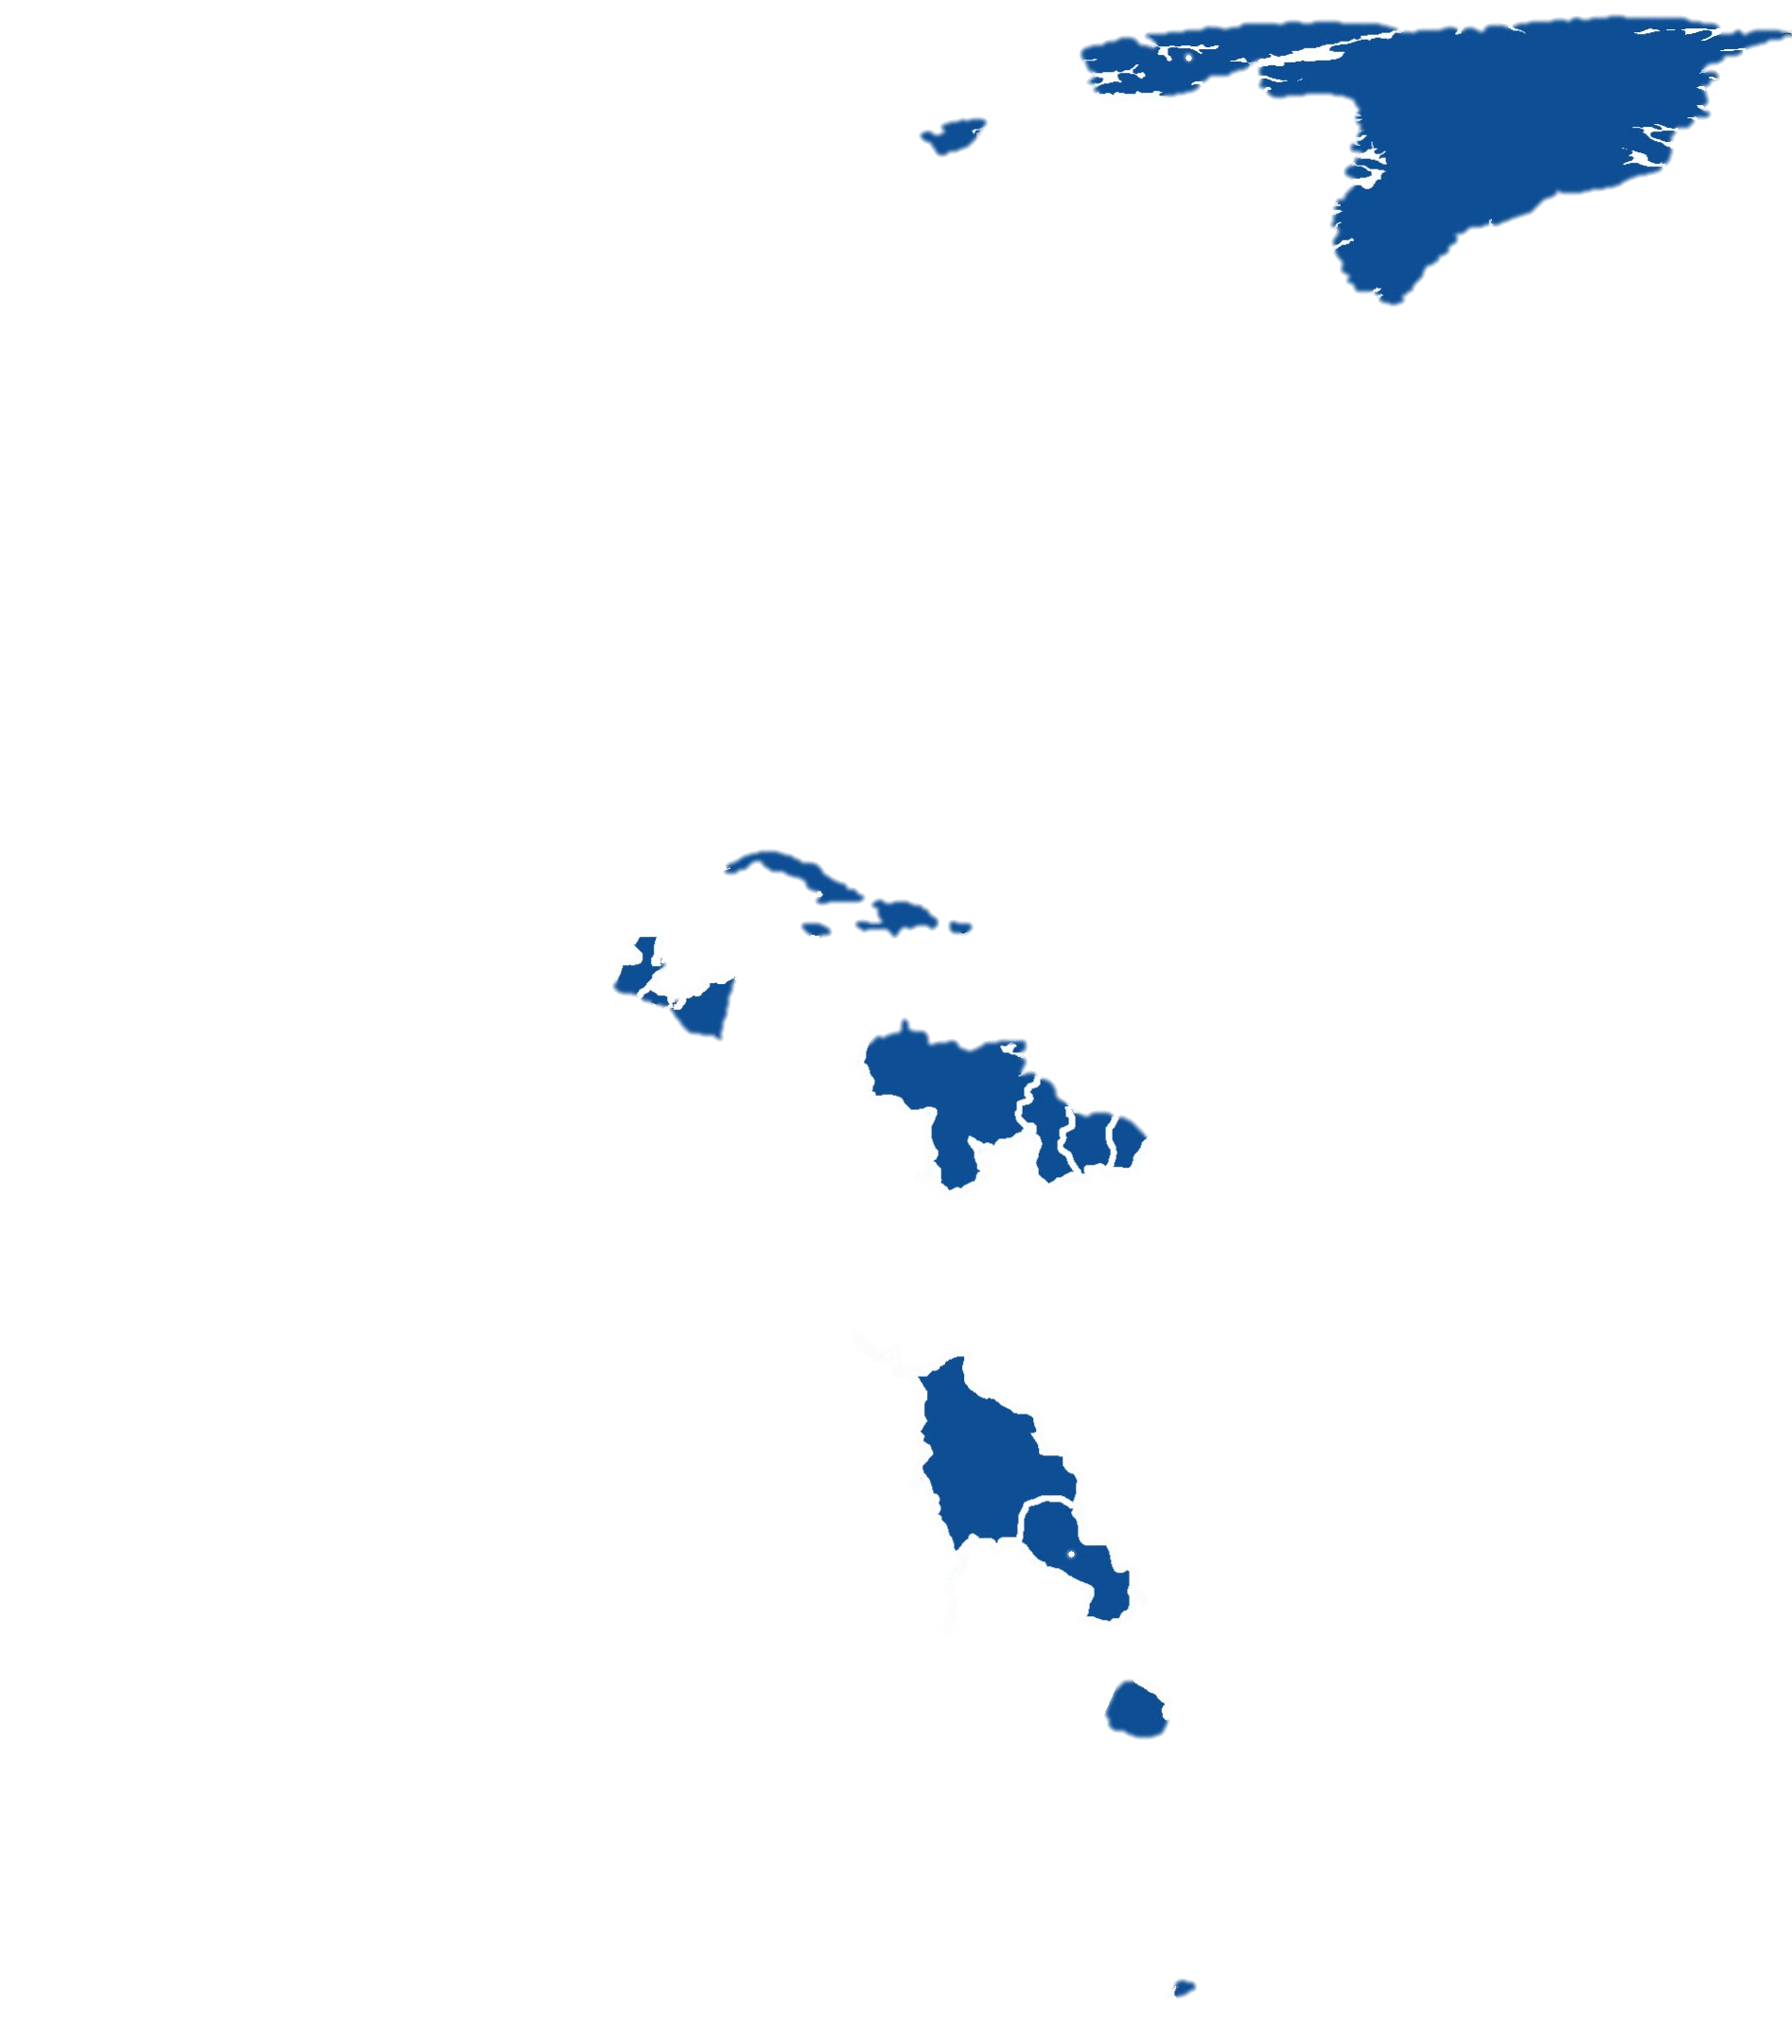
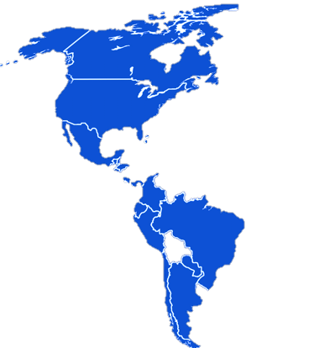

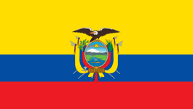
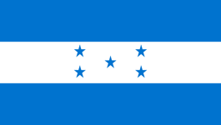






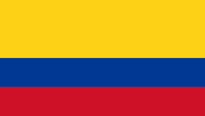


AmeriGEOSS
Initiative & Regional Coordination
Is a cooperative effort of the 16 GEO member countries in the Americas that:
Reflects local, national, and regional interests of the GEO country-members for short and long-term planning, development, and implementation aligned with GEO activities.
AmeriGEOSS Members
Non-AmeriGEOSS Members
Is entrenched in the institutional and technical capabilities of its country members and in the resources of other global initiatives available for the benefit of the region.
  Argentina
  Bahamas
  Belize
  Brazil
  Canada
  Chile
  Colombia
  Costa Rica
  Ecuador
  Honduras
  Mexico
  Panama
  Paraguay
  Peru
  United States
  Uruguay
Seeks to increase institutional and personal capacity and engage experts, stakeholders, and decision makers in the process of decision making.
16 Member Countries
Notes:
Talking points:
AmeriGEOSS is a Group on Earth Observations initiative
This is an adaptable framework that can be leveraged for capacity building.
16 nations in the Americas currently participates
Work with regional and global partners to advance the use of EO data
Develop and leverage member capacities to support stakehoder and decision-maker needs.

Slide 3
AmeriGEOSS GEO Principal
Dr Conrado Franco Varotto
Mr Trevor McNeil Basden
Mr Dennis Sylvestre Gonguez
Mrs Maria Rita Fontes Faria
Mr David Ronald Grimes
Mr Luciano Francisco Parodi
Mr Omar Franco Torres
Mr Juan Carlos Fallas
Argentina
Ms Maria Fernanda Espinosa
Mrs Patricia Brocatto
Mr Rolando Ocampo
Dr Ligia Castro De Doens
Mrs Maria Cristina Morales
Mayor General Carlos Elias Rodriguez Pajares
Dr Steve Volz
Vacant
Ecuador
Bahamas
Honduras
Belize
Mexico
Brazil
Panama
Canada
Paraguay
Chile
Peru
Colombia
United States
Cosa Rica
Uruguay
Notes:
Each nation has an assigned principle who represents the national interest and coordinates contributions to GEO and the community.

Slide 4


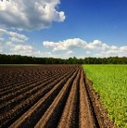
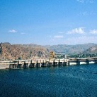
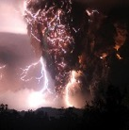
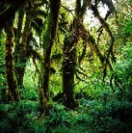
Thematic Focus Areas
AmeriGEOSS Initiative is a framework that seeks to promote collaboration and coordination among the GEO Members of the American Continent
Disaster risk reduction, particularly for data exchange associated with early warnings and for the generation of regional products of early warnings
Biodiversity and Ecosystem Monitoring including biodiversity observation in coastal, marine, and continental habitats, in the context of capacity building for better monitoring, management, and maintenance of ecosystems and biodiversity they support; also to predict future changes.
Agriculture, associated with climate variability, climate change, and food security.
Water, associated with the management approach of water resources and data management.
Agriculture
Water
Disasters
Biodiversity & Ecosystems
The AmeriGEOSS initiative
focuses its efforts in the
four Societal Benefit Areas (SBA’s) selected and prioritized by the
Americas Caucus
country-members:
Notes:
AmeriGEOSS is a regional initiative that promotes collaboration and coordination among GEO Members of the American Continent.
[Space bar for Animation]
The community is currently focusing its efforts in the following thematic areas
Agriculture
Water
Disaster and
Biodiversity Societal Benefit areas.

Slide 5

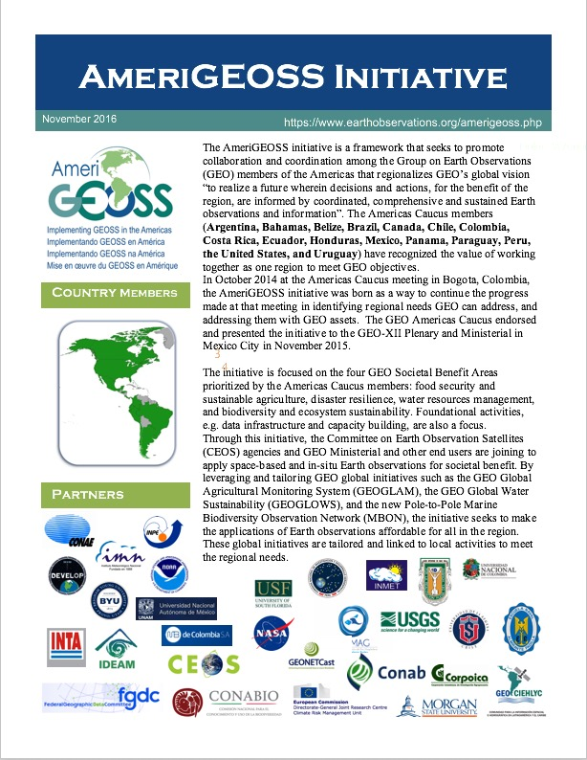
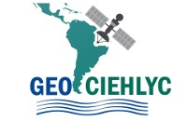


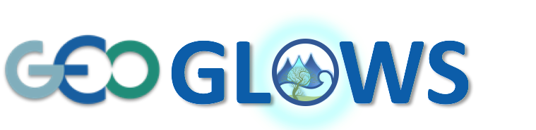





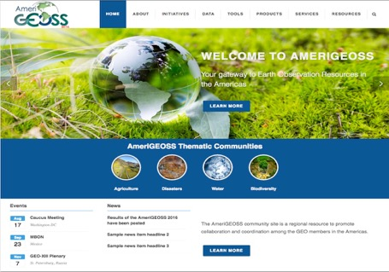



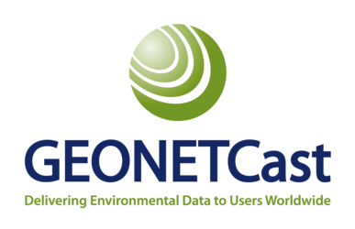
AmeriGEOSS Capacity Building
- Developing and Strengthening Partnerships and Capabilities
Engage
Capacity Building
Analyze
Building
Partnerships
Cold
Regions
Engaging Users
National
Needs Assessment and Gap Analysis
User-Driven Framework
Develop
Partner > Mobilize > Implement
Regional
Delivering Solutions
Data
Tools
Mobilizing Resources
Data Tools Products Services
Delvier
Share
Curate
Harmonize
Visualize
Mapping
Modeling
Publication
Reports
Acquisition
Reports
Training
Products
Global
Services
Community Platform
Community Platform
Notes:
Framework = Partner -> Mobilize ->Implement
We have been strengthening current partnerships and creating new ones in the four thematic areas.
We have been engaging users of flagships, initiatives and community activities to understand their needs and conducting a gap analysis to mobilize resources through the AmeriGEOSS Community Platform
Through these efforts we are
supporting the launch of new initiatives such as GEOGLOWS
engaging and linking new partners like GeoSur (Support Latin America/Caribbean) who is now sharing over 18000 datasets through the GeoPortal and we have integrated the GEO-DAB API into the GEOSur Portal
We are working with the arcticsdi to register resources in the GCI to support cold region and a use case pilot on EO and food security scenario monitoring that crosses many SBAs.
We are working with several Latin American countries on use cases to showcase our efforts in the water and disasters communities
We are linking data and resources from providers like the UN Human Data Exchange, CEOS and others.

Slide 6
AmeriGOESS Capacity Building Efforts
- Outreach and Education Examples
Increasing and strengthening Partnerships through outreach and education:
Workshops
The 2016 AmeriGEOSS week event was organized around capacity building activities directly related to the priority areas of the AmeriGEOSS Initiative. Training and informative presentations were provided by public and private participants.
Webinars
The purpose of the webinars is to share information stressing the importance of open access to information and data for the benefit of the Latin and Caribbean American Region, to find potential applications and collaborations among scientists and decision makers, and to expand and strengthen the
network of research and applications as it relates to the water cycle.
Communications
AmeriGEOSS principles meet regularly to provide information on
activities, newsletters, and other communications are provided
to the community on events, activities, and accomplishments.

Slide 7


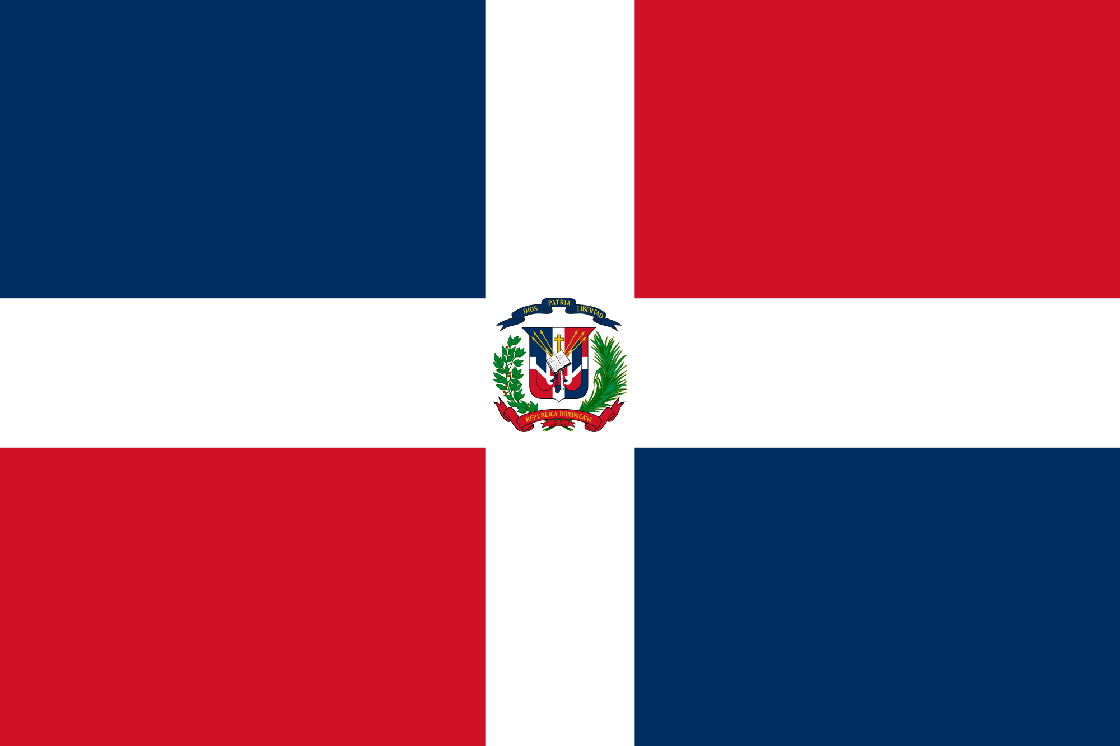
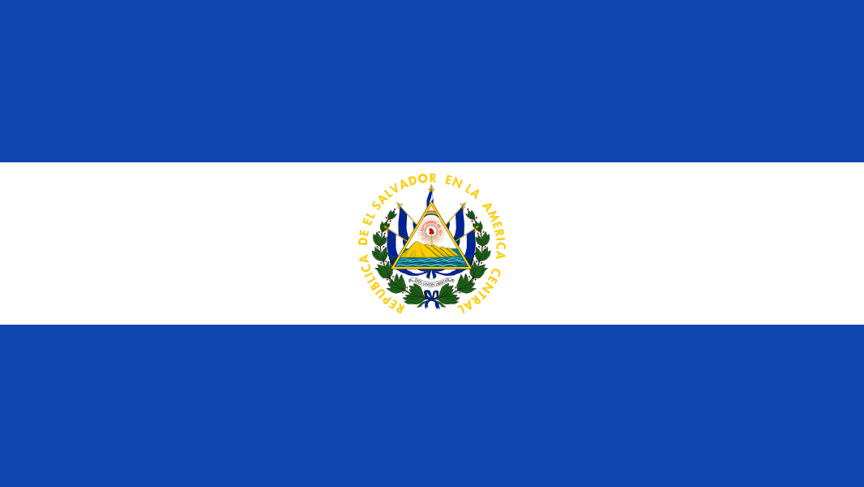
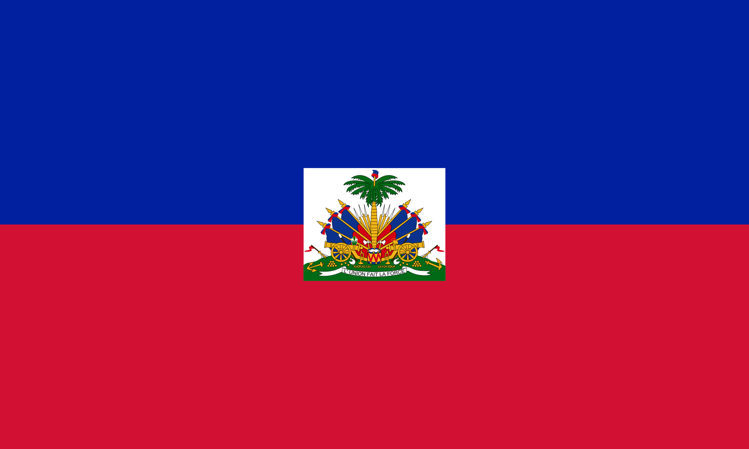
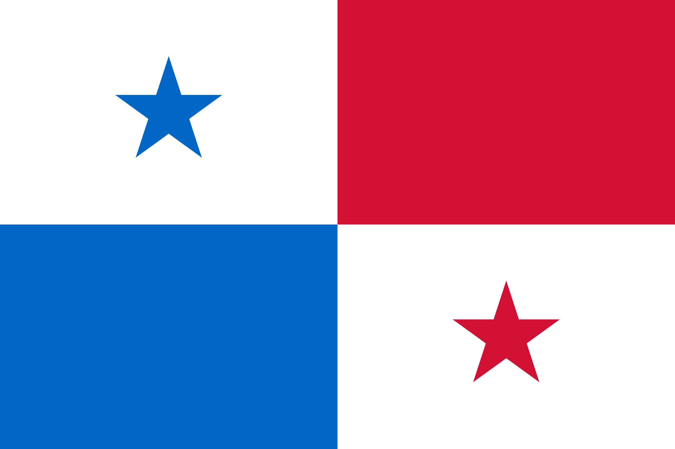
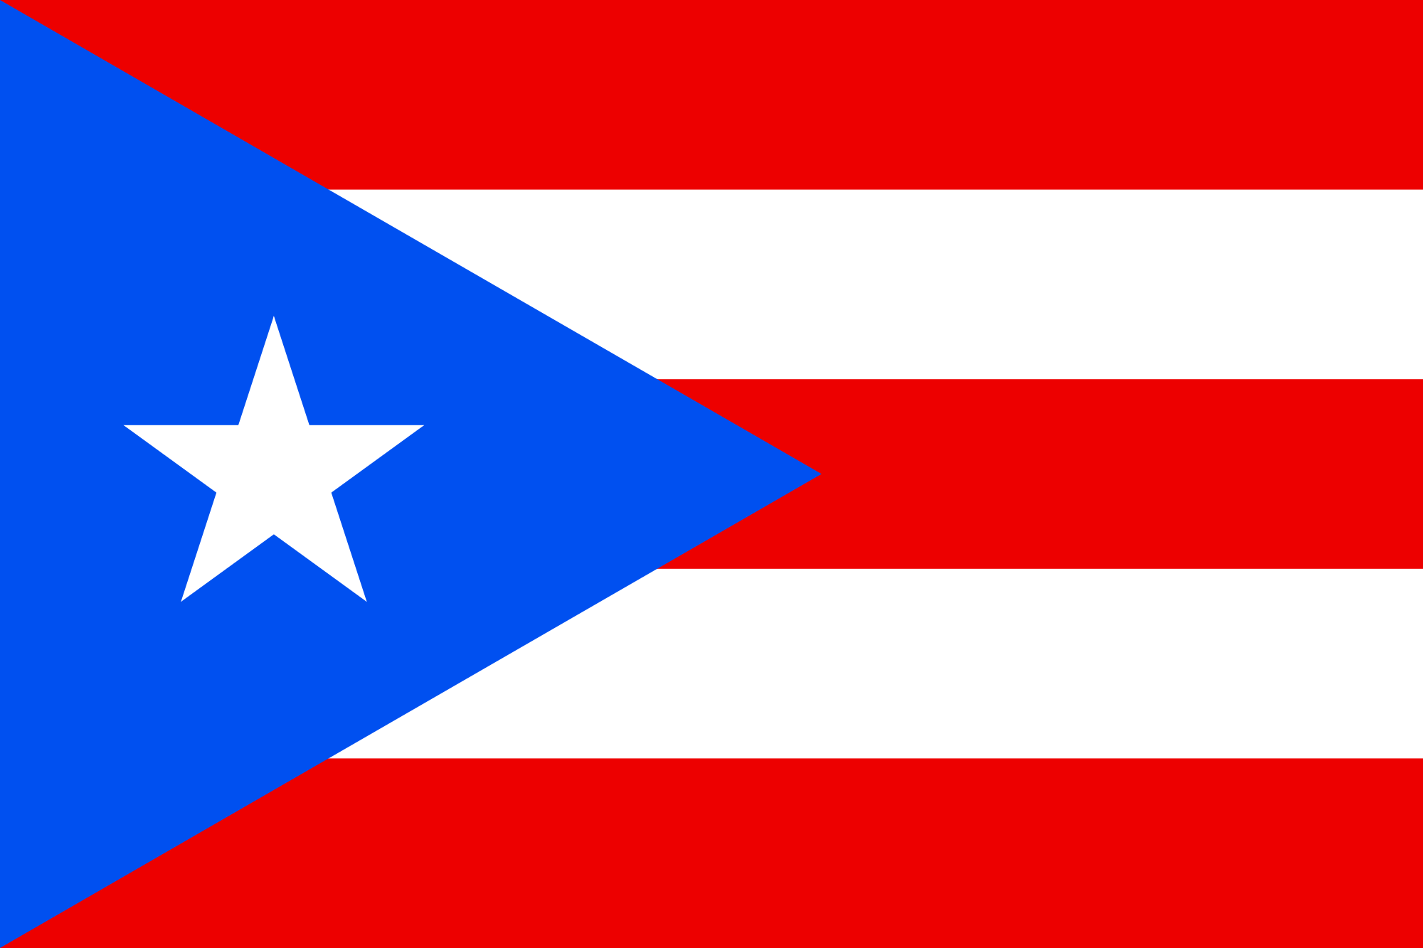
Connecting the Community to EO Resources
- AmeriGEOSS Capacity Building Example
50 Stations as of 3/30/2017
Operational Stations
Installations in Progress
Dominican
EMUMETCast-Americas Converting
In Consideration by Organization
Acquiring Equipment
GNC-A stations, credit Diego Souza from CPTEC/INPE
The near real-time, global network of satellite-based data dissemination systems is designed to distribute space-based, airborne and in situ data, metadata, and products to diverse communities lacking in high speed internet access.
Notes:
The near real-time, global network of satellite-based data dissemination systems is designed to distribute space-based, airborne and in situ data, metadata, and products to diverse communities lacking in high speed internet access.

Slide 8
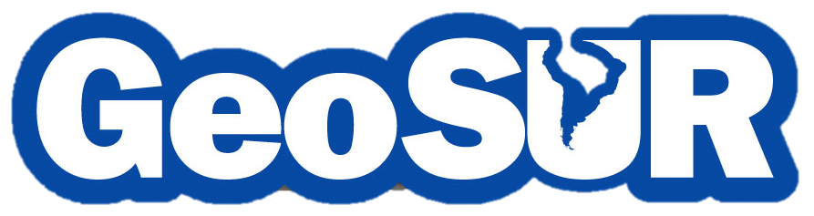
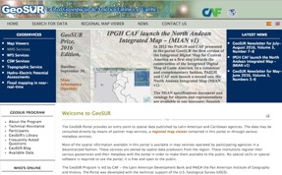
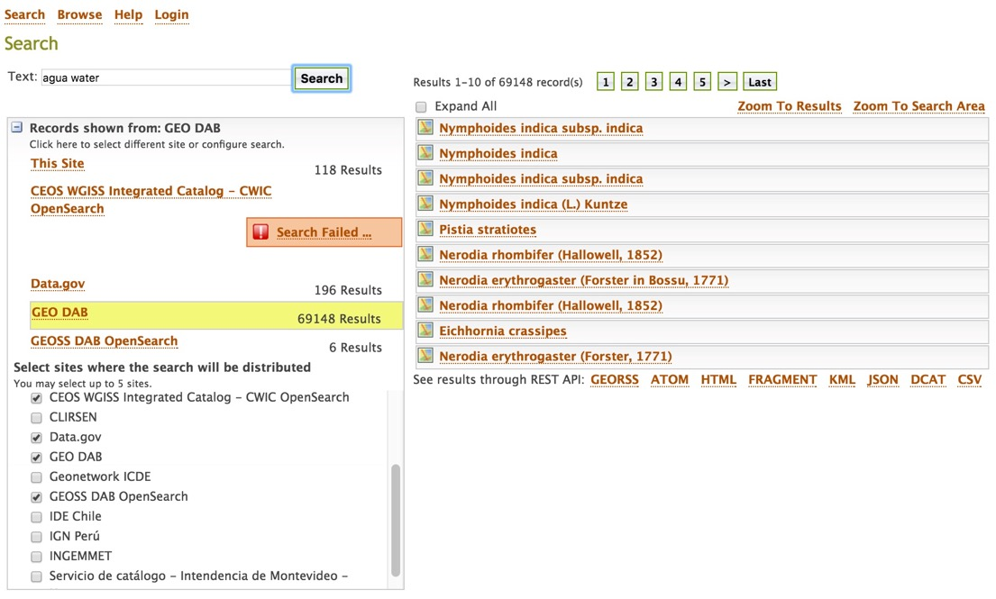

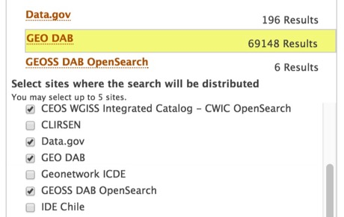

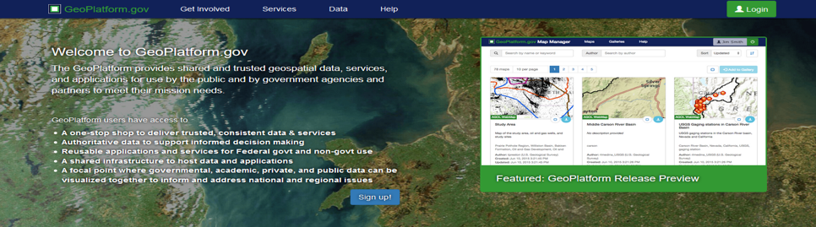
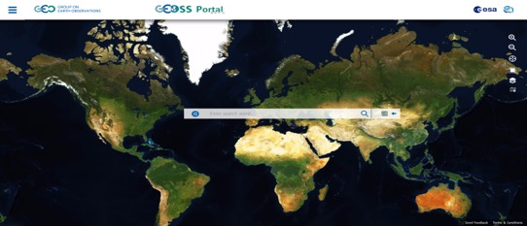
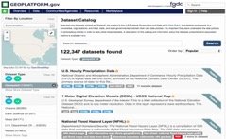
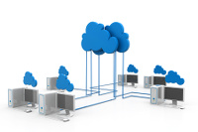
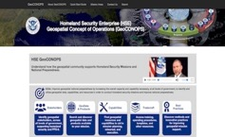

Connecting the Community to EO Resources
- AmeriGEOSS Capacity Building Example
Previous Results
AmeriGEOSS
Support
GLOBAL Earth Observation System of Systems (GEOSS)
Increasing Discovery and Access to EO AmeriGEOSS–GEOSur
2016 Partnership Success
Data Catalog
Tools
Products
Services
Communities
Global
National
Global
8
Notes:
Another Example:
As part of the capacity building efforts we work with communities to provide access to data. In 2016 we partnered with GEOSur to provide integrated discovery, access and useablity of EO resources from community providers:
We linked:
GEOSS
US Data.gov
CEOSS and other resources.
Click remote for zoom:
A previous search provided 118 results now users can have access to an additional 70,000 resources that include imagery, files, documents, reports etc.

Slide 9

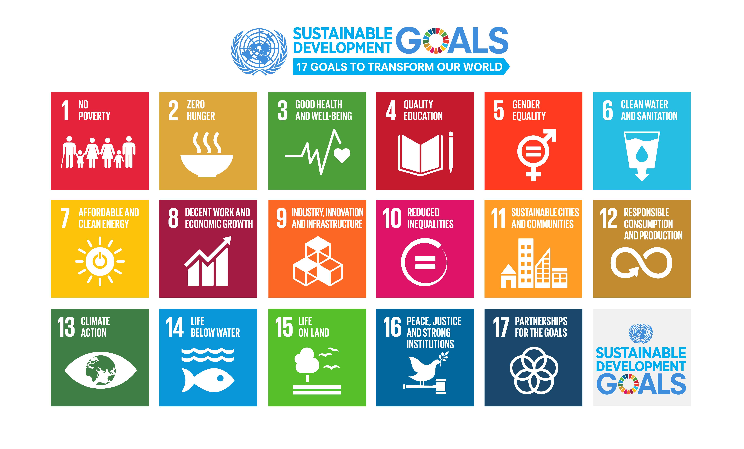















Supporting Understanding and Decision-Making
The AmeriGEOSS Community Platform is bringing together Social, Economic and Environmental data to support understanding and decision-making.
Social
Data
Tools
💰
💶
Services
Economic
Environmental
Biodiversity and Ecosystem Sustainability
Disaster Resilience
Energy and Mineral
Resource Management
Infrastructure and
Transport Management
Public Health Surveillance
Sustainable
Urban Development
Food Security and Sustainable Agriculture
Water Resource Management
Notes:
One of the strategic objectives of AmeriGEOSS is to provide capacity to use EO resources in decision-making.
The platform is being developed to bring together social, economic and environmental data to support understanding and decision-making around a variety of topics

Slide 10
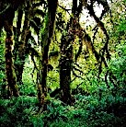
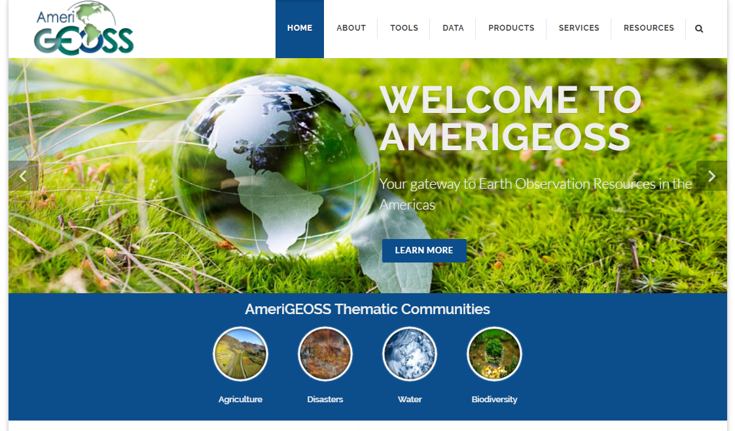
AmeriGEOSS Community Platform Vision
About AmeriGEOSS Initiatives | Data | Tools | Products | Services | Resources |
Welcome to AmeriGEOSS Community Platform your gateway to Earth Observation resources in the Americas.
Agriculture
Biodiversity & Ecosystems
Disasters
Water
The AmeriGEOSS Platform is a regional community resource to promote collaboration and coordination among the GEO members in the American continent.
Your resource to share, find, discover, learn and participate in coordinated, comprehensive and sustained Earth observations for understanding and decision-making.
Notes:
A key objective of our engagement is to evolve beyond data to support usability of data to support understanding and decision-making.
Through the user engagement and needs assessment we agreed to establish the AmeriGEOSS community platform as an Americas caucus capacity building mechanism to support sharing, finding, discovering, learning and participating in the use of EO resources to support understanding and decision-making.
This is a snapshot of the platform. I will provide more context on the envisioned capabilities and services on the following slides.

Slide 11
AmeriGEOSS Community Platform Services
About AmeriGEOSS Initiatives | Data | Tools | Products | Services | Resources |
Welcome to AmeriGEOSS Community Platform your gateway to Earth Observation resources in the Americas.
Agriculture
Biodiversity & Ecosystems
Disasters
Water
Data
Catalog of Americas EO data assets,
Tools
Data Visualization and Modeling tools
Products
Publications (e.g Agricultural, Climate Report)
Services
Resources
Share, Publish, Manage and Use data
Co-create, Curate, Harmonize, Semantically enrich and tagging
Map Viewer and Thematic Gallery
Other Tools from providers or custom tools can be added
Reports (e.g. Water Quality)
Brochures (Preparing for a disaster)
Others
Access a variety of community developed tools
GeoNetCast Americas
Geohazard Supersites and Natural Laboratories
Training
Workshops
Alerts & Notifications
Other
News
Social Media Resources
Community Calendar
Collaboration Tools
National and Regional Portals and Platforms
Document Library
Notes:
The platform is being developed to provide a variety of collaborative services and capabilities to use data and tools to co-create in the development of products and resources to support understanding and decision making.

Slide 12
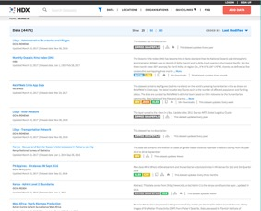
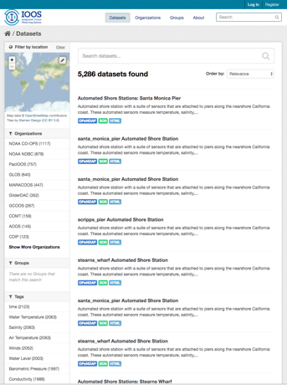
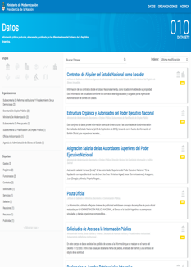
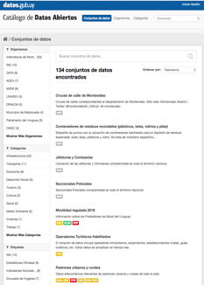

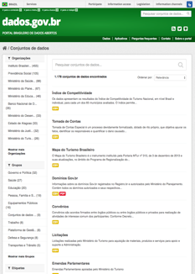

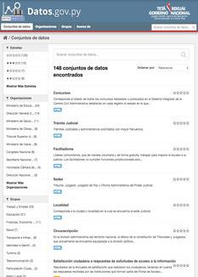
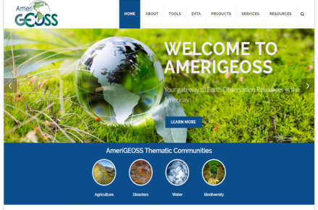
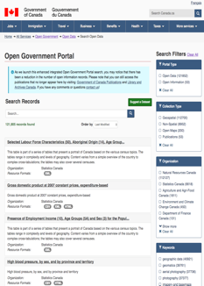

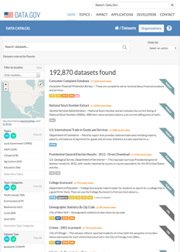

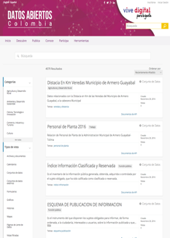



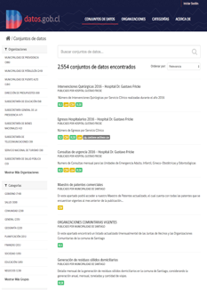






AmeriGEOSS Linking Capabilities
Linking Local to Global GEO Capabilities
Open Data Portals
Global
National
National
Regional
Global
*378,243 Datasets
Regional
*31,812 Map Layers
*413 Applications & Tools
Share Data, Tools, Applications and Services
*Current assessment of available resources
Notes:
Through the AmeriGEOSS we have been mobilizing data and resources to provide the capacity to support the use of social economic and environmental data through open data portals at the national, regional and global scale.
These are snapshots of the national portals.
We also have regional portal like the Artic SDI and GEOSUR and
Global resources like the UN Human Data Exchange and the integrated ocean observing system.

Slide 13









AmeriGEOSS Community Platform
About AmeriGEOSS Initiatives | Data | Tools | Products | Services | Resources |
Data Catalog
Spatial Search
Tools and Products
Datasets
Collections
Map Viewer
The AmeriGEOSS Community Platform prototype provides a suite of resources and tools for integrating, synthesizing, analyzing, problem-solving and visualizing geographically enriched data to accelerate understanding and decision-making.
Notes:
Using the platform users can discover, access and use data and tools from national, regional and global data sources. Our community can access economic, social and environmental data on a variety of topics related biodiversity, ecosystem health, food security, water use, availability, quality and other indicators that will support the communities ability to develop products and services that support understanding and decision-making.

Slide 14
















AmeriGEOSS Data-Hub
– Data Catalog and Capabilities
About AmeriGEOSS Initiatives | Data | Tools | Products | Services | Resources |
Search
- Text¹, Faceted² and Spatial Search³
1
3
Find
- Resources in many Formats⁴
4
Use
- Multi-platform support⁵
2
5
Notes:
The platform provides a variety of methods to search for data, find data in various formats and use the resources from a variety of platforms and devices.
The AmeriGEOSS Data-Hub uses the CKAN open source platform to link resources in the region.

Slide 15










AmeriGEOSS Data-Hub Capabilities
About AmeriGEOSS Initiatives | Data | Tools | Products | Services | Resources |
Tools and Resources from
Global Providers in one Place
Find Data
Tools
Imagery
Notes:
We are now in the use case development phase working with the community to leverage the platform around societal issues such as food security.
Using the platform the community can access a variety of social, economic and environmental resources from providers to understand causes and develop knowledge based products and services to model, forecast and respond.

Slide 16












AmeriGEOSS Data-Hub Capabilities
About AmeriGEOSS Initiatives | Data | Tools | Products | Services | Resources |
Explore Social, Economic and Environmental , Reports, Information, Indicators…..and More
Find Water Data
Water Variables
Water Reports & Indicators
Use maps, applications and other analytical tools
CEOS Water Portal
Notes:
One of our community initiatives GEOGlows is initiating efforts to support capacity building to understand water use, water availability, and water quality. The outcomes of these activities will support clean water and sanitation efforts under SDG 6.
Through the platform a researcher or analyst can find water data - Click
Access a variety of hydrometric data to understand variables and – click
Access reports, community developed maps, applications and analytical tools to support understanding and decision-making.

Slide 17
Capacity Building - Current Status and Next Steps
Initiated
February - September
Data needs, gap analysis/solution development, linking data
Enabling Analytical tools for data visualization
Establishing Group Curators
Working with thematic working groups on use cases
Present early results at the Work Programme Symposium and Plenary
Building Partnerships
AmeriGEOSS Week 2017
University of Costa Rica
July 31 – August 4
Strengthening Partnerships – Mobilizing Resources – Implementation
Notes:
2016 - building the foundational services and capabilities
2017 - focus on implementing - working with a small group of users to develop use cases
In may the prototype will be made available to the community
Invite to AmeriGEOSS Week.

Slide 18










AmeriGEOSS – CEOS Possible Synergies
AmeriGEOSS Cross-walk to
CEOS 2017-2019 Work Plan
Agriculture | Bio-Eco | Disasters | Water | Foundational
Agriculture
Biodiversity & Ecosystems
Disasters
Water
Foundational Task
3.1. Climate Monitoring, Research, and Services
3.2. Carbon Observations, Including Forested Regions
3.3. Observations for Agriculture
3.4. Observations for Disasters
3.5. Observations for Water
3.6. Capacity Building, Data Access, Availability and Quality
3.7. Advancement of the CEOS Virtual Constellations
3.8. Support to Other Key Stakeholder Initiatives
3.9. Outreach to Key Stakeholders
Notes:
Identified synergies between CEOS work plan and AmeriGEOSS efforts.

Slide 19
AmeriGEOSS – CEOS Possible Synergies
Outreach & Education
Coordinate Communication
Use Cases
Support efforts to Identify opportunities
Applications & Tools
Thematic Tools and resources (e.g. Water Portal)
Data & Products
Coordinated User Needs Assessments
Harmonized Thematic Regional Products
Thematic datasets
Hands-on
Computer Base
Workshops
Coordinate Training
Videos
Participation in development
Thematic pilots, prototypes
Coordinated Gap Analysis
Outcome of activities will inform development and implementation in other regions.

Slide 20

Advancing the Vision of GEO:
GEOSS Implementation
Questions?
Community Platform

