Slide 1
Enhanced GEOSS Portal
Joost van Bemmelen / Guido Colangeli
ESA/ESRIN
WGISS#43 Meeting, 3-6 April 2017 – Annapolis (US)

Slide 2
Overview
Short Introduction
FedEO/CWIC in GEOSS
Demo

Slide 3
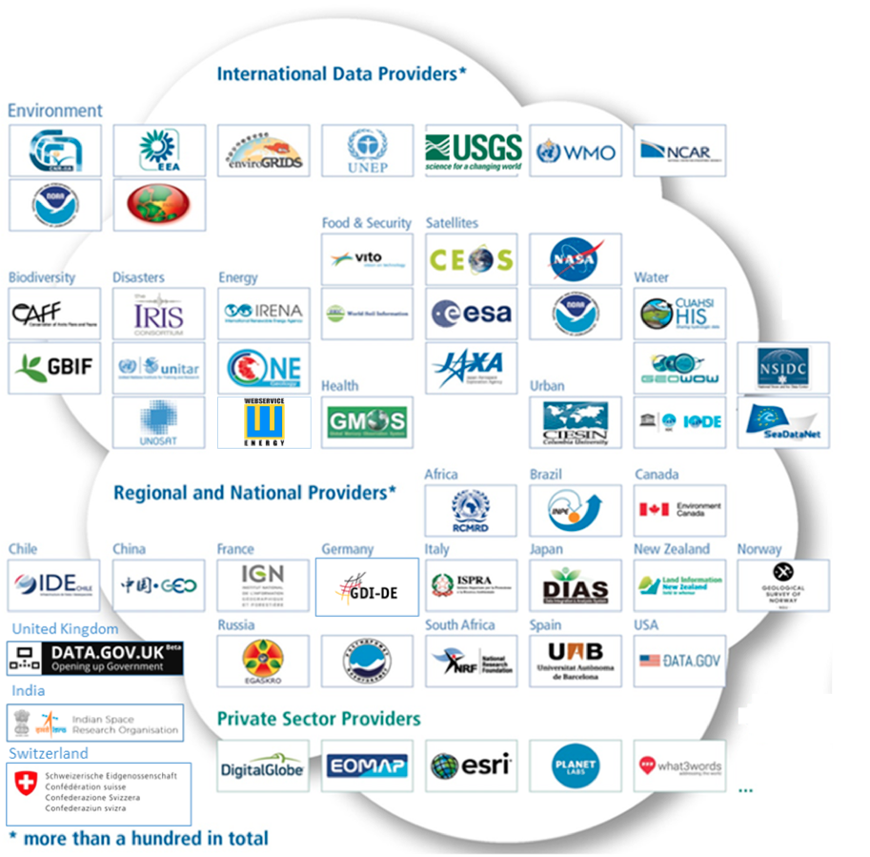

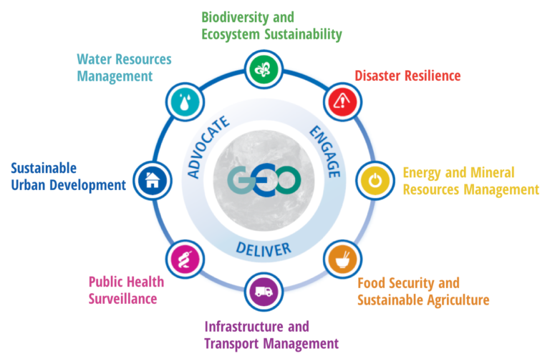
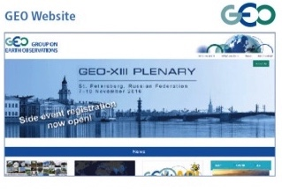





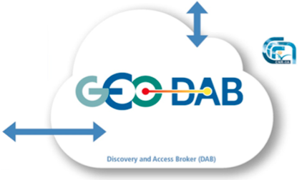
Linking of Users with Resource Providers
Data Providers
Users
GCI
GUI
M2M
Discovery & Access
> 200 million data resources spanning all SBAs

Slide 4
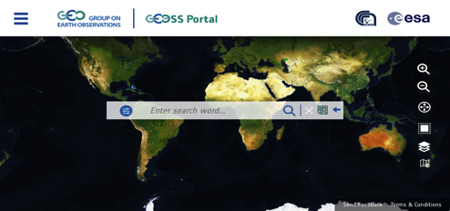
Enhanced GEOSS Portal - Overview
Enhanced during 2016
Accessible from www.geoportal.org
Coordinated with ESA, CNR-IIA, DG-RTD, DG-JRC and GeoSec
  Focus on engagement, delivery and advocating
  Structured in 3 phases
1st phase – 2016: interface restyling: completed
2nd phase – 2017/18: deployment of major upgrades
3rd phase – 2019 onwards – operations and evolutions
Notes:
Engagement of users, delivery of what users need, advocating available functionality and data

Slide 5
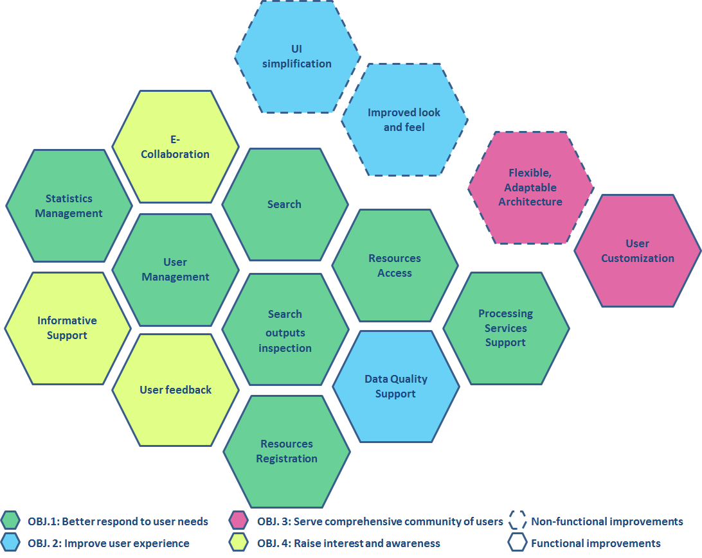
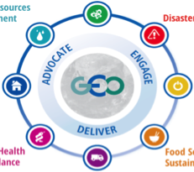
GEOSS Portal Enhancements (phase 1/2)
Completeness
Usability
Do we offer everything the user needs for their purpose?
Is it easy and intuitive enough for the user
1. User Central to Enhancements
Openness
Integrity
Are access and use restrictions kept to a minimum?
Are we providing appropriate, verifiable information?
2. GCI Enhancements Objectives are user focused
Usefulness
Improve User Experience
Is it pleasant
and appealing enough for users?
Is this really what the users want?
Desirability
Better Respond to User Needs
3. Enhancements Areas identified to achieve the objectives
Serve Comprehensive Community of
Users
Raise User
Interest and
Awareness
Findability
Accessibility
Can the portal be found easily (e.g., through search engines(?
Is access well supported in diverse conditions
Social Inter-connection
Customizability
Can the users get to know each other and share ideas?
Can the portal be easily customized for different communities
User Involvement
Is the portal adaptable to different devices?
Do we make users feel considered?
Adaptability
4. Different actual Enhancements identified for the Enhancement Areas
Notes:
Enhancements are based on overall objectives (4 visualised at the left). For each of these 4 objectives – focal improvement/enhancement areas have been identified (outer circle on the left) – the figure at th right shows the actual proposed (already identified) enhancements that will be/are addressed in the enhanced GEOSS Portal / GEO DAB [colours correspond with the objectives/enhancement areas on the left]

Slide 6

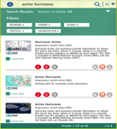

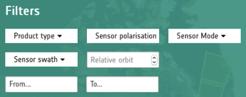
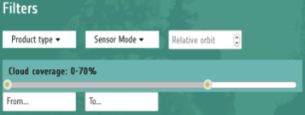



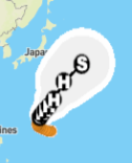
Enhancements: first phase status
Restyling of the Graphical User Interface: completed
  Aligned with new GEO Web-site and Brand
  Simpler / More Intuitive
    Improvements include: page structures, search & discovery, results display & access
Inclusion of smart filters for imagery (Landsat, Sentinel 2) and SAR-type
(Sentinel 1) satellite data
My WorkSpace initial set-up (Personalisation/Profiling, Save and reuse searches, Bookmark results)
Geo-localisation services: API,
Base maps selection (CartoDB, ESRI, MapBox, OpenStreetMap)
Proprietary ESRI data (e.g. regarding active hurricanes, tropical storms)

Slide 7






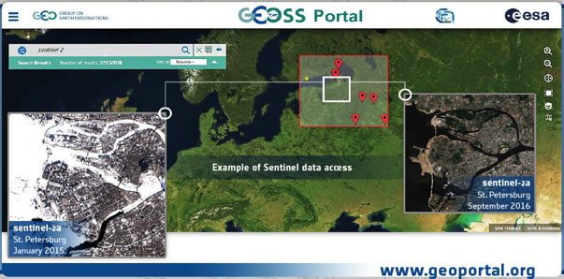
Current focus
User-centric, considering various user communities:
  GEO Flagships and Global initiatives
  ESA Thematic Exploitation Platforms
Additional enhancements considered include:
  Improved search and results access
  User management and My workspace evolution
  Multi-modality (including hand-held devices)
  Modular evolution via Portlets (for reuse)
  Processing services
  Visualisation services (e.g. layers, responsive web-design, …)
Upcoming
  (Online) Workshops: User-Oriented ones, Data-Provider-Oriented ones, Developer-Oriented ones

Slide 8
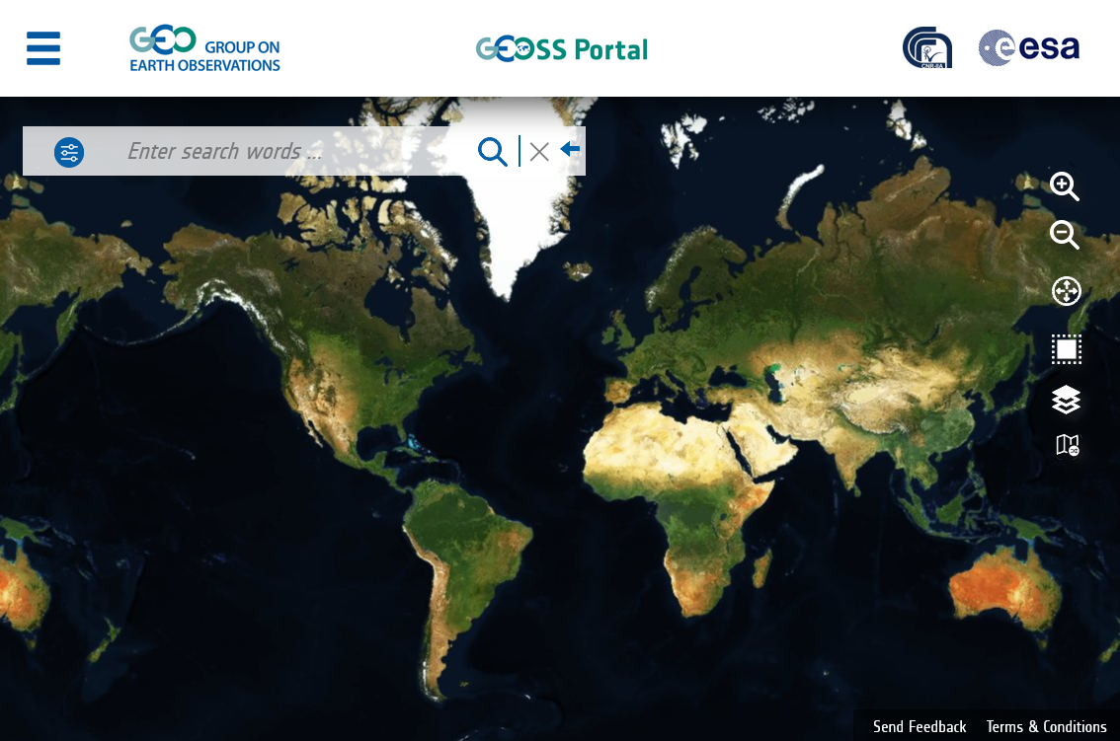

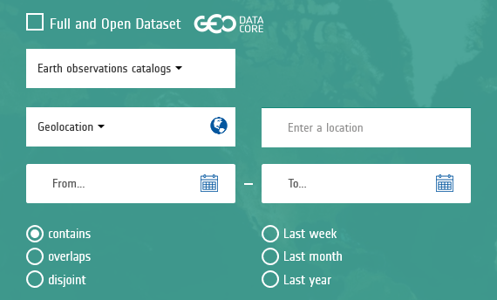
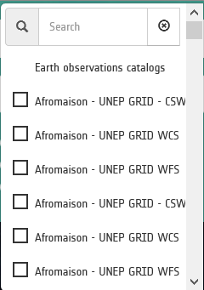
How to access FedEO/CWIC Catalogues from the GEOSS Portal
fedeo
3. Search for FedEO …
2. Click on the Earth observations catalogs
drop-down menu
1. Open the Advanced Search Criteria panel

Slide 9
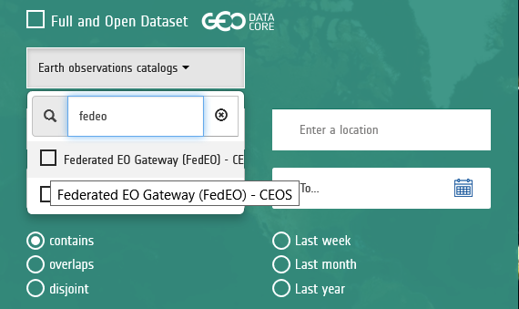
How to access FedEO/CWIC Catalogues from the GEOSS Portal
fedeo
… and select
FedEO
3. Search for FedEO …

Slide 10

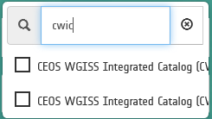
How to access FedEO/CWIC Catalogues from the GEOSS Portal
… and select
CWIC
4. Then search for CWIC …

Slide 11
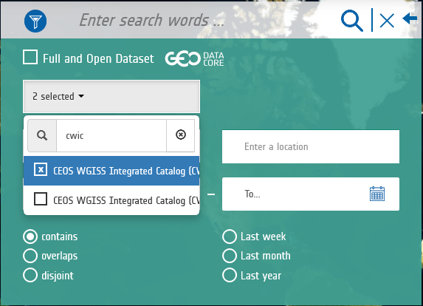
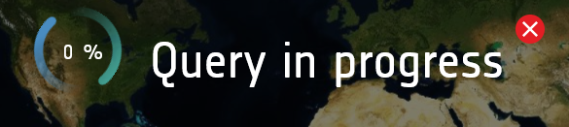
How to access FedEO/CWIC Catalogues from the GEOSS Portal
5. You can now start the Search, to retrieve resources from FedEO and CWIC only.

Slide 12
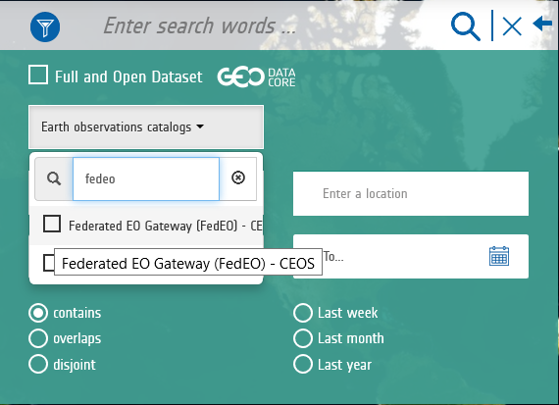

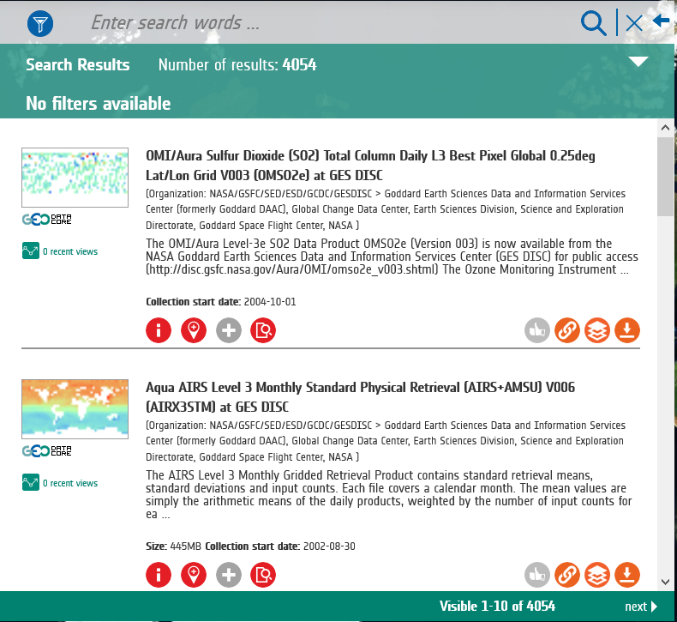
How to access FedEO/CWIC Catalogues from the GEOSS Portal
As per today,
FedEO:
2210 Collections
CWIC:
1844 Collections

Slide 13
CWIC and FedEO Resources Accessible
From the GEOSS Portal
Brokered source | Records | GEOSS Data Core records | Elements | GEOSS Data Core elements | Comments
CEOS WGISS Integrated Catalog (CWIC) | 1.844 | 1.814 | 70.000.000 | 70.000.000 | Declared by Provider
Federated EO Gateway (FedEO) - CEOS | 2.210 | 0 | 82.355.410 | 0 | The number of granules is obtained by issuing a request with no constraint to each collection, and summing the total number of records
Source : GEO DAB
Link : http://www.geodab.net/11-nov-2016
Date : 11/Nov/2016

Slide 14
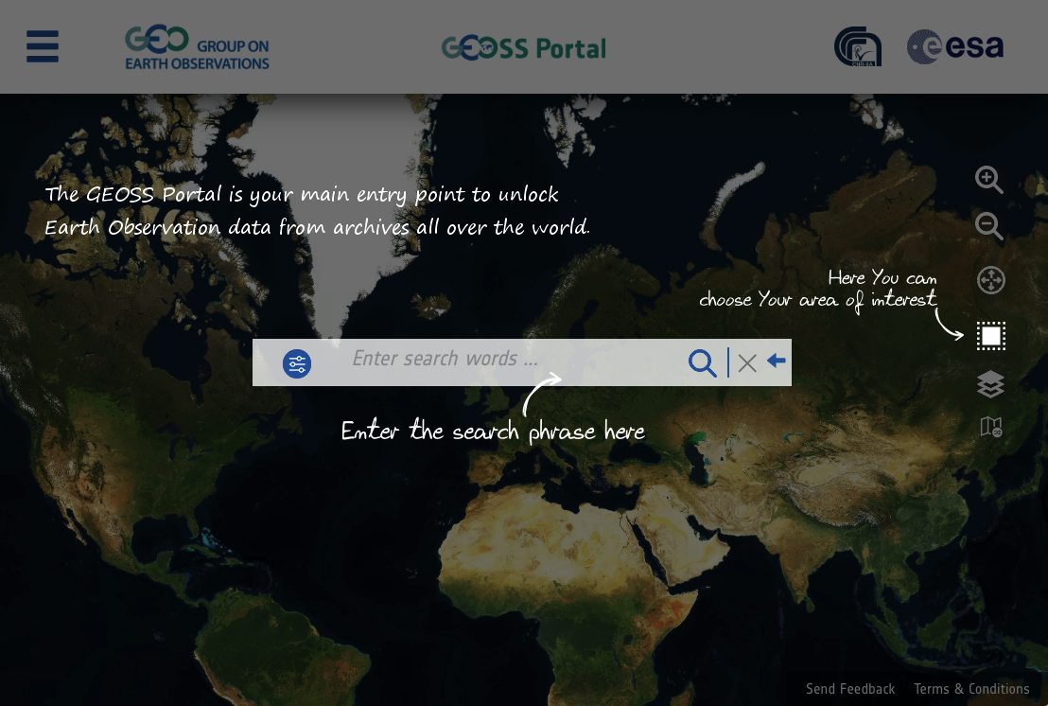
demo

Slide 15
THANK YOU
URL:
http://www.geoportal.org
Contact:
  Joost van Bemmelen – joost.van.bemmelen@esa.int
  Guido Colangeli – g.colangeli@rheagroup.com

