Slide 1



GEOSS EVOLVE
Osamu Ochiai
GEO Secretariat
CEOS WGISS-43
3-6 April 2017, Annapolis, MD, USA

Slide 2
Overview
The objectives of GEOSS-EVOLVE are:
To advance and evolve the GEOSS architecture based on the architectural principles described in the GEO Strategic Plan 2016-25, the analysis of the evolving landscape for technology and production/ consumption of Earth Observation (EO) data products and services, and the specific user requirements coming from the GEO Flagships and Initiatives;
To conduct research and development activities, in collaboration with public, private, and voluntary sectors, to develop and test new functionalities, solutions, and components, including those needed to advance the GCI, to support the GEO Strategic Plan objectives and user needs;
To prepare documentation and training materials needed to support the transition from development to operations of the new components and solutions identified.

Slide 3
Activities in 2017-2019
The activities of GEOSS-EVOLVE for 2017-19 are articulated in six work packages summarized next slides.
Close collaboration with the GEO Secretariat and the Foundational tasks addressing data sharing, GCI operations and user requirements will be ensured through regular meetings and continuation of past collaborative working practices.
This collaboration will also identify more clearly in 2017 which activities of GEOSS-EVOLVE are best addressed in the context of operations and may therefore be moved to one of the relevant Foundational Tasks, and which should stay in the Initiative being more focused towards development and evolution.

Slide 4
WP1: GEOSS Architecture and Evolution
(Lead: US-USGS/Italy-CNR)
Advance and evolve GEOSS architecture based on technology watch and user requirements by selected Flagships and Initiatives;
Develop and Maintain the “Evolution of GCI functionalities and Architecture” document and service framework; and
Research, report on emerging technologies that facilitate use of Earth observation resources.

Slide 5
WP2: Functionality Testing
(lead China-RADI)
Test functionalities of the GCI, the GEOSS data providers and the GEOSS community portals needed to support the requirements expressed by the users through the dedicated foundational tasks.
The needs of different categories of users (decision-makers, researchers and practitioners addressing the Societal Benefit Areas at national and regional levels, the general public) will be considered. Therefore this work package will consider usability by different user categories as a key dimension.

Slide 6
WP3: Data Management Principles
(Lead: ESIP, CODATA)
Demonstrate implementation of Data Management Principles (DMPs) with selected Initiatives and Flagships;
Revise implementation guidelines based on lesson learned; and
Develop and evolve training material.

Slide 7
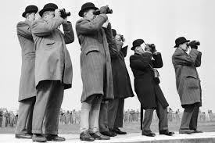
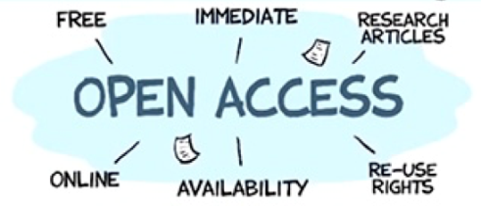



Data Management Principles Strategy
The value of Earth observations are maximized through data life-cycle management based on ten Principles supporting five themes.
DISCOVERABILITY
DMP-1: Data and metadata will be discoverable
ACCESSIBILITY
DMP-2: Data will be accessible via online services
USABILITY
DMP-3: Encoding DMP-4: Documentation
DMP-5: Traceability DMP-6: Quality
PRESERVATION
DMP-7: Preservation DMP-8: Verification
CURATION
DMP 9: Review and reprocessing
DMP 10: Persistent and resolvable identifiers

Slide 8
WP 4: Standards Interoperability Forum
(lead IEEE)
Organise yearly interoperability workshops;
Develop and evolve training material and best practice guidelines; and
Support selected GEO Initiatives and Flagship in extending their interoperability arrangement.

Slide 9
WP5: Demonstrations Projects
(Lead OGC)
The OGC Architecture Implementation (Projects) and Pilots (AIP) which have already taken place for more than 10 years. AIP develops and deploys new process and infrastructure components for the GEOSS Common Infrastructure (GCI) and the broader GEOSS architecture.
In 2017-21 the interoperability pilots and demonstration projects will benefit from the activities of the NextGEOSS project (http://nextgeoss.eu) funded by the European Commission for the period 2017-21 (42 months, starting 1st Dec 2016).
Previous AIP’s had a focus on discoverability (DMP-1) and accessibility (DMP-2) and somewhat on DMP-3 (Usability). AIP-10 and up shift its focus to accessibility (DMP-2) and Usability (DMP-3 - 6).

Slide 10
WP 6: Community Portals
(Lead NOAA)
The original and primary purpose of this WP is to develop and publish a Community Portal Paper with a set of recommendations, best practices and guidelines that will assist the developers of GEO community data and information systems to fully utilize the capabilities that are provided by the GEOSS Common Infrastructure (GCI).
In implementing their own community portals that serve their particular, objectives, programs and projects it is envisioned that these groups will use the GCI to discover and access many of the Earth observation resources that are relevant to their particular discipline.
To develop the community portal recommendations a team has been formed that includes representatives from the GCI component providers and representatives from multiple GEO communities that have efforts planned or underway to use the GCI.

Slide 11


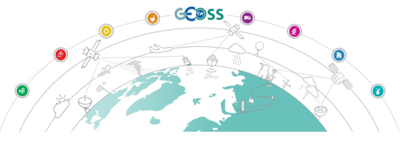









Users/GEO Portals
Regional or thematic community Portals, leveraging GCI resources and GEO DAP APIs
Community
Community
National
Regional
Regional
Regional
Regional
Community
Notes:
Add portal counts prior to and after
CEOS
Wetlands

Slide 12
Leadership and Contributors
Leadership
  Ivan DeLoatch (Federal Geographic Data Committee/USA), ideloatch@usgs.gov
  Max Craglia, (JRC/EC), massimo.craglia@jrc.ec.europa.eu
Contributors
  Members: Australia, Chile, China, EC, France, Finland, Italy, Poland, South Africa, Spain, Switzerland, UK, USA.
  Participating Organizations: CEOS, CODATA, ESA, ESIP, ICSU, IEEE, OGC, RCMRD, WMO.
GEO Secretariat
  Osamu Ochiai, oochiai@geosec.org
  Paola De Salvo, pdesalvo@geosec.org
  Wenbo Chu, wchu@geosec.org

Slide 13
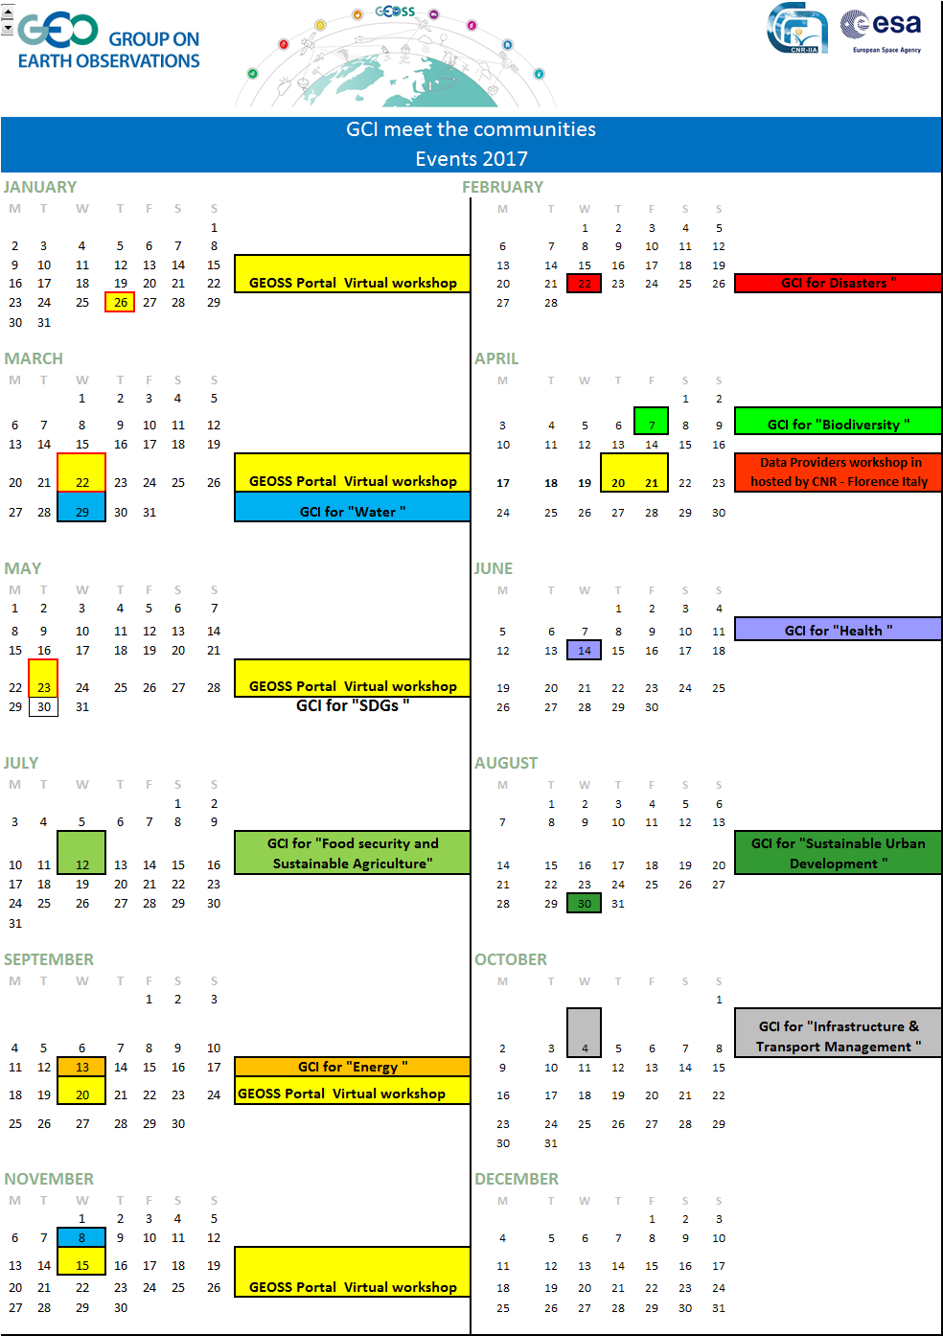


Interaction with User Communities
GCI and SBA communities Virtual Meetings
  One SBA per month
  Interact with Flagships, Initiatives and Community Activities
  Demonstrate GEOSS Portal
  Feedback from SBAs

