Slide 1
CWIC Status Report
Yonsook Enloe yonsook.k.enloe@nasa.gov
WGISS-43
April 5, 2017

Slide 2
WGISS
Science/Theme clients
GEOSS clients
WGISS Connected Data Assets
CWIC
FedEO
IDN
Technical supports
WGISS Connected Assets System Level Team

Slide 3

CWIC Mechanism
Open
Search
CSW
CWIC
Heterogeneous
protocols
CWIC data partners

Slide 4
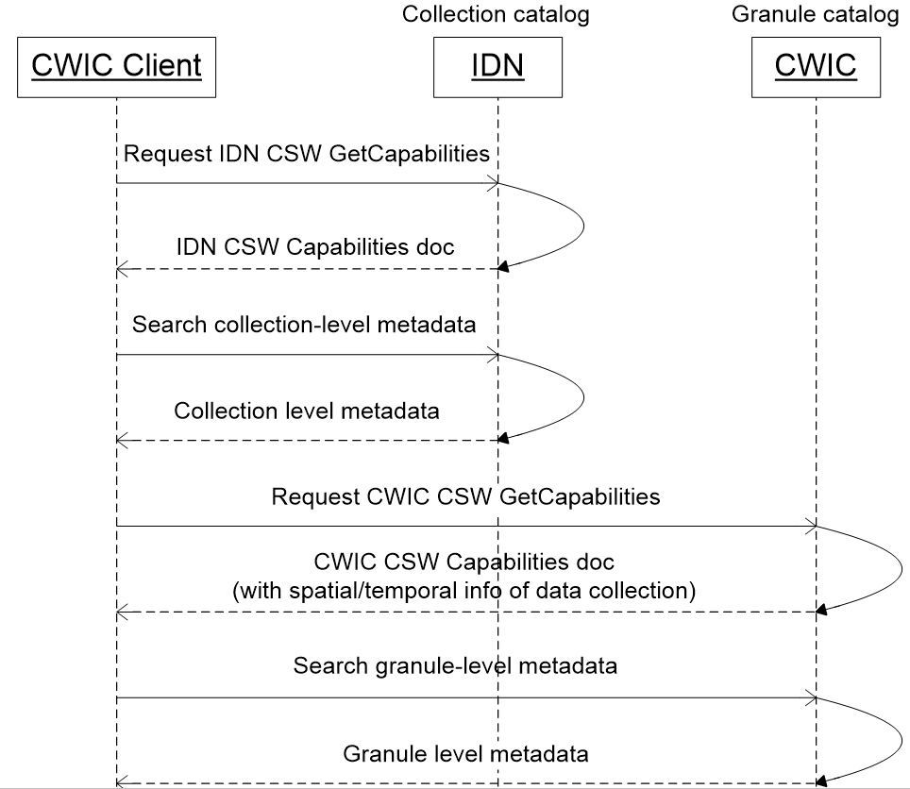
IDN/CWIC CSW 2-step search
Collection level search
  Request IDN CSW GetCapabilities
  Search collection-level metadata
  in IDN (through CSW)
  Return pointer to CWIC OSDD
Granule level search
  Request CWIC CSW GetCapabilities
  Search granule-level metadata
  in CWIC (through CSW)

Slide 5
IDN/CWIC CSW 2-step search
CWIC CSW GetCapabilities
CWIC CSW
Capabilities doc
Service Identification
Basic information about CWIC catalog service
ServiceProvider
Contact information of CWIC catalog service
Supported
CSW Operations
List of of supported CSW operations
(e.g., GetRecords)
Supported queryables
List of of supported queryables of catalog search
(e.g., spatial, temporal and logic operator)
Supported datasets
Metadata (id, spatial footprint, temporal extent)
of archived datasets in CWIC

Slide 6
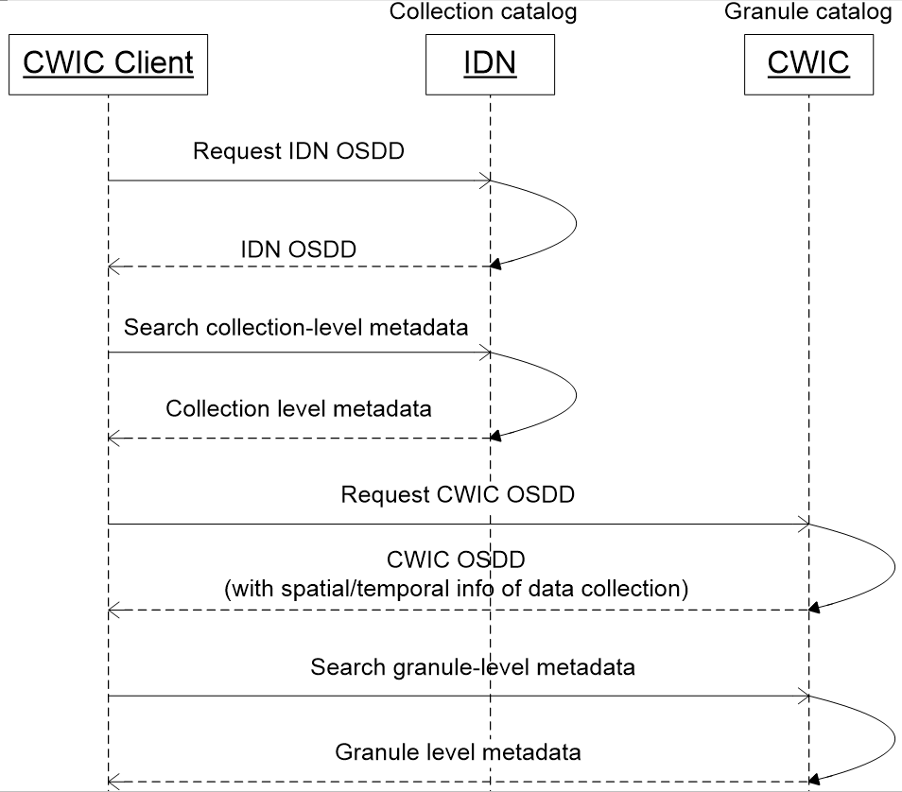
IDN/CWIC OpenSearch 2-Step Search
Collection level search
  Request IDN OSDD
  Search collection-level metadata
  in IDN (through OpenSearch)
Granule level search
  Request CWIC OSDD
  Search granule-level metadata
  in CWIC (through OpenSearch)

Slide 7
IDN/CWIC OpenSearch 2-Step Search
CWIC OSDD
CWIC OSDD
OpenSearch
service metadata
Basic metadata about CWIC OpenSearch service
OpenSearch
request template
Request template for searching granules with constraints
(id, spatial and temporal constraints)
Request template for searching a single granule by identifier
General OSDD
  OSDD with generic information (e.g., template) about how to search granule
  metadata through CWIC OpenSearch
Dataset specific OSDD
  OSDD with dataset specific information (e.g., pre-populated id, spatial and temporal info)
  about how to search granule metadata of a specific dataset through CWIC OpenSearch

Slide 8
Identifying Data Providers from Dataset Identifiers
Where to send the search request?
  CWIC client searches for granules from CWIC using the CMR Concept ID or the IDN Entry ID to identify the dataset
  CWIC identifies the data provider to which the request is to be dispatched based on the dataset identifier provided
  CWIC has an internal mapping table for CMR Concept-id/Entry ID → native dataset ID
CWIC uses the data provider’s native dataset ID in the granule search request, not necessarily the dataset identifier provided by the client

Slide 9
What Metadata is Returned in Search Response?
Responses Dublin Core or ISO-19115 (CSW) or Atom (OpenSearch)
Collection contact information
Granule identifier information
Granule temporal extent
Granule spatial extent
Browse image links
Download/order links

Slide 10
Data Provider Protocols and Requirements
As a mediator, CWIC’s capabilities of querying and returning response rely exclusively on the native protocol supported by data providers.
To be better integrated with CWIC, data provider inventory systems are expected to meet the following requirements:
  Query by dataset identifier
  Spatial/temporal query
  Support pagination
  Support returning essential metadata info
  Exception handling

Slide 11
Data Provider Protocols and Requirements
Requirements of exception handling
  Data provider remote inventory system should indicate errors and return exception status through either application level (e.g. CSW exception response) or generic protocol level (e.g. HTTP status code)

Slide 12
Dataset Identifier Changes
Collection searches to IDN/CMR CSW Capabilities will give correct identifiers for dataset queries
Collection searches to IDN/CMR OpenSearch OSDD will give correct identifiers for dataset queries
Cached (or locally stored) identifiers or DIFs should be updated to ensure valid dataset queries
Recommended to use CMR concept-ids when at all possible
Some IDN EntryIDs have changed
  Version numbers added to previous EntryIDs
  Could cause problems for GEO CSW clients which have cached old identifiers

Slide 13
Adding CWIC Datasets
Publishing new CWIC datasets through four stages
Stage description | Stage
Registering CWIC datasets in IDN (CMR) | Registration stage
Synchronizing datasets from IDN (CMR) in CWIC | Testing stage
Testing datasets in CWIC | Testing stage
Tagging ready-to-search CWIC datasets in IDN(CMR) | Tagging stage
CWIC datasets are: Collection-level info is ready to search in IDN (CMR) Granule-level info is ready to search in CWIC | Production stage

Slide 14
CWIC/ IDN(CMR) synchronization
CWIC/ IDN(CMR) synch in a big picture
IDN
Migration
Remote repository
CMR
Synchronize
Testing
CWIC
Remote repository
…
Tagging
Remote repository
Daily

Slide 15
CWIC Data Partners
Welcoming new CWIC data partners
CWIC Data Partner Guide documents (CSW, OpenSearch) on CWIC page on WGISS website
CWIC Team will provide technical support for new and current partners
Operational Data Partners revising their internal systems
INPE implementing OpenSearch
NOAA have re-implemented their system for GHRSST and will use this system for NCEI data;
While new partners still working on 1.0
AOE still working to connect 3 data centers
Australia (CSIRO, GA, BoM)

Slide 16
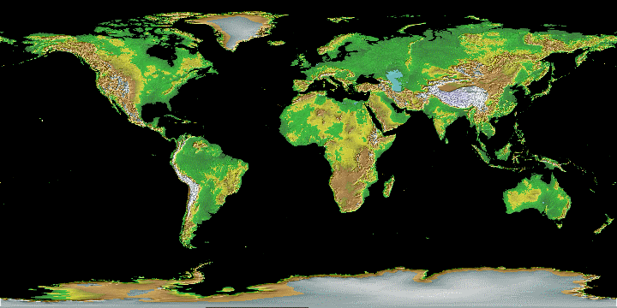



















CWIC Data Partners
CCMEO
AOE
AOE
USGS
NASA
NOAA
ISRO
INPE
GA/BoM
CSIRO

Slide 17
CWIC Client Partners
Welcoming new CWIC client partners
CWIC Client Partner Guide documents (CSW, OpenSearch) on CWIC page on WGISS website
CWIC team will provide technical support for new client partners
Earthdata Search Tool https://search.earthdata.gov
  Collection/Granule search for all CWIC data
  Open source
COVE Tool (Radarsat2, CBERS4, ResourceSat-2)
GEODAB, GEO Portal, ……..

Slide 18
CWIC Metrics
On the WGISS Connected Data Assets webpage, detailed CWIC metrics are frequently updated
Summary metrics
4329 collections are CWIC enabled
With 284+ million granules
Detailed list of datasets for each provider listed
Access to each dataset tested regularly

