Slide 1
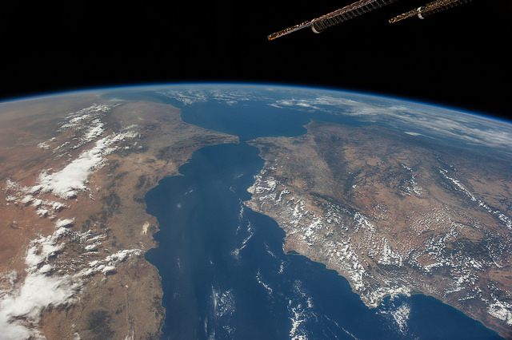
Future Data Access and Analysis Architectures - Overview
Dr Robert Woodcock – WGISS 43
CSIRO

Slide 2
Overview
Why FDA?
Brief Review of 2016 - Why FDA?
Interim Report from 2016
What FDA? - So far in 2017
The pillars of CEOS FDA
How FDA? - What's next for WGISS and FDA
Pilots
WGISS
Open Data Cube
TEP and VLs
CARD4L
SAR ARD
…

Slide 3
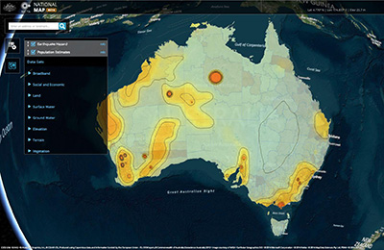
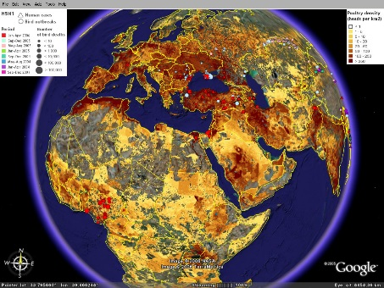
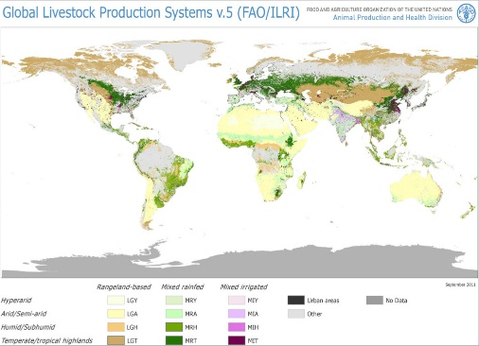
Quick Review
FDA 2016 – Why?
Digital Economy
SME direct Cloud hosting
Entrepreneurship
Economic benefit
Growing EO Awareness
Increasing value
Continued investment
Significant activity
Global Services and Partnerships
UN Sust Dev Goals
Development banks
Food, Ag, Climate
CEOS
Open Data, Interoperable data discovery, New missions
Notes:
The FDA AHT surveyed current developments and priorities from a range of agency contributions and confirmed that there are both challenges in the operating environment and opportunities.
Of particular note in the current development and priorities as it relates to CEOS as a community that recognises the need for coordination:
+ Strong investment driven directive to Maximise the value of EO – Industry/economic benefit
+ Contribution to Global initiatives – interoperate and integrate (analysis)
+ Engagement with Developing countries – access to data and analysis
Also noted a Growing EO awareness (thanks to all the mapping apps!) is resulting in continued investment and Significant activity
Finally, the work of CEOS and others in Open data, Interoperable data discovery (thank you WGISS) and new missions and cooperation is having valuable impact.

Slide 4
Significant change Significant opportunity
Substantial expectation of growth in the EO based digital economy across Industry and Government
A step change in EO satellite capability over the next 5 years leading to new applications
Freely available data and Cloud computing combine to create new industries
New applications from new capabilities in EO
Increased awareness leads to more (non-EO expert) users
Higher spatial resolution
Greater diagnostic capability through increased spectral resolution (hyperspectral) and new modalities (active and passive radar)
New capabilities in monitoring through increased acquisition rate
Notes:
The report also shows a number of changes are providing new opportunities and putting pressure on existing architectures and their ability to meet demand and expectations...
Of those two significant ones are (see slide)…
Two actions:
A further year of work to continue exploration of key areas, and for facilitated strategic discussions;
Parallel efforts to progress CEOS pilot projects to ensure strategic discussions are supported by real-world evidence.

Slide 5
FDA 2017 – What?
Reaching consensus
The questions included … What should agencies do together or alone? What actions have the greatest potential benefit and what should we do?
There were many common responses and desires:
Cloud and data platforms
Interoperability – data (..discovery, Portals, analytics interfaces?)
Open source tools
Users want data systems and analysis tools that allow easy access and use of satellite data
Integratability – easily using different satellite data together
Many users desire ARD to minimize data preparation time and knowledge requirements
Interactivity
Notes:
•The FDA ad-hoc team’s task in 2017 is to establish consensus on what the CEOS FDA strategy should focus on from the various topics identified in the interim report.
•In February, an FDA Strategic Assessment Survey was released for comment. Responses were received from 14 agencies - CNES, CSA, CSIRO, DLR, EC, ESA, EUM, GA, INPE, ISRO, SEO, UKSA, USGS, and WGISS
•The first analysis is looking to present the findings surrounding ‘What should CEOS agencies do together?’
Questions
What should CEOS agencies do together?
What should CEOS encourage that individual agencies do better on their own (e.g. best practices, etc.)?
What should be considered ‘out of scope’ for CEOS?
Which aspect of FDA has the biggest potential to transform how satellite data is exploited?
When you first read the interim report, what struck you as the action CEOS should most urgently take in the FDA area?
Which of CEOS’s strategic priorities could benefit most from the application of FDA?
From the perspective of a user, where is coordinated effort by CEOS agencies on FDA most critical?
What is one thing your agency is already doing in this area that you would like to see contribute to future CEOS efforts in this area?
What could be the key blockers that prevent your agency from participating in CEOS efforts to promote the benefits of FDA?
What might be the main technical barriers?

Slide 6
Overarching comments
Reduction of barriers to find, access and exploit EO data
Sharing of business practices, lessons learned, and usage metrics to form a CEOS information base.
Better understanding of their data users, their needs and expectations.
Development and management of data access and management approaches (e.g. Data Cube, Exploitation Platforms, CWIC).
Gathering of requirements for Analysis Ready Data datasets
Creation of reference architectures and implementations (that test and demonstrate) for interoperable use of CEOS services
Creation, adoption and testing of common standards on EO data that will facilitate EO data interoperability.

Slide 7
How? – order from chaos
Help users benefit from all CEOS data:
Contrasted with current approaches which help improve unity of ‘discovery’ …
But then send users off to disparate incompatible systems once they have discovered some data …
And they need to re-write their application to use alternate (but similar) sources …
And move large amounts of data to the compute capacity they can access …

Slide 8
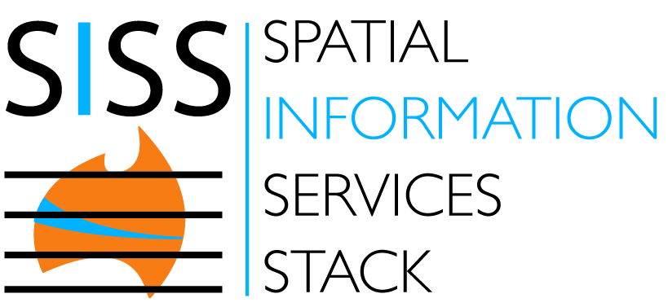
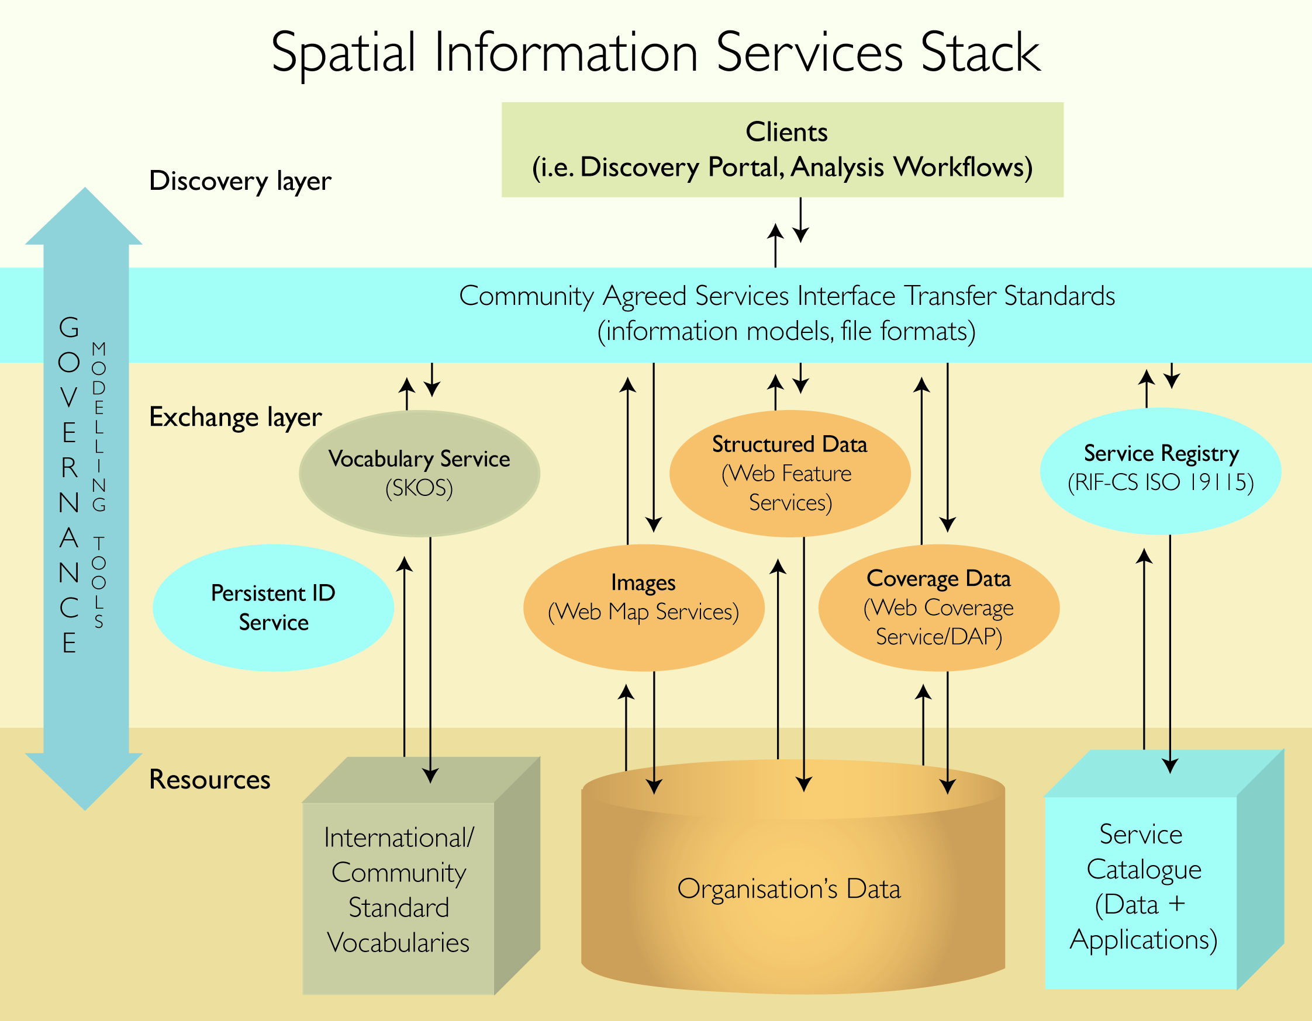
What do WE need to know?
Role of reference architectures
Examples:
OGC Reference Model
OGC Services Architecture
ReST

Slide 9
What do WE need to know?
Examples of topics from OGC ORM:
Enterprise view
Why and the value proposition
Geospatial Information
Information specifications
Spatial referencing
Geographies features
Geospatial Services
Services architectures
OGC Web Services
Reusable Patterns for Deployment
Publish, find, bind pattern
Geospatial portal and clients
Spatial Data Infrastructures
Geoprocessing workflows
Implementation of standards

Slide 10
Emergent first steps…
We have pilot, prototypes and enabling technology work underway within SEO, LSI-VC, GFOI, TEP and WGISS and all the others I have not mentioned

Slide 11
Analysis Ready Data
See Brain K, LSI-VC…
BUT
Many issues with standards development and ongoing consensus …
Can be improved through use of dynamic on-demand processing …
This requires provenance, algorithm registration and discovery…
Automated discovery, processing, downloading and ingesting of data into Data Cubes – Brian K request
And much discussion on how WGISS services support

Slide 12
Future Data Architectures Principles
“Analysis for the masses”
Interaction | Discovery and Download (files) User provides compute | In-place analysis of ready-to-use data User application, data and compute combine from different parties on-demand
Integration | Single sensor discovery Integration a user problem | Comparable observations Global multi-sensor analysis routine
Interoperability | Discovery of files Emphasis on access | Refined discovery of pixels Emphasis on usability for analysis
Interfaces | Independent application development over data Agency stores and distributes data | APIs, Virtual Labs enabled by standards Use of third parties for storage, distribution and analysis
Notes:
This slide shows the architectural principles that change.
Discussion will be mostly providing an brief explanation of each component – most likely only emphasising a few as there will likely not be time for all.
In some respects the before and after picture is really just a repeat of slides 4 and 5 but it starts to tie into architectural practices – so it leads us from the survey and analysis into the next step – how to make it work in practice. Which the AHT has touched on and is recommending is explored more fully in 2017 with both pilots and more technical work…so leads into next slide.

Slide 13
FDA User Summary
What are the user categories and their characteristics?
# | User Type | Examples | Data Volume | Knowledge Capacity | Computing Capacity | ARD Requirement
1 | Data Holders | Google, Amazon, SERVIR | High | Medium | High (cloud, HPC) | Not required, as they will grab what is available
2 | Science | Researchers, Analyses | Low to High | High | Medium (PC, cluster, cloud) | Varies … some desire ARD, others do not
3 | General Global Public | Developing Countries, New Users | Low | Low | Low (PC, cluster) | Typically desired

Slide 14
Pilot Projects
Location | Colombia | Switzerland | Vietnam | USA | Europe | Australia AGDC + Industry Hub
CEOS Lead | SEO (Brian K) | SEO (Brian K) | CSIRO (Alex) | USGS (Brian S) | ESA (Mirko) | CSIRO, GA (Rob, Adam)
Partners | IDEAM | UN-GRID Geneva | VNU, VNSC | BU, USGS EROS | EPOS/INGV | NCI
User agencies | Colombia Gov. | Swiss Gov. | FIPI, Vietnam Govt. | U.S. Gov. and Public | European Governments and Researchers | Australian Govt., Industry, and Public
Application(s) | Forest (GFOI), Change Detection (CCDC, BFAST), Water | Land Change, Water | Water, Agriculture, Disasters, Forestry (priority order) | LCMAP and CCDC (6 national test sites) | Geohazards | Land Change, Water
ARD requirements | L-5,7,8, MODIS, SRTM/ASTER Future: S1, S2 | L-5,7,8. Future: S1, S2. | L-5,7,8 + S1 + ALOS-1/2. Future: S2 | L-4,5,7,8 S-2 (future) Resourcesat-1, -2 (future) | S1, S2 | L-5,7,8, MODIS, S-1,2, SRTM
Other Information | Open Source AWS Demo Analysis to Data | Open Source AWS Demo Analysis to Data | Open Source AWS Demo Analysis to Data | Data Download | Analysis to Data | Open Source Analysis to Data

Slide 15
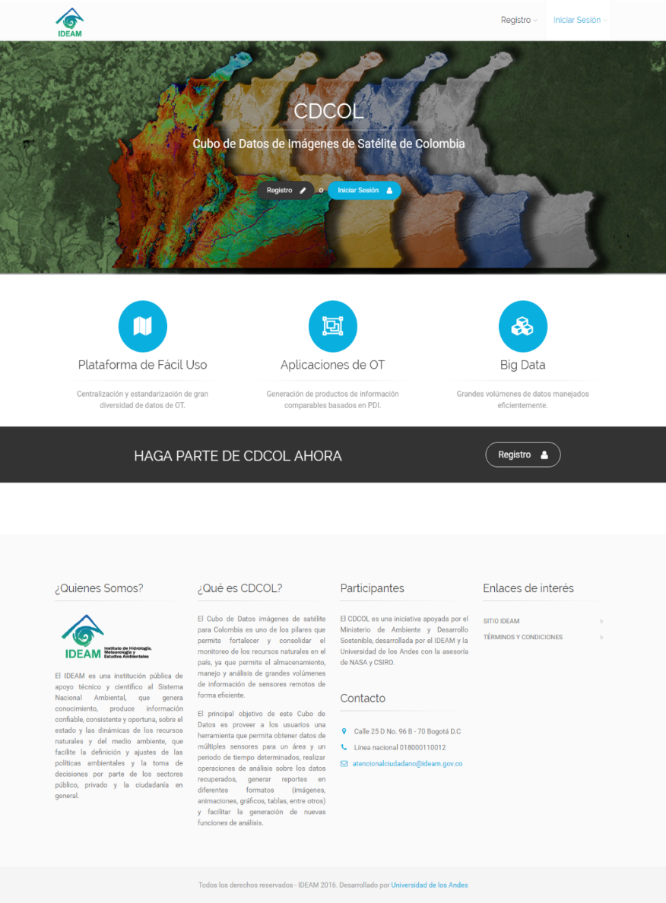
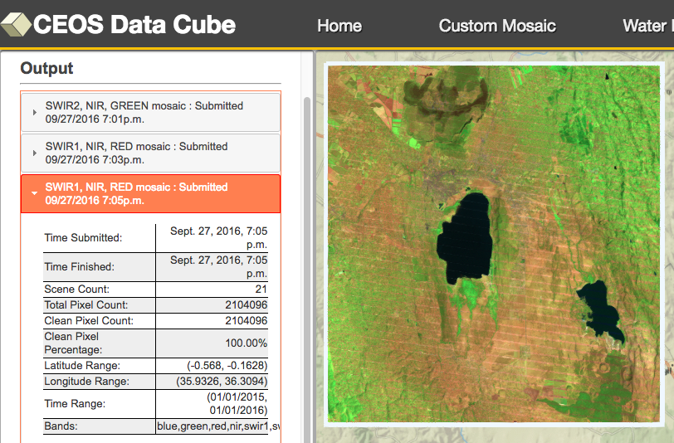
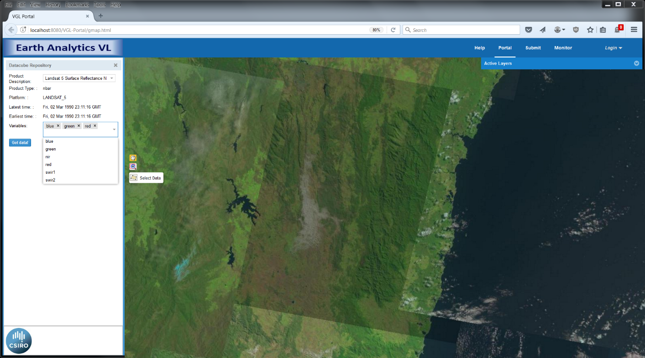
Web Portals

Slide 16
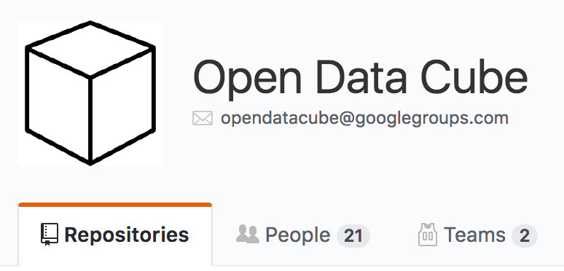
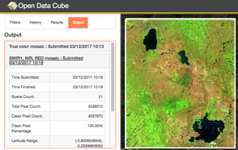
CEOS Open Data Cube
Based on an open source operational system: Australian Geoscience Data Cube (AGDC).
The Open Data Cube, is a comprehensive solution that builds the capacity of global users to apply CEOS satellite data.
Based on Analysis Ready Data (ARD) products that contribute to the increased uptake and impact of growing data volumes
Coordination between GA, CSIRO, NASA, USGS to manage an open source software repository: https://github.com/opendatacube
Current prototype testing in Colombia, Switzerland and Vietnam, with more planned.
Free/Open demo available on Amazon AWS with 14 sample data cubes and 7 applications: http://www.tinyurl.com/datacubeui

Slide 17
Lessons Learned
The Open Data Cube pilot projects have resulted in a number of key “lessons learned” that will improve the success of future deployments. These include:
Users want “customer service” and on-demand help to resolve issues, especially during initial deployment
Users prefer ARD to reduce processing burden, but they still have many issues getting old or new data
Most users want to use QGIS as their GIS tool
Switzerland has a preferred DEM, that is local, not public
Colombia has issues with cloud masking and does not like the standard Landsat CFMask flag

Slide 18
What do WE need to know?
Themes that need attention
Doing and learning
Pilots of different architectures/approaches – engaging users and other key stakeholders (e.g. partner governments, world bank, etc).
Includes producing “ARD” – make it real to find the challenges.
Technical frameworks
Architectural recommendations and best practices.
ARD framework.
User Requirements framework.
Community dimension
Fostering engagement, e.g. open source community, algorithm sharing, etc.
Measuring engagement
Strategic dimension
What do we need to do together to support uptake of satellite EO data from the “CEOS Constellation” e.g. in support of key global agendas?
What should CEOS do to support agencies to do their own things, e.g. best practices etc?
What should be ‘outside scope’ for CEOS?

Slide 19
How do we get there?
Grow a community of contributors to underpin FDA technology (e.g. Data Cube) … CEOS, countries, domain experts
Prototype demonstration projects … 3 now + more
Develop a FDA Learning Center with documentation, training tools, and a user forum … end of 2017
Conduct frequent training workshops and webinars?
Agency focus on ARD creation and provision - WGCV
Leverage WGISS exisiting and expand capabilities
Engage key stakeholders who can help with scaling and sustainability
Notes:
Continue and support existing WGISS efforts on:
Discovery Search Engine Optimization (search relevancy, keyword search, persistent identifiers)
Access Common Standards for Interoperability of Product Formats (metadata/data) and Application Program Interface (API)
Exploration of Emerging Big Data services including Cloud Computing

