Slide 1
OGC TB13 EO Cloud Thread
Cristiano Lopes
03/04/2017

Slide 2
OGC Testbed 13
Part of the Open Geospatial Consortium (OGC) Interoperability Program (IP).
The IP provides global, hands-on, collaborative prototyping for rapid development and delivery of proven candidate specifications to the OGC Standards Program.
A Testbed is a collaborative research and development effort to develop, architect, test, and demonstrate candidate standards for interoperability.
In a Testbed participants collaborate to examine specific geo-processing interoperability questions posed by the initiative’s Sponsors.

Slide 3
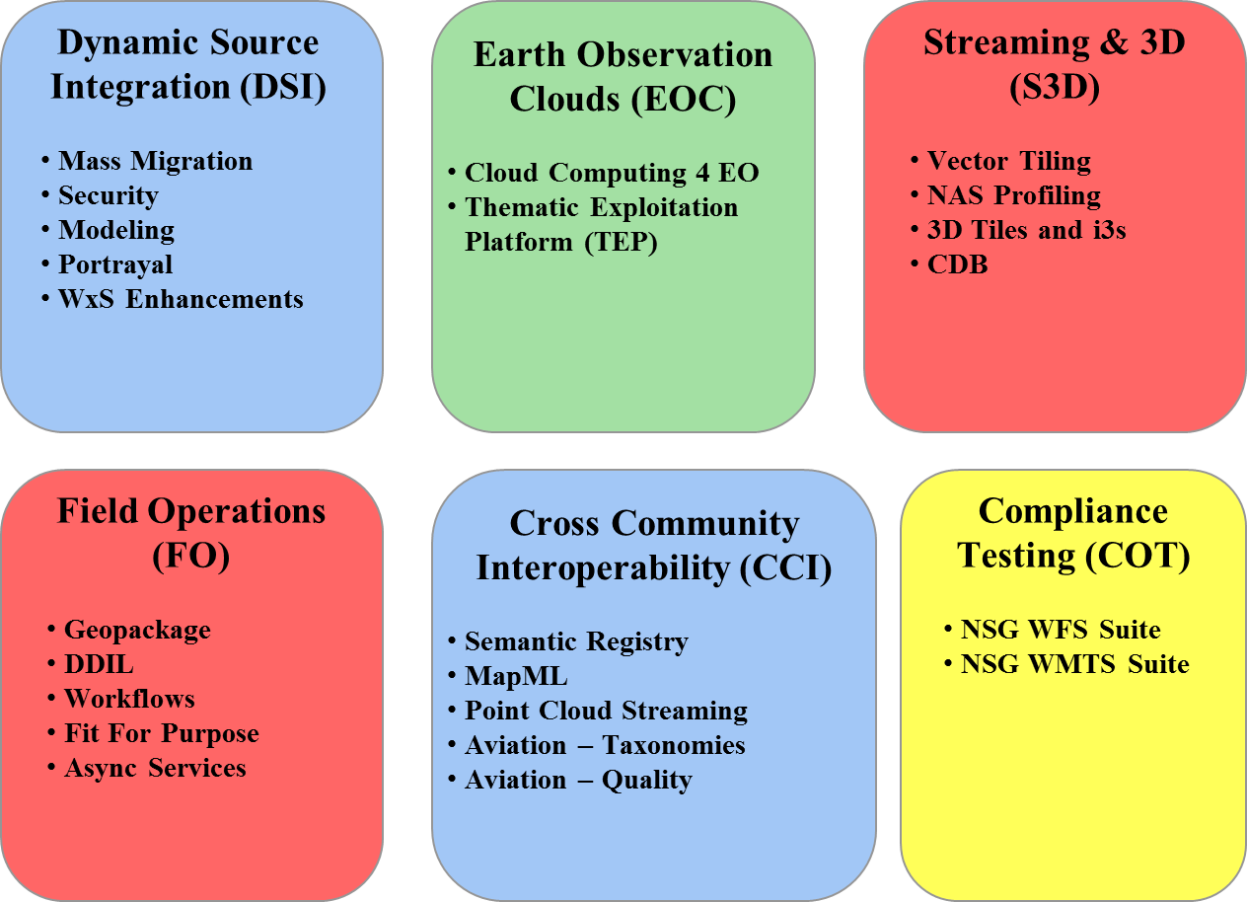
OGC Testbed 13 Threads

Slide 4
TB13 Earth Observation Clouds Thread
Thread composed of two independent Work Packages. Sponsored by NRCan and ESA.
Cloud API interoperability Look into into how Cloud APIs can be standardized, so interaction with different clouds would have minimal impact on the customer’s components. Changing cloud services across providers would be a smooth experience.
Thematic Exploitation Platform - Application portability Investigate how to easily transfer an application or application components from one cloud service to a comparable cloud service and run the application in the target cloud service, without making significant changes to the application code.

Slide 5
ESA Objectives for Testbed 13
Primary, Application Package for (Thematic) Exploitation Platforms
Definition of a package for user applications enabling automatic management (upload, deploy, run) and sharing between platforms
Definition and execution of bulk processing (time-driven) for historical data and continuous data generation
Secondary, gain experience with:
GeoJSoN OpenSearch extension (17-003r0)
AuthN and AuthZ (IdP+STS) in interoperability context
Accounting information exchange interface between platforms

Slide 6
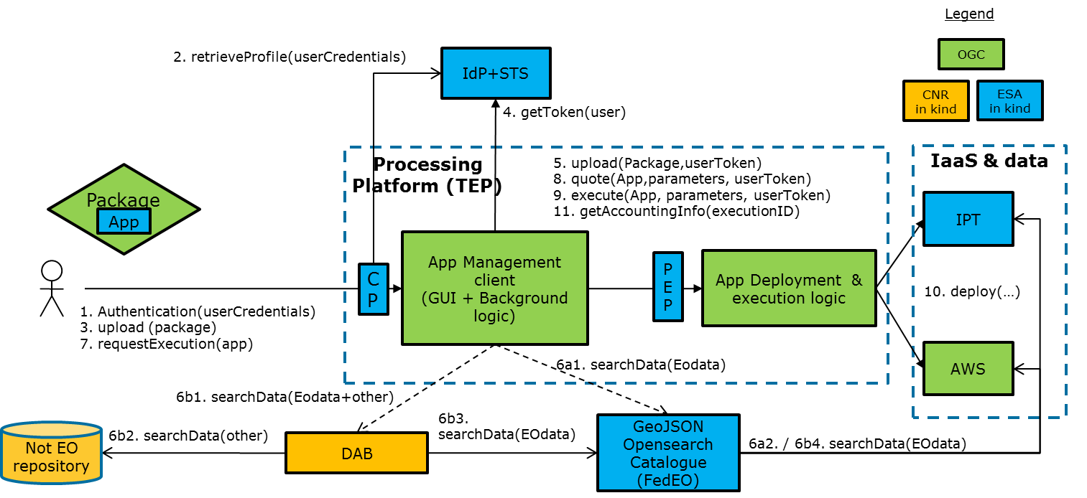
Architecture Overview

Slide 7
Application Portability

Slide 8
Scenario 1: Historical Data Generation
User selects an Application
User selects a processing window parameters, as:
Start time -> stop time
N days shifting window
N days shift
User selects execution parameters of the Algorithm, as:
Input products selection rules, e.g.:
AOI: Romania
Cloud coverage < 10%
Cumulative time coverage: all available data
Algorithm processing parameters
User runs a Bulk Windowed execution (multiple windows are launched in parallel)
User is notified at the end of the processing and can access the status of the different processing windows

Slide 9
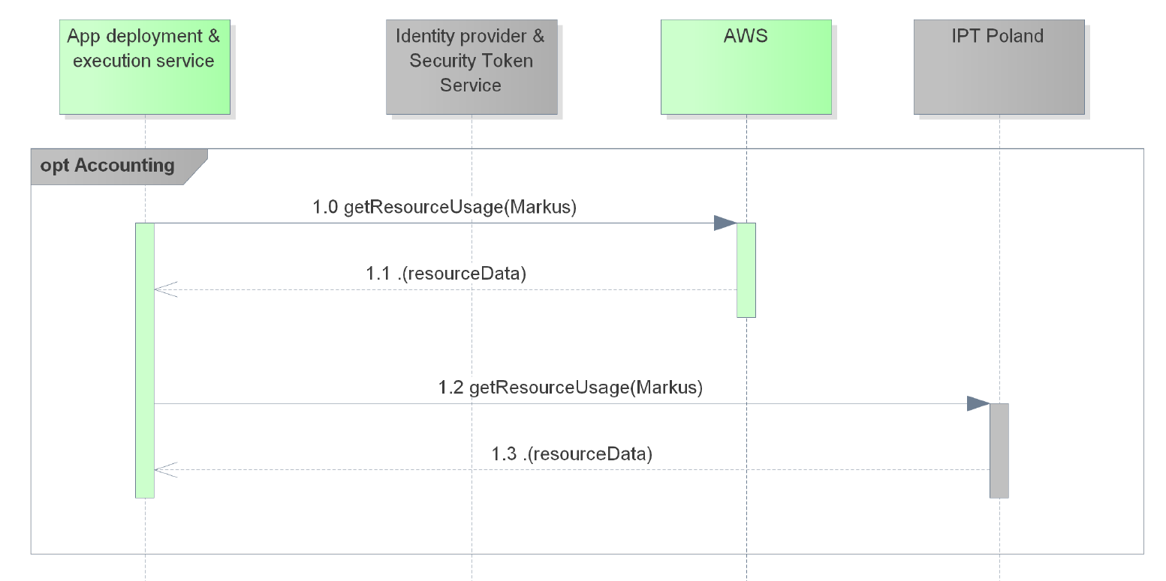
Scenario 2: Continuous Weekly Data Generation
As per Scenario 1, with the following differences:
Frequency (“each week on Tuesday”) and shifting window relative to execution date (e.g. “execution day -8” to “execution day -2”)
User are notified upon each window execution completion
Processing is repeated until manually disabled
Sub-scenario: Accounting & Billing (Optional)

Slide 10
EOC Thread deliverables
Cloud API interoperability
Cloud Engineering Report
2 x Cloud environment (WPS, WMS, WCS based)
Application portability
Application Package Engineering Report
2 x Application Management Client
Application Deployment and Execution Service Engineering Report
2 x Application Deployment and Execution Service Implementation

Slide 11
Testbed schedule
CFP Issuance (all approvals received prior) | 25 January
CFP Proposals Due – Part 1 CFP | 20 February
TEM-1 | 28 February
TEM-2 | 7 March
Bidder Notifications begin | 1 March
Kickoff Workshop – Reston, VA | 4-6 April
… work work work ...
Demo Event | December

Slide 12
References
OGC Testbed 13 http://www.opengeospatial.org/projects/initiatives/testbed13 http://www.opengeospatial.org/standards/requests/154
Open Geospatial Consortium - Interoperability Program http://www.opengeospatial.org/ogc/programs/ip

Slide 13
Cristiano Lopes
Ground Segment System Engineer
Earth Observation Programmes
Phone: +39 06 941 80735
Email: cristiano.lopes@esa.int

