Slide 1
AGDC Current Status
Challenges and Plans
CEOS WGISS 43
Prepared by Simon Oliver, Matt Paget, Peter Wang
Presented by Robert Woodcock

Slide 2
Overview
Open Data Cube - the code has a new home!
Archive Reprocessing
Collection Management
Coherence / Completeness / Operations tools
Product support
/ MODIS / rainfall / SRTM / radiometrics
Pipelines beta
/ S2 NBAR / S1 gamma0 / Landsat SBT
Temporal stacks
Stackability
Ingest - 3D NetCDF creation
AWS Deployment - Datacube with S3
AWS Hyderabad Cube / AMI / On-demand DC / LEDAPS support
Grid Workflow
Temporal Statistics
PiPy
Communication channels
Challenges
In 10 minutes!

Slide 3
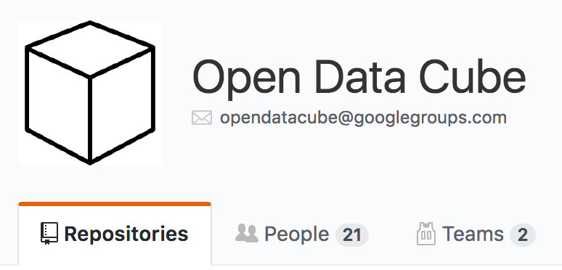
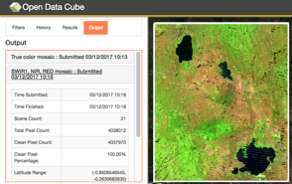
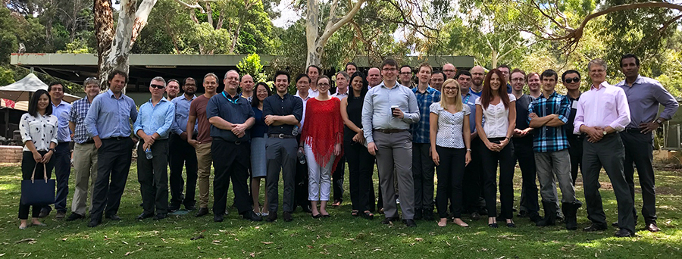
CEOS Open Data Cube
The Open Data Cube, is a comprehensive solution that builds the capacity of global users to apply CEOS satellite data.
Based on Analysis Ready Data (ARD) products that contribute to the increased uptake and impact of growing data volumes
Coordination: GA, CSIRO, NASA, USGS. Open source software repository: https://github.com/opendatacube
Current prototype testing in Colombia, Switzerland and Vietnam, with more planned.
Free/Open demo available on Amazon AWS with 14 sample data cubes and 7 applications: http://www.tinyurl.com/datacubeui

Slide 4
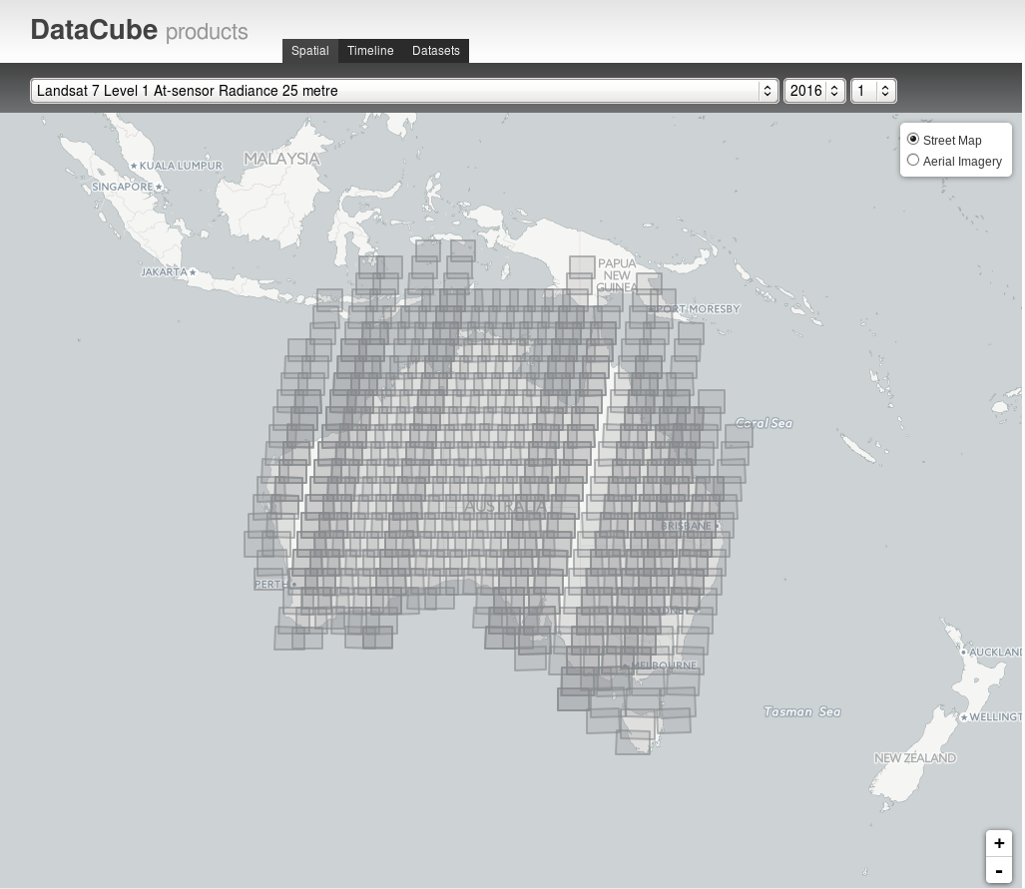
Archive reprocessing
Complete reprocessing of Landsat archive
Level 1
NBAR / T (+T = new product )
PQ
Moved scene processes to datacube
Fractional Cover
NDVI
Dashboard for visualising data holdings and dataset metadata

Slide 5
Collection Management
Providing users with a view of the archive content
Completeness
Of the potential datasets, how many exist
Consistency
Duplication (handling upstream production quirks)
Coherence
Orphan checking / descendents and ascendants
Syncing to ensuring files on disk match datacube content
Notes:
So the datacube core currently tracks what we have. What datasets we know about (that existed at any time), where they are etc. It says what there is, but not what there should be.
You can tell the datacube about a dataset (I have a level1 here->) and it will keep record of it for you. But keeping it consistent is done manually (is this replacing an old scene? Need to archive the old one when you add the new one).
During tumultuous beta period for a collection, datasets can be deleted and replaced, and our diverse ecosystem of software doesn't all know to tell us that it changed the dataset.
You can add three reprocessed copies of the same scene and it will happily keep track of them all for you, but we probably don’t want all three to be returned in normal search results.
The cube tracks what there is, but not yet what there should be. The coherency effort is to start looking at automating the maintenance of what should be. If we have three copies of that scene, which is the one that should be used?
And importantly, we’ve done this manually up to now with ad-hoc scripts, but we want something that’s trustworthy enough to run automatically and hands-off, and to remain maintainable as the system evolves.
First level: Ensuring the index matches the storage
(examples of edge cases we find/fix)
Second: We may have multiple copies of datasets from different sources. Find the logically equivalent datasets (eg. of the same scene acquisition), and decide on which one is best.
(examples of edge cases we find)
Third: Going up the tree. Do all nbars have a level1, do all level1s have telemetry etc.
[Going down the tree would be completion, not covered here].
(examples of edge cases we find)
Define what/where we expect of a collection.
Introduced a new ’sync’ command. Designed to be hands-off, so we can run it automatically.

Slide 6
Collection Management
Collection Management Interface
Product Definition
Product version
Business Managed allocation of Major Minor Patch designation based on principles of collection scope and significance evidence through assessment of impacts of change
Major, Minor, Patch
1.1.1
1.2.2
x.x.x
Version controlled software
AGDCv2 Core Code v1.1.12
Landsat Level 2 processor v2.2.2
EO Dataset scene based packager v 2.1.1
Landsat Level 1 production system v1.1.1
LPGS v3.3.4
Version controlled inputs
Version of inputs and code repositories in provenance
Collection coherence validation
Ancillary 1 v1.1.1
Ancillary n v1.1.1
AGDC Database
Datasets v x.x.x

Slide 7
Product support – not data cube native
Leveraging existing datasets on NCI systems
MODIS MCD43A1-4 indexed
BoM Rainfall indexed
Radiometrics
Shuttle Radar Topography Mission
Feedback from users on potential new data sources
Enabling alternate protocols
HTTP/S3 indexing for Sentinel-2 and Landsat 8 L1T files on AWS
Support for re-projection on Data Cube Load

Slide 8
Temporal Stacking
Ingest – netCDF
Generation of XYT NetCDF storage objects + chunking.
important part of enhancing data access and in managing inode counts and relates to the combination of a number of datasets into a single file.
The internal chunk size can be modified at stack creation time to tailor to a give mode of access (temporal or spatial)
Notes:
Stacking is an important part of enhancing data access and in managing inode counts and relates to the combination of a number of datasets into a single file. The internal chunk size can be modified at stack creation time to tailor to a give mode of access (temporal or spatial). With stacking comes a number of challenges in an operational setting in terms of dealing with changes to the content of that stacked data.csiro/s3-driver -> csiro/s3-driver
Improvements currently in csiro/s3-driver.
Improved ingester to support generation of 3D NetCDF storage objects with 3D chunking support.
Keeps same indexing/database structure. One Dataset per time slice in the 3D NetCDF file. Provenance is per Dataset/timeslice in the NetCDF file.
This will be extended to support s3 storage.
3D NetCDF in testing phase.
3D S3 in development.

Slide 9
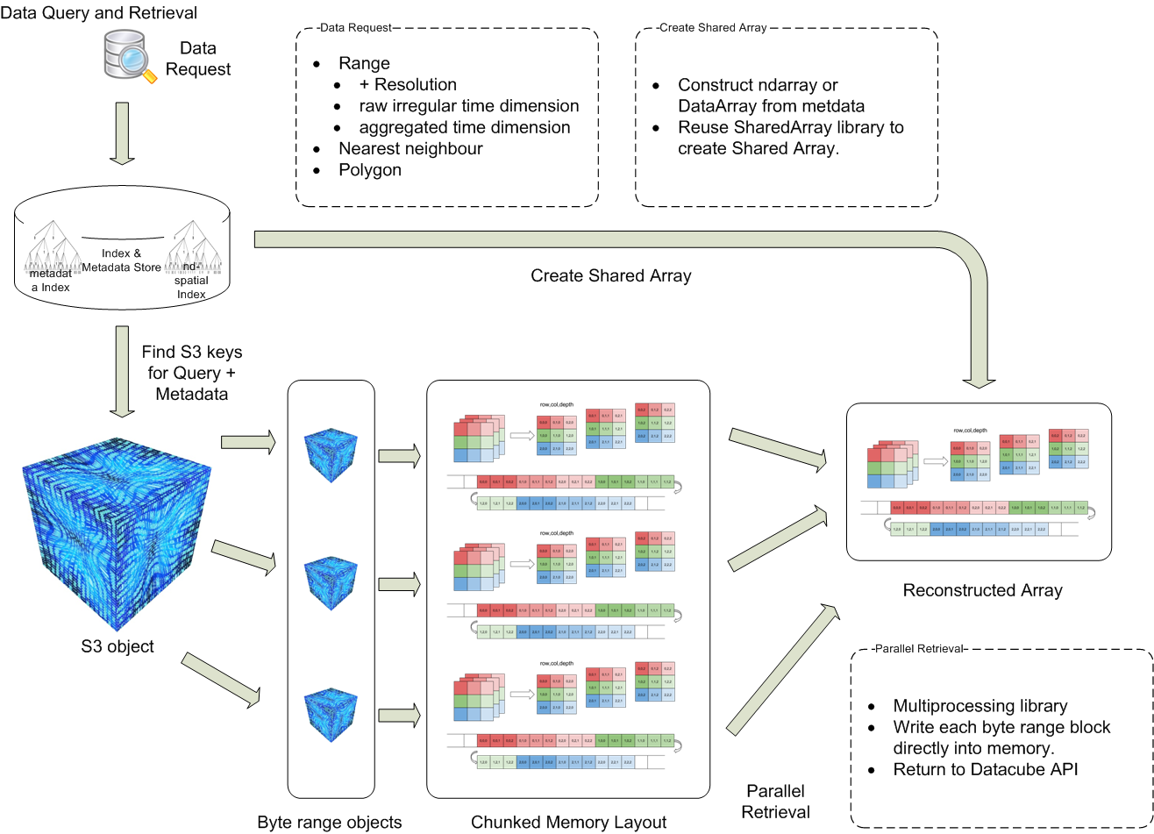
Data Cubes and AWS with native S3 support
AWS for exploratory analysis and market access
Fast, scalable and accessible
Address multi-platform criteria
New data structures for EO
Aligned with S3 principles
Analytics to take advantage of I/O concurrency
Notes:
Data Cube with Native S3 object storage
Usual Data cube API but no files. Store just the raw bytes in S3.
Data Cube Storage Drivers (pluggable storage with index)
Choose NetCDF storage, S3 storage, or OPeNDAP or ...
Use S3 like main memory for raw array storage and access.
Ingest to 3D storage objects with 3D sharding across S3 objects.
Parallel reads/writes to S3 and numpy ndarray.
Expected to scale linearly to network/instance(s) limit.
ndarray read/write (e.g. slice) operate on S3 objects.
Less translations required to read/write nd array data.
Data stored on s3 is compute ready.
Stored data is ready to be consumed by CPU/GPU on the low-level.

Slide 10
Statistics Tools
Adds support for deep temporal analysis statistics
Keeps full provenance of source datasets
Splits processing into small spatial chunks, never be limited by available memory
Out of the box support for standard statistical means/percentiles/etc as well as high dimensional stats like medoid and geomedian (soon)
Has been developed in a separate repository, but will be merged into core in the next month
https://github.com/GeoscienceAustralia/agdc_statistics

Slide 11
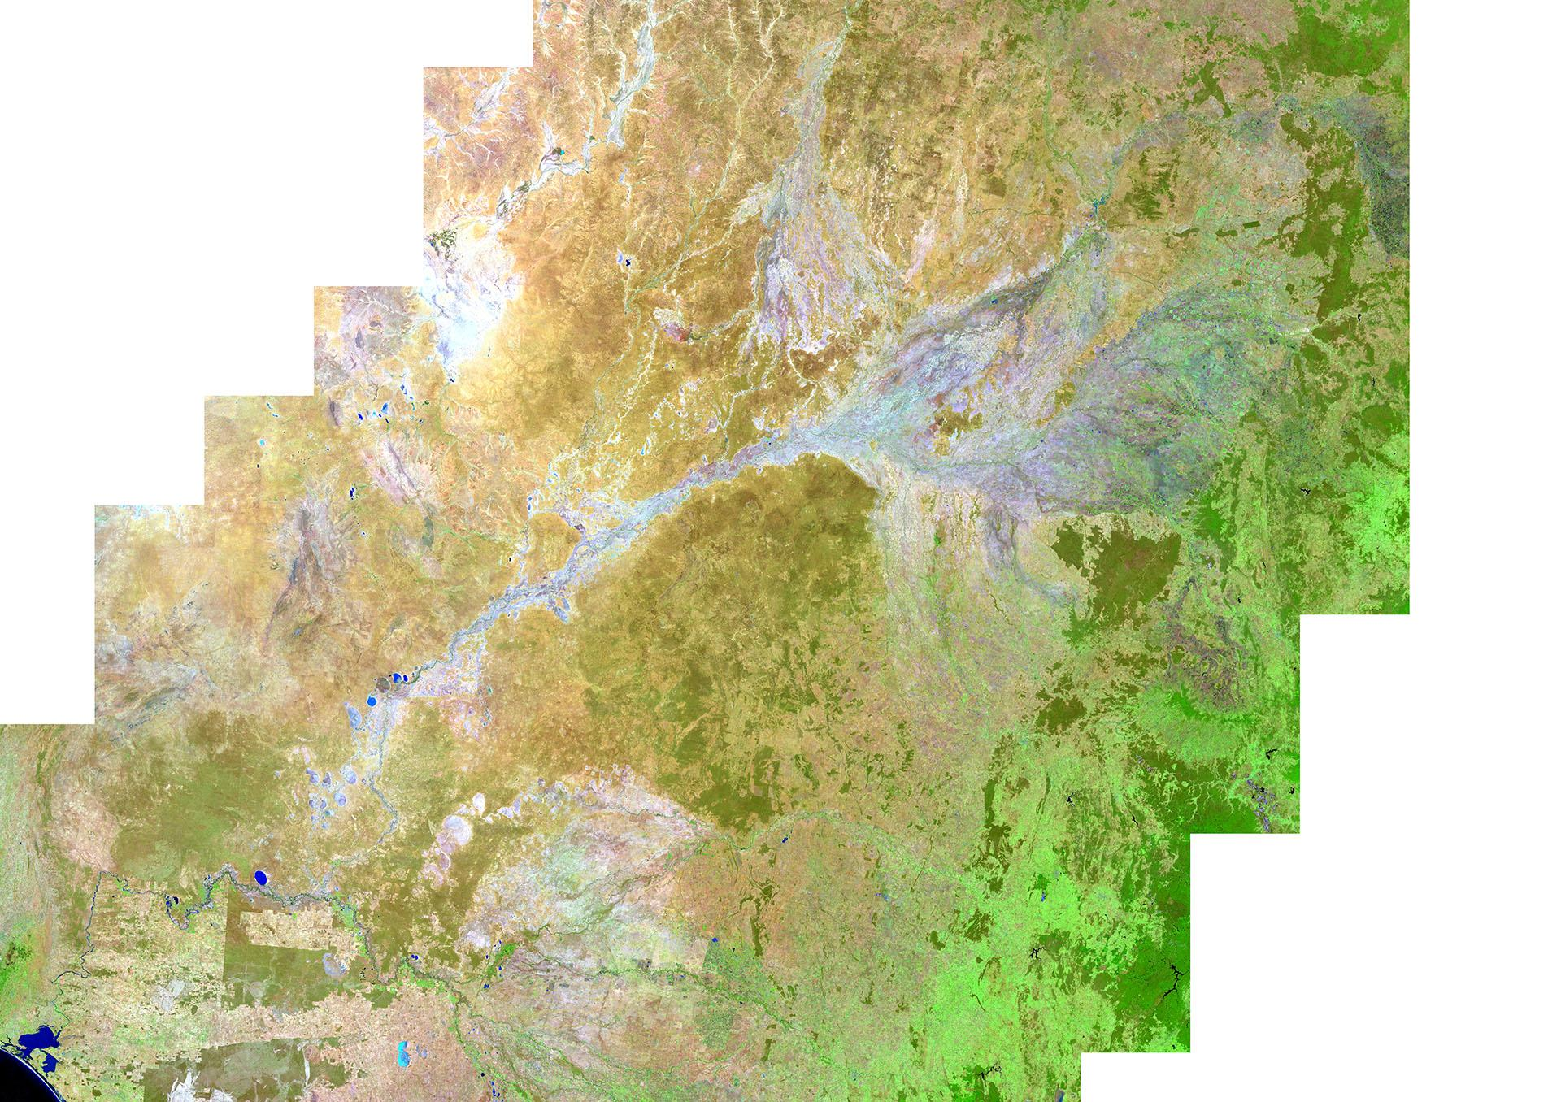
NBAR-T
Geometric Median
Murray Darling Basin
1,061,469 km2
Geometric Median
Preserves the spectral character
Terrain corrected
Notes:
It is the geometric median of Landsat 8 observations for the 2015 calendar year over the Murray Darling Basin, displayed as band 6, 5, 3 false colour (that is SWIR on red channel, NIR on green channel, Green on blue channel). The geometric median is a high dimensional median that preserved the spectral character of the observations from which they are derived and provides a summary of median conditions for the entire basin. Without ARD this would show scene edges, variance in illumination and other conditions that impact the creation of composites.

Slide 12
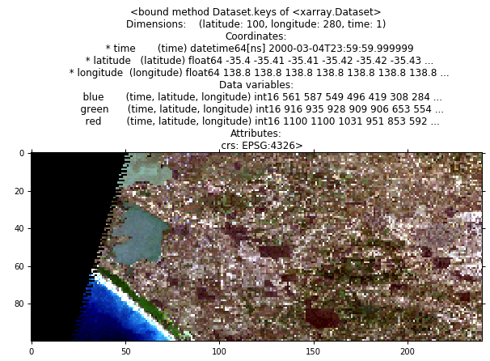
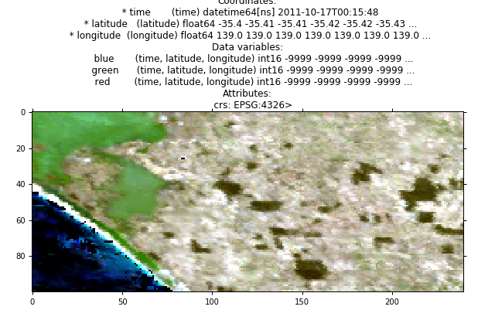
Sensor Ignorance
Require no sensor understanding
Spectral equivalence measures
Below using wiki definitions of red, green and blue to find equivalent sensor bands (Landsat TM MODIS)
Notes:
Removing the requirement for sensor understanding to be able utilise data from a given platform, is seen as a major obstacle to greater adoption of remote sensing by the masses. Sensor Ignorance is a concept (still under development) to allow a user to match sensors to a given spectral response (band matching or an idealised band i.e. “blue from wikipedia”) This example demonstrates uses the datacube to match Landsat bands to the relevant MODIS bands, purely by examining and evaluation the spectral responses store in the datacube metadata.

Slide 13
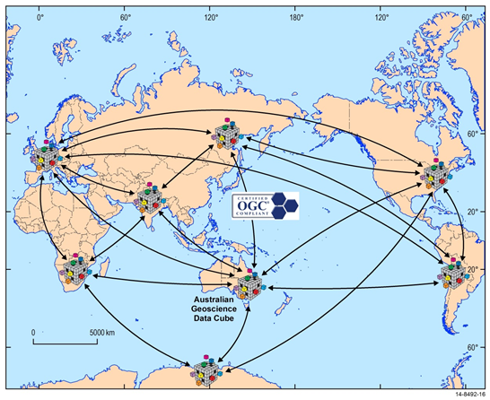
Earth Analytics Industry Hub (CSIRO)
Public good component using free satellite data
A global network of interoperable data cubes
Commercial component
Business processes and engagement to sustain science and data pipelines
“App Store” of analytics routines
EO and geoscience researchers delivering to minerals, agriculture and environment domains
Multi-platform
Data cube applications work seamlessly across Cloud, HPC and your desktop
Notes:
Who wants in? We’re keen to partner with you.

