Slide 1

WGISS Working Group for Information Systems & Services
Chair report
Committee on Earth Observation Satellites
Andrew Mitchell - NASA
WGISS-43
Annapolis, Maryland - USA
3rd April 2017

Slide 2
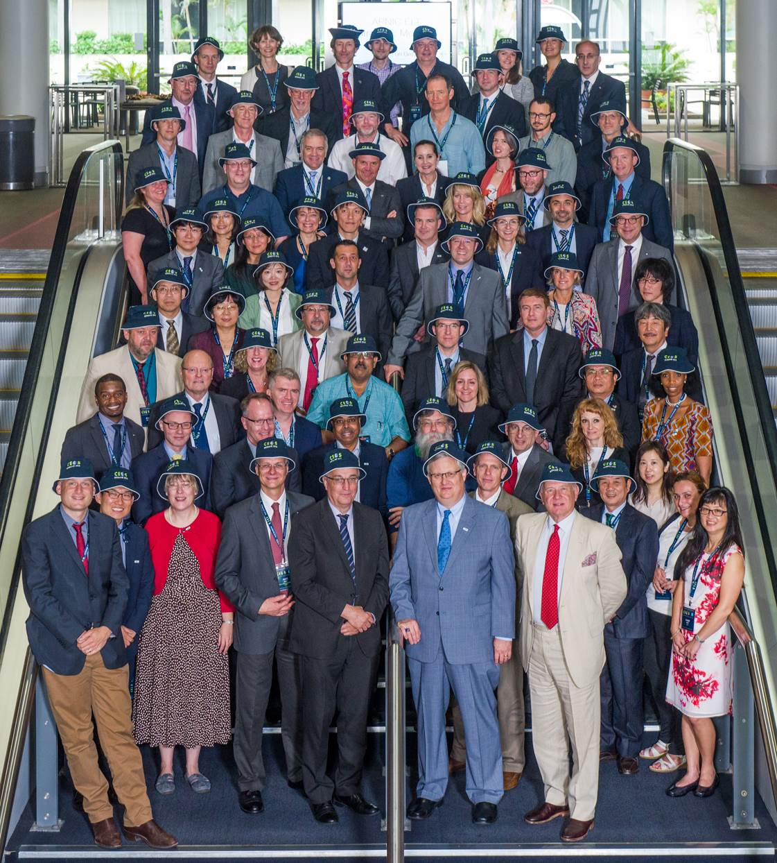
CEOS Plenary
Conclusions Brisbane, AU
October 31st – November 2nd 2016
Committee on Earth Observation Satellites

Slide 3
2017 CEOS Chair Objectives
NEW 2017 CEOS Chair – USGS - Frank Kelly
Ensure continuity and coherence of current CEOS activities
Ensure that the priorities and themes identified by the outgoing Chair (CSIRO) and the current SIT Chair (ESA) are supported and further developed through 2017
  Chair (CSIRO)
    Future Data Access & Analysis Architectures
    Non-meteorological Applications for Next Generation Geostationary Satellites
  SIT Chair (ESA)
    Consideration of future partnerships and priorities for CEOS, notably with GEO, the UN system, development banks, and the big data players
    Expediting existing CEOS thematic acquisition strategies – in relation to forests, agriculture, disasters, climate, carbon and water
Pursue 2017 Chair Initiatives

Slide 4
2017 Chair Initiatives
2017 Chair Initiatives
    Future Data Architectures Continuation
    Moderate Resolution Sensor Interoperability

Slide 5
Future Data Architectures
Continuation
Approval for the Ad-hoc Team on Future Data Access and Analysis Architectures to continue for a further year to complete the mandate and to pursue confirmation of the Co-Chairs.
Agreement for the proposed pilot project(s) to be progressed in parallel with the ongoing report work, with oversight by the FDA team and contributions from LSI-VC, SEO, and SDCG.
Invitation for further proposals for practical demonstrations in the area of FDA for ‘lessons learnt’ evaluation by CEOS Principals at CEOS-31.
Action for CEOS and SIT Chairs to confer with the FDA Team to ensure necessary CEOS Principal engagement on the strategic issues arising from the 2017 Report, in support of identifying common ground as the basis for a long-term CEOS strategy.

Slide 6
Moderate Resolution
Sensor Interoperability
Priority #1: Generally applicable framework for land moderate resolution interoperability
  Led by LSI-VC (with SEO support)
  Comprehensive framework that includes characteristics such as radiometry, geometry, data formats, browse, metadata, data access, metrics, and reporting
Priority #2: Case Studies. Document, publish, and communicate clearly to the community the objectives and intended uses of the interoperable products
  Led by WGCV & WGISS (with LSI-VC and SEO support)
  Case Study #1: Landsat-Sentinel-2 Interoperability
  Other Case Studies welcomed
Moderate resolution = 10 – 100m

Slide 7
Participation at Recent Meetings
Richard Moreno/CNES presented methods for accessing CEOS data via WGISS assets during the GEO-XIII Plenary’s Data Provider Side Event, on 7 November 2016 in St. Petersburg.
Gabor Remetey/Hungarian Association for Geoinformation) presented ‘WGISS Interoperable Standards and Information Architectures’ at GSDI (Global Spatial Data Infrastructure World Conference ) 15 World Conference (Track 3 - Earth Observation, Sensors, Geo Technology & SDI Innovation Theme 5. Earth Observation and Sensors) 28th Nov – 2nd Dec 2016.
WGISS (Richard Moreno) will be giving a keynote presentation during the GEO Data Provider’s Workshop in April 2017 on the GEO/GCI Success story of GCI-CEOS Interoperability Achievements and Next Steps.

Slide 8
1st Tech Expo Webinar
Held the first Technology Exploration webinar on March 14th on ‘Relevancy Ranking of Data Search Results’. The GEODAB (GEO Data Access Broker) along with NASA’s Common Metadata Repository (CMR) were co-presenters.
As CEOS Earth Observations, ranking data search results by their expected relevance for the user is potentially one of the most powerful ways to help users quickly zero in on the best data for their purpose. This webinar discussed some of the techniques being used within Earth Observation data search tools and also included a discussion of possible future directions in relevancy ranking.
http://ceos.org/ourwork/workinggroups/wgiss/technology-exploration/ceos-wgiss-technology-exploration-webinars/

Slide 9

Coordination Group for Meteorological Satellites (CGMS)
Working Group (WG) IV Global Data Dissemination
In response to CGMS action item # A44.03 (identify how far WGISS Interoperable standards were adopted), WGISS provided a list of CEOS agencies who have implemented CEOS Opensearch Best Practices: EUMETSAT, NASA, ESA, CNES, USGS, JAXA, ISRO (NRSC) and CCMEO.

Slide 10

GEOSS EVOLVE
In the 2017-2019 GEO Workplan, the GEO Foundational Task GD-07 is transitioning to a GEO Initiative titled ‘GEOSS EVOLVE’.
WGISS, as a data provider of GEOSS, is now included under GEOSS EVOLVE “Work Package 2: Functional Testing”.
WP2: Functionality Testing (lead China-RADI): Test functionalities of the GCI, the GEOSS data providers and the GEOSS community portals needed to support the requirements expressed by the users through the dedicated foundational tasks.
WGISS has representation in many other WPs including:
  WP1- Evolving GEOSS Architecture,
  WP3: Data Management Principles
  WP 5: Demonstrations Projects (Lead OGC)
  WP 6: Community Portals

Slide 11

WGISS Vice Chair Nomination
WGISS Vice Chair Nomination – Awaiting response from the CEOS agency which expressed interest in putting forward a nominee. They are considering the four-year commitment which would begin in Nov 2017.

