Slide 1
WGISS-42
September 19-22, 2016
ESA-ESRIN, Frascati

Slide 2
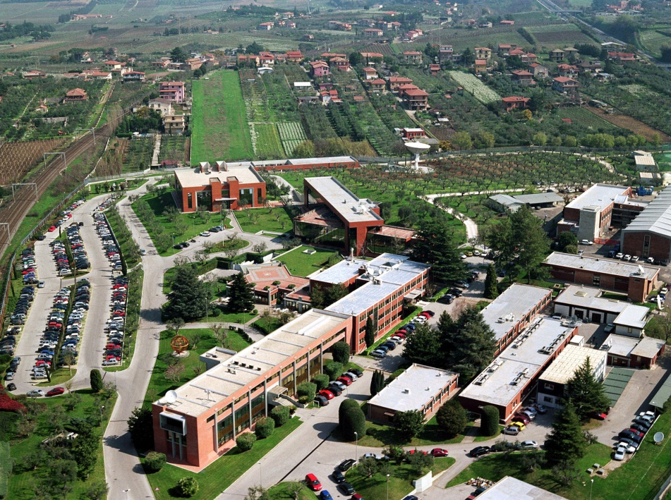
ESRIN location
ESRIN, in Frascati, Italy, is ESA’s centre for Earth Observation where operations and exploitation of Earth Observation satellites
are managed.
The world’s largest database of environmental data for both Europe and Africa is managed from ESRIN.
http://esamultimedia.esa.int/multimedia/ESRIN/virtualtour/content_full.html

Slide 3
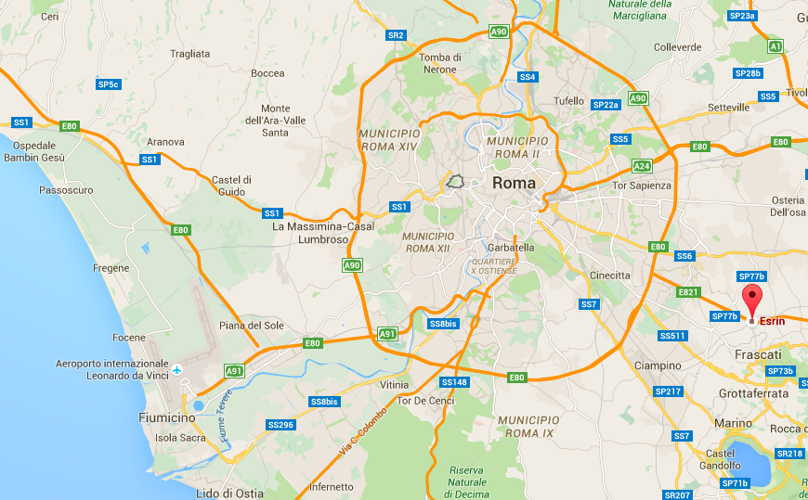
Getting to and from ESRIN
ESA Centre for Earth Observation (ESRIN)
Via Galileo Galilei snc, 00044 Frascati, Rome
Arriving by car from Rome Leonardo da Vinci Fiumicino airport: Approx. time: 45 mins & Distance: 44 km
Arriving by car from Ciampino airport: Approx. time: 20 mins & Distance: 17 km
Arriving by car from Rome city centre: Approx. time: 40 mins & Distance: 25 km
Arriving by train: Approx. time: 20-25 mins. Tor Vergata train station is 2-3 minutes walking distance from ESRIN.
Additional information:
http://www.esa.int/About_Us/ESRIN/Getting_to_ESRIN

Slide 4
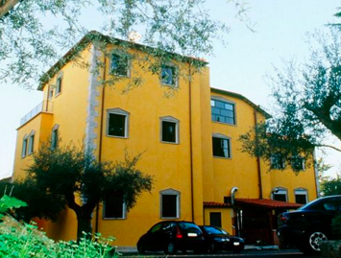
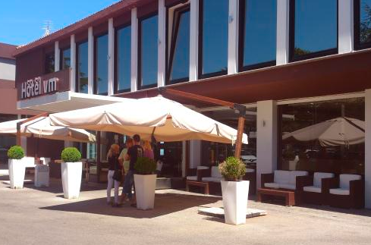
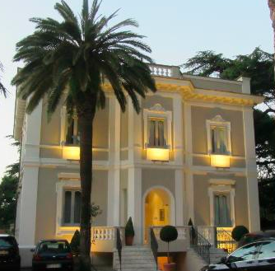
Recommended accommodation in Frascati
(make reference to “ESA meeting” at time of booking)
Hotel Antica Colonia
http://www.hotelanticacolonia.it/
Standard room: ~ 80 Euro
Hotel Villa Mercede
http://www.villamercede.com/
Standard room: ~ 94 Euro
Hotel Flora
http://www.hotel-flora.it/
Standard room: ~ 90 Euro

Slide 5
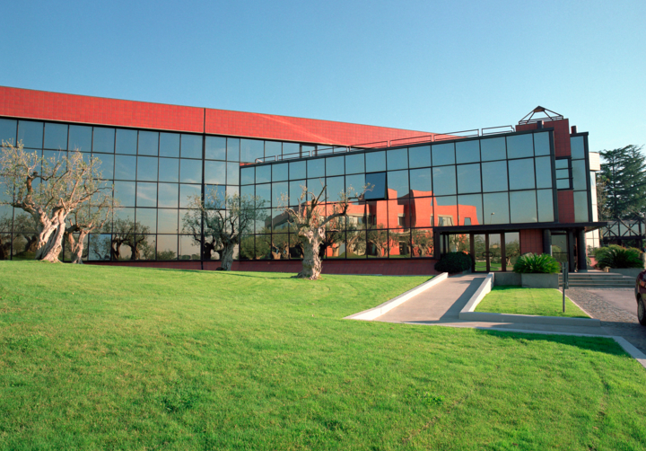
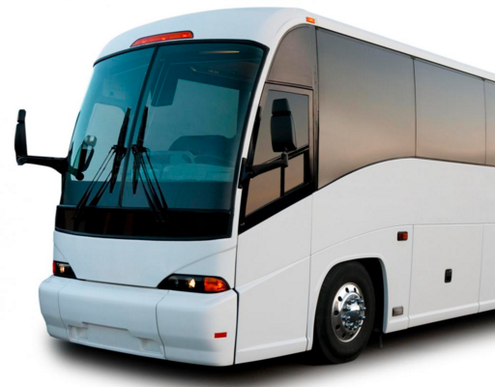
Transfer Hotel - ESRIN
Shuttle bus provided by each recommended hotel to and from ESRIN
ESRIN
Hotels

Slide 6
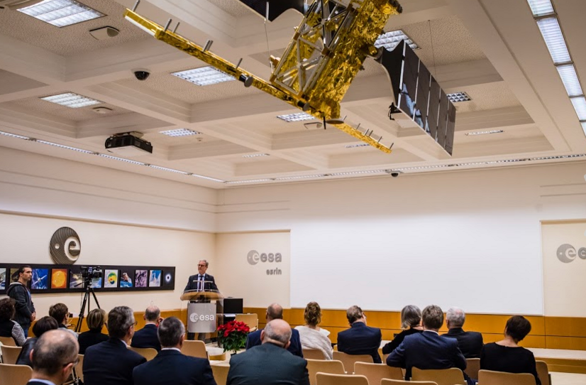
Meeting Venue
Magellan Room
Main Conference Room in ESRIN Building 1
Wireless Internet will be available in the meeting room.

Slide 7
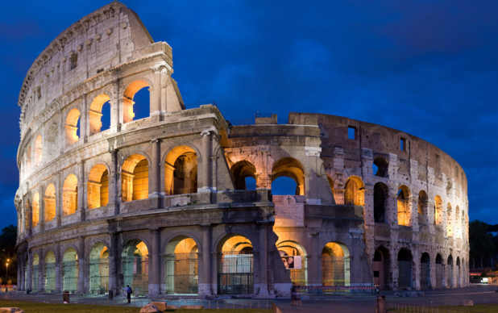
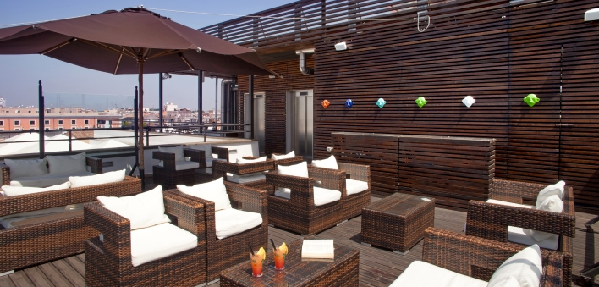
Free time in Rome & No Host Dinner
No Host Dinner (max 35-40 Euro)

Slide 8
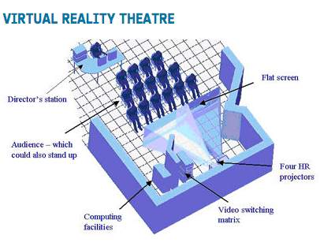
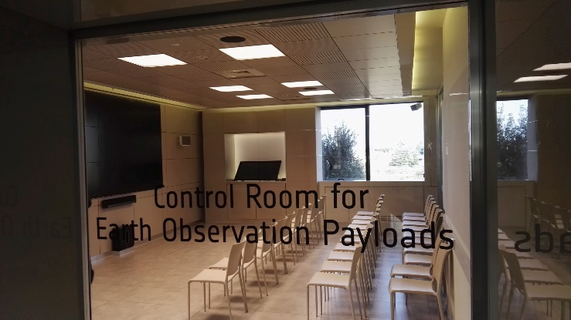
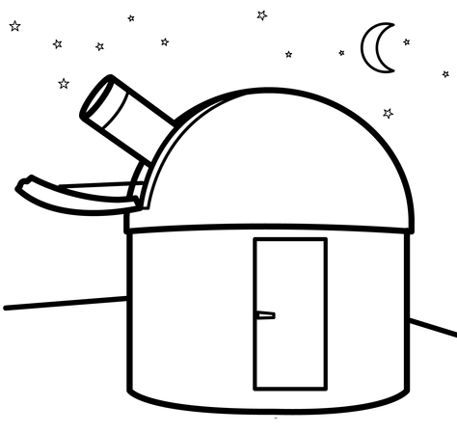
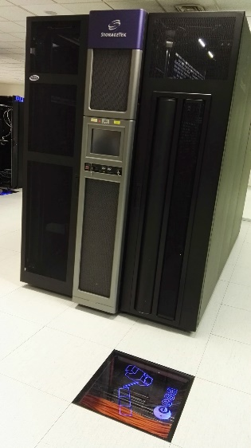
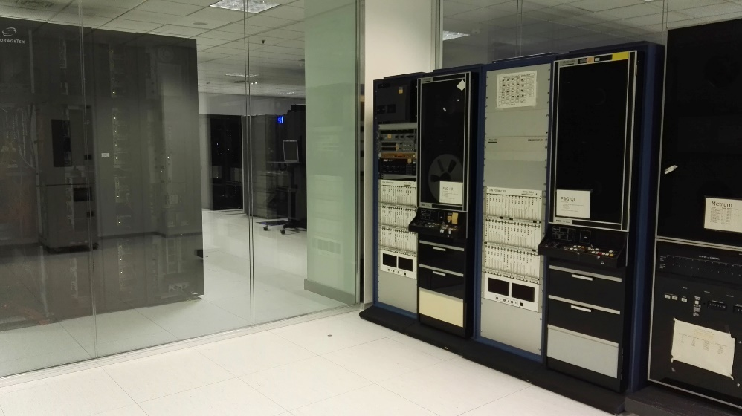
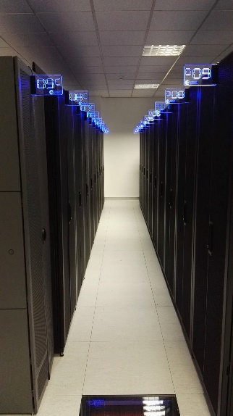
ESRIN Facility Tour
ESRIN CREOP
ESRIN Astronomical Observatory
ESRIN Computer Room & LTDP Heritage Systems Permanent Exhibition and Heritage Media Transcription Facility

Slide 9
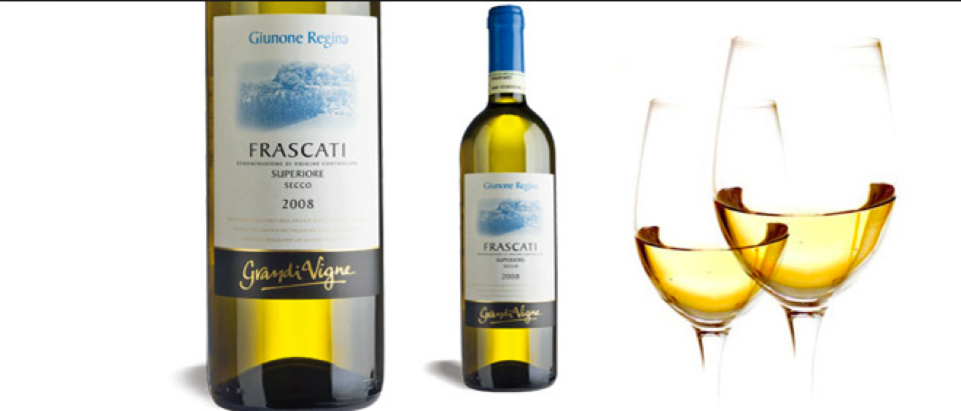
See you all at WGISS-42 in Frascati !

