Slide 1
WGISS Working Group for Information Systems & Services
Summary Report
Committee on Earth Observation Satellites
Andrew Mitchell - NASA
WGISS-42
Frascati – Italy
21st September 2016

Slide 2
Committee on Earth Observation Satellites

Slide 3
Foundational Task prioritization by GEO Program Board
GCI Operation (GD02) will remain the Foundational Task.
Perform GCI Components operations (GEOSS Portal, GEO DAB, Registries)
Maintain partnership with Data and Service Providers and improve these Providers discoverable and accessible
Connect new providers which are relevant to Flagships and key members and participating organizations
Collect requirements and feedback from User Communities and Stakeholders
GCI Development (GD07) will likely be moved to an Initiative.
Develop a GEOSS Architecture based on documented and emerging user requirements
Develop and test new GCI functionalities, solutions, and components
Develop a process to implement the Data Management Principles Guidelines for providers
WGISS made recommendations to move this to Data Sharing task
Promote the advancement of GEOSS interoperability through the Standards and Interoperability Forum (SIF)
Develop the Community Portal Recommendations

Slide 4
Proposal to work further
CEOS WGISS to identify a PoC to discuss further for improving CEOS agencies assets discoverable and accessible through IDN, CWIC and FedEO
WGISS identified the NEW System Level Team
The GEO Sec, GEOSS Portal and DAB team PoCs are following:
GEO Secretariat
Paola De Salvo, pdesalvo@geosec.org
Osamu Ochiai, oochiai@geosec.org
GEOSS Portal
Joost Van Bemmelen, Joost.van.Bemmelen@esa.int
Guido Colangeri, g.colangeli@rheagroup.com
DAB team
Stefano Nativi, stefano.nativi@cnr.it
Mattia Santoro, mattia.santoro@cnr.it

Slide 5
Data Providers Side event in the GEO-XIII Plenary
November 7th 2016
GEO-XIII Plenary venue, St. Petersburg, Russia
Objectives
Establishing a two-ways dialogue with data providers to improve the discoverability, accessibility and usability of GEOSS resources.
Data providers already contributing to GEOSS and new data providers, flagships and initiatives and users are invited and encouraged to participate to ensure that the key objectives of the workshop are met.
Help the GEO community define priorities and shape the agenda of a more comprehensive event to be held in early 2017.
Draft agenda
Implementing the GEO Data Management Principles
Options and procedures for certification of data providers
Process for new data providers to engage with GEO
Discussion and way forward

Slide 6
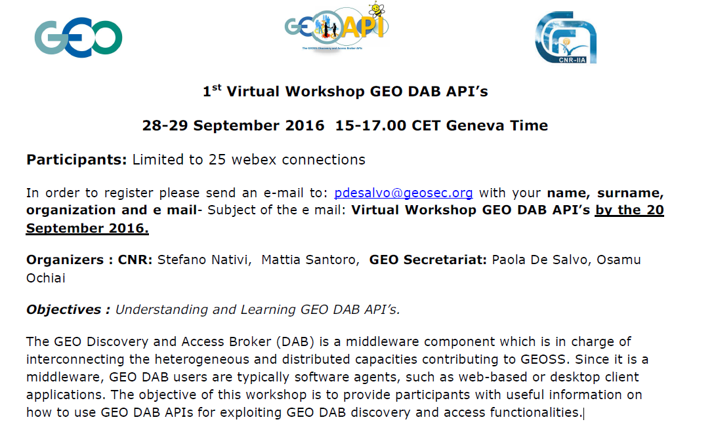
Virtual Workshop GEO DAB API’s

Slide 7
SEO Proposed WGISS Support
Continue support to expand the connections from mission archives to the COVE tool. Here are some future targets: Sentinel-2 and CBERS-4.
We need to find an approach for automated discovery, processing, downloading and ingesting of data to support users with Data Cubes. WGISS may be able to help ...
If any members of the WGISS team have used one or more of the CEOS Systems Analysis Tools (e.g. MIM Database, COVE, Data Policy Portal), please give your feedback to CEOS in the following Survey: https://www.surveymonkey.com/r/ceos-info-systems

Slide 8
CGMS: Global Data Dissemination (WG IV)
CGMS WG IV provides a regular forum for CGMS agencies to address topics of interest in areas related to data access in general and the contribution to the WMO Information System (WIS). The Working Group addresses issues related to data dissemination systems, data formats and metadata exchange, and it also deals with the user interfaces and data access.
Many common tasks.
WGISS can/should support action items of WGIV to enable interoperability
Invite WG IV members to WGISS – 43

Slide 9
CEOS Future Data Architecture
WGISS is asked to review the latest FDA Report
Comments during discussion:
“Current report doesn’t focus on access although it did mention it”
“Need to add a user needs section”
“The report is focused on new users needs and not the current users needs”
“Current trends focus on data cubes and not web processing”
“Need to clarify statements that say we should make data free but then say users will need to pay for access in the cloud”
“Need to clarify and expand on cloud costs”
“There needs to be more context on data standards”
“The lack of an executive summary makes the applicability hard to understand”

Slide 10
Cloud Computing Workshop
GS evolution and EO Innovation Europe (Henri Laur, Mirko Albani)
Thematic Exploitation Platforms and Cloud Computing Activities at ESA (Sveinung Loekken)
Cloud Computing and Security (Julien Airaud)
JAXA Approach on Virtualization and Cloud Computing (Satoko Miura)
ISRO - EO Data Processing Cloud: Requirements and Research Issues (Nitant Dube)
Computing in the Cloud at Geoscience Australia (Simon Oliver)
NOAA (Martin Yapur)
USGS (Kristi Kline)
Assessing Applications of Cloud Computing to EOSDIS (Chris Lynnes*)
CEOS Data Cube use of Cloud Computing (Brian Killough*)
Cloud Computing Discussion
Move User activities to the Data (ESA)
Move more analysis closer to the data (NASA)
Cloud Interoperability (ISRO)
Big Data Project success requires the expertise (algorithms, workflows, interpretive skill) and viable Use Cases (NOAA)
WGISS will create a summary report of the workshop

Slide 11
Cloud Computing Workshop Discussion
Topics/actions for WGISS to research:
Will cloud save us money?
What interoperability issues will cloud solve?
How best to make ARD discoverable/accessible
What are we going to do with the data in the cloud? (cloud enabled applications)
Interoperability becomes more complex with the use of multiple cloud vendors
Host a workshop on developing cloud-aware software

Slide 12
PHASE 1: Current Architecture Consolidation Approach
For discussion
PHASE 1: Consolidation of current CWIC/FedEO/IDN overall architecture to quickly address some of the identified open issues
CLIENTS
FedEO Node
CWIC Node
Collection
Directory
(FedEO, CWIC)
Collection metadata population & harvesting
Search (1st step)
IDN
Collection
Directory
(CWIC, FedEO, Others)
Non-European Partners
product catalogues:
USGS, NASA, ISRO, NOAA, NOAA/GHRSST, INPE, AOE, CCMEO
European Partner product catalogues:
ESA, EU Copernicus, DLR, CNES, ROSCOSMOS, VITO, EUMETSAT, ASI, UKSA

Slide 13
Technology Exploration Future Topics
Discovering and Accessing data in Future Architectures
Geospatial Applications Workshop on the use of CEOS data
Metadata Interoperability
User Authentication Interoperability
Hack-a-thon on client development (or API use) to access CEOS data
Andy will present at the first webinar in December 2016
Continue our discussions on Cloud Computing

Slide 14
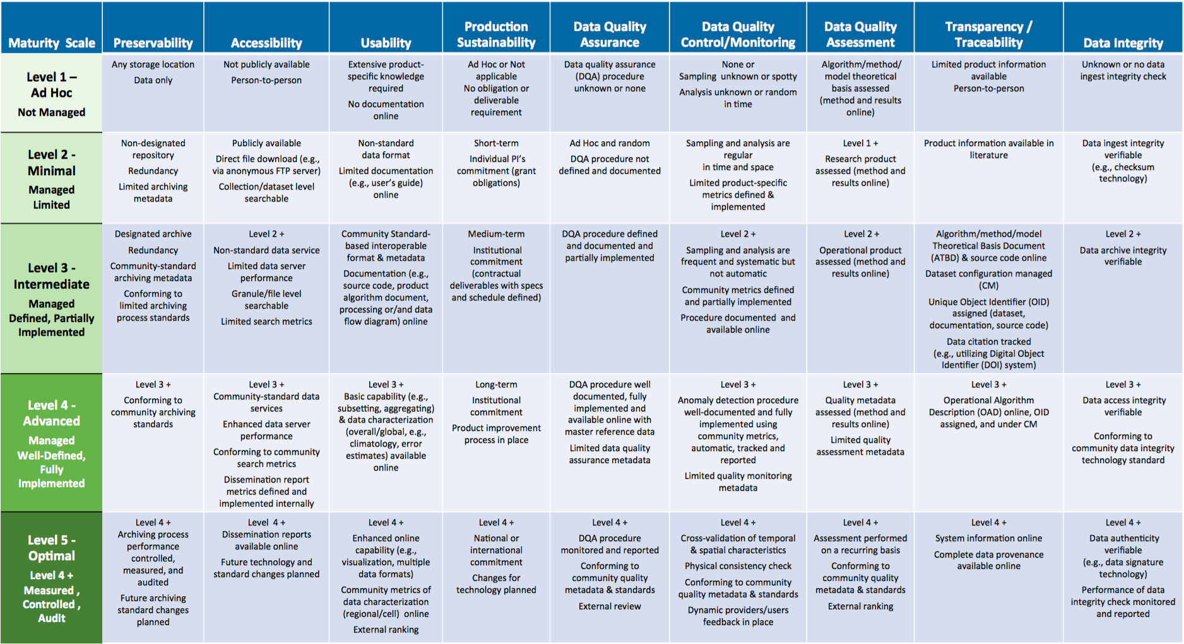
Scientific Data Stewardship Maturity Matrix
Coordination with Data Management Principles
Align with LTDP Recommendations
Notes:
Preservability: it focuses on assessing practices associated with data storage for resilience requirements, i.e., backup or a duplicate copy in a physically separate facility for disaster recovery, and on compliance to community-accepted archive practices and metadata standards. Preservability metadata are necessary for file storage and retrieval purposes only. They include a unique identifier for the dataset, file naming convention, file size, data volume, and, if available, a unique identifier for the collection- level metadata record associated with the dataset. The file naming convention is treated in this paper as being more relevant to preservability; however, the implication of defined file naming conventions on data usability and interoperability should also be considered when determining file naming conventions.
Accessibility: The maturity of the accessibility key component will focus on whether users can easily find and access data online. It measures whether a dataset is searchable and discoverable for collection only or to the granule level.
Usability: it deals with how easily users are able to use the data and learn whether the data are suitable for their own data requirements. It is closely tied to online documentation availability (e.g., Quick starter guide, Users’ guide, or Readme file), file format for interoperability, online data customization and visualization capability, and data characterization. It strives to alleviate the users’ burden of learning about and understanding the data.
Production Sustainability: it is addressed in terms of various degrees of commitment for and associated requirements on the product. Here, it is assumed that the commitment is backed by the necessary financial support. At maturity level 5, changes for technology in data production should be routinely incorporated into planning for continued, sustained stewardship.
Data Quality Assurance (DQA): is a set of activities or procedures focused on defect prevention to be followed in order to ensure product quality during development. Data quality screening (DQS) is a set of activities intended to ensure the source data are clean. DQS is a commonly used procedure for identifying missing or redundant records.
Data Quality Control/ Monitoring: is a set of activities taken to evaluate the product to ensure that it conforms to the required specifications. It is product-oriented and focuses on data anomaly detection. It is usually carried out after the product is created or at each major milestone of the product development and processing cycle.
Data Quality Assessment: is a set of activities designed to ensure that the products are scientifically sound (i.e., building the right thing), by carefully evaluating the product, usually by comparison with similar well-established and validated observations or data product(s).
Transparency /Traceability: The focus here is on the level of availability of information about the product and how it was created, the level of practices associated with management of documents, source code, and system information, and whether data and publication citations were tracked, such as by utilizing a Digital Object Identifier (DOI) system.
Data Integrity: Data integrity refers to the validity of data, i.e., the accuracy and consistency of data over its entire lifecycle. The Data integrity component in this version of the stewardship maturity matrix primarily assesses the practices applied to datasets to ensure the data files are free of intentional or unintentional corruption during data transfer, ingest, storage, and dissemination and to ensure data authenticity at access.
Level 5 is Level 4 + other things

Slide 15
Document Adoption
CEOS OpenSearch Best Practices
Data Purge Alert
Associated Knowledge
Preservation Best Practices
CEOS Maturity Matrix

Slide 17
Grazie
Especially to
Mirko, Iolanda, Razvan, Chiara

Slide 18
See you all at WGISS-43 in Annapolis!

