Slide 1
“PRESERVATION DOMAIN”
Preservation Discussion
WGISS-42 Meeting – ESA-ESRIN, Frascati
19–22 September, 2016
Mirko Albani, European Space Agency

Slide 2
Discussion Topics:
Landing Page & DOI for Associated Knowledge
Glossary Extension
Transcription Chains
Thesaurus

Slide 3
Preservation Topics:
Landing Page & DOI for Associated Knowledge
Glossary Extension
Transcription Chains
Thesaurus

Slide 4
Landing Page definition
DEFINITION: a persistent webpage which shows all of the relevant information about a data set (e.g. data information, metadata, associated information and related links, re-processing activities, spacecraft status, link to data access systems, publications that have used the dataset, citation recommendations, data policy, etc.).
Can be reached upon Persistent Identifiers (PID) resolving
Should be actively updated and maintained by data provider
Landing Pages widely covered by the CEOS Persistent Identifiers Best Practices document v 1.1:
Procedure for Landing page maintenance (update & change location);
PID numbering: use the landing page for versioning problem. [REC_04];
Permanence of landing page. [REC_06], [REC_12], [REC_13], [REC_14];
Resolving and provenance [REC_16], [REC_17], [REC_18];
Documentation [REC_26] and Interoperability [REC_29];
Use case scenarios described in ANNEX B

Slide 5
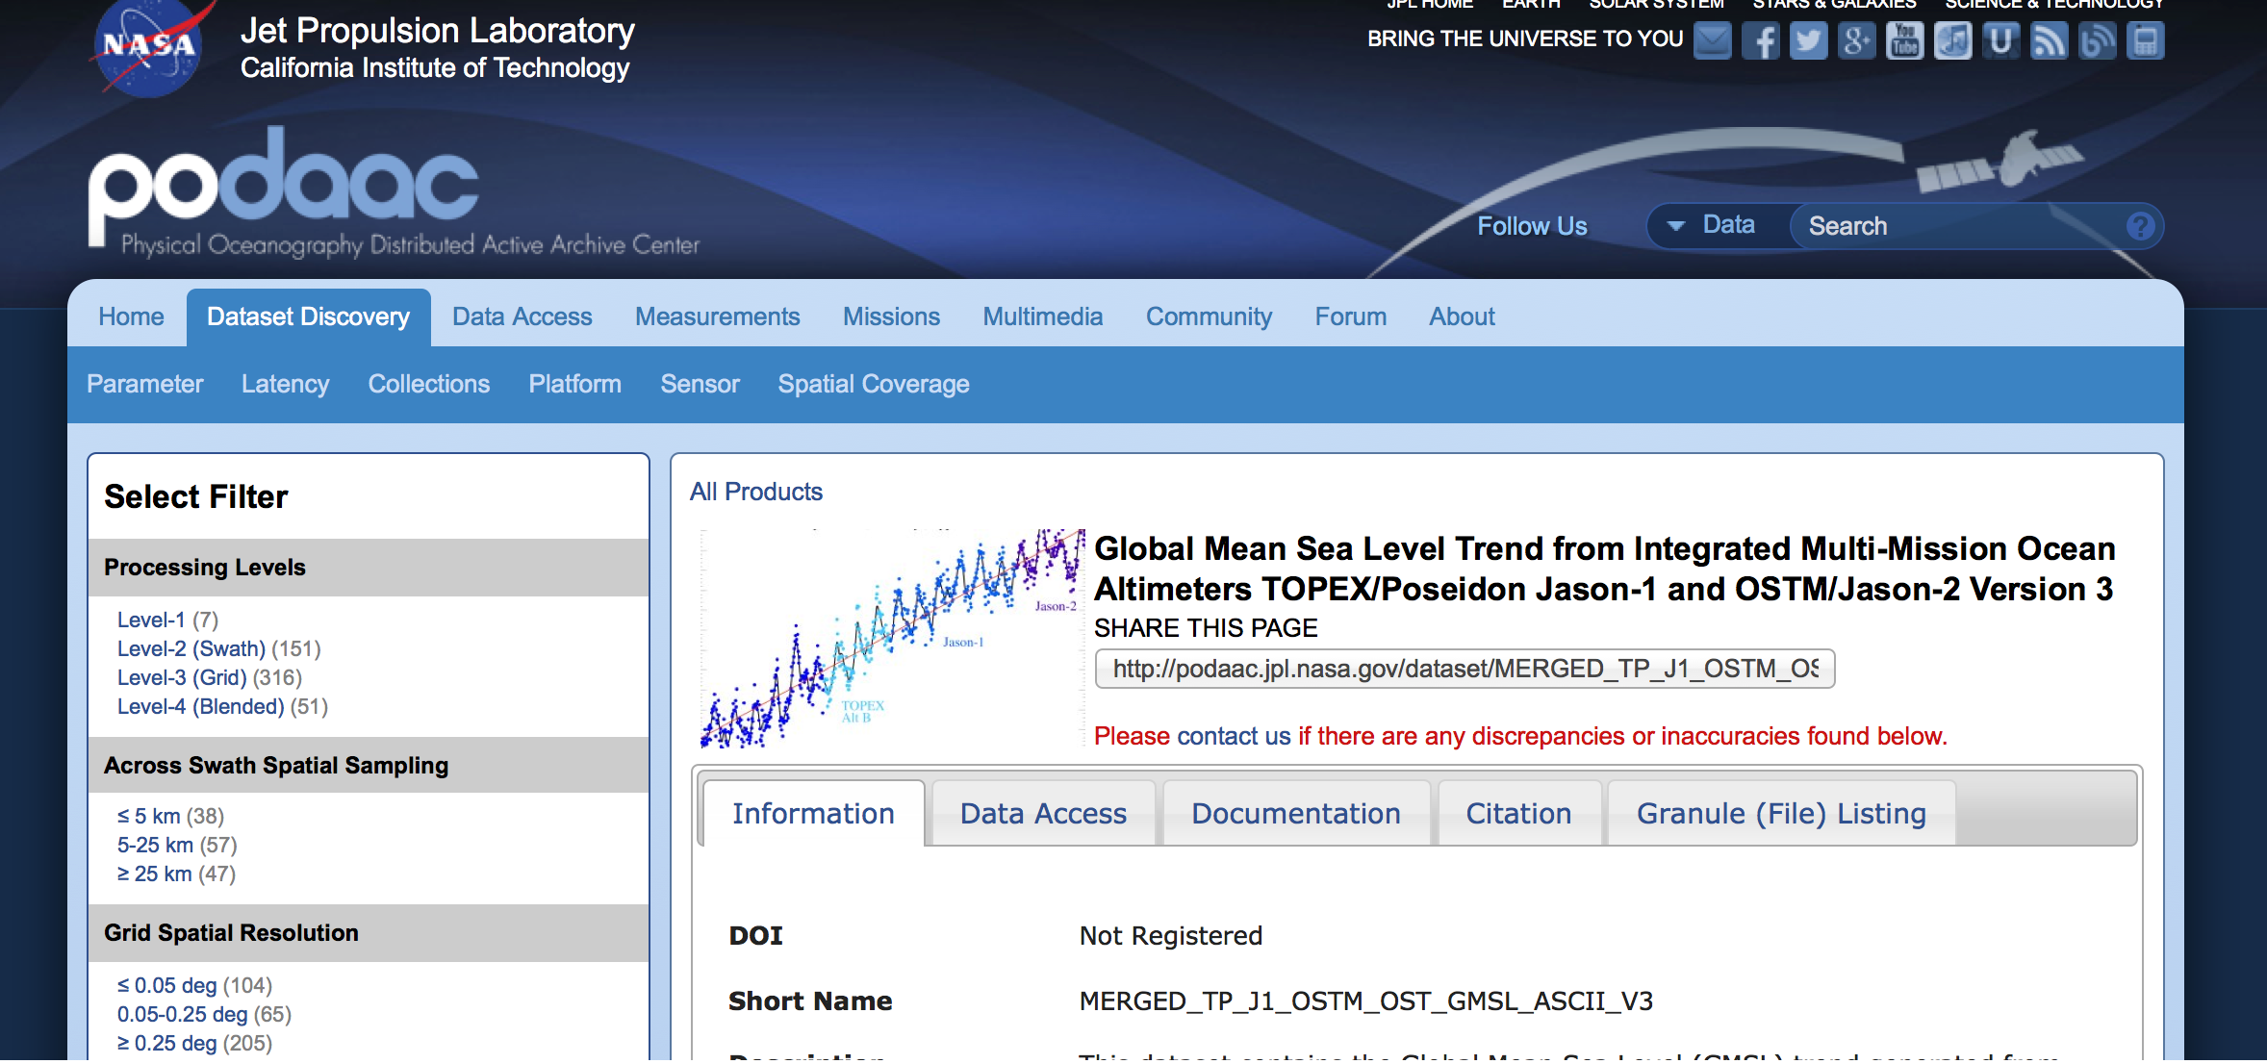
Landing Page Example

Slide 6
Landing Page: open points for discussion
Refer to the associated knowledge of a data set series via the landing page?
Dataset PID Landing page format – would it make sense to identify a minimum set of information which should be contained in there ?
Updating CEOS PID Best Practice with recommendations on landing page format and management?
WGISS#41: “Effort is underway for the new metadata repository to have a generator to automatically produce the landing page”.
Can we elaborate more on this point? Any WGISS activity?

Slide 7
Persistent Identifiers (PIDs) for Associated Knowledge
Definition in CEOS Persistent Identifiers Best Practices document v 1.1:
[REC_26]: Documents related to a data set should be linked on the landing page, not as subset PIDs.
Open points for discussion:
Assign PIDs to data associated knowledge (e.g. documents)?
Assign a PID only to the associated knowledge permanently archived?

Slide 8
Preservation Topics:
Landing Page & DOI for Associated Knowledge
Glossary Extension
Transcription Chains
Thesaurus

Slide 9
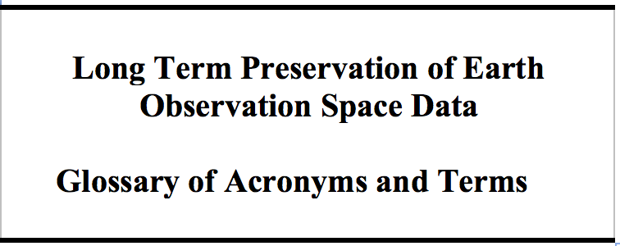
Glossary of Acronyms and Terms: Points of discussion
Final version (V1.1) circulated to WGISS-all.
The document is officially adopted
Points for Discussion
Should be extended to include Glossary of Science Keywords?
Should we ensure harmonisation with other organizations like:
Vocabulary Services Interest Group of RDA https://rd-alliance.org/groups/vocabulary-services-interest-group.html
Digital preservation vocabularies of PREMIS Editorial Committee http://id.loc.gov/search/?q=cs:http://id.loc.gov/vocabulary/preservation&start=1
Should some new identified terms be included?
GEOSS Data-CORE, Open Data, Full data access.

Slide 10
Preservation Topics
Landing Page & DOI for Associated Knowledge
Glossary Extension
Transcription Chains
Thesaurus

Slide 11
Possible Activity on Heritage Media Transcription Chains
Issue: Recovery of unique data still on heritage media via dedicated transcriptions or to fill identified gaps in master datasets is a recurrent need in many space agencies.
Need to maintain heritage media transcription chains up and running: cost, difficulties
Worth to coordinate and join efforts
Possible Activity for Discussion:
Coordination of set-up and maintenance of heritage media transcription chains at different organization for possible mutual support.
Possible Next Steps:
Definition of “Transcription Chains” metadata to build an inventory; “Transcription Chains” information survey in CEOS agencies; Creation of a common inventory.
Definition of further coordination and cooperation steps.

Slide 12
Preservation Topics
Landing Page & DOI for Associated Knowledge
Glossary Extension
Transcription Chains
Thesaurus

Slide 13
Thesaurus
Discussion

