Slide 1
Data Stewardship Interest Group
WGISS-42 Meeting
Associated Knowledge Preservation Best Practice
ESA-ESRIN, Frascati 19-22 September, 2016

Slide 2
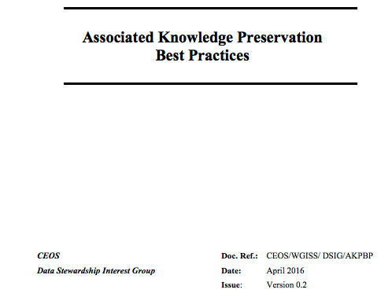
Background
How to manage the preservation of Data Associated Knowledge?
Discussion, Collection of information and survey performed on approaches at CEOS & LTDP WG Agencies and in other domains
Need for an harmonized approach
Drafting of CEOS Best Practice on recommended approaches for Associated Knowledge (i.e. information and SW tools) preservation

Slide 3
EO Data Associated Knowledge
EO Data Associated Knowledge
Information
Documents
Images
Videos
Metadata
Etc.
Software/Tools

Slide 4
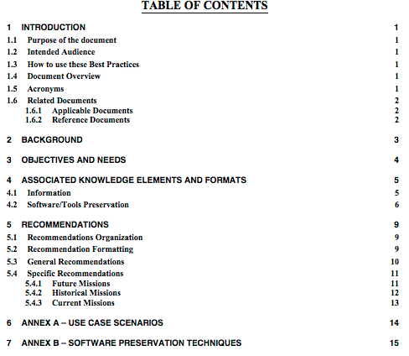
Best Practice ToC

Slide 5
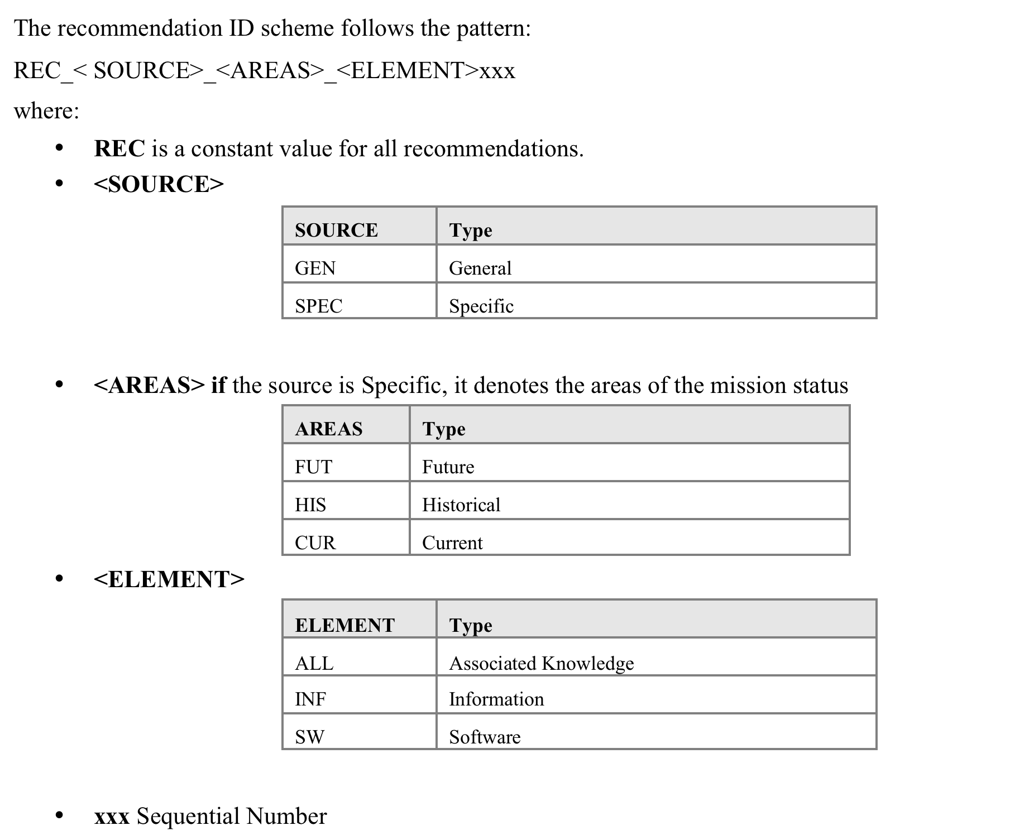
Recommendation Formatting

Slide 6
Recommendations composition
General
Information
Software/Tools
All
Specific
Future
Historical
Current
Software/Tools
All

Slide 7
  Information Preservation Recommendations

Slide 8
Information Preservation
Formats Recommended
Text documents can be preserved as:
Images can be preserved as:
Metadata can be preserved as:
Multimedia can be preserved as:
FITS, PDF/A
TIFF, FITS
XML,
ASCII
MPEG-4,
MJ2
Two possible preservation formats have been identified for each type of EO Data Information: both should be used when the relevant digital object is identified as mandatory.

Slide 9
Information Format Recommendations
Documents:
  Mission documentation (mandatory): two preservation formats recommended for implementation → PDF/A and FITS
  Other documentation (e.g. papers, presentations): one preservation format is considered sufficient → PDF/A
Images related to EO missions (e.g. old missions quick-looks):
  Preservation format recommended is TIFF or FITS depending on the complexity level of the metadata schema to be preserved (i.e. FITS flexibility for metadata editing allows to handle more complex metadata schema)
Metadata files: recommended preservation format is XML
Video files: recommended preservation format is MPEG-4

Slide 10
  Software Preservation Recommendations

Slide 11
Software Preservation
During the initial dataset appraisal a decision on the approach to be followed to handle and preserve the mission data, information and the related SW has to be taken.
  Decision depends on mission relevance, temporal and geographical coverage, size, storage media and archiving format, technical aspects and cost.
Software preservation approach can be based on different strategies for different missions (e.g. virtualization, periodic migrations, hibernation).

Slide 12
Software Preservation Recommendations
Three options considered:
Future Missions:
Recommendations about software engineering best practice such as: clear licensing; clear documentation; use of commonly adopted and modern programming languages; modular design; revision management and change control; established software testing regime and validated results; separation between data and code; clear understanding of dependencies. If the already existing Software Engineering Best Practices cover all preservation requirements, only a statement, with the standards references, could be highlighted.
Historical Missions:
Recommendations take into consideration different scenarios and the methodology to be implemented depend on:
  Mission relevancy; preservation scenarios; amount of funding; cost/benefit analysis, designed community requirements; Intellectual Propriety Rights (IPRs); and SW dependencies, etc.
Current Missions:
Mixed approach. For any new development, the Future Missions recommendations should be implemented, otherwise the approach to be followed is the Historical one.

Slide 13
Comments from WGISS#41 - Open points & Actions
Comm#1: Sustainment of associated-knowledge should also be included (E.g. for documents there is no guarantee that formats will persist).
  Clarification: [REC_GEN_INF_01] In order to guarantee a reliable preservation of information, several formats are identified. When a digital object is identified as mandatory, two different formats should be used.
Comm#2: Check practices at a more international level.
  Clarification: wide survey was performed in terms of specific and technical documentation and ad-hoc presentations.
  OPEN POINT: Possible collaboration with external organizations? Research Data Alliance (RDA), Digital Curation Centre (DCC)…???
Comm#3: Inclusion of Open Source Software.
  Clarification: [REC_ SPEC_FUT_SW_01] Open source software should be preferred for any development in future missions.
Comm#4: Coverage of reproducibility since different hardware may produce different results.
  Clarification: the reproducibility concept was referred in different recommendations.
  Action#1: Improve or add a new recommendation to cover this concept.

Slide 14
Comments from WGISS#41 - Open points & Actions
Comm#5: Need to document snapshot of SW/HW infrastructure used to process the data. Should keep information on compilers used, hardware etc. which might be needed to recreate.
  Clarification: this concept is defined in the overall best practices but no specific recommendation was created.
  Action#2: Improve or add a new recommendation to cover this concept.
Comm#6: Consider SAFE beside FITS.
  Clarification: SAFE format was not developed for the documentation archiving. It can not represent the structure of a document without any SAFE evolution.

Slide 15
Way Forward: Next steps & Due date
Best Practice Review and comments from WGISS members;
Due Date: End of November 2016
Comments implementation & circulation of final document (if mature).
Due Date: February 2017
Approval during the next CEOS WGISS Meeting
Due Date: March 2017

Slide 16
  Thanks for your attention

Slide 17
Software Preservation Attributes to be taken into account -1
Functionalities;
Environment (platform, operating system, programming language, Versions);
Dependencies (libraries, compilation dependency, etc.)
Digital object components
Architecture (Client/server, storage system, input / output)
User interaction (Command line, User Interface, User model)
Diversity (in application of software, software architecture, scale of software, provenance)
Software preservation is complex
  – Software not easy to define.
  – Software has lots of different components and dependencies
  – Software operates in a complex environment
Software preservation can be done in lots of different ways
  – Preservation, emulation, migration, cultivation, hibernation ...
  – Each strategy has different consequences and cost/benefits
Clearly Software is highly complex with a lot of factors which need to be considered

Slide 18
Software Preservation Techniques
Preservation
Procrastination
Virtualization
Techniques
Deprecation
Emulation
Hibernation
Migration
Cultivation

Slide 19
New input for Preservation of SW & Docs Way Forward – NASA (1)
SOFTWARE
Missions are required to deliver product generation software (source code)
Purpose of preservation of software is primarily for users to understand exactly how products were generated
  Algorithm Theoretical Basis Documents are generally not a precise description
  PCS states “The final version of a derived product should be the version archived. If results reported in peer reviewed publications were based on earlier versions of the product, those versions or at least representative subsets of those versions should also be archived. At a minimum, the algorithm and software that generated such earlier versions should be archived.”
  “Versions of science data product software should be archived for each major product release. A major product release is characterized by the appearance of peer reviewed publications where reported results are based on the product version.”
It is not expected that “heritage software” will necessarily be executable; it may take significant effort to regenerate products from preserved software
In some cases, software specification documents have been deemed acceptable as substitutes for source code

Slide 20
New input for Preservation of SW & Docs Way Forward – NASA (2)
DOCUMENTATION
PCS calls for several types of documentation covering project/data life cycles
DAACs archive and maintain checklists of specific documentation delivered by instrument teams and flight projects
Goddard DAAC uses Fedora Commons, an open-source repository management system
  Simple web-based Graphical User Interface (GUI).
  Allows entry of objects or data-streams (these can be of any type document, image, source code, binary data, etc.)
  The DAAC has developed a command line script to allow batch ingest of objects into the Fedora Repository.
Public access documents are kept separate from restricted (sensitive or proprietary) documents
Heritage missions require extensive work for gathering and processing documents for preservation

Slide 21
New input for Preservation of SW & Docs Way Forward – JAXA (1)
SOFTWARE: Current Possible Options in JAXA
No. | Approaches | Possible? | Notes
1 | Preservation of hardware | √
2 | Emulation
3 | Virtualization | √
4 | Migration | √
5 | Cultivation |  | Maybe in the future
6 | Hibernation
7 | Deprecation |  | Not yet, but…
8 | Procrastination | √

Slide 22
New input for Preservation of SW & Docs Way Forward – JAXA (2)
SOFTWARE: Issues on Software Preservation
No. | Approaches | Issues
1 | Preservation of hardware | Support completion is certain to come.
3 | Virtualization | Support completion is certain to come to “a hypervisor”.
4 | Migration | High cost is required every few years.
8 | Procrastination | Today OK, but tomorrow…

Slide 23
Thank you for your attention !!!
Questions ??
Approaches and Lessons Learned at ESA

Slide 24

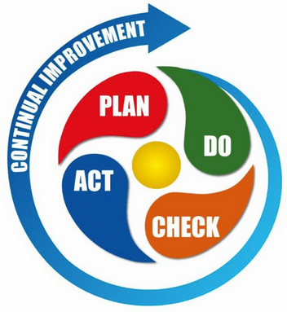
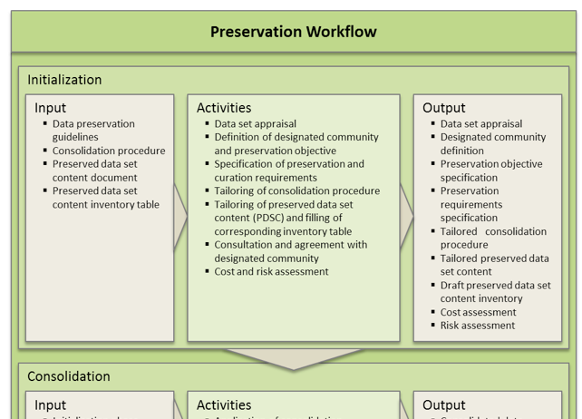
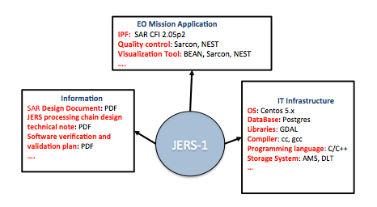
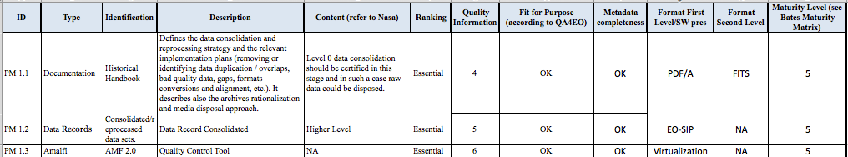
ESA Approach – Preservation Life cycle
Mission Preservation Requirements
Appraisal, Preservation Requirements, Objectives and Cost Assessment
Lesson Learned
Preservation Workflow
IMPLEMENTATION
Application/Infrastructure/Information
Schema
What to preserve, Information Format & Software preservation approach
PDSC Tailoring Checklist

Slide 25
ESA Approach – Preservation Life cycle
Mission Preservation Requirements: Designated community requirements.
PRESERVATION WORKFLOW: during the initial phase a dataset appraisal will provide an initial conception of whether the data set should be preserved and kept accessible and usable for the long term. Topics to be considered include mission relevance, economic considerations, temporal and geographical coverage, size, storage media and archiving format. The results of this phase are some main decisions on Preservation Requirements but also on File Format and how preserve the Software.
  Application/Infrastructure/Information Schema: result of the dataset appraisal and allows the definition of a preservation network used by Curator to take decision in terms of Risk and Cost management.
PDSC TAILORING CHECKLIST: Preserved Dataset Content addresses on WHAT preserve and it should be used as a “checklist” and opportunely tailored for each EO mission/instrument according to their specific characteristics to generate one or more inventory documents.The checklist shows the relevant fields on Format File for any documents to be preserved and for which it is foreseen also another secondary file format to grant the preservation. For the Software preservation the file indicates which strategy needs to be pursued.
IMPLEMENTATION: during the preservation process all lessons learned are collected in order to improve the mission preservation cycle

Slide 26
Approaches at ESA:
Information and SW Tools preservation
Two categories of documents to be preserved:
  Mission documentation (mandatory) for which two preservation formats are considered for implementation → PDF/A and FITS
  Other documentation (e.g. papers, presentations) for which one preservation file format is considered sufficient → PDF/A
  Currently many documents in paper; several formats for other info.
Images related to EO missions (e.g. old missions quick-looks)
  Preservation format considered is TIFF or FITS depending on the complexity level of the metadata schema to be preserved (i.e. FITS flexibility for metadata editing allows to handle more complex metadata schema)
Metadata files selected preservation format is XML
Multimedia files format (e.g. Videos) under analysis

Slide 27
Approaches at ESA:
Information and SW Tools preservation
During the initial dataset appraisal a decision on the approach to be followed to handle and preserve the mission data, information and the related SW is taken.
  Decision depends on mission relevance, temporal and geographical coverage, size, storage media and archiving format, technical aspects and cost.
Software Preservation approach can be based on different strategies for different missions (e.g. virtualization, periodic migrations, hybernation).

Slide 28
Approach at ESA:
Virtualization Experiences
Dependency on legacy hardware, difficult to maintain, was a critical issue for long-term exploitation of the EO products archive and a typical situation for IPFs of historical missions.
Instrument Processing Facilities Virtualization: a series of mission data processors was virtualised - AVHRR, SeaWiFS, Landsat TM, Envisat ASAR, Envisat MERIS, Envisat AATSR, Envisat GOMOS, Envisat MIPAS, Envisat SCIAMACHY, Envisat MRA2/MWR, ERS SAR, ERS Scatterometer, ERS GOME, ERS Altimeter.
Multi-Mission Facility Infrastructure Virtualization: Migration of MMFI building elements including IPF processors to a virtual-machine hosted environment, identifying and eliminating as much as possible dependencies on specific HW and related SW libraries.
IPFs and MMFI components can be now executed in virtual environments and have been installed on Cloud for many pilot and operational activities.

Slide 29
Approach at ESA
Preserved Missions examples
SEASAT and JERS-1:
Missions documentation will be preserved in PDF/A and FITS (both copies to be generated)
JERS-1:
  After an initial dataset appraisal JERS-1 Processing Software was improved, aligned to ALOS mission and VIRTUALIZED
  Reprocessing campaign being performed in a Cloud environment
SEASAT:
  After an initial dataset appraisal the decision on DEPRECATION of the original processing software was taken
  New SAR IPF derived from ALOS-JERS processors: virtualized to run on cloud.
  Full reprocessing done and processor HIBERNATED.
Other Historical Missions
  Processing software hibernation (e.g. after reprocessing campaigns)

Slide 30
Discussion & Possible way forward

Slide 31


Summary
What formats would be most convenient for preserving text documents, metadata files, and videos?
Text Documents (word, txt, ppt) → PDF, PDF/A, FITS, other;
Images (bmp, tif, jpg, gif) → TIFF, FITS, other;
Metadata file → XML, ASCII;
Video (avi, vob, m4v, mov, mpx, etc) → MJ2, other.
Drafting a Best Practice on recommended approach(es) for information and SW tools preservation on the basis of CEOS agencies experience?

