Slide 1
WGISS Connected Data Assets

Slide 2
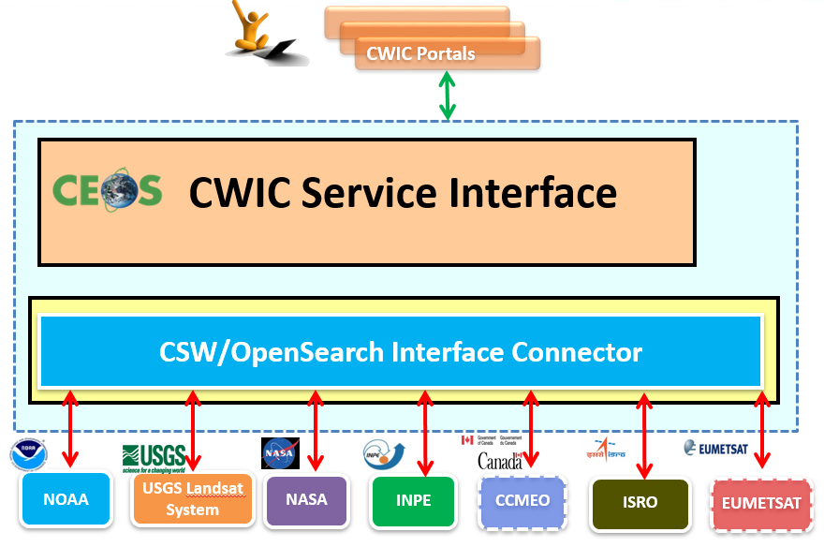
Interoperability - CWIC
CWIC = CEOS WGISS Integrated Catalog
Implemented to realize a federated catalogue for data discovery from multiple EO data centers
CWIC acts as a virtual clearinghouse of spatial, temporal, and science keyword metadata that brokers access to Earth Observation data by interoperating with data archives of other agencies and countries.
CWIC provides a translation gateway from the WGISS-supported search standards to the inventory systems of the CWIC Data Partners that describe collections of data granules.
CWIC is currently providing access to data from NASA, USGS, NOAA/GHRSST, INPE, EUMETSAT, ISRO (MOSDAC, NRSC), and CCMEO.

Slide 3
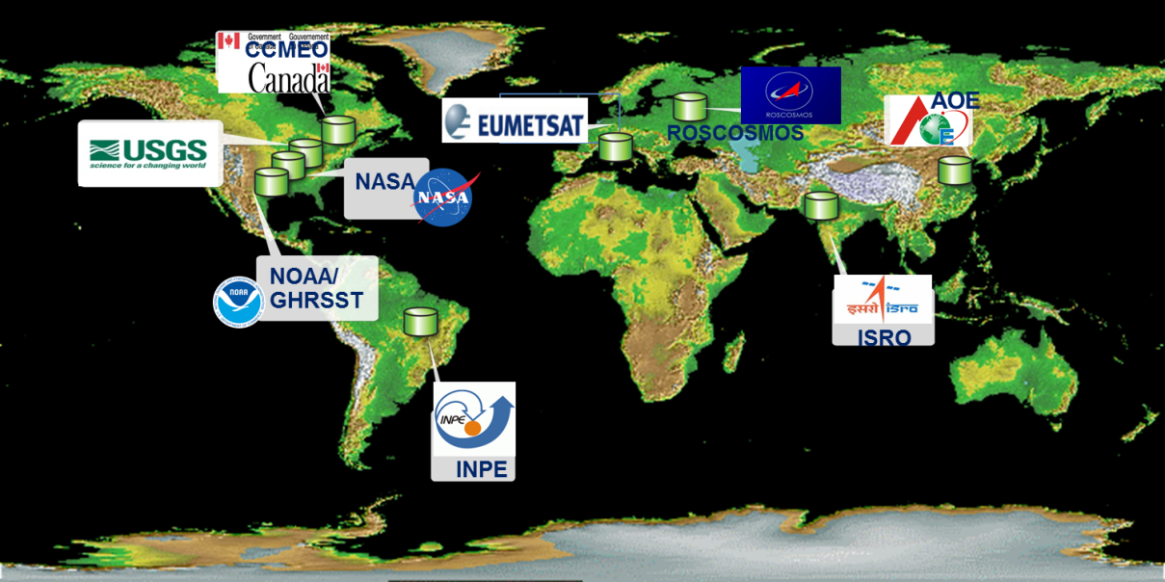
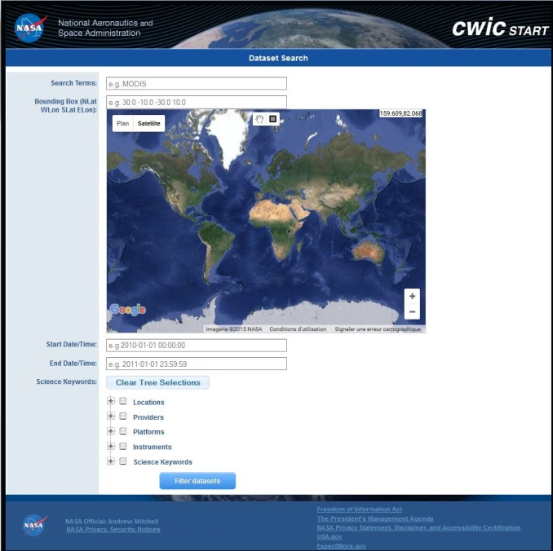
CWIC
Data partners:
NASA, NOAA/GHRSST,
USGS, INPE, CCMEO,
ISRO, EUMETSAT,
AOE, NOAA,
ROSCOSMOS
Implements CEOS Opensearch
Access to
Over 4451 collections
258+ millions granules

Slide 4
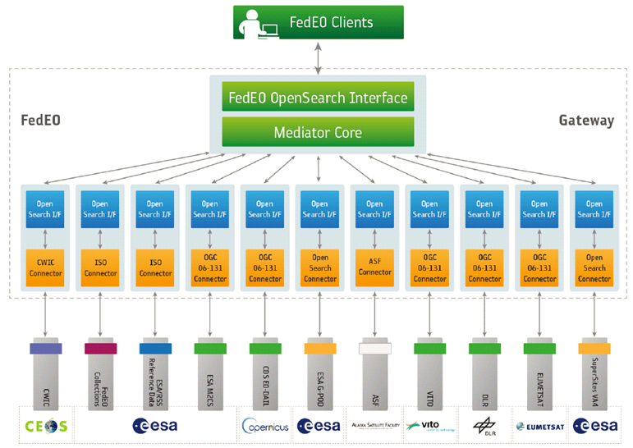
Interoperability - FedEO
FedEO = Federated Earth Observation missions access
The FedEO system provides a unique entry point to a growing number of scientific catalogues and services for, but not limited to, EO European and Canadian missions.
FedEO is deployed with ESA (European Space Agency) infrastructure as a gateway to:
Provide brokered discovery, access and ordering capability to European/Canadian EO missions data based on HMA (Heterogeneous Missions Accessibility) interfaces;
Implement the OpenSearch OGC (Open Geospatial Consortium) and other interfaces for an increased number of discoverable and accessible EO data collections;

Slide 5
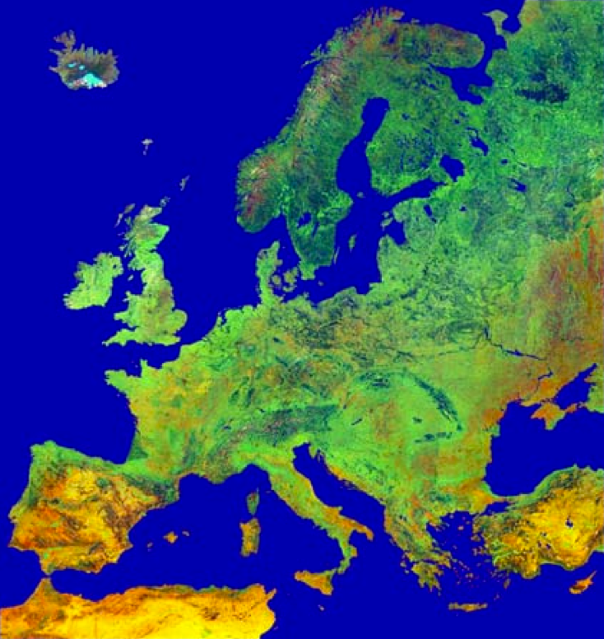
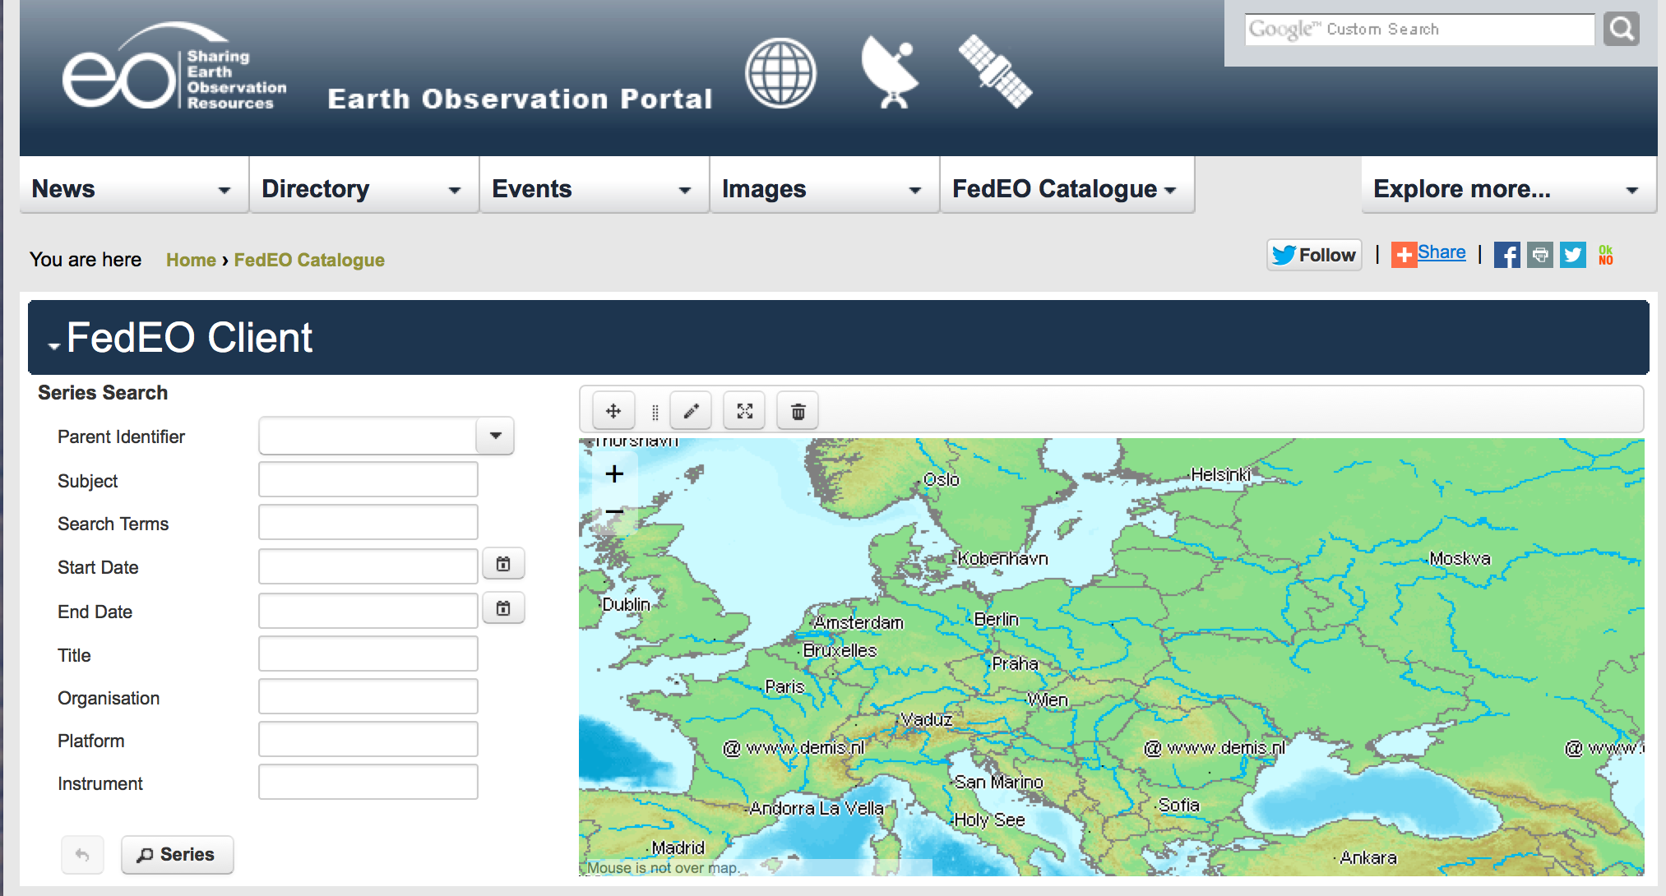
FedEO Federated Earth Observation
Gateway System
Brokered discovery, access and ordering
Implements HMA and CEOS OpenSearch interfaces
Partners (Europe and Canada):
ESA, DLR, CNES,
EU Copernicus
VITO, EUMETSAT,
NASA, ASF, ROSCOSMOS
Access to
477 collections
6+ millions granules

Slide 6
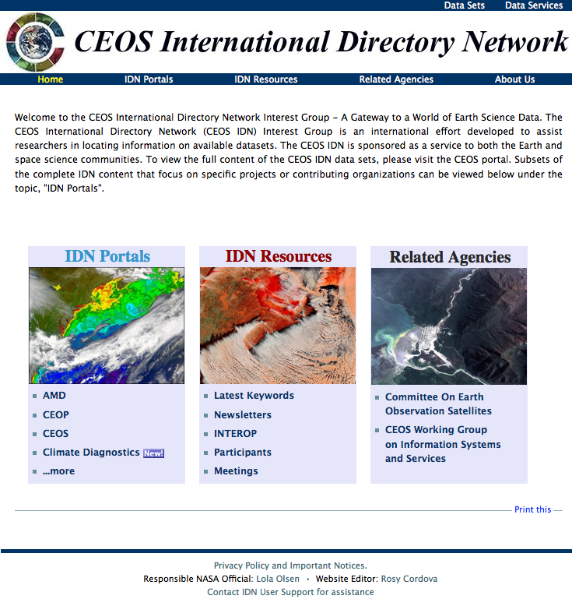
Interoperability - IDN
IDN = International Directory Network
An international effort developed to assist users in locating data sets, data services, and visualizations.
Provides free, online access to metadata on scientific data in the Earth sciences: geoscience, hydrospheric, biospheric, satellite remote sensing, and atmospheric sciences.
Provides clients/portals directory-level search of CEOS agencies and others who have registered their collections in the IDN
http://idn.ceos.org/

Slide 7
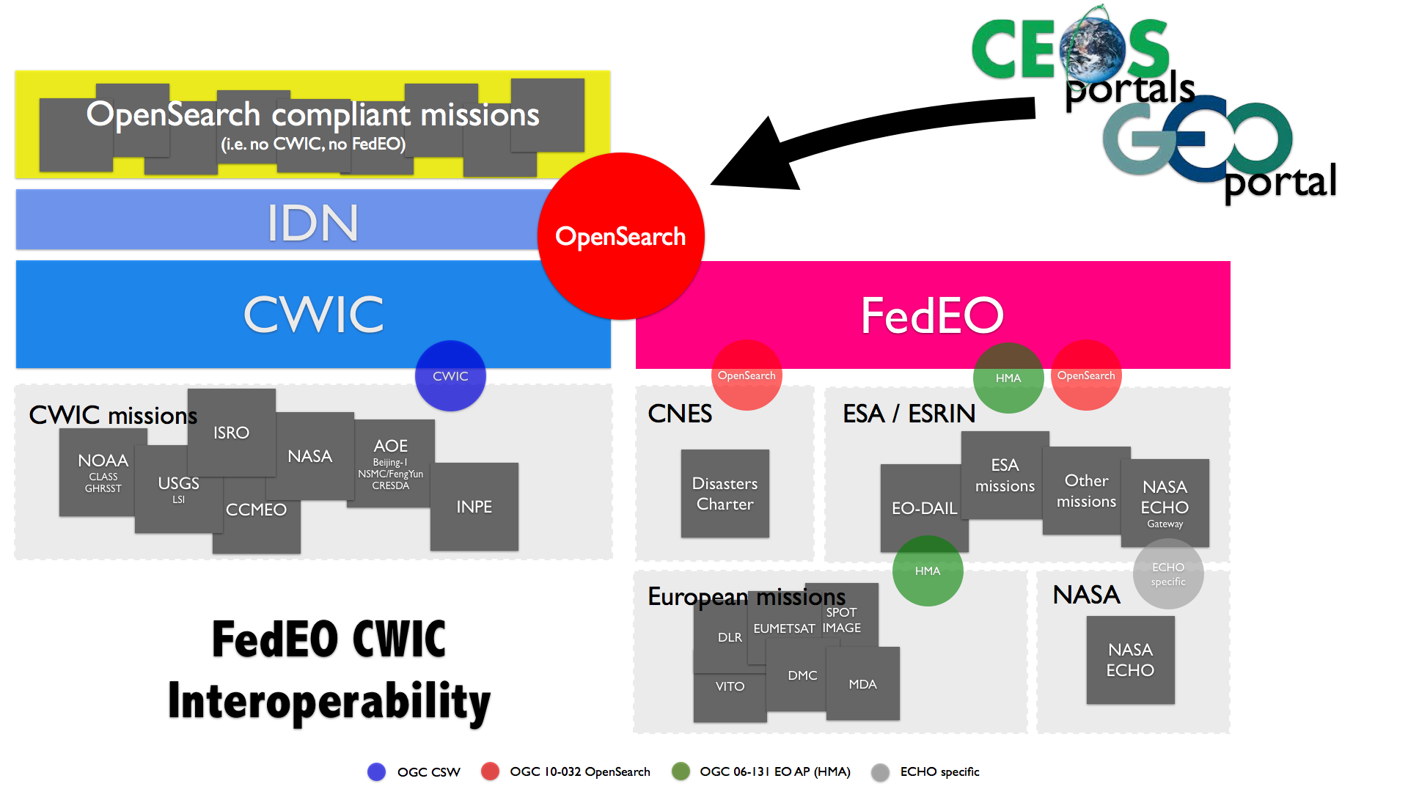
WGISS Interoperability Standards Architecture
WGISS has adopted the CEOS OpenSearch Best Practices in addition to the Open Geospatial Consortium (OGC) Catalog Services for the Web (CSW) v2.0.2 standards for searching remote sensing catalogs, both for collection and inventory information.
The FedEO, CWIC and IDN systems have implemented the WGISS supported standards are providing access to over 2300 collections and 76+ millions granules of EO mission data.
The IDN provides descriptions of data sets (collection level) of relevance to global change research. Both the CWIC and the FedEO systems offer search of inventory data (granule level) and access to the data records. A WGISS system level team will provide technical support to register data collections in the IDN and to on-board new data providers to connect their inventory systems to CWIC or FedEO.

Slide 8
Connected Data Assets

Slide 9
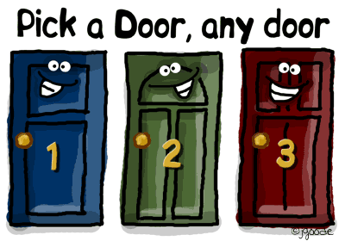
WGISS Connected Data Assets Architecture Discussion

Slide 10
Current Issues
For discussion
Not easily understandable outside (and inside?) WGISS

Slide 11
Current Issues
For discussion
Duplication: E2E architecture risks to return the same result twice (e.g. GEO DAB may route a request both to CWIC and FEDEO and get NASA CMR or EUMETSAT results twice)
User risks to get many collections that are anyhow included in other collections
User might get different results when accessing different portals
User has no idea about stability (e.g. DOI) and quality of collections (was the latest reprocessing applied? Quality Indicators?)

Slide 12
Current Issues
For discussion
Ranking of results might not match user query and does not take into account where the user might actually have higher rights to access data
Infrastructure leaves user “alone” for:
access to the real data (after discovery)
discovery and access to data associated knowledge and information: not linked to the data
Different metadata models and transport layers don’t make the user’s life easier… and implementation costly
Others?

Slide 13
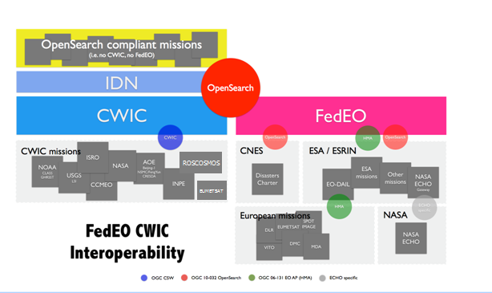
Need a Unified Architecture for WGISS Assets
CEOS Systems
Supporting WGISS
Interoperability Standards

Slide 14
System Level Team
For discussion
A WGISS Integrated System team need to be set-up to coordinate and oversee the WGISS Integrated System and Standards:
Coordinate operations, maintenance and evolution activities (e.g. for infrastructure, standards adoption, etc).
On-board new data partners
Provide technical support for client partners
Monitor the health of the federated system and report outages and errors etc. to the partners
Test all the components of the federated system, including end to end search and data access
Work with data and client partners to identify and resolve system and component bugs
Provide support for metrics collection

Slide 15
Future Activities Objective
For discussion
Review CEOS Discovery & Access Infrastructure Architecture, Functions and Interfaces: simple draw outside (and inside) WGISS
Concerted approach to give a homogeneous results to the user allowing to easily filter duplicates within the CEOS Infrastructure
Ensure reliability and redundancy of CEOS Discovery and Access Infrastructure (no single points of failure)
Address shared collections and mirror collections
Harmonize collection/product metadata models along ISO 19115
Enhance Directory information with data access condition information (e.g. pointer to T&C signature) and Quality Indicators
Provide result ranking with user-selectable criteria
Link data to associated information and knowledge for user access
Harmonize Terms & Conditions acceptance and data access authorisation process in a federated user management approach
Improve minor shortcomings on current standards (e.g. Opensearch, JSON binding, …

Slide 16
Future Activities Implementation through WGISS
For discussion
Two Phase approach proposed:
PHASE 1: Consolidation of current CWIC/FedEO/IDN overall architecture to quickly address some of the identified open issues (Q3 2016 – Q2 2017)
PHASE 2: Dedicated “Interoperability Project” to evolve and fully address all open issues:
Preparatory phase Q3 2017
Implementation Phase Q4 2017 – Q4 2018

Slide 17
PHASE 1 activities
For discussion
Consolidate overall architecture and concept (starting from previous slides)
Consolidate components and interfaces to Partners; population
Remove duplicated discovery and access to identified data collections (e.g. EUMETSAT, NASA, ASF, ROSCOSMOS) to align with overall concept
Consolidate and maintain WGISS web pages and a coherent set of statistics
Finalise Opensearch Developer Guide and Best Practice
Contributors: CWIC/FedEO/IDN teams, WGISS support

Slide 18
PHASE 1: Current Architecture Consolidation Approach
For discussion
Objectives: architecture “operationalization” & redundancy, data duplication removal, improve minor shortcomings of current standards
CLIENTS
FedEO Node
CWIC Node
Collection
Directory
(FedEO, CWIC)
Collection metadata population & harvesting
Search (1st step)
IDN
Collection
Directory
(CWIC, FedEO, Others)
Non-European Partners
product catalogues:
USGS, NASA, ISRO, NOAA, NOAA/GHRSST, INPE, AOE, CCMEO
European Partner product catalogues:
ESA, EU Copernicus, DLR, CNES, ROSCOSMOS, VITO, EUMETSAT, ASI, UKSA

Slide 19
Next Steps, Actions, Milestones
DISCUSSION
Update IDN content to reflect new architecture
IDN Metadata Evolution
System Level Team Working Procedure (e.g. telcos, )
Others

