Slide 1
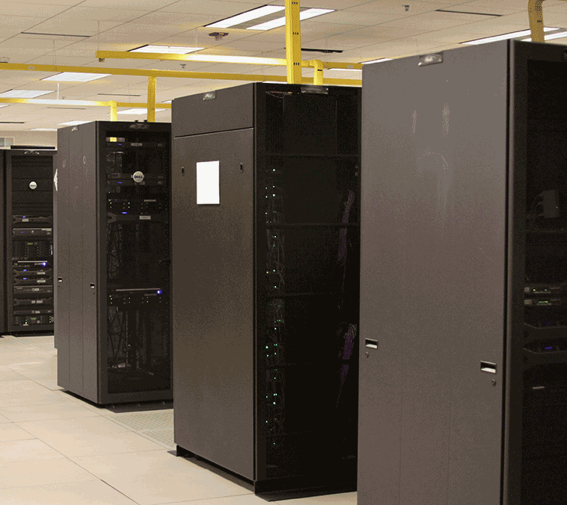
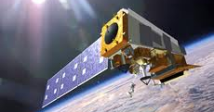
NOAA’s Cloud Computing:
Leveraging the Value of Data with Industry
WGISS-42 Frascati, Italy
20 September, 2016
Martin Yapur (presenter)
Jeff de La Beaujardière, PhD (author)
NOAA Data Management Architect
Ed Kearns, PhD (author)
Technical Lead, NOAA BDP
US Department of Commerce | NOAA Satellite and Information Service | NOAA’s National Centers for Environmental Information

Slide 2
Acknowledgements
NOAA Project Mgmt: Amy Gaskins, Brian Eiler, Maia Hansen, Chelsea Mastrapa
NOAA Technical: Ed Kearns, Steve Ansari, Alan Steremberg, Steve Del Greco, Jeff de La Beaujardière, Brian Nelson, Tony LaVoi, Jay Morris, Carlos Rivero, Ken Casey, Ken Knapp, Michelle DeTommaso
NOAA Advisory Group:
NC State University / CICS-NC: Otis Brown, Jonathon Brannock, Lou Vazquez, Scott Stevens
Big Data Project Collaborators and partners for NEXRAD data:
Amazon: Ariel Gold, Jeff Layton
Climate Corporation: Adam Pasch, Valliappa Lakshmanan,
Unidata: Jeff Weber
Google: Eli Bixby, Tino Tereshko, Amy Unruh, Tanya Shastri, Ossama Alami
Microsoft: Sam Khoury, Sid Krishna
Open Commons Consortium: Maria Patterson, Walt Wells
Notes:
NEXRAD Products and NOAA's Big Data Partnership
Edward J. Kearns, NOAA/NESDIS/NCEI, Asheville, NC; and S. Ansari, S. A. Del Greco, S. E. Stevens, S. Wilkins, B. Eiler, and O. Brown

Slide 3
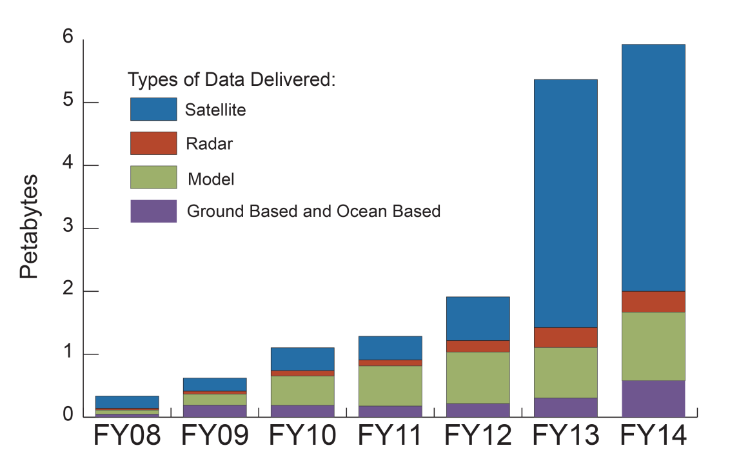
Accelerating User Demand for NOAA data
NOAA’s National Centers for Environmental Information (NCEI) alone is now serving >8 PB of data annually
Servicing over 20,000 personal contacts across many sectors
2.6 billion web hits in FY14 with 19 million users
Significant load on NOAA infrastructure

Slide 4
Premise of NOAA Big Data Partnership
NOAA has large and diverse datasets, which are expensive to acquire, store, and disseminate.
Much of NOAA’s environmental data are under-utilized, especially beyond the expert community, because of accessibility issues.
There is untapped economic value in those data.
That value can be leveraged to improve accessibility by staging data on the public Cloud, where people and organizations of all kinds can innovate as part of a market ecosystem.

Slide 5
Conceptual Overview of NOAA Big Data Project
new customers
& lines of business
Customer 1
Customer 2
Customer 3
application &
product providers
Custom
Product/
App #1
Custom
Product/
App #2
Custom
Product/
App #3
Cloud IaaS
provider(s)
[Infrastructure as a Service]
integration functions
analysis functions
working copy of data
agency security boundary
Agency Service Tier
agency-provided
services
Catalog
Access Services
Metadata
Formatting
master
copy of data
Earth
Observations
Earth
Observations
Model
Outputs
Notes:
Technical:
NOAA retains master copy of its environmental data, including Earth observations and model outputs.
NOAA performs basic functions for data discovery, access and usability, providing services inside its security boundary. Users currently use NOAA-hosted services to find and retrieve our data.
If we had enough bandwidth, we could send all or most of our data out to a commercial Cloud provider, who would then have a working copy of our data.
Computing functions for data integration and analysis could be provided, and could operate on multiple datasets co-located with the computing.
Application and product developers could provide products and decision support apps tailored for individual customers.
We would enable maximum diversity in the user space, for decisions based on specialized knowledge and algorithms.
The more we can standardize the lower layers, the easier it would be to support this scenario.
Financial:
No funds would be exchanged to or from NOAA. Data provided into the Cloud would remain available free of charge in the format provided.
The network service provider would provide bandwidth at no cost to NOAA, and recoup costs from the Cloud provider.
Application developers would pay Cloud provider for computing and for storage and transmission of derived products.
Customers would pay developers for derived products and decision-support apps.

Slide 6
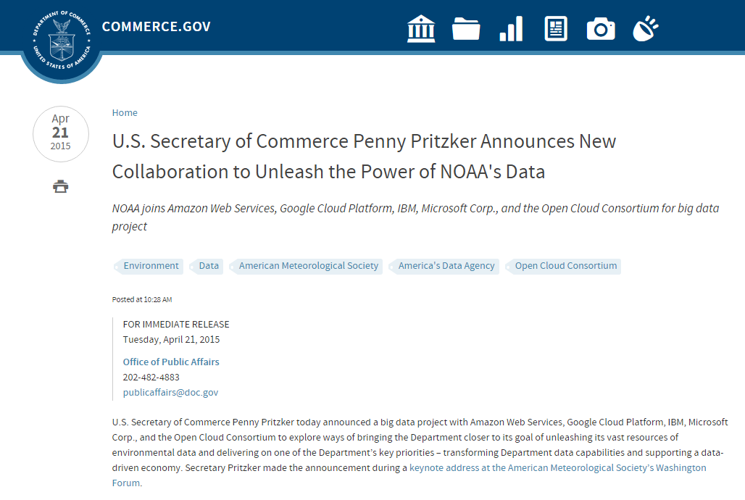
April 2015: Partnership Announcement
Unusual, no-net-cost proposition
Could the value inherent in NOAA’s datasets support the cost of their distribution?
Enthusiastic, cross-industry response
Interest from 200 companies
70+ responses to NOAA’s Request for Information
Need for further R&D became apparent
5 Cooperative Research and Development Agreements signed 21 Apr 2015
Notes:
Initially planning for a no-cost RFP, but:
How do bidders estimate initial capital outlay and measure ROI?
How does NOAA pick the “best” solution?
More information needed before RFP responses could be submitted
Add a research and prototyping phase
Explore technologies and methodologies
Incubate ideas for business models
Prove out self-sustainability
Reduce risk and initial capital investment

Slide 7
BDP CRADA Collaborators
Infrastructure-as-a-Service (IaaS) companies to serve as project anchors
These BDP Collaborators are nuclei for data alliances and markets
Members of industry, research, and academia may join these alliances

Slide 8
NOAA BDP Data Alliance Concept
Partner
Partner
Partner
Partner
Partner
Partner
Partner
Partner
Partner
Partner
Partner
Partner
Partner
Partner
Partner
Agency Service Tier
NOAA data

Slide 9
Big Data Partnership Rules
Level Playing Field for all interested companies via IaaS Collaborators
All NOAA Data available on equal terms with no privileged access
NOAA-sourced data are "free and open" - only cost recovery allowed
Charging for Cloud computing or value-added products is allowed
5 individual CRADAs with NOAA
3 year terms + 2 one-year options
CRADAs can be ended early with appropriate notice
No funds may move from NOAA to Collaborators

Slide 10
Methodology
BDP Collaborators & their Partners identify datasets of interest
Each collaborator can choose which dataset(s) to copy
Based on their understanding of possible Use Cases
NOAA & Collaborators determine technical approach for data delivery from NOAA Cloud(s)
NOAA subject matter experts, BDP Collaborators, and their Partners engage in technical interchanges as needed
Collaborators and their Partners create applications
NOAA continues all of its existing data services
No interruption of services to customers
BDP activities are an augmentation of existing services

Slide 11
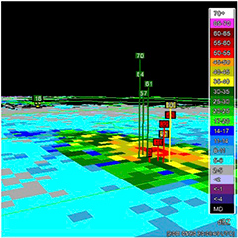
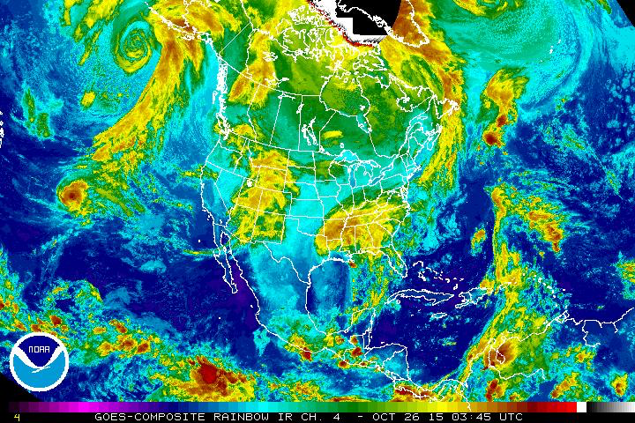
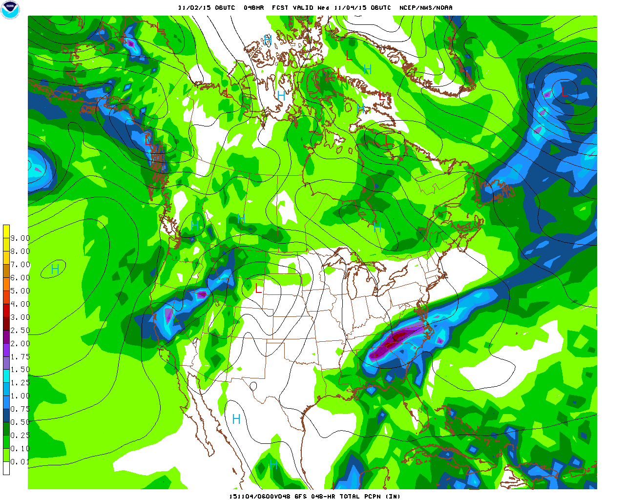
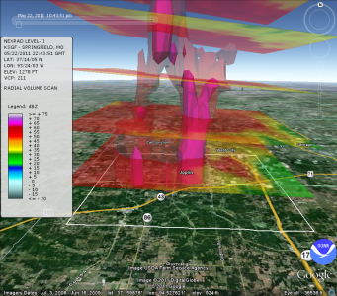
Requested Initial Data Included…
Multi-Radar Multi-Sensor
GOES / GOES-R
Numerical
Models
NEXRAD

Slide 12
NEXRAD Weather Radar selected first
Archived NEXRAD data are optimized for preservation, not access
All NEXRAD data are publicly available, but difficult to use
unwieldy size (270 TB for compressed Level II alone)
specialized format (radial volume scans)
resides on NOAA’s NCEI tape archive, relatively slow to access
Highly popular dataset for use in industry
Many industry users of realtime and archived NEXRAD data
Multiple derivative uses possible - hail, rain, snow, tornadoes, etc.
The utilization of entire NEXRAD archive never before realized
NOAA had recently reprocessed 2001-2012 NEXRAD Level II
half of the dataset already resided on disk
Cooperative Institute for Climate and Satellites in NC (CICS-NC)
easy to jump-start initial delivery

Slide 13
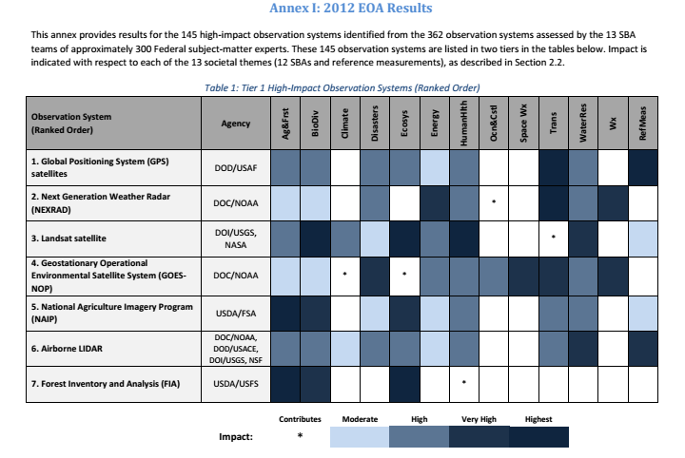
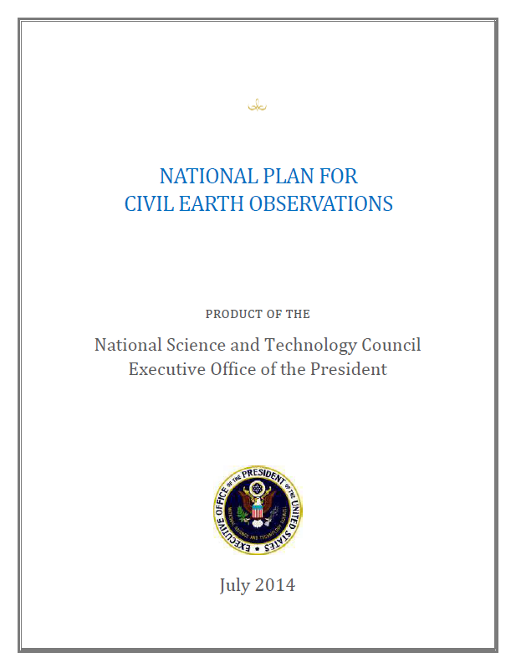
NEXRAD #2 in US National Observation Value
National Plan for Civil Earth Observations (2014)
Notes:
NEXRAD #2 among 145 high-impact observation systems

Slide 14
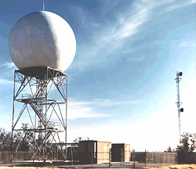
NEXRAD Level II Data Transfer
Archived data from NOAA Natl Ctrs for Environmental Information (NCEI)
Over 270 TB for compressed Level II volume scan file (>1 PB uncompressed)
Move from the NCEI tape archive to disks at CICS-NC
CICS-NC as middleman minimized impact to NOAA’s data operations
Updates from NCEI archive operations as new data are pushed to the archive
Realtime data from NOAA’s National Weather Service
Established using existing Unidata IDD/LDM feed
Data moved to 4 BDP Collaborators (1 declined)
Amazon Web Services (entire archive plus realtime)
Microsoft (entire archive)
Google (entire archive)
Open Commons Consortium (2015 plus realtime)

Slide 15
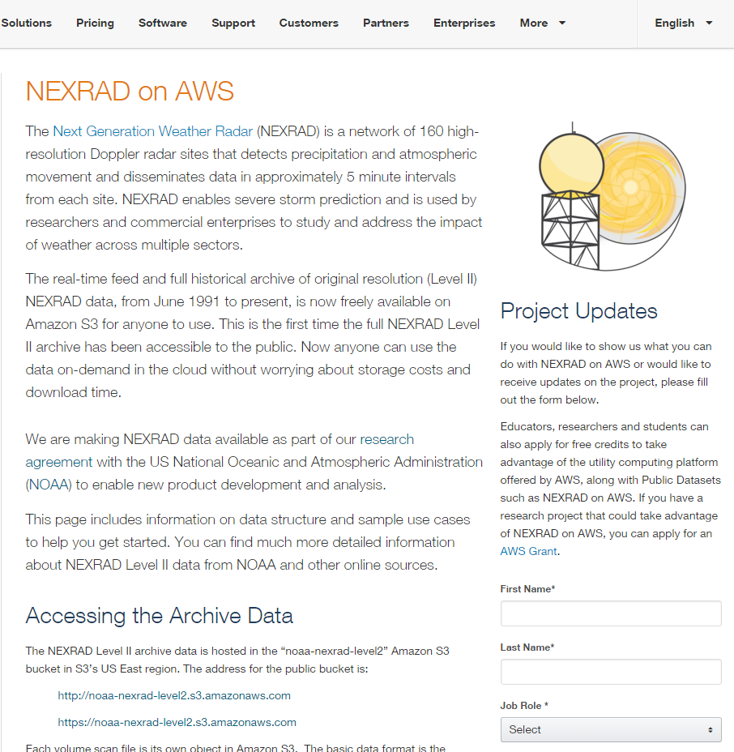
AWS Access to NEXRAD Level II Data https://s3.amazonaws.com/noaa-nexrad-level2
AWS now serving all NEXRAD Level II from 1991 to 5 min ago
Single point of access for archived and realtime data on S3
Free data download available to users
CPU charges apply for in-place computation
AWS public announcement 2015 Oct 27
Google, Microsoft, and OCC have not announced their access.

Slide 16
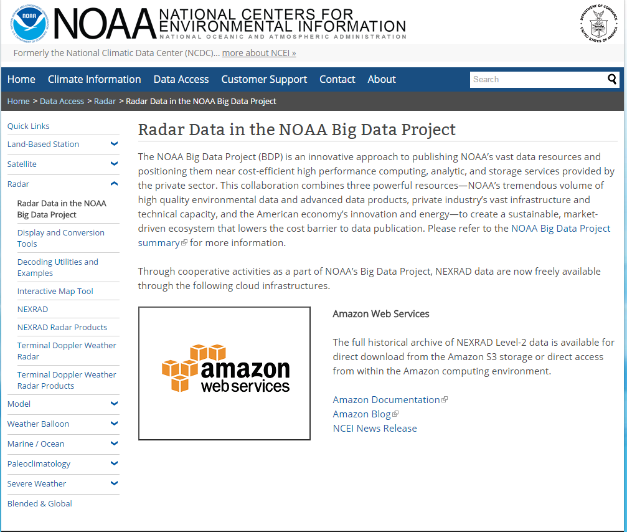
Steering Users to New Services
New services are being referenced from NOAA NCEI’s website
60% decrease in archival data ordering observed (Feb 2016)
Integration into the NOAA Weather and Climate Toolkit

Slide 17
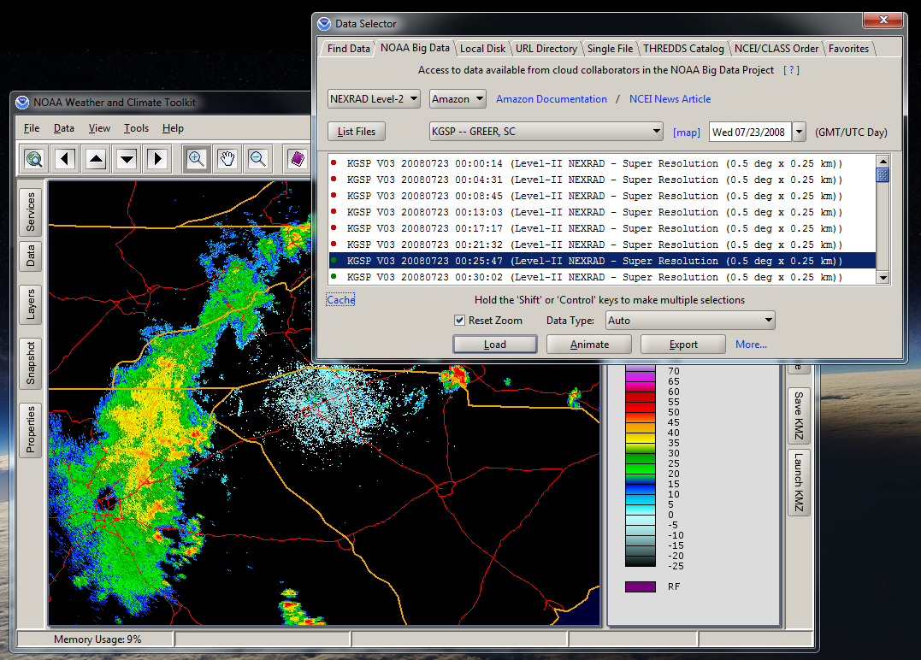

Slide 18
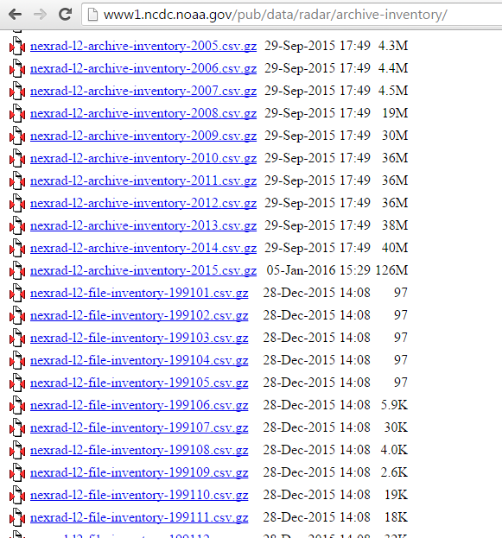
Improvements to Data Stores
NCEI & CICS-NC worked with AWS, Unidata & Climate Corporation to verify inventories/checksums
Identified and fixed ~20K corrupted archive files (0.01% of 180M total)
An improved NOAA archive is a direct and positive result of the AWS Big Data Partnership effort for NEXRAD Level II
Climate Corp discovered the corruption, NOAA fixed
Recovered data were reintroduced to the NOAA archive and sent to all the other BDP Collaborators.
Notes:
Building upon

Slide 19
Role of NOAA in the BDP Market Ecosystem
Ensure all data remain freely available
Provide objective scientific expertise
Ensure long-term preservation and sound data management

Slide 20
So What?
One valuable, large, unwieldy dataset has been “liberated” for wider utilization by industry and the public at no net US taxpayer cost.
Seamless access across time: users find both historical and realtime NEXRAD Level II data in the same place, in the same way.
Historical data provides context for new realtime observations – important for decision-making
New business opportunities are being created
custom severe weather products, bird migration studies, etc. are easier to develop
New applications can be developed faster when data are co-located with processing
Quickens the pace of app development and time-to-market
NOAA’s NEXRAD recent reprocessing (of 11 years’ data) took years; Same volume of processing today could now take weeks
Notes:
Before
researchers could not have the entire dataset usable in one place
retrospective data were found in one place, realtime in another
realtime data access required special links, relationships, and/or payment
had to use smaller chunks (limited time, limited places) to develop new ideas
had to move 10’s of TB across networks, and store them somewhere
had to maintain their own compute power to utilize the data
statistical or probabilistic products were incomplete, not as accurate
could not develop comprehensive products easily (e.g. CONUS-wide)
industry did not have equal access to government data
NOAA researchers had advantageous access
After
All data -- old to new -- availble for free, in one place
can use all available data to develop new ideas
no need to move any data at all across networks
processing and visualization resources on AWS are integrated with storage
Can develop comprehensive, accurate statistical and probabilistic products
industry has equal access to government data
all industry, public, academic have equal access to the government data

Slide 21
What's Next?
Geostationary satellite data (GOES)
Weather Forecast Models
Fisheries bycatch information
other NOAA data t.b.d.

Slide 22
Current GOES data situation
GOES (Geostationary Operational Environmental Satellites) is USA’s 4th most impactful observing system* * From on OSTP Civil Plan for Earth Observations
Numerous factors** hinder access to GOES data, making a simple request a very complex task **Per Dr. Ken Knapp
Determine satellites operating at time of request
Order Data from CLASS website, download them to your own disk
Figure out how to handle duplicate files
Learn how to read GVAR and/or create AREA files
Investigate how to calibrate data, then apply calibration
Remap and subsample data for desired region
Process data to level/product desired
Notes:
* Based on OSTP Civil Plan for Earth Observations

Slide 23
Path to improved GOES data usability
NOAA provides improved dataset
Extract all GOES data from CLASS
While sending to BDP Collaborators:
Remap and reformat (to GOES-R HDF5)
Remove duplicates and apply calibration
BDP Collaborators provide seamless access and co-located computing for GOES data
Provide single API or website for entire time series
Collaborators, Partners, Expert Community develop value-added products

Slide 24
Conclusion
NOAA has engaged 5 Cloud IaaS providers in R&D to host NOAA data
NOAA has moved the NEXRAD dataset first, based on market need and data opportunity. AWS experience starting in Oct 2015 appears successful so far…
New applications created, increased use of AWS infrastructure, reduced load on NOAA systems
NOAA is investigating distributing GOES data next to the Collaborators, to improve utilization of archived data and future realtime flows.
Big Data Project success requires not just access to the data, but the expertise (algorithms, workflows, interpretive skill) and viable Use Cases
Potential developers and users encouraged to engage with BDP Collaborators at https://data-alliance.noaa.gov/

Slide 25
Thank You
Questions?

