Slide 1
Geoscience Australia
Cloud EO Big Data processing
Simon Oliver - Simon.Oliver@ga.gov.au
Damien Hart - Damien.Hart@ga.gov.au
Claire Trenham - Claire.Trenham@anu.edu.au

Slide 2
Outline
GA’s Cloud Management Capability
National Computational Infrastructure Cloud Services
Amazon Web Services
Responses to questions

Slide 3
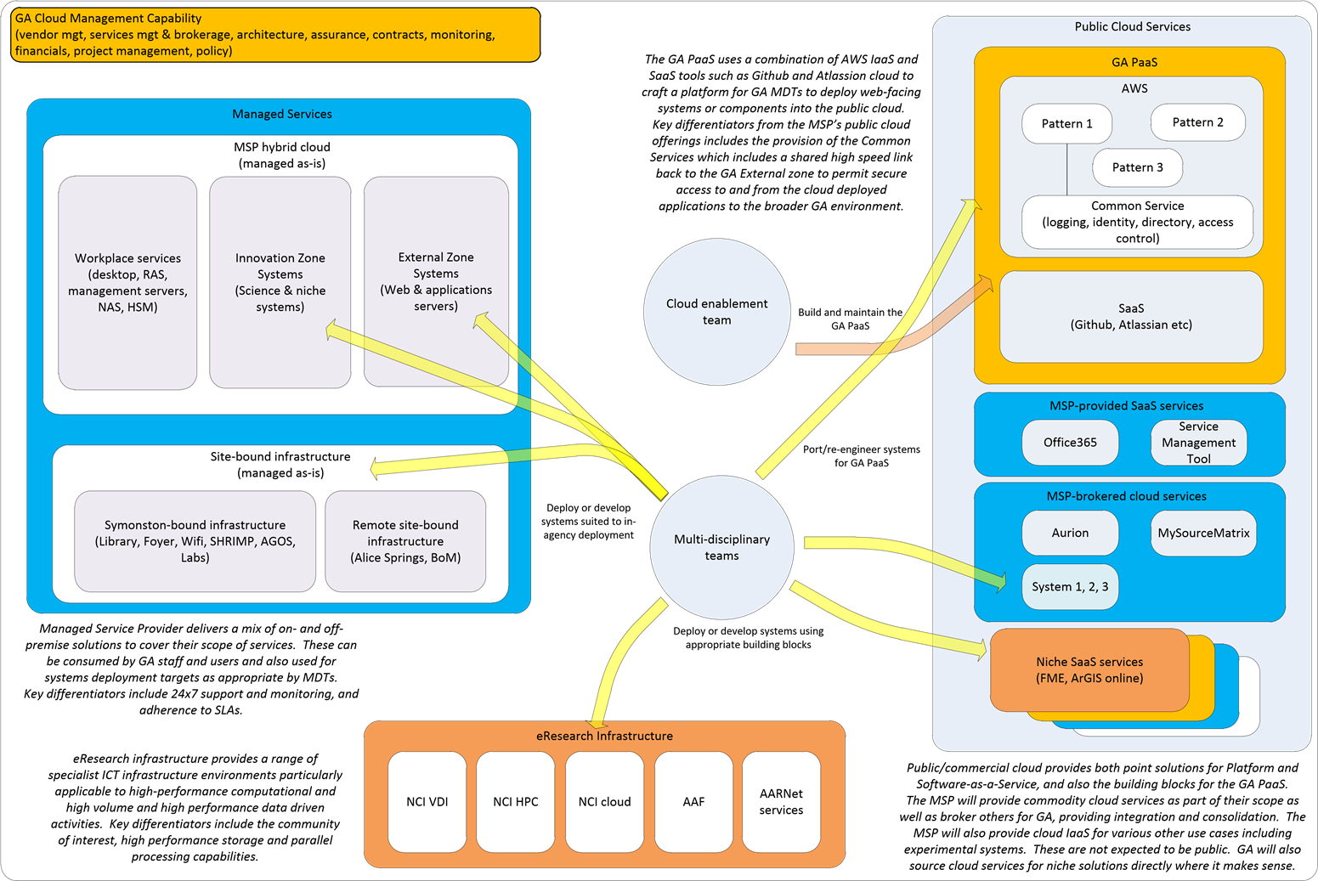

Slide 4
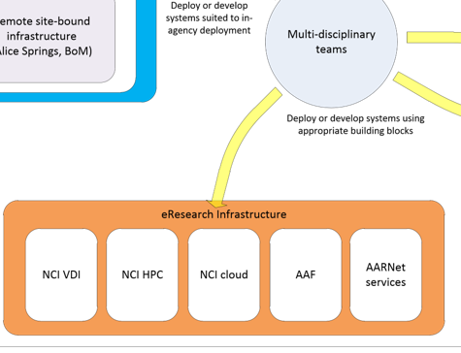
eInfrastructure for Multi-disciplinary teams

Slide 5
Public Cloud Services

Slide 6
National Computational Infrastructure
NCI is supported by the Australian Government’s National Collaborative Research Infrastructure Strategy, with operational funding provided through a formal collaboration incorporating CSIRO, Bureau of Meteorology, The Australian National University, Geoscience Australia the Australian Research Council, and a number of research intensive universities and medical research institutes.

Slide 7
The NCI VDI
Data downloading and analysis by many users has potential risks (apart from the data being too big for this to be feasible!). Bringing scientists to the data can help mitigate these issues by ensuring everyone is working on the same data. To support this workflow, the NCI runs a Virtual Desktop Environment with: Tools to support data analysis & visualisation
Virtual laboratory to access, process & analyse data
Analyses input data in a consistent format
Workflow tools allow science community to implement own analyses without dealing directly with filesystems & HPC
A range of standard software tools connected to the global Lustre filesystem and HPC
Desktops: 32GB RAM, 140GB local scratch, 8vCPUs

Slide 8
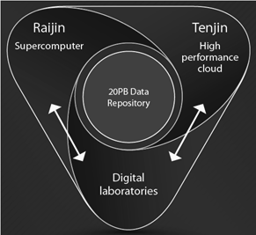
National Computational Infrastructure

Slide 9
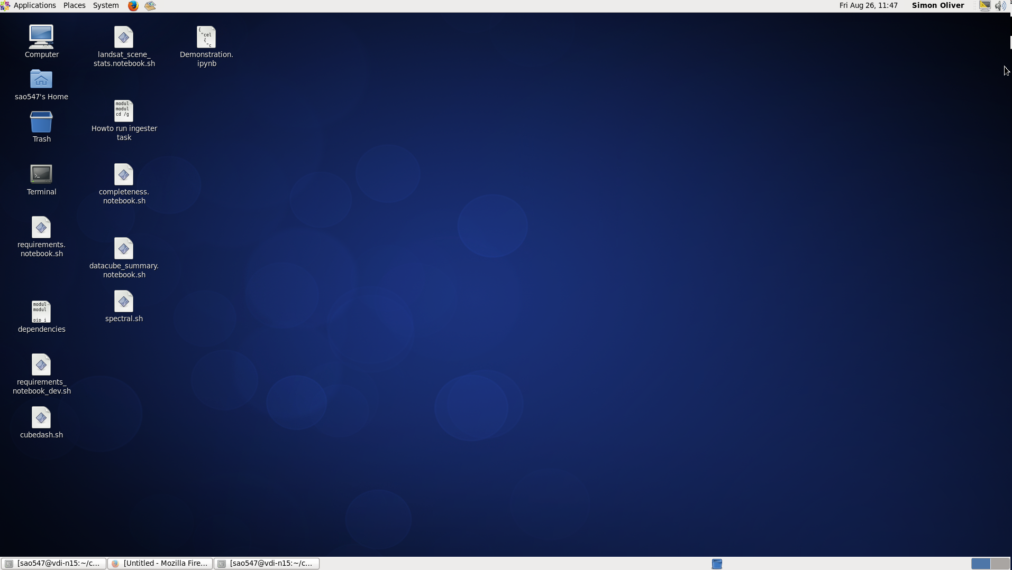
AGDC on NCI VDI
GA IT self service request for NCI’s Virtual Desktop Interface desktop tools: http://intranet.ga.gov.au/CherwellPortal/SSMS#1 Strudel and TurboVNC About the NCI VDI http://nci.org.au/systems-services/national-facility/vdi/ How to access: http://vdi.nci.org.au/help https://training.nci.org.au/course/view.php?id=3 Additional material https://training.nci.org.au/course/view.php?id=8#section-2

Slide 10
1. How are you using cloud computing in your organization/project?
GA is using a range of cloud computing offerings to cover off the range of requirements we have. We use AWS as an IaaS/PaaS provider and have built a continuous delivery pipeline to deploy systems into it. We consume SaaS and PaaS services from other vendors and we consume cloud IaaS from a specialist high performance computing eResearch environment that we are partnered with.

Slide 11
2. How mature is your organization in the use of cloud computing?
We are still relatively immature with regards to governance but I’d say we have quite a high level of understanding of the technical aspects – at least in pockets. We are progressing rapidly.

Slide 12
3. Are you using public clouds, private clouds, hybrid clouds? Are you using Multiple cloud providers? Which ones? (Vendors)
GA is using a mix and a range. We are currently outsourcing our in-house infrastructure to a managed service provider who provide a private cloud as part of their offering, we utilise cloud services at the National Computational Infrastructure (NCI) based at the ANU, and we are making increasing use of AWS to host our external facing web services. Applications are assessed for suitability against all of the providers at our disposal to ensure the most appropriate fit.

Slide 13
4. What benefits have you seen from using cloud computing?
Certainly the ability to self-serve is one of the greatest benefits we have seen and this is in line with our move to using multi-disciplinary teams to build our bespoke systems. The ability to experiment and try different things and then capture that configuration within scripts that can be reused is also valuable. The other big benefit is the range of mature capabilities built into the platforms are very stable, comprehensive and easy to use. Dual data centre deployments of applications can be as simple as clicking a few buttons.

Slide 14
5. What are the challenges you have faced? (security, costs, expertize, etc.)
Costs appear to be manageable for now but we have been fairly careful with what workloads we have placed where. A general lack of governance – both technical and procedural – poses some potential threats and this is a focus for us going forward. We need to establish safe patterns and architectures for our use, and have them followed.

Slide 15
6. What are your opinions about using cloud computing for your organization/project? Where do you think it is appropriate and where it is not?
I think it has a very important role in all of our projects and I think GA has positioned itself well with the range of providers that it has to be able to ensure that the best location is chosen for each system , or component of a system. Some workloads are not well suited to public cloud but some are very well suited, and in fact the public cloud offerings provide benefits for these use cases far above what we could deploy locally.

Slide 16
7. What kind of Big Data challenges your organization/project is facing? Are they data management and/or data analytic challenges?
Much of GA’s scientific data is large in volume, and while this isn’t the industry definition of “Big Data” it is nonetheless one of our biggest challenges. We need to curate and maintain these ever-increasing data sets through their entire lifecycle, provide comprehensive data protection and archiving, as well as make it accessible to the people (and systems) that are interested in consuming it.

Slide 17
8. Do you see Cloud Computing as the solution to your Big Data challenges?
Potentially. Some of our volumes are cost-prohibitive at the moment and part of our challenge is the desktop-centric way that many of our data are worked on by our own staff. Many of our largest datasets are held at the NCI and consumed there as well and this makes good sense, as moving large volumes around is still an impediment and a cost. The eResearch cloud environments provide perhaps the most attractive solutions to these challenges but other cloud services can help, and maybe complement this for data accessibility and distribution.

Slide 18
Thank you

