Slide 1
Datacube projects in ESA
Guenther Landgraf
Pierre Philippe Mathieu 19/09/2016
With credits to the MEEO/Sistema Group

Slide 2
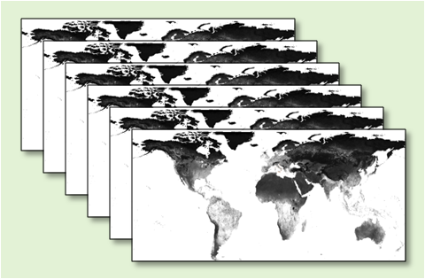
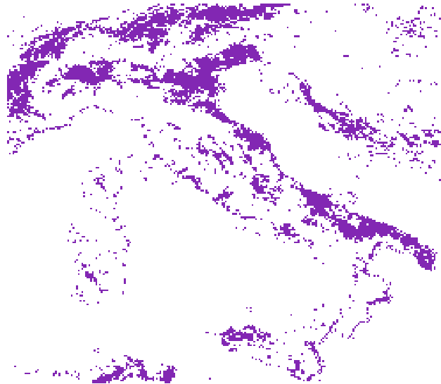
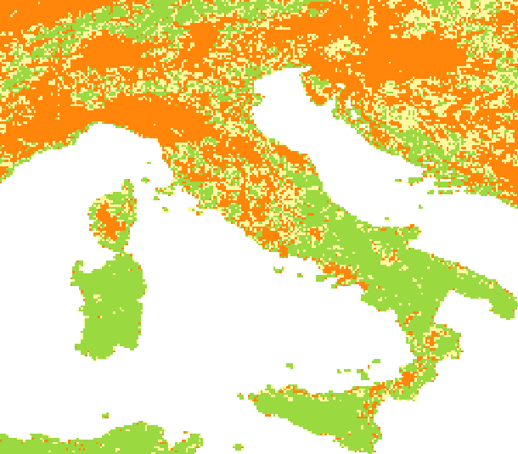
A new way of working
Access
Download
Exploring
Processing
Results
Traditional EO User
Remote
local
EO Datacube User
Access
Exploring
Processing
Results
Download
Remote
Locally

Slide 3
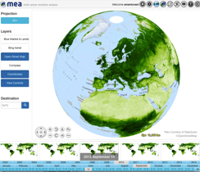
European Optical HR Data Cube
eodatacube.eu
EODC Infrastructure
Deployed MEA application
MEA
Data exploitation
- Sub-setting
- Time series
- On-the-fly analytics
EO Data
Users
rasdaman
- Array data storage
- OGC services
NRT operation and
Rolling Archive

Slide 4
European Optical HR Data Cube
Operational Datacube facility hosted at EODC (Vienna) and operated by MEEO (Italy)
Powered by RASDAMAN
Coverage:
Image2006 Reference Dataset
Europe/N-Africa Landsat TM time series starting with Landsat 4
Europe/N-Africa Landsat-8 L1T available in NRT
S-2/other Third Party missions planned
Available since July 2016
Fully OGC-compliant WCS and WCPS service available

Slide 5
Datacube Access Protocols
The Open Geospatial Consortium Web Coverage Service Interface Standard (WCS) defines Web-based retrieval of coverages – that is, digital geospatial information representing space/time-varying phenomena. […]
WCS Core functionalities
GetCapabilities: returns an XML with summary description of data collections
DescribeCoverage: lists more information about specific coverage offerings
GetCoverage: allows for the retrieval of coverages in a specified output format to the client
WCPS is a protocol-independent language for the extraction, processing, and analysis of multi-dimensional gridded coverages representing sensor, image, or statistics data. Services implementing this language provide access to original or derived sets of geospatial coverage information, in forms that are useful for client-side rendering, input into scientific models, and other client applications.
5

Slide 6
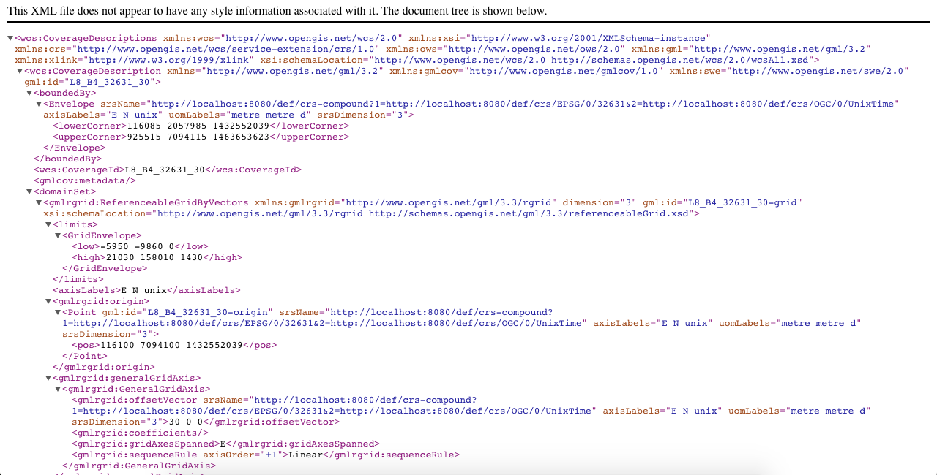
WCS – an example

Slide 7
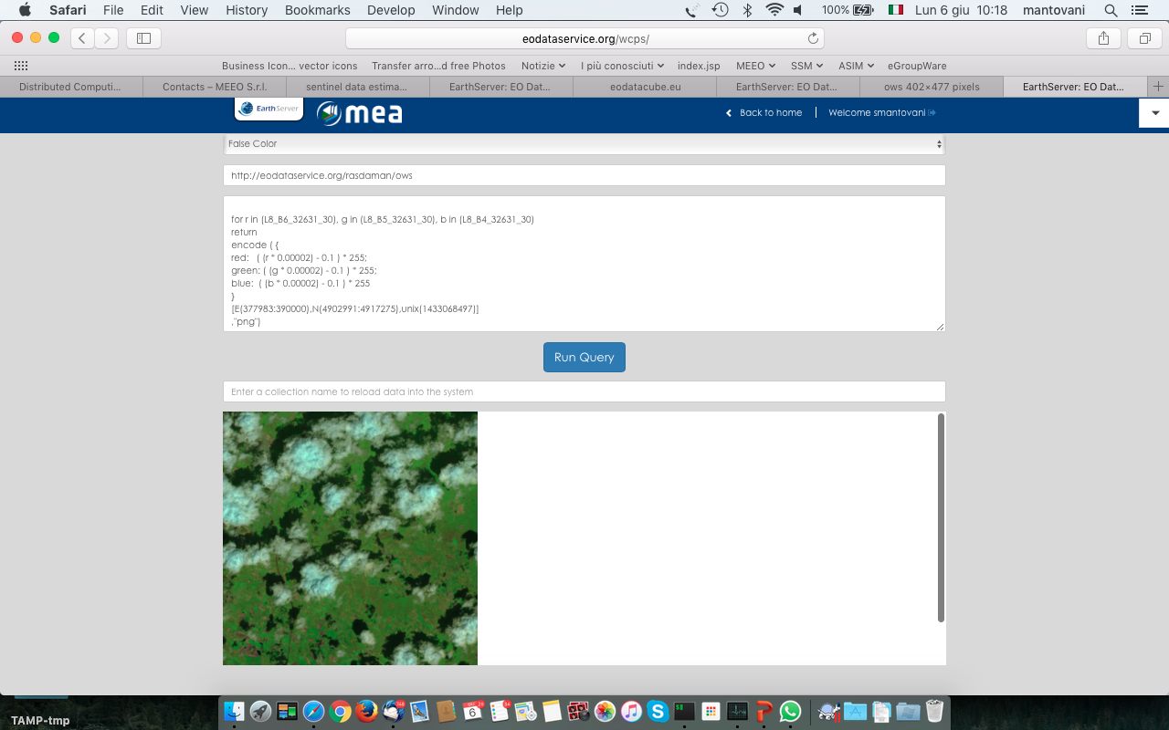
WCPS – an example

Slide 8
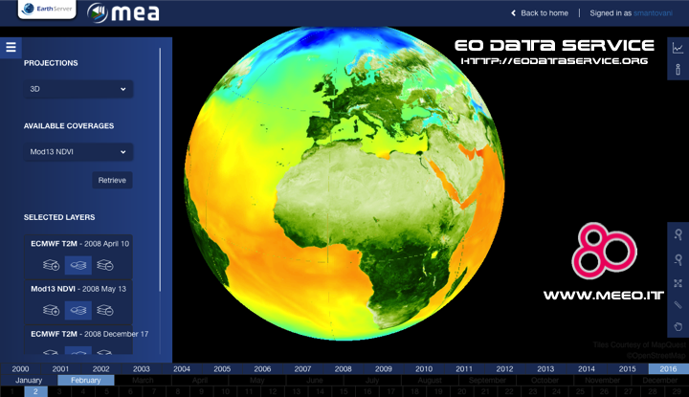
Graphical Interface – the Web Portal
8

Slide 9
User Uptake
Promotion Plan
Pilot projects
ENEA(Italy): Land Productivity Map Production
Geoville (Austria): Urban Growth Monitoring in Eastern Austria
Questions?
Are level 1 data suitable for new access technologies?
User comfort with WCS/WCPS ? Extend to python?

Slide 10
EO Exploitation Platform Datacube
Storage/access of “features” (analysis-ready-data”) produced by Thematic Exploitation Platforms
Central European Facility shared by all exploitation platform activities
Procurement end 2017

Slide 11
Earth System Data Cube
earthsystemdatacube.org

Slide 12
Earth System Data Cube

Slide 13
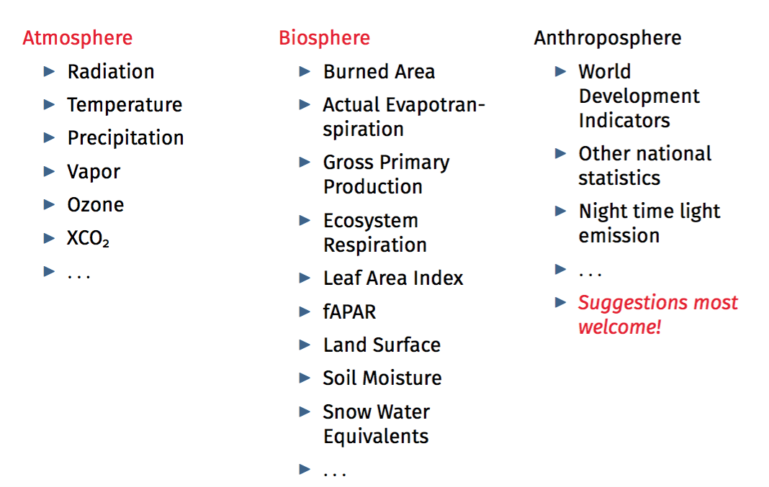
Earth System Data Cube – Essential Variables

Slide 14
Earth System Data Cube – Jupyter notebook

Slide 15
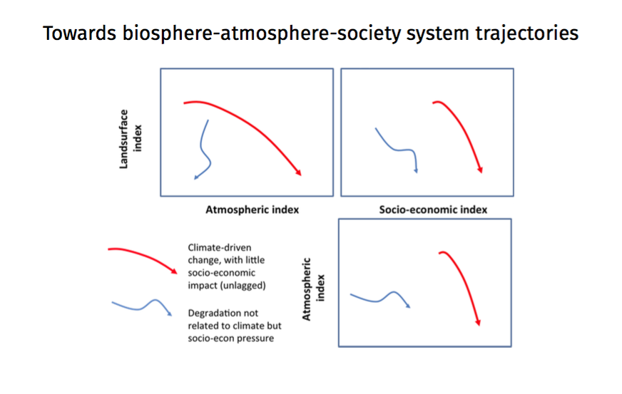
Earth System Trajectories

