Slide 1

Future Data Architectures
Status Report
Committee on Earth Observation Satellites
Andrew Mitchell - NASA
WGISS-42
Frascati – Italy
19th September 2016

Slide 2
FDA-AHT Objectives & Approach
CSIRO proposal for FDA Team
Survey opportunities and challenges around operating environment
  Ability of developing countries to realise the potential value of satellite EO for the big global agendas
  Desire to have solid concrete opportunities to develop partnerships with development banks and UN institutions (including in reference to above).
  Challenges around supporting next generation of climate applications
  Challenges around promoting uptake by industry/value-adders, working together to lower technical barriers to enable industry to really get to work - ideally in a way that supports the CEOS concept that users having access to an international constellation of systems (not just stovepiped systems) is a good thing

Slide 3
FDA Participation & Process
FDA Leads: Rob Woodcock and Tom Cecere as co-chairs
Telcon process had good participation:
  ESA, JAXA, NASA, WGCV, WGISS, SEO, GA, CSIRO, UKSA, USGS, CSA, CMA, EC plus SIT Chair and CEOS Chair Team Support
SIT Chair Tiger Team to accelerate the report:
  Rob Woodcock
  Jono Ross
  Brian Killough
  Steve Labahn
  Andy Mitchell
  George Dyke
  Mirko Albani
  Stephen Ward

Slide 4

Envisioned Study Outcomes
An inventory of relevant initiatives and plans being undertaken by CEOS and related agencies;
A report on lessons from the early prototypes currently underway with the governments of Kenya and Colombia;
A report identifying key issues and opportunities resulting from the trend towards Big Data, Analysis Ready Data, etc;
A report listing recommendations for the way forward for CEOS and its agencies, including in relation to standardisation, interoperability etc, and how the current CEOS priorities might benefit from the proposed activities.
Image Source http://necsl.org/Elections_Results

Slide 5
Report Status and Issues
Section 1 – Introduction
Section 2 – Current Trends and developments in EO systems architecture and applications
Section 3 – The challenge and opportunity of changing user expectations and increasing EO data volume, variety and velocity on EO systems architecture
Section 4 – The Future of EO Data Architectures
Section 5 – Conclusions & Recommendations (TBD)

Slide 6
Section 2 – Trends & Developments
Maximising the Value of Earth Observations
Open Data Policies
Open Source Software
Emerging EO analysis platforms in the cloud
Increased commercial and non-govt interaction
Pre-processed analysis ready data
Time series analyses and change detection
Advanced user requirements
Limited internet in developing countries
Confirms that there are both challenges in the operating environment and opportunities from new technologies and architectures

Slide 7
Section 3 - The challenge and opportunity of changing user expectations and increasing EO data volume, variety and velocity on EO systems architecture
The impact of volume, velocity and variety
Data discovery
Data access
Data usage
Data system functions
Identified aspirations, constraints and open problems

Slide 8
Section 4 – Future of EO Data Architectures
Bringing the user to the data: EO Exploitation Platforms
Architectural Change
Discovery and Access
Usage
Integration
Infrastructure

Slide 9
Preliminary Conclusions
Significant activity across CEOS agencies – with great diversity of approaches and capacities. FDA effort is needed.
Move to on-line data systems plus increased size/complexity of data (volume, velocity, variety)
The big data players and their advanced platforms, populated with CEOS agency data (amongst others), are changing expectations as to how easy it could and should be to access and apply EO satellite data
Broadening user base for EO satellite data, to more sectors and more users, many non-expert / not from large technical institutions; implications for ease of data handling for CEOS agency mission data
CEOS placing more emphasis on supporting uptake and application of data – including grand themes like SDGs, climate, food security…

Slide 10
Preliminary Conclusions
  Interaction / Integration / Interoperability / Interface cooperation
Interaction model: in-place analysis of ready to use data is replacing discovery and download
Dictates architecture changes: in the interfaces between agencies, between computational infrastructures and agencies, between discovery and analysis tools and users
Significant and diverse approaches among agencies:
  Bringing the user to the data
  APIs/Virtual Laboratories, enabled by standards
  pre-processing data to a point where it is a measurement comparable in space and time with other measurements from other sectors
  integration of different types of data, across different domains
  moving the burden of data processing for the extraction of application information from the users to the space agencies (TEPs, ARD..)
  HPC approaches such as the CEOS Data Cube

Slide 11
Making sense of it all…
The future will consist of multiple approaches to cover all circumstances and uses - the FDA effort is not a beauty contest
Sensitive and strategic decisions
Realisation of dense time series applications requires improved interaction/ integration / interoperability
Expectations of communities that CEOS is targeting are changing
Related activities already initiated within SEO and LSI-VC – and ongoing fundamental work within WGISS...
The AHT has done a great job of characterising the issues and surveying the activity. Out of time for debate on identifying the common ground for CEOS attention

Slide 12
A major strategic challenge for CEOS
Technology is changing rapidly.
Agency initiatives do not happen in a vacuum.
There will be no ‘single system’ or ‘single stack’ solution.
The challenge for CEOS: How do we work together to take advantage of these opportunities to:
  Highlight the value of CEOS’s efforts in coordinating ‘virtual constellations’ that de-risk and simplify for users?
  Help users benefit from all CEOS data:
    Contrasted with current approaches which help improve unity of ‘discovery’ …
    But then send users off to disparate incompatible systems once they have discovered some data?

Slide 13
What next…
AHT proposes to break down recommendations as short, medium and long term
Only short term recommendations in the 2016 Report to Plenary
USGS and CSIRO willing to take forward the AHT through 2017, subject to Plenary approval, focused on med- and long-term
We have pilot, prototypes and enabling technology work underway within SEO, LSI-VC, GFOI, and WGISS and the AHT recommends these be progressed and accelerated meantime

Slide 14
What next…
Continue and support existing WGISS efforts on:
  Discovery Search Engine Optimization (search relevancy, keyword search, persistent identifiers)
  Access Common Standards for Interoperability of Product Formats (metadata/data) and Application Program Interface (API)
  Exploration of Emerging Big Data services including Cloud Computing

Slide 15
What next…
Continue and support other CEOS FDA-related efforts:
  Demonstrate value for space agencies
  Demonstrate value for users/use
  Include a range of approaches, reflecting the diversity
Small-scale demonstration of the potential of ARD
  Trial process of ARD production by several agencies
  Get a sense of scale of effort etc
  Show the value agencies get back by way of uptake
  Show the value users get through ease of use
  Demonstrate dense time-series applications

Slide 16
What next…
Continued development of CEOS Data Cube as an example
  3-year CDC Work Plan
  GFOI pilot underway with Colombia
  Application framework for the ARD
  User participation and feedback crucial
  24 month period then review lessons learned
  Adapt to full FDA recommendations late 2017 as needed
Explore other FDA-related suggestions
  ESA proposed CEOS Disasters TEP pilot
  Need to establish capacity and leadership
Extend AHT at Plenary for 1 year under USGS/CSIRO leadership

Slide 17
Analysis Ready Data
Committee on Earth Observation Satellites

Slide 18
Analysis Ready Data
LSI-VC were tasked (Nov 2015) to “Define intercomparable Analysis-Ready Data (ARD) products within the context of land surface imaging”
CEOS Analysis Ready Data for Land (CARD4L) is defined at two levels, a General Description and Technical Specifications:
Mature content, ‘on target’
Future refinements to content and
expression may be needed
General Description
minimum characteristics
Technical Specifications
specifically, what is needed
for optical, radar or other
datasets to be CARD4L?
E.g., what is CARD4L
surface reflectance?
Under development, early days.
This will continue to evolve and will
require ongoing work.
Specifications will not change the
General Description

Slide 19
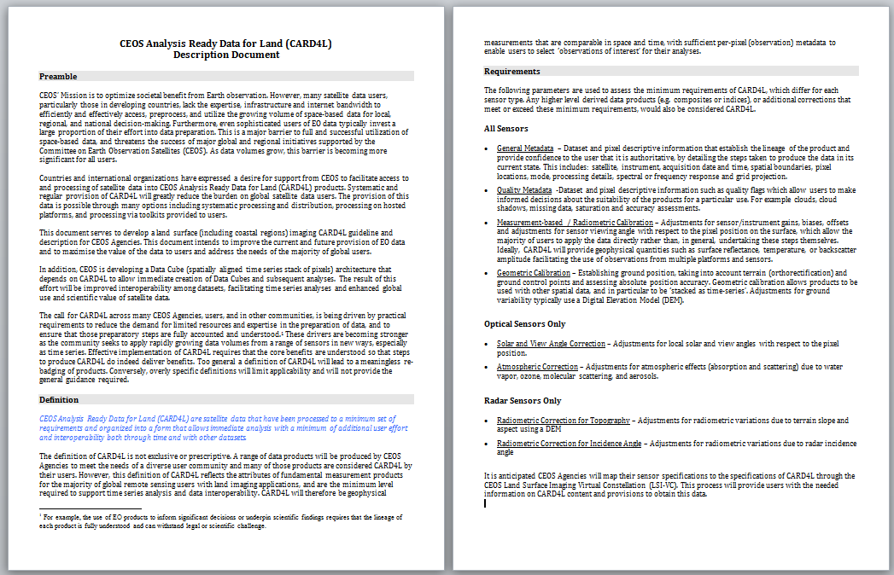
CARD4L – General Description
Definition paragraph
CEOS Analysis Ready Data for Land (CARD4L) are satellite data that have been processed to a minimum set of requirements and organized into a form that allows immediate analysis with a minimum of additional user effort and interoperability both through time and with other datasets
Caveats: not the only products that Agencies will produce for their users.

Slide 20
CARD4L – General Description
Requirements (minimum)
General metadata
lineage; authoritative data
Quality metadata
quality flags; suitability for a particular use
Corrections
allow the users to use the data directly; geophysical measurement of the land surface
Geometric correction
accurate location; data can be ‘stacked as time-series’

Slide 21
CARD4L – General Description
Requirements (optical and radar)
Optical : atmospheric and
solar view angle corrections
Radar: radiometric corrections for
topography and incidence angle

Slide 22
CARD4L – Specifications
LSI-VC were tasked (Nov 2015) to “Define intercomparable Analysis-Ready Data (ARD) products within the context of land surface imaging”
CEOS Analysis Ready Data for Land (CARD4L) is defined at two levels, a General Description and Technical Specifications:
Mature content, ‘on target’
Future refinements to content and
expression may be needed
General Description
minimum characteristics
Technical Specifications
specifically, what is needed
for optical, radar or other
datasets to be CARD4L?
E.g., what is CARD4L
surface reflectance?
Under development, early days.
This will continue to evolve and will
require ongoing work.
Specifications will not change the
General Description

Slide 23
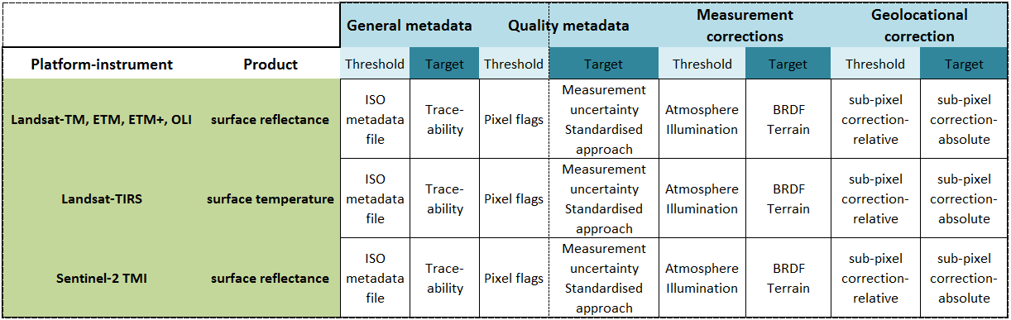
CARD4L – Specifications
Developing specifications (next steps / future work)
Materials will be developed that map CEOS agency products to the high level requirements for CARD4L (possible focus for LSI-VC-3)

Slide 24
CARD4L – Benefits
CARD4L will enable CEOS agencies to better provide interoperable data that can be used for time-series analysis because the data are stackable as time-series and measurement-based.
CARD4L will help users to overcome the challenges of big EO data, by removing the need for users to pre-process larger and larger data volumes.
CARD4L will lead toward more interoperable data between like instruments (eg., Landsat-OLI and Sentinel-2 MSI), supporting CEOS constellations.

Slide 25
Challenges
Closure on the high level definition / description document is needed to allow LSI-VC to focus on the next level of detail
Increased participation is sought from agencies to lead and participate in sub-teams to take this work forward
Specifically, a team is needed to work on specifications for Radar data, with involvement of the major Radar providers

