Slide 1
CEOS and GEO Workplan Review
Committee on Earth Observation Satellites
Andrew Mitchell - NASA
WGISS-42
Frascati – Italy
19th September 2016

Slide 2
CEOS Work Plan 2016-2018
DATA-2: Full representation of CEOS Agency datasets in the IDN and accessible via WGISS Interoperable Standards
Status: WGISS began discussions with ISRO and the following Australian centers in order to get their data accessible via WGISS interoperable standards (i.e. IDN, CWIC). (Geosciences Australia / CSIRO / Bureau of Meteorology /Australian National University &National Computational Infrastructure). New entries were added to the IDN from ESA, EUMETSAT, and JAXA datasets.
VC-1: List of Relevant Datasets from VCs
Status: WGISS is requesting updated list from the VCs.
VC-25 Increase the visibility of land surface imaging data holdings
Status: WGISS will work in conjunction with the LSI-VC to ensure relevant datasets are visible through WGISS Interoperable Standards.
OUT-7: Data Cube infrastructure development
Status: WGISS will support the SEO in the development of a general CEOS Data Cube infrastructure
CARB-9: GFOI Data Services Pilot Projects for Kenya and Colombia
Status: WGISS will support the SEO in the delivery of Data Services Pilot Projects (based on the Data Cube architecture) for Kenya and Colombia.

Slide 3
CEOS Work Plan 2016-2018
In the CEOS Work Plan 2016-2018,
Pre-existing
CARB-08-35 – The CEOS Carbon Subgroup (recommended in Carbon-Action-38) will develop guidelines for appropriate data use of satellite data and data products. This will require improved interaction between the carbon cycle community and the satellite community; comprehensive review of the current use of data products, including current data limitations; and reconciliation of methodological differences and spatial compatibility. Such interactions may include co-sponsorship of joint workshops targeting specific data needs and investment in community product assessments, especially for key in comparison exercises.
Status: Strategy presented at CEOS SIT Tech Workshop 2016 (see next slides)

Slide 4
WGISS initiatives in support to Carbon Action
Committee on Earth Observation Satellites
Presented during SIT Tech Workshop 2016
A.Mitchell (WGISS Chair, NASA), M.Albani (WGISS Vice-Chair, ESA)
SIT Tech Workshop 2016 Agenda Item #
Oxford, UK
14th-15th September 2016

Slide 5
ECVs/CDRs Discovery and Access through WGISS Systems
Objective: facilitate discoverability and accessibility of ECV Products and space-born CDRs relevant for the CEOS Carbon Action via WGISS Interoperability Systems & Standards (FedEO/CWIC/IDN, OpenSearch).
Approach: start from results of WGClimate Questionnaire for ECV Inventory population; tailoring for Carbon Action and gaps identification wrt data records already discoverable/accessible through WGISS systems (Q1/Q2 2017); feasibility analysis, priorities setting and liaising with relevant organizations (Q2/Q3 2017); start technical activities (Q3/Q4 2017).
Additional Resources: support from WGClimate and experts for priorities setting; activities at data providers’ side to be carried out by relevant entities.
Notes:
Carbon Portal prototype

Slide 6
WGISS Carbon Portal
Objective: development as WGISS project of a CEOS WGISS Carbon Portal prototype similar to the Water portal (http://waterportal.ceos.org/) to allow displaying Carbon datasets and providing assistance to scientists and general users in the development of related services & tools.
Approach: collection of needs from Carbon (or WGClimate) experts on what needs to be in the portal (Q1/Q2 2017); Carbon Portal requirements definition and system design (Q2/Q3 2017); start development (Q3/Q4 2017).
Additional Resources: requirements definition and development resources provided by NOAA; support from WGClimate and experts for requirements definition.
Notes:
Carbon Portal prototype

Slide 7
GEO Activities & Status
Committee on Earth Observation Satellites

Slide 8
2016 GEO Work Program
In the 2016 GEO Work Program,
WGISS has been added as a contributor to the Foundational Task GD-7 Subtask 2 ‘GCI Development’ and GD-2 ‘GCI Operations’.
As contributors, WGISS will:
continue to advocate for CEOS agency mission data to be contributed to the implementation of the GEOSS via the WGISS interoperable systems and standards (e.g. IDN, CWIC, and FedEO). As more CEOS data providers adopt WGISS supported standards (e.g. OGC CSW 2.0.2 and CEOS OpenSearch Best Practices) these data providers holdings will be made discoverable via these systems.
maintain the website titled ‘Connected data assets’ to provide up-to-date metrics for IDN, CWIC and FedEO.
contribute to this activity through the WGISS Technology Exploration Interest Group which serves as a forum for the exchange of technical information and lessons-learned about current and trending software technologies, services, and other internet-based software technologies.

Slide 9
Connected Data Assets

Slide 10
GEO Foundational Tasks Changes
There is a recommendation from the GEO Plenary Board to reduce the Foundational Tasks from 17 to 6 (Secretarial operations, GCI operations, data sharing, and requirement analysis: using current codes, GD 02, GD 03, GD 09, and SO 01, 02, 03), and use other delivery mechanisms for the other activities.
GD7 group is working on drafting a new GEO initiative addressing GEOSS Architecture evolution and GCI Development.
They don’t foresee it being much different from what they have already agreed to do in the current draft of the WP. They are considering their relationships with GCI Operations (GD 03) by distinguishing between activities that are operational in nature and should be grouped with GD 03 (which is still a Foundational Task) and those that are about future development, and which should be in scope of our new activities.

Slide 11
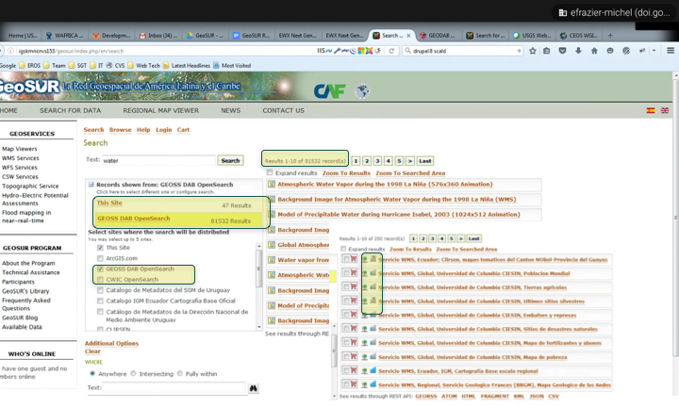
GEO WGISS Connected API Updates
GEO integrated CWIC in GeoSUR Portal
Next Steps:
GEO will be working on integrating CWIC in GeoPlatform community and the ArticSDI community

Slide 12
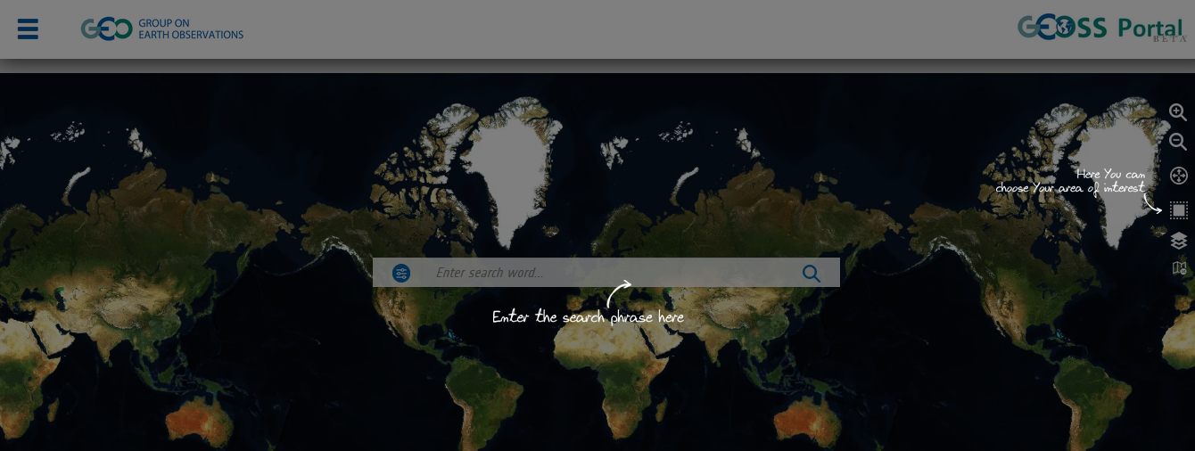
GEOSS Portal Updates
The GEOSS Portal is being enhanced by the European Space Agency to best respond to the actual user needs, i.e. to provide a simple, intuitive and easy to use interface to discover, access and use all of the ever growing amounts of heterogeneous GEO-resources from different sources and providers they need. The enhanced GEOSS Portal’s main objective is to provide users with a much better experience than ever had before.
A first issue of the enhanced portal will be open to the public from October 2016 after an extensive beta testing period. It will be accessible directly from the GEO home page (www.geoportal.org).

Slide 13
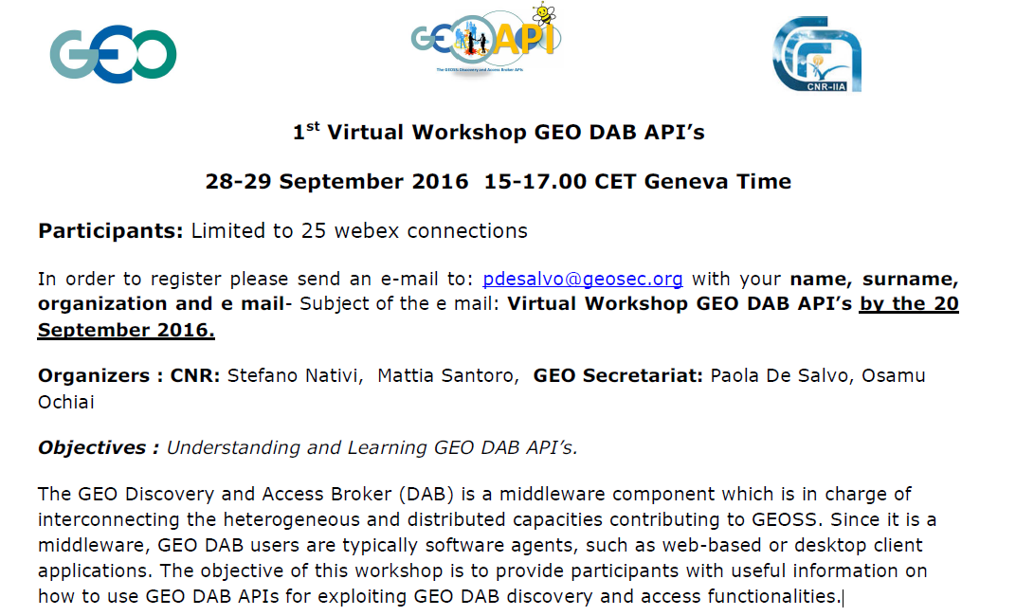
Virtual Workshop GEO DAB API’s

