Slide 1
Welcome
/
Benvenuti
Henri Laur
EO Mission Operations & Ground Segment department, ESA

Slide 2

Purpose of ESA
“To provide for and promote, for exclusively peaceful purposes, cooperation among European states in space research and technology
and their space applications.”
Article 2 of ESA Convention

Slide 3
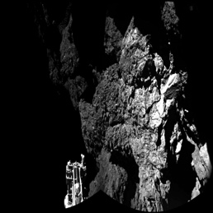
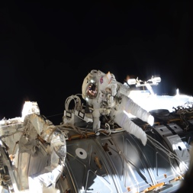
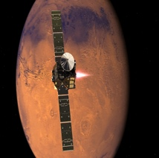
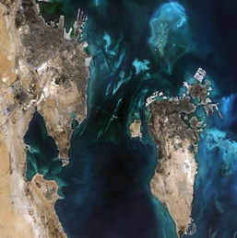
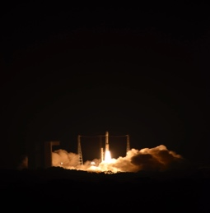
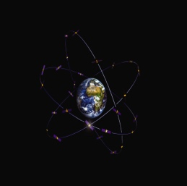
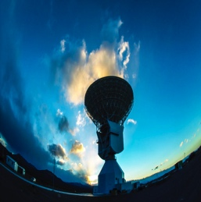

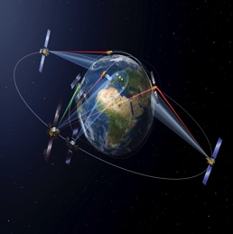
ESA activities
space science
human spaceflight
exploration
ESA is one of the few space agencies in the world to combine responsibility in nearly all areas of space activity.
earth observation
launchers
navigation
* Space science is a Mandatory programme,
all Member States contribute to it according
to GNP. All other programmes are Optional, funded ‘a la carte’ by Participating States.
operations
technology
telecommunications

Slide 4
Member States
ESA has 22 Member States: 20 states of the EU (AT, BE, CZ, DE, DK, EE, ES, FI, FR, IT, GR, HU, IE, LU, NL, PT, PL, RO, SE, UK) plus Norway and Switzerland.
Seven other EU states have Cooperation Agreements with ESA: Bulgaria, Cyprus, Latvia, Lithuania, Malta, Slovakia and Slovenia. Discussions are ongoing with Croatia.
Canada takes part in some programmes under a long-standing Cooperation Agreement.

Slide 5
ESA budget for 2016
ESA Activities and Programmes
Programmes implemented
for other Institutional Partners
Other income:
5.5%, 204.4 M€
CA: 0.4%, 13.2 M€
AT: 1.3%, 47.6 M€
UK: 8.7%, 324.8 M€
BE: 5.0%, 188.9 M€
Other income:
2.4%, 35.6 M€
CZ: 0.4%, 15.6 M€
CH: 3.9%, 146.4 M€
DK: 0.8%, 29.5 M€
Income from Eumetsat 9.8%, 147.9 M€
EE: 0.0%, 0.9 M€
SE: 2.0%, 73.9 M€
FI: 0.6%, 21.6 M€
ES: 4.1%, 152.0 M€
Total:
1.51 B€
RO: 0.7% 26.1 M€
Total:
3.74 B€
PT: 0.4%, 16.0 M€
PL: 0.8%, 29.9 M€
NO: 1.6%, 59.6 M€
FR: 22.6%, 844.5 M€
NL: 2.7%, 102.6 M€
Income from EU: 87.8%, 1324.8 M€
LU: 0.6%, 22.0 M€
DE: 23.3%, 872.6 M€
B€: Billion Euro
IT: 13.7%, 512.0 M€
GR: 0.3%, 11.9 M€
IE: 0.6%, 23.3 M€
HU: 0.1%, 5.0 M€
Total ESA budget
for 2016: 5.25 B€

Slide 6
ESA 2016 budget by domain
European Cooperating States Agreement (ECSA)
0.1%, 4.0 M€
Space Situational Awareness
0.2%, 12.9 M€
Technology support*
1.9%, 99.5 M€
Basic Activities
4.4%, 232.1 M€
Robotic Exploration & Prodex
3.7%, 192.8 M€
Scientific Programme
9.7%, 507.9 M€
Navigation*
11.6%, 609.5 M€
Associated with General Budget
4.1%, 214.8 M€
Telecom & Integrated Applications*
6.8%, 359.3 M€
Budget 2016
5.25 B€
Human Spaceflight
7.0%, 365.1 M€
Earth Observation*
30.5%, 1603.5 M€
Launchers
20.0%, 1051.2 M€
M€: Million Euro
*includes Programmes implemented for other Institutional Partners

Slide 7
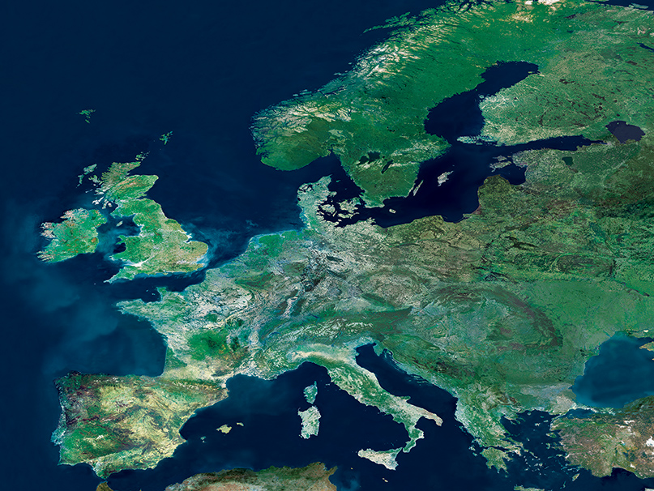
Space for Europe
The European Union and ESA share a common aim:
      → to strengthen Europe and benefit its citizens.
Closer ties and an increased cooperation between ESA and the EU bring substantial benefits to Europe by:
  guaranteeing Europe’s full and unrestricted access to services provided by space systems for its policies,
  encouraging the increasing use of space to improve the lives of its citizens,
  increasing political visibility of space and taking full benefit from its economic and societal dimension.

Slide 8
Strong ties all over the world
Partnership: one of ESA’s key words
As a European research and development organisation,
ESA is a programmatically driven organisation, i.e. the international cooperation is driven by programmatic needs and rationale.
Strategic partnerships with: USA, Russia and China
Long-standing cooperation with Japan, India, Argentina, Brazil, Israel, South Korea, Australia and many more…
EU Members, but not ESA Member States: enhanced cooperation and joint activities. European Cooperating States (ECS): Bulgaria, Latvia, Lithuania, Slovakia and Slovenia. Cooperating States: Cyprus and Malta. Discussions are ongoing with Croatia.

Slide 9

ESA’s industrial policy
About 85% of ESA’s budget is spent
on contracts with European industry.
ESA’s industrial policy:
ensures that Member States get a fair return on their investment;
improves competitiveness of European industry;
maintains and develops space technology;
exploits the advantages of free competitive bidding, except where incompatible with objectives of the industrial policy.

Slide 10
ESA’s locations
Salmijaervi (Kiruna)
Moscow
Brussels
ECSAT (Harwell)
ESTEC (Noordwijk)
EAC (Cologne)
Washington
Maspalomas
ESA HQ (Paris)
ESOC (Darmstadt)
Houston
Oberpfaffenhofen
Santa Maria
Kourou
Toulouse
New Norcia
Perth
Redu
Malargüe
ESAC (Madrid)
Cebreros
ESRIN (Rome)
ESA sites
Offices
ESA Ground Station + Offices
ESA Ground Station
ESA sites + ESA Ground Station

Slide 11
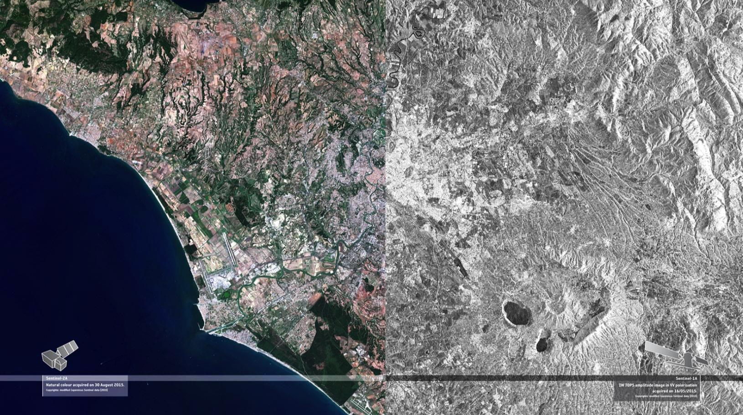
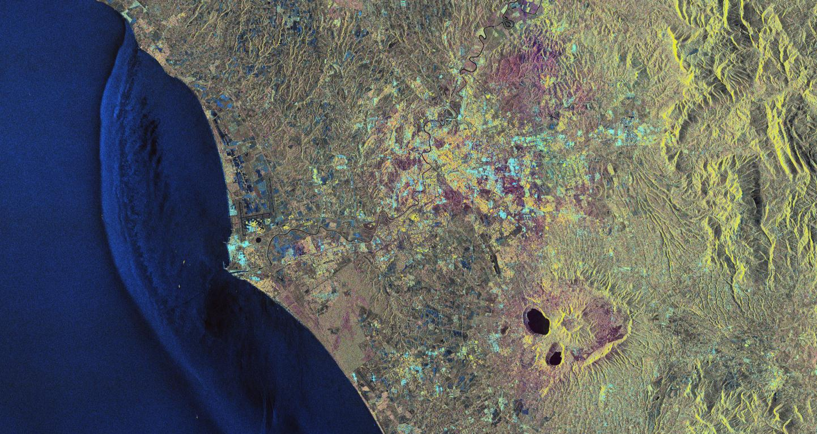
Rome and surroundings
Sentinel-2A
ESRIN
Sentinel-1A
Notes:
False colours

Slide 12
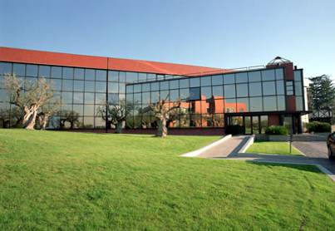
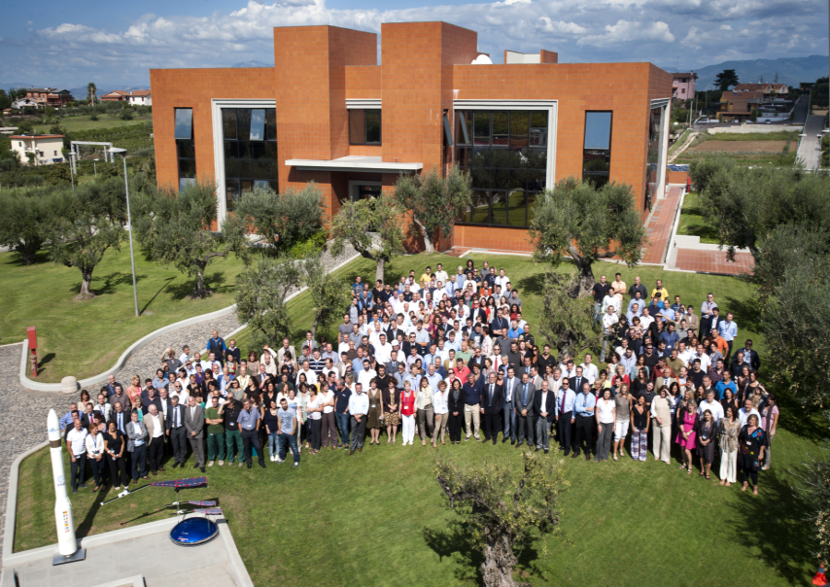
ESRIN, Frascati
Personnel on site (June 2014): 515
207 ESA staff
308 contractors
  Earth Observation
  Vega Department
  Corporate Informatics
  Telecommunications
  Contracts, Site, Personnel,
  Communication
  ESA Security Office
  + 86 conferences and 42.000 visitors in 2013
Notes:
Mission and Payload Operations

Slide 13
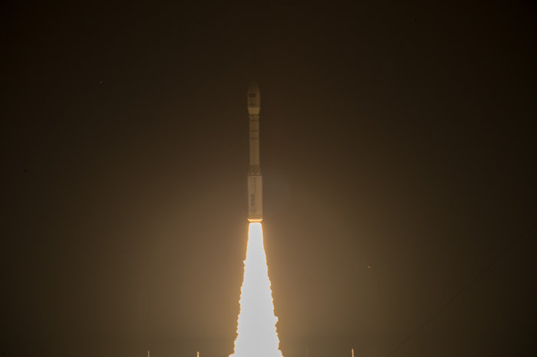
VEGA Small Launcher Programme
Liftoff of Vega VV05 carrying Sentinel-2A
23 June 2015
ESRIN is the management centre for the VEGA small launcher programme
VEGA is able to place up to 2500 kg satellites into polar and low-Earth orbits
7 launches
→ 7 successes

Slide 14

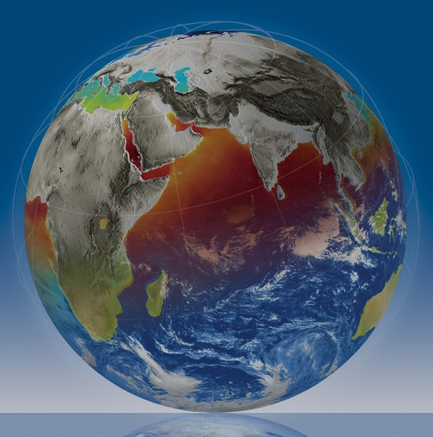
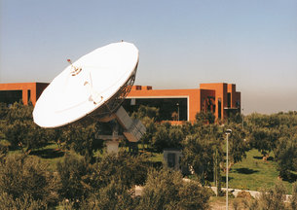
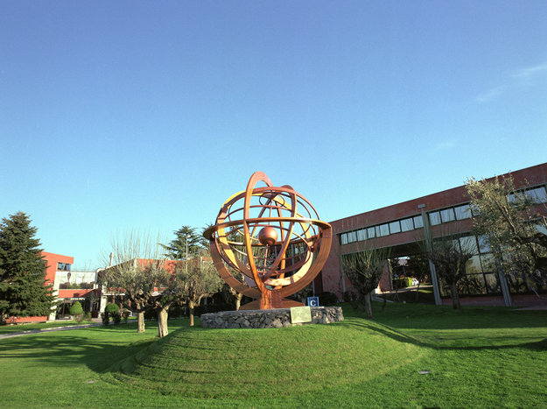
ESA’s eye on Earth
ESRIN, in Frascati, Italy, is ESA’s centre for Earth Observation where operations and exploitation of Earth Observation satellites are managed.
EO mission management
EO payload operations
EO data access
Support to data exploitation
User education & training
Communication & outreach
International Charter for Space & Major Disasters

Slide 15
ESA Earth Observation Programmes
Earth Observation Envelope Programme
Heritage Mission Programme (LTDP)
Earthnet
Earth Watch

Slide 16
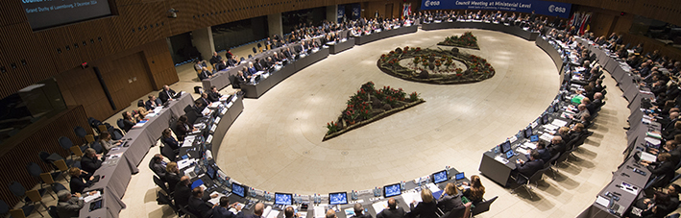
Ministerial Council 2016,
December 2016, Lucerne, Switzerland
For Earth Observation:
Optional programmes:
New period of Earth Observation Envelope Programme (EOEP-5)
New elements of Earth Watch Programme (GMECV+, InCubed, Altius, MicroCarb)
Within General Budget:
LTDP+ (“Heritage Data Programme”, new period of existing programmatic line)
Earthnet (new period of existing programmatic line)

Slide 17
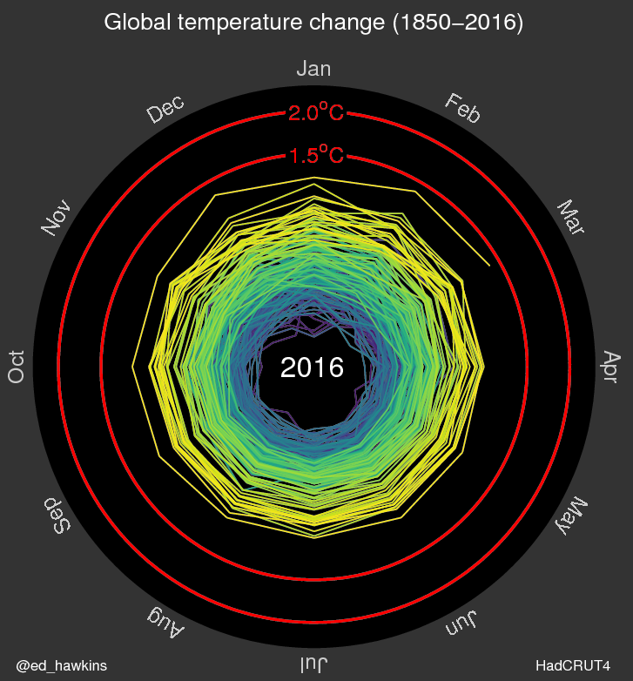

Two key elements in the ESA General Budget 2017-2021
“Heritage Data” (a.k.a. LTDP+)
“Data are central in science and in economy and are the only remaining assets once the mission is ended”
LTPD+ not only care for data preservation of the data, but also for their accessibility / usability e.g. for long-term climate studies.
Implemented as a common programme across ESA
“Earthnet”
“European international gateway for Earth Observation”
Equal & persistent MS access to Third Party Mission (including historical SPOT series, Jason-3, Landsat series, …)
24/7 coordination of the International Charter on Space and Major Disasters,
presence in organisations and committees (e.g. UN, GEO, CEOS) and in initiatives for promoting the international use of EO data (e.g. in Africa, China)
Notes:
Image of global temperature trends over long period demonstrates the need to long and consistent record.
http://www.climate-lab-book.ac.uk/2016/spiralling-global-temperatures/

Slide 18
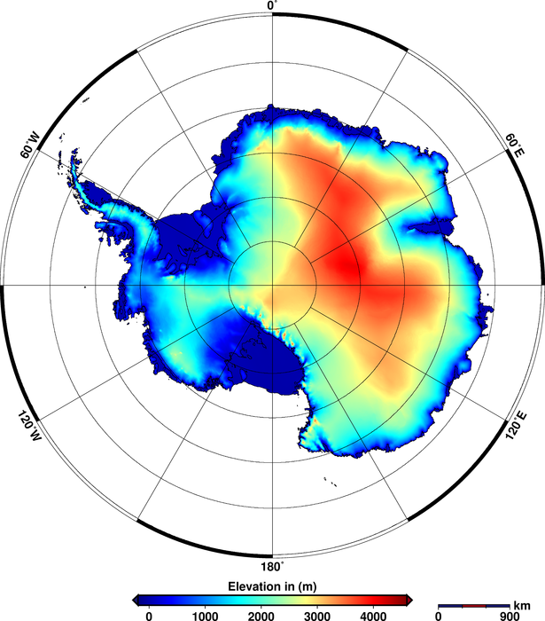
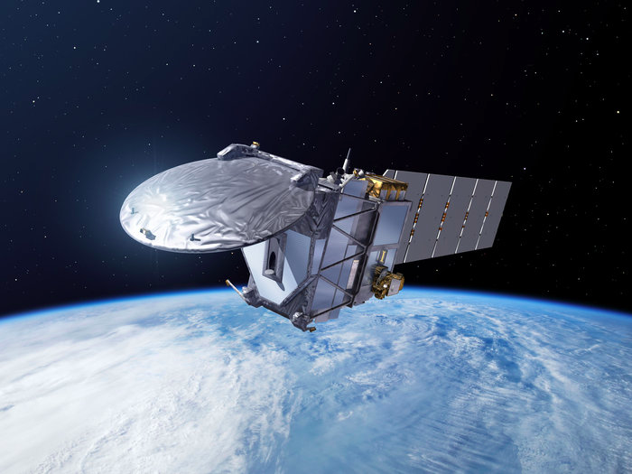
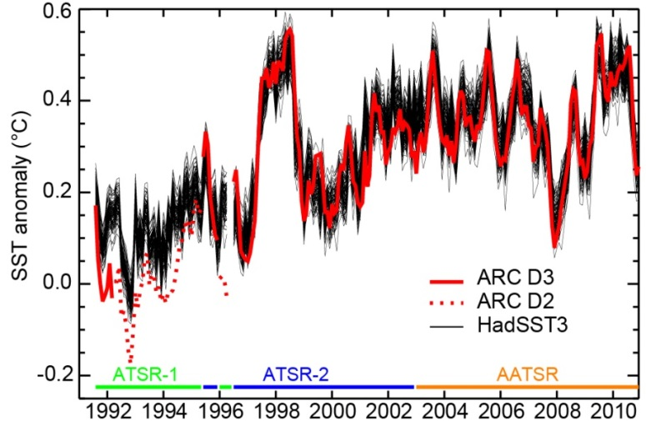
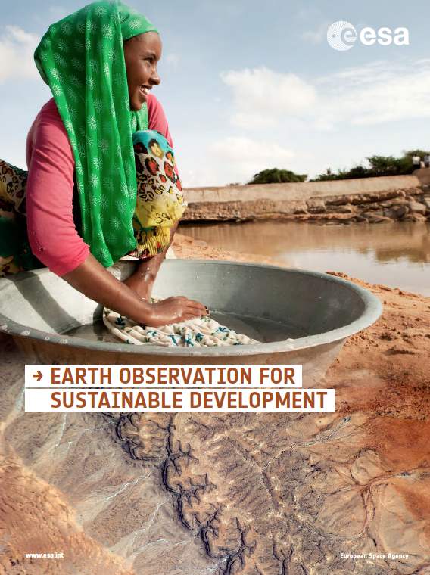
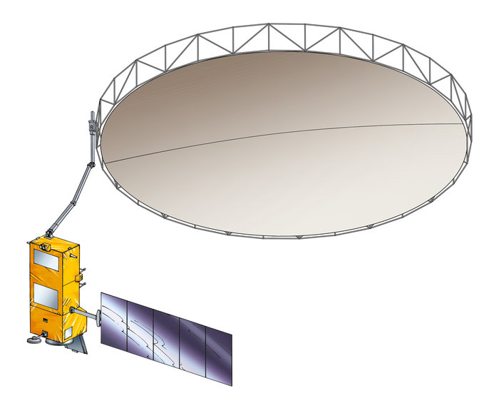
Earth Observation Envelope Programme - 5 (EOEP-5: 2017-2021)
EO backbone programme to implement
ESA’s Space 4.0
Addresses societal challenges (climate, water, food, SDG, etc.)
Enhances competitiveness of European space, ground and services industry
From pre-development to exploitation
Prepares all future missions
Drives scientific excellence and innovation
Improved, user-ready data access
Brings EO to all levels of society
EOEP-5 secures the continuation of the programme, with however significantly new content and methods.
Notes:
Implications and benefits for industry
Continuation of an established framework.
Development of new technology for ambitious science mission.
Strategic preparation for future operational missions (Sentinels, Meteo)
Opportunity to engage with ground segment developments towards big-data technologies
Pre-commercial service developments for downstream industry

Slide 19
EOEP-5: Future Missions - Block 1
Industrial studies on systems & key technologies
End-to-end simulation frameworks
Instrument pre-development
Earth Explorer - 10 (EE-10): early phases
Copernicus evolution - early phases (new)
EO “Mission of Opportunity” - early phases (new)
Call for early mission concepts (new)
Polaris preparatory activities

Slide 20

EOEP-5: Mission Development - Block 2
Definition, development, launch, commissioning of Earth Explorers and Missions of Opportunity
Copernicus Evolution Instrument Models
SAOCOM-CS
Biomass (EE-7)
Flex (EE-8)
EE-9 (under selection)
Copernicus Evolution:
CO₂, TIR, “Cryosat-FO”, hyperspectral, “SMOS-FO”)

Slide 21



EOEP-5: Mission Management - Block 3
Earth Explorer missions exploitation phase:
  SMOS, CryoSat, Swarm (until 2019)
  ADM-Aeolus, EarthCARE, SAOCOM-CS (until 2021)
  Earth Explorer data access
  Cal/Val
Earth Explorer Level-2 products:
in development and exploitation phases

Slide 22
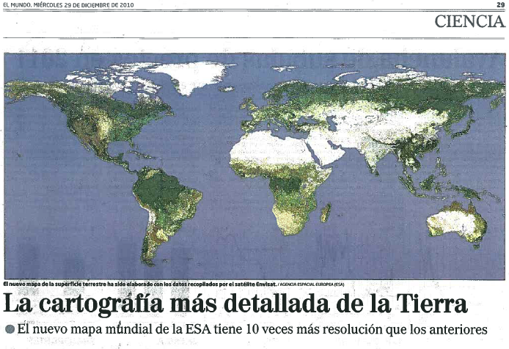
EOEP-5: EO Science for Society - Block 4
Scientific data exploitation
EO Exploitation Platforms → EO-Innovation Europe concept
EO for Sustainable Development
Community engagement, science/development projects, toolbox development (new)
Develop data access/platform technology (new)
Business incubation
Cooperation with Intl. Funding Institutions
  Open science, EO social networking

Slide 23
ESA Earth Observation Programmes
Copernicus
Earth Observation Envelope Programme
Heritage Mission Programme
Earthnet
Earth Watch

Slide 24

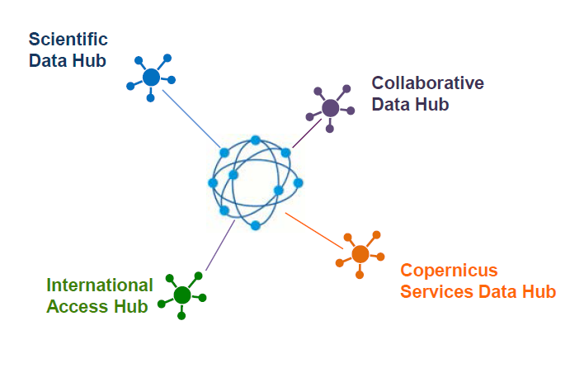

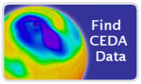









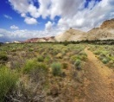

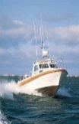






Copernicus data access & redistribution
→ Sentinel Data Hubs operated by ESA
The Copernicus Ground Segment features dedicated data access infrastructure solutions, tailored to the needs of the various use typologies:
Large and small private companies are re-distributing Sentinel products via free and pay-per-use schemes
The open access Data Hub, for anyone (45,000 users)
Collaborative mirror sites directly serve 600+ users (status end 2015)
As of spring 2016, international partners mirror sites have started disseminating towards own national communities
Copernicus services are providing their higher level products to ~10,000 users (status Q1 2016)

Slide 25


Copernicus evolution
→ essential to widen EO data use
Users shall have free, full and open access
to Copernicus dedicated Sentinel data
and Copernicus service information
data policy
The Copernicus Space Component (CSC) Ground Segment architecture implements the above policy, and includes an evolutionary approach to further enhance the data exploitation by the broad user community
The CSC Space & Ground Segment evolution benefits from the innovation activities funded through ESA programmes (e.g. EO Envelop Programme)
Partnership
Innovation
Programmes
evolution
Operational
Programmes

Slide 26




Common concept & partnership
EO Innovation Europe
Innovation
Programmes
evolution
Operational
Programmes
Common concept & partnership,
for synchronised programming, complementary funding
EOEP-5 (“EO Science for Society”)
Heritage Data (LTDP+), Earthnet
InCubed
National/commercial missions data access
Sentinel Collaborative Ground Segment
Copernicus Data and Information Access Services
Open Science Cloud
EU
GEOSS Common Infrastructure
….
“EO Market Place”
Open to additional actors

Slide 27
www.esa.int earth.esa.int sentinels.copernicus.eu

