Slide 1
Logistics
Committee on Earth Observation Satellites
ESA
CEOS WGISS#42 meeting
ESA/ESRIN, Frascati, Italy
19th-22nd September 2016

Slide 2
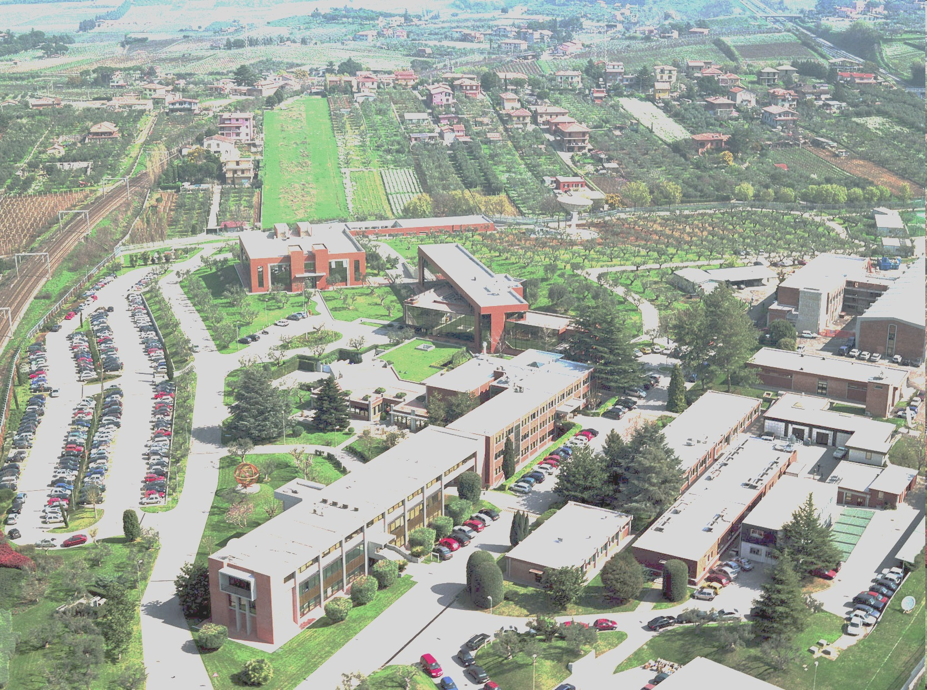
Welcome to ESRIN (European Space Research Institute) the ESA Centre for Earth Observation

Slide 3
Logistics (1/2)
LUNCH
ESRIN canteen. Lunch tickets available for non-ESA participants.
BREAKS
Coffee, tea and water at the break, close to meeting room.
BANK, TRAVEL AGENCY, COFFEE BAR & MEDICAL CENTER
Located one floor below Magellan room.
SECURITY
Free access: Magellan room, Bank, Travel agency, Coffee Bar, Canteen and Medical Center.
Restricted access: rest of ESRIN site is accessible to visitors only if accompanied with staff.
Badge valid for the full duration of the meeting (do not lose it).

Slide 4
Logistics (2/2)
TRANSPORTATION
Transportation from/to Frascati through hotel shuttle or ESA shuttle bus
Bus transportation for social event on Tuesday: ESRIN-Rome-Hotels
Taxi on demand (travel agency)
Train (between ESRIN – Tor Vergata and Roma Termini – see schedule on http://www.trenitalia.com/ )
WIFI
Individual Wifi access code (“esa-public”) provided to each participant.
WELCOME PACKAGE
Provided to each guest.
SUPPORT
Contact Chiara (Chiara.Stellani@esa.int, tel: 80364 internal)

Slide 5
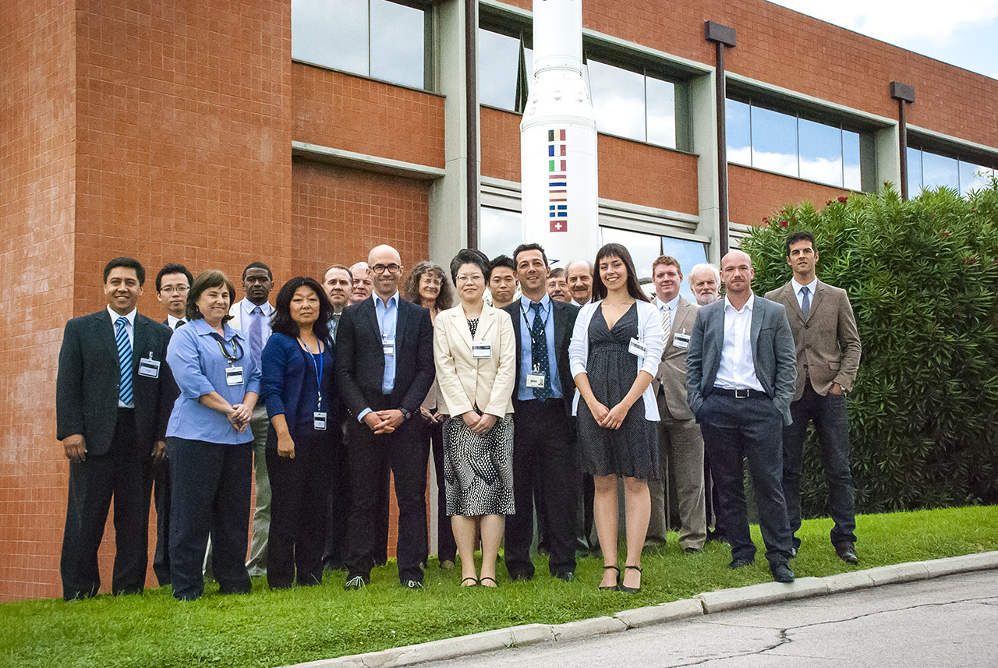
Group Photo
Tuesday 20 Sep at 12:20
WGISS#36, September 2013

Slide 6
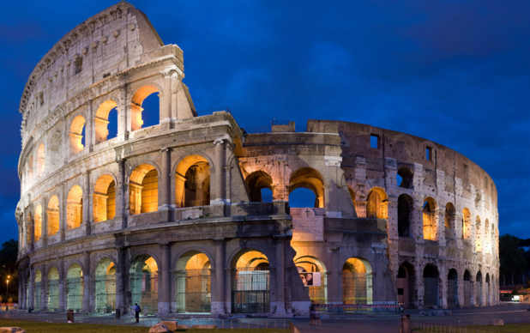
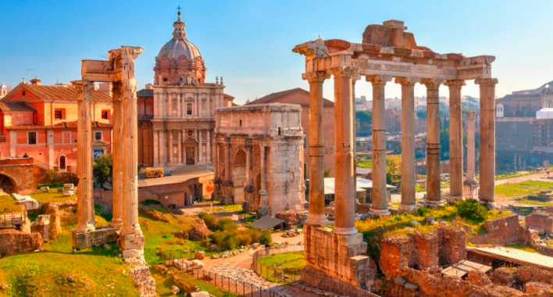
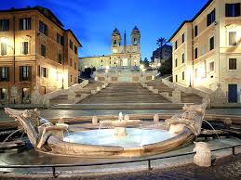
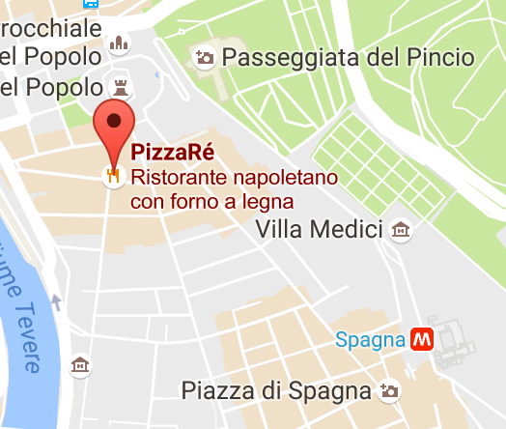
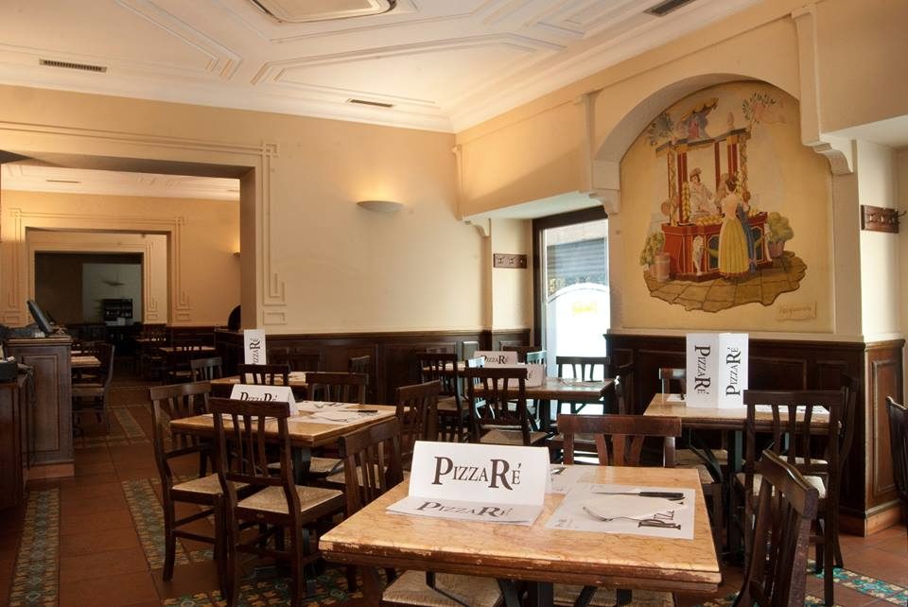
WGISS-42 Social events
Tuesday 20 Sep - Rome Tour & No Host Dinner
Via di Ripetta, 14

Slide 7
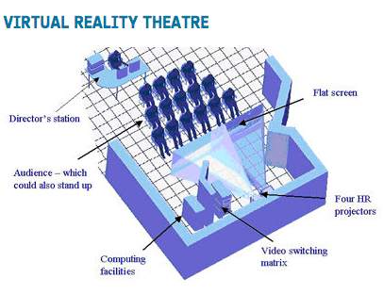
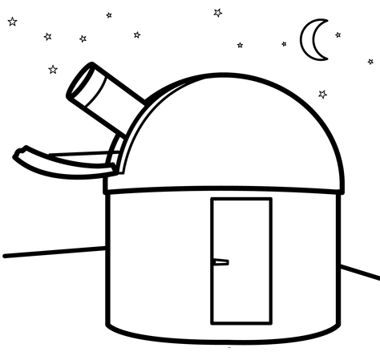
WGISS-42 Social events
Thursday 22 Sep – ESRIN Facility Tour
ESRIN Control Room for EO payloads (CREOP)
ESRIN Astronomical Observatory

