Slide 1

Liaison’s Report on GSDI Association
An update on selected activities since WGISS-40
Source: ESA ESRIN
Dr. Gábor Remetey-Fülöpp
Liaison, GSDI-WGISS
Past Secretary-general, HUNAGI (1994-2015)

Slide 2
Outline
Evolution of the GSDI World Conferences
Activities and topics of the past six months incl. GSDI at the GEO XII Plenary and Ministerial Meeting
GSDI Capacity building: any WGISS involvement welcomed
The Themes of the coming GSDI World Conference: relevance with SDGoals and EO SBAs
Conclusions

Slide 3
A flashback on GSDI Conferences held so far
GSDI 1 Bonn-Königswinter, Germany 4-6 Sept, 1996 The Emerging GSDI | GSDI 8 Cairo, Egypt 16-21 April, 2005 From Pharaohs to Geoinformatics: The Role of SDI’s in an Information Society
GSDI 2 Chapel Hill, USA 20-21 Oct, 1997 | GSDI 9 Santiago, Chile 6-10 November, 2006 GI: Tool for Reducing Poverty
GSDI 3 Canberra, Australia 17-19 Nov, 1998 Policy and Organizational Frameworks for GSDI | GSDI 10 St. Ausustine, Trinidad 25-29 February, 2008 Small Island Perspectives on Global Challenges: The Role of Spatial Data in Supporting a Sustainable Future
GSDI 4 Cape Town, South Africa 13-15 March, 2000 Engaging Emerging Economies | GSDI 11 Rotterdam, The Netherlands 15-19 June, 2009 Spatial Data Infrastructure Convergence: Building SDI Bridges to address Global Changes
GSDI 5 Cartagena, Colombia 21-24 May, 2001 Sustainable Development: GSDI for Improved Decision-Making | GSDI 12 Singapore 19-22 October, 2010 Realising Spatial Enabled Societies
GSDI 6 Budapest, Hungary 16-19 Sept, 2002 From Global to Local | GSDI 13 Quebec City 14-17 May, 2012 Spatially Enabling Government, Industry and Citizens
GSDI 7 Bangalore, India 30 Jan - 6 Feb, 2004 Spatial Data Infrastructures for a Sustainable Future | GSDI 14 Addis Ababa 3-8 November, 2013 Spatial Enablement in Support of Economic Development and Poverty

Slide 4
GSDI Conference Themes so far
14 | 2013 | Spatial Enablement in Support of Economic Development and Poverty
13 | 2012 | Spatially Enabling Government, Industry and Citizens
12 | 2010 | Realising Spatial Enabled Societies
11 | 2009 | Spatial Data Infrastructure Convergence: Building SDI Bridges to address Global Changes
10 | 2008 | Small Island Perspectives on Global Challenges: The Role of Spatial Data in Supporting a Sustainable Future
9 | 2006 | GI: Tool for Reducing Poverty
8 | 2005 | From Pharaohs to Geoinformatics: The Role of SDI’s in an Information Society
7 | 2004 | Spatial Data Infrastructures for a Sustainable Future
6 | 2002 | From Global to Local
5 | 2001 | Sustainable Development: GSDI for Improved Decision-Making
4 | 2000 | Engaging Emerging Economies
3 | 1998 | Policy and Organizational Frameworks for GSDI
2 | 1997
1 | 1996 | The Emerging GSDI

Slide 5
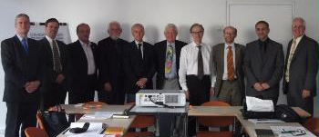


High-level cooperation with learned societies of
the geospatial world
  MoU cooperation with FIG, ICA, ISPRS.
  Last sign: with ISDE in Halifax in late 2015
JBGIS Meeting in Paris, 2011
The current members of the JBGIS are the Presidents or equivalent officers of:
Global Spatial Data Infrastructure Association (GSDI)
International Association of Geodesy (IAG)
International Cartographic Association (ICA)
IEEE Geoscience and Remote Sensing Society (IEEE-GRSS)
International Federation of Surveyors (FIG)
International Geographical Union (IGU)
International Hydrographic Organization (IHO)
International Map Industry Association (IMIA)
International Steering Committee for Global mapping (ISCGM)
International Society for Photogrammetry and Remote Sensing (ISPRS)
Last JBGIS Meeting
was in Rio Aug. 2015

Slide 6
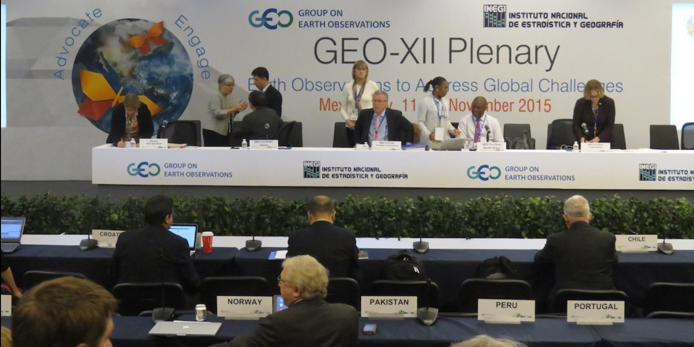
GSDI activities
partly highlighted in GIM International
GSDI supports SDIs in Africa (Relevance with GEO 2016 Work Program Activities CA-02, GI-06)
Personal SDIs (citizen engagements, citizen sciences) (GI-13, GI-17)
GSDI Small Grant Program (Relevance with GEO Foundational Task: CD-02, CD-03)
GSDI best practice project on Marine/Coastal SDIs (w initiatives: GI-07, GI-22)
Preparing the coming GSDI World Conference and Workshops around the theme ‘Smart Homeland’ (Relevance with many GEO Initiatives)
Workshop: SDI Research on Disaster Risk Reduction in Nepal (CA-27)
GSDI participation at GEO XII Plenary and Ministerial Summit and Geospatial World Forum of the Americas
GSDI Statement submitted to GEO XII Plenary
Contribution related to Big data at the Defense Geospatial Intelligence London, January 2016
GSDI at the GIM International Forum in Amsterdam, February, 2016

Slide 7
GEOSS foundational tasks, where GSDI has potentials or might be interested to contribute
ad Data Sharing
GD-01 Advancing GEOSS Data Sharing principles
ad Developing GEOSS Common Infrastructure
Data Management Principles’s Criteria–related lifespan assessments of geospatial data in SDIs related to
GD07 .03 Develop Data Management Principles Guidelines Implementation & process
ad engagement: community development and capacity building
CD-02 Reinforcing engagement at national and regional level
CD-03 Assess the benefits from EOs and of their socio-economic value

Slide 8
Outreach: partners from WGISS welcomed
GSDI is interested in finding partners to contribute to the planned GSDI Capacity Building activities, which include the webinar programme that Dr. Joep Crompvoets and GSDI Secretary-General Roger Longhorn are putting together and workshops having SDI components.
Webinars planned for 2016 and 2017 include those on SDI Policy and Legal Issues, SDI for Land Registration and Marine SDI Best Practice.
Additional SDI workshops are planned for Africa in partnership with GSDI Member, RCMRD (Regional Center for Mapping of Resources for Development) and other African-based members.
Marine SDI Best Practice workshop at the INSPIRE 2016 Conference in Barcelona, September 2016.

Slide 9
GSDI Information sources
GSDI home page http://gsdiassociation.org
SDI Regional and Global News http://gsdiassociation.org/index.php/news.html
Publications http://gsdiassociation.org/index.php/publications.html
GSDI Projects information (including Small Grants) http://gsdiassociation.org/index.php/projects.html
SDI Cookbooks (online and downloadable) http://gsdiassociation.org/index.php/publications/sdi-cookbooks.html

Slide 10


Slide 11
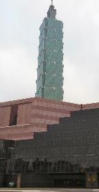
GSDI 15 World Conference
Location: Taipei, Taiwan
Date: 29 November to 2 December 2016
Venue: Taipei Nangang Exhibition Center
Theme of GSDI 15:
Spatial Enablement in the Smart Homeland
Smart Disaster Prevention, Smart transportation, Smart City
GSDI 15 offers numerous opportunities for workshops, oral presentations, posters and refereed publications
Taipei, ICSU Codata
Conference, 2011
GSDI 15 World Conference Sponsor and Exhibitor Prospectus
gsdiassociation.org/images/GSDI_15_Conference_Prospectus_ver5_7March2016.pdf
General information is available from gsdi-15-info@gsdi.org
GSDI World Conference website: http://gsdi15.org.tw/

Slide 12
15th GSDI World Conference
Theme Groups at a Glance
2 Land Information and Management Systems
3 SDI Governance and Policy Development
4 Disaster Management, Reduction and Mitigation
5 Earth Observation and Sensors
6 Geo Technology and Innovation for SDI
7 Geo Data for Decision Making
8 Geo Education and Cartography
9 Regional and Global SDI Initiatives
Building Resource Wealth,
Ensuring Community Safety,
Securing Water Resources,
Managing Marine Jurisdictions,
Providing Fundamental Geographic Information,
Maintaining Geoscience Knowledge and Capability
Above: GA’s major focus areas
4
Spatial Data
Infrastructure
for the
Smart
Homeland
7
8

Slide 13
The Next, 15th GSDI World Conference
Theme Groups at a Glance 1/3
Theme 1: SDI for the Smart Homeland
• SDI for Smart Cities, Smart Territories and Smart Environments
• Location-based Services for Smart Environments
• Indoor SDI (positioning) and Personal SDI Developments
• VGI, Crowdsourcing, and Citizen Science
• Internet of Vehicles (IoV) and Intelligent Transport Systems (ITS)
Theme 2: Land Information and Management Systems
• Land Information Systems
• Land and Urban Data Management
• SDI for Low Impact Development (LID)
• SDI for Resilience and Sustainable Development
Theme 3. SDI Governance and Policy Development
• Open Data and Open Government
• E-Government and E-Governance
• Geospatial Legislation and Policies
• Privacy, Security and Institutional Concerns
2 Land Information and Management Systems
3 SDI Governance and Policy Development

Slide 14
The Next, 15th GSDI World Conference
Theme Groups at a Glance 2/3
Theme 4. Disaster Management, Reduction and Mitigation
• Innovation in Disaster Management Technology
• Disaster Management ‘Best Practice’
• Protecting Critical Infrastructure
• Risk Modelling and Assessment
• Disaster and Emergency Management
• Earthquake Mitigation Challenges
• Flooding, Debris Flow, and Landslides – Risk Assessment, Mitigation and Management
Theme 5. Earth Observation and Sensors
• Observatories (environmental, transportation, logistics, citizen, health, urban)
• Earth Observation
• Remote Sensing, Survey & Mapping Applications
(UAVs, LiDAR, SAR...)
• Sensor Web / Internet of Things (IoT) and Linked Data
4 Disaster Management, Reduction and Mitigation
5 Earth Observation and Sensors

Slide 15
The Next, 15th GSDI World Conference
Theme Groups at a Glance 3/3
Theme 6. Geo Technology and Innovation for SDI
• SDI in the Cloud – Challenges and Solutions
• CyberGIS
• Geospatial Big Data Management and Analytics
• 3D/4D Spatial Data Visualization and Analytics
Theme 7. Geo Data for Decision Making
• Geospatial Decision Support Systems
• Geospatial Business Modelling
• Geo-Intelligence
Theme 8. Geo Education and Cartography
• Geospatial Education
• Web Cartography
• Historic Geo Data Management
Theme 9. Regional and Global SDI Initiatives
• UN-GGIM Global and Regional Initiatives
• GEO/GEOSS Developments
• UN Sustainable Development Goals
• European Pan-European SDI - INSPIRE
6 Geo Technology and Innovation for SDI
7 Geo Data for Decision Making
8 Geo Education and Cartography
9 Regional and Global SDI Initiatives

Slide 16
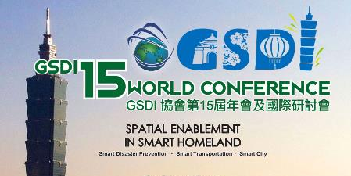
GSDI 15 World Conference
Important dates:
Deadline for submission of
Extended Abstracts: 1 May 2016
Notification of acceptance/rejection: 15 May 2016
Deadline for submission of
Workshop proposals: 1 June 2016
Notification of acceptance/rejection: 1 July 2016
Deadline for submission of full Papers and Posters: 1 July 2016
Notification of acceptance/rejection: 1 August 2016
Notification of selection for Conference Book and
IJSDIR article submission: 15 August 2016
IJSDIR - International Journal of Spatial Data Infrastructures Research
is a peer-reviewed journal operated by JRC
(http://ijsdir.jrc.ec.europa.eu/index.php/ijsdir)
Authors will be required to agree to a Creative Commons By-Attribution License (CC-BY version 4) to ensure continued global access to their work over time.
More information:
http://gsdiassociation.org/index.php/homepage/gsdi-15-world-conference.html
Notes:
(http://creativecommons.org/licenses/by/4.0/)

Slide 17
Relevant news from Europe: WWEC 2016
NASA World Wind Europa Challenge 2016
This year’s topic: CitySmart, Open Source Apps for Urban Management
All information related to the previous years and the WWEC 2016 Call:
http://eurochallenge.como.polimi.it/
Announcement of the winners at
OGRS – Open source Geospatial Research and Education
Perugia, 12-14 October 2016 http://2016.ogrs-community.org/
with WWEC Session on CitySmart, Open Source Apps for Urban Management
Chairs: Patrick Hogan (NASA Ames), Prof.Maria A. Brovelli (Polimi Como)
Urban Transitions Conference
Beijing, 5-9 September, 2016 http://urbantransitionsconference.com/
More on the NASA Web World Wind: www.WebWorldWind.org

Slide 18


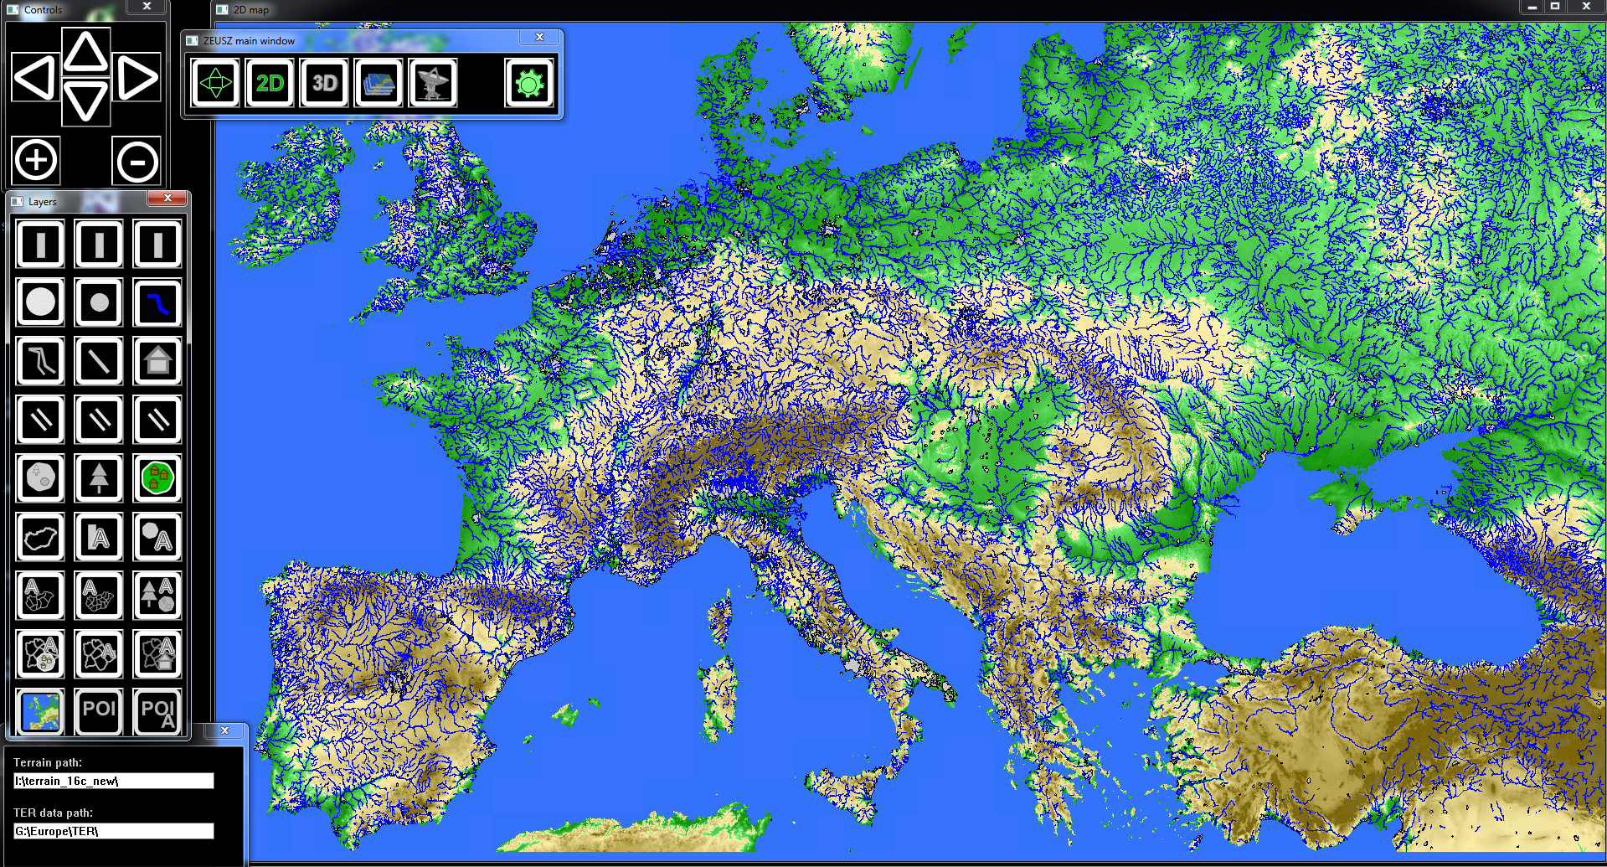
Selected news from Hungary
János Áder, President of Hungary was invited by UN Secretary General Ban Ki-moon and President of the World Bank Group Jim Yong Kim to the High Level Panel on Water, with the aim of accelerating the implementation of the "Water SDG" (SDG 6) and related targets
Presentation on the Recent Technology exploration in EO Information Systems and Services at the 20th GISopen Conference hosted by the Óbuda University AMK Institute of Geoinformatics at Székesfehérvár 13-15 April 2016 with the theme “Geodata - from acqusition to service”
Lóránt Czarán (UNOOSA): Geospatial Technologies and Remote Sensing for Monitoring SDGs A CEU Summer Course in Budapest between July 4-9, 2016
Creating an open source, cross platform, easy to use geospatial ecosystem intended for end users (ZEUS) where selected/created data are stored in small raster and vector tiles and drawn using high-performance render engine by Krisztián Fehér http://feherkrisztian.magix.net/public/
www.gisopen.hu
http://www.summer.ceu.hu/geospatial-2016

Slide 19
Conclusions
Local, national, regional SDIs and associated services are enabling tools for EO applications and also vital from the local and regional Data Cube development point of view
GSDI is capable not only serving and supporting EO applications, but also capacity building, providing awareness raising and generating user feedbacks with special emphasis on user requirements
As GEOSS foundational tasks are concerned, GSDI is continuing support the GEOSS data sharing policy and ready to contribute to the data management principles implementation guideline development,
The theme ‘Smart Homeland’ of coming GSDI World Conference in Taipei are matching many of the GA’s focused areas but having EO session and workshop possibilities it offers excellent outreach opportunity for the WGISS community

Slide 20
Acknowledgements
Roger Longhorn, Secretary-General, GSDI Association
rlonghorn@gsdi.org, http://gsdiassociation.org,
http://www.linkedin.com/groups/GSDI-Association-3794985
Csaba Körösi, Director, Directorate for Environmental Sustainability,
Office of the President of the Republic, Hungary

Slide 21


Thank you for your attention!
Image sources: NASA , ESA ESRIN and Internet

