Slide 1
Committee on Earth Observation Satellites
CEOS Chair New Initiative
Non-meteorological Applications for
Next Generation Geostationary Satellites
A brief Introduction
Thomas Schroeder, CSIRO
On behalf of the NMA Ad-hoc Task Team
Joint CEOS WGCV/WGISS Meeting
Canberra, Australia
16th March 2016

Slide 2
As Chair of CEOS for 2016, CSIRO proposed to provide leadership and coordination on two new initiatives:
A study of Future Data Access and Analysis Architectures (co-chaired CSIRO and USGS)
A study of Non-meteorological applications for next generation geostationary satellites
Studies will draw upon expertise and capacity from existing CEOS WG’s and VCs, as well as member agency experts.

Slide 3
Non Met-Applications Task Team
Established in January 2016, activity period 1 year
Co-chaired by CSIRO, ABoM, EUMETSAT and NOAA
Supported by 14 other CEOS Agencies:
CNES, CSA, DLR, EC, ESA, GA, JAXA, JMA, KARI, NASA, NSMC-CMA, UKSA, USGS, WMO
Study will result in a report that provides comprehensive and pragmatic guidance to CEOS on new opportunities arising from next generation geostationary satellites and GEO-LEO synergies.

Slide 4
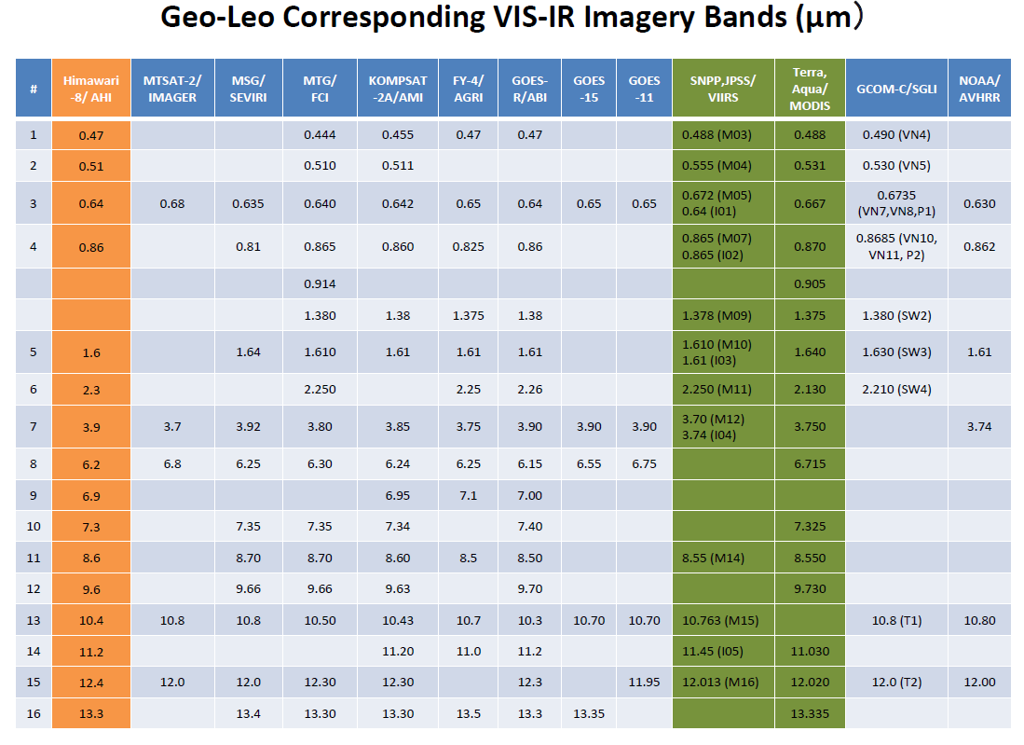
Oct 2014
2020
2018
2016
2016
(Credits: T. Kurino, JMA)

Slide 5
(Image credits: JMA)

Slide 6
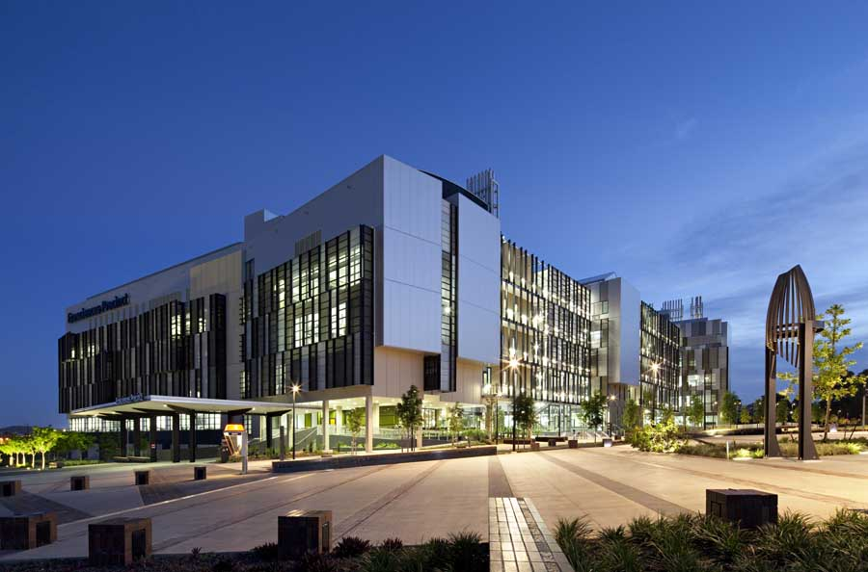
JAXA
JMA
Chiba University
Tokai University
CSIRO
Bureau of Meteorology
Geoscience Australia
Symbios Communications
Department of Environment
Curtin University
Charles Darwin University
University of Queensland
University of Southern Queensland
Wollongong University
James Cook University
University of Melbourne
Dept. of Science Information Technology and Innovation
50 people from 17 organisations
WS objectives: Exchange information on status of HW8 incl. data access and explore ideas on suitable new non-met applications of interest to Japan and Australia

Slide 7
Outcome: Detailed catalogue of potential products
http://geoapplications.org/

Slide 8
Non met-applications Himawari-8
Land
Land surface temperature
Flood mapping
Surface reflectance – BRDF corrected
Vegetation Indices
Evapotranspiration
Land surface silicate – mineral particle size
Hot spots (wild fire)
Oceans
Water-leaving radiance
Chlorophyll-a
Total Suspended Matter
Turbid flood plume mapping
Algal bloom detection
Atmosphere
Aerosol optical depth, type
Volcanic ash
Surface reflectance – BRDF corrected

Slide 9
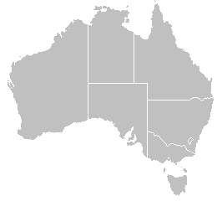
MERIS
Whitsunday Islands
Great Barrier Reef
15.06.2011
20.06.2011

Slide 10
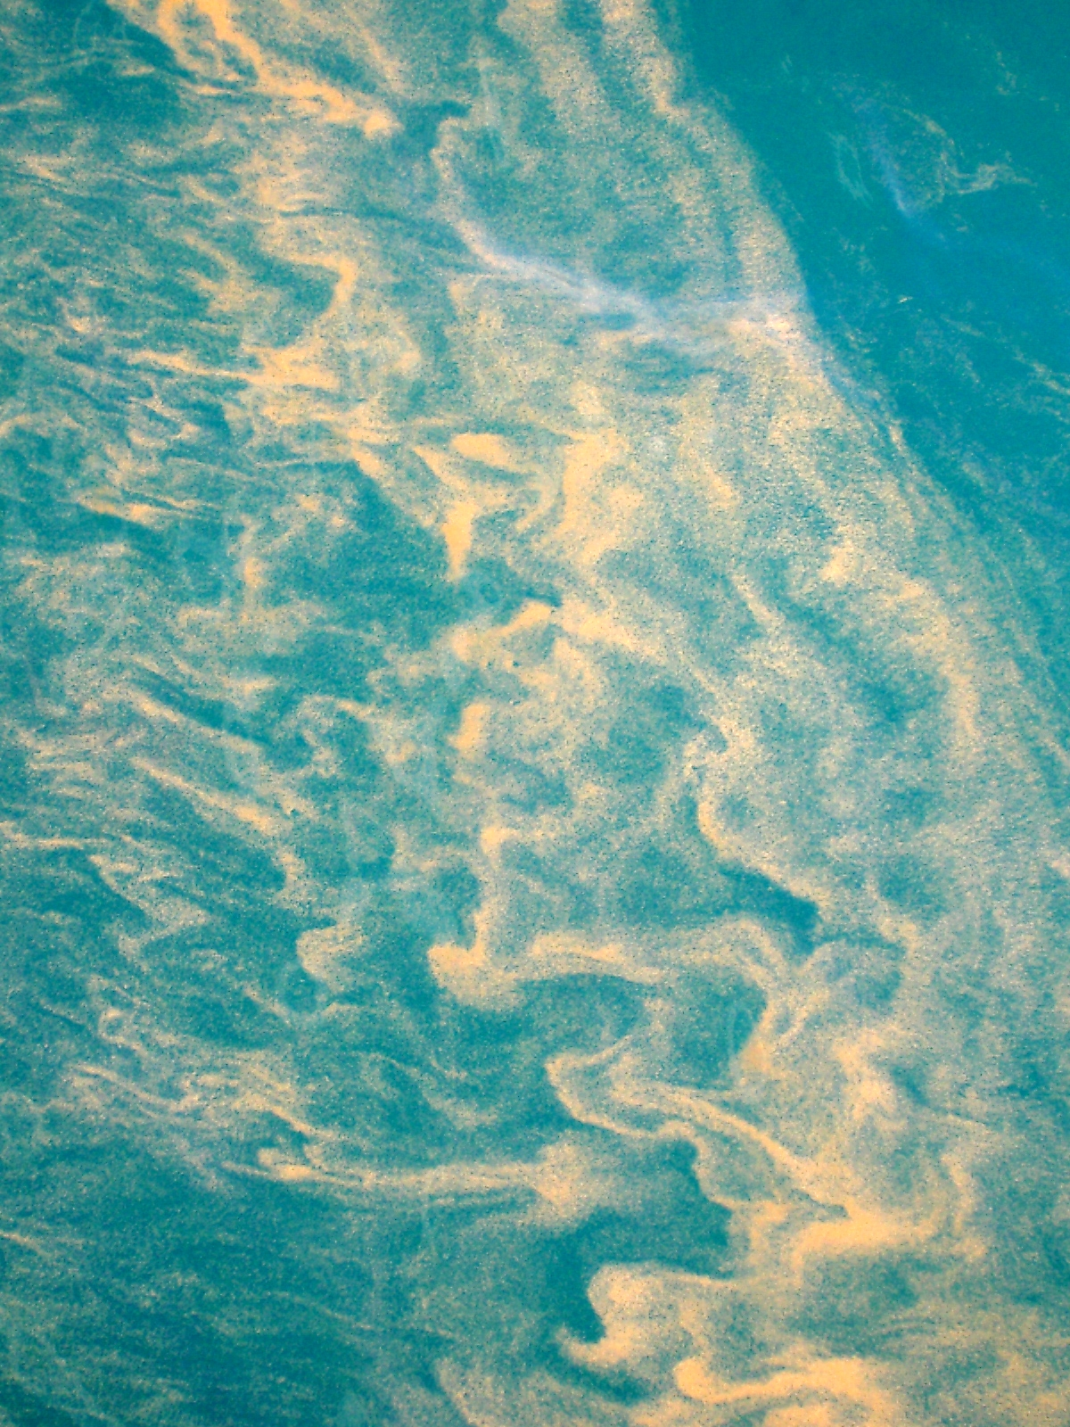
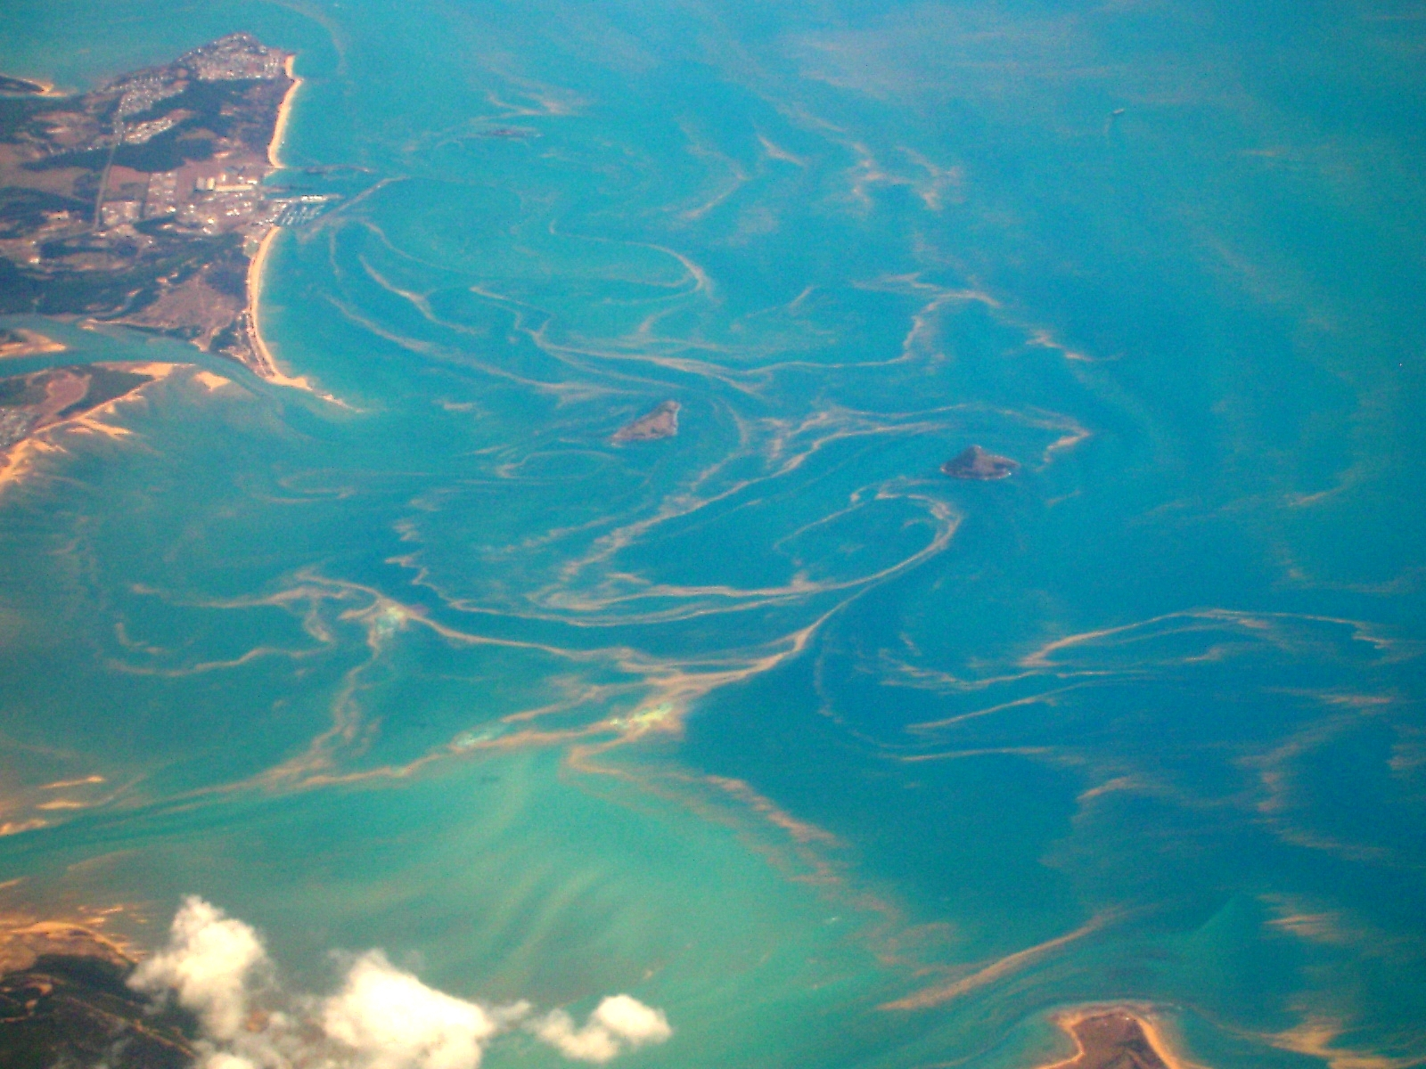
Floating algae – Trichodesmium
Great Barrier Reef, Australia
From a vessel
From an aircraft

Slide 11
Envisioned NMA study outcomes
Trends & Outlook for Geostationary EO Satellite Capabilities – Catalogue of CEOS/CGMS agency missions, instruments, measurements, data volumes etc.
Inventory of relevant non-met applications and review of initiatives being undertaken by CEOS and related agencies – atmosphere, land and ocean (build on Japan-Australia bilateral effort initiated in 2015)
Benefits of synergistic use of GEO-LEO systems
Identify key opportunities and benefits to CEOS and CGMS agencies as well as challenges
Recommendations for the way forward tactically and strategically for CEOS and its agencies

Slide 12
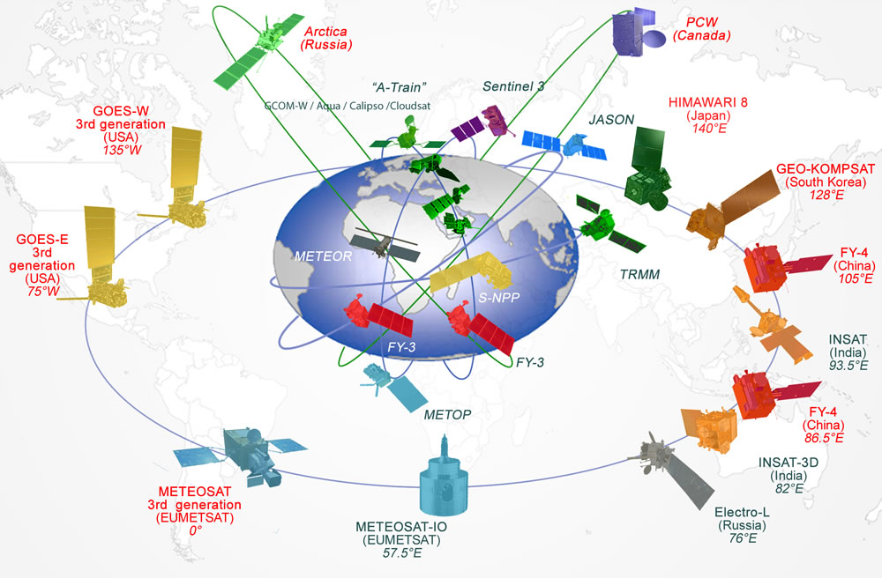
Challenges
Constellations of EO satellites are expanding – becoming more diversified
MTG, Kompsat-2A, GOES-R, Feng-Yun-4, …
WMO & CGMS promoting data harmonization
Image credit WMO

Slide 13
Challenges & Opportunities
Inter-calibration, data harmonization, inter-operability of data sets
Important aspects – increased demand of global
Any corrections based on standards agreed by GSICS
(Global Space Based Inter-Calibration System)
Inputs from WGCV (IVOS, QA4EO), CGMS agencies and GSICS
(side meeting at CGMS-44, June)
Synergistic use of GEO-LEO satellites
Algorithm advancements
Inter/cross-calibration
Image credit WMO

Slide 14
Follow-ups …
NMA co-chairs:
Ian Grant (ABoM) – I.Grant@bom.gov.au
Kenneth Holmlund (EUMETSAT) – Kenneth.Holmlund@eumetsat.int
Satya Kalluri (NOAA) – Satya.Kalluri@noaa.gov
Thomas Schroeder (CSIRO) – Thomas.Schroeder@csiro.au

