Slide 1
Discrete Global Grid Systems A New Way to Manage ‘Big Earth Data’
Dr. Matthew B.J. Purss
Geoscience Australia
Co-Chair
OGC Discrete Global Grid Systems
Standards Working Group

Slide 2
Overview
The Challenge of Big Earth Data
What is a DGGS?
Standardizing DGGS
Applying DGGS to the world of Big Earth Data

Slide 3
The Challenge of Big Earth Data
The 3 V’s of Big Data…
Volume
Variety
Velocity

Slide 4
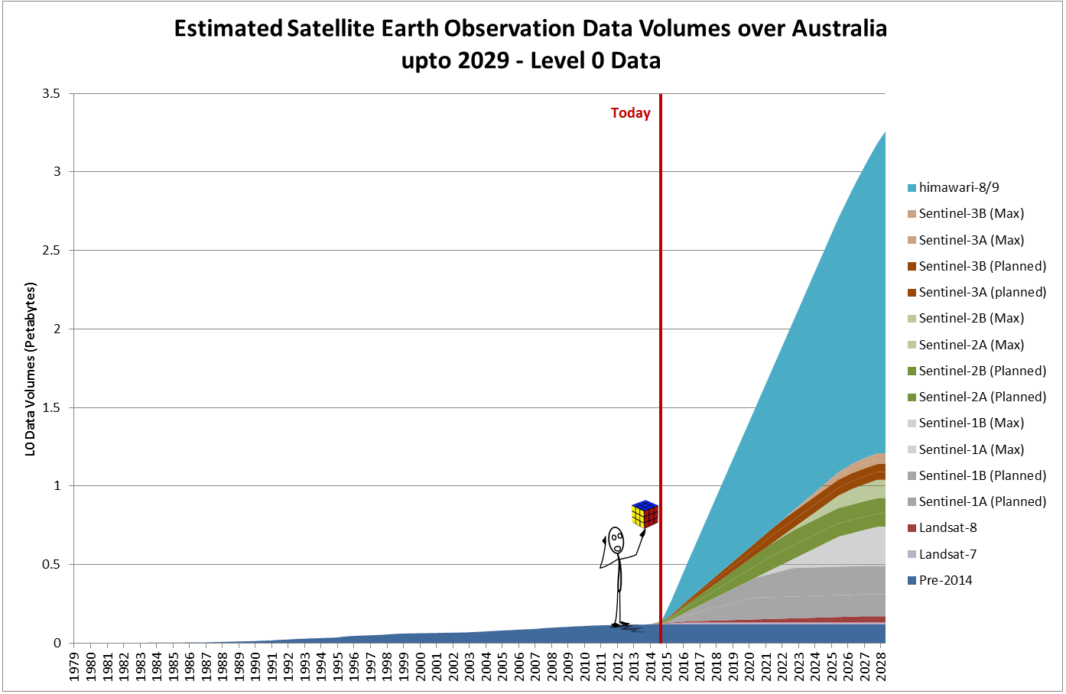
The Challenge of Big Earth Data

Slide 5
The Challenge of Big Earth Data
The 3 V’s of Big Data…
Volume
Variety
Velocity
Traditional GIS and image analysis approaches assume flat earth geometries = simpler code… but data is warped to fit the “flattened” view of the Earth.
OK for local scales (where approximate Earth surface is relatively flat)
Fails at larger scales (where curvature of the Earth becomes significant.)
A transition from siloed data to integrated information is now an operational requirement

Slide 6
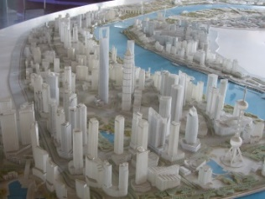
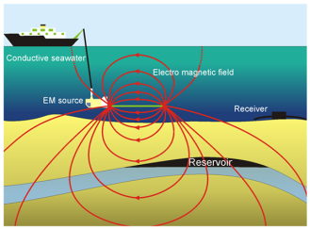
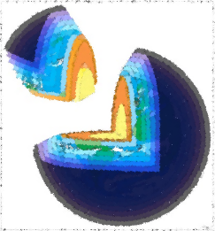
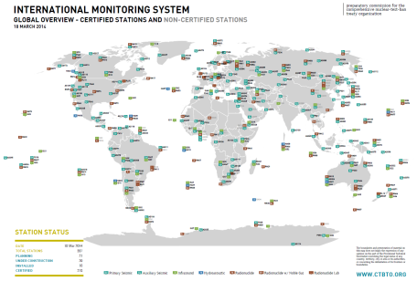
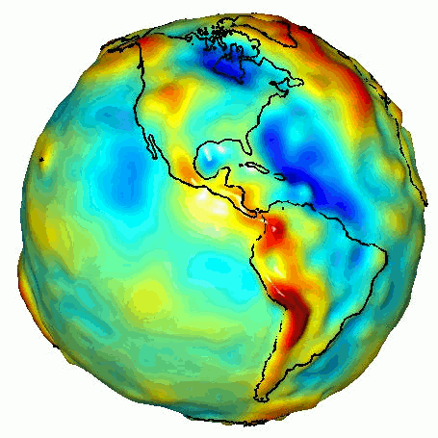
The Challenge of Big Earth Data
Without a common analytical framework
Data Fusion is very difficult!!!

Slide 7
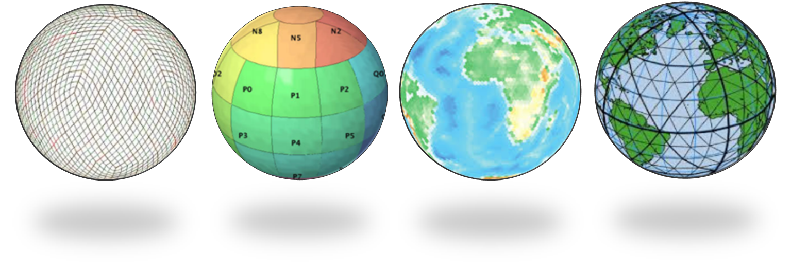
What is a DGGS?
A DGGS is a Digital Earth reference model
A DGGS is designed to be an information grid, not a navigation grid
OGC defines a DGGS as:
“…a spatial reference system that uses a hierarchical tessellation of cells to partition and address the globe. DGGS are characterized by the properties of their cell structure, geo-encoding, quantization strategy and associated mathematical functions.”

Slide 8
What is a DGGS?
Any tessellation of the Earth does not necessarily produce a DGGS.
Single resolution computational grids are not sufficient to constitute a DGGS.
MUST have a hierarchy of grids with successively finer resolution
Global Grids that do not have ‘Equal Area’ cells are not sufficient to be described as a DGGS
Equal Area cells are critical to:
Ensure uniform coverage of data in an area of interest;
Facilitate efficient statistical analyses; and,
Enable standardized interoperability between DGGS and other data infrastructures

Slide 9
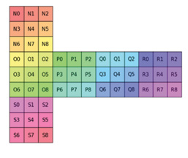
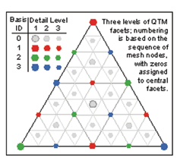
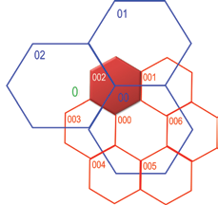
What is a DGGS?
Equal Area Partitioning
Platonic Solids mapped to the Surface Model of the Earth (e.g. WGS84)
Unique Cell Indices
Hierarchy-based, Space-filling Curve, Axes-based or Encoded Address

Slide 10
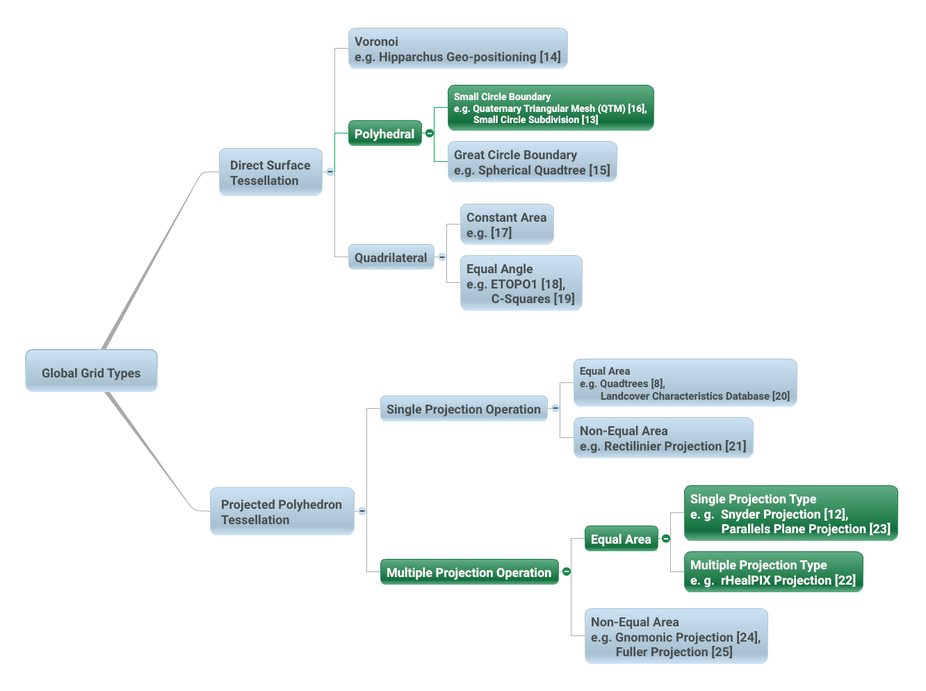
A Brief History of DGGS
Formal development of DGGS began in the 1980s.
Numerous methods proposed for achieving a tessellation of the Earth.
Each with varying degrees of area and/or shape distortion
These tessellations can be organized into a limited set of categories that describe a hierarchical taxonomy of global grids
Valid DGGS under
the New
OGC DGGS Core Standard

Slide 11
Standardizing DGGS
Why Standardize DGGS?
The diversity, incongruity and lack of standardized applications of global grid infrastructures limits the development of accurate analysis tools for Big Earth Data
March 2014 – OGC established a Standards Working Group to address this problem
The OGC DGGS Core Standard defines:
A concise definition of the term Discrete Global Grid System as a spatial reference system;
The essential characteristics of a conformant DGGS; and,
The core functional algorithms required to support the operation of a conformant DGGS.

Slide 12
Standardizing DGGS
Adoption anticipated
mid 2016
DGGS Core Standard v1.0
SWG Established
Candidate Standard Drafted
(6-18 mths)
Public Comment Period
(30 days)
SWG Review and Response to Comments
OGC Vote to adopt Standard
(45 day vote)
OGC Approval for Adoption
OGC Standards Development Pipeline

Slide 13
Applying DGGS to the World of ‘Big Earth Data’
A DGGS provides a framework where the three fundamental questions of geospatial analysis can be answered
“Where is it?”
“What is here?”, and,
“How has it changed?”
Big Earth Data that is aligned to a DGGS is easy to access, store, sort, process, transmit, integrate, visualize, analyse and model.

Slide 14
Questions?

