Slide 1
Natural Language Interface for Exploratory Data Analysis
A Collaboration between Geoscience Australia, CSIRO and NCI
Notes:
My talk today will be about steps we are taking to head towards a more natural language interface for Exploratory Data Analysis.

Slide 2
Overview
Demo of current progress
Goals
Analytics API Components
Analytics Expression Language
Analytics API examples
Notes:
Here’s an a brief overview.

Slide 3
Analytics & Execution API Demo
Notes:
Here’s a demo of the prototype system. It will be performing some exploratory data analysis on Landsat 5 data of Lake Burley Griffin for 1 year during 1990.
It will create tasks that pulls band 30, band 40 and pixel quality data.
It will then create tasks that performs NDVI, adjusting the value, apply cloud masking and finally performing median reduction summary over time.
It will then execute the tasks and plotting the result.
Now we are running the example.
Here is the result of the median reduction over time.
Now the remaining code is prepping the data for input into glueviz for further Exploratory Data Analysis.
Here you can see the results have been imported into glueviz.
How we are importing the NDVI result, the median reduction result, band 30 and band 40.
Here are the slices through time.
Now we are going to do a Hovmöller diagram which is a plot of lat/long over time.
Now we trace a path through Lake Burley Griffin and create the diagram.

Slide 4
Questions to keep in mind.
What is analytics to you?
Should there be a difference between exploratory data analytics and analytics of big data?
Notes:
Here’s are 2 questions for you to think about during my presentation.
What is analytics to you? When performing analytics, if you can remove all the things you don’t care or want to think about, what do you have left?
Should there be a difference between exploratory data analytics and analytics of big data? - how much more work should be you need to undertake to shift between the two?
This is the very core of analytics.

Slide 5
Goals
Make Analytics:
simple.
for small and big data look the same.
on your desktop, cloud, HPC, GPU look the same.
Notes:
We have 3 goals for the AGDC:
Make analytics simple so anyone can use it without asking for assistance.
Make analytics for small data and big data appear the same.
Make analytics on your desktop, cloud, HPC, GPU appear the same.
Ultimately we want to make Analytics simple and something you can take for granted and use as already there infrastructure.
Ultimately we want to empower the EO scientist so he may be able to perform analytics without the need to ask for assistance.

Slide 6
The goal – make analytics simple
Interface to perform analytics
EO scientists consider the EO analysis cool stuff
Optimises distributed computation
Computational scientists care about the execution engine.
Data + Analytics, ok go
Analytics Engine
Execution Engine
Notes:
We are going to simplify analytics by modularizing & decoupling the analytics from the computation.
The Analytics Engine handles the problem description and the Execution Engine handles the distributed computation.
The design goal is to enable a separation of concerns and ensure both parties concerns are addressable.
On one hand, the EO scientists care more about the analytics and on the other hand the Computational scientists care more about the distributed execution.
The goal is to separate the analytics from “dishing out the computation” so EO scientists doesn’t really need to know about how to distribute the computation.
Less learning will be required, EO scientists will be more productive and more EO scientists are able use it.
But to make this usable, you really need a good interface, the Analytics API and the Analytics Expression Language

Slide 7
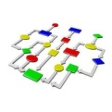
Analytics API Components
Data
Analytics
Data Access API
Cloud
EDA
V1
Analytics Expression Language
Data + Analytics Description
P(X|Y)
I(X:Y)
HPC
Analytics Engine
Execution Engine
ML
Analytics API
GPU
Notes:
Lets look a little deeper, the Analytics API consists of 3 components:
Analytics Expression Language
Analytics Engine
Execution Engine
The Analytics Expression Language is a customisable math like language that can be used to express the analytics.
The Analytics Engine is responsible for encapsulating the data and task description and its dependencies into a workflow.
The Execution Engine is responsible for platform independent execution of the workflow.
Currently we are working on EDA Analytics + Cloud execution and EDA + HPC execution is next.
After that, I plan to extend the Analytics API to incorporate probability computation, information theory and eventually machine learning as these builds on top of each other.
For this presentation, I will be focusing on the Analytics Expression Language.

Slide 8
Analytics Expression Language – the interface
What is it?
A natural mini-language to express the analytics.
Expressive n-dimensional array abstraction Interface.
Nested statements.
What is it really?
Abstraction for the data and the work.
Information about the data
How & where to get the data.
Information about what happens to the data.
Why are we doing this?
Scientists care about the data, the analytics not the magic (how to distribute the computation)
Why are we really doing this?
So the analytics can be made easier to manage.
Control over what the language looks like that suits the scientists!
Single language, multiple target platforms.
Reusable analytics.
Flexibility in distributing computation.
Notes:
It is a mini intuitive language to express the analytics.
It is an expressive n-dimensional array abstraction interface which Scientists are already familiar with.
Something that looks like a matrix or a multi-dimensional array.
What is it really from a software perspective?
It is an abstraction and a way to describe the data and the analytics, the math.
It has information about the data and what it looks like, how and where to get the data from, and the transformations that will happens to the data.
Why are we doing this?
We are doing this because EO scientists care about the data and the math, not so much how to distribute and execute analytics.
Why are we really doing this from a software perspective?
Imagine, you can intuitively describe your problem and have it computed on multiple platforms at the same time with little to training required.
This approach makes analytics easier to manage and it is platform independent.
You will have control over what the language looks like and you can change it to suit the scientist or domain.
It promotes reusable analytics.
It enables more flexibility in distributing computation.
We believe this approach will be a necessity for the future of analytics because the diversity and complexity of computational platforms will increase and scientists needs to be able to work seamlessly in this environment.

Slide 9
Analytics Expression Language – Operators
Math & Logical
Dimension Reduction
Masking
Indexing
Bit wise
Conditional
User-defined functions
Operators are Bad-value aware.
Notes:
These are the current set of operators supported.

Slide 10
Analytics API
The Analytics API revolves around 2 functions:
create_array – creates a virtual array, a descriptor of the data
apply_expression – takes as input the data descriptor and some analytics expression and creates a analytics task.
Notes:
The Analytics API has 2 main functions.
create_array – this creates a virtual array or if you’d like a description of the data, what it looks like, how to retrieve it and other useful metadata. i.e. enough data to be able to know if x is applied to it, what will it look like.
apply_expression – this is the task creation step that takes as input the output of create_array and some analytics expression and creates an analytics task.

Slide 11
Analytics API – Create Array
Lake Burley Griffin
dimensions = longitude: 149.07 to 149.18
latitude: -35.32 to -35.28
time: 1/1/1990 to 31/12/1990
b40 = create_array(LANDSAT 5, NBAR, band_40, dimensions)
Notes:
Here is an pseudocode example to create an array.

Slide 12
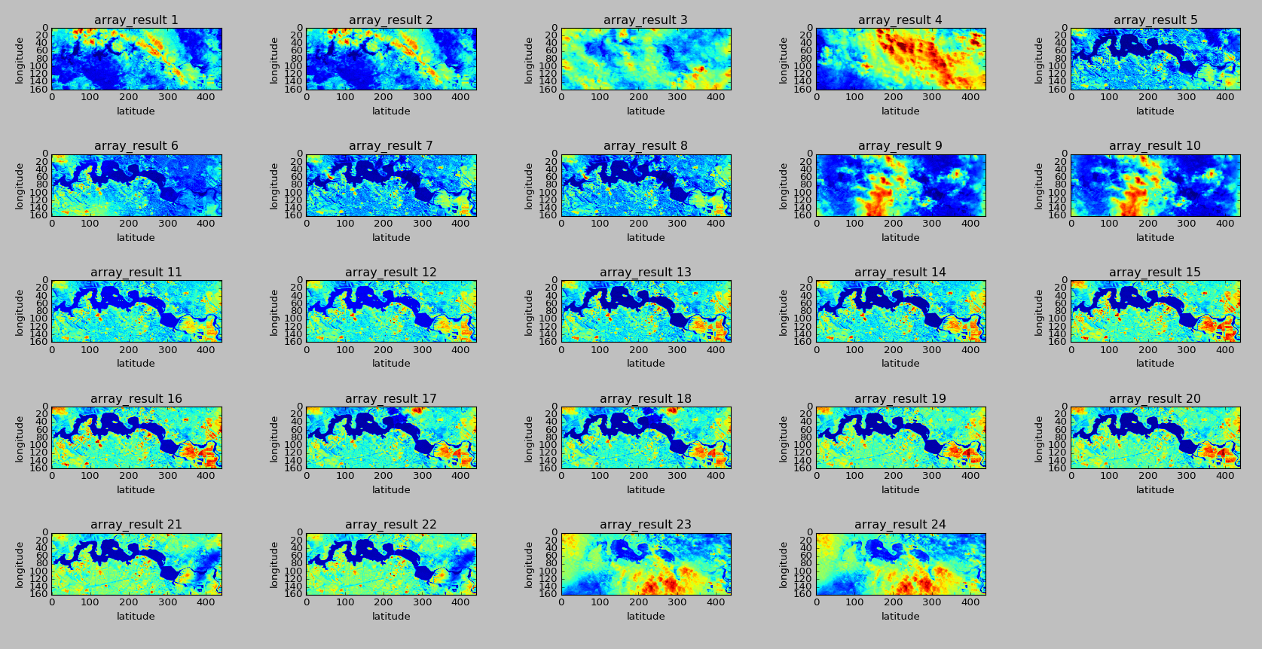
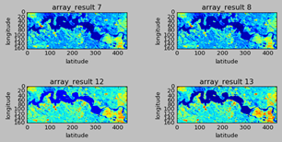
Analytics API – Create Array example

Slide 13
Analytics API – NDVI example
Lake Burley Griffin
dimensions = longitude: 149.07 to 149.18
latitude: -35.32 to -35.28
time: 1/1/1990 to 31/12/1990
b40 = create_array(LANDSAT 5, NBAR, band_40, dimensions)
b30 = create_array(LANDSAT 5, NBAR, band_30, dimensions)
ndvi = apply_expression((b40 – b30) / (b40 + b30))

Slide 14
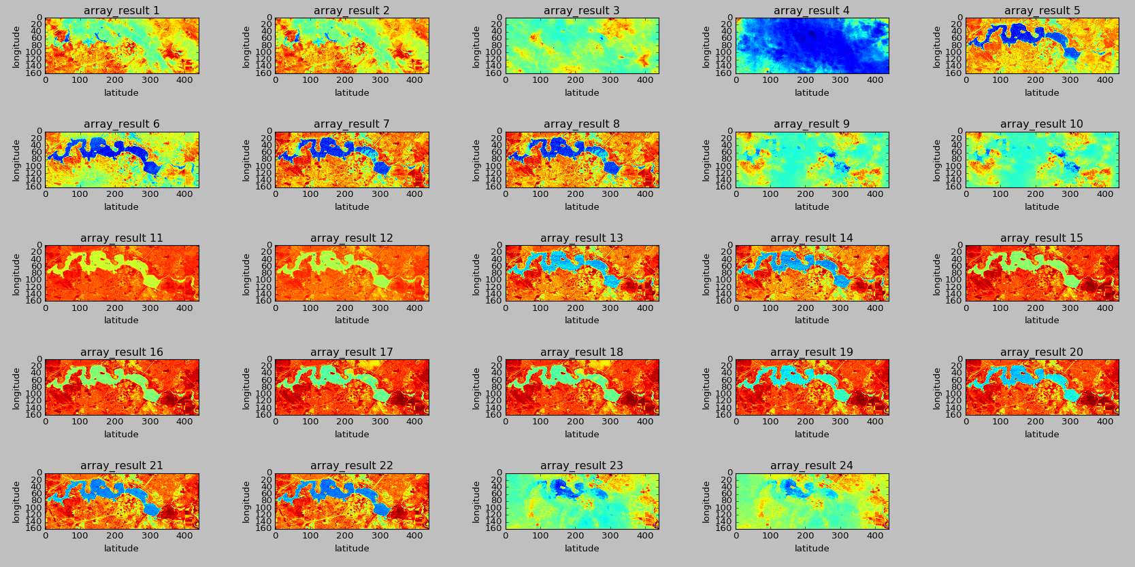
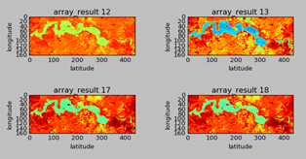
Analytics API – NDVI example

Slide 15
Analytics API – Median reduction over time example
Lake Burley Griffin
dimensions = longitude: 149.07 to 149.18
latitude: -35.32 to -35.28
time: 1/1/1990 to 31/12/1990
b40 = create_array(LANDSAT 5, NBAR, band_40, dimensions)
median = apply_expression(median(b40, time))

Slide 16
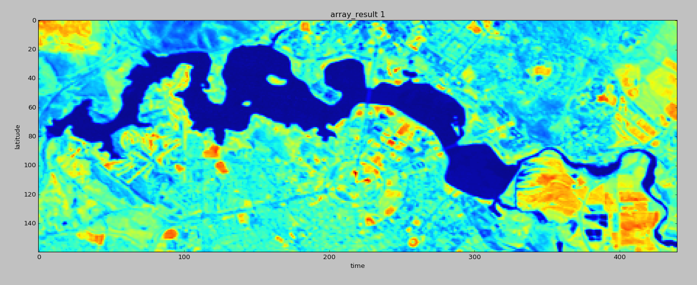
Analytics API – Median reduction over time example

Slide 17
Analytics API – Median reduction over lat long example
Lake Burley Griffin
dimensions = longitude: 149.07 to 149.18
latitude: -35.32 to -35.28
time: 1/1/1990 to 31/12/1990
b40 = create_array(LANDSAT 5, NBAR, band_40, dimensions)
median = apply_expression(median(b40, lat, long))

Slide 18
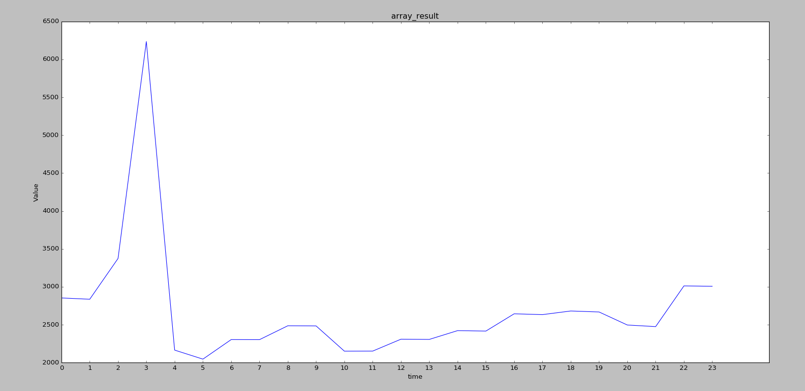
Analytics API – Median reduction over lat long example

Slide 19
Analytics API – Slightly more involved example
Lake Burley Griffin
b40 = create_array(LANDSAT 5, NBAR, band_40, dimensions)
b30 = create_array(LANDSAT 5, NBAR, band_30, dimensions)
pq = create_array(LANDSAT 5, PQ, pixelquality, dimensions)
ndvi = apply_expression((b40 - b30) / (b40 + b30))
adjusted_ndvi = apply_expression(ndvi*0.5)
mask = apply_expression(adjusted_ndvi{pq})
median_t = apply_expression(median(mask, time))

Slide 20
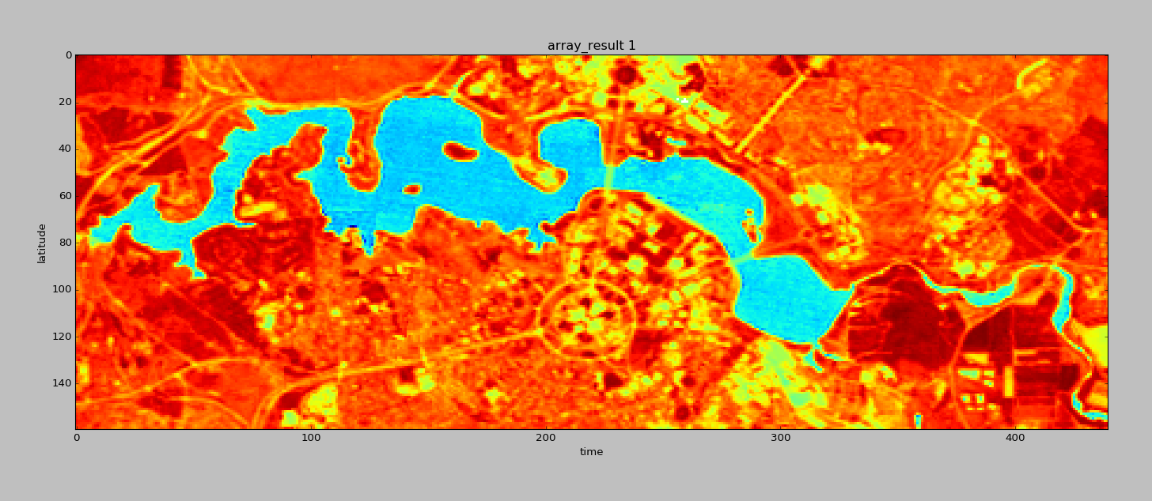
Analytics API – Slightly more involved example

Slide 21
What can we do to make it more natural language like?
Explore existing W3C standards for encoding the workflow.
Explore linked data as part of the semantic web.
Explore Natural Language Processing techniques for parsing and making sense of plain English queries.

Slide 22
Linked data for satellite imagery
The goal is to develop methods and a reference implementation for a linked data datacube.
Start with the W3C RDF datacube
Lines up beautifully with the development of the Australian Geoscience Data Cube as a storage and access model (this is not by chance)
Notes:
There’s a project proposed by Dr Kerry Taylor from ANU. It’s still early days.
The goal is to develop methods and a reference implementation for a linked data datacube.
It lines up beautifully with the development of the Australian Geoscience Data Cube as a storage and access model (this is not by chance)
We may explore this work further as a way to increase interoperability of the AGDC.

