Slide 1
Landsat Global Archive Consolidation
WGISS-41 Data Preservation
Kristi Kline
USGS EROS Center
U.S. Department of the Interior
U.S. Geological Survey

Slide 2
LGAC Objective
Obtain a consolidated copy of the global archive of current and historical Landsat imagery, metadata, browse, and ancillary data at EROS – to the greatest extent possible
International Ground Stations (IGSs) received unique Landsat 1-7 data
Historically, only small sets of IGS data were requested / received by USGS prior to the start of the LGAC initiative
Concern about the state of historical archives, especially at inactive stations where there is little operational contact
Provide vastly better support for global change analysis and assessment for over 40+ years of data across multiple Landsat sensors

Slide 3
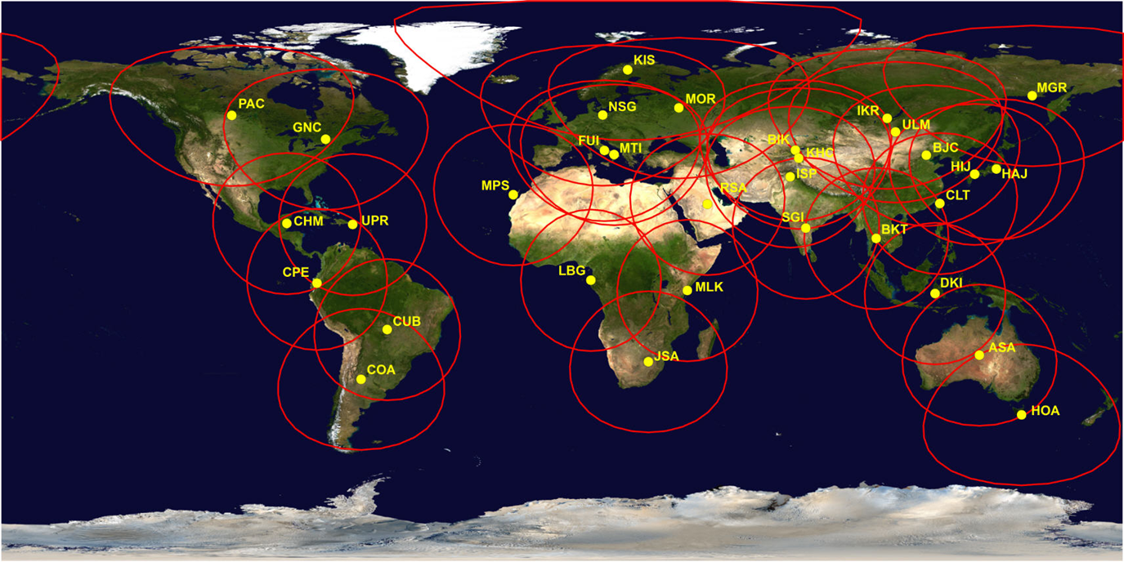
Historical Landsat Ground Stations
* Does not include Landsat Ground Network (LGN) stations for U.S.

Slide 4
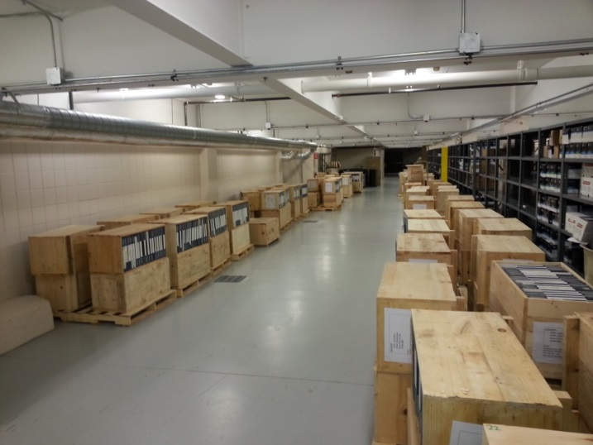
Recent Major Accomplishments
Completed Pakistan (SUPARCO) HDDT Ingest
Successfully read data off of 2,443 tapes
Through continuous process improvements and lessons learned, tapes were read in a 21 month period (original projection was 84 months)
63,564 scenes recovered, with 97% new to the archive
96% of data with good-to-great scene quality

Slide 5
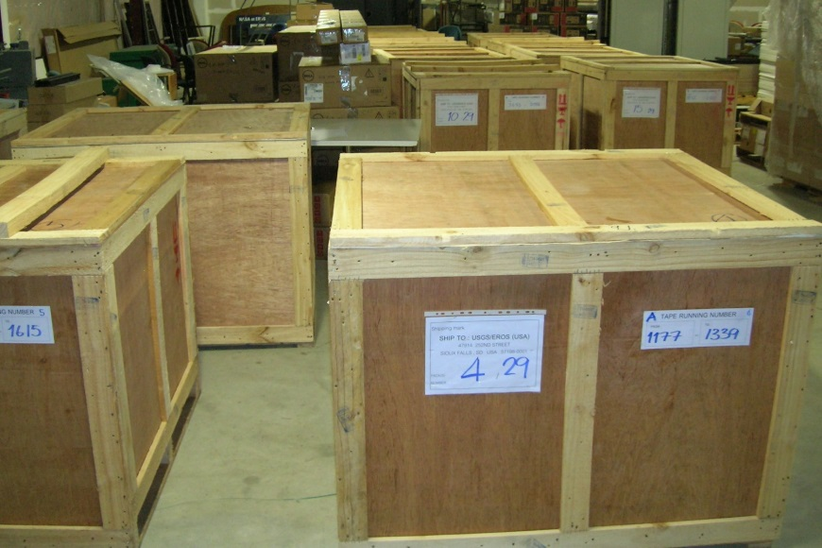
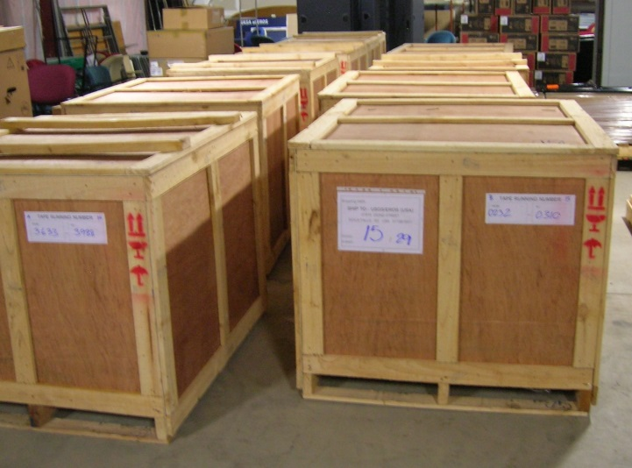
Recent Major Accomplishments
Thailand (GISTDA) – Received ~2,000 HDDTs and 3 tape drives to be used for continued LGAC data recovery
Begun recovery of data

Slide 6
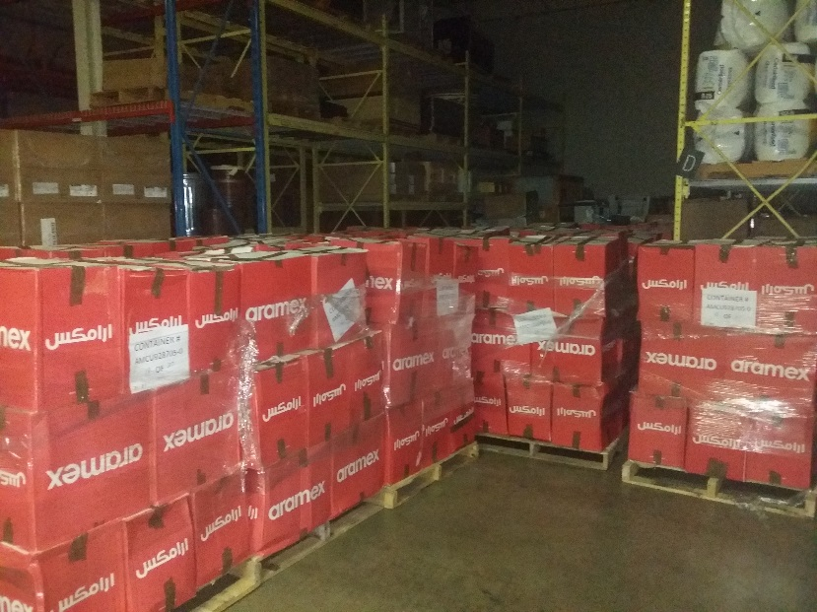
Recent Major Accomplishments
Saudi Arabia (KACST) – Received all TM and MSS data on HDDTs and DLTs
17,300 HDDTs
4,045 DLTs
~250,000 TM scenes
MSS scene count unknown
Canada (CCMEO) – Received HDDT drive and spare equipment to assist with continuing data recovery effort
India (ISRO) – Received and ingested entire TM archive holdings (~39,000 scenes)

Slide 7
LGAC Status
Country (Organization) | Ground Station | % LGAC Delivered | % LGAC Ingested
Argentina (CONAE) | COA | TM | TM
 |  | ETM+ | ETM+
Australia (GA-NEO) | ASA | MSS | MSS
 |  | TM | TM
 |  | ETM+ | ETM+
Australia (GA-NEO) | HOA | TM | TM
 |  | ETM+ | ETM+
Brazil (INPE) | CUB | MSS | MSS
 |  | TM | TM
 |  | ETM+ | ETM+
Canada (CCMEO) | GNC | MSS | MSS
 |  | TM | TM
 |  | ETM+ | ETM+
Canada (CCMEO) | PAC | MSS | MSS
 |  | TM | TM
 |  | ETM+ | ETM+
Argentina – LTOs
TM and ETM+ data delivery continues
Brazil – HDDTs
USGS to investigate setting up Wideband Video Drive to read tapes
~875 tapes to be sent by Brazil upon sample tape success
Primarily consist of MSS data, with very small number of TM intervals also included

Slide 8
LGAC Status
Country (Organization) | Ground Station | % LGAC Delivered | % LGAC Ingested
China (RADI) | BJC | TM | TM
 |  | ETM+ | ETM+
China (RADI) | KHC | TM | TM
Ecuador (IEE) | CPE | TM | TM
Europe (ESA) | FUI | MSS | MSS
 |  | TM | TM
 |  | ETM+ | ETM+
Europe (ESA) | KIS | MSS | MSS
 |  | TM | TM
 |  | ETM+ | ETM+
Europe (ESA) | MTI | TM | TM
 |  | ETM+ | ETM+
Europe (ESA) | MPS | MSS | MSS
 |  | TM | TM
 |  | ETM+ | ETM+
Europe (ESA) | NSG | ETM+ | ETM+
India (ISRO) | SGI | MSS | MSS
 |  | TM | TM
China – Electronic data delivery
TM data delivered in FRED format
Ecuador – All data has been received
Addressing several problematic tapes
Europe – NAS HDs
Phase I LGAC support consisted of Kiruna (KIS) TM data
Issues with missing PCD for ~500,000 TM scenes
USGS analysis currently in progress
Possible that overlap data may be archived at ScanEx in Russia
Phase II LGAC data to consist of all outstanding TM and ETM+ data
KIS ETM+, MPS ETM+, and MPS TM data partially delivered so far
Additional shipments of TM and ETM+ data in early 2016
MSS data to also be delivered in 2016
India – USB HDs
All TM data delivered and ingested

Slide 9
LGAC Status
Indonesia – All data has been received
DCRSi drive parts needed for remaining tapes
Pakistan – All HDDTs have been delivered
Tape reading completed in Dec 2015
Delivery of additional TM data on LTOs pending
Saudi Arabia – All HDDTs and DLTs have been delivered
MSS and TM data
South Africa – Migrating from electronic data delivery to USB drives
Thailand – All HDDTs and LTOs have been delivered
MSS, TM, and ETM+ data received
Three HDDT drives also delivered
Country (Organization) | Ground Station | % LGAC Delivered | % LGAC Ingested
Indonesia (LAPAN) | DKI | TM | TM
 |  | ETM+ | ETM+
Japan (HIT/HEEIC) | HIJ | ETM+ | ETM+
Japan (JAXA/RESTEC) | HAJ | MSS | MSS
 |  | TM | TM
 |  | ETM+ | ETM+
Kyrgyzstan (DLR) | BIK | TM | TM
Mongolia (DLR) | ULM | TM | TM
Pakistan (SUPARCO) | ISP | TM | TM
Saudi Arabia (KACST) | RSA | MSS | MSS
 |  | TM | TM
South Africa (SANSA) | JSA | MSS | MSS
 |  | TM | TM
 |  | ETM+ | ETM+
Taiwan (CSRSR-NCU) | CLT | TM | TM
Thailand (GISTDA) | BKT | MSS | MSS
 |  | TM | TM
 |  | ETM+ | ETM+
US (U of Puerto Rico) | UPR | ETM+ | ETM+

Slide 10
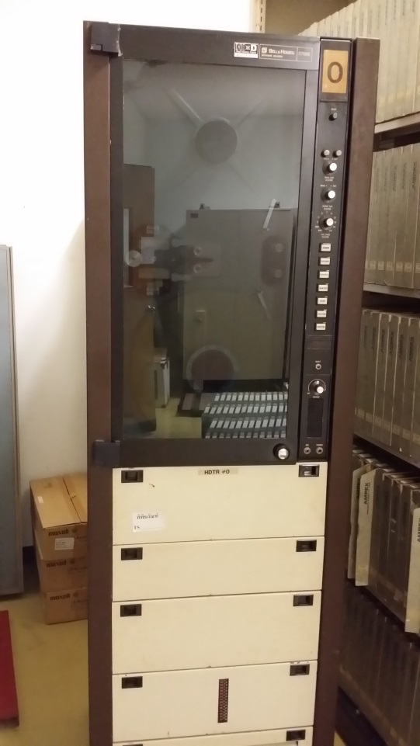
Remaining Work
Continue to work to improve ingested data that is not capable of producing L1Ts
Continue to refine process for reading data off of old media
HDDTs
DCRSi tapes
Address parts and equipment concerns for old drives
Thailand provided three HDDT drives
Canada provided one HDDT drive and
spare parts
Develop MSS data format converters
Many different format types
Handling of partially processed data

Slide 11
LGAC Status Summary
GSID | Country | Location | Scenes Ingested Since Sept. 2010
 |  |  | MSS |  |  |  |  | TM |  |  |  |  | ETM+
 |  |  | Actual | Estimated | % Comp | Unique | % Unique | Actual | Estimated | % Comp | Unique | % Unique | Actual | Estimated | % Comp | Unique | % Unique
ASA | Australia | Alice Springs | 223,791 | 224,000 | 100% | 166,582 | 74% | 184,963 | 185,000 | 100% | 181,058 | 98% | 207,262 | 205,000 | 100% | 112,177 | 54%
BIK | Kyrgyzstan | Bishkek |  |  |  |  |  | 2,340 | 2,000 | 100% | 1,749 | 75%
BJC | China | Beijing |  |  |  |  |  | 192,325 | 560,000 | 34% | 183,342 | 95% | 95 | 47,000 | 0% | 17 | 18%
BKT | Thailand | Bangkok | 0 | 57,000 | 0% | 0 | 0% | 124,066 | 185,000 | 67% | 115,447 | 93% | 18,704 | 26,000 | 72% | 8,268 | 44%
CLT | Taiwan | Chung Li |  |  |  |  |  | 11,586 | 12,000 | 97% | 11,297 | 98%
COA | Argentina | Cordoba |  |  |  |  |  | 103,610 | 190,000 | 55% | 96,185 | 93% | 116,393 | 190,000 | 61% | 48,162 | 41%
CPE | Ecuador | Cotapaxi |  |  |  |  |  | 25,246 | 50,000 | 50% | 12,304 | 49%
CUB | Brazil | Cuiaba | 0 | 76,000 | 0% | 0 | 0% | 306,656 | 307,000 | 100% | 263,745 | 86% | 83,052 | 80,000 | 100% | 48,753 | 59%
DKI | Indonesia | Parepare |  |  |  |  |  | 17,001 | 32,000 | 53% | 16,670 | 98% | 47,321 | 45,000 | 100% | 20,767 | 44%
FUI | Italy | Fucino | 0 | 2,000 | 0% | 0 | 0% | 48 | 567,000 | 0% | 48 | 100% | 0 | 51,000 | 0% | 0 | 0%
GNC | Canada | Gatineau |  |  |  |  |  | 53,004 | 53,000 | 100% | 14,681 | 28% | 37,955 | 38,000 | 100% | 9,988 | 26%
HAJ | Japan | Hatoyama | 158,352 | 158,000 | 100% | 95,208 | 60% | 131,556 | 132,000 | 100% | 127,107 | 97% | 20,556 | 21,000 | 98% | 10,667 | 52%
HIJ | Japan | Hiroshima |  |  |  |  |  |  |  |  |  |  | 39,365 | 39,000 | 100% | 15,316 | 39%
HOA | Australia | Hobart |  |  |  |  |  | 5,812 | 6,000 | 97% | 5,767 | 99% | 13,110 | 13,000 | 100% | 5,255 | 40%
ISP | Pakistan | Islamabad | 0 | 5,000 | 0% | 0 | 0% | 56,299 | 66,000 | 85% | 54,911 | 98%
JSA | South Africa | Hartebeesthoek | 0 | 18,000 | 0% | 0 | 0% | 77,619 | 119,000 | 65% | 65,608 | 85% | 28,352 | 25,000 | 100% | 8,520 | 30%
KHC | China | KaShi |  |  |  |  |  | 17,275 | 23,000 | 75% | 16,110 | 93%
KIS | Sweden | Kiruna | 0 | 432,000 | 0% | 0 | 0% | 183,508 | 300,000 | 61% | 180,755 | 98% | 28,592 | 43,000 | 66% | 17,764 | 62%
MPS | Spain | Maspalomas | 0 | 154,000 | 0% | 0 | 0% | 16,329 | 50,000 | 33% | 16,329 | 100% | 7,480 | 32,000 | 24% | 4,099 | 55%
MTI | Italy | Matera |  |  |  |  |  | 2,928 | 234,000 | 1% | 2,907 | 99% | 27 | 48,000 | 0% | 3 | 15%
NSG | Germany | Neustrelitz | 5,132 | 5,000 | 100% | 5,102 | 99% |  |  |  |  |  | 10,857 | 89,000 | 12% | 3,459 | 32%
PAC | Canada | Prince Albert | 413,758 | 414,000 | 100% | 201,692 | 49% | 369,687 | 370,000 | 100% | 193,020 | 52% | 100,374 | 100,000 | 100% | 28,671 | 29%
RSA | Saudi Arabia | Riyahd | 0 | 5,000 | 0% | 0 | 0% | 1,608 | 250,000 | 1% | 860 | 53%
SGI | India | Shadnagar | 0 | 12,000 | 0% | 0 | 0% | 38,404 | 39,000 | 100% | 38,054 | 99%
ULM | Mongolia | Ulan Bator |  |  |  |  |  | 556 | 500 | 111% | 554 | 100%
UPR | Puerto Rico | Mayaguez |  |  |  |  |  |  |  |  |  |  | 315 | 500 | 63% | 118 | 37%
Totals |  |  | 801,693 | 1,562,000 | 51% | 468,584 | 58% | 1,922,512 | 3,726,500 | 52% | 1,603,644 | 83% | 778,406 | 1,092,500 | 71% | 354,735 | 46%
Over 3.5 million scenes ingested!
Approximately 55% complete
Approximately 69% of scenes are new to the archive!
Includes partial scenes
Green = Completed
Notes:
3,500,000 complete or 55%
6,350,000 estimated
2,400,000 unique or 69%

Slide 12
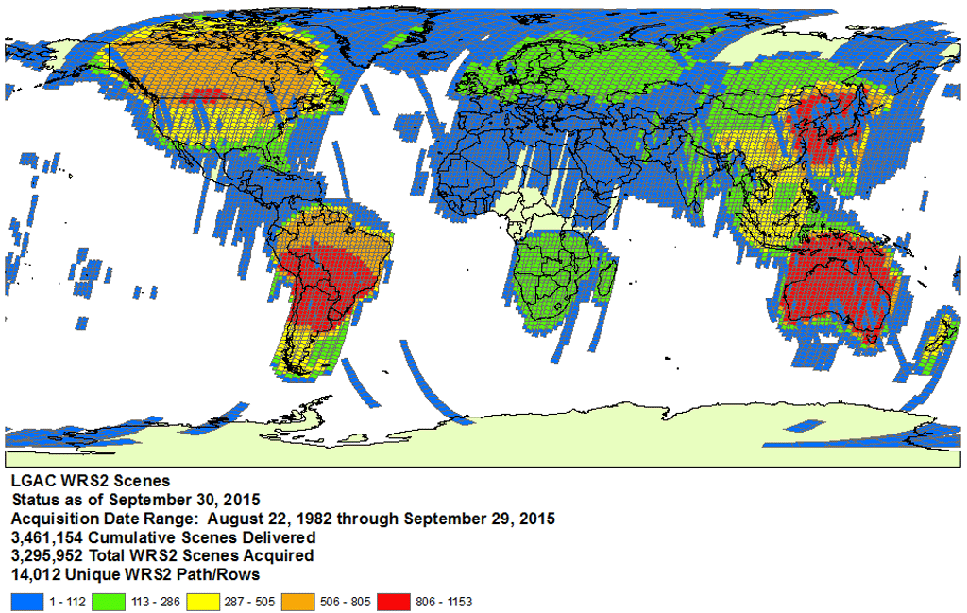
LGAC WRS-2

Slide 13
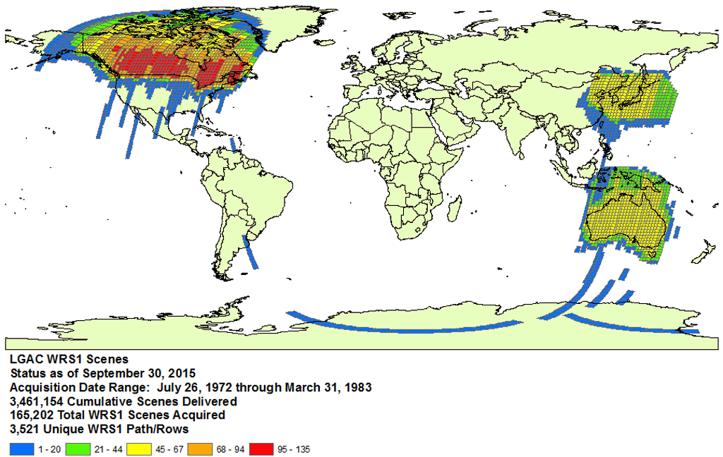
LGAC WRS-1

Slide 14
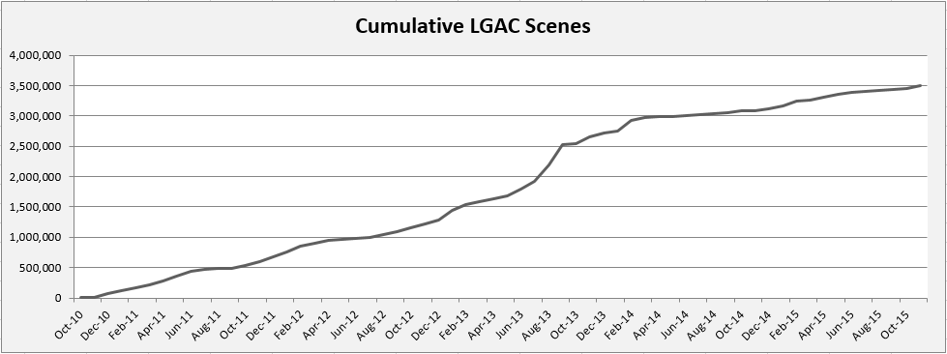
Cumulative LGAC Status
3,502,611 Scenes Recovered!

Slide 15
Questions

