Slide 1
OpenSearch API Validation
WGISS-40 2015
Doug Newman (NASA Earthdata – Raytheon)
Andrew Mitchell (NASA Earthdata)
This work was supported by NASA/GSFC under Raytheon Co. contract number NNG10HP02C

Slide 2
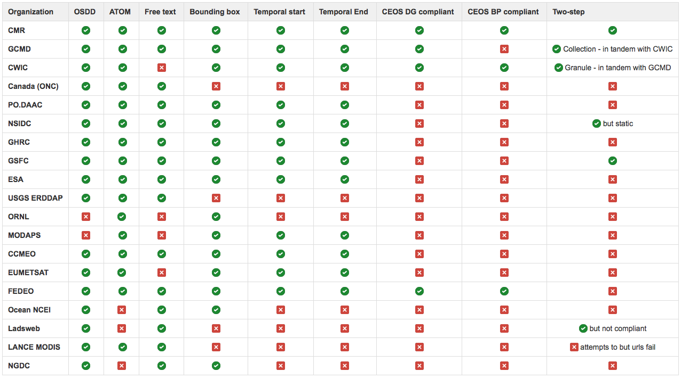
Are ‘we’ compliant? No
Notes:
We want everyone to work together in the ESIP discovery cluster. Huge gains can be made by presenting search results in a uniform manner. So we jumped on OpenSearch and created best practices that we thought would enable this.
But is the community compliant with that standard? No. Not yet.

Slide 3
Why not?
You can lead a provider to an OpenSearch Best Practice but you can’t make them compliant
Notes:
Why not? It is difficult and there are some valid reasons why.
How do I know what standards to code to?
How do I verify that compliance?
What do I gain from being compliant?

Slide 4
How to make the horse drink
☑ Provide specifications and best practices
Audit
Assist in achieving compliance
Provide a public means to test their implementation for compliance
☐Provide a private means to test their implementation for compliance*
☐Demonstrate the value of being compliant
* Requires open sourcing
Notes:
We have publicly provided standards and best practices
We have audited a large number of OpenSearch APIs for compliance
We have assisted the willing in making their APIs compliant
We will provide a means to test their compliance
And we will demonstrate the CWICSmart -> IDN -> CWIC functionality to show value and we can tell you this…
If you are compliant you can integrate with CWIC very easily and the value of compliance will become evident
Now about that testing that compliance

Slide 5
OpenSearch Validation Tool
Notes:
We have developed, and continue to develop, a tool for OpenSearch validation

Slide 6
Concept
Supply an OSDD location
Validation tool performs a series of tests to measure compliance of OpenSearch API
Split by specifications, extensions and best practices
Success – what you gain
Failure – what you lose
More than just your OSDD. Searches are performed to test two-step etc.
Notes:
Give us an OSDD
We will measure the compliance of the OSDD and the search API it represents
We will tell you how much it conforms to specification X and Best Practice Y
If you succeed we will tell you why that is a benefit
If you fail we will tell you what you are missing out on
We drill down on your OSDD and get to understand your API automatically

Slide 7
Roadmap of validation tool
☑ OpenSearch Specification
Geo extension
Time extension
ESIP Best Practices
Parameter extension
Relevancy extension
OGC Extensions
CEOS Best Practices
☐ CEOS Developer Guide
☐ Open source it
Notes:
The preliminary version of this tool does the following. And here is what we will be doing next.

Slide 8
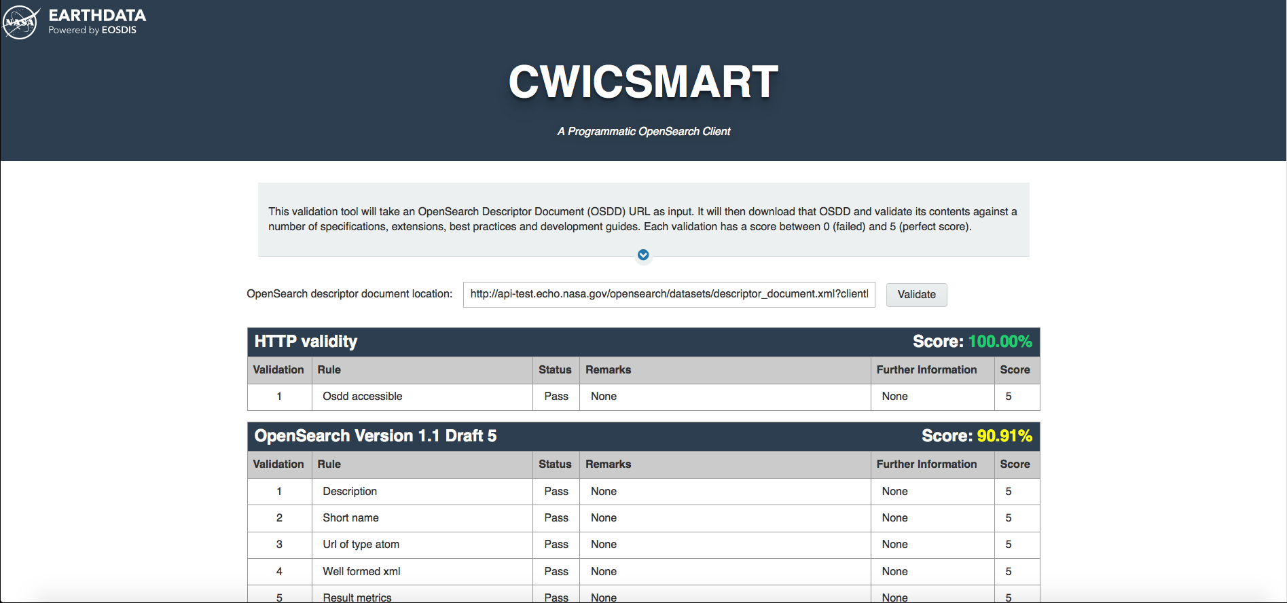
Screenshot
Notes:
Here it is. In future iterations, from a user perspective we will be adding scoring, profit/loss analysis of your score etc.
And more validations for OGC and CEOS.

Slide 9
Demo

Slide 10
Questions
Notes:
Thank you.

Slide 11
This work was supported by NASA/GSFC under Raytheon Co. contract number NNG10HP02C

