Slide 1
Open Source Practices at ESA
olivier.barois@esa.int
ESRIN Earth Observation Program
Ground Segment Department

Slide 2
ESA-wide policy on Open Source Software (OSS)
Objectives: Improve ESA governance on Open Source Software procurement, according to technical needs, covering licensing aspects and the establishment of clear guidelines and procedures for OSS transfer outside the MS.
An ESA inter-directorate OSS Taskforce was set up in 2010 and recommended the OSS policy
OSS Policy was approved in Sep-2011
Justifications:
For ESA space programmes OSS can provide cost savings and innovation.
For ESA technology programmes OSS can result in savings in the domain of software R&D (36% savings estimated in an EU study)
For industry it can provide ways to enter the market (in particular for SMEs) and cost reduction for development and maintenance of software products and tools.

Slide 3
ESA’s OSS Policy – Key points
Authorise the use of Open Source Licensing as legitimate, technically valid and a legally sound options for ESA software developments in the following cases:
Collaboration with Universities and Research Institutes;
Promotion of space international standards;
Mission Data Processing tools;
Engineering Tools;
Industrial Commercial Interest
Authorise the use of the ESA Open Source License Agreement for software that are not bound to another Open Source Licence Agreement
Establishment of an ESA’s Software Licencing Board (ESLB)
Modifications of existing OSS software shall be approved by the ESLB
Definition of OSS Procurement Guidelines (updates of ESA’s General Clauses and Conditions for ESA Contracts)
Implementation and maintenance of an ESA OSS Repository for ESA wide use and support to industry

Slide 4
ESA’s Software Licensing Board (ESLB)
The ESA Software Licensing Board, reporting to the Director General, is an internal governance body of the Agency with the responsibility to monitor the legal and licensing implications of all ESA Software developments and to decide whether the resulting software products can be (sub)licensed to third parties.
Main responsibilities:
Update relevant existing standards and procurement procedures to:
Ensure visibility on the actual components of a software product (including any re-used element) and their relative licensing conditions.
Identify any potential legal risk
Determine (with support of Legal Department) whether or not a given software product is fit for (sub)licensing
Create and maintain a database of all “licensable” ESA software products (European Space Software Repository)
The ESLB was established in March-2013

Slide 5
ESA’s Open Source Software Licence
Can be tailored to the copyleft flavour required by the project (strong, weak or none at all)
Strong copyleft: requires anyone who distributes the code or a derivative work to make the source available under the same terms. Similar to GPL.
Weak copyleft: lets people do anything they want with the code as long as they provide attribution back to ESA and don’t hold ESA liable. Similar to MIT, LGPL, BSD
none at all: sub-licencing forbiden. ESA retains all rights.

Slide 6
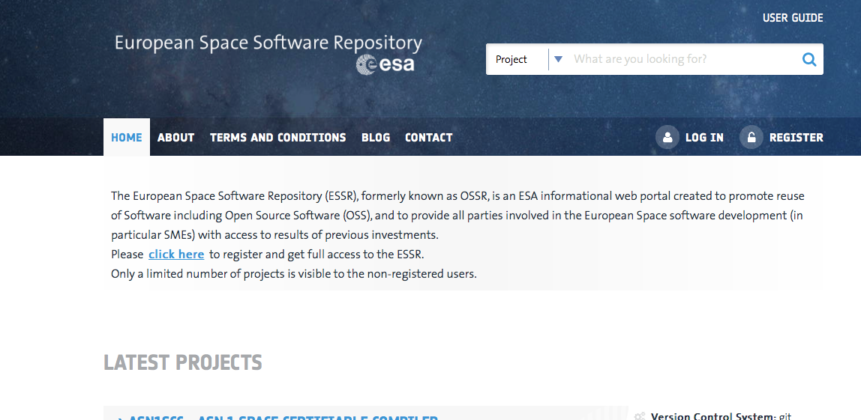
European Space Software Repository
Live since 19-Sep-2015: https://essr.esa.int
The European Space Software Repository (ESSR) is an ESA information web portal to promote reuse of Software including Open Source Software (OSS), and provide all parties involved in European Space software development (in particular SMEs) access to results of previous investments.
Guide European Space Industry in identifying available OSS
Allow Industry to make their OSS products and associated services known to the space community and beyond
Help European industry in joining ongoing OSS collective development projects;
Provide visibility on licensing schemes and legal aspects on European products
Support building up of collaborative OSS initiatives

Slide 7
OSS In practices
In line with the spirit of the free and open data policy, ESA’s Earth Observation ground segment department is committed to develop more and more open source software.
Affected domains:
EO tool boxes
Multi-mission components of ground segments infrastructures
EO data Processors
Operational software in general
Software developed in R&D (GSTP/TRP projects)
Contribution to OGC, WGISS
Earth Science Exploitation platform

Slide 8
ESA’s OSS practices in a nutshell
ESA has set-up a solid and wide policy concerning Open Source
ESA is deploying tools and procedures to support it
Many Open Source software released in the past
Open Source software contribution will increase in the future
Thank You

