Slide 1

WGISS 40
Technology Exploration Interest Group
Retirement of FTP
Kristi Kline
August 3, 2015
Kristi Kline
September 30, 2015

Slide 2








Moving Data
EROS
1 Gbps * Verizon
WWW
Public
*Upgrade planned
1 Gbps DOI/USGS Intranet
2.4 Gbps Networx (Primary)
Chicago
Starlight
10 Gbps REED
MOC, LGNs
10 Gbps NTNC (Secondary)

Slide 3



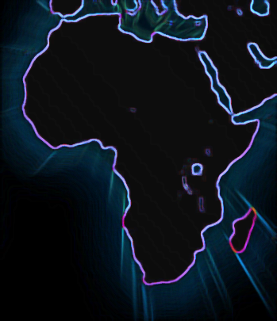



165 Terabytes
532 Terabytes
463 Terabytes
2200 Terabytes
10 Terabytes
1400 Terabytes
230Terabytes
9/30/2015
3

Slide 4
Continued Increase in Data In/Out
?

Slide 5
FTP - Before
Users requested products from interface
Email sent to user with instructions for download
  Username = “anonymous”
  Password = specific to product request
  Only allowed that user into the directory for the product
Generally referred to as “semi-anonymous FTP”

Slide 6
Today
All products distributed with HTTP
User basic authentication (not custom)
Initial issues/fixes:
  Data in “DMZ” – not behind web firewall
  Users had previously scripted downloads using FTP
  Tools like wget and curl allow scripting for HTTP
  No performance issues were noted
  Added bulk metadata and bulk download tools
  Some web tools like downloadthemall are helpful
  Machine2machine interface using api and role-based permission in EarthExplorer for large customers

