Slide 1
WGISS 40
USGS Plans for Archive and Distribution of Sentinel-2 Multispectral Imager (MSI) Data
Kristi Kline
September 29, 2015

Slide 2
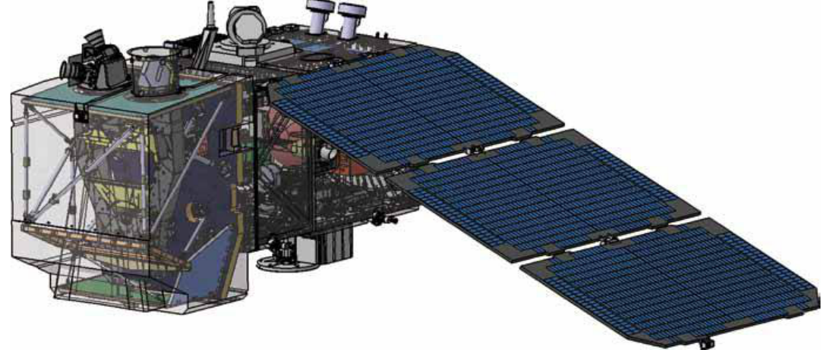
Background
Notional plans are for the USGS to acquire, archive and distribute Sentinel-2 MSI Level-1C (L1C) products
NASA would sponsor investigation of approaches for harmonizing Landsat and Sentinel-2 surface reflectance (SR)
USGS would archive and distribute NASA-generated surface reflectance products

Slide 3
S2 Products Summary
Name | High-level Description | Production | Preservation Strategy | Volume
Level-1B | Top-of-atmosphere radiances in sensor geometry | Systematic | Long-term | ˜27 MB (each 25x23km²)
Level-1C | Top-of-atmosphere reflectances in cartographic geometry (UTM/WGS84) | Systematic | Long-term | ˜500 MB (each 100x100km²)
Level-2A | Bottom-of-atmosphere reflectances in cartographic geometry | On user side (using Sentinel-2 Toolbox) | - | ˜600 MB (each 100x100km²)
Courtesy ESA

Slide 4
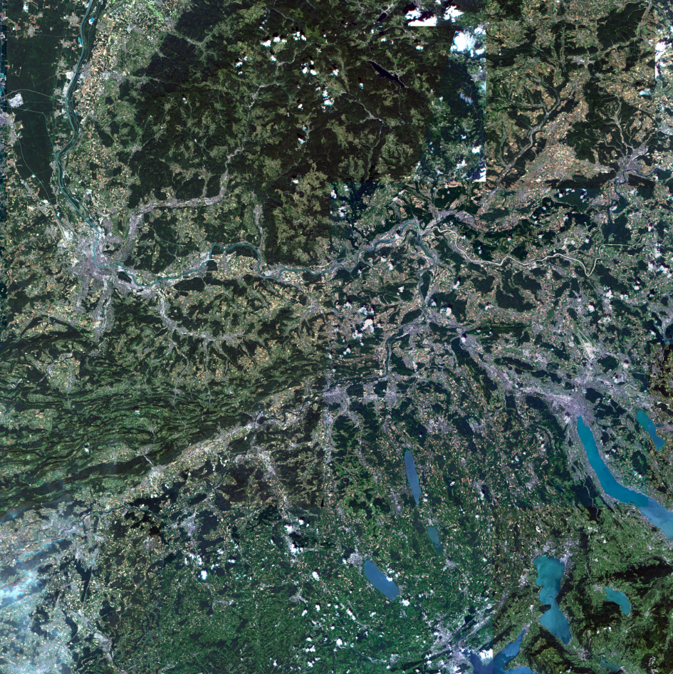
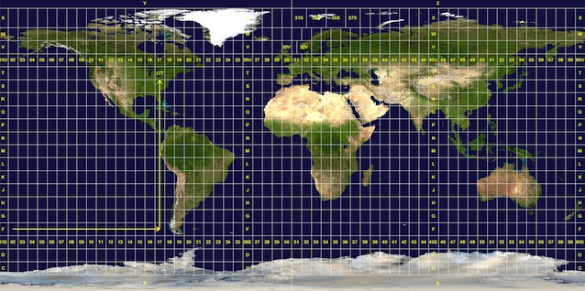
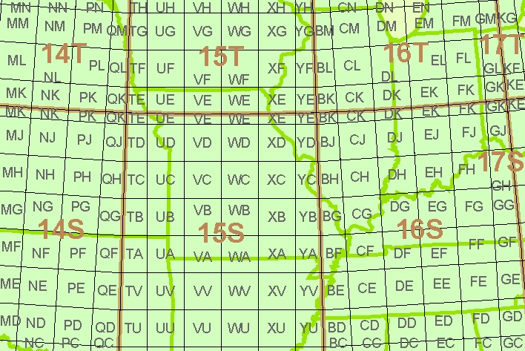
L1C Granularity - Tiling approach
Global Reference System in UTM space (6ºx8º grid zones)
Each grid zone is split into 100x100km (TBC) UTM “tiles”
An average orbit covers ~200 tiles, i.e. 106 /year/satellite.
One tile weights ~ 500MB with all bands
100km x 100km tile
Courtesy ESA

Slide 5
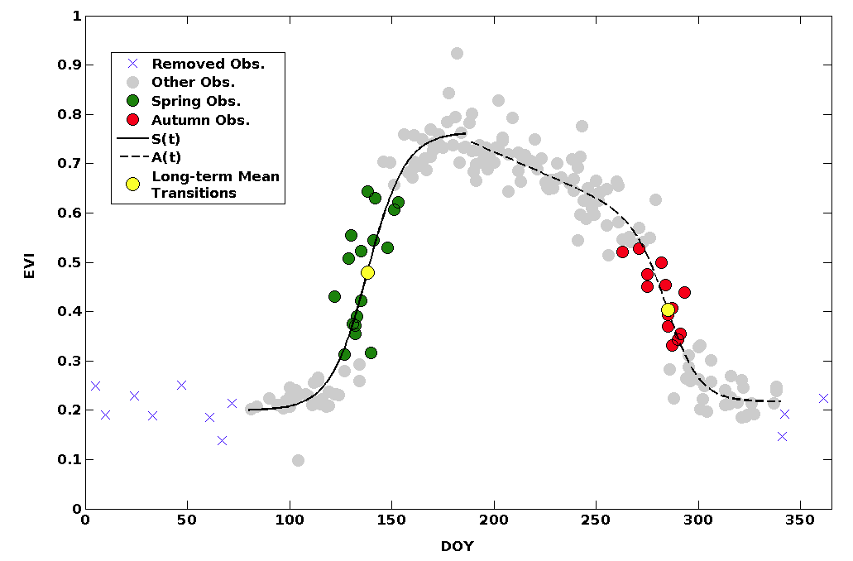
Science Rationale
Since the opening of the USGS Landsat archive, there has been increased science interest in intra-annual time series applications at ~30m resolution
Agricultural monitoring (e.g. GEO-GLAM)
Patch-scale vegetation biophysics (LAI, fPAR, productivity)
Phenology and climate linkages
WELD data products
Current systems struggle to meet these needs in terms of resolution (MODIS) or frequency (Landsat)
Combining Sentinel-2 and Landsat-8 data streams offers near-daily, global 30m coverage
Example: New England forest phenology from multi-annual Landsat observations, courtesy Mark Friedl (BU)

Slide 6
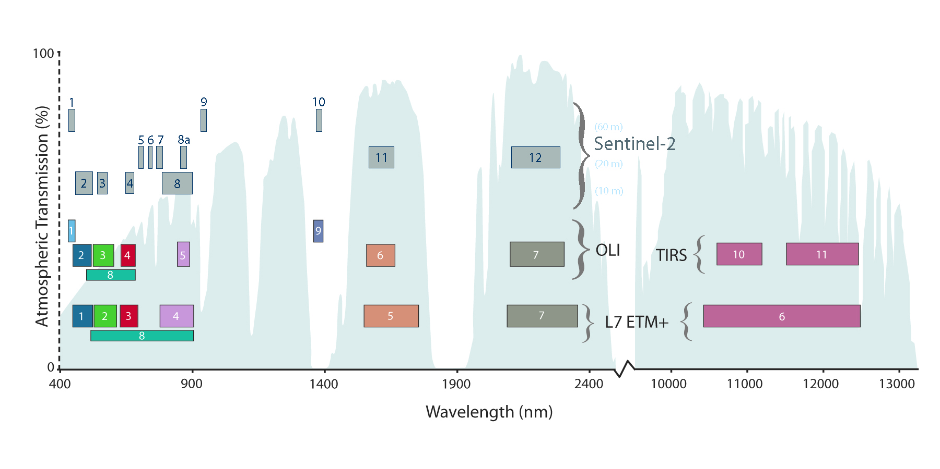
Comparison of Landsat & Sentinel-2

Slide 7
Revisit Performance Analysis
 | Individual Satellite Revisit Interval |  |  | Constellation Revisit Interval |  |  | Satellites Paired with Landsat 7 and 8 Revisit Interval |  |  | Scenario Duration
 | Equator | U.S. | Europe | Equator | U.S. | Europe | Equator | U.S. | Europe
Landsat 7 | 16d 7d 7h |  |  | 8d 3d 19h |  |  | ---- |  |  | 80 days
Landsat 8 | 16d 7d 7h |  |  |  |  |  | ----
Sentinel 2A | 10d 4d 11h | 10d 4d 17h | 10d 4d 11h | 5d 1d 12h | 5d 1d 11h | 5d 1d 10h | 3d 2h 1d 12h | 3d 2h 1d 11h | 3d 2h 1d 10h
Sentinel 2B | 10d 4d 11h | 10d 4d 17h | 10d 4d 11h
Analyses performed by Brian Kilough, NASA Langely/CEOS Systems Engineering Office

Slide 8
What’s Needed to Make Full Use of Sentinel-2 Data?
User access to S2 L1C Data (USGS)
MSI Characterization & cross-calibration with Landsat-8 (NASA, USGS)
- Prelaunch comparison of integrating spheres (GSFC/Astrium/UAz) - Planning for coincident imaging & vicarious campaigns
Higher-level Products (NASA)
Sensor reflectance products
L8 surface reflectance algorithm delivered from GSFC (Vermote) to USGS May 2014
S2 surface reflectance algorithm available from ESA Toolkit, or through GSFC development
Merged Landsat + S2 reflectance product
Object: a seamless, sensor-independent reflectance record at high spatial, and high-temporal resolution to support land science
Compatible atmospheric correction & cloud/shadow detection
Corrections for BRDF (solar, view angle), band pass differences
Adjustment to common frame, resolution (~30m), compositing period (~5 day)
Contributions from Vermote, Schaaf, Roy, Schott
Higher-level land cover & biophysical products

Slide 9
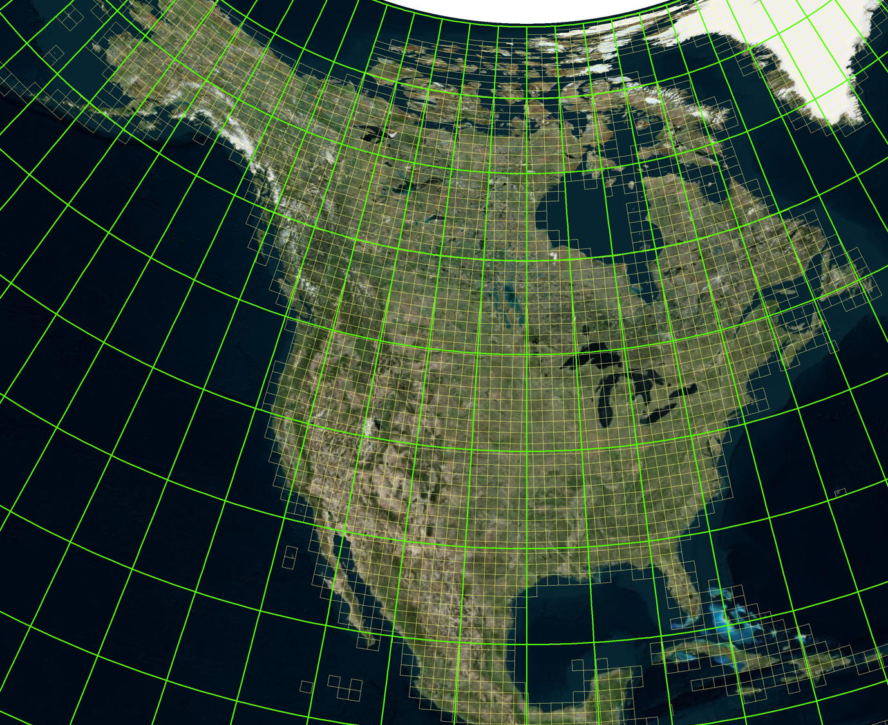
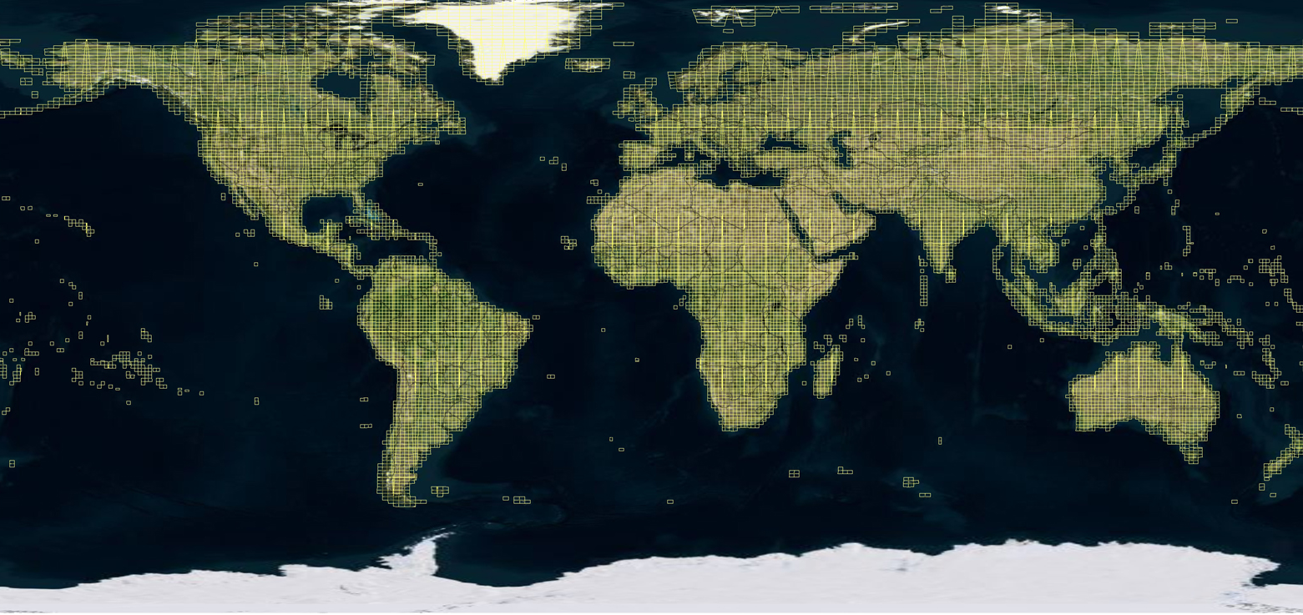
Sentinel-2 L1C Concept of Operations
Sentinel-2 L1C concept of operations is to automate data flow to minimize labor cost and minimize time required to make the data available.
As mentioned previously, estimates are based on 100x100km² tiles with a file size of 500MB per tile.
Tile schema is assumed to be based on the Military Reference Grid System (MRGS)

Slide 10
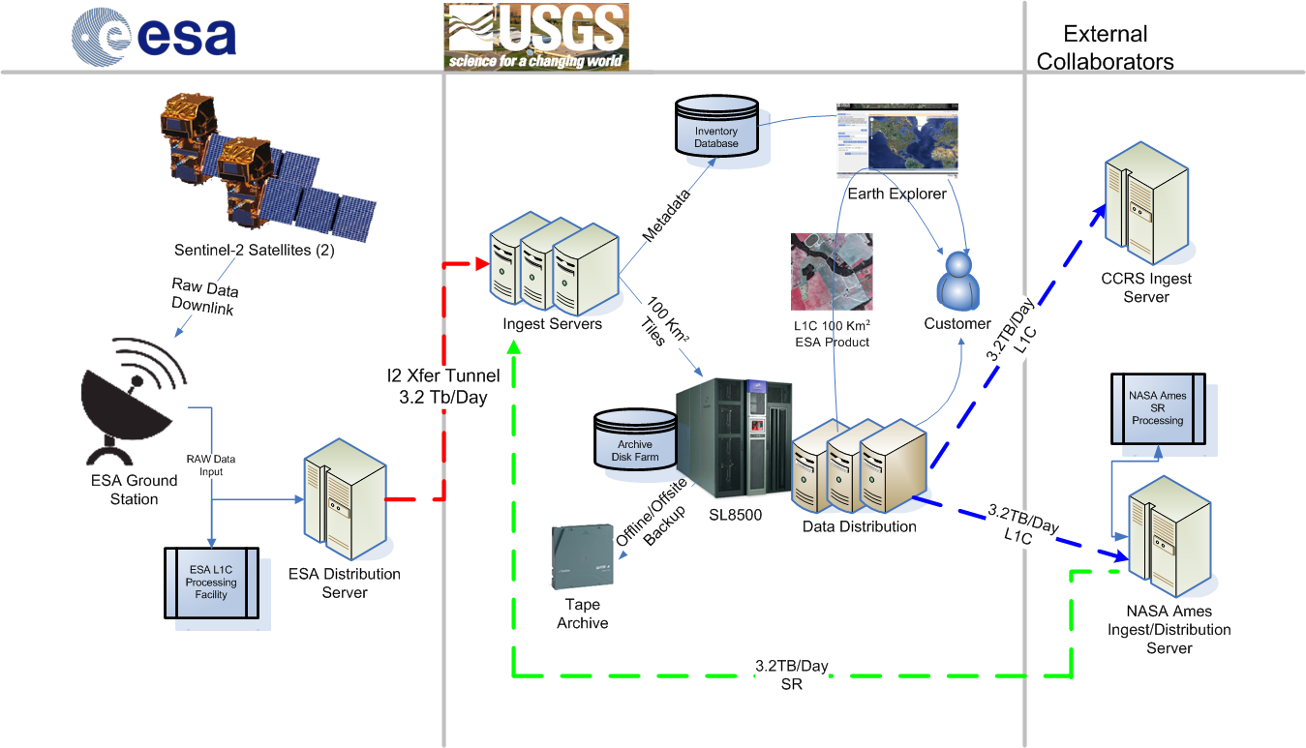
Concept of Operations-“Day in the Life” Data Flow
ESA processing steps include data capture at ESA ground station, process data to L1C, and initiate network transfer to EROS via ESA distribution server
Network transfer assumes use of GEANT network to United States and Internet 2 to EROS.
Data received on EROS ingest server
Requires write access from DMZ
server based on security credentials
Ingest servers monitor for new data
Create browse
Inventory Database metadata update
EE/GloVis product availability
Data archive copies created
Policy based archive creating three tape copies; nearline, offline, offsite
NASA Ames/CCMEO retrieve L1C data
Machine to Machine Interface
NASA Ames network transfer SR Data
SR Data archived and ingested
similar to L1C (steps 2-4)
Data distribution
EE/GloVis search and order enabled

Slide 11
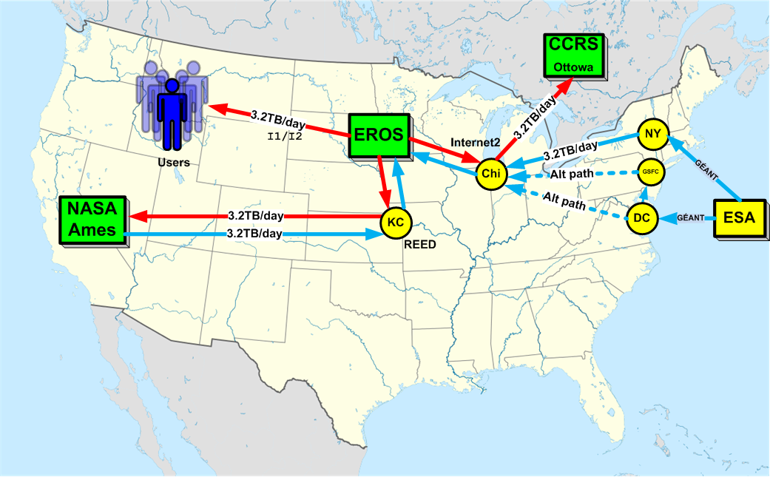
Network Connectivity

Slide 12
Potential Levels of Service
Sentinel-2 data would be made available under the same policy as Landsat – free and open access
The levels of service to be provided must balance user needs and available budget
“What is needed to enable the synergistic use of Landsat and Sentinel-2 data?”
The USGS has taken an initial cut at defining 3 tiers of service
Soliciting feedback from user community

Slide 13
Tier 1 - Threshold
The minimum requirement to be met to ensure that users can discover, access, and retrieve the Sentinel-2 data.
EROS will host a copy of the L1C data and enable basic data discovery and access capabilities, and distribute data “as is”
Standard reduced resolution browse for data discovery
Generate full resolution browse (8-bit, 10M resolution) as a product similar to LandsatLook
USGS EROS will archive and distribute Level-2 surface reflectance products generated by NASA Ames (or other cloud)

Slide 14
Tier 2 - Breakthrough
An intermediate requirement level between threshold and target which, if achieved, would result in substantial improvement in the accessibility and usability of the Sentinel-2 data.
Builds upon Tier 1 Levels of Service
Reformatting data to be more consistent with Landsat Level 1
Conversion of Sentinel-2 data into Landsat metadata model and pixel alignment for comparisons.
Coincident search and discovery of both inventories simultaneously in Earth Explorer (contingent on what it takes to get data compatible with data access tools)
Resample the Level-1C data to a 30m common grid for distribution; still archive and distribute the native multi-resolution Level-1C data which could potentially be a 3rd product.

Slide 15
Tier 3 Service Scenarios
Expanded processing capabilities for full radiometric and geometric characterization, calibration, and product generation.
Acquiring the Sentinel-2 Level-1B data, performing meaningful radiometric and geometric characterizations that lend confidence to our understanding of the data but is not completely redundant with what is done by the Copernicus program
Develop processing capabilities to generate the ESA Level-1C product and/or a Level-1C product with all bands gridded and resampled to 30m for alignment with ETM+ and OLI Level-1T products.
Cross calibration
Inter-comparison studies over PICS and selected PI study sites
Spatially and radiometrically compatible with Landsat data
Use of common, best available DEM
Perform spectral bandpass adjustments
Process data to common geophysical parameters (TOA reflectance or surface reflectance)

Slide 16
Implementation Tiers and Options
Implementation Tiers:
Tier 1: EROS will pull a copy of all L1C data from ESA, host a copy at EROS, generate a Full Resolution Browse (FRB) and enable basic data discover capabilities (no other processing included)
Tier 2: In addition to Tier 1, add a minimal amount of processing necessary to increase usability of the data, including reformatting data to be more consistent with Landsat Level 1 and resampling the Level 1C data to a 30m common grid and tiling scheme (Landsat-like) for distribution as an on-demand Landsat-like product
Tier 3: This is a separate and parallel scenario to Tier 2 to render the MSI data interoperable with Landsat and significantly increase the usability/utility of the data for research/applications and makes the data as seamlessly similar as possible to Landsat data for the user (feasibility pending and therefore, not yet estimated)
Additional defined options:
Option 1: Increase disk cache for S2 data from 180 days to 360 days and add 10% each year (base assumption includes 180 days of spinning disk) to improve user experience
Option 2: Generate surface reflectance products from S2 data and archive and distribute to the public (currently assuming use of NASA Ames Research Center (ARC) for processing SR data)
Option 3: Provide coincident search and discovery of both inventories (Landsat & S2) simultaneously in EarthExplorer and provide aggregated results (feasibility pending and therefore, not yet estimated)
Scope and Schedule remain contingent upon available funding

Slide 17
FY15 Milestones and Deliverables
Executive Milestones | Status | Start Date | End Date | Notes/Deliverable
FY15a Hardware Procurement Submission (2 months IT approval, 1 month TSSC award, 2 months to purchase and delivery) | In Process | Nov 2014 | May 2015 | Hardware procurement critical path – if not in place, will not be able to support Sentinel data ingest and delivery.
Sentinel-2A Software Requirements definition | In Process | Jan 2015 | Apr 2015 | Inventory, EE change requests
Sentinel-2A SW Dev initiated | In Process | Feb 2015 | Sep 2015 | Ingest, Inventory, EE, GloVis, TRAM
Sentinel-2A Launch | Done | Jun 2015 | Jun 2015 | Launch of first Sentinel-2 satellite
Document Sentinel-2 data characterization | In Process | Apr 2015 | Oct 2015 | Analysis and recommendation for 30m Landsat like product
FY15a Hardware Integration | In Process | May 2015 | Aug 2015 | Integrate hardware into existing architecture – Network switch, SAN switch, tape drives, ingest server, 1st and 2nd tier disk.
Sentinel-2A System testing | FutIn Process | Aug 2015 | Dec 2015 | System Testing Ingest, Inventory, EE, GloVis, TRAM
Receive L1C ‘ramp up’ data from ESA | In Process | Jul 2015 | Dec 2015 | Validate process flow and data
Sentinel-2 ORR | In Process | Sep 2015 | Sep 2015 | Operation Readiness Review for production release to support Sentinel-2 archive and distribution.
Sentinel-2 L1C test data availability to a limited audience | In Process | Oct 2015 | Oct 2015 | Test data made available for limited access
FY16 Hardware Procurement initiation | Future | Oct 2015 |  | Hardware procurement outline in FY16 budget
Sentinel-2A L1C data available for download | Future | Jan 2016 |  | Sentinel-2 data release

Slide 18
USGS Sentinel-2 Procurement Status
QTY | HW Description | Status | Comment
1 | Sentinel Ingest server | Installed | Waiting on Power and Network
2 | T10K-d tape drives | Installed | Waiting on fiber
1 | LTO-6 tape drive | Installed | Waiting on fiber
1 | SAN 96 port fibre switch | Awarded
1 | 1.2TB Solid State Disk to augment Inventory Database | Installed | Waiting on Power and Network
2 | V3700 dual ctrl with SSD/SAS -- CR1MSS 1st tier disk (L1C/FRB/WMS) ~35TB | Installed | Waiting on Power and Network
2 | V3700 exp tray with SAS disk -- CR1MSS 1st tier disk (L1C/FRB/WMS) | Installed | Waiting on Power and Network
2 | V3700 dual ctrl with 12x4TB disk -- CR1MSS 2nd tier disk -- ~2x288TB | Installed | Waiting on Power and Network
12 | V3700 additional disk tray with 12x4TB disk -- CR1MSS 2nd tier disk | Installed | Waiting on Power and Network
1 | Network infrastructure -- Extreme Black Diamond 8810 core switch | Awarded
1 | Juniper firewall (upgrade to existing asset) | Awarded
2 | Rack for additional hardware | Installed

Slide 19
Questions?

