Slide 1


ESA EO missions: overview of satellites, ground segment and data access evolution
29 September 2015
Mirko Albani, Pascal Gilles (ESA)

Slide 2
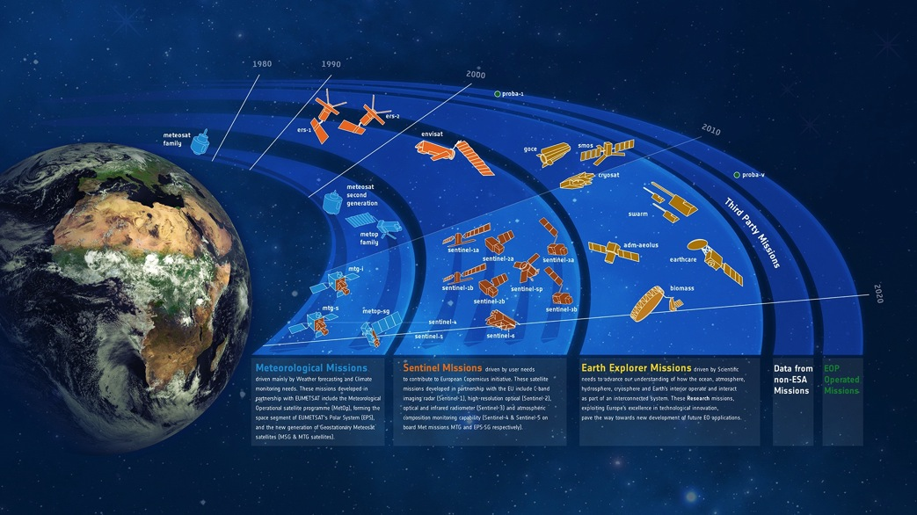
ESA Earth Observation Programmes
Meteorological
Programme
Copernicus
Programme
Earth Observation
Envelope Programme (EOEP)
Notes:
Earth Explorers: Scientific satellites bringing innovation on the instruments.

Slide 3
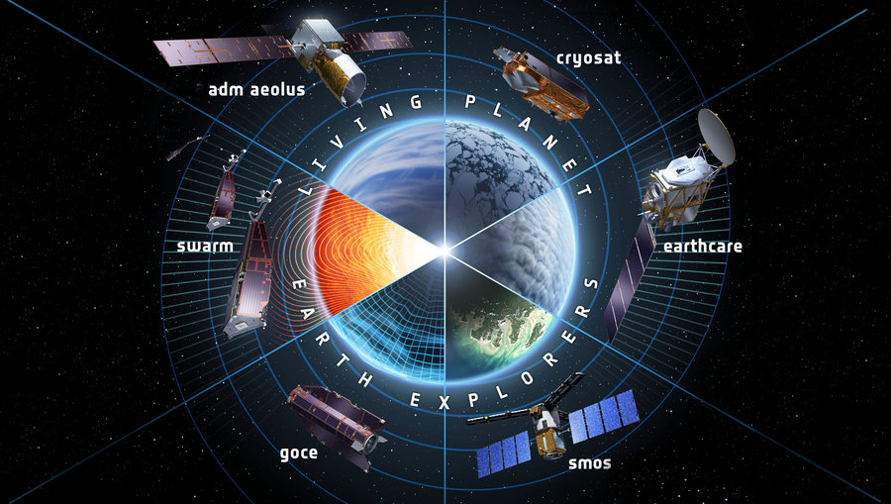
Science – 6 Earth Explorers
Biomass is the 7th
Notes:
BIOMASS is missing!
The Explorers in orbit have surpassed the original mission scopes.

Slide 4
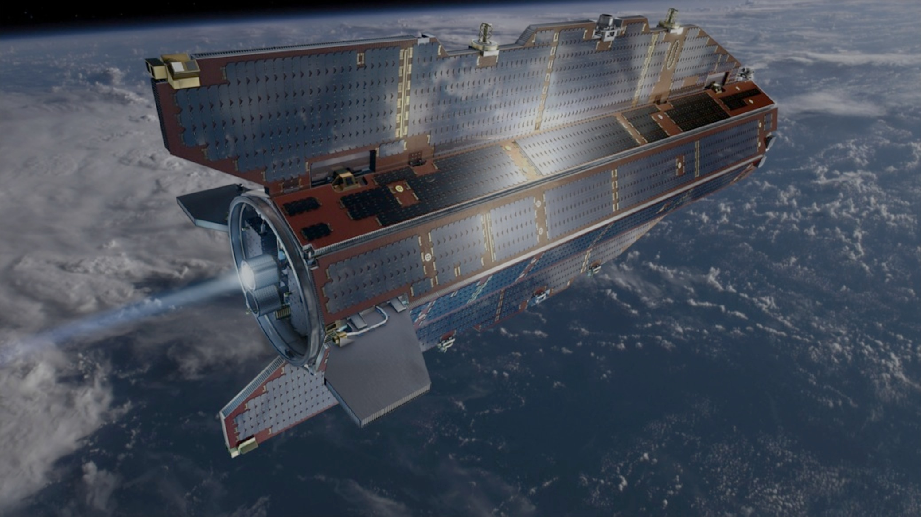
GOCE: Gravity and Ocean Circulation

Slide 5
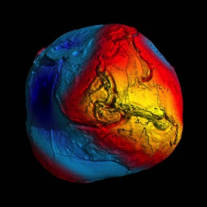
GOCE: Gravity and Ocean Circulation
First gradiometer in space, launched in March 2009, very low orbit (255 km)
Best geoid ever: accelerometers onboard GOCE are 100 times more sensitive than any previously flown
Improvement in the spatial resolution of the gravity field and geoid by a factor 5-6 (compared to GRACE).
5th version of geoid in 2014, including all GOCE measurements (more than 50 million) of variations in gravitational attraction
Geoid important for many applications like unified height systems or navigation.
End of mission declared 21 October 2013 following depletion of Xenon fuel; re-entry 11 November 2013

Slide 6
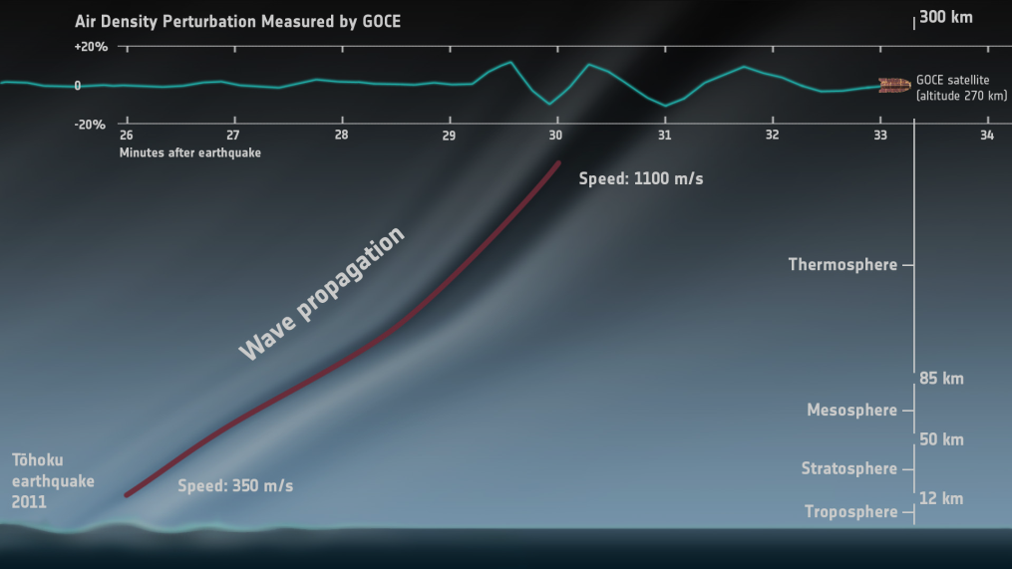
GOCE: Seismometer in Space
Large earthquakes cause seismic waves and make the Earth’s surface vibrate
Resulting sound waves travel upwards
GOCE’s accelerometers sensed atmosphere displacements

Slide 7
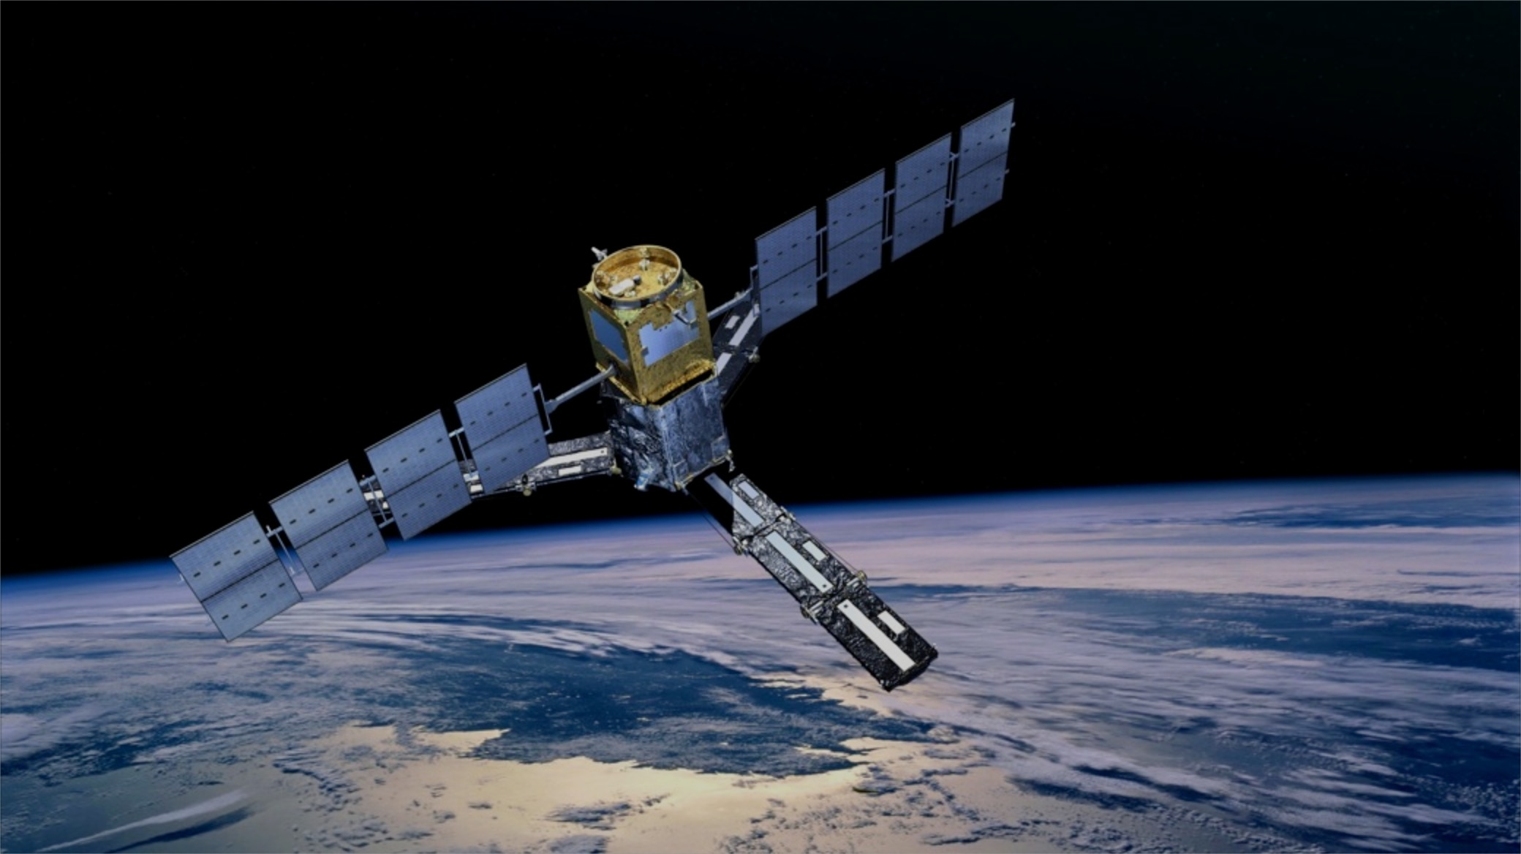
SMOS – Soil Moisture and Ocean Salinity

Slide 8
SMOS – Soil Moisture and Ocean Salinity
Launched in November 2009, data delivery since February 2010
Sea surface salinity measured in psu (practical salinity units), soil moisture measured in cubic metre of water per cubic metre of soil
First global observations of two key variables of the Earth’s water cycle
Improve models of global water cycle and global ocean currents, improved management of water resources
Complete Earth coverage within three days
Radio Frequency Interference (RFI) mitigation continues
Outstanding international cooperation (CNES, CDTI, NASA)
Mission extension until 2017

Slide 9
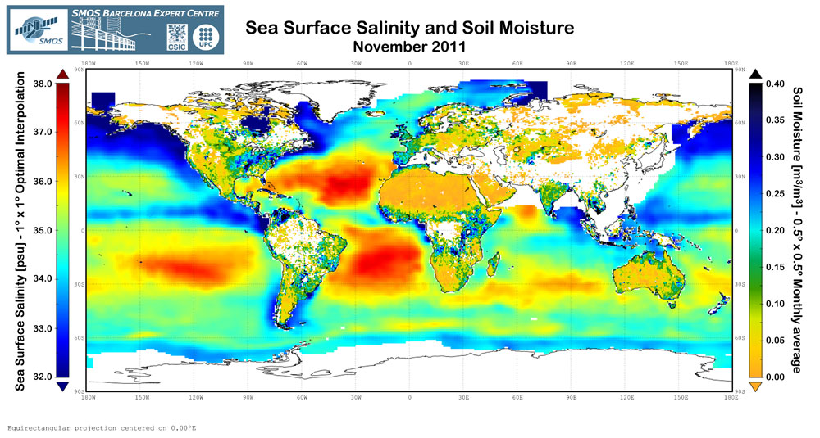
SMOS Measurements
Satellites for emergency relief:
Data acquisition in case of natural or
man-made disasters
Data delivery to civil protection agencies, emergency and rescue services
Notes:
SMOS observations of brightness temperature is a totally new source of information for tracking hurricanes Strong winds over oceans whip up waves and whitecaps, which in turn affect the microwave radiation being emitted from the surface. This means that although strong storms make it difficult to measure salinity, the changes in emitted radiation can, however, be linked directly to the strength of the wind over the sea.

Slide 10
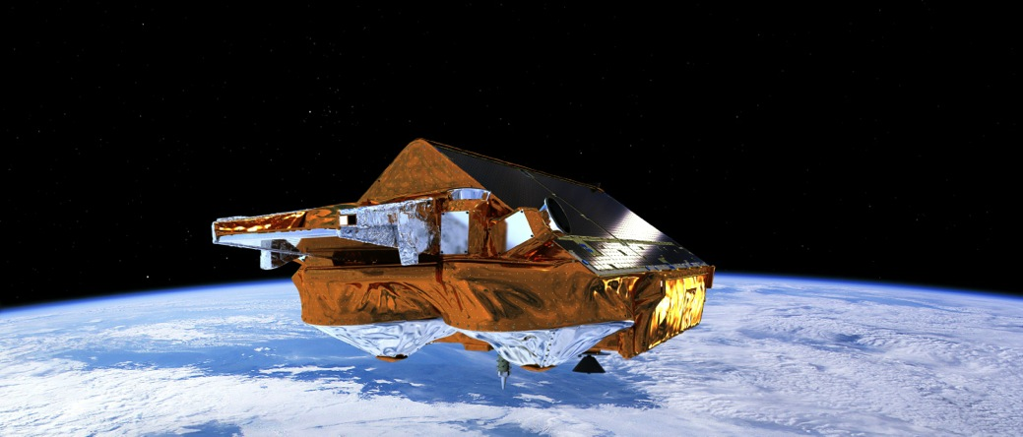
CryoSat: The Ice Mission

Slide 11
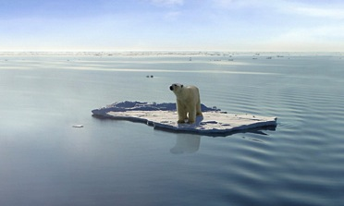
CryoSat: The Ice Mission
Launched 8 April 2010
First interferometric altimeter in space
Global sea ice thickness measurements: monitoring precise changes in the thickness of the polar ice sheets and floating sea ice, reaching latitudes of 88°
Data used for ice research, but increasingly also for oceanography
Mission extension until 2017
© Thinkstock by Getty Images

Slide 12
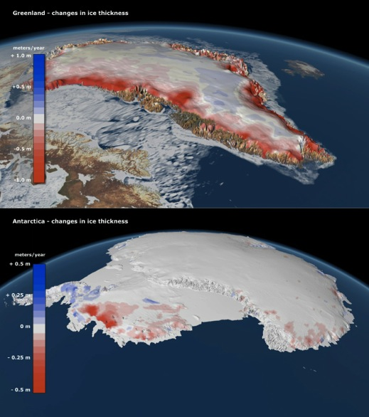
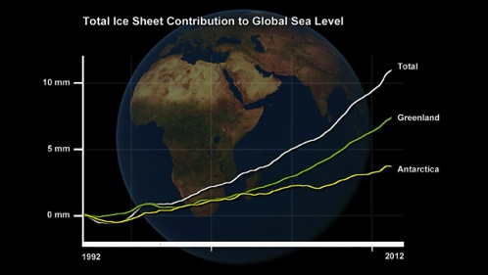
Change in ice thickness and contribution to sea level increase
Changes in ice thickness in Greenland and Antarctica

Slide 13
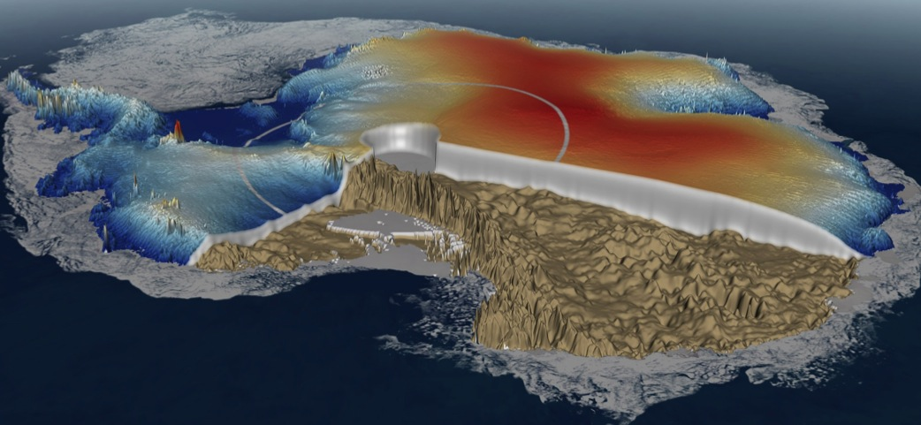
CryoSat allowed to map the height of the ice sheet in Antarctica (data from February and March 2011).
Orbiting closer to the poles than other Earth observation missions, CryoSat offers additional coverage: the outer white circle represents the limits of earlier missions and the inner circle shows that CryoSat is collecting data up to 88°latitude.

Slide 14
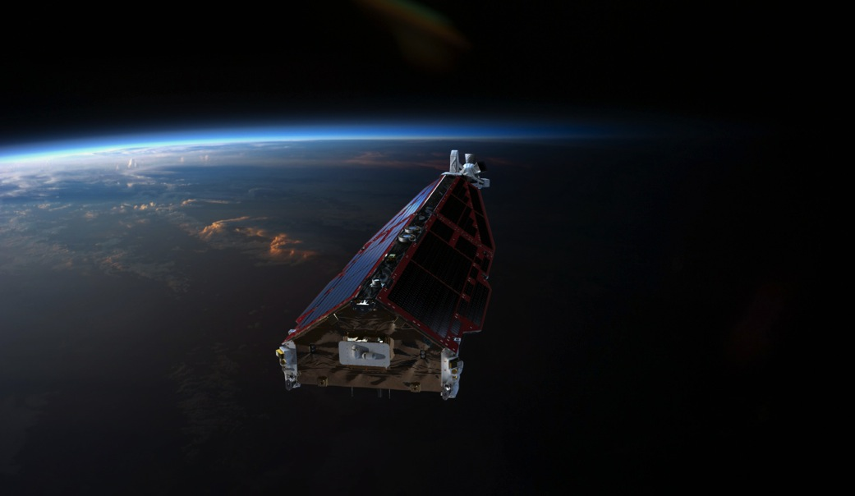
Swarm

Slide 15
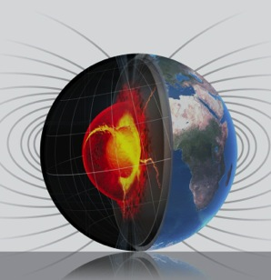
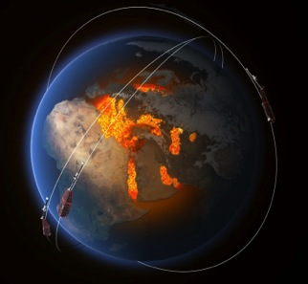
Swarm
Three-satellite-constellation,
launched November 2013
Dedicated to the geomagnetic field and its variation in time

Slide 16
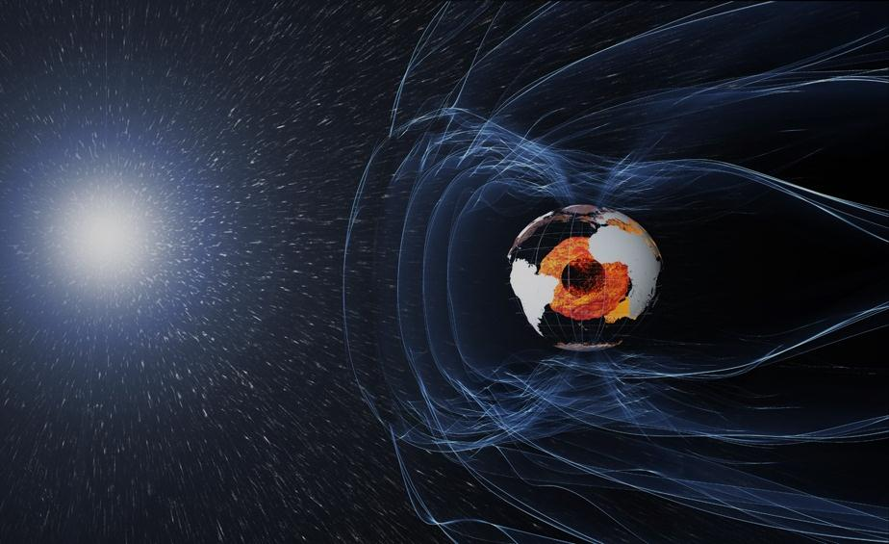
Swarm Science Objectives
understanding the weakening of Earth’s protective shield
magnetosphere
ionosphere
solar wind
studying the effect of solar charged particles near Earth and the connection to “weather” in space

Slide 17
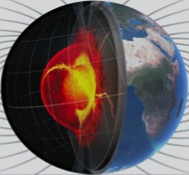
Swarm revealing Earth’s inner secrets
understanding the “Earth’s dynamo” in the outer core
mapping magnetic fingerprints in Earth’s crust & Composition of the mantle
sensing the weak signature of the ocean currents

Slide 18
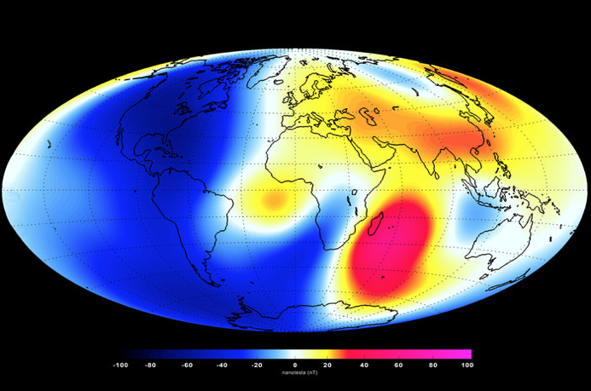
SWARM FIRST RESULTS
First set of high-resolution results reveals the most recent Earth’s Magnetic field changes (Jan to Jun 2014). Shades of blue show areas of weakening while red represent areas of strengthening over the 6-month period.
Notes:
18
Measurements made over the past six months confirm the general trend of the field’s weakening, with the most dramatic declines over the Western Hemisphere.
But in other areas, such as the southern Indian Ocean, the magnetic field has strengthened since January.
The latest measurements also confirm the movement of magnetic North towards Siberia.
These changes are based on the magnetic signals stemming from Earth’s core. Over the coming months, scientists will analyse the data to unravel the magnetic contributions from other sources, namely the mantle, crust, oceans, ionosphere and magnetosphere.

Slide 19
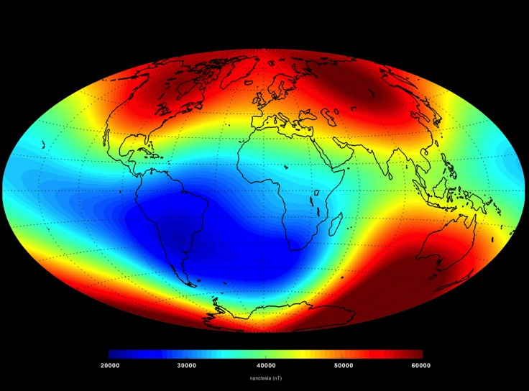
EARTH EXPLORERS (5)
SWARM FIRST RESULTS
Earth’s Magnetic field in June 2014
Notes:
19

Slide 20
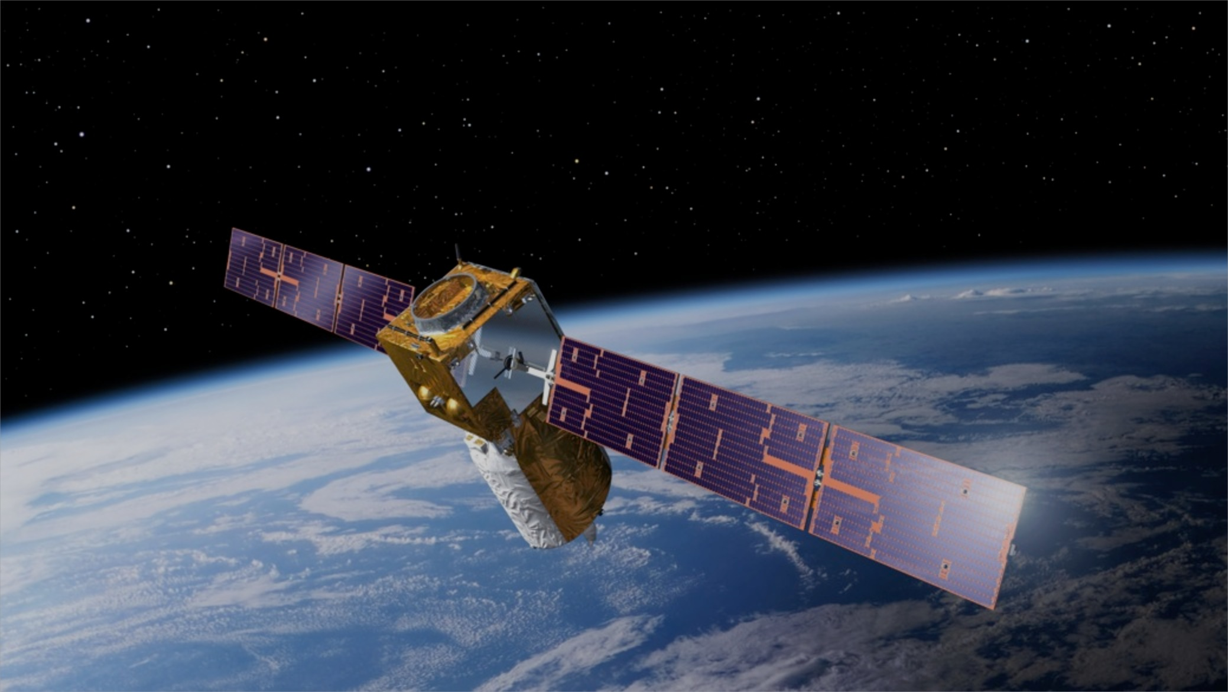
ADM-Aeolus – ESA‘s Wind Mission

Slide 21

ADM-Aeolus – ESA‘s Wind Mission
Global observations of wind profiles for analysis of global 3D wind field
Understanding of atmosphere dynamics and climate processes
Improved weather forecasts and climate models: impact of Aeolus in the ECMWF weather forecast will be significant, in particular for mid-term forecasts.
Laser transmitter of Lidar has passed operational qualification tests
Launch planned for early 2017

Slide 22
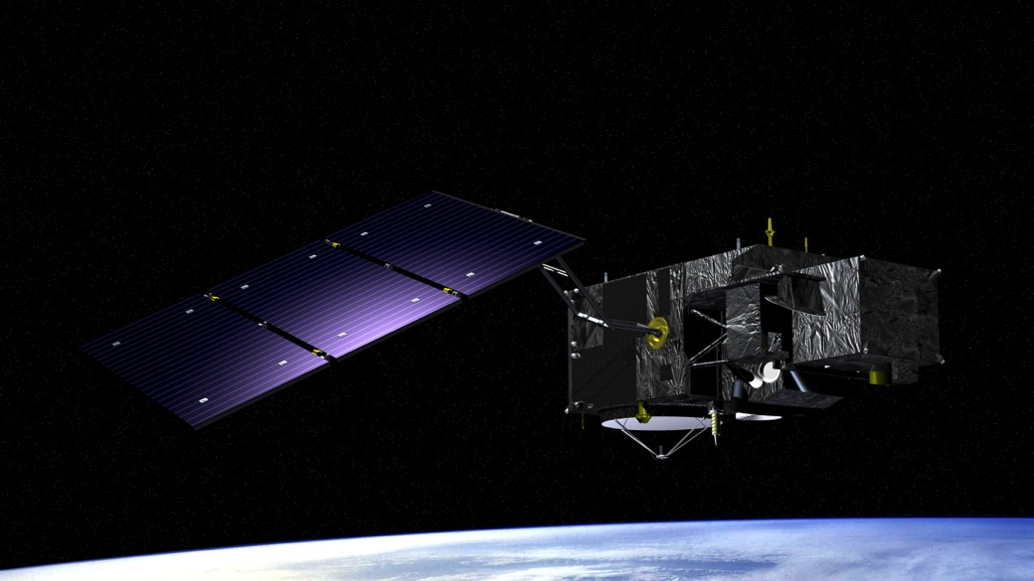
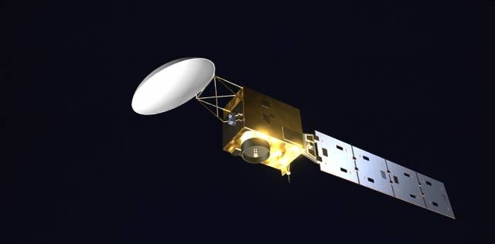
EarthCARE – ESA‘s Aerosol Mission

Slide 23
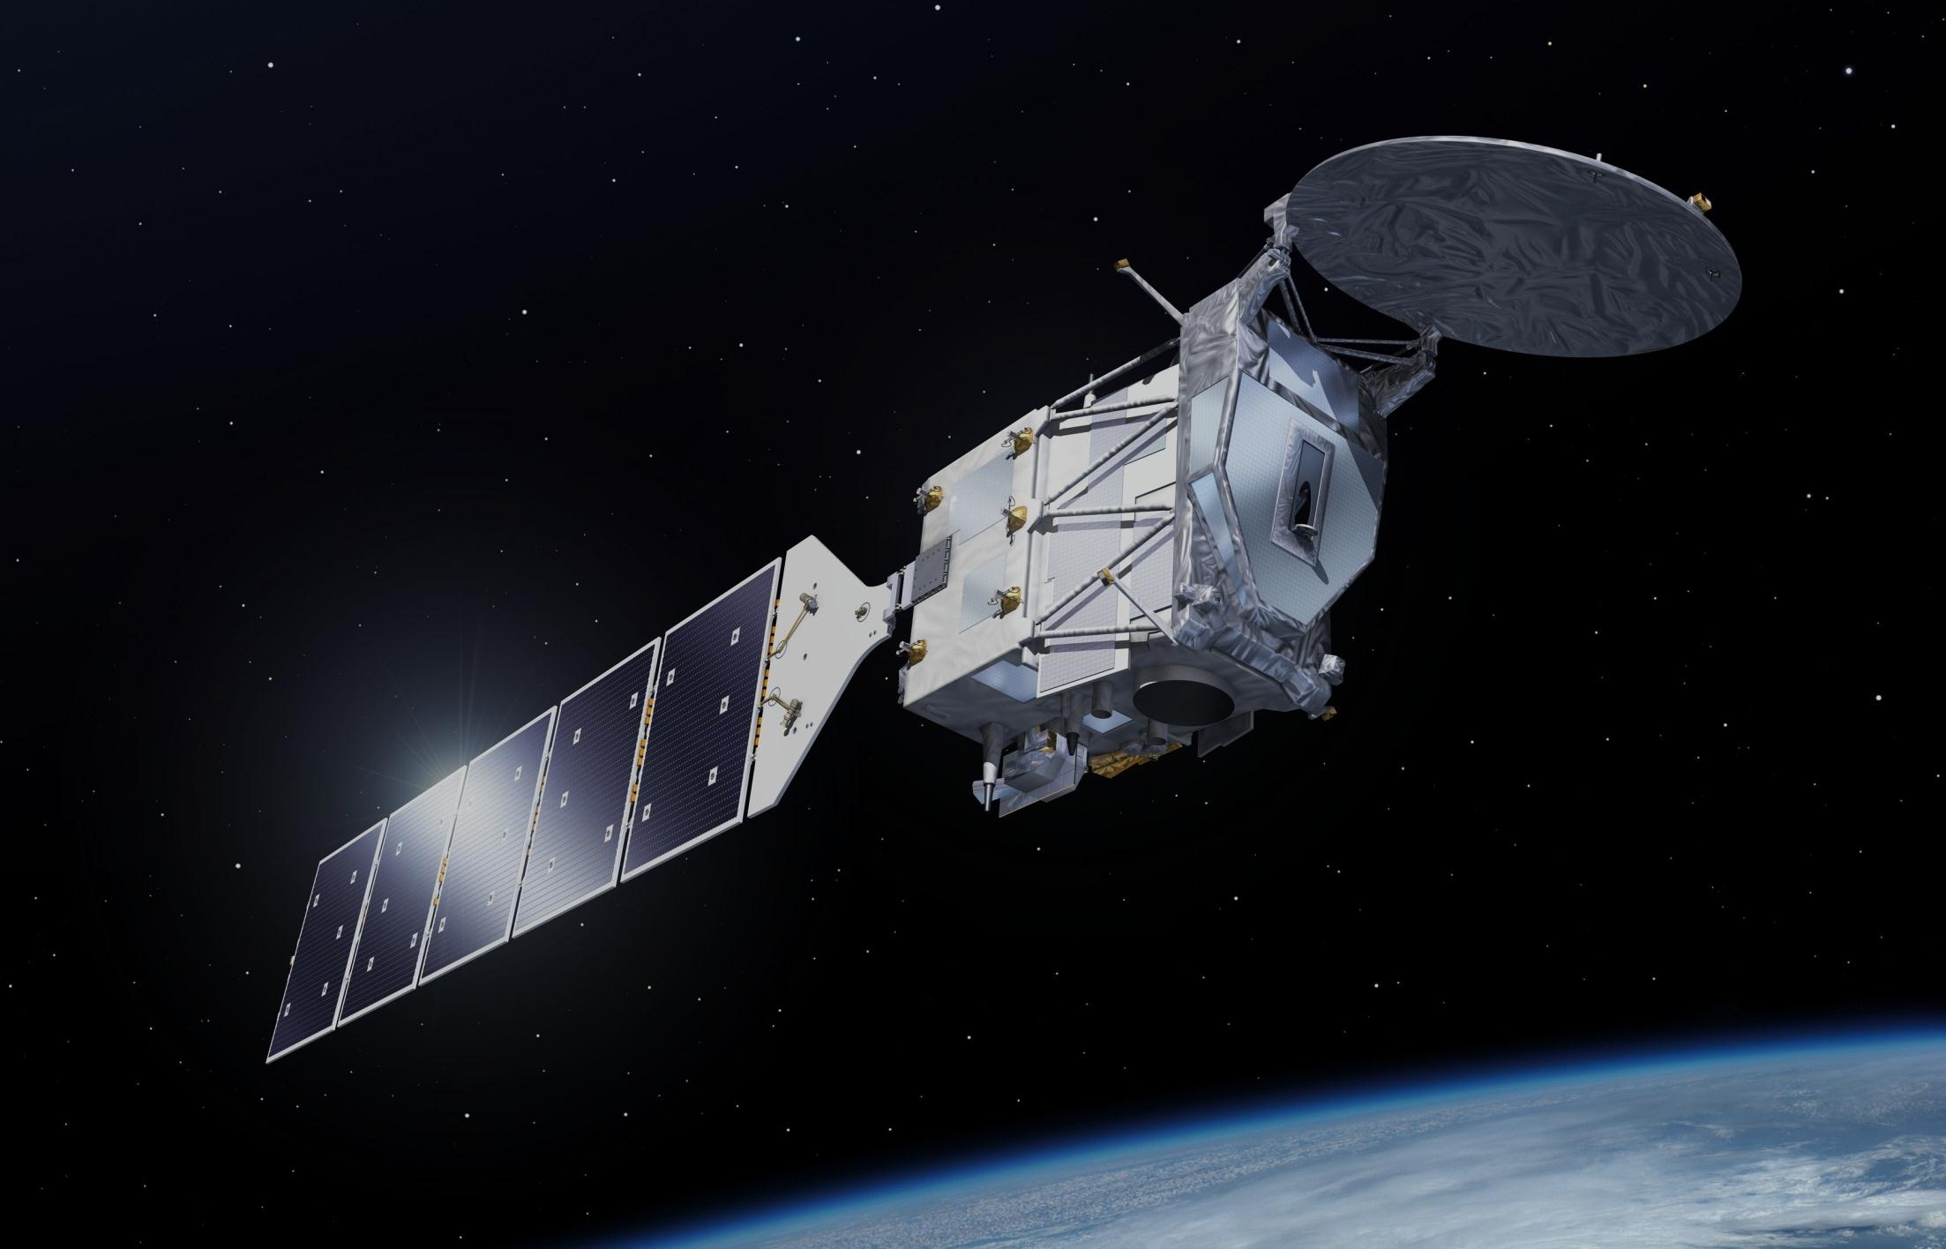
EarthCARE – ESA‘s Aerosol Mission
Global observations of clouds, aerosols and radiation
Collaboration with JAXA
Scientific instruments:
  First UV Lidar
  First Doppler Cloud Profiling Radar (JAXA contribution)
  Multispectral Imager
  Broadband Radiometer
Launch planned for 2016

Slide 24
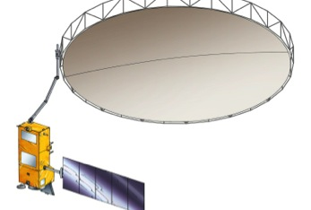

Future Earth Explorer Missions
BIOMASS will be the 7th Earth Explorer
  Biomass estimates based on global interferometric and polarimetric
  P-Band Radar observations
  Essential to understand the
  Earth’s carbon cycle
  To be launched in 2020

Slide 25
Future Earth Explorer Missions
Candidate missions for 8th Earth Explorer: Flex and CarbonSat
ESAG has recommended FLEX
  The Fluorescence Explorer mission, FLEX, aims to provide global maps of vegetation fluorescence, which can be converted into an indicator of actual photosynthetic activity. These data would provide information on plant health and stress, thereby improving our understanding of the global carbon cycle and supporting food security. The FLEX satellite would orbit in tandem with one of the Copernicus Sentinel-3 satellites.

Slide 26







































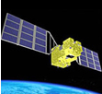

ESA & TPM EO Heritage Missions
2013-2016
2017-2018
Post 2019
ERS-1
IRS-P3
ERS-2
POES AVHRR 15-18
Envisat
ADM
Ikonos-2
SMOS
MOS-1/1b
JERS-1
ALOS
Landsat 5
SPOT-4
IRS-P6
SWARM
ADEOS-1
POES AVHRR 7-14
DMC-UK-1
GOCE
CRYOSAT-2
Kompsat-2
HCMM
Nimbus 7
Orbview-2
Proba-V
EarthCARE
Landsat
1/2/3/4/7
SEASAT
Kompsat-1
Formosat-2
Proba-1
ESA & TPM missions become “Heritage Missions” starting 5 years after end of life or end of agreement with ESA
SPOT 1-2
GOSAT
Scisat
Qscat

Slide 27

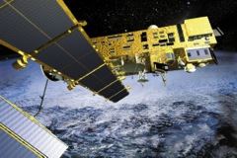
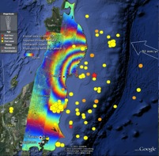
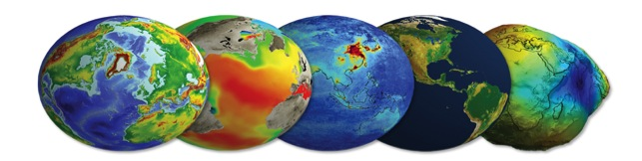
ENVISAT
Envisat (2002 - 2012)
  Status operational for 10 years
  (nominal lifetime was 5 years)
  Objectives multi-instrument environmental
  Instruments 10 instruments
  Users ~4000 scientific projects, many operational services (GMES, meteo, oil spill, emergency, …)
  Facilities 10 facilities distributed in Europe
  Data volume 1.5 PB
Notes:
27

Slide 28
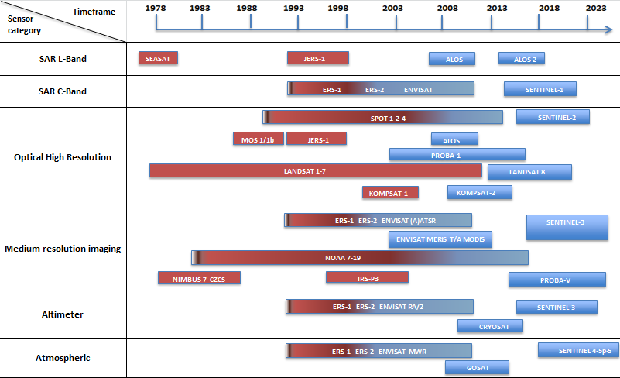
ESA Long Time Data Series (excerpt)
Missions in red are covered by the ESA LTDP Programme
Notes:
Heritage ESA and TPM missions are covered today through the LTDP Programme which is part of ESA’s mandatory activities, implemented in coordination with other ESA directorates.
Dedicated activities are being conducted for all Heritage Missions data available at ESA to ensure Consolidation of Level-0 datasets (and associated information), and generation of two copies to be archived in two different locations; data migration to latest available archive technology. Ensure basic discoverability via ESA catalogues, products generation through the currently available processors and dissemination through ESA standard systems; reprocessing when feasible for alignment to future missions with particular focus on Climate Change Initiative requirements and needs.

Slide 29
ESA EO Ground Segment
Notes:
29

Slide 30

EO Ground Segment Functions
Mission Management and User Consultation
Satellite Control
Payload Operations and Programming
Plan Data Acquisition
Receive Satellite Data
Process and Archive Satellite Data Products
Quality Assurance
Disseminate Data Products
User Interface and Support Services

Slide 31

ESA ESRIN
Control Centre for Distributed Facilities
ESA & TPM Satellite Flight Control Centres
10 Processing and Archiving Facilities
+ small thematic archives
Centralised Functions
Development, Management and Maintenance of a distributed Ground Segment
User Services
Mission Planning
Instrument Performance Monitoring, Product Development & QC
Exploitation Development and Management
Technology Development
Standardisation and Technology Transfer
Mission Management, Data Policy
25 Expert Support Laboratories
ECMWF & Meteorological Network
10 National Ground Stations
Data Dissemination Networks and Data Flow
28 Foreign Stations worldwide
200 VAC and Service Companies
Several 1000 Science Users
Operational Services
Notes:
31

Slide 32
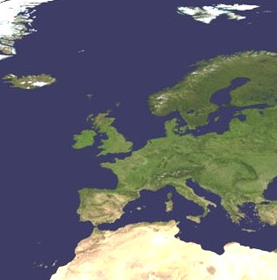
PROCESSING AND ARCHIVING
EO Data Archives Network
ESA Reference archive
National Archiving centres shared by ESA
Excerpt
ENVISAT: ESRIN, F-PAC, E-PAC, D-PAC, UK-PAC, Fin-coPAC, I-PAC
ERS: ESRIN, F-PAF, D-PAF, UK-PAF, I-PAF
PROBA: Kiruna, ESRIN
Terra/Aqua: Matera, Kiruna, Maspalomas, Oberpfaffenhofen
LANDSAT: Matera, Kiruna, Maspalomas, Neustrelitz
SCISAT: Kiruna
AVHRR: Tromso, Matera, Maspalomas
SEASAT: D-PAF
Others
Tromso
Kiruna
Sodankila
West Freugh
Farnborough
Neustreltz
Brest
DLR, Oberpfaffenhofen
CNES, Toulouse
ESRIN
Matera
Maspalomas

Slide 33

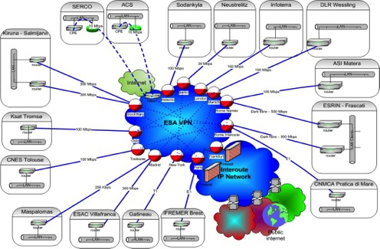

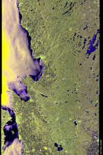
Data Dissemination
1-Physical media
2 – Ground
Users
Product
3–Satellite (DDS)
Not anymore in operation
Notes:
33

Slide 34
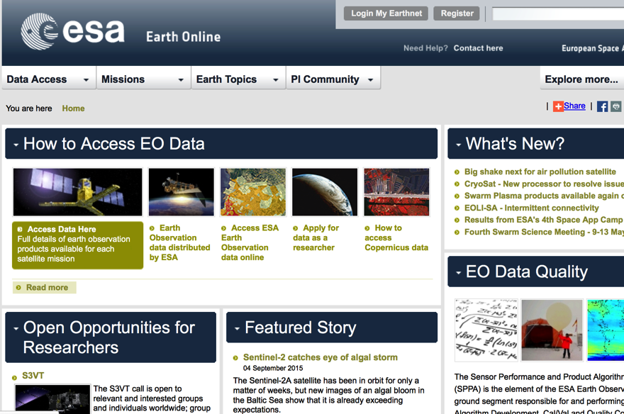
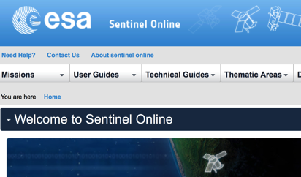
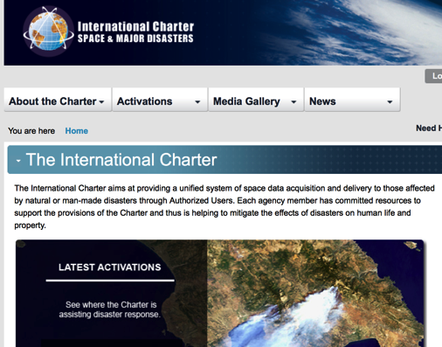
Web Portals

Slide 35
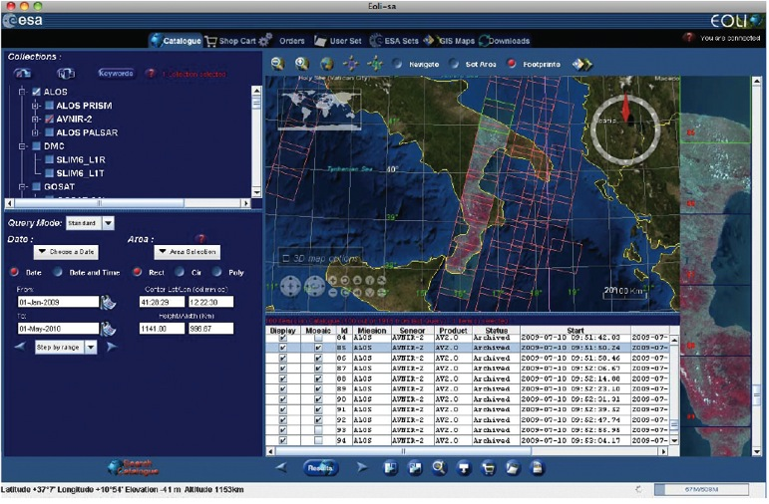
Multi Mission Data Catalogues
Multi-mission Data Catalogues provide access to most of ESA’s online collections and provide an intuitive way of selecting and ordering Earth observation products.

Slide 36
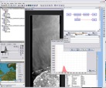
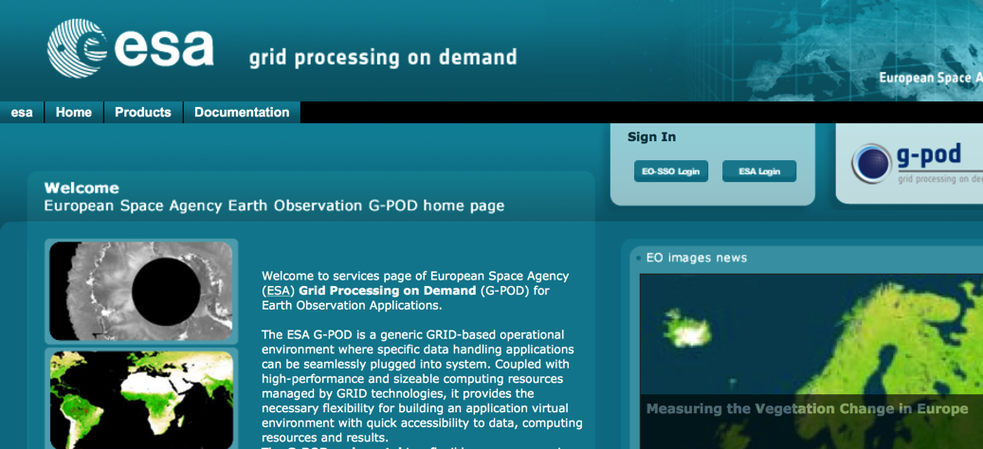
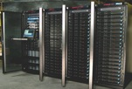
Data Exploitation
Several data visualization and manipulation tools available to users (e.g. BEAm, BRAT, etc). https://earth.esa.int/web/guest/pi-community/toolboxes
Service Support Environment (SSE) for Service creation, chaining, provision (services remain by Service Providers).
Grid Processing on Demand (GPOD): A User-Segment data processing environment with AO permanently open to scientists:
  Hosts user processors: “production” lab / “collaboration” environment. http://gpod.eo.esa.int/
Geohazard Community (Pilot)
Science Community
x
Science Community
y
Operational Service
1
Operational Service
2
Community operated
plug-in processors
(L2+)
Science and Service Exploitation Platform
(PaaS or SaaS)
Private/Commercial Cloud as Federated Collaboration Platform providing Processing Storage and Network Capabilities (IaaS)

Slide 37



ESA EO Ground Segment Evolution
A Future Scenario of
interconnected EO Platforms
How will EO data be used in 2025 ?

Slide 38




Interconnected Exploitation Platforms
The best worldwide
EO data asset
Increasing data volume & diversity
Evolving
user expectations
Europe EO
Vivid global user communities
Operational public
EO data
(Sentinel, Meteo)
“traditional” data delivery
5 interconnected user groups
Users public services
Heritage EO data
(e.g. Spot-1, Envisat)
Network of
exploitation platforms
“EO-Innovation Europe”
Users R&D remote sensing
Users profit-making services
R&D EO data
(e.g. Earth Explorers)
Commercial
EO data
e.g. RapidEye, Deimos
Users geosciences
“Big Data”
General public, education, media
Airborne &
in-situ data
Objectives of the network concept:
Enabling large scale exploitation of EO data
Stimulating the innovation with EO data
Maximising impact of European EO assets
and preserving European independence
How:
Interoperable/interconnected platforms around a core enabling element
Open to multi-source funding initiatives
Common governance rules
EO-Innovation Europe is a concept providing a framework for “innovation and science”. An open concept, inviting initiatives of partners, at EC, national and industrial level.
It is currently under discussion with Member States as part of the Ground Segment evolution strategy.

Slide 39

What is an Exploitation Platform ?
“Move User activities to the Data”
An innovative operations concept: users access a work environment containing the data and resources required, as opposed to downloading and replicating the data ‘at home’.
→ An R&D scenario for data intensive exploration gradually complementing the traditional operations concept for the ground segment
Exploitation platforms
EO
software
ICT
resources
EO data
In-situ data
Exploitation platform (or community platform)
=
Virtual open and collaborative environment
bringing together:
data centre (EO and non-EO data)
computing resources and hosted processing
collaborative tools (processing tools, data mining tools, user tools, …)
concurrent design and test bench functions
application shops and market place functionalities
communication tools (social network) and documentation
accounting tools to manage resource utilisation
Community
Collaboration
Exploitation platform = Community platform = EO platform = Applications platform

Slide 40

Different types of Exploitation Platforms
Examples at ESA of different types of Exploitation Platforms:
Thematic exploitation platform (TEP) → Focusing on a geophysical theme (e.g. forestry)
Current ESA Thematic Exploitation Platforms (TEPs):
Geohazards (consortium prime: TerraDue)
Hydrology (consortium prime: Isardsat,
Urban (consortium prime: DLR),
Coastal environment (consortium prime: ACRI-ST),
Polar (consortium prime: PolarView),
Forestry (consortium prime: VTT) ,
Under development (2015-2017) with ESA EOEP funds
Not intended to be operated by ESA
Regional (multi-thematic) exploitation platform:
Focusing on a regional theme (e.g. West Africa)
Mission/Sensor exploitation platform (MEP):
Tailored to a particular mission/sensor community
(e.g. an Earth Explorer user community)
Could be developed with ESA funds (no plans yet)
Not intended to be operated by ESA
e.g.
BIOMASS mission community (exploitation) platform
Proba-V mission exploitation platform
Technological exploitation platform :
To assess new technologies to be rolled out to the exploitation platforms
To be developed with ESA EOEP funds,
To be operated with ESA EOEP funds (as part of mission operations)
Exploitation platforms are also being developed outside ESA context
Could be developed and operated with ESA funds,
Could be shared with national space agencies

Slide 41
EO Innovation Europe
→ linked with large science networks and ecosystems
European
EO data asset
ESA
missions data
EO-Innovation Europe
General public, media
Science network #1
Copernicus missions data
EO
enabling element
=
Technical
& economical interoperability
EO
stimulating element
=
Remote sensing expertise
EO
outreach element
=
Thematic expertise
Meteo missions data
National missions data
Science network #2
Commercial missions data
Potential new networks / ecosystems
which may thrive on
EO Innovation Europe
Heritage missions data
Science network
e.g. European Plate Observing System (EPOS) [H2020]
Airborne & in-situ data

Slide 42
European EO data asset
Heritage Core GS
(data preservation, curation & discovery)
Heritage missions
ESA missions
ESA Core Ground Segment
EO-Innovation Europe
Sentinel missions
Copernicus Core Ground Segment
Core Ground Segments
ASI, CNES, DLR, UKSA, CSA
National missions
Industry missions
Core Ground Segment industry
Meteo missions
Core Ground Segment Eumetsat

Slide 43
ESA EO Ground Segment Evolution Strategy:
Reasons for Change and objectives
  Reasons for change
  Industry & Technology Trends: maturity of industry & technologies; increased “service offerings”.
  Missions profile and Programmatic: From Envisat type missions to Earth Explorers type missions
  Data Management
  User driven mission planning to systematic acquisition and limited mission planning (e.g. calibration, housekeeping); Systematic processing vs delayed on-request processing
  Cyber Security – protect data integrity and avoid data loss.
  Growing & Evolving “customer community”
  Objectives
Improve data availability & facilitate exploitation; Better serve a broader user community
Improve the overall missions operability, reliability and availability
Sustainably reduce operating cost to meet budget constraints
Ensure preservation and access of data and associated information in the long term
Leverage technological evolution and continuous decrease of HW costs
Use commercially available (European) products whenever possible
Standardise, streamline and simplify interfaces to support modular concepts
Notes:
43

Slide 44
Main interfaces
Coordination, Monitoring and Control
Reporting consolidation
Mission performance monitoring
Configuration management
reports
reports
User services
User Management
(registration, authentication, authorization…)
Information services
(Guide & Directory, web pages…)
Data Discovery
(Catalogue of data products offering)
reports
Data improvement
CAL/VAL
(Calibration files, product validation)
Algorithm improvement
(new prototypes and IPF)
LTPA
(QC and trends analysis)
Query/product list & browse
Data Reprocessing
Data consolidation
Data Reprocessing
Data Quality Control
(for data conformance)
QC
K
reports
reports
reports
Metadata
SIP
Bulk extraction
IPF
Algo-IPF
SIP
Data access
As-is dissemination
(all products processed systematically)
On-the-fly processing
(cache with all required input, e.g lvl0, aux…)
Virtual Research environment
(hosted processing)
Systematic Generation
Data Acquisition
(or procurement, and including mission planning)
Data processing
(including partial reprocessing)
Data Quality Control
(for data conformance)
Datasets Preservation
Data Master Archive
(all preserved datasets)
Cold back-up
(including partial reprocessing)
Master inventory
All Data Holdings
EO Dataset Management
All Data related information
product request & retrieve
SIP
SIP
Knowledge

Slide 45
PDGS Operations concept Functional Elements

Slide 46
PDGS Operations concept Functional Elements
User helpdesk, ESA Web Portals and Data Documentation
Functionality: EO helpdesk, EO Order desk, EO on-line portal, EO-portal, GEO-Portal, Disaster Charter Portal
Past implementation: functionality partially implemented on ESA infrastructure and operated as part of a series of different service contracts .
Intended implementation: functionality regrouped and provided as two service contracts.

Slide 47
PDGS Operations concept Functional Elements
Data Discovery
Functionality: provide access to the user to the catalogue of data products available to the users
Past implementation: functionality implemented on ESA infrastructure and operated as part of service contracts. Many separated catalogues exist, sometimes providing overlapping services to the users.
Intended implementation: functionality to be implemented on ESA infrastructure and operated as part of Service Contracts.

Slide 48
PDGS Operations concept Functional Elements
Data Access
Functionality: allow access of the data to the users, for direct retrieval of products that are already generated, or seamless on-the-fly production and subsequent retrieval.
Past implementation: direct retrieval of products functionality implemented on ESA and non-ESA depending on the mission providing many different (and sometimes confusing) opportunities for the user to retrieve the data. On-request data processing and retrieval was provided through a cumbersome data ordering process involving several elements of the ground segment (user services, archive, processing systems, dissemination, etc…) and shall be replaced in the future by an automatic process based on On-the-fly production.
Intended implementation: functionality to implemented on virtual infrastructure procured by ESA through service contracts and providing product as-is retrieval capability, and on-the-fly processing and retrieval capability in an identical manner for the users.

Slide 49
PDGS Operations concept Functional Elements
Virtual Research Environment
Functionality: Provide hosted processing capability to specific users (e.g. implementing a MEP for a DISC).
Past implementation: functionality partially implemented as part of the G-POD platform.
Intended implementation: functionality to be implemented on virtual infrastructure procured by ESA through service contracts and providing hosted processing capability, in particular benefitting from the presence on the same platform of the data hosted for the data access functionality.

Slide 50
PDGS Operations concept Functional Elements
Master archive
Master Archive Functionality: Preservation of all ESA managed data records within a Managed Archive.
Past implementation: the storage part of the functionality was provided as part of the Operations Contracts with the PACs (mainly ERS and ENVISAT data) and the Stations (mainly Third Part Missions).
Intended implementation: functionality intended to be provided as part of a service contracts hosting the ESA managed data records for preservation purposes.

Slide 51
PDGS Operations concept Functional Elements
Cold Backup archive
Cold back-up archive Functionality: provide a Disaster Recovery element, not providing continuity of service, . for all ESA managed data records
Past implementation: this functionality was not provided.
Intended implementation: functionality intended to be provided as part of service contracts, relying on a specific dedicated ESA infrastructure.

Slide 52
PDGS Operations concept Functional Elements
EO Datasets (PDSC) Management
EO Datasets Management Functionality: Preservation of all Information and knowledge related to ESA owned data records ensuring future data curation capability.
Past implementation: this functionality was not provided.
Intended implementation: functionality intended to be provided as part of Service Contracts,

Slide 53
European EO data asset
Heritage Core GS
(data preservation, curation & discovery)
Heritage missions
ESA missions
ESA Core Ground Segment
EO-Innovation Europe
Sentinel missions
Copernicus Core Ground Segment
Core Ground Segments
ASI, CNES, DLR, UKSA, CSA
National missions
Industry missions
Core Ground Segment industry
Meteo missions
Core Ground Segment Eumetsat

Slide 54
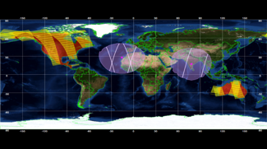


Future EO Data Preservation and Valorisation Scenarios

Slide 55
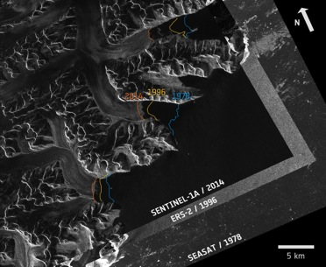
Realizing the full potential of Earth Sciences through harnessing “Big Earth Science Data”
Enabling factor: availability of “Good quality, reliable, interoperable, trusted and curated new & historical data” and their associated information.
Example: Total Column Water Vapour from 1991 onwards based on ATSR data
Example: Greenland glaciers as seen by 3 generations of radar missions: Seasat (1978), ERS (1996), S-1A (2014)
About 20 to 30 years of continuous measurements from space available for many geophysical parameters: LONG TIME DATA SERIES
  Need to ensure continuity of observations and comparability with current/future data (e.g. Sentinels) providing new opportunities for European Users, Operators and Value Adders

Slide 56
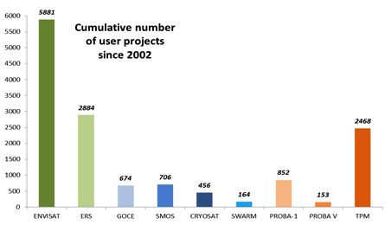
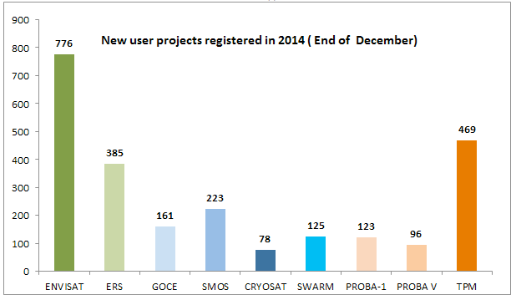
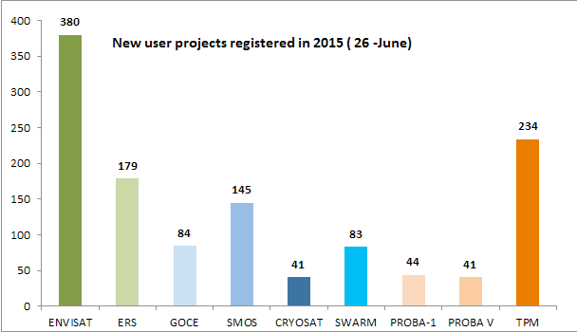
ESA Heritage EO Data Holdings Utilization
Extremely high interest from users on heritage EO data
Data value & utilization increase if part of long time data series
More than 1700 new ERS and Envisat user projects registered in the period Jan 2014 – June 2015 out of a total of about 9400 projects registered since 2002

Slide 57

Data & Knowledge Digital Preservation: future approach at ESA
Preserve ESA EO Heritage missions data & knowledge ensuring authenticity and understandability in the long term (Authority Entity).
  With the assumption/awareness that one can never anticipate the exploitation value of the data asset in the future.
Plan and Implement preservation activities in all EO mission phases to capture knowledge at EO data set generation.
Establish a coordinated and harmonised approach across ESA and in cooperation with EO data owners in the MSs, to preserve European Space Science data.
  Prevent loss of non-ESA EO data at preservation risk and judged of European long-term interest.

Slide 58

Data Curation and Valorization:
future approach at ESA
Make sure the full content of the ESA EO heritage archives is maintained discoverable, accessible and usable in the long term through state of art technologies and innovative tools & services.
Valorize ESA EO Heritage Data:
    Ensure the full content of the ESA EO archives is fit for contemporary purpose thus enabling multi-disciplinary applications & broader data use.
    Improve data quality through algorithms evolution, data reprocessing, data validation and traceability (QA4EO).
    Build long time series of coherent data and data collections for specific applications.
    In cooperation with other EO data owners and users in the Member States.
  Generate Fundamental Earth Observation Data Records based on the combination of archived data assets (heritage and current) from MSs National & ESA EO Missions, for land, marine, atmosphere, solid Earth and also climate research, to better address high priority societal challenges in Europe.

Slide 59
Way forward: Long Term Data Preservation & Mission to Heritage Data Programme (LTDP+)
Why: ESA heritage science data assets (growing) holdings represent a unique, valuable, independent and strategic resource owned by ESA MS.
[2017-2021]
Envisat
ERS-1/-2
GOCE
European assets from Landsat, ALOS, AVHRR, etc…
Long Term Data Preservation (LTDP)
Secure preservation of ESA scientific heritage data assets and their associated information
Prevent loss of data from (non-ESA) missions at preservation risk and judged of European interest
Mission to Heritage Data (M2HD)
Ensure accessibility to users relying on latest ICT as expected by users
Ensure continuous quality improvement of EO heritage data for continuity with current & future missions for multi-disciplinary applications and broader data use
Generation and management of Fundamental EO Data Records (Level-1) using ESA and MSs National archived data complemented with current ones, to better respond to societal challenges
Long Term Data Preservation & Mission to Heritage Data (LTDP+)
In cooperation across ESA Directorates and with science data owners and users in MSs through a cooperative, harmonised and shared approach

Slide 60


Thank you for your attention

